Slide 1
ESEA Office Hours
CRF Updates & Q&A
July 30, 2020

Slide 2
CRF CDE Cross Unit Team
Jennifer Okes, Chief Operating Officer
Adam Williams, Financial Data Coordinator
Jennifer Austin, Director of Grants Fiscal Management
Kate Bartlett, Turnaround Program Manager
…in partnership with the Governor’s Office and Office of the State Controller

Slide 3
CARES Grants
CARES Act
Education Stabilization Funds (ESF)
Elementary & Secondary School Emergency Relief Funds (ESSER)
$120 million
Governor’s Emergency Education Relief (GEER)
$44 million
TBD
CARES Relief Funds (CRF)
Title V
Governor’s Executive Order
Education Relief
$510 million
PPA to LEA
ESSER Funds – Formula
(90%) to LEAs
$108 million
Title I formula to LEA
ESSER Funds – State Level
$12 million
TBD (survey)

Slide 4
Today’s Agenda
Updated guidance published 7/30/2020 following discussions with the Governor’s Office and Office of the State Controller
We have included slides from last week in this presentation as a reminder but will not be covering them. New material begins on slide 17
Highlights in the updated guidance we will go over today:
  Charter school guidance
  Materials
  Records retention
  Preschool
  Increased Instructional Hours – sample template
Q&A

Slide 5
Allowable Uses Updates: Increasing Instructional Time
CRF funds were intended, in part, “to stimulate the economy by supporting Colorado’s workforce through increasing free instructional hours for our kindergarten through 12th grade education system.”
As such, funds may be used for expenses to increase instructional hours that were reduced due to COVID-19 closures in the spring of 2020, in order to return to a normal level of instructional hours in the fall of 2020.
  Instructional hours calculations may include in-person, remote and/or online instruction
Increasing instructional hours can be evaluated on a standalone basis and does not need to be considered in combination with other criteria.
Districts must document increased instructional hours offered in Fall 2020 versus the baseline number of hours offered in Spring 2020. This calculation may be done on a school level, grade level, or district level, as appropriate - this is a district level decision.
  CDE is researching common methodologies for calculations to share in the upcoming weeks and will update guidance accordingly
Expenses associated with increasing instructional time can only be incurred in fall 2020
Reference: Section 2A of Guidance Document (Section 2 lines 1-10)

Slide 6
Allowable Uses Updates: Increasing Instructional Time - Examples
High School Example - Hours:
  March-June 2020: Provided 4 hours of remote instruction per day (whether online or self-guided)
  August-December 2020: Will provide 6 hours of in-person and/or remote instruction per day
  Difference: 2 hours per day
  Increase: 33% of instructional time being offered in the fall represents the increase (2 out of 6 hours)
  Allowable: 33% of staff salaries and other instructional time costs for August-December 2020
Elementary School Example - Hours:
  March-June 2020: Provided 2.5 hours of remote instruction per day (whether online or self-guided)
  August-December 2020: Will provide 6 hours of in-person and/or remote instruction per day
  Difference: 3.5 hours per day
  Increase: 58% of instructional time being offered in the fall represents the increase (3.5 out of 6 hours)
  Allowable: 58% of staff salaries and other instructional time costs for August-December 2020
2
Chargeable to CRF
4
4
Spring:
Fall:
3.5
Chargeable to CRF
Spring:
2.5
Fall:
2.5

Slide 7
Allowable Uses Updates: Substantially Different Guidance
Reference: Appendix 1 of Guidance Document: Considerations for Payroll Eligibility when Employees’ Job Duties change due to COVID response
Use this guidance primarily when an employee’s job duties have changed / pivoted due to COVID-19 response. These criteria should allow districts to determine if an employee’s time is eligible for CRF funding under allowable uses related to having their job duties becoming “substantially different” due to COVID-19 response. In addition to “substantially different,” an employee’s time under this guidance must also be “substantially dedicated” to COVID-19 response.
  Are the employee’s duties substantially different?: Costs incurred for a “substantially different use” include, but are not necessarily limited to, costs of personnel and services that were budgeted for in the most recently approved budget but which, due entirely to the COVID-19 public health emergency, have been diverted to substantially different functions. (Treasury FAQ)
  Is the employee substantially dedicated to COVID-19 response?: The OSC is interpreting “substantially dedicated” to mean 51% or more time devoted to the COVID-19 public health emergency. The OSC is using this interpretation based on comments from a high-ranking official at the US Department of Treasury. (OSC Payroll Guidance)
If yes to both, can charge the percentage (which much be 51% or higher) of the employee’s payroll cost for a given pay period to CRF.
Expenses associated with substantially different job duties can be incurred in spring 2020 OR fall 2020

Slide 8
Allowable Uses Updates: Substantially Different Guidance - Examples
Front office staff member’s normal job duties are greeting visitors, answering phones and responding to school staff needs. In fall 2020, staff member will spend 75% of their time doing temperature and health checks for students.
  Substantially different job duty, related to COVID-19 response? Yes
  Substantially dedicated to COVID-19 response (51% or more of time in a pay period)? Yes
  Eligible for CRF? Yes
  Percentage eligible for relevant pay periods? 75% of payroll expenses
Front office staff member’s normal job duties are greeting visitors, answering phones and responding to school staff needs. In fall 2020, staff member will spend 25% of their time doing temperature and health checks for students.
  Substantially different job duty, related to COVID-19 response? Yes
  Substantially dedicated to COVID-19 response (51% or more of time in a pay period)? No - does not meet the 51% threshold
  Eligible for CRF? No
  Percentage eligible for relevant pay periods? N/A
Teacher normally spends 8 hours a day on instructional duties. In March-May 2020 pay periods, teacher spent 3.5 hours per day on instructional duties and 4.5 hours a day providing IT technical support to students and families to address COVID-19 pandemic.
  Substantially different job duty, related to COVID-19 response? Yes
  Substantially dedicated to COVID-19 response (51% or more of time in a pay period)? Yes
  Eligible for CRF? Yes
  Percentage eligible for relevant pay periods? 4.5 / 8 = 56%

Slide 9
Allowable Uses Updates: Developing Capacity for Remote Learning
The development of remote or online learning capabilities is distinct from the delivery of remote learning itself.
Delivering remote or online instruction in lieu of in-person instruction is not an allowable CRF expense per the US Treasury. This includes daily lesson planning, teaching, student interaction and the other regular duties that teaching staff would normally have in an in-person learning environment.
However, a school or district’s development of remote or online learning capabilities, which may include curriculum or online learning platform development or selection, planning or systems development, is an allowable CRF expense.
Reference: Section 2 of Guidance Document (Section 2 line 38)

Slide 10
Allowable Uses Updates: Small (Non-Capital) Equipment
Purchasing equipment, i.e. carts or additional point of sale devices for food service delivery to classrooms or automatic door openers, auto-flush toilets, touchless faucets, etc. to comply with public health orders that are not considered capital equipment purchases.
Smaller equipment purchases to comply with State and local public health orders and address the COVID-19 public health emergency, and are not capitalized, would be eligible for CRF funding.
Reference: Section 2 of Guidance Document (Section 2 line 54)

Slide 11
Allowable Uses Reminder: Capital Expenditures
Please remember that items which exceed the LEA’s capitalization threshold are not allowed as expenditures under CRF
  Typically, the capitalization threshold is $5,000, but your local policy may have a lower threshold.
Items that are likely to be unallowable include but are not limited to:
  HVAC systems
  School buses
  Other equipment with a high per-item cost
Rationale: Items that have a useful life greater than one year and exceed the entity’s capitalization threshold must be capitalized. Such capitalized purchases are expensed over the useful life and are not totally expensed on December 30, 2020; therefore, they are not eligible for CRF funds.

Slide 12
Charter School Considerations
CDE’s guidance is that districts distribute CRF funds to charter schools up front (100% allocation, not by reimbursement) and then require charters to expend them based on the allowable uses guidance.
A district cannot withhold the 0.5% for admin/indirect costs from the charter school’s allocation
District payments to charter schools, and charter school revenue recording, must follow flow-through accounting as detailed in the Chart of Accounts
  District records CRF revenue: source 4000, grant 4012
  District records flow-through payment to charter: object 0594, grant 4012
  Charter records CRF revenue from district: source 4954, grant 4012
  Charter records CRF expenditures per allowable uses, grant 4012

Slide 13
Reporting Guidance
CRF expenditure reporting through June 30
CDE is required to report the amount of CRF expenditures by districts, BOCES, and facility schools through June 30, in our financial statements. It is understood that districts are in the process of making year-end accounting entries. However, CDE needs to obtain a reasonable estimate of the expenditures that will be charged to CRF statewide through June 30. CDE is requesting each district, BOCES and facility schools to provide their estimated CRF expenditures for FY 2019-20 by Friday, July 31. This information can be submitted via this survey.
Quarterly reporting expected for periods ending Sept. 30, Dec. 30
The U.S. Treasury has issued preliminary reporting requirements. While CDE does not yet have the detailed reporting requirements, it is anticipated that districts, BOCES and facility schools will be required to report on CRF expenditures quarterly for the periods ending Sept. 30, and Dec. 30. Expenditures will likely need to be categorized into broad categories, including budgeted personnel and services diverted to a substantially different use, public health expenses, to facilitate distance learning, and providing economic support. CDE will provide more information on these reporting requirements as soon as they are available.

Slide 14
Electronic Survey
All recipients of these funds are requested to notify the State of Colorado ASAP, of their intent to use all or a portion of the allocated funds. Recipients must identify any funding they are unable to use for allowable expenditures so these funds can be returned and reallocated to other recipients.
If you have already emailed Jennifer Okes with your information – you do not need to complete the survey again.
Here is a direct link to the survey: https://fs10.formsite.com/ZuOMFN/3jfbp2dgal/index.html
It is also available on the CARES Act page under the CRF section. http://www.cde.state.co.us/caresact

Slide 15
Reminder: CRF Guidance References
Allowable uses guidance is posted on CDE website
  We will be updating the guidance as we get additional questions and clarifications from OSC and others
  The CARES Act web page will always have a link to the most up to date guidance doc: https://www.cde.state.co.us/caresact
Helpful resources
  Addendum A re: allowable uses
  Treasury CRF FAQs
  OSC Payroll Guidance
  Weekly ESSER-CRF Office Hours, hosted by Federal Programs, every Thursday 1-2pm. Zoom log in and previous recordings.

Slide 16
Reminder: CRF Guidance - Step by Step
Recommended path for CRF questions:
Review the allowable use guidance
Review OSC’s payroll guidance
Ask yourself these two questions:
  Is this expenditure directly related to COVID-19 response?
  In absence of CRF funds, would you have had to incur this expenditure in order to operate in Fall 2020?
  If yes to both, it is likely to be allowable--barring capital expenditures, which are not allowable
If questions remain, please email Adam Williams, Williams_A@cde.state.co.us
Thank you for your patience as we research and respond to your questions!

Slide 17
Recent Updates to CRF Guidance Document
Note: recent updates have been made to the CARES ACT CRF/ESSER Allowable Expenditures document
http://www.cde.state.co.us/caresact/crf-allowableexpenditures
Charter School updates – Section 1, Line 5 – CRF Column updated: 7-29
Materials related to allowable expenditures: December 30 – Line 2 CRF Updated: 7-30
Preschool – Section 1, line 6 – CRF Column updated: 7-29
Record Retention – Section 1, Line 11 – ESSER and CRF Column updated 7-29
Optional Instructional Hours Template

Slide 18
Charter School updates – Section 1, Line 5 – CRF Column updated 7-29
While not a statutory requirement, CDE’s guidance will be that districts distribute CRF funds to charter schools up front (100% allocation, not by reimbursement) and then require charters to expend them based on the allowable uses guidance.
A district cannot withhold the 0.5% for admin/indirect costs from the charter school’s allocation.
District payments to charter schools, and charter school revenue recording, must follow flow-through accounting as detailed in the Chart of Accounts:
  District records CRF revenue: source 4000, grant 4012
  District records flow-through payment to charter: object 0594, grant 4012
  Charter records CRF revenue from district: source 4954, grant 4012
  Charter records CRF expenditures per allowable uses, grant 4012

Slide 19
Materials related to allowable expenditures: December 30 – Line 2 CRF Updated: 7-30
Allowable expenditures must be made prior Last Update: 7-30-2020 3 to December 30th 2020. Materials related to allowable expenditures do not necessarily have to be received by December 30th: If a recipient enters into a contract requiring the delivery of goods or performance of services by December 30, 2020, the failure of a vendor to complete delivery or services by December 30, 2020, will not affect the ability of the recipient to use payments from the Fund to cover the cost of such goods or services if the delay is due to circumstances beyond the recipient’s control

Slide 20
Preschool – Section 1, line 6 – CRF Column updated: 7-29
CRF can be used for allowable preschool expenditures. Please refer to Addendum A on the Office of the State Controller website:
  https://www.colorado.gov/pacific/osc/form/cares-act-certification
  https://drive.google.com/file/d/1QEV8c0objwwIf5jYKAMUI215YjnjHckY/view

Slide 21
Record Retention – Section 1, Line 11 – ESSER and CRF Column: updated 7-29
Record Retention Guidance
  ESSER
    funding is subject to 2CFR200.400-475 as well as 2CFR200.300-345 which specifically indicates Record Retention Requirements for Federal Funding. The requirements for record retention of expenditure detail and supporting documentation is subject to 3 years, following the date of the final expenditure report, or close out
  CRF
    Recipients of CRF payments shall maintain records for a period of five (5) years following the date of the final expenditure report, or close out per https://home.treasury.gov/system/files/136/I G-Coronavirus-Relief-Fund-Recipient-Reportin g-Record-Keeping-Requirements.pdf

Slide 22
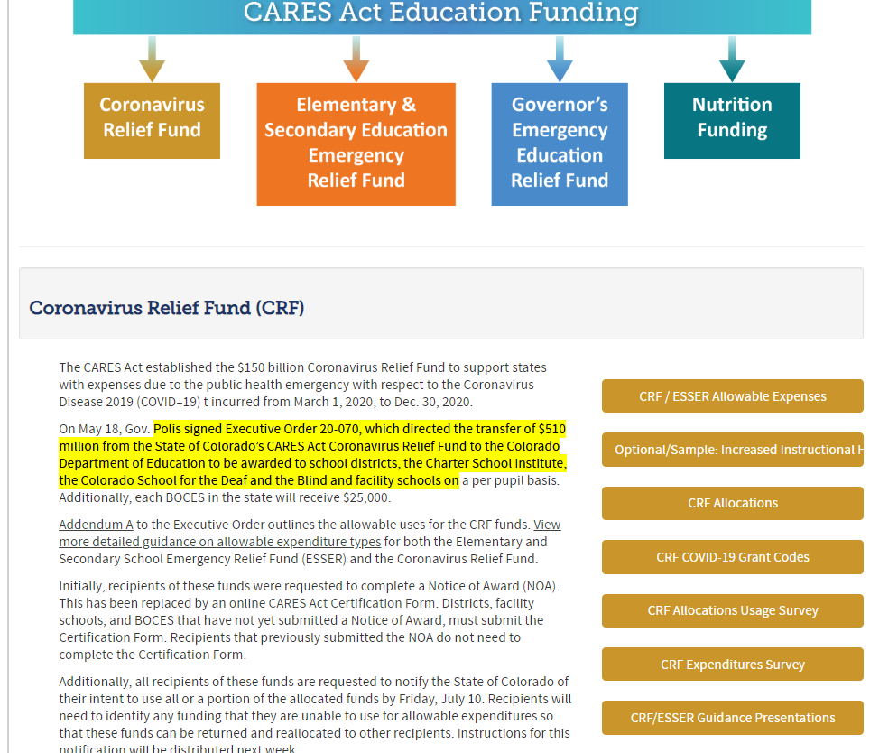
Increased Instructional Hours Calculation
Optional template to calculate the increase in instructional hours from spring 2020 to fall 2020
  Huge shout out to Glenn G. in D11 for creating this template!

Slide 23
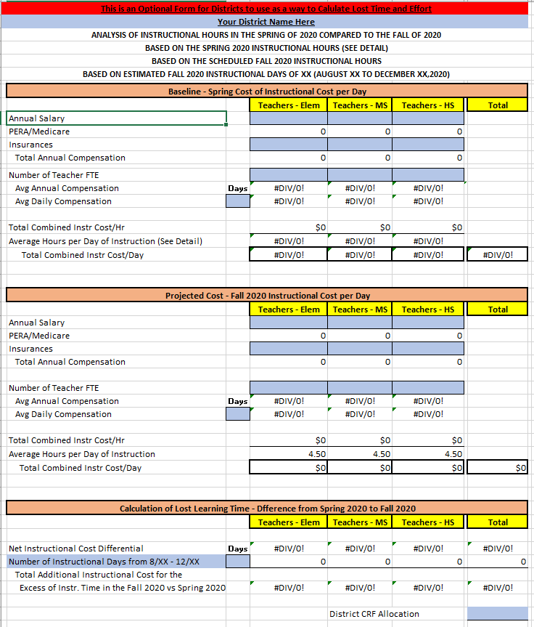
Optional Template: Summary Tab

Slide 24
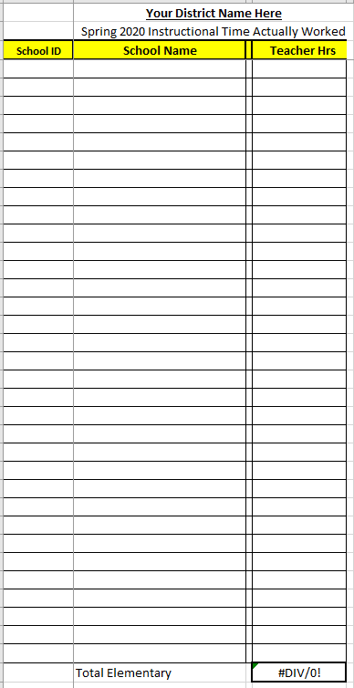
Optional Template: Detail Tab

Slide 25
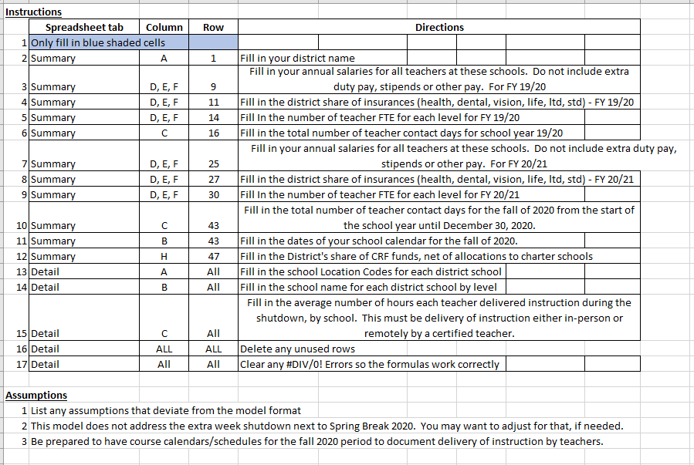
Optional Template: Instructions and Assumptions Tab

Slide 26
Questions

