Slide 1
Federal Programs Office Hours
Elementary and Secondary School Emergency Relief (ESSER) Fund Application
June 18, 2020

Slide 2
Agenda for Today’s Training
Review of CARES Act grants
Coronavirus Relief Funds
  CDE Office
  Resources
  FAQs

Slide 3
CDE Colleagues
Jennifer Okes, Chief Operating Officer
Jennifer Austin, Director of Grants Fiscal Management
Kate Bartlett, Turnaround Program Manager

Slide 4
Review of CARES Act Funds

Slide 5
CARES Grants
CARES Act
Education Stabilization Funds (ESF)
Elementary & Secondary School Emergency Relief Funds (ESSER)
$120 million
Governor’s Emergency Education Relief (GEER)
$44 million
TBD
CARES Relief Funds (CRF)
Title V
Governor’s Executive Order
Education Relief
$500 million
PPA to LEA
ESSER Funds – Formula
(90%) to LEAs
$108 million
Title I formula to LEA
ESSER Funds – State Level
$12 million
TBD (survey)

Slide 6
Coronavirus Relief Funds

Slide 7
CDE Unit Managing CRF
School Finance: https://www.cde.state.co.us/cdefinance/psfucontacts
  Jennifer Okes
  Tim Kahle, School Finance Analyst
  Adam Williams, Fiscal Data Coordinator

Slide 8
Resources
CARES Act Expenditure Types v. Funding Sources: Guidance for Colorado School Districts Summer 2020 – COMING SOON
  Side-by-Side Comparison of ESSER (90% allocation to LEAs) and CRF
  Sections
    General Guidance
    Frequently Asked Questions on Allowable Expenditure Types
    Agency Roles and Responsibilities, Contacts, and Additional Resources

Slide 9
Big Themes for Planning Purposes
CRF funds have some / different restrictions than ESSER funds do not
Timelines are different
  ESSER funds: costs incurred March 13, 2020 – June 30, 2021
  CRF funds: costs incurred March 1, 2020 – December 30, 2020
CRF funds can only be spent on items that were not in the adopted budget as of March 27, 2020
  Example 1: District costs exceeded the custodial budget in FY20 due to COVID response, needs to use CRF funds to cover excess expenditures
  Example 2: District planned to reduce the custodial budget in FY21, but needs to use CRF funds to offset this reduction for July-December 2020 in order to have adequate COVID response

Slide 10
Sections of Guidance Document
Supporting documentation required for CDE’s monitoring of allocations
General provisions
  Are allocations made/required at the school level?
Type of School | ESSER | CRF
Facility Schools | Did not receive a direct allocation, but the LEA may choose to serve the facility school. | Received an allocation. Allocation must be spent on allowable expenditures outlined here.
Charter Schools (that are not an LEA) | Did not receive a direct allocation, but the LEA may choose to serve the school; CDE encourages LEAs to treat all public schools, including charters, on equal footing. | The CRF funds are distributed on a per pupil basis based on a calculation inclusive of charter school students. Therefore, Section 22-30.5-112(3), C.R.S. directly applies and requires sharing with charter schools on a per pupil basis. The distribution approach used to share the funds for furniture, fixture and equipment for full-day kindergarten through HB19-1055 may be instructive for the distribution of the CRF funds, since both use the same allocation methodology.
Non-Public Schools | LEA is required to provide equitable services to all non-public schools in the district’s boundary. | There is no equitable distribution provision for CRF funds; therefore, there is no requirement to share these funds with private schools.

Slide 11
Types of Allowable Activities Covered in Guidance Document
Technology
Personnel
Increasing instructional time
Educational materials and supports
Student & staff supports
Communication & family engagement
Indirect costs
Additional budget guidance
Additional resources:
  Paying for laptops, internet/hot spots, software, food http://www.cde.state.co.us/safeschools/covid19-grantprogramexpenses

Slide 12
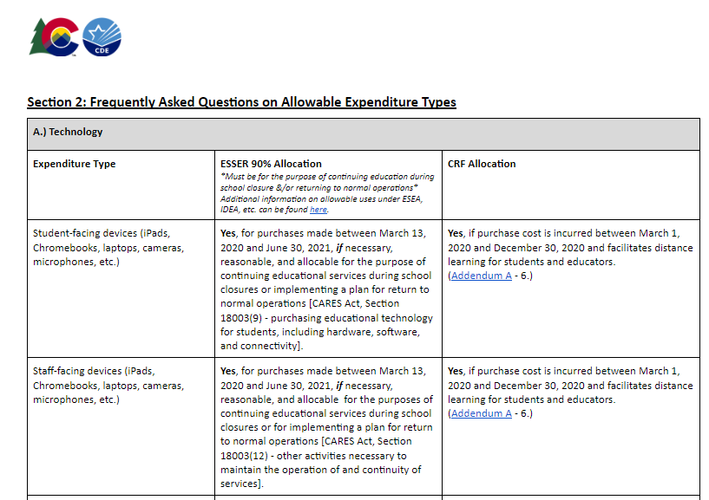
Example from Guidance Document

Slide 13
Questions

Slide 14
Topics for Future Office Hours?

