Slide 1
Federal Programs Office Hours
Elementary and Secondary School Emergency Relief (ESSER) Fund Application and FAQs
June 4, 2020

Slide 2
Agenda for Today
Review of CARES Act grants
Other Allowable Uses of ESSER-Formula Funds
Considerations for Developing ESSER Budget
FAQs
Other Logistical Matters

Slide 3
Review of CARES Act Funds

Slide 4
Breakdown of ESSER Funds in CO
  Funds flow from ED to SEAs, which then must allocate not less than 90 percent of the funding to LEAs, based on share of Title I in FY2019.
  SEAs may use up to 10% for state level activities for emergency needs as determined by the SEA to address issues related to COVID-19
  SEAs may use some funds for administration (0.5%) and the rest for emergency needs to respond to the coronavirus as determined by the SEA.
Colorado ESSER: $120,993,782
LEA’s 90%: $108,894,404
SEA’s 10%: $12,099,378
SEA Admin: $604,969
Notes:
DeLilah
Provision for equitable services for NPS
What we’ve heard – focus on mental health to students and staff
Streamlined application released 04/16
Funds out within 3 days
Funds retroactive to March 13

Slide 5
Allowable Activities under ESSER
Any activity authorized under ESEA, IDEA, Perkins, Adult Education and Family Literacy, or McKinney-Vento
Coordination of preparedness and response efforts of local educational agencies with State, local, Tribal, and territorial public health departments, and other relevant agencies
Planning for and coordinating on long-term closures (including on meeting IDEA requirements, how to provide online learning, and how to provide meals to students)
Staff training and professional development on sanitation and minimizing the spread of infectious disease; purchasing supplies to sanitize and clean facilities
Purchasing educational technology (hardware, software, and connectivity) for students, that aids in the regular and substantive educational interaction between students and their instructors, which may include assistive or adaptive technology
Mental health services and supports
Summer learning and supplemental after-school programs
Discretionary funds for school principals to address the needs of their individual schools
Other activities that are necessary to maintain the operation and continuity of services in LEAs and to continuing the employment of their existing staff

Slide 6
Allowable Activities Under Other Federal Education Programs

Slide 7
Elementary and Secondary Education Act (ESEA) Grants
Ordinarily required under ESEA grants, but not under ESSER:
Based on a Comprehensive Needs Assessment
Supplemental supports & services
Serving eligible schools and students
Still required under ESSER:
Reasonable and Necessary
Funding considerations
LEAs can use the ESSER funds to cover declines in state/local funds. However, ESSER will provide only temporary support and will not be a permanent replacement for lost state funds. – avoid the funding cliff!
SNS for Titles IA, IIA, IVA do not implicate federal funds, only state/local. However, Title IC (Migrant Education) and Title IIIA do reference federal funds, so be careful, these could present SNS issue.
Reminder: ESSER Funds were calculated using LEAs’ Title I, Part A funding formula. However, ESSER Funds are not Title I funds. There are important flexibilities related to ESEA-type activities under ESSER.

Slide 8
Title I, Part A – Allowable Activities Examples
The purpose of Title I, Part A is to provide all children significant opportunity to receive a fair, equitable, and high-quality education, and to close educational achievement gaps.
Examples of common Title I, Part A Activities:
Delivering enhanced instruction for at-risk children (e.g., hiring teachers, interventionists to meet student needs)
Offering afterschool, enriched, and/or accelerated academic programs
Providing behavior, social & emotional supports
School-based improvement planning
Meaningful parent and family engagement
Good to know! If exercising ESEA “Title I-like” activities, things like Title I designation, parent engagement set aside, and CS/TS program requirements do not apply.

Slide 9
Title I, Part D – Allowable Activities Examples
The purpose of Title I, Part D is to improve educational services for children and youth who are neglected or delinquent so they have the opportunity to meet state academic content and achievement standards; successfully transition from institutionalization to further education or employment; and prevent youth from dropping out of school.
Examples of common Title I, Part D Activities:
Programs that serve children and youth returning to local schools from correctional facilities to assist in the transition to school environment and complete education
Dropout prevention programs which serve at-risk children and youth, including pregnant and parenting teens, children and youth in juvenile justice system
Health and social services, e.g., day care, drug and alcohol counseling, and mental health services, if it will help students progress

Slide 10
Title II, Part A – Allowable Activities Examples
The purpose of Title II, Part A is to increase student achievement on challenging state academic standards by improving the quality and effectiveness of teachers, principals, and other school leaders, and providing low-income and minority students more equitable access to effective teachers, principals, and other school leaders.
Examples of common Title II, Part A Activities:
Academic/instructional coaching supports for educators
Professional learning supports for teachers, school leaders
Development and support for educational leadership pipelines
Strategies to attract and retain teachers, including stipends and differential pay to meet high-need subjects/schools
Good to know! If exercising ESEA “Title II-like” activities, things like prioritization of funding, SNS, and meeting ESSA’s definition of PD do not apply.

Slide 11
Title III, Part A – Allowable Activities Examples
The purpose of Title III, Part A is to improve and enhance the education of English learners (ELs) in becoming proficient in English, as well as meeting challenging state academic standards.
Examples of common Title III, Part A Activities:
Upgrading English Language Development (ELD) program objectives, curricula, instructional materials, and effective instructional activities
Providing community participation programs, family literacy services, and parent outreach and training activities to EL students and their families
Providing tutoring and intensified instruction for EL students
Offering early college high school or dual/concurrent enrollment programs or courses designed to help ELs achieve in postsecondary education
Good to know! If exercising ESEA “Title III-like” activities, consider focused activities to expand or enhance existing language development programs to address unique needs of ELs during school closures/remote learning.

Slide 12
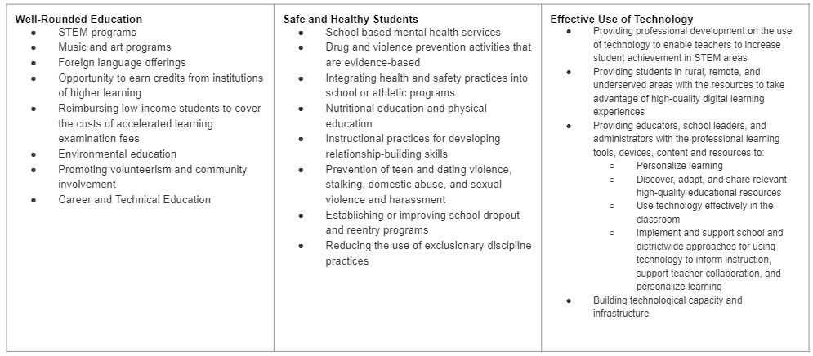
Title IV, Part A – Allowable Activities Examples
The purpose of Title IV, Part A is to increase the capacity of districts, schools, and local communities to provide all students with access to a well-rounded education, improve school conditions for student learning, and improve the use of technology in order to improve the academic achievement and digital literacy of all students.
Examples of common Title IV, Part A Activities:
Good to know! If exercising ESEA “Title IV-like” activities, things like content area alignment, and percentage requirements do not apply.

Slide 13
Title V, Part A – Allowable Activities Examples
The purpose of Title V, Part B is intended to address the unique needs of rural school districts that frequently lack the personnel and resources needed to compete effectively for Federal competitive grants and receive formula grant allocations in amounts too small to be effective in meeting their intended purpose.
The Rural, Low-Income School (RLIS) program [ESSA, Title V, Part B, Subpart 2] program targets rural LEAs that serve large numbers of low-income students.
Title V activities are allowable if they are allowable under Title I, Part A, Title II, Part A, Title III, Part A, and/or Title IV Part A.
Examples of common Title IV, Part A Activities:
ELA/Math Interventionist
Conferences or PD trainings for teachers, admin or district staff
Technology or equipment purchases
Stakeholder involvement activities

Slide 14
McKinney-Vento Act
Core Components
The intent of the McKinney-Vento Education for Homeless Children and Youth program is to remove all educational barriers facing children and youth experiencing homelessness, with an emphasis on educational enrollment, attendance and success. Specific provisions ensure the enrollment, accessibility, and educational stability for students lacking a fixed, regular, and adequate nighttime residence.
Examples of Allowable Activities
Tutoring to support gaps in learning
The purchase of technology, educational
materials, and school supplies
Transportation to support emergency needs,
in-person instruction, and equitable access

Slide 15
Perkins Career and Technical Education (CTE) Act
Core Components
Providing supports/services in career or technical education
Examples of allowable activities
Salary/benefits to support CTE
Professional learning opportunities
  CTE educators
Materials/Supplies in support of CTE activities
Software/Technology in support of CTE activities

Slide 16
Adult Education and Family Literacy Act (AEFLA)
Core Components
Assist adults, including English learners, to become literate and obtain the knowledge and skills necessary for employment and economic self- sufficiency, including attaining a high school credential and transitioning to postsecondary education and training
Assist adults who are parents or family members to obtain the education and skills that—
  are necessary to becoming full partners in the educational development of their children; and
  lead to sustainable improvements in the economic opportunities for their family;
Examples of Allowable Activities
Salary/benefits to support instructors
  Family literacy activities that include the four required components
  High school equivalency preparation for students ages 17+ that are not currently enrolled in secondary school
Materials/Supplies in support of adult education services
Software/Technology in support of adult education services
Professional development for adult education instructors
Notes:
The purpose of AEFLA as outlined in the Workforce Innovation and Opportunity Act (WIOA) Section 202 is:
assist adults to become literate and obtain the knowledge and skills necessary for employment and economic self- sufficiency;
assist adults who are parents or family members to obtain the education and skills that-
are necessary to becoming full partners in the educational development of their children; and
lead to sustainable improvements in the economic opportunities for their family;
assist adults in attaining a secondary school diploma and in the transition to postsecondary education and training, including through career pathways; and
assist immigrants and other individuals who are English language learners in—
improving their—
reading, writing, speaking, and comprehension skills in English; and
mathematics skills; and
acquiring an understanding of the American system of Government, individual freedom, and the responsibilities of citizenship.
The four components of Family Literacy Activities as outlined in WIOA Section 203(9) are:
Parent or family adult education and literacy activities that lead to readiness for postsecondary education or training, career advancement, and economic self-sufficiency.
Interactive literacy activities between parents or family members and their children.
Training for parents or family members regarding how to be the primary teacher for their children and full partners in the education of their children.
An age-appropriate education to prepare children for success in school and life experiences.
USDOE AEFLA website: https://www2.ed.gov/about/offices/list/ovae/pi/AdultEd/index.html
WIOA law: https://www.govinfo.gov/content/pkg/PLAW-113publ128/pdf/PLAW-113publ128.pdf

Slide 17
Individuals with Disabilities Education Act (IDEA)
Core Components
IDEA Activities are Allowable
Examples of Allowable Activities
Support for special education students in general education to address COVID slide
Compensatory education

Slide 18
Considerations as You Develop Your ESSER Budget

Slide 19
To Streamline Application Approval…
Provide a rationale for identified areas of need, e.g., if you need technology for virtual learning, indicate what created that need. You don’t need to do this for every budget line item if a need has already been established.
Tell us how many and for whom the identified equipment, resources, or supports are provided. If equipment, indicate how much each device is and the number purchased.
If reimbursing for a past activity, confirm that the date of purchase/cost incurred was on or after March 13, 2020.
Be intentional with Program Codes and Object Codes. Reviewers will be checking that these align with budgeted activity.

Slide 20
Frequently Asked Questions

Slide 21
Non-public Schools FAQ
Q. How do we account for students that attend non-public schools within our district boundary but reside outside of our district?
A. LEA will need to consult with neighboring districts to determine if the student resides in a Title I school boundary to be counted in the proportionate share calculation.
Q. How do we determine the number of children who are from low-income families and attend private school for the purpose of calculating the proportionate share under Title I, Part A?
A. Section 1117(c)(1) LEAs with four methods to select from to determine the number of children who are from low-income families and attend private school for the purpose of calculating the proportionate share under Title I, Part A.
When deciding the standard to apply when determining the low-income status of a student attending private school, the local educational agency has the final authority to determine which of the following methods is comparable and appropriate:
  (1) the same measure of low income used to count public school children (i.e. free or free and reduced);
  (2) the results of a survey that, to the extent possible, protects the identity of families of private school students, and allowing such survey results to be extrapolated if complete actual data are unavailable;
  (3) the low-income percentage of each participating public school attendance area to the number of private school children who reside in that school attendance area; or
  (4) an equated measure of low income correlated with the measure of low income used to count public school children.
2020-2021 Income Eligibility Guidelines

Slide 22
Non-public Schools FAQ cont.
Q. Will we use the same consultation form that we use for the Consolidated Application for the ESSER fund?
A. No. LEAs will need to capture the consultation process using the ESSER Non-public Schools Certification form. LEAs and non-public schools will certify that a consultation process has occurred, and an agreement has been reached with respect to the ESSER funds.
Q. When will we be required to submit the ESSER Non-public Schools Certification form?
A. The ESSER Non-public School Certification form is due on or before December 31, 2020. Certifications will be sent to esserapplications@cde.state.co.us.

Slide 23
FAQs Cont.
Q. Does the LEA application for ESSER funds require a presentation to the local school board or signature of the board prior to submittal of the application?
  The LEA is required to follow local policies and protocols for obtaining grant signature authority, informing the school board of grant funding, and uses of funds, as well as informing the local board of the decision to apply for ESSER funds and the plans for the use of funds. Therefore, the ESSER fund application can be submitted with the signature of the superintendent or district leadership authorized to sign grant applications on behalf of the district in accordance to the LEA's local policy.
Q. Can a district facing severe financial crisis, due to declining state/local funds, use federal funds to provide basic, general education services?
  Consider using CARES Relief Funds first. LEAs received per pupil allocations under CARES Relief Funds (CRF) by Executive Order from the Governor for this purpose. After CFR funds, consider using ESSER funds for this purpose. If the district still has financial needs after those funding sources have been considered and used, contact the ESEA Regional Contact(s) to consider various allowable activities under Titles I-IV.

Slide 24
FAQs Continued
Q. How should LEAs determine allocations for charter schools?
  The CARES Act does not directly address allocation of district ESSER funds to charter schools that are not standalone LEAs. The clear legislative intent, however, is to benefit all public schools and students regardless of school type.
  CDE asks that districts include their charter schools on equal footing with traditional schools when determining the most important educational needs as a result of COVID-19, consistent with the intent of the CARES Act, see CARES Act Sec. 18003(d)(3), and the intent of Colorado law, see C.R.S. 22-30.5-112(3).

Slide 25
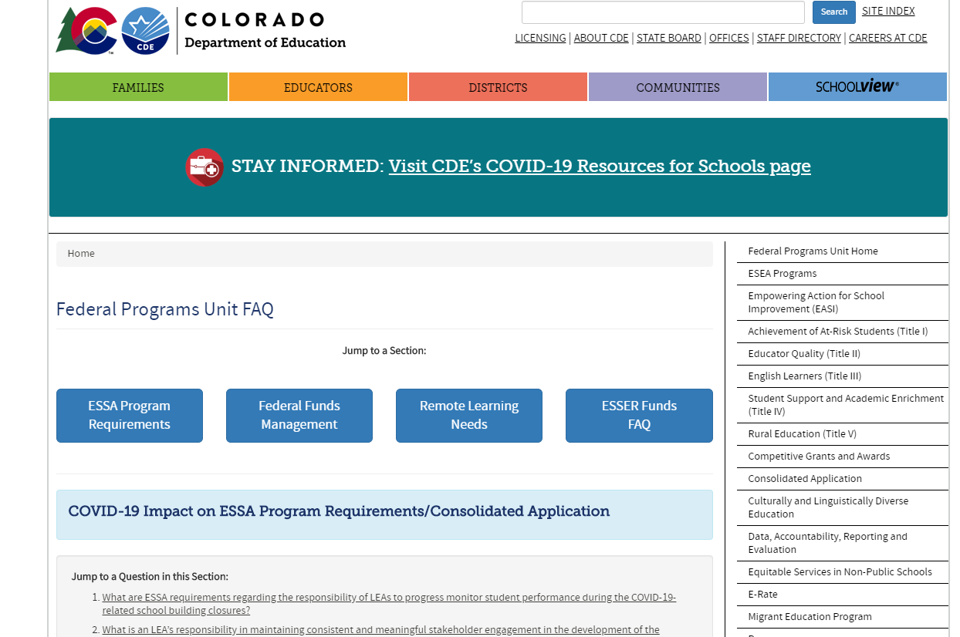
More FAQs here!
We are continually working to answer questions and post them here: http://www.cde.state.co.us/fedprograms/covidcaresactfaq

Slide 26
Other Logistical Matters

Slide 27
Requesting Reimbursement
Request for Funds (RFF)
  Formsite
  Available once LEA receives final approval
  Anticipate reporting more information when completing the RFF
Reporting
  USDE has not released the reporting requirements. Each LEA will certify that it will comply with reporting requirements.
  CDE will do our best to provide as much time as we can to respond to reporting requirements.

Slide 28
Questions?
Online system and application submittal: Michelle Prael at prael_m@cde.state.co.us or Brittany Jimenez at jimenez_b@cde.state.co.us
Allowable uses of funds: Nazie Mohajeri-Nelson at mohajeri-nelson_n@cde.state.co.us or DeLilah Collins at collins_d@cde.state.co.us or your ESEA Regional Contacts: https://www.cde.state.co.us/fedprograms/regionalcontactspage

Slide 29
Remaining Questions?
Topics for Future Office Hours?

