Slide 1
Program Evaluation Training
January 2020
Notes:
Hi everyone, this is Tina Negley with the Colorado Department of Education, Unit of Federal Programs Administration, Office of ESEA Programs. I’m here with my colleagues Rachel Matson, Michelle Prael, and Mary Shen. We are also joined by Janet Joyce from Marzano Research at REL Central.

Slide 2
Program Evaluation Module 5
Overview
REL Central and CDE
Notes:
This webinar will cover Module 5 of the Program Evaluation Training series. Modules 1 through 4 were recorded and can be accessed by visiting the Program Evaluation webpage of the Data, Accountability, Reporting, and Evaluation (DARE) team. If you do not have access to the handouts, please contact Michelle or Rachel. Janet will be introducing REL.

Slide 3
Notes:
REL Central is one of 10 Regional Educational Labs across the country provided by IES through the U.S. Department of Education. The mission is to provide applied research and technical support for education stakeholders in the region. REL Central serves 7 states: Colorado, Kansas, Missouri, Nebraska, North and South Dakota, and Wyoming. REL Central has been collaborating with CDE on this project in trying to create and deliver these Program Evaluation modules. REL Central is working on an online toolkit based on some of this work, which will hopefully be available in another year or so once it’s gone through full development and approval.

Slide 4
Introductions
REL Central Team
Josh Stewart, Jeanette Joyce, David Yanoski, Mckenzie Haines, Doug Gagnon
CDE Team
Nazanin Mohajeri-Nelson, Ph.D.
  Director, ESEA Office
Tina Negley
  Coordinator, Data, Accountability, Reporting and Evaluation Team
Mary Shen
  Research Analyst
Notes:
From CDE, we have other staff who have also been involved in the partnership with REL over the last couple years, including Nazanin Mohajeri-Nelson, the Director of the ESEA Programs Office, and Mary Shen, who is also part of the DARE team. The individuals listed under both REL Central and CDE are available for additional, more customized technical assistance after you complete the modules. You are encouraged to contact any of the team members listed.

Slide 5
Program Evaluation:
Overall Training Goals, Purpose, and Process
Notes:
We’ll get started with the overall purpose of program evaluation and why we are providing these trainings.

Slide 6
Overall Goals of Program Evaluation Training
Develop understanding of the evaluation process and cycle.
Build capacity to effectively implement quality evaluation.
Form a common language to facilitate evaluation.
Identify how program evaluation can apply to small scale, targeted interventions.
Notes:
One of the reasons we are currently providing these trainings is because ESSA has emphasized and highlighted the need for identification and selection of evidence-based interventions. As those interventions are implemented at the local level, there is a requirement to collect a body of evidence that demonstrates the effectiveness of those evidence-based interventions as they’re implemented in your local context. What that translates to is a need to do program evaluation on a scale that is suitable to the size of the program being implemented at the local level. The larger the program and the more ESEA funds that are being used to support the program, the greater the need to have a body of evidence at the local level demonstrating that these programs have resulted in the intended outcomes. The purpose of these Program Evaluation trainings is to prepare districts in building that local body of evidence that demonstrates the effectiveness of the program.
Another reason these trainings are currently being provided is because, beginning with the 2020-21 school year, we are going to begin collecting evidence of local program evaluations through our monitoring of ESEA programs. All of the Titles, Titles I through V, have a requirement for conducting program evaluation and using evidence-based interventions. Because of that requirement, that is being rolled into our monitoring process to look at the local evaluations that are being conducted.
In order to have that understanding of the evaluation process and the cycle and what capacity is needed in order to conduct a local program evaluation, we’re providing these trainings. The trainings are also designed to form a common language to facilitate evaluation and to identify how program evaluation can apply to small scale projects, all the way up to larger scale projects. Again, the scale of the program evaluation should be aligned to the scale, and the time, effort, and resources being invested in the program.

Slide 7
What is Evaluation?
Evaluation
  Involves collecting and analyzing information about a program’s activities, characteristics, and outcomes
  Answer questions specific to local context
  Iterative process
Purpose
  Make informed judgements about a program
  Inform programming decisions
  Tool to inform continuous improvement
Notes:
So what is a program evaluation? An evaluation is a process that involves collecting and analyzing information about a program’s activities, characteristics, and outcomes. It answers specific questions to how things are working and what outcomes are being achieved as a result of an intervention being implemented at the local context. As a note, when we mention interventions throughout these modules, that is inclusive of any practices, strategies, or activities that are funded with ESEA funds. Evaluations happen in an iterative process and we are hoping that individuals participating in these modules will select 1 or 2 activities to go through the full development of the logic model and evaluation plan, and implementation of that evaluation plan. As you build those practices and build capacity at the local level, then those practices can be applied to other interventions throughout the district, especially those supported through ESEA funds.
The purpose of evaluations are to make informed judgements about how well a program is meeting the needs that have been identified through a comprehensive needs assessment, and to ensure that programmatic decisions are based in that needs assessment and to ensure that interventions are being implemented as designed and approved and are producing the intended results. Evaluation is a tool for informing continuous improvement, so as we talk about program evaluation moving forward, especially at the local context, it’s really important to frame it as a process to look for what’s working so we can scale up those efforts, and continue to make modifications to what’s not working, so we can achieve the desired outcomes.

Slide 8
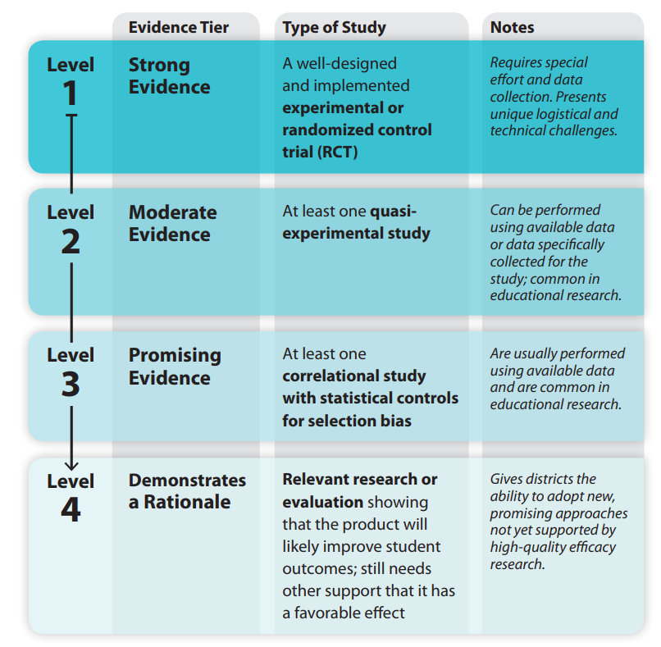
Defining ESSA Levels of Evidence
See Handout A for more information
Notes:
As mentioned earlier, one of the driving forces behind providing Program Evaluation Trainings is the required ESSA levels of evidence that are called upon when selecting and implementing evidence-based interventions. There are 4 different levels of evidence that are explained in ESSA, and all states and districts that accept ESEA funds, including Titles I, II, III, IV, or V, as well as Title I 1003 or school improvement funds, are required to have a demonstration of the level of evidence that is in support of the interventions that are being funded with these funds. The 4 levels range from 1 being the strongest level of evidence that is based on a well-designed and implemented experimental or randomized control trial, which is a practice that requires special effort and data collection. When you are looking at the research base behind an intervention, what you are looking for is that there is a certain level of rigor in studying whether that intervention has worked in other contexts. There are resources that are available for looking at the level of strength for existing programs and interventions and we have an entire webinar training series and website that explain these levels and how to search the resources that are available to look at the evidence base behind the interventions you are considering at the local level. If you navigate to the CDE website and enter Evidence-Based Interventions in the search bar, you’ll find the link to where those webinars are stored. The second level is moderate evidence, which means there was at least one quasi-experimental study that was used in looking at the effectiveness of that intervention. Level 3 is looking for at least one correlational study, which means that two variables are related to each other, either positively or negatively. When there is a correlational study that demonstrates the relationship between two variables, that is considered a promising level of evidence. For school improvement funds or Title I section 1003 funds that are awarded through EASI, there is a requirement for any interventions that are funded to meet levels 1 through 3. For Consolidated Application funding, formula funds under Titles I through V, however, interventions can meet any of the levels, including level 4. Level 4 indicates there was relevant research or evaluation, whether nationally or at the local level, showing that the intervention will likely improve student outcomes, but there is still a need for other supports that is has a favorable effect and there needs to be a plan for evaluating that impact to collect and build that body of evidence as you’re developing and implementing any promising practices that are based on a theory or research that demonstrates a rationale.

Slide 9
The Program Evaluation Cycle
Part 1: Logic Model
Part 6: Dissemination
Part 2: Evaluation Questions
Part 5: Data Preparation and Analysis
Part 3: Data Sources
Part 4: Data Collection Tools
Adapted from: http://toolkit.pellinstitute.org/.
Notes:
The training modules for program evaluation are designed to follow a typical program evaluation cycle, which typically happens with development of a logic model, development of evaluation questions, development and identification of data sources, development and identification of data tools that are necessary for conducting the program evaluation, identification of the data preparation strategies and analyses to be used to answer the evaluation questions, and then, once you have the results, determining how best to disseminate and communicate those findings to your stakeholders. Each one of these buckets are a separate training module that has been developed by REL in partnership with CDE and are being provided through webinars.

Slide 10
Part 5: Developing an Analysis Plan and Data Preparation Strategy
Notes:
With that, we are going to get started with this module, which is focused on developing an analysis plan and data preparation strategy…

Slide 11
The Program Evaluation Cycle: Part 5
Part 1: Logic Model
Part 6: Dissemination
Part 2: Evaluation Questions
Part 5: Data Preparation and Analysis
Part 3: Data Sources
Part 4: Data Collection Tools
Adapted from: http://toolkit.pellinstitute.org/.
Notes:
which falls into the third bucket in the evaluation cycle. Modules 4 and 5 are more capacity intensive, but even individuals without a background in data analysis can benefit from this module. This module is not designed to replace formal training in data analysis and statistics, but rather to provide common language that all individuals can use to better participate throughout the program evaluation process and to become better consumers of program evaluation results.

Slide 12
Goals for Part 5
Discuss data analysis plan considerations
  Purpose of data analysis
  Connection between logic model, evaluation questions, and the variable selection process
  Analysis methods
Discuss data preparation strategies
  Data cleaning considerations and limitations
Notes:
The goals for this module are to discuss data analysis plan considerations, outlining the purpose of data analysis and the connection between your logic model, evaluation questions, and variables of interest. This module will also provide a high-level overview of a variety of analysis methods, and will discuss data preparation strategies, such as data cleaning considerations, that can be used to help ensure accuracy of your results.

Slide 13

Purpose of Data Analysis
Data analysis
  Is the process of developing answers to questions through the examination and interpretation of data.
  Provides insight that drives decisions.
  Summarizes collected data.
How do you plan to get from raw data…
…to decision-making?
Adapted from https://www.ngdata.com/what-is-data-analysis/; https://up-za.libguides.com/c.php?g=485435&p=4425510; https://www150.statcan.gc.ca/n1/pub/12-539-x/2009001/analysis-analyse-eng.htm.
Notes:
The purpose of data analysis is to develop answers to your evaluation questions through the examination and interpretation of data. Data analysis can provide insight into the impact of your program, enabling you to summarize raw data and use it to drive data-informed decision-making.

Slide 14
What are the Variables I Should Care About?
Covariate: A variable that has a relationship to the dependent variable.
Confound: A variable that creates a spurious relationship between the independent and the dependent variable.
Independent variable: A variable that we believe will have some relationship to what we hope to achieve.
E.g., Teacher experience
E.g., Professional learning of reading strategies
Dependent variable: A variable that may be predicted or caused by one or more independent variables.
E.g., Quality of PL presenter
E.g., Student achievement
See Handout Q for more information
Notes:
There are four main variable types of interest. Independent variables are those you believe will have some relationship with the intended outcomes. In our example, for instance, one independent variable is the professional learning of reading strategies that teachers and other educators received. Covariates are other variables that have a relationship with the dependent variable. They are not direct activities in your logic model, but represent additional factors that should be considered when evaluating your outcomes. Teacher experience, for example, could relate to both teacher and student performance, regardless of participation in the professional learning opportunity. Confounds are variables that create a spurious relationship between the independent and dependent variables. A spurious relationship is a situation in which two or more variables are correlated with each other, but not causally related, as a result of either coincidence or the presence of a third unseen factor. An example of this can be seen by looking at a city’s ice cream sales. Sales are highest when the number of reported sunburns is also highest. To say that ice cream sales cause sunburns, or vice versa, would imply a spurious relationship. In reality, a heat wave may have caused both. The heat wave is an example of a confounding variable. Lastly, dependent variables are variables that may be predicted or caused by one or more independent variables. In our example, for instance, a long-term outcome or dependent variable is improve student achievement. As you can see in this diagram, independent variables, covariates, and confounds can all impact your dependent variables.
Throughout this webinar we encourage you to refer to Handout Q for more information. It provides a list of terms, and their accompanying definitions, that will be referenced throughout this module.

Slide 15
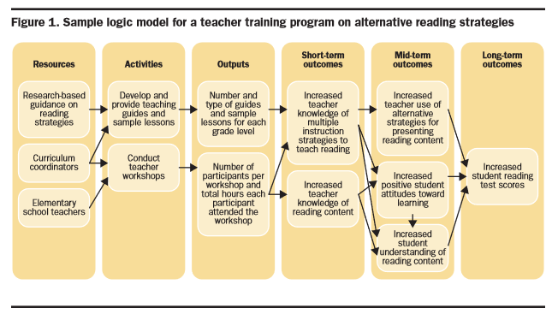
How do Variables Connect to the Logic Model?
Independent Variables
Dependent variables
Covariates
Confounds
Source. Logic models: A Tool for Effective Program Planning, Collaboration, and Monitoring, by W., Kekahio; B., Lawton; L., Cicchinelli; & P., Brandon, 2014, Washington, DC: U.S. Department of Education, Institute of Education Sciences, National Center for Education Evaluation and Regional Assistance, Regional Educational Laboratory Pacific. p. 3. Retrieved from http://ies.ed.gov/ncee/edlabs.
Notes:
This graphic shows how the different types of variables relate to your logic model. The dependent variables are what we hope to achieve, our short-, mid-, and long-term outcomes. To accomplish those outcomes, we have a number of activities, our independent variables, which should be carried out with fidelity. We must also be aware of any covariates, such as teacher experience and background, which impact the dependent variables. As well as any confounds which might impact the relationship between the independent and dependent variables.

Slide 16
Which Analysis Method do You Choose?
It depends on what your research questions are and what you hope to learn. Common approaches include:
Descriptive
Describes the sample
–Measures of central tendency (mean, median, mode)
–Distribution and dispersion (minimum, maximum)
–Association among variables
Inferential
Draw inferences based on a sample
–t-tests
–Analysis of variance (ANOVA)
–Correlation among variables
–Regression
See Handout Q for more information
Notes:
Once you have determined the variables of interest, you must think about which analysis method to choose. The appropriate analysis method depends on your research questions, and what you hope to learn. Descriptive and inferential methods are common approaches. Descriptive statistics help to describe your sample. This includes measures of central tendency, such as the mean, median, and mode, as well as looking at the distribution and dispersion of the sample, such as the minimum and maximum values. Descriptive statistics can also be useful when looking at the association among variables. Inferential statistics, on the other hand, are used to draw inferences to a larger population based on your sample. If you pilot a professional learning opportunity in 3 schools, for example, inferential statistics can be useful in evaluating whether similar outcomes can be expected when the professional learning is rolled out to the entire district.

Slide 17
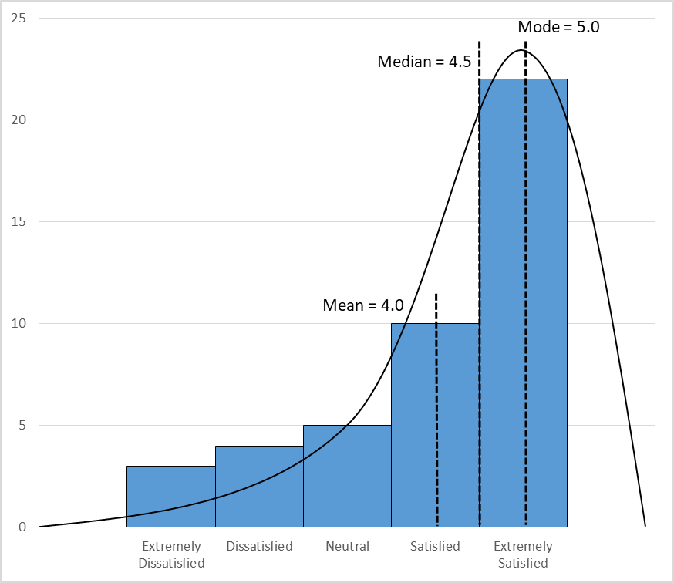
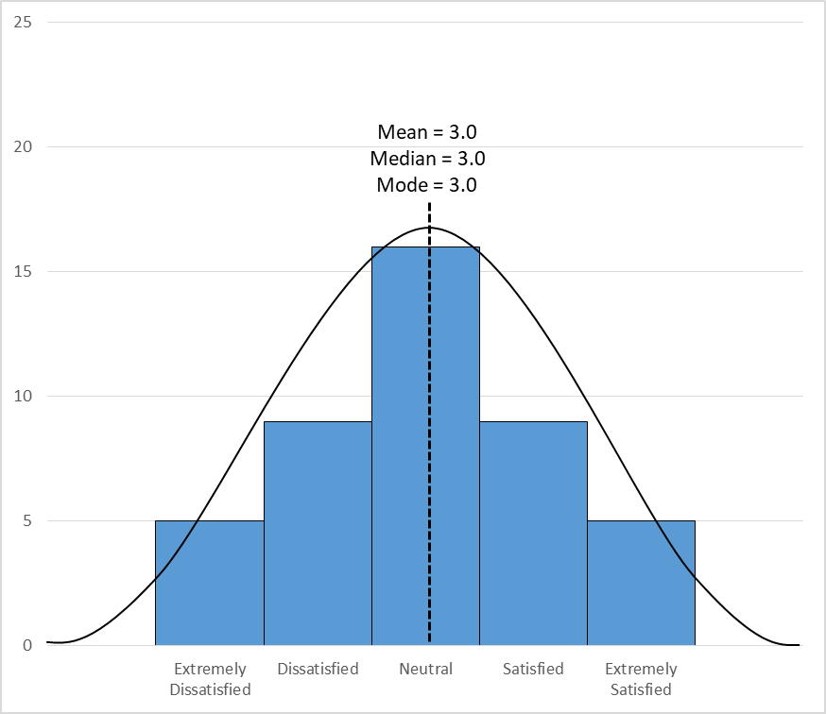
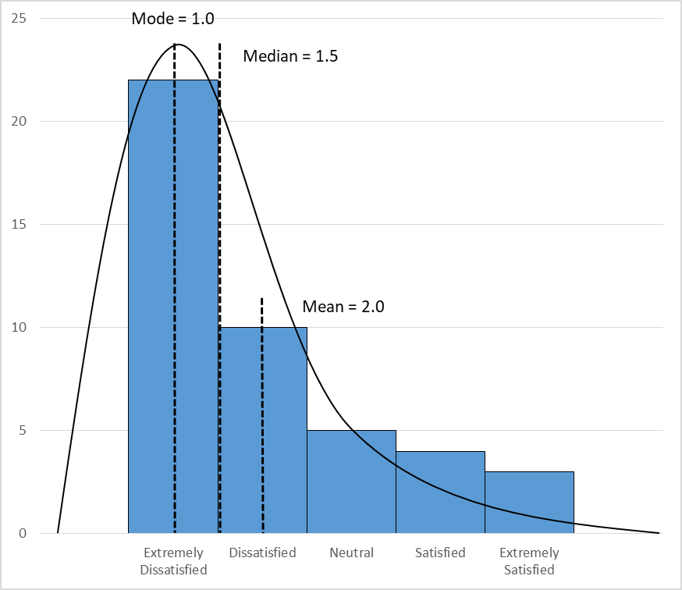
Which Analysis Method Do You Choose - Descriptive
Descriptive:
How many students took part in the reading strategies intervention?
  Questions like these might be answered with means, standard deviations, counts, and percentages.
      Why? Because we are just looking to describe how many students were involved, what their average scores were, or what percentage of students participated from a particular group (e.g., males and females).
For more information, see Descriptive Analysis in Education: A Guide for Researchers.
Notes:
Descriptive statistics can answer questions such as “How many students took part in the reading strategies intervention?” Those types of questions could be answered using means, standard deviations, counts, and percentages, as we are just looking to describe how many students were involved, what their average scores were, or what percentage of students participated from a particular group.
For example, imagine we are looking at teacher satisfaction with the professional learning opportunity on a 5-point scale, ranging from extremely dissatisfied on the left to extremely satisfied on the right. The center figure shows a normal distribution, with most folks rating their satisfaction as neutral in the middle, and with very few teachers reporting being extremely satisfied or dissatisfied. In that example, the mean, median, and mode are all 3 or neutral.
A negative skew, however, occurs when most of the scores are at the higher end (the right side) of the scale. It is considered to be negatively skewed because the mean occurs at a value lower than the center. In this example the mean is 4, whereas the center of the data, the median, is 4.5. The mode is 5, as most teachers reported being extremely satisfied. In this example, it may make sense to use the mode or median to describe the sample, rather than the mean.
A positive skew, on the other hand, occurs when most of the scores are at the lower end (the left side) of the scale. In this example, the mean is 2, the median is 1.5, and the mode is 1.

Slide 18
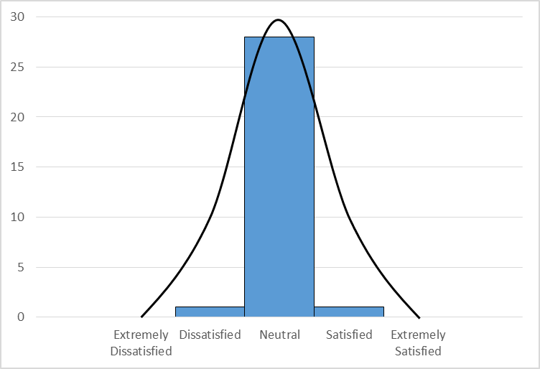
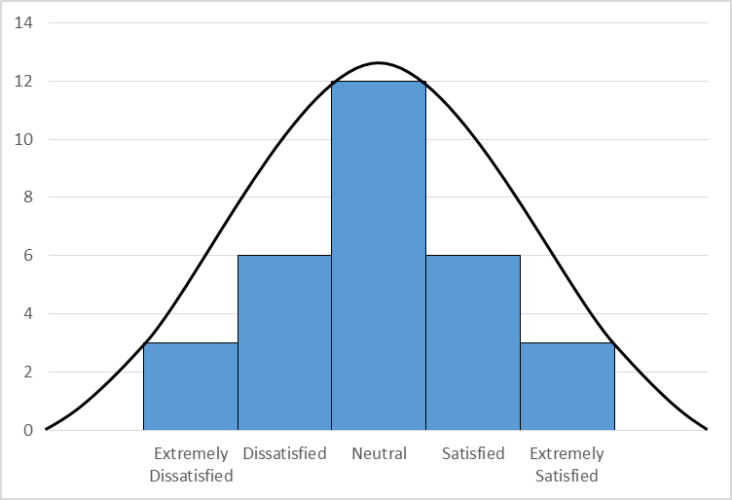
Which Analysis Method Do You Choose – Descriptive
Descriptive:
How many different groups of students took part in the reading strategies intervention?
  Questions like these might be answered with means, standard deviations, counts, and percentages.
      Why? Because we are just looking to describe how many students were involved, what their average scores were, or what percentage of students participated from a particular group (e.g., males and females).
Small variance
Large variance
For more information, see Descriptive Analysis in Education: A Guide for Researchers.
Notes:
In addition to skewness, it is also important to look at the distribution of the values. Small variance indicates all of the values are highly clumped together. For example, all teachers rated the training as satisfied or extremely satisfied. Large variance indicates the values are very dispersed. For example, some teachers were extremely dissatisfied, others were extremely satisfied, and others rated their satisfaction somewhere in between.

Slide 19
Which Analysis Method Do You Choose – Inferential
Group Differences:
Did girls outperform boys on the end-of-course reading assessment?
  Questions like these can be answered with inferential statistics, like a t-test or analysis of variance.
    Why? Because we do not know if differences are large enough to say one group did better than the other.
More information can be found at Social Science Statistics.
Notes:
To determine whether there are significant differences between groups, inferential statistics can be used. For example, to answer the question “Did girls outperform boys on the end-of-course reading assessment?” A t-test or ANOVA could be used to evaluate whether the intervention had more of an impact for a particular set of students.

Slide 20
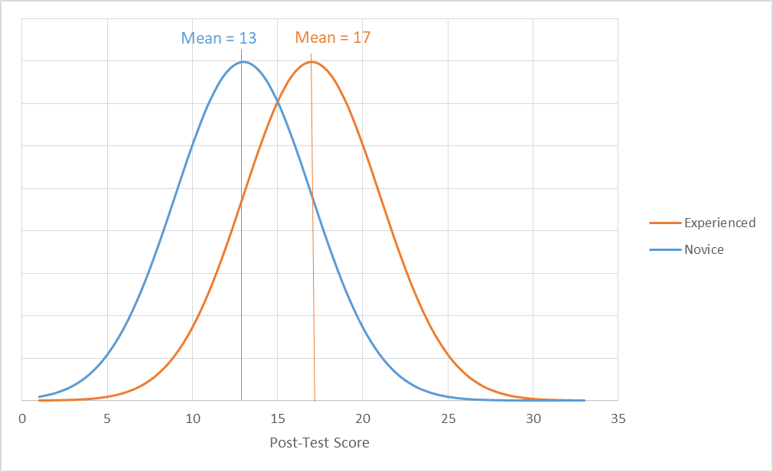
t-tests
This test compares the means and standard deviations of 2 groups to see if they are meaningfully different.
  For our example, let’s say the data on the post-test looks like this for novice v. experienced teachers:
  It looks like one group may have grasped the training better than the other, but we need a statistical test to determine whether the difference between the groups is meaningful.
Notes:
A t-test compares the means and standard deviations of 2 groups to see if they are meaningfully different. For example, looking at post-test scores for novice versus experienced teachers. Here we see that experienced teachers have a higher average post-test score, but we need a statistical test to determine whether the difference between the groups is meaningful.

Slide 21
One Tail or Two?
If we have a direction of difference in mind in our evaluation question, such as “Did experienced teachers perform better on the post-test than novice teachers?”, we can use a one-tailed t-test.
If the direction isn’t so obvious, we can use a two-tailed t-test.
The t-test result corresponds with a probability level (p-value). Low p-values indicate your data are unlikely if the null hypothesis (i.e., there is no difference between groups) is true.
Notes:
If we have a direction of difference in mind for our evaluation question, such as “Did experienced teachers perform better on the post-test than novice teachers?”, we can use a one-tailed t-test. If the direction isn’t so obvious, we can use a two-tailed t-test instead. The results of a t-test provide a probability level or p-value. A small p-value indicates strong evidence against the null hypothesis (i.e., that there is no difference between groups).

Slide 22
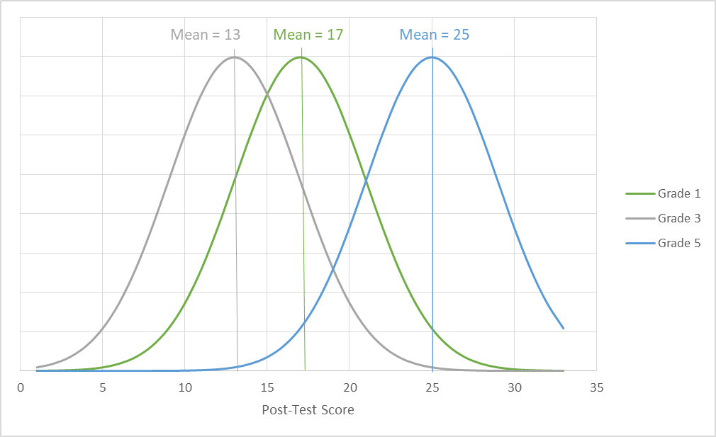
What If There Are More Than Two Groups?
If you want to investigate differences in more than 2 groups (for example, by grade), you can use analysis of variance (ANOVA).
In general, the ANOVA result tells you that a difference exists (using a p-value), but not between which groups.
If you find a difference and want more information, you will have to do further statistical analysis.
Notes:
What if you have more than two groups you’d like to compare? If you want to investigate differences in more than 2 groups, you can use an analysis of variance, or ANOVA, instead. Similar to a t-test, the results of an ANOVA provide a p-value indicating whether there are significant differences between groups, but it does not indicate between which groups. If you find a difference and want more information, you’ll have to run additional statistical analyses. For example, an ANOVA might indicate a significant difference in post-test scores based on grade-level, but additional analyses would be required to explore those differences. For instance, there may be a significant difference in post-test scores between grade 3 and grade 5, but not between grade 1 and grade 5.

Slide 23
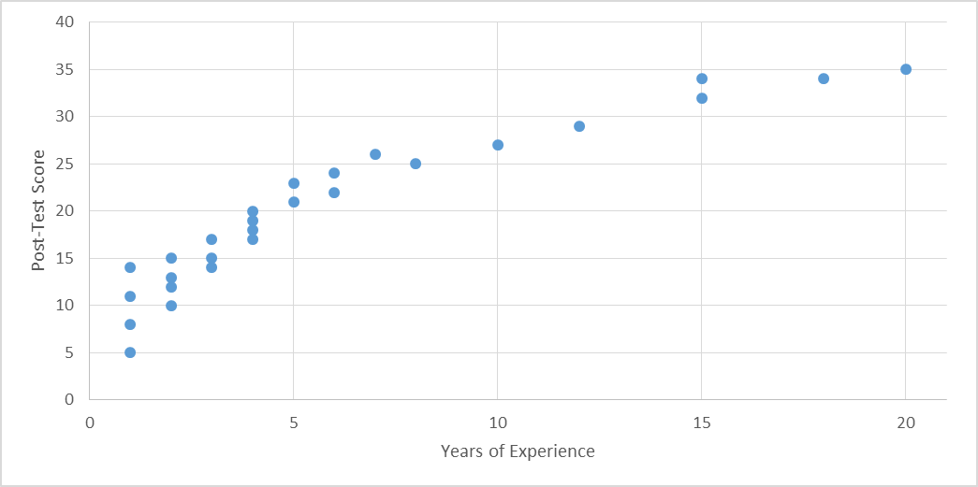
Which Analysis Method Do You Choose – Inferential, Cont.
Correlation:
Do students who spend more time on reading tend to do better on a end-of-course reading assessment?
  Questions like these can be answered with correlational analyses.
    Why? Because we want to understand the relationship between two concepts, such as whether scores on a reading exam go up when students spend more time reading.
More information can be found at Social Science Statistics.
Notes:
Another form of inferential statistics is correlational analyses. A correlation can be used to answer questions such as “Do students who spend more time on reading tend to do better on an end-of-course reading assessment?” A correlation can be used to understand the relationship between two variables, such as whether scores on a reading exam go up when students spend more time reading. In this graph, for example, teacher’s post-test scores have been plotted in comparison to their years of experience. Visually, there appears to be a positive relationship, as teachers with more years of experience have higher post-test scores. A correlational analysis will allow you to evaluate whether that relationship is statistically significant.

Slide 24
Correlations
The correlation coefficient will tell you how likely changes in one variable (years of experience) will correspond to changes in another variable (scores on the post-test).
The correlation coefficient will NOT tell you that one variable caused the other to change.
Correlation coefficients can be positive (as one variable increases, the other variable also increases) or negative (as one variable increases, the other variable decreases).
Correlation coefficients range from -1 to 1. The closer the value is to zero, the less likely that the two variables are related.
Notes:
A correlation coefficient will tell you how likely changes in one variable are to correspond to changes in another variable. A correlation coefficient does not tell you that one variable caused the other to change, it only indicates the potential presence of a relationship between the two variables. Correlation coefficients can be positive, such as the graph on the previous slide, or negative, indicating that as one variable increases, the other decreases. Correlation coefficients range from -1 to 1, with values closer to zero indicating it is less likely that the two variables are related.

Slide 25
Causality or Impact
Did the reading strategies program cause a change in students’ end-of-course reading assessment scores?
  Questions like these require rich datasets that use experimental or quasi-experimental designs.
    Why? Because we want to be sure that, out of all other variables that might have influenced student scores, the reading strategies program caused the change.
More information can be found in the Institute for Education Sciences report Statistical Theory for the RCT-YES Software.
Notes:
Establishing causality or impact requires rich datasets that use experimental designs, such as randomized control trials, or strong quasi-experimental designs. To answer questions such as “Did the reading strategies intervention cause a change in students’ end-of-course reading assessment scores?” you must be sure that, out of all other variables that might have influenced student scores, the reading strategies intervention caused the change.

Slide 26
Revisiting the ESSA Levels of Evidence
See Handout A for more information
Notes:
Establishing causality can be a difficult task, but could provide strong or moderate evidence to support the continued implementation of the program. Causality is not required to meet the ESSA levels of evidence though. For example, a correlational study could be used to show promising evidence and meet level 3 of the ESSA levels of evidence.

Slide 27

Applying Plan Learnings
What type of analysis is best suited to address your evaluation question(s)?
  Are you hoping to describe your participants, schools, or other factors?
  Do you want to explore differences between groups (e.g., groups of students with different characteristics, teachers who did or did not attend the workshop)?
  Are you wondering if more exposure to the reading strategies workshop is associated with increases in student reading test scores?
Activity!
Notes:
At this time, we’d like to pause the recording and invite you to, if you haven’t already accessed the handouts, open Handout R, which is the expanded evaluation matrix, and review the information provided, reflecting on how you’d use the handout to determine what type of analysis is best suited to address your evaluation questions.

Slide 28
Activity: Applying Plan Learnings
Develop a data analysis plan for one of your evaluation questions. Complete the last two columns in your Evaluation Matrix, using Handout R.
EVALUATION QUESTION | DATA SOURCES | DATA COLLECTION TOOLS | DATA COLLECTION TIME FRAME | ANALYSIS METHOD How will you summarize data to make it usable? | INTERPRETATION How will you reach a conclusion regarding your evaluation question?
To what extent did the teacher training program improve students’ attitudes toward learning? | Collect new data using a survey instrument. | 5-item Likert response scale measuring students’ attitudes towards learning. | Survey administered twice – prior to teacher training and after the training. | Attitude scores are aggregated into means, which are then subtracted from each other. | The difference in the means is compared to a 0 using statistical significance tests. If it’s statistically different from a 0, then you can conclude that the scores changed during the teacher training period.
Notes:
You likely populated the first four columns during Module 3 and would now focus on the last two columns. The analysis method column should be used to think about what type of analysis you will use to summarize your data. For example, would you use a t-test to compare students’ attitudes toward learning, based on surveys administered once prior to teacher training and once after the training? The final column, interpretation, should be used to think about how you will interpret the results. We will pause the recording and give everyone 5 minutes to review Handout R and ask any questions you may have.

Slide 29
Data Preparation Strategies
Develop a system to organize your data:
  Define a unit of observation (e.g., class, grade, teacher, student, school).
  Assign a unique participant ID (you do not need to create one, you can use existing ID numbers for teachers, schools, students).
  Develop a codebook with variable names, response options, and numerical codes.
Organize the data by item/question.
Activity!
Review Handout S and discuss what you might need to consider in creating your own codebook.
Click here for more information from The Pell Institute for the Study of Opportunity in Higher Education.
Notes:
We are now going to shift to data preparation strategies that can be used to help ensure the accuracy of the data you’ll use in your data analysis. The first step is to develop a system to organize your data. Start by defining the unit of observation and by assigning a unique ID for each record. For example, if you are collecting student-level data, you could use SASIDs or other unique student ID number. It is important to ensure the ID reflects a unique value. Using a student’s name as the identifier, for instance, is not recommended as multiple students in the school or district could have the same name. Using a unique ID ensures that data is assigned to the appropriate record. It is also recommended that you develop a codebook with variable names, response options, and numerical codes. If you have a variable for student gender, for example, and you have assigned a value of 0 for males and 1 for females, a codebook ensures that those codes are documented and can be readily accessed when data are analyzed to ensure results are reported accurately. At this time, we’d like to pause the recording again and invite you to open Handout S and reflect on what you might need to consider in creating your own codebook. If you’d like to share out, enter your considerations into the chat, as well as any questions you may have about the handout. We will give everyone 5 minutes to review Handout S at this time.

Slide 30
Data Visualization
No clear pattern
Potential linear relationship
Notes:
Once you have developed a codebook and have collected your data, data visualization is an important step prior to conducting data analysis. Data visualization can be used to identify potential errors or concerns, and can also be used to identify initial trends in your data. For example, the first graph suggests no clear pattern between the data elements, as the data points are scattered. The second graph, however, suggests a potential linear relationship. The graph suggests there may be a positive relationship between the number of hours a student spends reading per week and that student’s end-of-course reading score.

Slide 31
Data Visualization
Potential for group difference
Notes:
Data visualization can also be used to help identify the analysis methods to be used. For example, plotting data might suggest potential differences between groups or indicate that the relationship between two variables might vary by group.

Slide 32
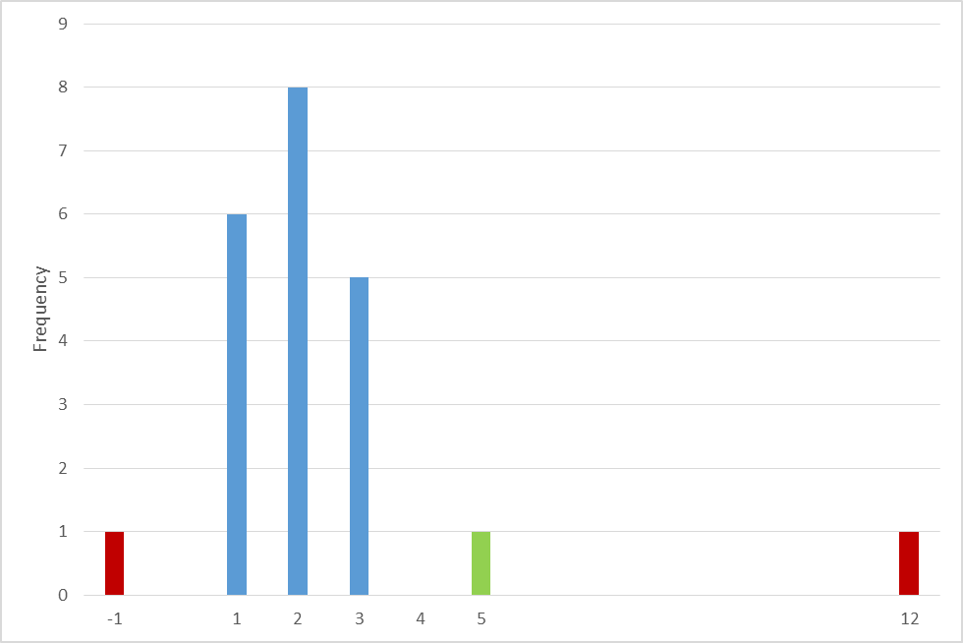
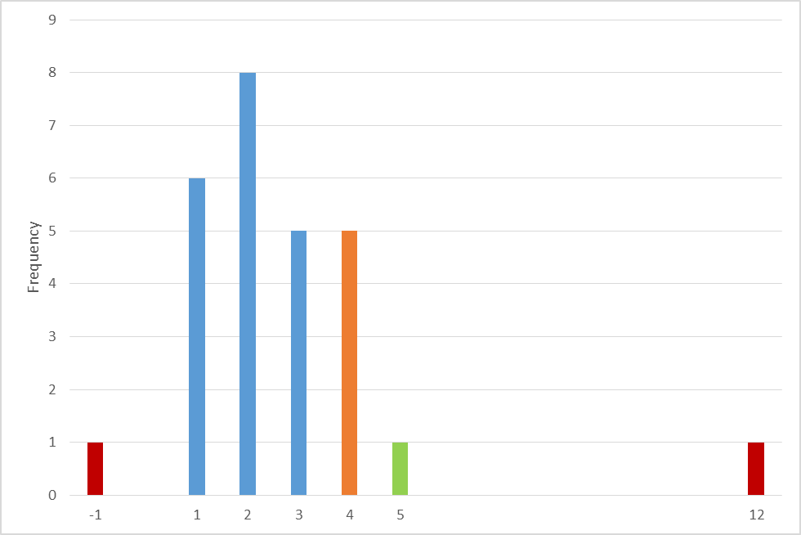
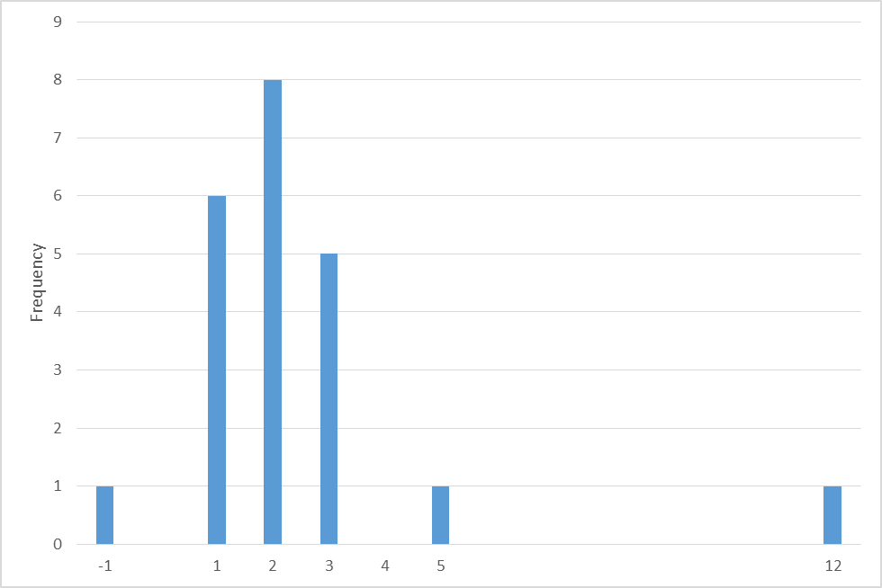
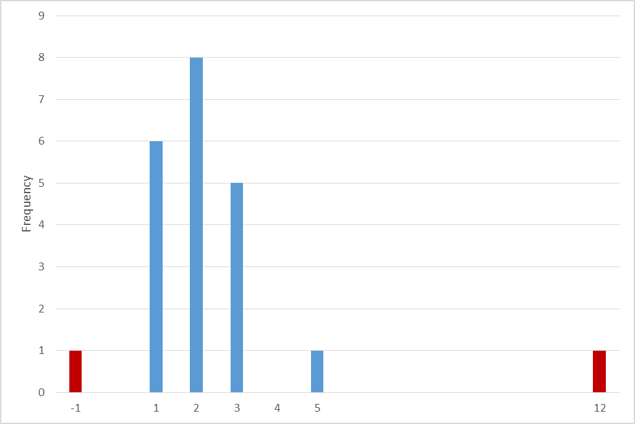
A Visualization of Data Errors
On a scale of 1-5, how satisfied were teachers with the PL?
Mean = 2.4
Median = 2
Mode = 2
-> 2.1
-> 1.9
-> 2.5
Missing data
Unexpected / out of range values
Potential outlier
Notes:
Here is an example of how data visualization can be used to identify potential errors, and also shows how data errors can affect analysis. Say you’ve collected survey data from teachers to evaluate their satisfaction with a professional learning opportunity. At first look, it appears teachers were pretty dissatisfied, with a mean score of 2.4 and a mode and median of 2. (Click) If we visualize the data, however, we can now see that we have (click) two unexpected values of -1 and 12, which are out-of-range of the possible values of our 5-point scale. These must be errors. If we eliminate those values, our mode and median don’t change, but we now have a mean score of 2.1. (Click) Visualizing the data also shows that we have a potential outlier, a single high score of 5. Is that a mistake in data entry, or is it just one teacher who was very satisfied with the professional learning? If the outlier were to be removed, the mean would decrease further to a value of 1.9. But what if we find a stack of survey results that were not entered into the system? (Click) Adding this missing data not only increases our mean to 2.5, but also suggests that our single high score of 5 may not be an outlier after all.

Slide 33
Sources of Data Errors
Errors come from a variety of sources and can occur at any stage during the evaluation process:
  Data collection
  Data entering and cleaning
  Data analysis
Notes:
Data errors such as those can come from a variety of sources and can occur at any stage during the evaluation process. Data errors can occur during data collection. For example, you administer a survey to all elementary and middle school teachers participating in a professional learning opportunity, but forgot to collect data from the high school teachers. Data errors can also occur during data entry. As shown on the previous slide, a value of -1 might have been entered instead of a value of positive 1, or a value of 12 instead of 2. Data errors can also occur during data analysis, if inappropriate data methods are used to evaluate your results.

Slide 34
Data Cleaning
Error checking techniques:
  Spot checking
  Eye-balling
  Logic check
  Double entry
  Descriptive analysis
Review Handout T for more information on data errors, and for information on helpful Excel functions for data cleaning.
Notes:
So, what can be done to help minimize or prevent data errors? Data cleaning is an important step in the process, and there are a number of error checking techniques that can be used. Handout T provides a list of various sources of errors, and gives several helpful resources and tips that can be used when checking for errors. A couple examples of error checking techniques are listed on this slide. Spot-checking consists of randomly selecting records of data, and comparing the raw data (such as the information on a paper survey) to the values actual entered into the database. Eye-balling is a method of examining the overall pattern of the data, such as was done with the teacher satisfaction results, which revealed errors with values of -1 and 12. Logic checks consist of reviewing the data to make sure that the answers make sense. For example, if a teacher indicated he was not evaluated during the school year in question 2, it would be illogical for him to rate his satisfaction with the evaluator’s feedback in question 3. Double entry is a process by which two or more people enter the same data and then check from discrepancies. Lastly, descriptive analysis is the process of using computer software to check for out-of-range values or missing values in the data.

Slide 35
Data Cleaning, Cont.
What to do with problematic data?
Remove duplicates.
Check forms or other data sources to correct entry errors or impossible values:
  If you cannot correct the error, consider removing the data point.
Consider the influence outliers might have on your results:
  Smaller datasets will be influenced more by outliers.
  Explore why you have outliers in your dataset.
Notes:
So, what can be done if you have problematic data? You can remove duplicate values if they exist in your dataset. If you identify out-of-range values or other errors, you can refer back to the raw data if it’s available or use other data sources. If you cannot reliably correct the error, consider removing that data point. During this process, it’s also important to consider the influence that outliers might have on your results. Outliers can have a greater impact on smaller datasets, therefore it’s important to explore why you may have outliers in your dataset.

Slide 36
Activity: Data Cleaning
Using Handout U, complete the Data Cleaning Activity with a partner to examine the following:
  Do the data contain duplicate cases?
  Do the data contain missing values?
  Are there entry errors?
  Are there missing values?
  Are there outliers?
Activity!
Notes:
Handout U provides a data cleaning activity that you can do with a partner or group. It provides a mock dataset that can be used to apply the error checking techniques we discussed to answer the following questions: Do the data contain duplicate cases? Do the data contain missing values? Are there entry errors? Are there potential outliers? You will see that the handout also reiterates the importance of developing a codebook, as it provides definitions for the data elements collected and numerical codes for some of the data elements, indicating that values of -1 indicate that no data is available and values of -2 indicate the information is not applicable.

Slide 37
Limitations to Interpretation of Results: Considering Generalizability
Is the sample representative?
Is the sample large enough to take action based on the results?
Were the analyses appropriate?
Do results justify conclusions?
Are there alternative explanations for results?
Are there alternative explanations for results?
Notes:
The final slide of this module covers limitations to the interpretation or generalizability of your results. Some things to consider include whether the sample was representative. For example, if a professional learning opportunity was only offered to elementary school teachers, it might not be appropriate to generalize the results to all teachers in the district. Also consider whether the sample was large enough to take action based on the results. For example, if the results are based on a sample of 3 teachers, they may not demonstrate the same level of need to continue the intervention as results based on a sample of 300 teachers. Were the analyses appropriate? You should consider all of the information presented on the previous slides when determining whether you should take action based on the results. Do the results justify conclusions? Is there statistical evidence to support those conclusions? Are there alternative explanations for the results? For example, if the professional learning opportunity was voluntary, it might be that it demonstrated greater success because the teachers who tend to participate are those who are more open to changing their practices and those who are more motivated. Collectively, these factors influence the generalizability or the ability to take the findings to other schools or settings and expect the same results.

Slide 38
ESEA Office
ESEA Office | Position | Phone | E-mail
Nazie Mohajeri-Nelson | Director of ESEA Office | 303-866-6205 | Mohajeri-nelson_n@cde.state.co.us
DeLilah Collins | Asst. Director of ESEA Office | 303-866-6850 | Collins_d@cde.state.co.us
DARE Team | Expertise | Phone | Email
Tina Negley | ESSA Accountability, Program Evaluation, and Reporting | 303-866-5243 | negley_t@cde.state.co.us
Alan Shimmin | ESEA Reporting and Data Collections | 303-866-6209 | shimmin_a@cde.state.co.us
Mary Shen | ESEA Program Evaluation, Research, and Accountability | 303-866-4571 | shen_m@cde.state.co.us
Notes:
That concludes our Program Evaluation training module on analysis plans and data preparation strategies. We again encourage you to reach out to the REL team or our CDE team for additional technical assistance. Thank you all for attending! At this time we’ll end our recording and open up the phone lines for any questions you may have.

