Slide 1
Program Evaluation Training
December, 2019

Slide 2
Program Evaluation Modules 1-2
Overview
REL Central and CDE

Slide 3
Notes:
Josh

Slide 4
Introductions
REL Central Team
Josh Stewart, Jeanette Joyce, David Yanoski, Mckenzie Haines, Doug Gagnon
CDE Team
Nazanin Mohajeri-Nelson, Ph.D.
  Director, ESEA Office
Tina Negley
  Coordinator, Data, Accountability, Reporting and Evaluation Team
Mary Shen
  Research Analyst
Notes:
Jeremy

Slide 5
Program Evaluation:
Overall Training Goals, Purpose, and Process
Notes:
Jeremy

Slide 6
Overall Goals of Program Evaluation Training
Develop understanding of the evaluation process and cycle.
Build capacity to effectively implement quality evaluation.
Form a common language to facilitate evaluation.
Identify how program evaluation can apply to small scale, targeted interventions.
Notes:
Who should be in the room?
LEA leaders who will make decisions about the exploration and selection of the intervention (e.g., Assistant Sup, CAO, Principals)
LEA leaders who will evaluate the intervention (e.g., data and evaluation staff)
LEA and school staff with expertise in the subject field of the intervention (e.g., teaching or coaching staff with expertise in behavioral, instructional, etc. interventions, depending on the type of intervention)
LEA training or coaching representatives
What will I learn?
See goals above
What do I need to know already going in?
District and school context (e.g., conversant in LEA CNA results (i.e., UIP) – from priority performance challenges to root causes to major improvement strategies
If the LEA wants to explore and select a new intervention and evaluate it, the LEA team needs a baseline understanding of exploring and selecting a intervention – including considerations such as evidence strength, fit, capacity (e.g., contextual fit)
What are the expected takeaways?
Understand the phases of program evaluation and inherent complexity, what it takes to do rigorous PE, and make informed decisions about the scope of PE based on staff skills, capacity, and funding.
Be equipped to understand the baseline principles, technical skills, and implications of a PE effort.

Slide 7
What is Evaluation?
Evaluation
  Involves collecting and analyzing information about a program’s activities, characteristics, and outcomes
  Answer questions specific to local context
  Iterative process
Purpose
  Make informed judgements about a program
  Inform programming decisions
  Tool to inform continuous improvement
Notes:
A program worth implementing is a program worth evaluating.
A program that can account for its investment by demonstrating progress and results is more likely to be viewed as impactful (and worthy of funding) by stakeholders.
The purpose is not to prove, but to improve…
Evaluation is a process that critically examines a program. It involves collecting and analyzing information about a program’s activities, characteristics, and outcomes.
Its purpose is to make informed judgements about a program, to access the impact of what is working or what needs to improve, in other words, to inform programming decisions.
It’s important to approach this work through the lens of inquiry, with an open mindset, and the enthusiasm to explore options and investigate discoveries—wherever they may lead.
It is important to evaluate all efforts, even if strategies or interventions are backed by evidence. LEA/school context and implementation can mitigate (or enhance!) the effectiveness of any program.
Start in a strong place with program selection. To the greatest extent possible, select a program that is evidence-based.
If there is no evidence base, or the evidence is not rigorous, program evaluation becomes even more important.
Program evaluation empowers LEAs/schools to build local evidence from efforts. Your school can be a proving ground for new solutions to support student learning
Evaluation can answer questions specific to your local context.
The depth and focus of your evaluation effort should be tailored to your local context and immediate needs.
Start where there’s evidence already.
Your school is a proving ground for new solutions!
Program Evaluation is an iterative process, and can be a tremendous tool to inform continuous improvement. The learning happens in the journey!

Slide 8
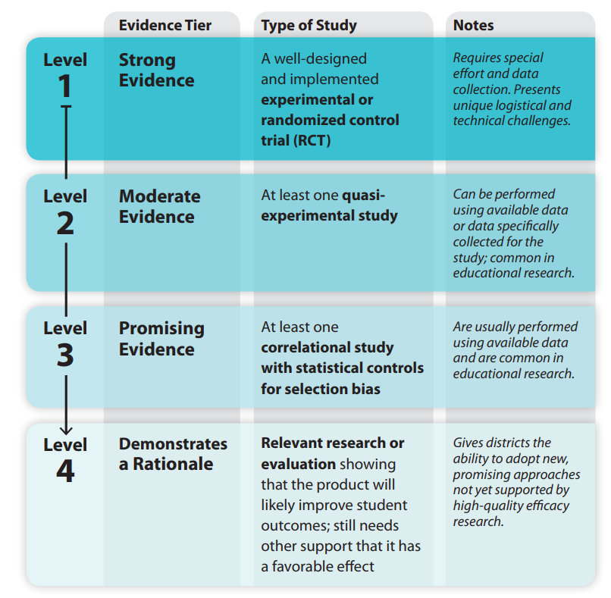
Defining ESSA Levels of Evidence
See Handout A for more information
Notes:
Jeremy - There is an emphasis of EBI under ESSA, and the types of evidence outcomes you seek to improve often determines the level of the evaluation effort. Our focus today is Level 4 : Evaluation shows that the intervention will likely improve student outcomes. We are providing you with Handout A: Exploring, Selecting, & Implementing Evidence-Based Interventions (EBIs) for further information on levels of evidence.

Slide 9
The Program Evaluation Cycle
Part 1: Logic Model
Part 6: Dissemination
Part 2: Evaluation Questions
Part 5: Data Preparation and Analysis
Part 3: Data Sources
Part 4: Data Collection Tools
Adapted from: http://toolkit.pellinstitute.org/.
Notes:
Jeremy

Slide 10
Part 1:Drafting a Logic Model

Slide 11
The Program Evaluation Cycle: Part 1
Part 1: Logic Model
Part 6: Dissemination
Part 2: Evaluation Questions
Part 5: Data Preparation and Analysis
Part 3: Data Sources
Part 4: Data Collection Tools
Adapted from: http://toolkit.pellinstitute.org/.
Notes:
Josh

Slide 12
Goals for Part 1
Build knowledge of Logic Models
  Definition and purpose
  Elements of a Logic Model
Drafting Your Logic Model
  Develop a Problem Statement
  Build your Logic Model
Notes:
Who should be in the room?
LEA leaders who will make decisions about the exploration and selection of the intervention (e.g., Assistant Sup, CAO, Principals)
LEA leaders who will evaluate the intervention (e.g., data and evaluation staff)
LEA and school staff with expertise in the subject field of the intervention (e.g., teaching or coaching staff with expertise in behavioral, instructional, etc. interventions, depending on the type of intervention)
LEA training or coaching representatives
What will I learn?
See goals above
What do I need to know already going in?
District and school context (e.g., conversant in LEA CNA results (i.e., UIP) – from priority performance challenges to root causes to major improvement strategies
If the LEA wants to explore and select a new intervention and evaluate it, the LEA team needs a baseline understanding of exploring and selecting a intervention – including considerations such as evidence strength, fit, capacity (e.g., contextual fit)
What are the expected takeaways?
Understand what a logic model is, why it is important,
Learn how to draft a problem statement based on the LEA CNA findings, and inform the development of the LM with the problem statement
Identify desired local changes in short, medium, and long term outcomes (e.g., knowledge, behaviors, and outcomes)
Walk away with a strong first draft of an LM

Slide 13
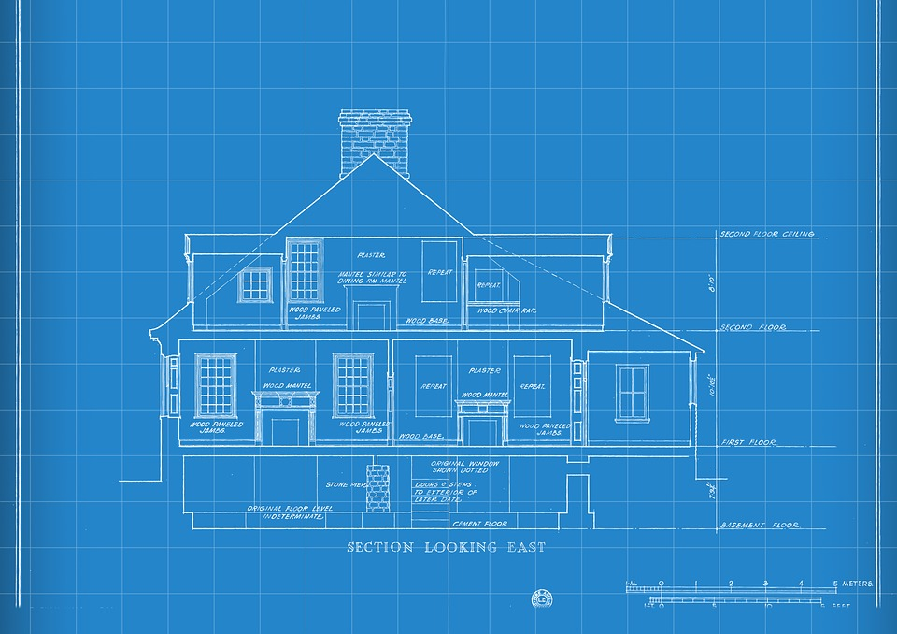
What is a Logic Model?
A Logic Model is:
A graphical representation of your theory of action
A preliminary blueprint for planning, doing, and evaluating.
Consider this! A logic model is like a house blueprint; it provides a sense of scope and relationship between parts of the overall structure.
Notes:
Josh - describes key program components, and the relationship between parts.

Slide 14
The Purpose of a Logic Model
Develop a shared understanding of the program
Draw explicit connections between program components
Capture assumptions
Notes:
Josh-
In order to conduct a quality program evaluation, you need to have a clear sense of the program that you intend to evaluate.
Develop a shared understanding for what resources are needed to do the work, what the work is, and what outcomes are sought as a result of the work.
Draw explicit connections between resources, work, and desired outcomes.
Capture assumptions about existing context and what needs to be in place to accomplish your goals.

Slide 15
Elements of Logic Model
Problem Statement
Resources
Activities
Outputs
Short-term Outcomes
Mid-term Outcomes
Long-term Outcomes
If we have these resources in place
And we do these things
We will generate these deliverables
Achieve these changes in knowledge
Shape these behaviors
And achieve these outcomes
Logic Model Theory of Action
Do you currently have a LM on an ESEA-funded strategy or activity?
Notes:
Josh-
The problem statement serves to drive the specifics under each of the categories below – resources, outputs etc. and draw explicit connections between the categories.
What is the difference between outputs vs. outcomes? Outputs lead to desired outcomes. They are the deliverables that result from your planned activities, but not the changes you expect. Outcomes are the evidence of your service delivery—the results your program intends to achieve if implemented with fidelity.

Slide 16
What Is a Problem Statement?
Problem Statement: The challenge the program or policy is designed to address
Questions to ask in defining the situation:
What is the key challenge?
  e.g. The low district reading scores
How was the proposed solution chosen?
  e.g. Evidence-based reading strategies
What do the program evaluation staff seek to understand?
  e.g. Do the resources affect instruction?
Common challenges to consider:
Student academic performance
Gaps between student groups
Tier I Instruction, Best First Instruction
School and district culture
Non-academic considerations (behavior, etc.)
Aligning curriculum to standards
Parent, family, community engagement
See Handouts B & C for more information
Notes:
Josh

Slide 17
Example District: Mountain Top 300
Geography: Located in a mountainous, rural region of NW CO
Size: 1,150 students
Schools: 2 Elementary, 2 Middle, 1 High School
Demographics:
40% White, 35% Hispanic, 15% Native American, 5% Black, 5% Other
18% students w IEPs, 25% English Learners
76% Free and Reduced Lunch (FRL)
School Quality:
1 Comprehensive Support school, 2 Priority Improvement Schools
Overall academic underperformance in elementary ELA, esp. among ELs.
Notes:
To help us develop the problem statement, we’ll quickly run through a hypothetical district context to ground our conversation.
The district is rural, small, has a handful of schools, the majority of its students are white and Hispanic, experiences high poverty, and is struggling academically, especially in its K-5 English Language Arts.

Slide 18
Leverage Your CNA findings to develop your problem statement
Level | Priority Performance Challenge | Root Causes | Possible Solutions
District | Lack of consistent and high quality instruction to meet CO learning standards | Inexperienced teachers Lack of data driven instruction Lack of school structures that protect teacher collaboration and planning time | Data driven instruction Professional learning communities Mentorships
School (Elementary) | Low reading scores in elementary grades, particularly among ELs | Lack of rigorous academic interventions in reading Lack of tiered academic supports to support struggling students Inconsistent parent and family engagement | Reading curriculum intervention tools/packages to support ELs Professional Learning for teachers on the reading strategies Processes to engage parents/families in learning
School (High School) | High dropout rate Low graduation rate (62% @ HS) | Inconsistent college and career engagement and planning Weak data systems to identify students off track | Early warning indicator system High impact strategies to engage students in career goals and build plans to meaningfully pursue goals
Notes:
If we think of the problem statement development in the context of improvement plans, such as the UIP process, this becomes very concrete.
Here’s a few examples of district and school level identified PPCs, root causes, and possible solutions.
For our purposes today, we’ll look at the PPCs, root causes, and possible solutions for the elementary school.

Slide 19
Developing a Problem Statement: Key Considerations
What is the problem or challenge?
  What does the Comprehensive Needs Assessment identify as a key challenge?
Why is this a problem?
  What is likely contributing to this situation or driving the results of the CNA?
For whom does this problem exist?
  Digging into the results; disaggregating the data; identify the individuals/groups that need support
Who has a stake in the problem?
  Stakeholders and benefactors
  Role to play – developers, implementers, supporters, funders
What is known about the problem (through previous work, research, etc.)?
  What have we tried? What has worked?
  What have others tried? What has worked?
Problem Statement
  Synthesize the above elements to explain who, what, when, where, why

Slide 20
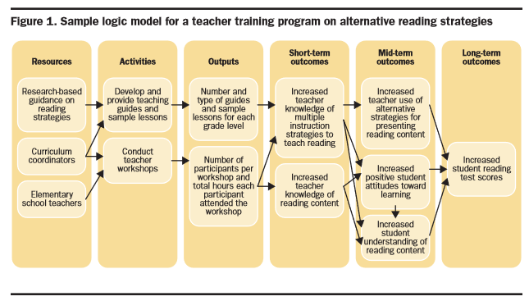
Example of a Problem Statement
Problem Statement: The elementary reading scores are below benchmark, particularly for ELs. To address this, the administration wants to make sure that all teachers have access to and feel comfortable with evidence-based reading strategies. They are developing a resource library and trainings based on strategies identified by What Works Clearinghouse. New strategies are expected to be implemented in the fall.
Source. Logic models: A Tool for Effective Program Planning, Collaboration, and Monitoring, by W., Kekahio; B., Lawton; L., Cicchinelli; & P., Brandon, 2014, Washington, DC: U.S. Department of Education, Institute of Education Sciences, National Center for Education Evaluation and Regional Assistance, Regional Educational Laboratory Pacific. p. 3. Retrieved from http://ies.ed.gov/ncee/edlabs.

Slide 21

Let’s Draft a Problem Statement!
Using Handouts B, C, and D, draft a problem statement
  Pause this recording
Consider
  What is easiest to capture on paper?
  What was most difficult?
  What questions do you have?
Activity!
Notes:
Jeremy – explain but don’t do

Slide 22
Elements of Logic Model: Resources, Activities, Outputs
Problem Statement
Resources
Activities
Outputs
Short-term Outcomes
Mid-term Outcomes
Long-term Outcomes
If we have these resources in place
And we do these things
We will generate these deliverables
Achieve these changes in knowledge
Shape these behaviors
And achieve these outcomes
Logic Model Theory of Action
See Handout C for more information
Notes:
Josh-
The problem statement serves to drive the specifics under each of the categories below – resources, outputs etc. and draw explicit connections between the categories.
What is the difference between outputs vs. outcomes? Outputs lead to desired outcomes. They are the deliverables that result from your planned activities, but not the changes you expect. Outcomes are the evidence of your service delivery—the results your program intends to achieve if implemented with fidelity.

Slide 23
Logic Model Components: Resources, Activities, Outputs
Resources | Activities | Outputs
Staff capacity and additional duties Funding External support (consultants) Materials (curricula, instructional materials, observation rubrics) Data tools | Planning Meetings Cross-disciplinary collaboration Analysis Training Surveys | Lesson plans Completed rubrics Refined training materials Verbal and written feedback
Using Handout D, let’s identify 1-3 resources, activities, and outputs for the planned intervention [pause recording]
Activity!
Notes:
Jeremy – talk through but don’t do Allow time for the participants to draft something. Then either pair and share or share back. Questions? What areas were hardest to describe?

Slide 24
Elements of Logic Model: Short-Term, Mid-Term, and Long Term Outcomes
Problem Statement
Resources
Activities
Outputs
Short-term Outcomes
Mid-term Outcomes
Long-term Outcomes
If we have these resources in place
And we do these things
We will generate these deliverables
Achieve these changes in knowledge
Shape these behaviors
And achieve these outcomes
Logic Model Theory of Action
See Handout C for more information

Slide 25
Logic Model Components: Outcomes
Outcomes: What difference will our activities make?
Short-term
Mid-term
Long-term
Most immediate and measurable results for participants that can be attributed to a change in knowledge and understanding.
More distant, though anticipated, these are often the implemented behaviors, practices, or skills associated with the program.
Desired outcomes or lasting impacts of the program. Can be influenced by program, as well as external factors.
Notes:
Josh
Short-term outcomes are the changes in program participants’ knowledge and beliefs due to their involvement in the program.
Mid-term outcomes are changes in program participants’ behavior due to changed knowledge and ongoing, embedded reinforcement through instructional supports.
Long-term outcomes attempt to capture the program’s lasting impact. Examples include changes in teacher and/or student performance, enhanced collaboration, demonstration of leadership, or systematized practices. More and more often, federal funding requires a student level outcome

Slide 26
Logic Model Components: Short, Mid, Long-Term Outcomes
Short-Term | Mid-Term | Long-Term
Knowledge Beliefs Awareness | Beliefs Behaviors Skills/competencies | Performance Professional judgment Leadership Shared goals Systematized changes in expectations
Using Handout D, let’s identify one short-, mid-, and long-term outcome for the logic model [pause recording]
Activity!
Notes:
Josh- Explain but don’t do
Go back over the example on slide 20. Allow each person to work as an individual or pairs, and then get feedback from one another

Slide 27
Example of a Logic Model
Problem Statement: The elementary reading scores are below benchmark, particularly for ELs. To address this, the administration wants to make sure that all teachers have access to and feel comfortable with evidence-based reading strategies. They are developing a resource library and trainings based on strategies identified by What Works Clearinghouse. New strategies are expected to be implemented in the fall.
Source. Logic models: A Tool for Effective Program Planning, Collaboration, and Monitoring, by W., Kekahio; B., Lawton; L., Cicchinelli; & P., Brandon, 2014, Washington, DC: U.S. Department of Education, Institute of Education Sciences, National Center for Education Evaluation and Regional Assistance, Regional Educational Laboratory Pacific. p. 3. Retrieved from http://ies.ed.gov/ncee/edlabs.
Notes:
Josh

Slide 28
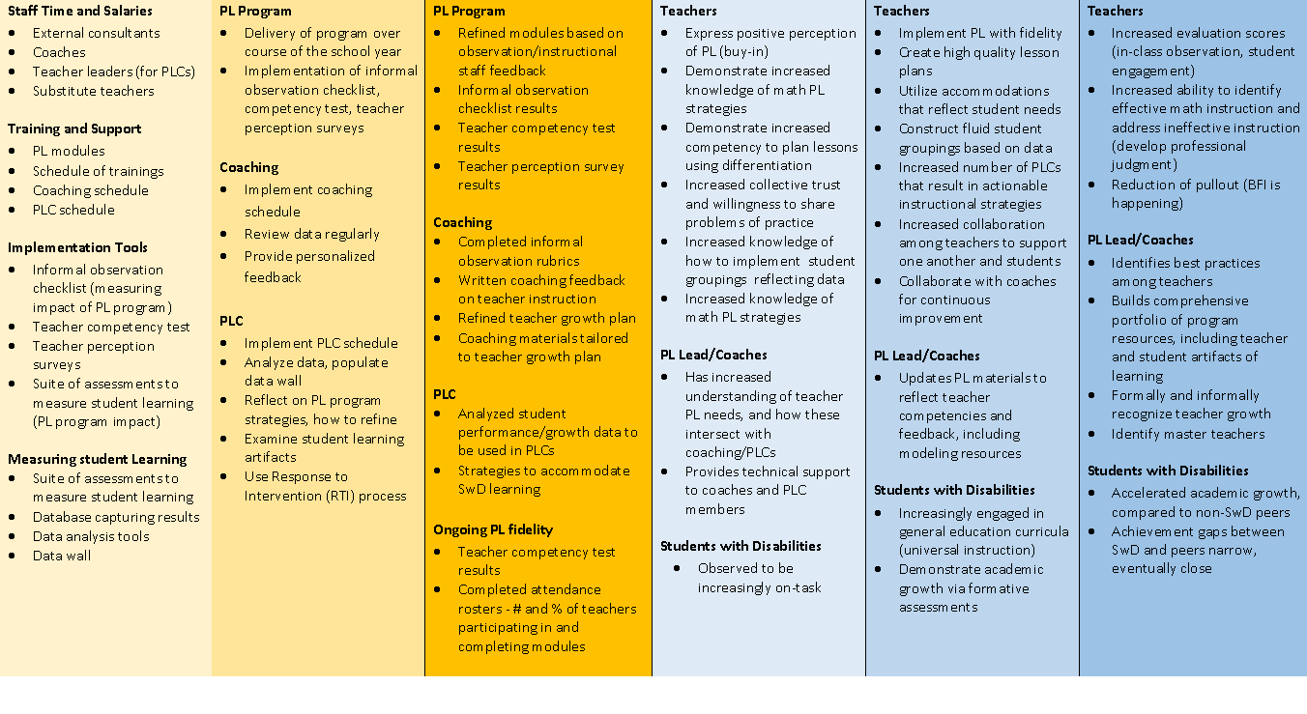
More Complex Example of a Logic Model
Resources | Activities | Outputs | Short-term outcomes | Mid-term outcomes | Long-term outcomes
Notes:
Jeremy

Slide 29
Review and Reflect
Revisit Handout D and look for the connections between resources to long-term outcomes.
  Is there a logical throughline?
  Is there anything missing?
  Can you add arrows that would work in your local context?
  [pause recording]
Notes:
Nazie

Slide 30
Part 2: Evaluation Questions

Slide 31
The Program Evaluation Cycle: Part 2 Evaluation Questions
Part 1: Logic Model
Part 6: Dissemination
Part 2: Evaluation Questions
Part 5: Data Preparation and Analysis
Part 3: Data Sources
Part 4: Data Collection Tools
Adapted from: http://toolkit.pellinstitute.org/.
Notes:
David

Slide 32
Goals for Part 2
Discuss how logic models can inform the creation of evaluation questions.
Discuss the elements of high-quality evaluation questions and create draft evaluation questions.
Practice prioritizing evaluation questions.
Notes:
Who should be in the room?
LEA leaders who will make decisions about the exploration and selection of the intervention (e.g., Assistant Sup, CAO, Principals)
LEA leaders who will evaluate the intervention (e.g., data and evaluation staff)
LEA and school staff with expertise in the subject field of the intervention (e.g., teaching or coaching staff with expertise in behavioral, instructional, etc. interventions, depending on the type of intervention)
LEA training or coaching representatives
What will I learn?
See goals above
What do I need to know already going in?
Understanding of the LM identified changes in knowledge, behaviors, and long term outcomes.
Deep understanding of the LEA’s context, relevant goals, operational context, services being delivered and existing implementation approaches.
What are the expected takeaways?
Understand the elements of high-quality evaluation questions (PARSEC rule)
Learn how to draft research questions based on the LM and problem statement
Walk away with a strong first draft of research questions (ideally under 10)

Slide 33
Reminder: Logic Model Purpose and Use in Drafting Evaluation Questions
Logic Models offer a shared understanding for what resources are needed to do the work, what the work is, and what outcomes are sought as a result from the work.
Logic Models draw explicit connections between resources, work, and desired outcomes.
Logic Models capture assumptions about what needs to be in place to do the work with success.
Your logic model will directly inform program evaluation questions!
Notes:
David – slides 29-31 4 minutes

Slide 34
Types of Evaluation Questions
Process | Outcome
Concerned with program implementation Generally ask: Was the program delivered as intended? | Concerned with results of program implementation Generally ask: Did the program accomplish what it set out to do?
Notes:
Doug

Slide 35
Elements of Logic Model: Process and/or Outcome
Problem Statement
Resources
Activities
Outputs
Short-term Outcomes
Mid-term Outcomes
Long-term Outcomes
If we have these resources in place
And we do these things
We will generate these deliverables
Achieve these changes in knowledge
Shape these behaviors
And achieve these outcomes
Process
and/or
Outcome
Note. Adapted from https://ag.purdue.edu/extension/pdehs/Documents/Pub3669.pdf.
Notes:
Doug
The problem statement serves to drive the specifics under each of the categories below – resources, outputs etc. and draw explicit connections between the categories.
What is the difference between outputs vs. outcomes? Outputs lead to desired outcomes. They are the deliverables that result from your planned activities, but not the changes you expect. Outcomes are the evidence of your service delivery—the results your program intends to achieve if implemented with fidelity.

Slide 36
Characteristics of a Good Evaluation Question
Characteristics
Focuses on only 2 or 3 variables
Is defined with respect to local context
Can be investigated within available time/resources/ethical constraints
Uses comparative terms (e.g. "faster", "improved")
Uses clear concepts
Includes cause and effect relationships
Ask:
Who, What, Where, When, Why?
Process
Questions
Ask:
Changes, Effects, Impacts
Outcome Questions
Notes:
Doug
A convenient way to write or revise evaluation questions is to use the PARSEC framework(handout. Let’s walk through the framework now. Provide Handout E

Slide 37
Evaluation Questions
  P-A-R-S-E-C
  Pertinent: Meaningful to participants and stakeholders?
  Answerable: Using available data and resources?
  Reasonable: Aligned with program goals and objectives?
  Specific: Aligned with program logic model components?
  Evaluative: Able to inform program adjustments?
  Complete: Is there a question that should have been asked?
Notes:
David overview but don’t do Slides 41-42 4 minutes
Provide Handout F: Go back over the example on slide 20. Allow each person to work as an individual or pairs, and then get feedback from one another

Slide 38
What Makes a Good Evaluation Question?
Let’s consider some example questions to determine if each meets the quality check using PARSEC?
To what extent do the teachers enjoy using the new reading strategies?
(B) To what extent do the teachers report using the new reading strategies?
(C) How much did students’ test scores increase three years after the intervention was implemented?
P A R S E C
(Handout E)
Notes:
Doug (overview but don’t go into detail)
P stands for Pertinent, or meaningful to participants and stakeholders (option to provide Handout E now or later)

Slide 39
Evaluation Questions: Handout F
Using Handout F, let’s identify at least 2 process and 2 outcome questions for your logic model [Pause Recording]
  P-A-R-S-E-C
  Pertinent: Meaningful to participants and stakeholders?
  Answerable: Using available data and resources?
  Reasonable: Aligned with program goals and objectives?
  Specific: Aligned with program logic model components?
  Evaluative: Able to inform program adjustments?
  Complete: Is there a question that should have been asked?
Activity!
Notes:
David overview but don’t do Slides 41-42 4 minutes
Provide Handout F: Go back over the example on slide 20. Allow each person to work as an individual or pairs, and then get feedback from one another

Slide 40
Prioritizing Your Evaluation Questions
Prioritizing Questions
To prioritize your questions, consider what is important and what is urgent. Consider rating each question on a scale of 1-5 for urgency and importance, with 1 being less urgent/ important, and 5 being most urgent/important.
Urgency and Importance
An urgent question may give you an easy win (e.g. meet a reporting requirement).
An important question may be worth pursuing in the long run to inform strategic decisions.
The sweet spot
Important
See Handout G for more information
Urgent
Notes:
David overview but don’t do
It may be hard to narrow down to just 2-3 evaluation questions. If you generated more, here is a framework that may help you prioritize. Handout G.

Slide 41
Practice What You Have Learned
Prioritize the process and outcome questions you came up with using Handout F to identify the priority questions you can share with your teams/colleagues back at the district.
Notes:
Nazie

Slide 42
ESEA Office (Cont.)
ESEA Office | Position | Phone | E-mail
Nazie Mohajeri-Nelson | Director of ESEA Office | 303-866-6205 | Mohajeri-nelson_n@cde.state.co.us
DeLilah Collins | Asst. Director of ESEA Office | 303-866-6850 | Collins_d@cde.state.co.us
DARE Team | Expertise | Phone | Email
Tina Negley | ESSA Accountability, Program Evaluation, and Reporting | 303-866-5243 | negley_t@cde.state.co.us
Alan Shimmin | ESEA Reporting and Data Collections | 303-866-6209 | shimmin_a@cde.state.co.us
Mary Shen | ESEA Program Evaluation, Research, and Accountability | 303-866-4571 | shen_m@cde.state.co.us

