Slide 1
Comparability
2018-19
ESEA Programs | December 2018

Slide 2
Title I $$$ intended to provide extra resources to low- performing students from low-income neighborhoods.
Title I’s purpose is to ensure that all children have a fair, equal, and significant opportunity to obtain a high-quality education and reach proficiency on challenging State academic achievement standards and state academic assessments. Title I $$$ are used to:
Ensure that high-quality assessments, accountability systems, teacher prep and training, curriculum, and instructional materials are aligned with challenging State academic standards;
Meet the educational needs of low-achieving children in the highest-poverty schools, ELs, migratory students, students with disabilities, Indian children, neglected or delinquent children, and young children in need of reading assistance;
Close the achievement gap, especially between minority and non-minority students, and between economically disadvantaged students and their more advantaged peers;
Distribute and target resources sufficiently to make a difference to LEAs and schools where needs are greatest;
Provide children enriched and accelerated educational programs, including the use of schoolwide programs or additional services that increase the amount and quality of instructional time;
Promote schoolwide reform and ensure children’s access to effective, scientifically-based instructional strategies and challenging academic content.

Slide 3
Districts may get Title IA $$ IF:
Educational services paid with state and local funds in Title I schools are “comparable” to those in non-Title I schools (in same grade span—EMH).
Title IA funds are earmarked for extra resources to poorly performing students from low-income neighborhoods—above and beyond services provided through state and local funds.
If Title IA $$$ is spent on the basics:
  Students don’t receive extra resources the law intended them to have.
  Title I is not fulfilling its purpose to enrich and accelerate educational programs.

Slide 4
Example of Comparable
Non-Title I School
Local
Title I School
State
Title I $$$$

Slide 5
Example of Not Comparable
Non-Title I School
Local
Title I School
State
Title I $$$$

Slide 6
LEAs don’t have to demonstrate Comparability if:
  Don’t take Title IA $$.
  Take Title IA $$ but have:
      < 1,000 students; OR
      only 1 school per grade span (EMH); OR
      Title I schools with 100 students or fewer.
  Only Title I schools with >100 students are subject to comparability.

Slide 7
LEAs that must do Comparability:
Have Title I schools with 100+ students, and 2+ schools in the grade span.
May need to do Comparability in more than one grade span (EMH).
Calculations differ if:
      All schools in grade span Title I.
      Some schools in grade span Title I and some not.

Slide 8
IF . . .
LEA has only 2 elementary schools (K-2 and 3-6), does not have to do comparability because no overlap in grades.
LEA has a K-4 school and a 5-8 school, K-4 and 5-6 don’t have to be comparable.
Grades overlap, have to be comparable (K-4 and 3-6).

Slide 9
Districts likely to need to demonstrate Comparability in 2018-19
LEA | LEA | LEA | LEA
ACADEMY 20 | DENVER COUNTY | JEFFERSON COUNTY | PUEBLO COUNTY
ADAMS 12 FIVE STAR SCHOOLS | DISTRICT 49 | JOHNSTOWN-MILLIKEN | ROARING FORK
ADAMS COUNTY 14 | DOUGLAS COUNTY | LAMAR | SALIDA
ADAMS-ARAPAHOE | DURANGO | LAS ANIMAS | SCHOOL DISTRICT 27J
ALAMOSA | EAGLE COUNTY | LEWIS-PALMER | SHERIDAN
ARCHULETA COUNTY | EAST GRAND | LITTLETON | ST VRAIN VALLEY
ASPEN | EATON | MANITOU SPRINGS | STEAMBOAT SPRINGS
BAYFIELD | ELIZABETH | MAPLETON | SUMMIT
BENNETT | ENGLEWOOD | MESA COUNTY VALLEY | THOMPSON
BOULDER VALLEY | ESTES PARK | MOFFAT 1 | VALLEY
BYERS | FORT MORGAN | MONTE VISTA | WELD COUNTY 1
CANON CITY | FOUNTAIN | MONTEZUMA-CORTEZ | WELD COUNTY 8
CHARTER SCHOOL INSTITUTE | FREMONT | MONTROSE COUNTY | WELD COUNTY 3J
CHERRY CREEK | GARFIELD 2 | NORTH CONEJOS | WESTMINSTER
CHEYENNE MOUNTAIN | GREELEY | PLATTE VALLEY | WIDEFIELD
COLORADO SPRINGS 11 | GUNNISON | POUDRE | WINDSOR
DELTA COUNTY | HARRISON | PUEBLO CITY | WOODLAND PARK
*Based on 2018-19 October Count and Consolidated Application

Slide 10
CDE is trying to eliminate the online system
Pending EDAC Approval . . .
CDE will conduct comparability analyses based on FTE using December HR collection data.
Hope to alleviate burden on districts.
Like online system in the past, FTE will:
Include FTE of teachers paid from state and local funds (in full or part).
Exclude paraprofessionals, administrators, librarians, etc., and teachers paid with Federal funds.
CDE will not be able to access HR data until April or May 2019.

Slide 11







Visual Representation
Title I school’s state/local student-teacher ratio cannot exceed non-Title I average by more than 10%
Each school’s state/local student-teacher ratio must be within 10% of the average
ALL schools in grade span Title I
Not all schools in grade span Title I

Slide 12
If District does not demonstrate comparability by FTE method for the grade span, CDE will, when possible, conduct FTE analyses separately on high- and low-enrollment schools first, and then high- and low-poverty schools.
If district does not demonstrate comparability based on CDE’s FTE analyses, district will have to use the per-pupil allocation (PPA) option.

Slide 13
Per-Pupil Allocation Method
  Based on per-pupil allocation of state and local funds for “educational materials and resources.”
  If all schools in grade span are Title I, each school’s per-pupil allocation should fall within 10% (90% - 110%) of the average per-pupil allocation.
  If not all schools are Title I, each Title I school’s per-pupil allocation should be 90% or more of the non-Title I school average.
  CDE will not be able to conduct these analyses for districts.

Slide 14
Included in Per-Pupil Allocation
All educational and instructional resources purchased with state and local funds:
  Salaries and benefits for teachers, librarian, instructional coaches, paras and aides, principal, etc.
  Curriculum materials, educational software, manuals—hardware in some circumstances.
  Field trip costs.

Slide 15
Not included in Per-Pupil Allocation
Transportation and cafeteria costs.
Resources/materials purchased with funds other than state/local.
Office staff not directly involved in educational activities: secretaries, counselors, nurses, etc.
After-school or extracurricular activities: sports, clubs, newspaper, etc.
Operating costs: HVAC, electricity, building lease, etc.

Slide 16
Consolidated Districts
LEAs operating Consolidated Schoolwide programs may continue to submit the PPA alternative spreadsheets in advance due to CDE’s inability to assign the teacher funding sources necessary to use the FTE method.
  Classroom teacher FTE only OR
  All education resources & materials
Districts using per-pupil allocation method must submit copies of budgets and expenditures.

Slide 17
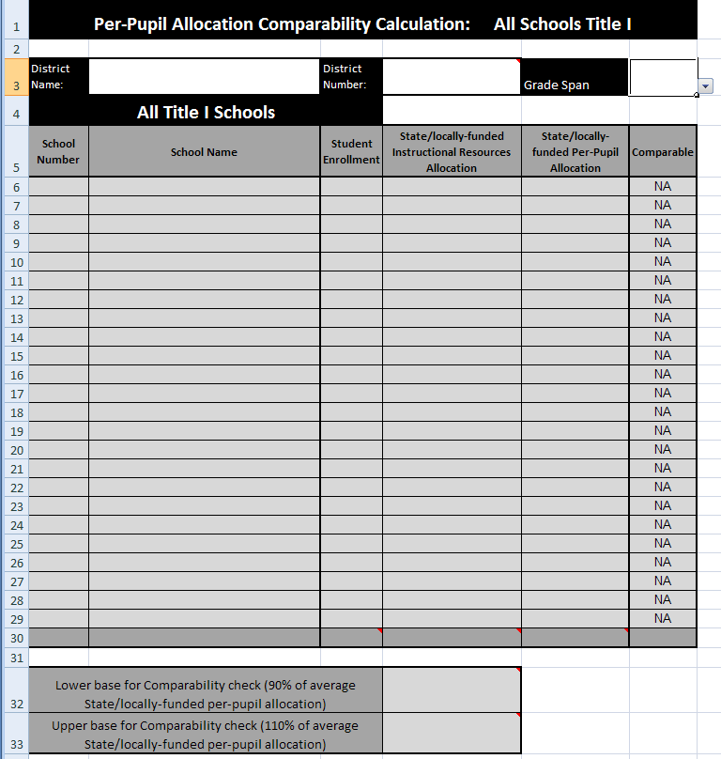
Only Title I
All schools in grade span Title I

Slide 18
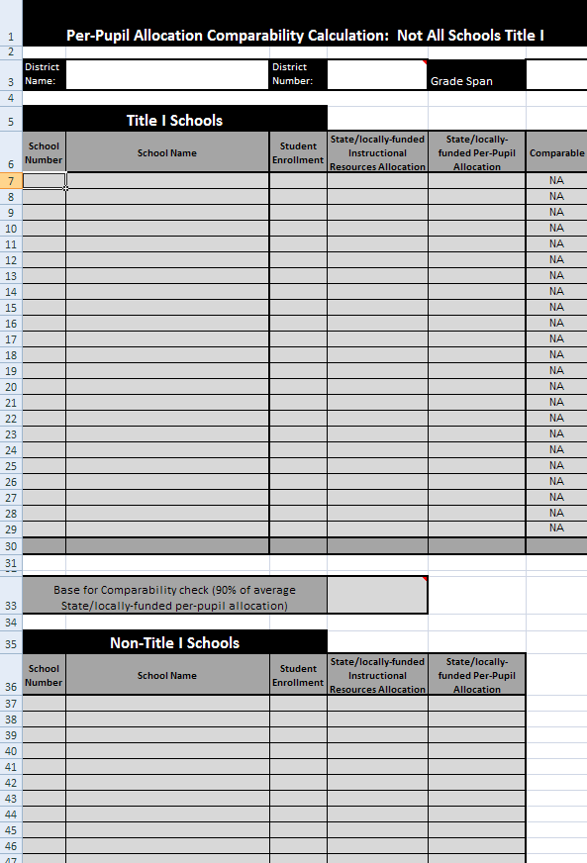
Title I and Non Title I
Not all schools in grade span Title I

Slide 19
Which Students Count for Enrollment?
K-12 students—no PK or younger.
Kindergarten students enrolled only half-time count as full student. Enrollment is a head count.
CDE will use 2018 October Count for the 2018-19 analyses.
Notes:
Question for group: How might this information inform your thinking about your logic model and the data that you’re trying to capture?
Experimental study:
Quasi-experimental:
Correlational Study:
Demonstrates rationale:

Slide 20
Questions?

Slide 21
Contacts
Barbara Vassis
vassis_b@cde.state.co.us
303.866.6065
Alexandra Tolentino
tolentino_a@cde.state.co.us
303.866.4571

