Slide 1
Parent Involvement in Planning & Implementation
Title I and Title III

Slide 2
Purpose and Objectives
To provide LEAs with a deeper understanding of parent involvement requirements in planning and implementing programs under Title I, Part A and Title III
To provide LEAs with a greater understanding of how CDE will monitor parent involvement requirements under Title I, Part A and Title III in 2018-2019

Slide 3
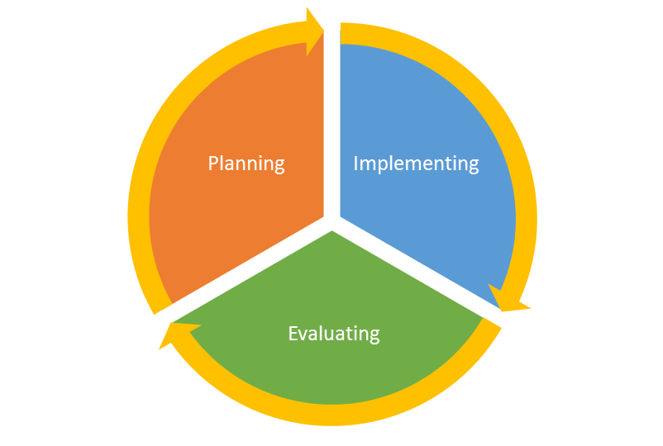
Using a Continuous Improvement Process
Meaningful Stakeholder Engagement (SE) Indicators
Identification and Delivery of Services (2019-20) Indicators
Evaluation of Program Impact (2020-21) Indicators

Slide 4
2018-19 Universal Meaningful Stakeholder Engagement Indicators
SE 9.1 Stakeholder Engagement in the Consolidated Application
SE 9.4 Student Performance
SE 9.8 Parent Notification - English Learner Identification
SE 9.9 Meeting with Parents and Families of English Learners
SE 9.11 Annual Consultation with Non-Public Schools
SE 1.1 Title I, Part A Annual Meeting
SE 1.3 Parent and Family Engagement Policy
SE 1.10 Comprehensive Plans
SE 1.11 Targeted Support Plans
SE 3.1 Provision of Parent, Family, and Community Engagement Activities
Covered in previous webinars
Workshopped in November/December Regional Network Meetings
Available online
Today

Slide 5
SE 1.3 Parent and Family Engagement Policy
Statutory Indicator
Each Title I school, with parents of participating children, develops, updates, and communicates a written parent and family engagement policy that describes:
opportunities for parent and family engagement throughout the year and
the shared responsibilities of parents, families, and the school to influence high student achievement.
Each Title I school and the LEA is implementing a parent and family engagement policy that has been developed
jointly by the LEA, Title I schools, and parents of children participating in Title I programs;
in coordination with all other parent and family engagement strategies being implemented by the LEA.
The LEA
builds the capacity of schools to more effectively engage parents and families
annually evaluates the policy to determine effectiveness of strategies
makes adjustments in subsequent years based on the findings of the evaluation.
Planning
Implementing
Evaluating
Notes:
Can be paid for with state, local, or other federal funds

Slide 6
SE 1.3 Understanding the Demonstration of Compliance
The written policy must:
  include expectations and objectives for meaningful parent and family engagement
  include a description of how parents and family of participating students will be involved in the development of the LEA plan
  include a description of how LEA will provide coordination, technical assistance, and other supports necessary to build capacity
  be developed jointly and agreed upon by parents and family of participating students
    Participant are representative of the students being served
  be communicated using materials in languages and formats based on needs of families and parents
  be developed in coordination with all other parent and family engagement strategies
Planning
Implementing
The LEA uses the strategies described in the written policy to build the capacity of schools to more effectively engage parents and families
The LEA conducts evaluation of the strategies implemented and uses that information to make adjustments, as necessary, to update the written policy
Evaluating

Slide 7
SE 1.3 Examples of Evidence
Written Parent and Family Engagement policy
Meeting agendas, attendance, and minutes for involvement of parents in development of policy
Content of meeting, including materials that guide discussions and provide opportunity for input(e.g., discussion or talking points, template or conversation guide, list of questions, PPT)
Planning
Schedule of professional learning opportunities related to parent and family engagement
Content of trainings or learning opportunities related to parent and family engagement
Meeting agendas, attendance, and minutes for opportunities that build school capacity
Implementing
Summary of evaluation results
Evaluating

Slide 8
SE 1.1: Title I, Part A Annual Meeting
Statutory Indicator
Each Title I school holds an annual meeting to explain the programs that will be in place, as a result of Title I, Part A funds and provides additional opportunities for parents and families to participate in the planning, review, and improvement of programs throughout the year.
Demonstration of Compliance
  Parents and family of all participating students have been invited and encouraged to attend annual meeting
    Clear and concise communications to parents in format and language that parents can access and understand
  Annual Meeting(s) are convened for parents and families of all participating students in a timely, convenient, inclusive and flexible manner
    Family schedules and availability are considered when scheduling meetings
    LEA determines the languages and formats that the information will be shared. Translation/interpretation services are consistent with this program as well as other policies and processes
  Evidence of ongoing parent and family input
    Evidence that opportunities, for parents whose primary language is not English, are able to understand and participate throughout the year.
Planning
Implementing

Slide 9
SE 1.1 Examples of Evidence
Communication sent to parents and families in advance with options for different meeting times
Meeting agendas, attendance, and minutes for involvement of parents in meetings regarding the planning, evaluation of, or improvement of the school’s Title I programs (UIP/schoolwide plan development, budget meetings, etc.)
Content of meeting, including materials that guide discussions and provide opportunity for input(e.g., discussion or talking points, template or conversation guide, list of questions, PPT)
Planning
Implementing

Slide 10
SE 9.9 Meeting with Parents and Families of English Learners
Statutory Indicator
The LEA implements an effective means of outreach to parents and families of English learners to inform the parents of how they can
be involved in the education of their children; and
be active participants in assisting their children to
  attain English proficiency;
  achieve at high levels within a well-rounded education; and
  meet the CAS and CELP standards expected of all students.
Demonstration of Compliance
Outreach is provided to explain how parents can support the linguistic and academic needs of their child
  Evidence that opportunities exist for parents/families of ELs to actively participate in the education of their child
Evidence that opportunities occur on an ongoing basis, during times and in modalities that meet the needs of parents/families
LEA collaborates with parents and families of English learners to collect recommendations for Title I and/or Title III programming
  Evidence that regularly scheduled meetings provide opportunities for parents to formulate and provide recommendations on Title I or III services
  Evidence that the recommendations from parents regarding Title I and Title III services have been considered and any resulting decisions have been shared with parents of ELs
Communication and materials are provided in languages and formats based on needs of families and parents
Planning
Implementing

Slide 11
SE 9.9 Examples of Evidence
Communication related to opportunities for parents/families of ELs to:
  Actively participate in the education of their child;
  Provide recommendations; and
  Be informed of decisions related to services provided to ELs.
Communication plan related to ELs/families of ELs
  Sample letter(s) that are sent to parents
Agendas, sign-in sheets, minutes, or materials shared during opportunities for involvement
Content of parent meetings and/or events related to supporting ELs with language attainment and academic needs (e.g., discussion or talking points, list of questions, PPT, resources provided)
Planning
Implementing

Slide 12
SE 3.1: Provision of Parent, Family, and Community Engagement Activities
The LEA/consortium uses state, local, other federal, and/or Title III funds to provide and implement effective activities and strategies for parent, family, and community engagement.
Demonstration of Compliance
Description of engagement policies and practices provided to parents, families, and communities of English learners that includes:
  The process for identifying and prioritizing activities to engage parents, families, and communities
  Specific outreach and engagement activities for parents and families of ELs
Demonstration of implementation of effective outreach and engagement activities
  Communication and materials used are provided in languages and formats based on needs of families and parents
Planning
Implementing

Slide 13
SE 3.1 Examples of Evidence
Title III, Part A Narrative Question 1 response (Consolidated Application)
Written notices for parents, families, and community members regarding engagement opportunities
Expenditure detail report that reflects parent and family engagement activities
Agendas, minutes, attendance logs for schoolwide plan, LEA Consolidated Application, and parent engagement policy meetings demonstrating parent engagement
Planning
Implementing

Slide 14
Leveraging Parent and Family Engagement Activities
LEAs may use existing structures (DAC, SAC, etc.) to meet ESSA requirements related to parent and family engagement.
Each indicator does not require a unique activity in order to demonstrate compliance. Through intentional planning, LEAs may leverage a single parent and family engagement opportunity to meet multiple requirements.

Slide 15
From Compliance to Effective Practices
In addition to providing a method for LEAs to demonstrate compliance, CDE aims to utilize the monitoring process to identify and share practices that have been found to be effective in Colorado.
Meaningful stakeholder engagement requires that LEAs continuously evaluate the effectiveness of each activity.
Questions to consider when evaluating parent and family engagement activities as part of a continuous improvement process:
  What is your desired outcome from this practice (immediate and distal)?
  Are you seeing the results you’d like to see?
  What evidence is there of the results?
  What could be changed about this practice to produce greater results?
Evaluating
Notes:
Track effective practices

Slide 16
Resources and Contacts
For more information on Monitoring
  Visit: www.cde.state.co.us/fedprograms/monit/index
  Contact: DeLilah Collins at Collins_D@cde.state.co.us
  Contact: Nazie Mohajeri-Nelson at Mohajeri-Nelson_n@cde.state.co.us
  Contact: Joey Willett at Willett_J@cde.state.co.us
  Parent and Family Involvement-Kristen Collins Collins_K@cde.state.co.us
  Title III- Robert Thompson at Thompson_R@cde.state.co.us

Slide 17

Questions and Comments
Questions?
Comments?

