Slide 1
Good Morning!
Welcome
Please log into PearsonAccess^{next} training center.
  http://trng-co.pearsonaccessnext.com
If your log in credentials do not work or you need help, please notify the Pearson presenters or CDE staff before training begins.
1

Slide 2
Colorado Measures of Academic Success (CMAS)
English/Spanish Language Arts – Mathematics
Science – Social Studies
Spring 2017
Administration Training for DACs

Slide 3
Overview
Timeline & Test Structure
PearsonAccess^{next}
Before Testing
Register & Transfer Students
Technology Readiness for Administrators
Accessibility Features & Accommodations
Testing Environment
Receiving Materials
During Testing
Administering Tests
Basic Technical Troubleshooting
Make-Up Testing
After Testing
  Returning Materials
  PAnext Clean-up
Additional Information
Resources & Support
Unless otherwise noted, references in this PPT are to the CMAS and CoAlt Procedures Manual

Slide 4
Handouts
Handout
Colorado Security Agreement Form
  Sign and return during this training
School List to Indicate Testing Mode and Window
  Requests for expanded ELA & math computer-based testing window and early HS science window must be submitted by December 15
  For CDE to indicate paper-based testing in the initial load of students, notification must be sent by December 15
CMAS Cross Program Highlights
Assessment Acronyms
Creating Sample Students for the PAnext Training Site
Testing Multiple Grades Guidance
Training Evaluation

Slide 5
Assessment Acronyms*
Handout
AF&A: Accessibility Features & Accommodations Manual (PARCC)
AO: Additional Order
CBT: Computer-Based Test
DAC: District Assessment Coordinator
ELA: English Language Arts
ET: Extended Time
LTC: LEA Test Coordinator (DAC)
PAnext: PearsonAccess^{next}
PBT: Paper-Based Test
PII: Personally Identifiable Information
SAC: School Assessment/Test Coordinator (SAC = STC)
SR/PNP: Student Registration/ Personal Needs Profile
S/SS: Science and Social Studies
TAM: Test Administrator Manual
TCM: Test Coordinator Manual (PARCC)
TTS: Text-to-Speech
UAR: Unique Accommodation Request
UI: User Interface
*See handout for additional acronyms and definitions.

Slide 6
Overview of What’s New this Year
CMAS: PARCC English Language Arts and Mathematics | CMAS: Science and Social Studies
PBT in packs of 5; order 1-to-1 | Units instead of sections
Math reference sheets updated; Spanish reference sheets available
CSLA in PAnext will work like other admins | Early HS science window – 3 weeks total
TAM: Scripts for grade 7 and HS math Unit 1 now have reminder to complete both sections of the unit
PAnext: Prepare Test Session – new function (no more 250 student limit)
CO Procedures Manual revised – includes all content areas, added data and accommodations supplements
SR/PNP layout changes: state fields, TTS, leading zeros
TestNav App update
Work Request updates

Slide 7
Science and Social Studies Update
Unit 1 sample items
  Administered during SAY directions before unit testing time starts
  Provide students with an opportunity to ask questions about how they respond to item types (SR, TEI, CR)
Online – there are no sample items this year
  ELA/math assessments do not include sample items
  Many students have already interacted with item types on ELA/math assessments
  ePATs available to students to preview/practice with item types
  Will allow Unit 1 make-ups to be administered without a separate SAY script
Paper – there are still sample items this year
  Different item types requiring unique (ELA/math assessments only include multiple choice/select and constructed response items)

Slide 8
Important Information
CO has specific policies that supersede PARCC policies
  Included in the state appendix in the PARCC TCM and/or in the CO Procedures Manual
  CO Procedures Manual covers all CMAS programs and CoAlt: Science and Social Studies
ELA measures reading and writing together; there are different rules around accommodations that are allowed for ELA

Slide 9
Differences in Policies
Some differences in CMAS: PARCC ELA/math and S/SS administration policies
Differences highlighted during this training
Some S/SS policies are more stringent than ELA/math. Districts may choose to use the S/SS policy for both programs so they are the same.
  Example: Used scratch paper must be returned for S/SS; may return for ELA/math as well.

Slide 10
Comparisons between
CMAS ELA/Math and S/SS
Handout
English Language Arts and Mathematics: Purple | Science and Social Studies: Green
Scratch Paper (locally provided) Provide for all PBT and CBT Math District decision for CBT ELA/L Sending back is optional* | Scratch Paper (locally provided) Provide for all PBT District decision for CBT Must send back in secure envelopes
Spanish Versions (Math Only) CBT Spanish Text CBT Spanish Text w/TTS PBT Spanish Text | Spanish Versions CBT Spanish Text w/TTS PBT Spanish Text (MS/HS) PBT Bilingual Spanish/English Text (ES)
Make-up Testing Units cannot be tested out of order, except for make-up testing* | Make-up Testing Units cannot be tested out of order
* May use S/SS policy

Slide 11
Manuals
CO Procedures Manual
PARCC Test Coordinator Manual (TCM)
PARCC: ELA/Math TAMs (January)
S/SS TAMs (January)

Slide 12
Personally Identifiable Information (PII)
FERPA does not permit the sharing of PII via email.
  The Colorado Open Records Act (CORA) requires that public records (including email sent to CDE) be available to the public. PII sent via email will be protected from further disclosures and uses;
  However, email can be intercepted, forwarded, or used in ways that were not intended when sent.
Do NOT email PII.
  Name, SASID, DOB, gender, etc.
  Anything that can identify a student

Slide 13
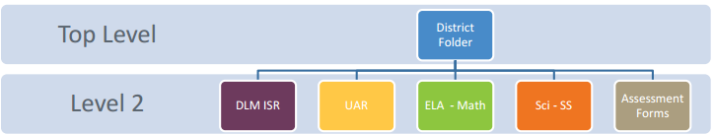
Syncplicity
Use Syncplicity to securely transfer PII to CDE
User Guide available
  http://www.cde.state.co.us/assessment/ausyncug
Folders
DACs provided with access to Assessment folder
Contact Collin Bonner if you are unable to access this folder in Syncplicity

Slide 14
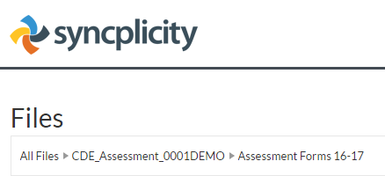
Syncplicity
New Syncplicity policy of not emailing links to files
  Anyone with the link can open the linked file
Instead, please email file path and include the file name:

Slide 15
Timeline & Structure

Slide 16
CMAS Administration Overview
Content Area | Grades
English Language Arts | 3-9
Spanish Language Arts | CSLA available for eligible students in grades 3 & 4
Mathematics | 3-8, Grade 9 will take one of the following assessments: Pathway 1: Algebra I, Geometry, Algebra II; Pathway 2: Integrated/Math I, Integrated/Math II, Integrated/Math III
Science | 5, 8, and HS (Grade 11) (all schools)
Social Studies | 4 and 7 (sampled schools only*)
* Districts notified of SS sample school selections on August 8, 2016.

Slide 17
Math Options
Student Grade | Mathematics Assessment Options for 2016-2017
7 | 7th grade Algebra I Integrated I (Math I)
8 | 8th grade Algebra I Integrated I (Math I) Geometry Integrated II (Math II)
9 | Algebra I Integrated I (Math I) Geometry Integrated II (Math II) Algebra II Integrated III (Math III)
Testing outside of these approved tests for a grade level is a misadministration.

Slide 18
Colorado Spanish Language Arts (CSLA)
CSLA is a paper-based accommodated version of ELA
CSLA follows rules and scheduling for ELA
  Administer at the same time as ELA
Since CSLA is an EL accommodation, other EL accommodations are not allowed on CSLA
All CSLA forms have 4 units (one of which is the field test)
  Small population takes CSLA so all students need to take the field test in order to have new items in the future
Students taking CSLA should not have a PARCC ELA registration
These students WILL take the appropriate PARCC math test

Slide 19
ELA: First Year in US
English Learners Only
If the student enrolled in their first U.S. school on or before April 10, 2016, they should test in English Language Arts. (April 10, 2017 would be their 366th day)
Reminder: For first year in U.S. English learners who have a home language of Spanish, CSLA is available in place of CMAS: PARCC ELA for eligible 3rd and 4th graders.
Note: For students who transfer from one U.S. school to another U.S. school, their date of enrollment from the first U.S. school should be used.

Slide 20
ELA: First Year in US
English Learners Only
There are two options available for these students:
Option 1
  Year 1: Students test in ELA but scores do not count for status or growth
  Year 2: Students test and scores are included in growth calculations
  Year 3: Students test and scores are included in status and growth calculations
Option 2
  Year 1: Students don’t test in ELA (Participation in ACCESS is required to count as a participant in ELA)
  Year 2: Students test and scores are included in status calculations
  Year 3: Students test and scores are included in status and growth calculations

Slide 21
Spring 2017 CMAS Window
CMAS (science, social studies¹, PARCC English language arts² and PARCC math) CoAlt (science and social studies) CoAlt: DLM (English language arts and math)
All science/social studies, ELA/math – official 3 week window | April 10 - April 28, 2017
HS (grade 11) science – optional early 3 week window | March 27 – April 14 or April 3 – April 21, 2017
Expanded ELA/math CBT testing window options with additional week(s)
4 weeks | April 3 - April 28, 2017
5 weeks | March 27 - April 28, 2017 or March 20 - April 28, 2017 with one week of spring break
6 weeks | March 13 - April 28, 2017 with one week of spring break in the middle
¹SS assessments administered on a sampling basis to 1/3 of schools each year
²Including Colorado Spanish Language Arts (CSLA)
³CoAlt: DLM system is not scheduled to open until March 15th

Slide 22
ELA/L Field Test
Since the ELA/L assessment has longer passages and many items related to those passages, the field test must be a separate unit
Schools selected for the field test will see 4 units in PAnext
Notification of schools selected for field test is posted in Syncplicity

Slide 23
Spring 2017 Tentative Critical Dates
Description | ELA and Math | Science and Social Studies
Submit updates through UI or SR/PNP import for initial orders | January 9 - 27, 2017
Online test session set-up begins | February 1 - Start of Testing
Materials scheduled to arrive in districts | February 27 - March 27, 2017 (Depending on district testing window) | March 27, 2017*
Proctor caching test content begins (prior to testing) | March 6, 2017 | March 27, 2017*
Prepare Test Session** | March 10, 2017 (Depending on district testing window) | April 7, 2017
*If participating in early HS science window, materials will arrive on March 17th and proctor caching may begin on March 20th
** Test sessions may be prepared one day before testing window opens

Slide 24
Spring 2017 Tentative Critical Dates
Description | English Language Arts and Mathematics | Science and Social Studies*
Additional Orders – Secure Materials | February 27 - April 25, 2017 | All - March 28 - April 25, 2017 Early HS opens March 20, 2017
Additional Orders – Non-secure Materials | February 27 - May 3, 2017 | All - March 28 - May 3, 2017 Early HS opens March 20, 2017
Deadline to schedule UPS scorable pickups | May 1, 2017
Deadline for UPS scorable pickups | May 3, 2017**
*Early window for HS science is not an expanded window. Materials must be returned at the end of the early 3 week window.
**If scorable materials are not picked up by May 3, 2017 there is no guarantee that records for these PBT students will be included in SBD or scored.

Slide 25
Spring 2017 Tentative Critical Dates
Description | Post Testing Clean-up Tasks | Window Dates
Initial PAnext Clean-up (School and District) | Confirm Student Registrations Update Used Accommodations Mark Complete Units* Stop Sessions Indicate Not Test and Void Test Score Reasons/Codes Resolve Rejected Student Tests | Prior to May 12, 2017
Final PAnext Clean-up (District) | Demographics and invalidations cleaned in PAnext | May 15 – 17, 2017
Student Biographical Data (SBD) Review** (District) | Demographics and invalidations cleaned in CDE’s Data Pipeline | May 22 – June 1, 2017
*Marked Complete Reasons are for local purposes only and DO NOT invalidate tests. Not Tested and Void Test Score Reasons/Codes must be indicated separately.
**If scorable materials are not picked up by May 3, 2017 there is no guarantee that records for these PBT students will be included in SBD or scored.

Slide 26
Math Spring Test
Administration Flowchart
Math
Unit 1
Section 1 (Non-calculator) (Grades 7 & HS)
Section 2 (Calculator) (Grades 7 & HS)
Unit 3
Unit 2
Unit 4
(3-5 only)
Grade 7 and HS math, Unit 1 has 2 sections
Grades 3-5, all units are non-calculator units
Grades 7-HS, Units 2-3 are calculator units
Note: This diagram illustrates
grades 6-8.

Slide 27
Math Grades 3-5 New CBT Item Type
Grade 3 math had drawing interactions as field test items last year
  Field tested items are now operational
Grades 4-5 will have drawing interactions as field test items this year
Students may practice with this item type by going to questions 21-22 on the Grades 3-5 Math Tutorial
  https://parcc.pearson.com/tutorial/

Slide 28
Science and Social Studies
Administration Flowchart
Unit 1
Science and Social Studies
Unit 2
Unit 3

Slide 29
Guidelines for Administration Time
Task | Time to be Allotted for an Administration
Prepare for testing (includes reading SAY directions script from TAM and answering student questions) | 10 minutes (recommended)
Distribute test materials | 5 minutes (recommended)
ELA unit testing times Math unit testing time | 75-110 minutes* 60-90 minutes*
ES/MS Science and Social Studies unit testing time HS Science unit testing time | 80 minutes 60 minutes
Complete end-of-unit activities, including closing units, and collecting test materials | 5–15 minutes (recommended)
*Testing time depends on unit and subject—refer to Testing Multiple Grades handout

Slide 30
Example of Unit Testing Times:
ELA/L & Math
Handout
Subject and Grade | Unit | Section | Unit Testing Time (Minutes)
Mathematics Grade 3 Mathematics Grade 4 Mathematics Grade 5 | Unit 1 | Non-calculator | 60
 | Unit 2 | Non-calculator | 60
 | Unit 3 | Non-calculator | 60
 | Unit 4 | Non-calculator | 60
English language arts/literacy (ELA/L) Grade 3* | Unit 1 |  | 90
 | Unit 2 |  | 75
 | Unit 3 |  | 90
ELA/L Grade 4* ELA/L Grade 5* | Unit 1 |  | 90
 | Unit 2 |  | 90
 | Unit 3 |  | 90

Slide 31
Unit Testing Times:
Science and Social Studies
Handout
Subject and Grade | Unit | Unit Testing Time (Minutes)
ES Science and Social Studies | 1 | 80
 | 2 | 80
 | 3 | 80
MS Science and Social Studies | 1 | 80
 | 2 | 80
 | 3 | 80
HS Science | 1 | 60
 | 2 | 60
 | 3 | 60

Slide 32
Guidelines for Administration Time
Guidelines for Administration Time (continued)
Schedule the entire amount of Unit Testing Time
Once the Unit Testing Time has elapsed, the unit must end
If all students have completed the unit, the unit may be ended (no minimum testing time)
A student may be allowed an extended time accommodation only if listed in his or her IEP, 504 Plan, or EL Plan

Slide 33
Guidelines for Breaks
Breaks
Between units, scheduled breaks may occur
During a unit, short “stand-and-stretch” breaks may be permitted at the discretion of the Test Administrator
  Time stops for the unit, but only for up to 3 minutes
  If you know you will take the 3 minute break, add the time in to the timing box at the beginning
8:00 a.m. – 10:00 a.m. | Unit 1
10:00 a.m. – 10:15 a.m. | Scheduled Break
10:15 a.m. – 12:15 p.m. | Unit 2

Slide 34
Paper-Based Testing
CO 22-7-1006.3 (1) (d-e)
Determined by Local Education Provider (LEP)
  Charter schools are their own LEP
Considerations
  Instructional match
    Grade level variation
  Test design
  Technology capacity
  Logistics
  Must have the grade appropriate calculators for math (grades 6-9)
Must commit to meeting the security requirements and accounting for all secure materials
  Includes chain of custody documentation and reports for missing materials

Slide 35
Scheduling Considerations
Test units can only be administered to students in consecutive order
  Only ELA/math make-ups may be administered out of order
PBT: A school must administer the same unit to all PBT students within the same day
  e.g., all Grade 4 Math Unit I on Tuesday
CBT: To the extent possible, all students within the school should be assessed at the same time
  If not possible, all students should be assessed within the shortest timeframe practicable

Slide 36
Scheduling Considerations
Paper-based testing
  Window for all grades/subjects does not open until April 10, 2017
  Schools must have the grade level appropriate calculator (grades 6-9) if administering math on paper
Computer-based testing
  PBT accommodations should be administered on the online schedule
All tests must be completed by April 28
Plan a couple of extra days during the window for snow days and makeup testing

Slide 37
Scheduling Considerations
Schedule first CBT group on the first day with more of a time cushion than other groups if possible
Determine whether one content area will be completed before beginning the next, or if testing will alternate between the content areas (make-ups excluded)
Determine whether the district wants to condense testing (make-ups excluded) or spread throughout the testing window
Determine how many units will be taken by students per day (make-ups excluded)

Slide 38
Scheduling Sessions
Handout
If the unit testing time and directions are the same, different grades can be administered in the same room.
  Algebra I and Geometry can be administered in the same room
  ELA/math cannot be administered in the same room because the directions are different
  Ensure that all calculator/non-calculator sections are the same (Grade 7)
  Elementary and middle school science and social studies:
    CBT can be administered in the same room
    PBT cannot be administered in the same room as materials and directions are different
  High school science cannot be administered with elementary or middle school science as timing is different
PBT and CBT cannot be administered in the same environment.
Students from different grade levels taking the same assessment (Algebra I for grades 8-10) can be combined in a testing environment.

Slide 39
Afternoon Testing
If the school is having technology issues, do not start a unit unless there is enough time left in the day to complete the unit
It is a misadministration for a testing group to start the test and then stop and complete it the next day
  This is only allowed for illnesses and unforeseen situations (e.g., school power outage)

Slide 40
After Hours Testing
If a school will test later than 4:30 PM, provide CDE with the school and list of individual test sessions
These test sessions will need to be granted permission by CDE to test after hours

Slide 41
PearsonAccess^{next}

Slide 42
User Accounts
User Roles - PearsonAccess^{next} users must be assigned roles
Permissions - Each User Role contains a set of permissions that determines which tasks can be performed in PAnext. Permissions are bundled into User Roles.
  Once a user has a specific role, they can grant that role to another user account
  Reference the User Role Matrix on PAnext > Support> Documentation for additional information on role permissions and which roles can be assigned

Slide 43
Base User Roles for CMAS
CMAS | PearsonAccess^{next} Role
District Assessment Coordinator (DAC) | LEA/District Test Coordinator
School Assessment Coordinator (SAC) | School Test Coordinator
District Technology Coordinator (DTC) | Technology Coordinator
Test Administrator | Test Administrator
CoAlt Test Examiner | Test Examiner

Slide 44

User Account Add-on Roles
Add-on Roles Assigned to DACs
Sensitive Data Role – View and edit Sensitive Student Data
  Users with this PAnext role will have access to Personally Identifiable Information
  Must have this role to import SR/PNP files
Delete Student – Delete students
  CDE will be checking October Count numbers versus test registrations in PAnext
Published Reports – Provides access to post-test reports (i.e., results reports) and data files
Student Test Update – Allows export/import of STU file to batch update Void and Not Tested codes/reasons

Slide 45
Before Testing

Slide 46
Annual Training Requirement
Everyone involved in CMAS: ELA, math, science, and social studies administration must be trained each year
Includes DACs, SACs, Test Administrators, Test Examiners, technology personnel, and any other school or district staff involved in administration
DACs and SACs are responsible for ensuring that all individuals involved in test administration receive training and sign the Colorado Security Agreement

Slide 47
Training
Comprehensive training must include:
  Test Security
  Standardized Test Environment
  Test Administration
  Test Session Management (for appropriate personnel)
  Test Administrator Role vs. Teacher Role
  Opportunity for personnel to ask questions
CDE will provide a basic PPT that districts may update and use for Test Administrator trainings
  Districts will need to add district-specific instructions

Slide 48
Who Can Administer a Test?
School and district employees who are trained on this year’s procedures and security
  Long term subs may be Test Administrators
Student Teachers are NOT allowed to be the only person in the room or responsible for the administration of the assessment
  Student teachers may be an additional person (proctor) in the room during testing

Slide 49

Student Readiness
Student tutorials and practice materials are available
  Tutorial walks through all item types
During testing, TAs will not be able to help students with TestNav navigation
  Not able to help with how to answer a question
  Not able to show how to go to the next question or use the review screen
  Not able to assist with drag and drop or other technology enhanced items
  Not able to tell how to change calculators from radians to degrees
Strongly recommend that students are provided with access to tutorials, practice tests, or ePATs prior to testing

Slide 50
Student Readiness
TestNav 8 Tutorial (~30 minutes)
ELA/Math Student Tutorials (~30 minutes)
  Equation Editor
  Text to Speech*
  Graphing Calculator (in secure testing environment)
  Printable Paper-based Student Tutorials
ELA/Math Items
ELA/Math Practice Tests (~60 minutes)
    Practice tests reflect the current test design
    3-5 UEB .brf will be available January 9th
  S/SS ePATs and ePAT Guides
    Comprised of released items
    ePAT Guides include performance data and sample student responses
*ELA/L requires an approved unique accommodation

Slide 51
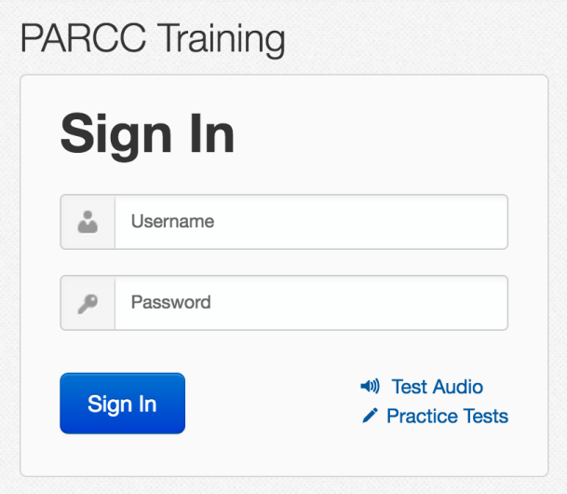

Student Readiness
Practice tests and ePATs updated for 2016-17
Practice tests can be administered on Google Chrome
  Testing will not be available on Google Chrome browser (can use Chromebook)
CSLA has practice tests available on http://www.cde.state.co.us/assessment/csla
TestNav App can access the practice tests by navigating to the “PARCC Training” sign in page and clicking the Practice Tests link.
On TestNav Home Screen, click:

Slide 52
Registering Students, Ordering Materials, and Setting up PearsonAccess^{next} Test Sessions

Slide 53
Student Registration Reminders
Middle names can be left blank
New students must be added into PearsonAccess^{next} prior to testing, including for PBT
  Temporary SASIDs should only be used for homeschool students
  Other than for homeschool students, do NOT use temporary SASIDs without permission from CDE
For more detailed information about the Student Registration process view the training module found at http://parcc.pearson.com/manuals-training/
There are several fields in the SR/PNP that are used to validate selected accommodations
  If an error is received upon import, check cross-validation fields
  These can only be seen by PAnext users with the Sensitive Data role

Slide 54
Registering for PBT
Orders for PBT materials will be generated using information indicated for individual students in the SR/PNP by January 27
For schools, grades, content areas or students using paper-based accommodated forms, change the SR/PNP (through file import or User Interface) testing mode to PBT
  Additional orders for whole schools or grades will not be approved
  Ensure that charter school choices are reflected in PAnext by January 27

Slide 55
Registering for CSLA
Eligible 3rd and 4th grade students will not automatically be added to CSLA
Districts will need to remove the ELA test assignment from PARCC and add the registration to the CSLA administration
  Students must be assigned a math test in PARCC
  Students should only be assigned to an ELA or CSLA test
    Duplicate test assignments will need to be removed

Slide 56
Accommodated Forms Ordering
Ensure that all large print and braille registrations are in PAnext by January 27*
Human Reader/oral scripts must be indicated during the January window*
ELA/math registrations will be checked against the CDE approved UAR list
  Districts will be notified when a student is assigned to an accommodation that requires an approved UAR and the accommodation was not approved by CDE for that student
  CSLA must have a student attached to an additional order
*Exception for new students after January 27 – DACs will need to place an additional order

Slide 57
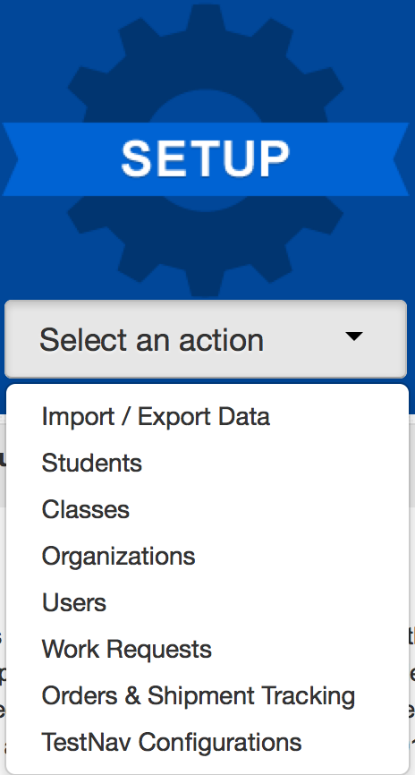
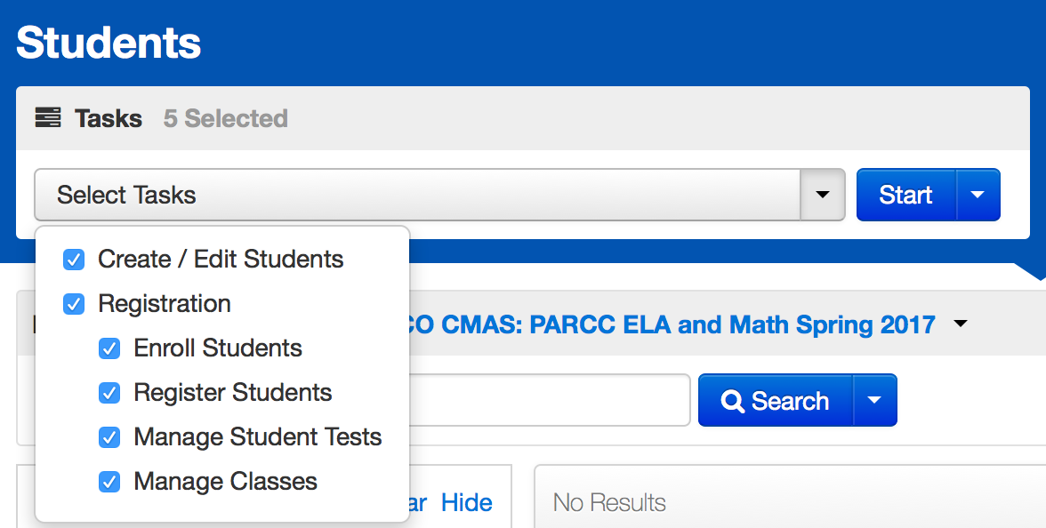
Registering a Student in PAnext
Select the Setup menu and choose Students
Choose the Tasks and click Start

Slide 58
Operational Reports within PAnext:
Help with Registration
PNP Report – accessibility features and accommodations for student tests
Students with multiple tests of same subject area
Students with only one subject test (PARCC only)
Students where responsible district/school is different from testing district/school – use for transfer students
Students enrolled but not registered for test administration
Students registered but not assigned to a test
Students with online test but not assigned to session
CSLA with ELA registration & ELA with CSLA registration

Slide 59
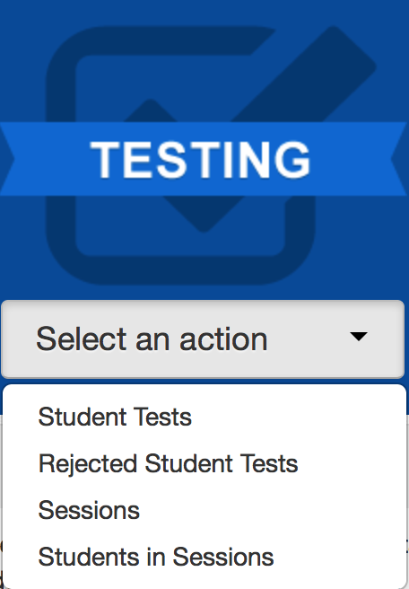
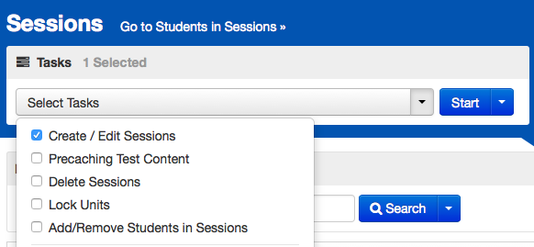
Online Testing Management
Select the Testing menu and choose Sessions
Choose the Tasks and click Start

Slide 60
New Students
Student arrives | Action | Example: ELA initial testing window is April 10-12
Initial testing window (by each content area)
Student will need to test
Student arrives on April 10th and will need to test
Make-up testing window (by each content area)
District decides if student will test
Student arrives April 13th, district has the option to test to receive data
Note: Registration and online test assignments for students who transfer from another CO school district (did not complete testing before transfer) can be transferred using the Work Request process.

Slide 61
Updates to Work Request Process
The following updates are scheduled to be implemented by the end of January:
Email notification of new pending requests
  Will need to identify notification recipient
Information icon next to Work Request will provide access to
  Name, SASID, and data pertinent to each request
Date of request visible on Work Request screen
Sorting columns in PAnext
Information tags for fields
  DOB and SASID format reminders

Slide 62
Work Request – Student Transfer Process
Student transfers from District A to District B prior to beginning testing:
District B attempts to register student in PAnext, but receives a message that the student cannot have 2 registrations
For each admin in PAnext, District B completes a Work Request to transfer the student to District B
An email is sent to District A and a red bell appears at the top of District A’s home screen
  In applicable admin(s), District A confirms that student has transferred and approves the transfer
    The student’s record is moved to District B
    District B must go into the student registration screen and make necessary changes to the responsible district
  In applicable admin(s), District A does not approve the transfer – the student’s record remains with District A

Slide 63
Student Work Request - Transfer Process (CBT/PBT) During Testing
The student has started an online test:
District B completes a work request within PAnext
District A approves the work request
  The online tests assigned to the student are automatically transferred to District B
    The tests are placed in a “Transferred [Grade - Subject]” test session
    The tests must be moved into another test session
DO not add fake or temporary student IDs into PAnext unless CDE approves their use; use the transfer process.
If you cannot find the student in PAnext, contact CDE for assistance. The typical errors involve hyphenated names, nicknames instead of birth names (e.g., Liz instead of Elizabeth), and DOB format (yyyy-mm-dd).

Slide 64
Work Requests – Releasing District
Check email and PAnext periodically
Look for the red bell at the top of the PAnext home screen
  Click on the bell to go to the pending requests for transfer
  Verify that the student listed in the Work Request has moved from your district and
    Approve the transfer
  If the student has not moved from your district
    Reject the transfer
      Will have to provide reason (e.g., student has not moved)
    The other district may have requested the wrong student
  If there is an error in the school field upon opening the work request, decline the request (the student has already been removed from your district)

Slide 65
Work Requests – Receiving District
Review the student registration in all applicable administrations and update the responsible school and district (if needed – BOCES might not need to update this field)
Updates to a responsible school that is not within your district must be done via a file upload or by CDE (call Sara Loerzel)
Updates to schools within your district can be done in the UI or via a file upload
If the responsible school and district field appears blank in the UI, then the student has a responsible school outside of your district
Use the Operational Report “Students Where Responsible District/School is different from Testing District/School”
  If your district should be the responsible district, change this in the student’s registration either via the UI or through a SR/PNP file upload

Slide 66
PBT Student Transfer
Complete a Work Request in PAnext
For a non-started test, no transfers are necessary
  The new school can provide a test booklet or can assign the student to an online assessment
If the transferred student started testing on PBT:
  Contact the other district and arrange for secure transfer of the test booklet
    In-person DAC to DAC hand-off
    Via Fed Ex or UPS – tracked shipment
  Students should not retest a unit that they took in a previous school
  Provide a chain of custody for the transferred test materials
    Both districts must keep a copy of chain of custody documents

Slide 67
Technology Readiness for Administrators

Slide 68
Technology Readiness for Administrators
New Proctor Caching Software available
  v2016.9.0.0
  Removes dependency on Java web plug-in for caching test content
  Caching can be done by test or by session in Panext
    Recommend using “Precache by Test” under Setup

Slide 69
Technology Updates for 2016-17
TestNav 8.8 – Will be released in January
  No new apps required, the current apps available on http://download.testnav.com will be used with TestNav 8.8.
PearsonAccess Next 4.1 will update in January/February.
Product changes will be minimal, and shared in the DTC Technology and DAC emails, as well as the PARCC Technology Crosswalk.

Slide 70
TestNav Updates
The keyboard was removed from Minimum Specifications, but kept in Recommended Specifications for tablet devices
iOS Automatic Assessment Configuration
  Allow Microphone
  Allow App Self-Lock prompt
Practice tests can be completed on Chrome and Edge Browsers
  Not operational tests or infrastructure trials!
Added support for Windows and Chrome OS Touchscreen devices
The TN log file new file name is Date-Time-StudentName to make log files easier to find
A Blacklist feature has been enabled to help prevent students from having applications open in the background during testing.

Slide 71
TestNav Updates
Firefox Extended Support Release (ESR)
  Firefox ESR 32-bit browser will be the only browser supported
    Available at http://download.testnav.com
  Students using a standard input peripheral as an accommodation must test with the Firefox 45 ESR 32-bit browser, which is only available on Windows and Mac (e.g. special keyboard or joystick) http://pearsononlinetesting.com/TestNav/AT/
  Note: Oracle Corporation has posted notice that Java updates are scheduled on the following dates:
    October 18, 2016
    January 17, 2017
    April 18, 2017

Slide 72
Site Readiness Checks
  Recommended: Run the Assess Testing Capacity task in PAnext
    Located in PA next under Organizations>Test Administration task Dropdown menu.
CO site readiness form now includes ELA audio items
  Strongly suggest that schools test their equipment with this form
  If using iPad 2, must use this form to ensure that audio will work

Slide 73
Technology Setup
If you are running a Sophos content filter solution, contact Collin Bonner
  bonner_c@cde.state.co.us
  303-866-6752

Slide 74
CMAS
Computer OS System Support
Windows
7, 8.1, 10
Firefox ESR-45 (32 bit)
Install Java 1.8
Turnoff popup blockers
Set trusted sites
Thin Client Systems will require additional support with TN configuration.
Operating System
Platform
Additional Considerations
TN Desktop App

Slide 75
CMAS
Computer OS System Support
Mac OS X 10.9, 10.10, 10.11
Firefox ESR 45 (32-bit)
Install Java 1.8
Turnoff popup blockers
Set trusted sites
OS X 10.12 is not yet certified by Pearson
Operating System
Platform
Additional Considerations
TN Desktop App

Slide 76
CMAS
Computer OS System Support
Linux
Fedora 24 (64-bit)
Ubuntu 16.04 (64-bit)
TBD
Operating System
Platform
Additional Considerations
TN Desktop App

Slide 77
CMAS
Computer Tablet System Support
Chrome OS 50+
Install TN app
Set up Kiosk Mode
User Data Settings
Operating System
Platform
Additional Considerations
TN Desktop App
iOS
9.3.2 – 9.3.5
iOS 10 not yet certified
Microphone
Self-Lock prompt
Operating System
Platform
Additional Considerations
TN Desktop App
Chromebooks
iPads
Androids
Android 5.0+
Install TN app
Set up User Access
Operating System
Platform
Additional Considerations
TN Desktop App

Slide 78
Schools Using iPad 2
iPad 2s are supported this year with some caveats:
  They have memory limitations (512 MB) which fall below the standard recommended memory for testing devices
  Do not use them for accommodated forms versions (TTS, ASL)
  May have issues with science simulations
  Have a plan in case there is an issue
    Must use the Colorado Site Readiness administration/form to test devices prior to administration
Note: iPad 2s will NOT be supported in 2017-18

Slide 79
Administration Considerations, Accessibility Features and Accommodations

Slide 80
Accessibility Features and Accommodations
Accommodations webinar posted on http://www.cde.state.co.us/assessment/trainings
Accessibility Features and Accommodations (AF&A)
Colorado Accommodations Matrix
Administrative Considerations and Accessibility Features for All Students
Accessibility Features Identified in Advance
Accommodations:
  Students with Disabilities (SWD)
  English Learners (EL)
  English Learners with Disabilities

Slide 81
Types of Accessibility Features and Accommodations
Features for All Students
Accessibility Features
Identified in advance
Accommodations
IEP/504/EL

Slide 82
Administration Considerations
Available to any student:
Adaptive and specialized equipment or furniture
Frequent breaks (do not stop the clock)
Noise buffers/headphones
Small group testing
Specified, separate, or alternate area or seating
Time of day
These do not need to be captured on the SR/PNP.

Slide 83
Accessibility Features
Identified in Advance
Must be marked in the SR/PNP:
Answer Masking
Assistive Technology
Auditory Presentation – Text-To-Speech Math, S/SS
Auditory Presentation – Human Reader (PBT) Math
Auditory Presentation – Translation Math
Color Contrast
Human Signer – Math
Note: Auditory Presentation of ELA is a unique accommodation that requires an approved UAR

Slide 84
Braille
TVIs provided information to ESSU about braille ELA and math assessments earlier this fall
  That information did not order the braille versions of the assessment
In order for students to receive a braille test, his/her registration in PAnext must be updated by January 27 for each assessment

Slide 85
Extended Time (ET)
Extended time accommodations must be administered in a separate room from regular time administrations
CDE does not recommend providing more than double time
Unit must be completed on the day it was started
S/SS has time-and-a-half built into unit time
S/SS double time as an accommodation
  ES/MS – 110 minutes
  HS – 80 minutes
Extended time is not included in unit time for ELA or math
85

Slide 86
AF&A Clarifications and Updates for 2017
Math, S/SS
Differences between Text-to-Speech, Human Reader/Oral Script, and Screen Reader
Text-to-Speech (TTS) – Computer reads the content via the embedded TTS functionality. This is not for blind or low-vision students.
Human Reader/Oral Script – assessment is read aloud by test administrator
  Math, S/SS must use the provided script
  ELA requires an approved UAR
    No script provided
Screen Reader – for visually-impaired students using a program that reads the screen (e.g., JAWS)
86

Slide 87
Speech-to-Text
Students cannot use web-based speech-to-text devices
Content and privacy issues

Slide 88
Auditory Presentation for Math, S/SS
Computer-based testing
Students will use Text-to-Speech
Math, S/SS: EL students who will have the test translated into a language other than English or Spanish, may have a human reader translate using the applicable script
  Student responses must be translated and transcribed into TestNav
Paper-based testing
The Test Administrator will use the applicable script to read the questions to the student(s) for math, S/SS
May be individual or small group
Individual words cannot be read to students
Scripts are secure and must be returned to Pearson
88

Slide 89
Text-to-Speech
What is the difference between “text with graphics” and “text only?”
For math:
  Text with graphics – reads all printed text and the hidden alternate text descriptions for images
  Text only – reads printed text but does not read any alternate text descriptions for images
  ELA only uses text with graphics

Slide 90
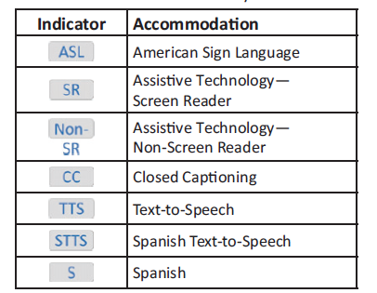
Form Assignment Markers in PAnext
Marker appears next to SASID on Students in Session screen if accommodation/AF was identified on the Manage Student Test Screen or through an SR/PNP import
These forms are independent forms and cannot be combined.
ASL, SR, and Non are only available for ELA/math

Slide 91
Technology for Medical Monitoring
Students who use a phone, tablet or other device to monitor their medical condition may have the device in the testing room
Documentation of medical necessity must be kept at the school and district
District plan for use of these devices must include:
  Where the device is located and who has control of the device
    If the student has control, the device must be visible at all times and may not be used for any other purposes
  Procedures for if/when the device alerts and what action is necessary
If student has to leave the testing environment, follow procedures for students who become ill
91

Slide 92
CMAS Accommodations for ELs
English Learner Accommodations
Extended Time
Word-to-Word Dictionary
General Admin Directions Read Aloud, Clarified and Repeated in Native Language
Online Transadaption into Spanish of Math, S/SS
Large Print Test in Spanish for Math
Text-to-Speech (TTS) in Spanish for Math, S/SS
Human Reader/oral script in Native Language for Math, S/SS*
*ELA requires an approved UAR
Note: EL accommodations not available on CSLA as the student is testing in native language

Slide 93
Student Responds in Spanish
Students should be assigned to the Spanish form of the assessment if responding in Spanish
Math – On English version, Spanish responses will not be scored
S/SS – If Spanish responses are identified, they will be scored by a Spanish speaking scorer
ELA – must be taking CSLA (grades 3-4) to respond in Spanish
  On ELA version, only English responses will be scored
  Student responses cannot be translated
93

Slide 94
Administering Spanish Versions & Other Language Accommodations
Test Administrators must be bilingual to administer a Spanish assessment (CSLA, Math, S/SS).
Only SAY directions for PARCC ELA can be administered in Spanish or other languages
  Auditory presentation of PARCC ELA in other languages is not allowed
Math, S/SS may be translated into other languages using the provided script (online or PBT).
  Online script is ONLY for translation
  Math responses that are submitted on English form must be in English
    Spanish responses are only allowed on the Spanish form
  If student responds in a language other than English or Spanish, it must be translated and transcribed into the test
94

Slide 95
Assigning Human Reader for Online Testing
For ELA, students must have an approved UAR and approved students should use TTS
Math, S/SS: This is limited to students that will have the test translated into a language other than English or Spanish
  Must be in a separate test session in PAnext (cannot be in same online test session as non-human reader/oral script tests)
    Math: Must check the Proctor Reads Aloud button
    Select form group type on the Test Session screen:
      Math - Human Reader
      S/SS - Oral Script

Slide 96
PARCC ELA and Math Top Ten Languages
ELA/math: Administrator scripts (SAY directions) available in these languages:
  Arabic
  Chinese Mandarin
  Haitian Creole
  Navajo
  Polish
  Portuguese
  Russian
  Spanish*
  Urdu
  Vietnamese
Report shells also available in these languages
*S/SS SAY directions are available in Spanish

Slide 97
Transcription Guidelines
Paper-based and Computer-based Transcription:
At least two persons must be present during any transcription of student responses.
  One person to transcribe
  One person to verify the transcription
The student’s responses must be transcribed verbatim into the Test Booklet/Answer Document or TestNav
  Note for braille transcription: Only a braille certified Test Administrator may transcribe student responses
After transcription, shred any responses made from an assistive technology device.
  Complete the Verification of Removal of Saved Data form

Slide 98
Transcription Guidelines - CBT
Computer-based Transcription:
Student responds to Constructed Response (CR) questions on their assistive device
  Student may respond to selected response items in TestNav
  Device with saved responses is secure until those responses are removed
Student will exit the unit, but the student should not submit the current unit
Resume the student’s test in PAnext
Log-in as the student and transcribe the CR responses
Student responses to CR questions should be entered into TestNav by the Test Administrator before the next unit
Submit responses for the transcribed unit
Student resumes testing in the next unit

Slide 99
Prior Access to Secure Test Materials
Access to test questions, and test materials prior to testing is limited to the following:
  4 days for translation of the script (math, S/SS) into another language
  24 hours for human readers (PBT) to review the script (math, S/SS) and prepare to administer the test
  TVIs may ONLY check that the braille version (UEB or EBAE) is appropriate upon arrival in the district (verify by test cover)
    TVIs may ONLY review Teacher Notes 24 hours prior to testing
    TVIs may NOT review the test content
Test materials must be secured at all time and follow chain of custody protocols
Test items may not be copied or discussed

Slide 100
Unique Accommodation Requests
Submitted by December 15
Unique accommodations must be approved by CDE Assessment Unit
Includes any accommodations not listed in the AF&A Manual (call Mindy Roden)
An approved unique accommodation request is required for:
  Auditory presentation of the English language arts/Literacy assessment (i.e., text-to-speech, ASL, human reader/signer)
  Calculation device on the non-calculator portion of the mathematics assessment
  Human Scribe on the constructed response portions of the English language arts assessment
UAR resources:
Guidance on Reading Access Accommodation (ELA: TTS, Human Reader/Signer, ASL)
Guidance on Human Scribe Accommodation
Guidance on Calculator Accommodation for Grades 3-7
Guidance on Calculator Accommodation for Grades 8 -9 (pilot)
Guidance on Other Accommodations

Slide 101
UAR Updates for 2017
Forms have been updated
All criteria within each form must be completed
  Recent data/test results must be included
Additional form for math:
  Grades 3-7 (updated 10.26.16)
  Grades 8 & 9 (pilot)
  Only slight differences in these two forms

Slide 102
Math Tools
Districts are responsible for approving the use of math tools during the non-calculator sections of the assessment:
  arithmetic tables (+, -, x, /)
  two-color chips
  counters and counting chips
  square tiles
  base 10 blocks
  100's chart
SR/PNP indication will create an accommodation reminder
Reminder: Number lines are not allowed

Slide 103
Accommodation Reminders
PAnext will have reminder notifications for all students identified with the following accommodations:
  TTS for ELA
  ASL for ELA
  Human Scribe for ELA
  Human Reader/Signer for ELA
  Calculator and math manipulatives for math
These reminders are not able to be removed, unless the accommodation is removed
If these reminders appear, check the students with reminders against the list of approved UARs and the district’s list of students approved for math manipulatives.
103

Slide 104
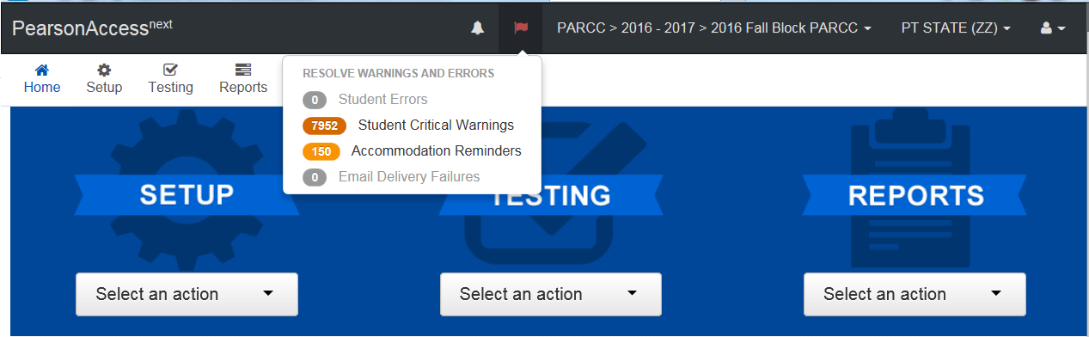
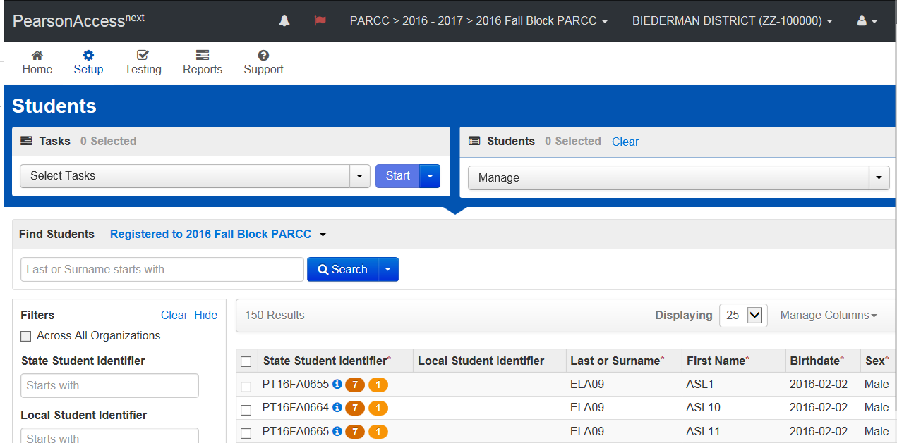
Accommodation Reminders
Clicking on the Accommodations Reminder Flag will auto-direct you to the Setup > Students screen and the flagged students will be displayed
104

Slide 105
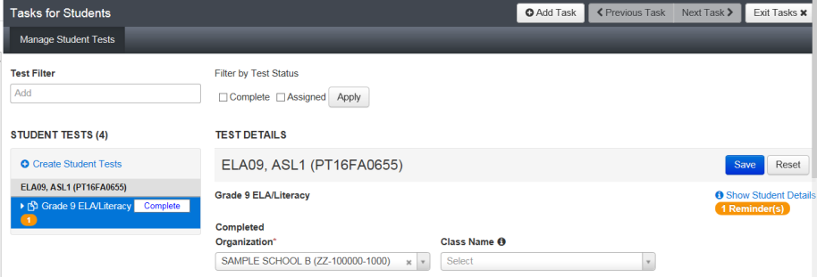
Accommodation Reminders
On the Manage Student Tests screen, you will see the accommodation reminder with the Student Tests box on the left and under Show Student Details on the right.
Example message: Adding TTS to an ELA test without proper documentation may result in the student’s test being invalidated.

Slide 106
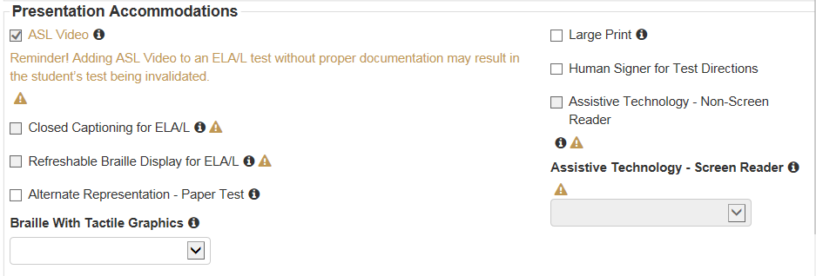
Accommodation Reminders
Scroll down on the Manage Student Tests screen to see the reminder text
Note: Other PNP fields show alert symbols because this test is in a prepared or started session and those PNP values are linked to form assignment. Users would need to remove the student from the prepared or started session to make updates to those PNP values.

Slide 107
UAR Reminder
Compare list in PA^{next} to approved UAR list from CDE
  If students are approved:
    Student is able to use the accommodation during the state assessment and will receive a valid score
  If students are not approved:
    If student is in a prepared or started test session, remove the student from the test session
    Return to “manage student test” screen
    Clear accommodation
    If student uses the accommodation during the state assessment the results will not be considered valid. The score will be misadministered or suppressed.

Slide 108
UAR Reminders
After a UAR is submitted through Syncplicity, email Mindy that it has been posted
If you do not receive a response, follow up on the UAR prior to testing
  If you have not received documentation indicating approval, assume “Not Approved”
  Contact Mindy prior to testing if have not received a decision on the UAR
CDE will post lists with approved/denied UARs in Syncplicity
CDE will post lists into Syncplicity of students registered for an accommodation that requires a UAR, but does not have one approved
  Check these lists prior to the beginning of testing
  Remove accommodations that are not approved
  Accommodations that are not approved, but are used will have suppression applied

Slide 109
Emergency Accommodation
A case where a student needs a new accommodation immediately due to unforeseen circumstances
  Cases could include students who have a recently-fractured limb (e.g., arm, wrist, or shoulder); whose only pair of eyeglasses have broken; or a student returning from a serious or prolonged illness or injury.
Emergency accommodation form must be completed and maintained in the district
Contact CDE if a student requires a paper-based administration
Refer to Appendix G for Emergency Accommodation Form
This will be identified on the Manage Student Test screen through the User Interface or via a SR/PNP file upload
  Human Scribe
  Other

Slide 110
ELA/Math: Student Accommodation
Refusal Form
If a student refuses an accommodation, the school should document in writing that the student refused the accommodation
Refer to Appendix H of the PARCC AF&A Manual: Student Accommodation Refusal Form
The accommodation must be offered and remain available to the student during testing
School Test Coordinators should send a copy of the form to parents when a student refuses an accommodation documented in an IEP, 504 Plan, or EL Plan
Forms are maintained in the student’s record

Slide 111
Testing Environment

Slide 112
Student-to-Test Administrator Ratio
Student-to-Test Administrator ratio must not exceed 30 to 1
  Test Administrator must be able to actively monitor the space within the physical testing environment
Consider room configuration
  Make special considerations for large testing environments or environments with complicated configurations
Test Administrators must:
  Actively proctor
  Remain attentive and in the room during the entire testing unit
  Circulate throughout the room during the test
    Should be able to see students working, not student work

Slide 113
The Test Environment
The testing environment must:
Be adequately lit, quiet, free of distractions, and heated or cooled
Provide an adequate writing surface (paper-based)
Be free of electronic devices and music
“Do Not Disturb/Only Authorized Personnel Allowed” sign must be placed on the door during test sessions

Slide 114
The Test Environment
No food or drinks are allowed on desks or near test materials
The testing environment must be free of any content related posters or aids that suggest possible answers to students:
  Word walls
  Steps for solving math equations
  Any content related materials
  Any resource that defines, explains, or illustrates terminology or concepts
General rule: When in doubt, cover it.

Slide 115
The Test Environment
Generally, posters that do not include content specific definitions, content related processes or solutions may remain on the wall.
Display unit testing time for students:
Unit Name: | Algebra 1, Unit 1
Unit Testing Time: | 90 Minutes
Starting Time: | 9:00
Stopping time: | 10:30

Slide 116
Room Configuration
Students should not be able to see each other’s work from a normal testing position
Consider the following seating configurations to maintain test security:
  Seat students in every other seat (useful in a computer lab setup)
  Arrange monitors back-to-back
  Seat students back-to-back
  Seat students in a semicircle (useful for schools using laptops)
  Seat students in widely spaced rows or in every other row (appropriate for a classroom setup)
Dividing screens or other privacy materials may be used if students cannot be placed far enough away from each other

Slide 117
Headphones
ELA
All students must have headphones for all units.
  Not every unit has sound, but one unit for each student will
  Need to be prepared and follow directions to adjust sound for each unit
Text-to-Speech
To be in a testing room with other students, headphones must be worn
Students must be tested separately if they are not able to wear headphones.
Note: Math, S/SS do not contain audio, unless TTS is used

Slide 118
Unauthorized Visitors and the Media
Only students, Test Administrators/Examiners, and authorized school, district, state personnel, or state-sanctioned test monitors may be in testing areas during administration.
Media are not allowed to have access to the tests before, during, or after test administration, or take pictures or video of testing materials or testing students.
Parents are not allowed in the testing room with their child.

Slide 119
Receiving Materials and
Test Security

Slide 120
Test Security Protocols
Protection of student information and data
Protecting the validity of the state assessments
Financial considerations
State law: Maintain the integrity of the assessment

Slide 121
Security Plan
Successful Security Plan requirements:
All personnel have appropriate annual training
All involved personnel understand security protocols
All involved personnel have signed security agreements
  Think about anyone who may be in/enter the testing environment
Test environments are secured against unauthorized personnel
Establish a documented chain of custody
Materials are kept in a central, secure, and locked location with limited access

Slide 122
Test Materials Security
Secure
Non-Secure
Student Testing Tickets
Paper-based Test Booklets
Answer Documents
Social Studies source books
Periodic Table (PBT HS Sci)
Human Reader/Oral scripts
Used scratch paper
Any student work/responses
Mathematics Reference Sheets prior to testing
  If written on, cannot be reused
Test Administrator Manuals (TAM)
Procedures Manual
PARCC TCM
Unused scratch paper
Test Examiner Manual (TEM)

Slide 123
Maintaining Security of the Assessments
All secure test materials must be secured while in the Test Administrator’s possession.
No duplication of secure CMAS materials is permissible.
No cell phones or other communication, reproduction or recording devices are allowed during test sessions unless required for accessibility.
  Students should be aware that cell phones or other electronic devices are prohibited. Students who are found with these electronic devices in their possession during testing (including if they have finished testing but other students have not) or during a break may lead to the invalidation of not only their test, but to the invalidation of others’ tests as well.
All individuals are strictly prohibited from taking photos or video of TestNav screens and paper test materials. Please ensure that individuals in your district are aware of this critical instruction.

Slide 124
Receiving Test Materials
  Initial materials will be received 2 weeks prior to the district start date
    HS science early window materials will arrive 3/17
  Materials are packaged by school and shipped to the district
  ELA/math quantities include a 5% overage per school and for the district
  For S/SS and CoAlt S/SS there is no overage sent

Slide 125
Contents of Initial Shipment
Test Coordinator Kit
  Resealable plastic bag (holds all materials)
  Paper Bands
  Pearson Scorable and Nonscorable Labels (different colors)
  UPS Ground return labels for Scorable and Nonscorable materials
  Pre-printed/pre-gridded Used Test Booklet/Return School Header
  Student ID Labels and Roster
  Return Instructions Sheet
  Shipping Carrier Return Instructions
Packing List and chain of custody Form
PARCC TCM
Test Administrator Manuals
Student Test Materials (if indicated by January 27 in PAnext)
  Test Booklets/Answer Documents
  Math Reference Sheets, Rulers, and Protractors, if applicable
  Large Print/Braille kits
  Human Reader/Oral Script kits

Slide 126
Header Sheets and Labels
Header sheets and labels are in the School Test Coordinator kits
  DACs may want to take these out of the school kits
  If these are sent to the school, ensure that they are returned at check in
These are needed for return of all secure materials

Slide 127
DAC – Receipt of Test Materials
Upon Receipt of Test Materials, DACs should:
Remove the Packing List, chain of custody Form, and Test Coordinator Kit from Box 1.
Inventory materials immediately to verify that all were received and that there is an adequate number for administration.
    NOTE: Count the number of shrink-wrapped packages only. Shrink-wrapped packages may be opened four school days before testing. Only distribute materials to schools one week prior to test window.
Optional: take header sheets and labels out of School Coordinator Kit
DAC may order additional material, if necessary
Keep all test materials in a centrally locked storage area, with limited access, until distributing them to schools
  Ensure that chain of custody procedures are followed at all times

Slide 128
SAC – Receive Materials & Chain of Custody
Document any movement of secure materials before, during, and after testing
Deliver materials to schools no more than 1 week in advance of school testing window
Schools inventory materials using the chain of custody/school security checklist
Deliver paper based forms and materials (oral scripts) to Test Administrators only on the day of testing, using a chain of custody process.
Distribute only the content area being assessed
  As close to testing time as possible
Return materials to a designated secure location
  Not stored in classrooms
  As soon as possible after the unit is complete
Return secure materials to DAC after testing is completed
  Includes scripts

Slide 129
Chain of Custody Forms
Districts may use the forms shipped with the materials or create their own to track all secure materials
If creating a district/school chain of custody form, for each day of testing the form must include:
  Security barcode/number
  TA signature
    Date and time checked out
  SAC (or designee) signature for return
    Date and time returned
Chain of custody forms are kept on file for three years. If materials are missing, these will be requested.

Slide 130
Documenting and Storing Test Materials
Keep all boxes in which the test materials were delivered and use them to return Scorable and Nonscorable materials after testing is completed
  Each program is returned separately
Report the following occurrences immediately to Pearson Customer Service using the CMAS Form to Report Contaminated, Damaged, or Missing Materials (see Appendix E):
  Non-receipt of any materials listed on the School Packing List
  Discovery of damaged test material
  Discovery of missing or duplicate sequence numbers on any Test Booklets

Slide 131
Additional Order Windows
2017 Spring Additional Order (AO) Windows:
Order at least 5 days prior to test administration
It is the District Assessment DAC’s responsibility to understand the additional order windows
Component | Additional Order Window
ELA and Math (Secure) | February 28* to April 25, 2017
ELA and Math (Non-Secure) | February 28* to May 3, 2017
Science and Social Studies (Secure) | March 28 to April 25, 2017 HS Early window opens March 20
Science and Social Studies (Non-Secure) | March 28 to May 3, 2017 HS Early window opens March 20
* ELA and math AO opens two weeks prior to district testing window.

Slide 132
Steps to Order Additional Materials
Orders Can Be Submitted by the DAC.
For a refresher on this process, refer to the PAnext Additional Orders Training Module found at https://parcc.pearson.com/training-modules/
Note: CDE will only approve AOs for accommodated materials if:
The ordered materials can be matched to a student registration in PAnext
  The registration/accommodation information must be entered on the student’s SR/PNP before placing the AO

Slide 133
Key Information to
Order Additional Materials
Keep in mind when ordering additional material:
Do not submit AOs prior to receiving the initial shipment of test materials
  All test materials should be inventoried prior to placing an AO
Once an AO is approved, please allow 4-5 business days for shipment delivery
Although ELA and math Test Booklets and Answer Documents will be shipped in packs of 5, they are ordered one-to-one. If materials are needed for 7 students, enter 7 and Pearson will calculate the number of packages to ship.
AOs are packaged by district and shipped to the district

Slide 134
Key Information to
Order Additional Materials
Keep in mind when ordering additional material:
Ancillary materials for return shipping are not automatically included in the AO
  Shipping labels
  Mathematics tools and Reference Sheet
  Header sheets
Account for the need of these additional materials when an AO is placed
  Pearson will call if they see these materials are needed
Check for return labels and header sheets prior to the end of the testing window as these will not have expedited shipping

Slide 135
Before Testing Checklists

Slide 136
November – December
Read the CO Procedures Manual to prepare for Test Coordinator responsibilities
Notify students and parents about the district/school spring assessment dates if not previously communicated
Create a list of students who require accommodations and accessibility features that must be identified in advance (e.g., large print, braille, auditory presentation, text-to-speech, Spanish accommodations, color contrast)
Submit any Unique Accommodation Requests by December 15
DACS update/create PearsonAccess^{next} and training center SAC accounts for ELA/math, science/social studies, and CSLA administrations. This can be done through any administration
Establish a district testing schedule

Slide 137
November – December
Confirm all school organizations are in PAnext for the district
  Verify shipping address
Verify and update student enrollment information in Data Pipeline before close of business on December 16, 2016.
  Extracts are generated from data in the untagged (tag=null) Student Interchange Student Demographic and School Association files
  Extracts generated from October Count file if untagged data is unavailable
Note: A homeschool organization was created for each district

Slide 138
January 9 – 27
Confirm student registration in PAnext against current district enrollment (SR/PNP info at http://www.cde.state.co.us/assessment)
  View applicable training modules at https://parcc.pearson.com/training-modules/
  Delete withdrawn students
  Register new students or use Work Requests to transfer
  Delete incorrect test assignments (e.g., math grades 7-9) and add the correct assignment
    Students must have only one math record and an ELA or CSLA record
Add accommodations and accessibility features that require physical test materials (e.g., large print, scripts)
  Must be identified in advance based on information collected from November – December
Registration information is used to automatically generate PBT labels and initial materials shipment
  If Class is included for PBT, then labels will be sorted by Class

Slide 139
Selected Tasks to Complete
Before Testing
Prepare for Test Administration
Prepare Test Administrators to administer accommodated tests, if necessary
  PBT ELA - audio guidelines that must be used by Human Readers for ELA
  PBT Math, S/SS have scripts that must be used
Schedule practice tests/ePATs and student tutorials (recommended)
Develop district plans:
  Security
  Logistics
  Training
Meet with and train Technology Coordinators
  Ensure DTC attends CDE technology webinars
  Complete technology setup
Conduct an Infrastructure Trial using CO CMAS Site Readiness administration

Slide 140
January 27 – Before Testing
SACs update/create PAnext Test Administrator and Test Examiner user accounts for ELA/math, science/social studies, and CoAlt administrations
DACs ensure all school and district personnel involved in the spring administrations are trained
  All personnel must sign a CO Security Agreement form
  Send Verification of District Training to CDE through Syncplicity Assessment Forms folder

Slide 141
February 1 – Before Testing
Confirm that all accommodations and accessibility features that must be identified in advance have been indicated in the SR/PNP
Create PAnext test sessions for CBT
Proctor Cache test sessions in PAnext
  “Prepare” test sessions in PAnext
    DO NOT “Prepare” test sessions until accommodations and accessibility features have been confirmed
Prepare testing environments and testing devices
DACs receive, inventory, and secure testing materials

Slide 142
Selected Tasks to Complete
Before Testing
Two weeks before testing:
  Finalize school testing schedules
  Finalize school security and logistics plans
At least one week before testing:
  Meet with Test Administrators and Proctors
  SACs receive, inventory, and store materials
  Confirm setup of test sessions in PAnext
    Active Test Administrator accounts
    Online tests Proctor Cache
Check for test administration updates in weekly DAC email.

Slide 143
Selected Tasks to Complete
Before Testing
Four days before testing:
  Open sealed test packages
  Provide access to accommodated materials as needed for translation
    Sign language and translation into languages other than English or Spanish
  Make final preparations, as needed (headphones for ELA, TTS)
24 hours before testing:
  Human readers/oral script viewing of script (math, S/SS)
  TVIs access Teacher Notes only for braille assessments

Slide 144
During Testing
(Administering Tests)

Slide 145
CBT Task “Prepare” Test Sessions
This step is completed at least 1-day prior to starting a test session
  Allows for the starting of multiple test sessions at one time
  Removes the 250 student limit for test sessions
  Can only be done by users with LEA or STC roles (DAC, SAC)
This step will assign forms to each student in the test session
  Prior to completing this step, ensure that students are assigned to the appropriate accommodations
  If accommodations are not indicated prior to this step, the student will need to be removed from the test session, PNP updated, and then added back to the test session.
Once this step is completed, and the window is open, the test session can be started

Slide 146
Incorrect Form Assignment
Check form assignment prior to students logging into the test
The incorrect form must be identified before the student logs into the test
If the error is identified after the student logs into the test, the options are:
  Continue with the test and suppress the score
    Student will receive an ISR, but the scores will not be aggregated
    This will count against participation for the school and district
  Stop the test and invalidate with Void 06
    Since this is a misadministration, the student will not receive an ISR
    This will count against participation for the school and district

Slide 147
PAnext Test Session Life Cycle
Create
Students can be added to un-prepared sessions.
Sessions can be set as Human Reader if the session is not in prepared status.
Prepare
Test forms are assigned when session is prepared.
Start
Must be started prior to student being able to test.
Can be started on the day the state window opens.
Stop
Students’ PNPs can be updated if session is not in prepared status.
DAC or SAC can prepare sessions (TA cannot prepare).
Students can be added to a prepared session only via the user interface.
Students can be added through the UI only.
Stop sessions once all students complete testing.
All students in the session must be in a complete or marked complete status to stop the session.
Code and remove students with all units in “ready” status.

Slide 148
PAnext “Prepare” Test Session
Checklist Prior to Preparing a Session
□ | All students’ PNP attributes are correct
□ | Students requiring tests to be read aloud are added to read aloud sessions and those sessions have been set to Read Aloud/Oral Script
□ | Test content is proctor cached (proctor caching is recommended)

Slide 149
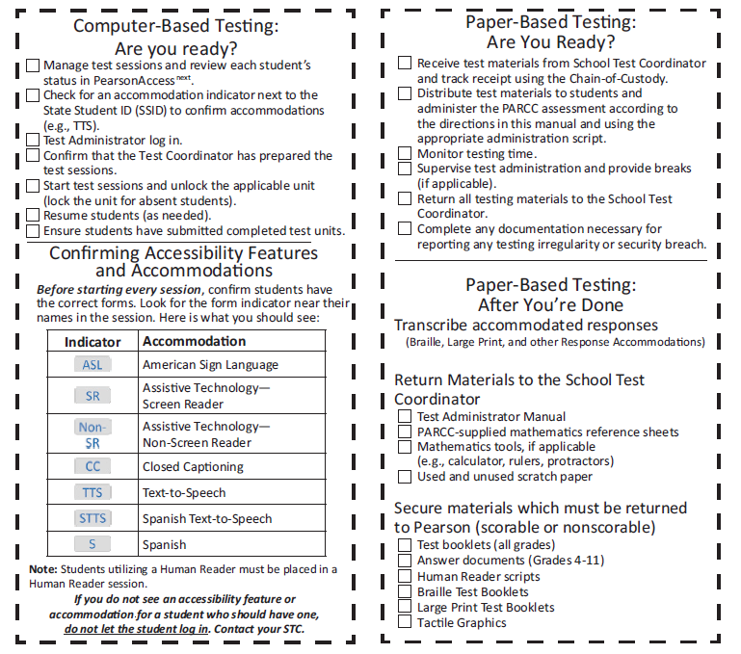
ELA/L and Math TAM Reminders

Slide 150
Tasks to Complete During Testing
On the Day of Testing (CBT):
Distribute test materials –ensure TAMs have 2017 on the cover
Ensure Test Administrators have a computer or tablet available
Check form assignment
Monitor test activity
Ensure accessibility features and accommodated forms are assigned to appropriate students
Be available to Test Administrators and Proctors
Investigate security breaches and testing irregularities
Follow protocol for contaminated or damaged test materials, safety threats and severe weather
Respond to all technology related issues
Collect materials from Test Administrators after each test unit

Slide 151
During Testing: Security Breaches
Monitoring and Reporting Security Breaches and Testing Irregularities
All instances of security breaches and testing irregularities must be reported to the School Test Coordinator (STC), and subsequently the DAC, immediately.
DAC will contact the state immediately upon receiving notification
Testing Irregularity or Security Breach
  SAC will complete the Form to Report a Testing Irregularity or Security Breach (either for ELA/math & CSLA or S/SS) and DAC submits it through Syncplicity into the folder for the appropriate administration
  See Appendix E for both forms

Slide 152
During Testing:
Contaminated & Damaged Materials
PBT - Contaminated or damaged test materials that must be replaced
Place Student ID label on replacement document or complete entire data grid
Record security barcode number of the damaged and new documents
Submit the Form to Report Contaminated Damaged, or Missing Materials to CDE. ELA/math, CSLA: Stephanie Boyd at boyd_s@cde.state.co.us, or Sara Loerzel for S/SS at loerzel_s@cde.state.co.us
If possible, transcribe responses from contaminated test material into the replacement. If not, for ELA/math and CSLA contact Stephanie Boyd at boyd_s@cde.state.co.us, for S/SS contact Sara Loerzel at loerzel_s@cde.state.co.us.
Destroy contaminated material according to local biohazards protocols

Slide 153
During Testing:
Safety Threats and Severe Weather
Create a Plan and Train Staff for Safety Threats and Severe Weather
Test Administrators and Proctors must:
Note the time of the disruption
Secure test materials as specified in your School Security Plan
Prepare students for the continuation of the unit and resume students’ tests
Document the situation in writing
If the disruption will cause the unit to be carried over into the next day, notify CDE

Slide 154
Test Administration Materials
2017 Test Administrator’s Manual (TAM)
  Select district/school options for after the test session
  Read script exactly as written (may clarify after read exactly)
  Practice in advance
  Each unit will be submitted independently
Student Testing Tickets
  Hand out and collect in the test environment
  Have a master list of students including accommodations
  Student Testing Tickets are secure

Slide 155
District Decisions:
After Students Finish Unit
District Decisions:
  Will students be able to leave when they have finished testing? (no minimum time)
  Sit quietly?
  Read (cannot use any electronic reading devices)?
  May students be released to location outside testing area?
  What to do when all students are completed with unit?
School Site Considerations:
  Where will students go if they are released?
  To whom will students be released?

Slide 156

Active Administration
Active Test Administrators:
Test Administrators May Not:
Ensure students have all necessary materials for each unit
Ensure a standardized testing environment
Follow all scripts exactly as written
Move throughout the room during testing
Read directions to students when asked
Use proximity to keep students on task
Use “continue working” script
Provide feedback
Clarify test questions
Answer content related questions
Interfere with the students’ demonstration of skills
Interact with students in any way that would impact student responses
Engage in other tasks during test sessions
Read sources, items, or student responses
Help with TestNav navigation

Slide 157
Administration Steps for Computer Testing
Prepare the test environment and situate students
Start test session (must have been “prepared” previously)
Unlock the unit being administered through PAnext
Follow directions and read script in the TAM
Hand out Student Testing Tickets and scratch paper when directed
Assist students in logging into TestNav 8
Complete SAY directions to students and start unit
Actively administer each test unit
Collect Student Testing Tickets and scratch paper
Confirm students have submitted the unit
Lock the unit
Stop test session in PearsonAccess after last unit only
  At this point, the status of all tests for all students in the test session must be “Completed” or “Marked Complete”*
*At the end of the testing window, incomplete units should be “marked complete” by SACs – this does not invalidate tests. Invalidations are entered separately (Void).

Slide 158
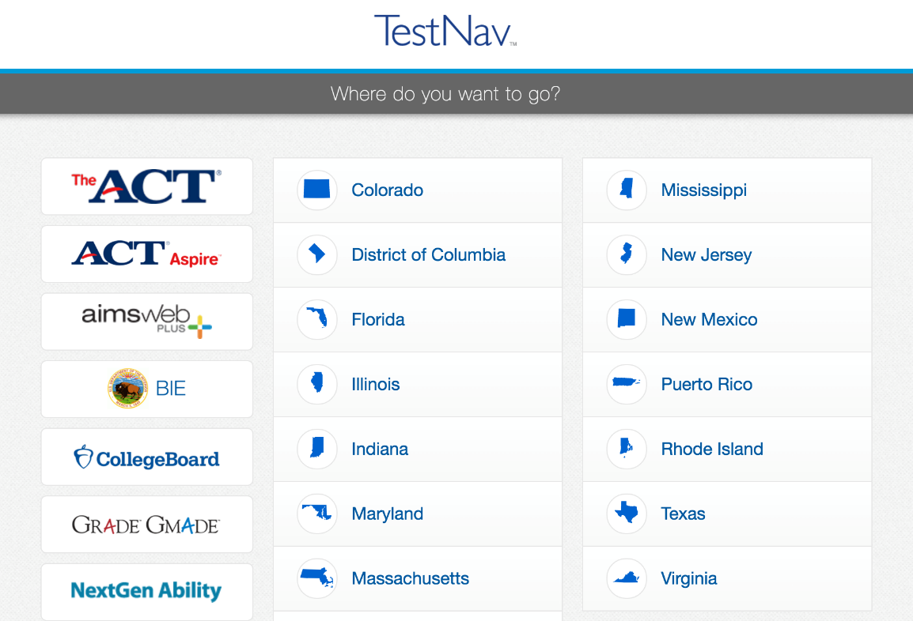
TestNav
ELA/math, Science/Social Studies
  Browser: https://co.testnav.com
  App:
Note: The Sign In page should say “Colorado” above the Username and Password fields. If it doesn’t click the User Icon and select “Choose a different customer”.

Slide 159

Technology Tip
Document the specific device on which each student is testing, for each unit of the test. This will aid in response recovery if it becomes necessary.
If a student receives an error. Do not move them to a new device immediately. Have them sign back in to the same device, and then click the User icon in the top right to “Sign out”. This will send all responses to the testing server.
Always have the student “Sign out” if they won’t be submitting their test. Never just power-off.

Slide 160
Basic Technical Troubleshooting

Slide 161
Common Error Codes
1001: “Your test has been saved. Please notify your test administrator.”
  Early Warning System initial message, does not indicate the issue, another error code will follow
1009: “Unable to download test content”
  Network connection issue between the testing device and Pearson servers.
5032: “TestNav has detected a blacklist application running…”
  Close the specified application in the error message and have the student sign in again.
3005: “TestNav has detected that another application attempted to become the active window”
  This could be caused by pop-ups in the background, power saving features, or key combinations like ctrl+alt+del
8026: “Unable to connect to the proctor caching computer. Please contact your administrator.”
  Network connection issue between the testing device and the local Proctor Caching device

Slide 162
Common Error Codes: Next Steps
Resume the student test in PAnext
Have the student log in again on the same testing device
  Do not move the student to another testing device unless the student safely exits the test using the log out feature
If the same error occurs repeatedly, or if the same error is affecting multiple students, contact the Technology Coordinator

Slide 163
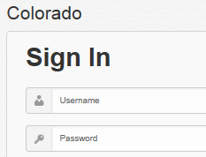
Common Errors
9059: “The username or password you entered is incorrect.”
If the username/password being used is accurate, the student may be on the incorrect login page
  “Colorado”

Slide 164
“Early Submission” of Test
There have been no confirmed cases of a student getting “kicked out” of TestNav and the test submitting itself.
  In all cases where a student’s test was submitted and the log files were sent to Pearson, the student hit the submit button and followed the on-screen logout procedures.
  This is like a shopping transaction:
    Put the item in your basket, then confirm that you want to checkout.
CDE will unsubmit tests for:
  3rd graders one time only
  Other grades: if log files for the test sent to Pearson show that the student did not submit the test

Slide 165
Student Logs into Another Student’s Test
Student A logs into Student B’s test
  Immediately exit the test
  School immediately contacts DAC
  DAC immediately contacts CDE
      CDE may be able to move the test
      CDE may have to void the unit

Slide 166
Student Response Files (SRF)
Before moving a student to another device during a unit:
  Do not move unless absolutely necessary
  Have student sign out
  If not able to sign out, manually move file from old to new computer
Occasionally SRFs need to be sent to Pearson. Additional documentation can be found here:
  https://support.assessment.pearson.com/display/TN/Find+SRF+and+Log+Files

Slide 167
Make-Up Testing

Slide 168
Make-Up Testing
Make-Up Testing
Students who are absent, become ill, or who can no longer test because of classroom, school, or technical interruptions during originally scheduled units, may utilize make-up testing.
  Students may not return to previously answered questions
Test security and administration protocols apply
School Test Coordinators will establish the make-up testing schedules for their schools
ELA/Math units may be taken out of order for make-up testing only
Science and Social Studies units may not be taken out of order
Priority: Minimize risk of prior exposure to test content that could result in an invalidation

Slide 169
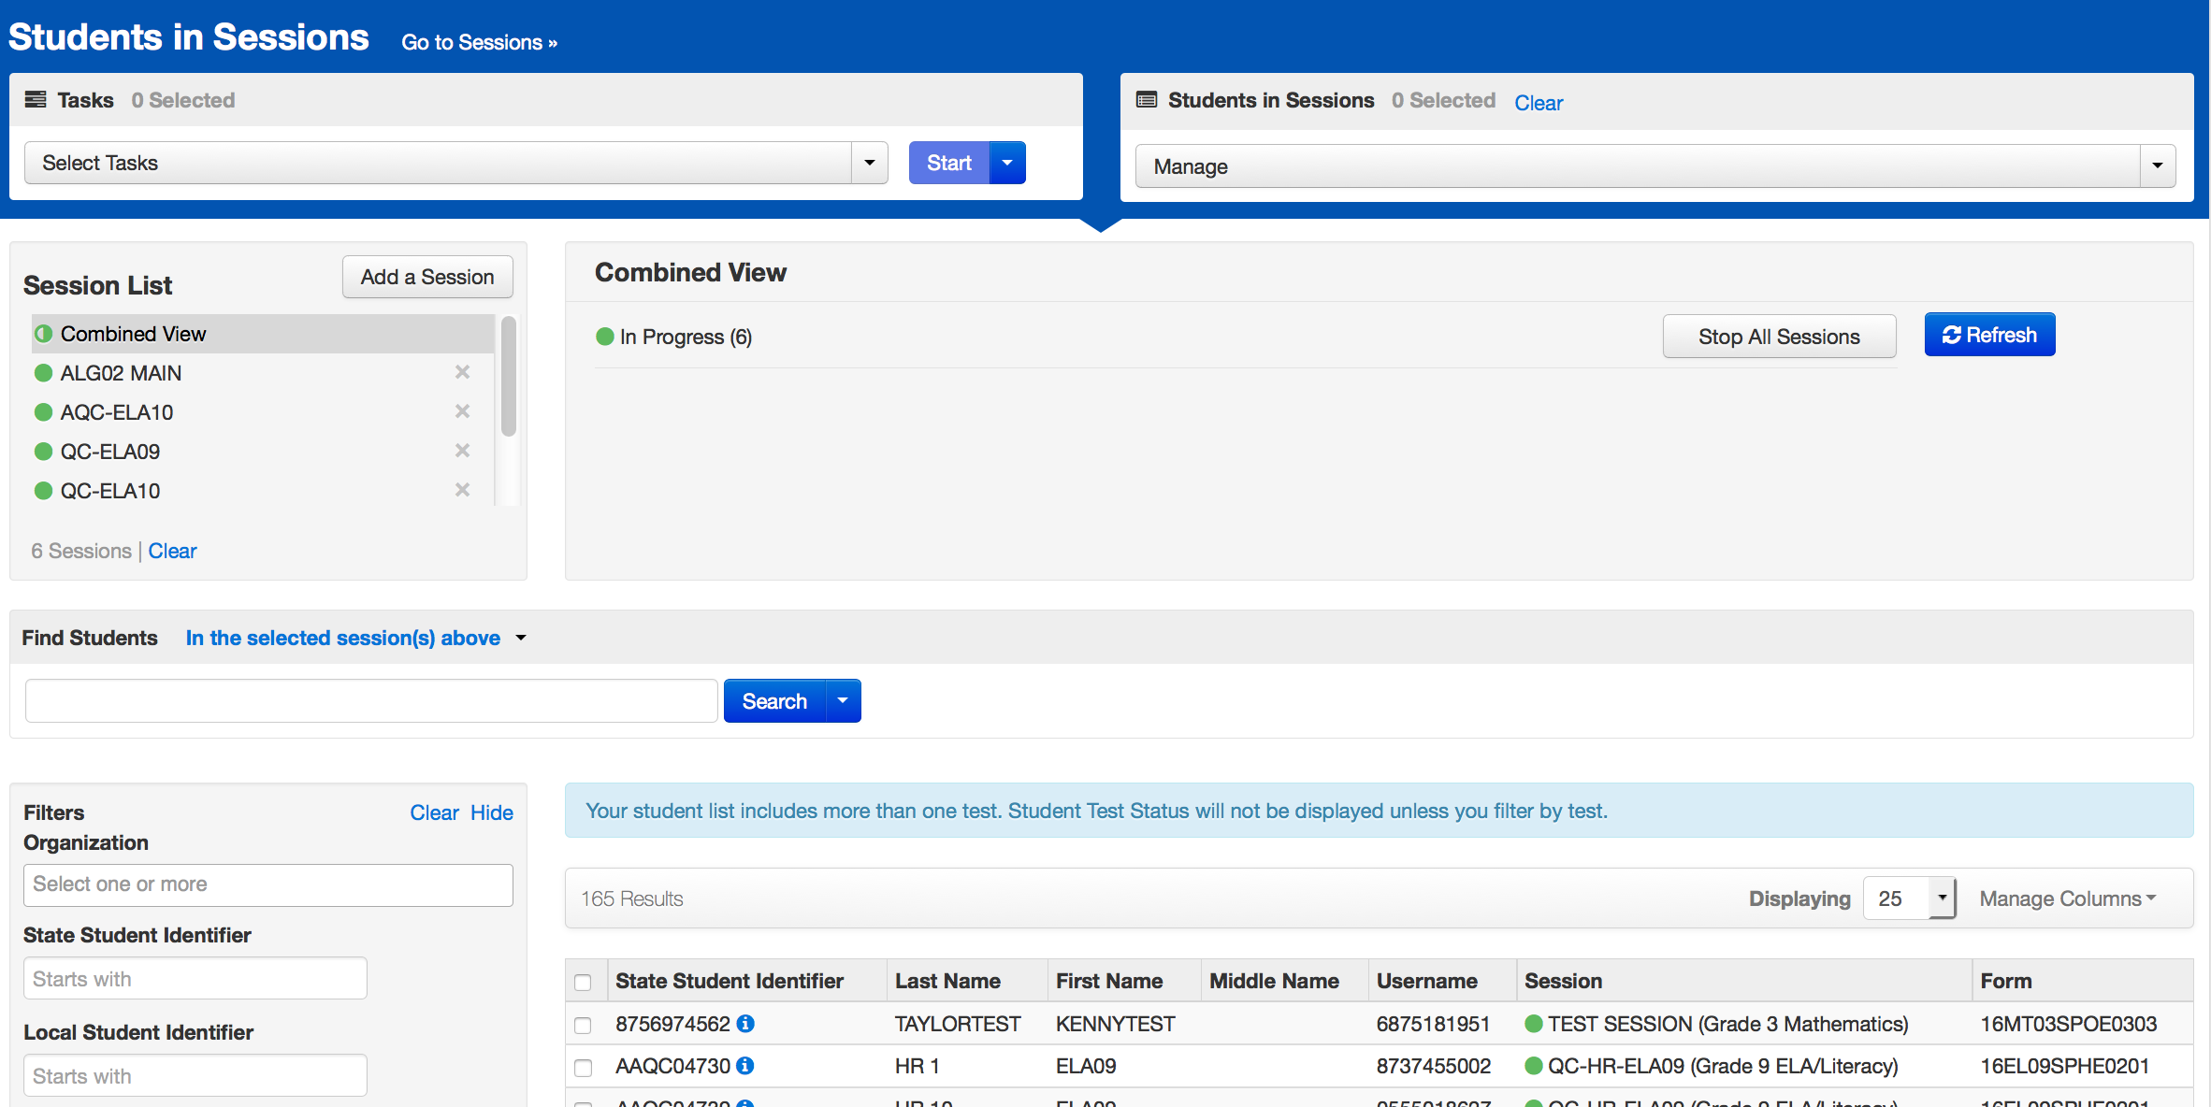
Online Test Management
Multiple sessions may be managed in PearsonAccess^{next} at the same time.

Slide 170
Test Irregularities
When to submit a form to CDE via Syncplicity:
Students were grouped incorrectly – not same directions or time
Students were given an incorrect amount of time (more or less)
Students were cheating
Students used an unapproved accommodation or were not given an accommodation with which they should have been provided
  Math, S/SS test read to students without the human reader/oral script
Test Administrator did not follow procedures
PBT students go past stop sign at the end of the unit
Large number of students involved in a technology related irregularity
  If technology issues cause testing to not be completed on one day
Test security has been breached
Student goes back into a unit on a different day and changes answers

Slide 171
After Testing

Slide 172
Tasks to Complete After Each
Unit/Session of Testing
Computer Based Testing – After Testing
The day of testing:
  Collect materials (Student Testing Tickets, scratch paper, etc.)
  Ensure students have logged out of TestNav correctly
  Return materials to SAC using chain of custody form
  Notify SAC of absent students and/or needed transcriptions
Paper Based Testing – After Testing
The day of testing:
  Collect materials (test booklets, answer documents, scratch paper, etc.)
  Ensure names are on test materials
  Return materials to SAC using chain of custody form
  Notify SAC of absent students and/or needed transcriptions

Slide 173
Final Day: Tasks to Complete After Testing
Computer Based Testing – After Testing
The final day of testing:
  Collect materials (Student Testing Tickets, scratch paper, etc.)
  Ensure student test units have been submitted/completed
  Ensure test sessions have been stopped
  Purge the cached test content
  Securely destroy materials listed in PARCC TCM (School or District)
  Return used scratch paper in provided envelopes
Paper Based Testing – After Testing
The day of testing:
  Collect materials (test booklets, scratch paper, etc.)
  Ensure labels are affixed or data grids are completed
  Return scorable PBT materials to Pearson as soon as possible (by 5/3*)
  Securely destroy materials listed in PARCC TCM
  Return used scratch paper in provided envelopes
*If scorable materials are not picked up by May 3, 2017 there is no guarantee that records for these PBT students will be included in SBD or scored.

Slide 174
Verification of Removal of Saved Data
Administration may require CMAS student responses or CoAlt task manipulatives to be temporarily stored on local devices
  These materials are secure and must be treated as such
  Student responses saved on secondary devices need to be transcribed into online or paper test forms in order to be scored
  All student responses must be removed from the secondary device or flash drive immediately following transcription or printing for transcription purposes
It is the DAC’s responsibility to ensure that all secure content is deleted after CoAlt testing or CMAS transcription in a secure manner
  Verification of Removal of Saved Data form found in Appendix G

Slide 175
Tasks to Complete After Testing
After Testing (continued)
One week after the final unit:
  Resolve critical warning/alerts in PAnext
    Do not need to resolve Title III warning
  Organize and return nonscorable test materials
    Identify transcribed and damaged test materials as “Do Not Score”
  Complete a Post-Test Certification Form for all CMAS and submit through Syncplicity Assessment Forms folder
  ELA/math: Destroy/shred scratch paper and used Mathematics Reference Sheets
  S/SS: Must return used scratch paper in secure return envelopes
  Keep records for three years

Slide 176
Separate Returns by Program
Each program (ELA/math, S/SS, CSLA) is returned separately
DO NOT mix these materials in boxes
Different colored labels by program for scorable and non-scorable
Program | Scorable | Nonscorable
CMAS: PARCC ELA/Math | Red | Purple
CMAS and CoAlt: S/SS | Orange | Blue
CSLA | Yellow

Slide 177
Student ID Labels
The student ID label will override any bubbled demographic information
Set aside student ID labels that were not used to be securely destroyed/shredded
If an ID label is not available, grid all the fields on the data grid (must match info in PAnext)
  Incomplete or incorrect bubbling will lead to rejected student tests that must be resolved later

Slide 178
ELA/Math PBT Rejected Test Attempts
Rejected Test Attempts are tests that will not be scored if not fixed (estimated timeline of mid-May)
If the information on the data grid does not match PAnext, it creates a Rejected Test Alert
All 6 fields must match PAnext exactly
  First name, last name, SASID, gender, date of birth, grade
If student was registered for online, with online accommodations, but takes the PBT version, a rejected student test is created.

Slide 179
Return Shipping Labels & Header Sheets
Ensure that you have labels and header sheets
  These are shipped with the school coordinator kits
These will not be overnighted, so make sure that you have these in time to return materials
  Scorable picked up by May 3*
  Nonscorable picked up by May 5
*If scorable materials are not picked up by May 3, 2017 there is no guarantee that records for these PBT students will be included in SBD or scored.

Slide 180
Packing Materials
    Checklist to prepare materials for packing:
DAC will receive materials from the School Test Coordinator
Scorable Test Booklets/Answer Documents have a Student ID Label or hand-gridded student demographic data
School Header Sheets completed for each grade level and/or subject
  E.g., All grades of Algebra I will be under one header sheet for the school
  All 7th ELA will be under one header sheet for the school
Scorable and nonscorable materials are packed separately for ELA/math, S/SS, and CSLA, and are in the boxes in which they were delivered
Boxes are not overfilled (under filled boxes are packed with crumpled paper)
One return shipping label (scorable or nonscorable) and one UPS label is placed on the top of each box

Slide 181
Secure Materials Must be Returned
Every Test booklet, answer document, and script has a secure barcode and will be tracked
Every secure test item must be returned, including scripts for math, science and social studies
Make sure that all materials are accounted for and returned
If something must be destroyed locally (contaminated) then call CDE prior to destruction for further instructions
Keep track of your UPS tracking numbers when shipping back materials
If secure materials are not returned after testing, there is a process that must be followed to document each item that is missing

Slide 182
PBT Materials Reminder
Must commit to meeting the security requirements and accounting for and returning all secure materials
Includes chain of custody documentation and reporting for any missing secure materials

Slide 183
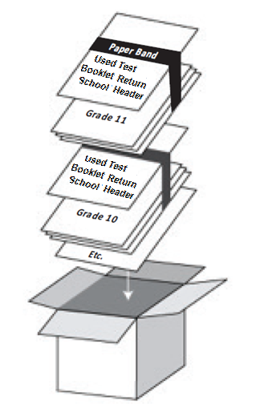
Packing Scorables
Scorable materials
Used test booklets (Gr 3, S/SS)
Used answer documents (Gr 4-HS)
Transcribed into test booklets (Gr 3, S/SS) or answer documents (Gr 4-HS)
Packing Scorable materials for Return Shipment:
S/SS materials separate from ELA/math materials
Do not mix Scorable and Nonscorable materials in the same box
One school, per box. Do not combine two schools’ test materials in one box.
Use appropriate shipping labels
Once all materials are in boxes, indicate the sequence of boxes being returned for the school (e.g., Box 1 of 3, Box 2 of 3, and Box 3 of 3) on the return shipping label

Slide 184
Nonscorable Materials
Nonscorable materials
Unused test booklets (including for absent students)
Unused answer documents (grades 4–high school)
Used test booklets (grade 3 and S/SS) and answer documents (grades 4–high school) that have been marked “Do Not Score”
Used ELA/math test booklets (grades 4–high school)
Large print test booklets (transcribed into scorable)
Braille test booklets (transcribed into scorable)

Slide 185
Arrange for Pickup
    Scorable materials must be picked up by May 3, 2017*
    Contact UPS at 800-823-7459 to schedule pickup:
Pickups must be scheduled at least 24 hours in advance. Call by May 1, 2017
Check to see if you qualify for freight shipment
UPS customer service is available 24/7 - tell UPS you are calling about a pickup request for Pearson and will be using their “Return Service”
Once pickup is confirmed, you will get a confirmation number from UPS that can be referenced if questions or changes arise
*If scorable materials are not picked up by May 3, 2017 there is no guarantee that records for these PBT students will be included in SBD or scored.

Slide 186
CMAS Forms
All district level forms are to be returned through CDE Assessment Unit Syncplicity - notify the appropriate CDE contact that the document has been uploaded.
Use the Colorado version of the following forms, which have been combined for ELA, math, science, and social studies:
Prior to testing
  CO Security Agreement (DAC) – submit via Syncplicity Assessment Forms folder
  Verification of District Training – submit via Syncplicity Assessment Forms folder
  SAC, DTC, Sensitive Data, TA, TE CO Security Agreements maintained locally
During Testing
  Irregularity Report – submit via Syncplicity in ELA/Math or S/SS folder
  Contaminated, Damaged, or Missing Materials – submit via Syncplicity in ELA/Math or S/SS folder
  School Chain of Custody maintained locally
After Testing
  CO Post Test Compliance report – submit via Syncplicity Assessment Forms folder
  Verification of Removal of Saved Data

Slide 187
PAnext Clean-up

Slide 188
PAnext Clean-up Activities
CBT and PBT
Use Operational Reports to ensure data accuracy:
Reports > Operational Reports > Students & Registrations >
  Not Tested Student Tests (students with a NT Code/Reason applied)
  Void Score Tests (students with a Void Code/Reason applied)
  Students Enrolled but not Registered for Test Administration
  Students Registered but not Assigned to a Test
  Student Tests that have been Assigned but Not Yet Completed
  Students where Responsible District/School is Different from Testing District/School
  Students with Multiple Tests of Same Subject Area
  Students with only One Subject Test (ELA/math only)
  CSLA with ELA registration & ELA with CSLA registration
Reports > Operational Reports > Online Testing >
  Online Student Tests Marked Test Complete
    For School/District records only – Mark Test Complete Reason does not invalidate
    Must enter Void Code/Reason separately

Slide 189
Coding Invalidations
There are two categories of invalidation codes:
  Not Tested Reasons/Codes
  Void Test Score Reasons/Codes
Coding can be indicated in PAnext in two ways:
  Student-by-student through User Interface (Sensitive Data role)
  Batch loaded through Student Test Update process (STU role)
Coding is unique to each test
  Does not transfer across ELA, math, S/SS, CSLA tests
  Entered for each test as appropriate
“Marked Complete” does not invalidate tests
  “Mark Test Complete Reasons” are for district/school use only
  They do not “flow” into scoring/reporting

Slide 190
Not Tested Students
Students who were absent or not tested (did not access any part of the test):
Paper-based Testing: Return test materials in nonscorable boxes with unused materials
  ACTION: Mark Not Tested Reason/Code in PAnext
Computer-based Testing: DO NOT mark complete students who did not start testing
  ACTION: Apply the correct Not Tested Reason/Code in PAnext
  ACTION: Remove students from started test sessions

Slide 191
Stop Test Sessions
Any test sessions that were started need to be stopped after testing
Test sessions cannot be stopped unless all units for all students are either “Completed” or “Marked Complete”
  Student tests with all units in “Ready” status need to be removed and coded with Not Tested Reasons
  Student tests with units in a combination of statuses need to be “Marked Complete” and may need to be voided

Slide 192
Combined Unit Statuses
Started sessions:
ACTION: Mark Complete any units for students who started, but did not complete testing
  Marked Complete reasons do not invalidate student tests (This information does not flow into scoring/reporting with the student test)
  ACTION: If invalidation is needed, Void Student Test Reasons/Codes must be applied
To find started but not completed tests, go to PearsonAccess^{next} > Reports > Operational Reports > Online Testing
Select Session Roster
Request the report
Download Report
  Tests with multiple unit statuses will need to be marked complete

Slide 193
Test Marked Complete
Void Score Code Applied
Test is not scored
No Void Score Code Applied
Test is scored, counts for participation
Codes 2, 4, 5, 6 count against participation
Codes 1, 3, 7, 8, 9
do not count against participation
Not Tested Code Applied
Test is scored, counts for participation
ACTION:

Slide 194
Void Test Score and Not Tested Coding
Reasons/Codes are the same for ELA/math and S/SS
 | Void Test Score | Not Tested
Not Started Tests | NA | Yes
Started Test that will Not be Scored | Yes | Ignored
When can this be marked? | CBT: once all test units are in completed/marked complete status PBT: once test has been scanned into PAnext | At any time
Note: Marked Complete Reason does not invalidate or flow with a test into scoring/report. It is only for internal district/school use. Enter Void separately.

Slide 195
Coding Parent Excuse
Documentation of Parent Excuse must be maintained locally.
In order for schools and districts to have parent excuses not count against participation, the following coding MUST be applied in PAnext or during SBD:
For students who never started the test (CBT units not in
“Complete” or “Marked Complete” status, PBT not returned with scorable materials)
  Not Tested Code of 09
For students who started but did not complete the test, or were “Marked Complete” by the school
  Void Test Score Code of 09
Note: Marked Complete text box “reason” does not indicate parent excuse for accountability purposes

Slide 196
Suppressions
CDE adds suppression codes and actions:
Suppression Reason | Receives Student Report | Impact to Participation
Expelled | Yes | Aggregated at district, not aggregated for school
Home School Students | Yes | Does not impact school or district
Misadministration | Yes | Impacts participation

Slide 197
Student Surveys
Student surveys will not be embedded in any assessment, online or paper
If student surveys are used this year, participation will be determined at the district or school level
Surveys would be accessed through a link that could be provided to students by the school

Slide 198
DAC Notification of Completed Training
If you were unable to attend an in-person CMAS training, viewing this webinar fulfills your annual CMAS training requirement.
Send an email to Margo Allen (allen_m@cde.state.co.us) stating that you have viewed this recorded training in its entirety.
Contact Stephanie and Sara with any questions regarding training material.

Slide 199
Complete Security Agreement
Each year, each DAC must submit their signed Colorado Security Agreement to CDE.
If not handed in at training, please upload your Security Agreement into Syncplicity and let Margo Allen (allen_m@cde.state.co.us) know that it has been posted.

Slide 200
Additional Information

Slide 201
CoAlt: DLM ELA and Math
(Dynamic Learning Maps)
Colorado Alternate English language arts and mathematics assessments for students with significant cognitive disabilities
Grades 3-11
Window: ELA /math window (3/15 early start date)
Links to recorded trainings are available on the Assessment Unit website: http://www.cde.state.co.us/assessment/trainings
  Annual training is required

Slide 202
CoAlt: S/SS
CoAlt: S/SS task manipulatives
  While hard-copy CoAlt task manipulatives are included in CoAlt test kits, they are also available electronically to allow for customization based on individual student need.
It is the DAC’s responsibility to ensure that all secure content is deleted after testing in a secure manner.

Slide 203
PSAT & SAT
PSAT – all 10th graders will test
SAT – all 11th graders will test
Webinar training for these assessments will be provided by College Board
  Jan 11th 3:00-4:30: SAT Essay Webinar
    Includes what the essay entails, how to order

Slide 204
Accountability Questions
Participation:
  State level participation with summary results will have all students in your school/district included
  Participation for state accountability purposes will have parent refusal removed from the calculations
If you have questions about how participation is calculated, please contact Accountability:
Dan Jorgensen - Jorgensen_D@cde.state.co.us
Jessica Knevals - Knevals_J@cde.state.co.us

Slide 205
Updates
US DOE Peer Review
Monitoring is to take place for state assessments
  Know school testing schedules
CMAS
  DACs will be notified prior to school visits
CoAlt: Science and Social Studies
  Districts will be contacted in advance to schedule score monitors visits when testing will take place
  Part of the validity research on CoAlt

Slide 206
Reminder: Upcoming Due Dates
December 15
  UARs due to CDE Assessment for approval
  Return early testing window to Stephanie Boyd
  Return list of schools/grades/subjects that will test on paper to have these loaded as paper by CDE for the initial load into PAnext
Complete by January 27
  All paper-based test assignments in PAnext
    Large Print
    Braille
    School wide paper-based administration
    Human reader/signer (math, science/social studies)
    Screen reader (for the tactile graphics)
    Paper-based Spanish

Slide 207
Reminder for DTCs
DTC TestNav Technical Site Readiness training Spring 2017
Check CDE Assessment Web page to make sure the correct person is identified as the District Technology Coordinator for your district
DTC’s will receive technology updates and invitations to trainings via email
Make sure you regularly connect with your DTC

Slide 208
Student Biographical Data
Early 2017
  Manual for SBD process will be available which covers all SBD processes
  Training Webinar
Clean-up in PAnext in May (tentative)
  Initial: Through May 12
  Final: May 15-17 (District level only)
SBD via Data Pipeline
  CMAS, CoAlt and CSLA will be together
  Tentative timeline: May 22-June 1

Slide 209
Checklists
Each manual has checklists within each section
Example: For “Before Testing” checklists, review Section 3 of each manual

Slide 210
2017 Reporting Timeline (Tentative)
ELA/math – paper scores may be available after online results
  Preliminary rolling file – early June
  Final student data file expected early July
S/SS student data file expected mid-June

Slide 211
Educator Involvement in Test Development
Looking for additional Colorado educators to get involved in assessment development:
ELA and Math
  https://docs.google.com/forms/d/e/1FAIpQLSfoaR7BLUROVhByq0XNTYoqWGn5-AqUlWgDQ7lTmwNWgQSnHA/viewform?usp=send_form
Science and Social Studies
  http://www.cvent.com/d/0fqndv

Slide 212
Resources & Support

Slide 213
Resources
CDE training materials, PPTs, Unique Accommodation Request Guidance, Accommodations Matrix:
  http://www.cde.state.co.us/assessment/trainings
  Accommodations matrix
Procedures Manual, TAMs and PARCC TCM:
    http://www.cde.state.co.us/assessment/newassess-parcc
  http://www.cde.state.co.us/assessment/newassess-sum
CSLA eligibility and information
  http://www.cde.state.co.us/assessment/csla
  Released items
  ELA/math https://prc.parcconline.org/assessments/parcc-released-items
  S/SS http://download.pearsonaccessnext.com/co/co-practicetest.html?links=1
Training Modules
  Located at https://parcc.pearson.com/training-modules/
PearsonAccess^{next}:
  Live site: https://co.pearsonaccessnext.com
  Training site: http://trng-co.pearsonaccessnext.com/

Slide 214
Resource - PAnext Training Modules
The following spring modules (released in Jan/Feb) are suggested for use by districts:
Welcome to PearsonAccess^{next}
Test Session Management
User Accounts
Monitor Student Test Status
Not Tested and Void Test Score Codes
Rejected Student Tests (PBT only)
Student Registration/Personal Needs Profile
Students

Slide 215

ELA/Math, S/SS Resources http://avocet.pearson.com/co/Home http://avocet.pearson.com/PARCC/Home
An online, alphabetical, topic-based index for assessment manuals and materials
Search capabilities
Frequently updated and updated on demand
View pages, print results, and download full PDFs

Slide 216
Resources – Office Hours
CMAS Call-in Office Hours
Every Thursday from 3-4 beginning January 12
  https://enetlearning.adobeconnect.com/assmtofficehrs/
  866-783-5479
  Next office hour scheduled for December 1
Topics will include
    PearsonAccess^{next}
    Procedures Review
    Updates
    Packaging PBT materials for return
    Coding
Weekly DAC Emails
Assessment Unit updates and information emailed to DACs weekly, as needed

Slide 217
Customer Support
Contact Support for assistance with:
Navigating PearsonAccess^{next}
Navigating the Training Center
Managing Student Registration Data
Setting up test units
Managing user IDs and passwords
Accessing resources
Setting up proctor caching
Submitting additional orders
Inquiring about shipments
CMAS: PARCC Online Support and Resources http://PARCC.Pearson.com/Support | CMAS Science and Social Studies and CSLA Support
Hours: 4:30 am – 5:30 pm MT, Mon.–Fri. | Hours: 7:00 am - 6:00 pm, MT Mon.-Fri.
Call Toll Free: 1-888-493-9888 | Call Toll Free: 1-888-687-4759
Email: PARCC@support.pearson.com | Email: cohelp@support.pearson.com
Chat is available | Chat is available

Slide 218
CDE Assessment Contacts
Questions | Contact | Email
General Questions | Margo Allen | allen_m@cde.state.co.us 303-866-6929
CMAS: PARCC ELA and Math | Stephanie Boyd | boyd_s@cde.state.co.us 303-866-6849
CMAS: Science and Social Studies | Sara Loerzel | loerzel_s@cde.state.co.us 303-866-3266
CoAlt and accommodations for students with disabilities | Mindy Roden | roden_m@cde.state.co.us 303-866-6709
ACCESS, CSLA and accommodations for ELs | Heather Villalobos Pavia | villalobospavia_h@cde.state.co.us 303-866-6118
Technology | Collin Bonner | bonner_b@cde.state.co.us 303-866-6752
PSAT 10 and SAT | Will Morton | morton_w@cde.state.co.us 303-866-6997
NAEP & International Assessments Coordinator | Pam A. Sandoval | sandoval_p@cde.state.co.us 303-866-6643

Slide 219
CDE Assessment Data Contacts
Staff | Programs | Email
Melissa Mincic | Data Support | mincic_m@cde.state.co.us
Jasmine Carey (Psychometrician) | Psychometrics and Data Support | carey_j@cde.state.co.us
Shangte Shen | Data Support | shen_s@cde.state.co.us

Slide 220
CMAS
Thank you

