Slide 1
An Effective Behavioral Health System
Starts with Every Student
September 27, 2017
Office of Learning Supports
Katy Goebel: goebel_k@cde.state.co.us
Kim Watchorn: watchorn_k@cde.state.co.us

Slide 2

This CDE guidance document is meant for clarification, is not legally binding, and is not to be confused with legal advice. This guidance reflects CDE’s recommendations, but Local Education Agencies (LEAs) and Administrative Units (AUs) may have developed their own policies or procedures that differ from those described herein. Be sure to refer to your local AU’s policies and procedures through local leadership (e.g., Directors of Special Education, Title I Coordinators, superintendents). If you are seeking legal advice, please contact your legal counsel.
Note that the contents of this presentation and corresponding handouts were developed under a grant from the U.S. Department of Education. However, the content does not necessarily represent the policy of the U.S. Department of Education, and you should not assume endorsement by the federal government.
Notes:
Key Points:
This slide notes the funding source for this work.

Slide 3
Welcome!
I am in a:
(1) large, (2) medium, or
(3) small community?
Who is in the room?
Hold up 1, 2, or 3 fingers for your response. If you choose to abstain, you don’t need to raise your hand.
PROMPTS
My current status:
(1) new to schools [1 yr or less],
(2) been in schools 2-3 yrs.,
(3) veteran: in schools 4+ yrs.
My familiarity with MTSS:
(1) I read the session description…maybe googled.
(2) I have read, viewed, studied, or “followed” some.
(3) I feel fluent; I can implement and/or coach.

Slide 4
Acknowledgements
Multiple offices/units within the Colorado Department of Education (CDE)
Frank Porter Graham Child Development Institute, Mary Ruth Coleman
Iowa Department of Education, David Tilly
Michigan’s Integrated Behavior and Learning Supports Initiative (MiBLSi), Steve Goodman
National Association of School Psychologists (NASP), Stacy Skalski
National Implementation Research Network (NIRN), Caryn Ward
National Technical Assistance Center on PBIS (OSEP), Rob Horner
and George Sugai
RtI Action Network
RtI Innovations (Annual Conference)
State Implementation Scaling up Evidence-Based Practices Center (SISEP), Karen Blase & Dean Fixsen
University of South Florida, George Batsche
University of North Carolina at Charlotte, Bob Algozzine & Kate Algozzine
University of Oregon, Kent McIntosh, Steve Newton, & Anne Todd
Utah Multi-Tiered System of Supports (UMTSS)
Notes:
We like to acknowledge all of those who have contributed to our thinking and this work.
Our information has a strong research base with expertise from varied national partners.
This is a list of many researchers and contributors to our work. Our work has greatly benefitted from their contributions.

Slide 5
Learning Session Outcomes
Participants will…
Reflect on the Multi-Tiered System of Supports (MTSS) framework
Focus on two of the five MTSS Essential Components: FSCP and EBP
Consider acceptable variations, adaptations to concepts, and potential (personal/system) applications

Slide 6
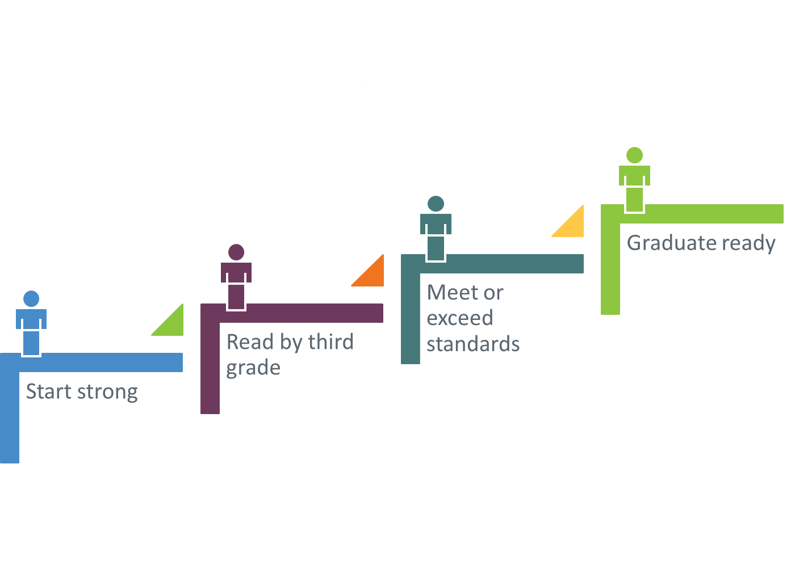
Notes:
Focus on “every”. We aren’t saying “all” here, as we want to ensure every means “each and every” – so that we measurably support every student – sometimes, the generalization of “all” diminishes the focus on “every.”
Then there was also the notion that if a student didn’t meet the criteria of a program and didn’t fit into a specific category or group, then the student didn’t receive supports (to be successful)
It’s every student…Not, every student except…. “students with disabilities”, “students who are English Learners,” “students in large schools or small schools or urban schools or rural schools or facilities schools”, students of every race and socioeconomic level.

Slide 7
Common Language and Common Understanding
Language reveals belief;
belief informs action;
action is visible in the behavior of adults
…which is what we are trying to
change or shape to support students.
Notes:
Common Language alone is not enough; we need to have Common Understanding.

Slide 8

What is MTSS?
Review the document
Consider key features
How does this connect to the work you are doing / plan to do?
2 minutes
Notes:
Read & then TTYN

Slide 9

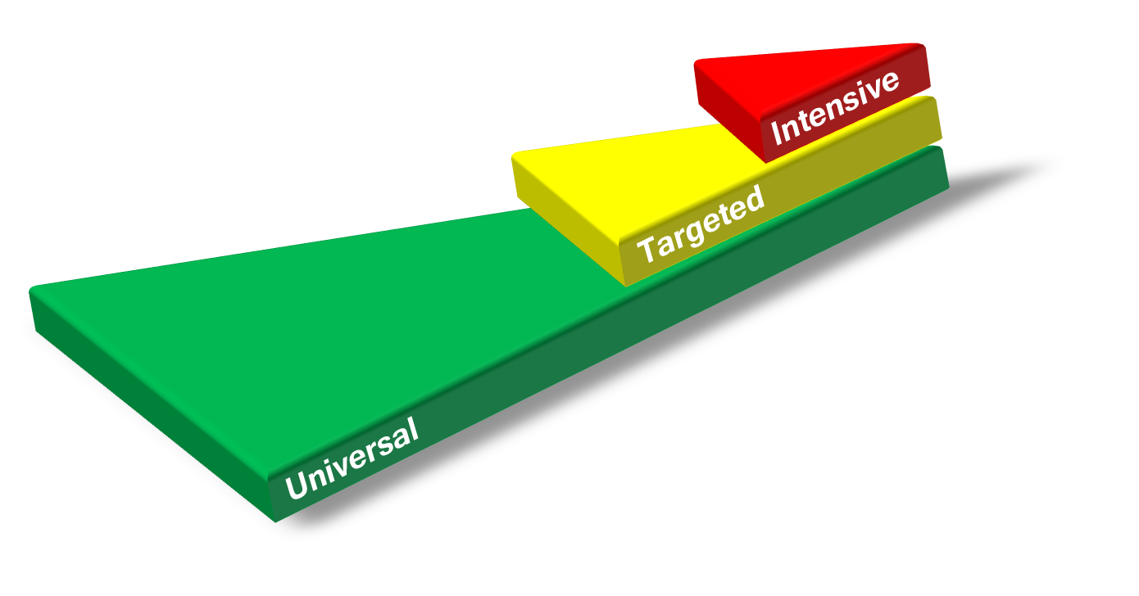
Prevention-Based: The Aim is to eliminate Barriers BEFORE they are shaped
Preventative approach applied across all tiers
Identify who needs support as early as
possible; Implement supports
when needed; and Determine if
those supports are effective
Prevent development of
new problems
Reduce the number of
existing challenges
Reduce the intensity
and complexity
of needed supports
Notes:
EMPHASIZE PREVENTION INITIAL: (e.g. diet/exercise IS primary action for everyone all…UNIVERSAL EVIDENCE-BASED PRACTICE); “prevention” = preventing from not reaching “potential”; preventing obstacles impeding student/stakeholder progress
Click for animation:
Note: Also…Prevention “across the tiers”, not universal alone; thus, the bulleted points and layered graphic. Describe Tiered Logic here, if desired. (reference connection to everyone gets, some may need & get, a few need more…maybe include “blanket analogy”, if helpful)
We also believe in “asset” or “strengths” based thinking across the tiers and application levels (of problem solving and decision-making)

Slide 10

Team-based Shared Leadership
Family, School, and Community Partnering
Data-Based Problem Solving
MTSS
Evidence-based Practices
Layered Continuum of Supports
Every student, every staff member… and every family and every school setting
academic & behavior supports
Imp. Sci.
“Every Ed” – Gen. Ed., Spec. Ed., Gifted Ed., CLD, ESEA
Notes:
We can also visualize this “MTSS system” idea in an overarching umbrella. Within the overall system, MTSS consists of six components including shared leadership, family, school, community partnering, data based problem solving and decision making, universal screening and progress monitoring, evidence based instruction, intervention and assessment practices and a layered continuum. Academic, behavior and any other supports are all housed under this one system or umbrella.
Language of “every ed” has been used across systems framework literature for many years. (author reference: Judy Elliott)

Slide 11
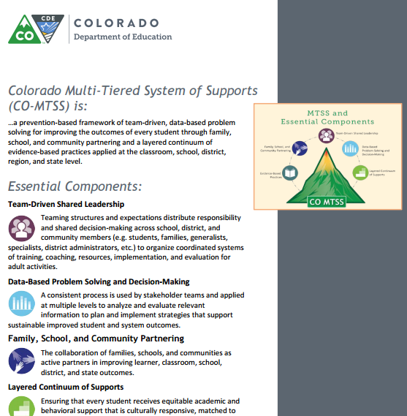
Definitions
Review the Definitions
Consider key features
How are these component definitions represented in your system?
1-2 minutes

Slide 12
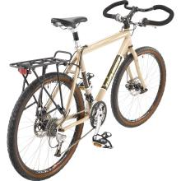
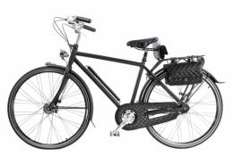
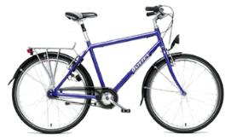
Which Bike do you Like?
Adapted from original slide from: U.S. Department of Education (Family Engagement)
Notes:
See how there are “essentials” (every bike has a seat, handlebars, tires) > those are the “components” needed (just as in our framework), but each can be “customized” for need/fit/context.
*This framework consideration originated from discussion on FSCP, but you can see the same needs within MTSS implementation.

Slide 13
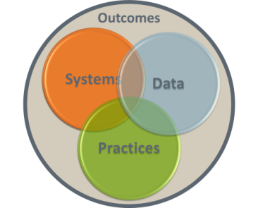
MTSS = Organizational Framework
General Education
+ Special Education
[it really is “every ed”…]
Academic + Behavioral Supports
Response to Intervention (RtI)
+ Positive Behavioral
Interventions and Supports (PBIS)
School-wide Systems
+ Individual Systems
Multiple Funding Streams
Merging Data, Practices,
and Systems
Notes:
See how it is “both/and”; we are not forgetting individual systems when we speak school-wide;
We do attend to school-wide, to have biggest impact first.
Connect to what’s worked; don’t disregard historical success. This is not “something new,” excluding what has been of benefit.
Reminder: Value add…if something isn’t bringing value to your system, why are you adopting/integrating it?
Speak to the “Circles” specifically…we need these integrated/overlapping to contribute to those outcomes, the outer circle, which is our constant vision/focus;
note the circles have origin in the PBIS TA Center (as “integrated elements”)

Slide 14



MTSS Makes it Possible
ALP
UIP
READ
IEP
ICAP
ILP
CAS
SR
HS
ELDGs
Notes:
Thinking of connecting the dots…
It’s not that MTSS is another thing “on the plate”…maybe, instead, it is the plate. (not another ‘thing on the plate’)
It is the “work” – if a well-articulated, well-designed MTSS is in place, you will have a system that is efficient, effective, durable, and sustainable. You will have the capacity to implement legislative priorities and additional initiatives.
It truly is a ‘framework’ that holds all those elements in as the “big picture.” Another analogy to consider is to think of MTSS as “a frame” (holding in all the legislative priorities and efforts we need to include).

Slide 15
Focus on the System
To get to “all”,
we must pay attention to “every”.
We must pay attention
to the “system” first, and then,
we move to small groups and individuals.
-Dave Tilly
Notes:
PREVENTION Reinforcement: IN Schools…sometimes, we try to “case by case”, and if we have MANY cases and only address one student per week…will we ever manage every case. We learned we need to attend to the system first…it’s more efficient AND more effective. And we reach more people. Students…with supports – and ADULTS with capacity-building, every stakeholder gaining confidence and COMPETENCE to do their roles well!
Slide notes:
This quotation from Dave Tilly summarizes what we have been highlighting.
It is most efficient and effective to be thinking about how we support the system and then can provide additional supports. Focus first on the universal. We say “every” (each and every student) to ensure we don’t mean “most.” Sometimes, when people say “all,” they imply “most” – not attending fully to the needs of ‘every’.
If we are intentional and develop an organized way of addressing every students’ needs, we are more likely to impact more students positively and improve student outcomes.

Slide 16
Systems Thinking
Systems thinking
is an approach to
organizational
improvement based on
awareness of the whole, the part,
and the interactions between the two.
Image: MS ClipArt
Notes:
We start with Systems thinking. It’s about the whole & parts. (“the global & the granular”)
(integrity of both, each sub-system & the entire system, and how they relate)
Example analogy (revisited): Jobs (roles/tasks) expected in a RESTAURANT (which has systems that function), what different jobs people do (anticipate ‘water is needed on the table’ = preventative approach)

Slide 17

One System…
(with sub-systems & supports)
Notes:
Note the “s” usage here. (what is plural & what isn’t, notable for CO)
Systems thinking – MTSS is “one system” - it is about symbiotic relationships. We’re thinking about how individual elements contribute to the whole and compose that larger entity. We’re also thinking about how that whole system supports each of its disparate parts. For the organization to improve, the focus cannot be either one or the other. How might that concept translate or compare to other systems you have seen (small or large) that are successful or that have faltered?
Analogy: The human body is one system with many “systems” within it (skeletal, circulatory, etc.); so, too, MTSS focuses on the “one system” with multiple systems – and Essential Components – that lead to its effective functioning.

Slide 18
Discussion: Turn and Talk
?
Now…
  How could you contribute to systems conversations…What are your assets/strengths?
  What do you predict are challenges with thinking about “What MTSS is” and how to implement it?
  What questions do you have in relation to what we have shared?
Notes:
POSSIBLE ACTIVITY
Mention resource: Initiative Inventory (2 page handout) – Technical Guide file in TOOLKIT

Slide 19
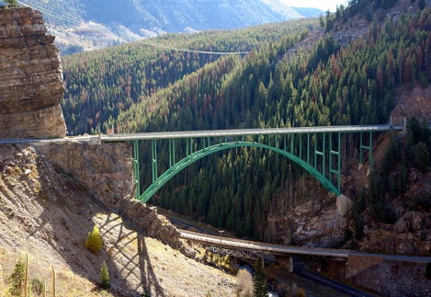
Taking Stock
Current State Desired State
We need to “take stock” to be able to “take action”…
HIGH-QUALITY IMPLEMENTATION
Notes:
Once we have identified ‘where we want to be’ (desired state), we must take stock to get to know ‘where we are’ (current state). We do this for our system, and then, we can bridge the gap between the two.

Slide 20

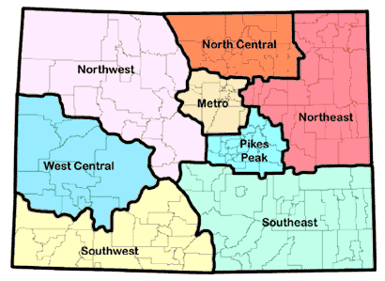
Classroom, School, District, BOCES, State
Shared responsibility:
Everyone in the learning community (every
stakeholder, i.e., families,
school staff, students)
School is often referred to
as the “unit of change”
Contextual application: Implementation may
vary by size or dynamics
of system but guiding principles are the same…
Think of the BIKE you LIKE!
Notes:
Everyone in the learning community (all stakeholders, families & students considered, as well)
A representative team is formed to define the vision, clearly communicate it and carry it out.
School is a safe place and reflects the healthy, cultural characteristics of the student’s community.
Family and community members are valued as equal partners.
School = ‘unit of change’ (it’s the ‘contact point’)

Slide 21







MTSS and Essential Components
Team-Driven Shared Leadership
Data-Based
Problem Solving and
Decision-Making
Family, School, and
Community Partnering
Layered Continuum
of Supports
Evidence-Based
Practices
Notes:
Transition slide: Focus on FSCP here
Our MTSS FSCP Definition:
Family, School, and Community Partnering - The collaboration of families, schools and communities as active partners in improving learner, classroom, school, district, and state outcomes.

Slide 22
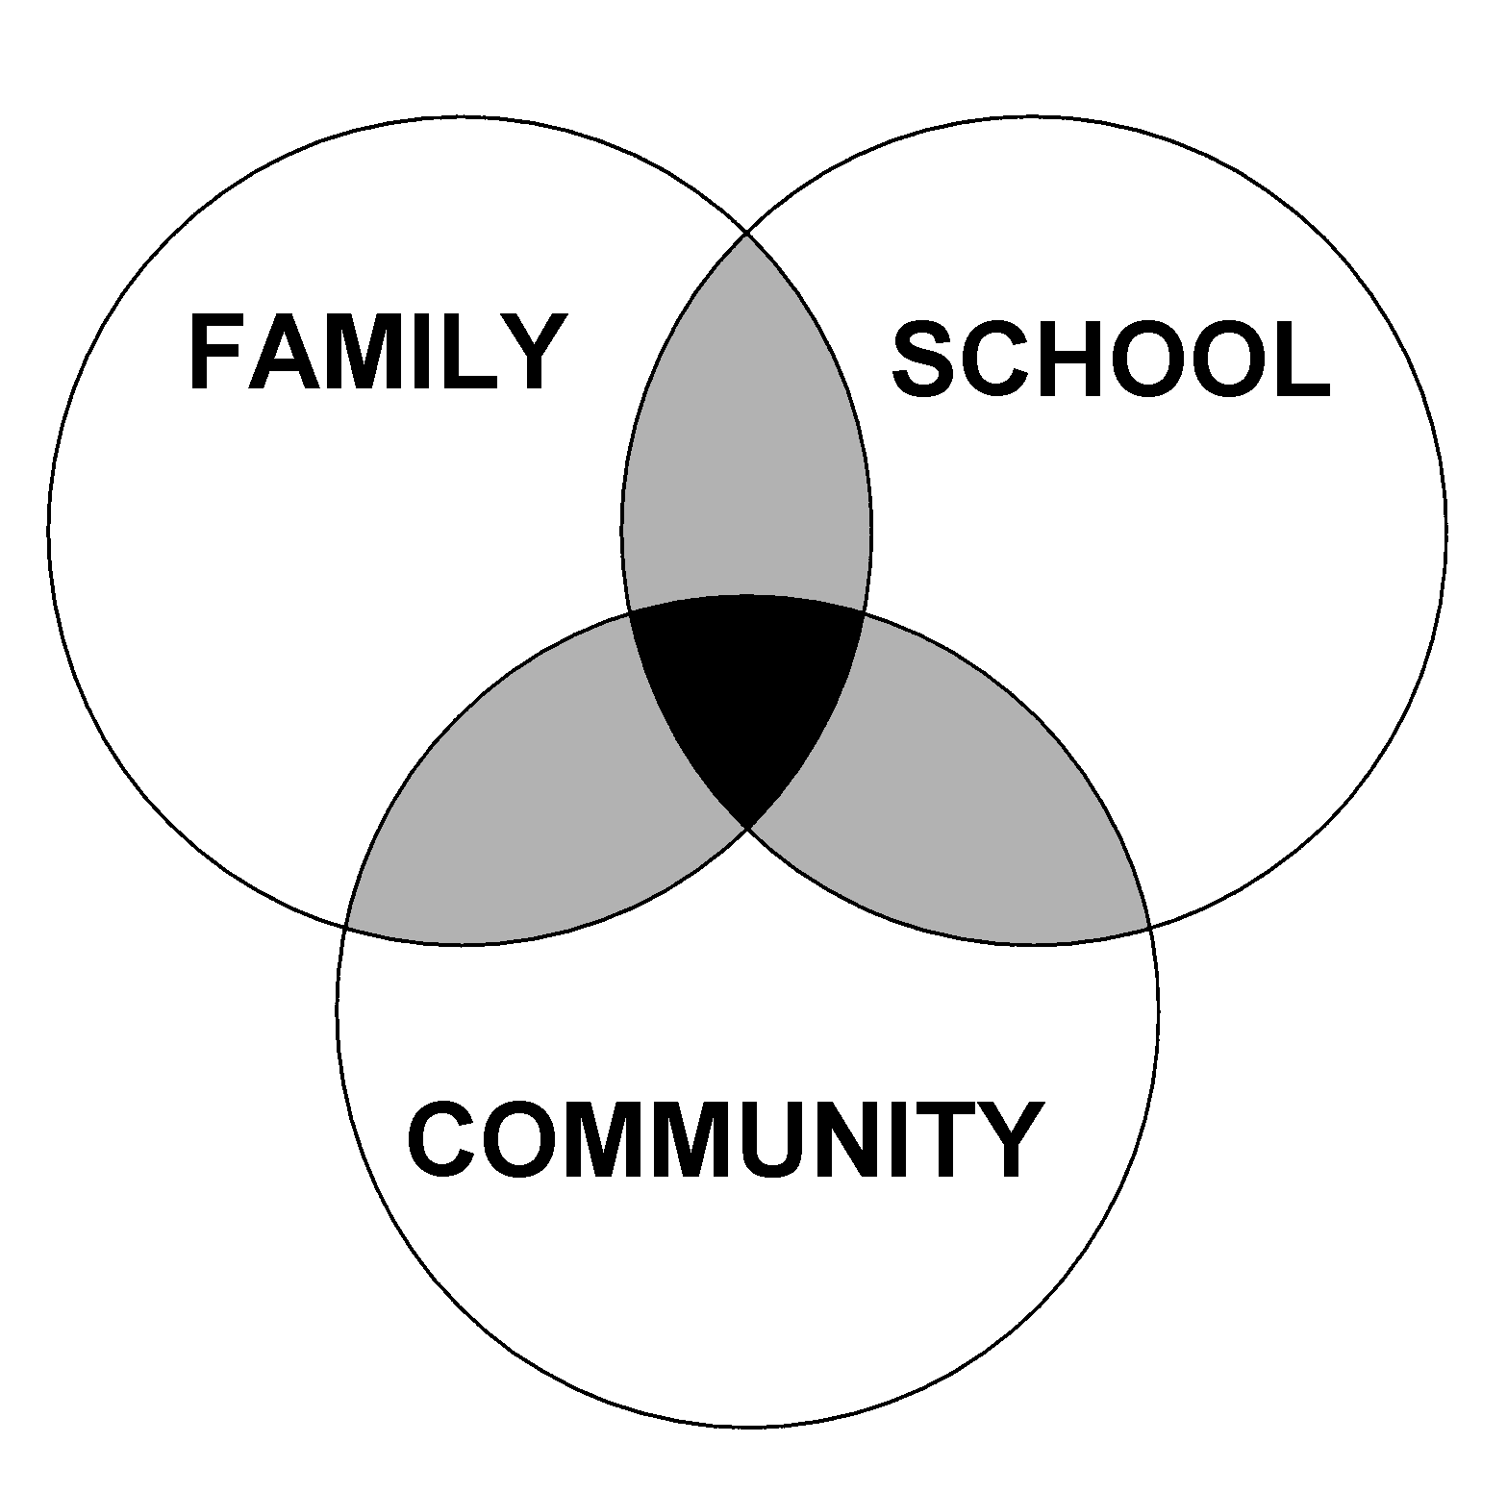
OVERLAPPING SPHERES OF INFLUENCE
Theoretical Model
Factors Influencing
Effective Partnering
Experiences,
Beliefs,
Practices
Notes:
This is a theoretical model for how school, family, and community interaction effects children’s learning. It was developed by Dr. Joyce Epstein based decades of research from schools primarily located in Baltimore City. You will see that three entities are represented: Family, School, and Community. Community can include businesses, school alumni, neighbors, parents with children not yet at school age. Each group does some things for students separately, and others together.
What are some sole responsibilities for families? Schools? The Community?
Depending on the extend of collaboration, the spheres either move closer together or farther apart. This model is NOT a Venn diagram. It is a dynamic model that is different for every student and school and can change over time. If the school’s beliefs and values differ greatly from those of the family, the circles will move away from each other. Likewise, if families, schools, and the community unite for a shared goal/vision, the circles will move closer together.
Just think about the answer to this question, you don’t need to vocalize it, but if you were to draw the Overlapping Spheres of Influence Model for you school, families, and community, how do you think it would look?

Slide 23
What are you “ready” to impact?
Multi-Tiered Family, School, and Community Partnering (FSCP)
Universal FSCP
Targeted FSCP
Intensive FSCP
MTSS FSCP Implementation Guide (ESSU resource)
http://www.cde.state.co.us/cdesped/mtssfscp_implementationguide
Notes:
Tiered Logic is key

Slide 24
Why do people conflict?
Conflict is a signal or message that something is not working and needs to be different.
-Talk Through Conflict Using Interests-Based Problem Solving, Education Service Center Region 4. (2011).
Miscommunication
Misperceptions
Perceived threat
Past issues and relationships
Cultural differences
Different interests or goals
Different processing styles
Different values
Lack of information or misinformation
Ambiguity
Emotions
Unmet psychological needs
Limited resources or unequal control
Notes:
Would you agree (with these “reasons”)?
Read the quotation.

Slide 25
How do we build the capacity of our partners?
What are ideas for stakeholders?
The “Why”, the “What”, and the “How” of PARTNERING (“FSCP”)
The Why = supports “Disposition” or mindset;
The What = Knowledge; The How = Skills
Staff learn: FSCP
Families learn: FSCP
Community learn: FSCP
Notes:
Capacity building must happen across stakeholder groups…not just for professionals.

Slide 26
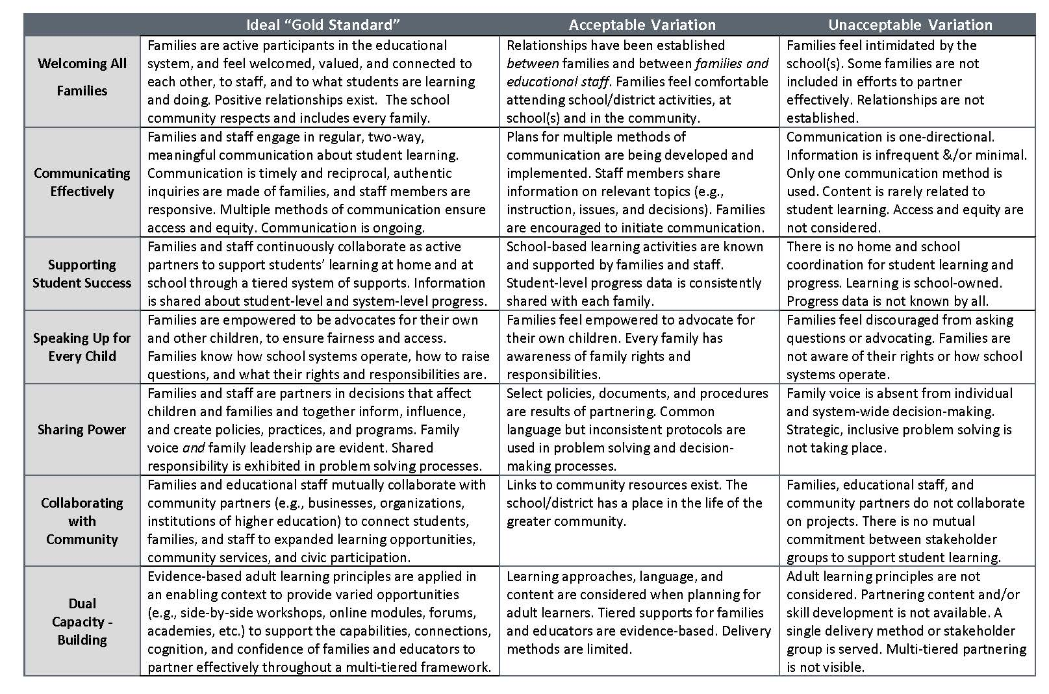
FSCP Standards-Aligned Resources
MTSS FSCP page: http://www.cde.state.co.us/mtss/fscp (has video and supporting tools) and links to…
Practice Profile – FYI in your conference toolkit: http://www.cde.state.co.us/mtss/fscp-practiceprofile

Slide 27
MTSS and Essential Components
Team-Driven Shared Leadership
Family, School, and
Community Partnering
Data-Based
Problem Solving and
Decision-Making
Layered Continuum
of Supports
Evidence-Based
Practices
Notes:
Transition slide: Focus on EBP here
Component Definition:
Approaches to instruction, intervention, and assessment that have been
proven effective through research indicating improved outcomes for students.

Slide 28
EBP for Social Skills
Can just use your expectations…define the expectation more explicitly
Discrete steps;
what it is/is not
Teaching of Skill
Controlled and Applied Settings
Model, Practice and Reinforcement of Skill
All Settings
Generalization and Maintenance
Monitor and Evaluation
Notes:
Teaching: modeling; discrete skills and steps. Application to real life: Emphasize the “what if you do” what if you don’t in real life examples
Forecast considerations for system. Making it effective as Tier 2 system

Slide 29
Formula for Success
What
How
Where
Effective Interventions
Effective Implementation Methods
Enabling Contexts
EBPs (Academic, Behavior,
FSCP Supports)
Systems, protocols, teams
Supportive Infrastructure
& Culture
Why
Desired
Outcomes
Adapted from 2012 Dean Fixsen and Karen Blase,
National Implementation Research Network
Notes:
For “WHERE”: Supportive infrastructure …also all people on the same page, so the culture feels positive.

Slide 30
Questions Teams Asks
 | Schoolwide | Student
Imple-mentation | Systems-Implementation: Who is on each team? When/where do the teams meet? What supports and interventions are available? What personnel development is provided (to individuals; to teams)? Is fidelity of use at least 90%? | Student-Implementation: What determines if a student should receive Tier 2 or 3 supports? What is the process? What documentation is needed? Who is responsible?
Impact | Systems-Impact: Are at least 80% of students successful with Tier 1 supports alone? Is there a maximum of 10-15% of the student population who need Tier 2 or 3 supports? Are at least 80% of students receiving Tier 2 and 3 supports successful? | Student-Impact: Which students need additional supports or interventions? What support or intervention does the student need? What progress is the student making? What is the success of students with this level of support?
Attention-seeking here…You can’t just live here. Must do all...
Notes:
When you consider systems and student along with implementation and impact, it creates a matrix. Questions that you ask/data to gather for each cell.

Slide 31
Feature | Description
Explicit instruction of expectations/skills | Teach the student exactly what is expected using examples and non-examples to illustrate desired behaviors (consider avoidance of “appropriateness”). Typically: Define behaviors, role play, and cite feedback for initial and ongoing implementation.
Structured prompts for behaviors | This might include reminders of expected behaviors, visuals, or cues on a point card.
Opportunities to practice the skills | Skill practice should be embedded throughout the school day and across [relevant] environments (and not just in an isolated instructional/skills group setting).
Frequent feedback to the student | Students should receive positive and corrective feedback at regular intervals throughout the school day on the expectations or skills being targeted (usually at least once per period or subject area). Feedback should be consistent and specific and focus on positive interactions.
Mechanism to fade support | This often involves reducing the number of times the student is prompted or receives feedback about a skill. It can also involve increasing the interval between delivery of acknowledgements (“positive referrals”) associated with success.
Communication with students’ families | Outreach to parents/families (e.g., brief notes home , daily or weekly ; phone calls, emails, post card mailers or other quick, culturally-relevant communication forms). Considerations: Content & Confidentiality & Two-way options
Adapted from CDE PBIS presentations
Notes:
The features are the salient things you’d see ... What does it look like?

Slide 32
Levels of School-wide SEL and 5 Domains of SEL
FAMILY, & COMMUNITY PARTNERSHIPS
FAMILY & COMMUNITY PARTNERSHIPS
SEL CURRICULUM & INSTRUCTION
SCHOOLWIDE PRACTICES & POLICIES
SEL CURRICULUM & INSTRUCTION
SELF-MANAGEMENT
SELF-AWARENESS
SOCIAL AWARENESS
Social and
Emotional
Learning
(SEL)
RESPONSIBLE DECISION-MAKING
SEL CURRICULUM & INSTRUCTION
Additional tool (on CDE site & from CASEL & SAMHSA): http://www.cde.state.co.us/cdesped/school-familypartnershipstrategies
RELATIONSHIP SKILLS
SCHOOLWIDE PRACTICES & POLICIES
Collaborative for Academic, Social, and Emotional Learning
http://www.casel.org/
Notes:
Think within the UMBRELLA of MTSS… (embedded…in partnership…not contradicting)
Collaborative for Academic, Social, and Emotional Learning. “For a growing number of schools and districts, SEL has become a coordinating framework for how educators, families, and communities partner to promote students’ social, emotional, and academic learning.
SEL is embedded in their strategic plans, staffing, professional learning, and budgets. It guides their curriculum choices and classroom instruction — both direct practice in SEL as well as integrated instruction with reading, math, history, and other core subjects.
It drives many of their schoolwide practices and policies. It informs how adults and students relate with each other at all levels of the system, creating a welcoming, participatory, and caring climate for learning.
It shapes their partnerships with families and community members, highlighting engagement, trust, and collaboration.”
“Our partner districts are developing tools to help districts conduct needs assessments, align resources, select programs, assess progress, and more.”

Slide 33
Priorities
?
PROMPT(s)…
Connections to your systems and your work?
Grant guidelines?
Behavioral Health Framework: http://www.coloradoedinitiative.org/resources/schoolbehavioralhealth/
Notes:
Self-reflect

Slide 34
What are you personally “planning” to impact?
See Action Planning Handout:
What would you like to see “in place”? (Pick any duration)
30 Days
60 Days
90 Days
Re: Action Planning Handout: Alternatively, you can use the back side of handout, which has a sample (more-detailed) template.
Notes:
(variation as handout)

Slide 35

For more information:
http://www.cde.state.co.us/mtss
PPT on: http://www.cde.state.co.us/mtss/adultlearningopportunities

