Slide 1
Creating an Integrated Approach to Behavioral Health and Emotional Wellness
September 25
Office of Learning Supports

Slide 2
Objectives
Consider an integrative approach to Behavioral Health and Emotional Wellness
Understand the importance of implementation and impact at the system and student level
Notes:
Go over slide. Will not cover how to use a specific intervention. This is not a training on any particular intervention

Slide 3
Turn to your neighbor…
1. What are the similarities between PBIS, SEL, and Trauma Informed Practices?
2. What challenges exist in your district for integrating each to reach all students?

Slide 4
Positive Behavioral Interventions and Supports
Notes:
Make point that most of them know what PBIS is so I won’t go over it in detail but I will provide a different way to think about it when we consider integration.

Slide 5
What I want a school to do for “my” individual student
Create an inviting and structured classroom
Greet him at the door with a smile
Teach him what you expect him to do and remind him of expectations and routines (as needed)
Engage him in appropriate (empirically- supported) instruction
Catch him doing the right thing and provide specific praise
If he makes a mistake, remind him what to do and make sure he knows how to do it (reteach if needed)
Notes:
It helps me to try and ground the theoretical approaches and frameworks into concrete examples.
Wife and I had our first child in early August.
When I think about what I want for him when he goes to school, these are the things I think about.

Slide 6
Equality VS Equity
We Can do Better
Equality
Equity

Slide 7
Remove the Barriers
PBIS
Redesign of Environments
Systems Change
Prevention Science
Notes:
Prevent development of new problems
Reduce the number of existing challenges

Slide 8
Social-Emotional Learning
Notes:
Make point that most of them know what PBIS is so I won’t go over it in detail but I will provide a different way to think about it when we consider integration.

Slide 9
What is Social Emotional Learning
“Social and emotional learning (SEL) is the process through which children and adults acquire and effectively apply the knowledge, attitudes, and skills necessary to:
understand and manage emotions,
set and achieve positive goals,
feel and show empathy for others,
establish and maintain positive relationships, and
make responsible decisions.”
CASEL Collaborative for Academic, Social, and Emotional Learning

Slide 10
Levels of School-Wide SEL and 5 Domains of SEL
FAMILY, & COMMUNITY PARTNERSHIPS
FAMILY & COMMUNITY PARTNERSHIPS
SCHOOLWIDE PRACTICES & POLICIES
SEL CURRICULUM & INSTRUCTION
SELF-AWARENESS
SELF-MANAGEMENT
Social and
Emotional
Learning
(SEL)
SEL CURRICULUM & INSTRUCTION
SOCIAL AWARENESS
RESPONSIBLE DECISION-MAKING
RELATIONSHIP SKILLS
SCHOOLWIDE PRACTICES & POLICIES
http://www.casel.org/
Notes:
Collaborative for Academic, Social, and Emotional Learning. “For a growing number of schools and districts, SEL has become a coordinating framework for how educators, families, and communities partner to promote students’ social, emotional, and academic learning.
SEL is embedded in their strategic plans, staffing, professional learning, and budgets. It guides their curriculum choices and classroom instruction — both direct practice in SEL as well as integrated instruction with reading, math, history, and other core subjects.
It drives many of their schoolwide practices and policies. It informs how adults and students relate with each other at all levels of the system, creating a welcoming, participatory, and caring climate for learning.
It shapes their partnerships with families and community members, highlighting engagement, trust, and collaboration.”
“Our partner districts are developing tools to help districts conduct needs assessments, align resources, select programs, assess progress, and more.”

Slide 11
Trauma-Informed Practices
Notes:
Make point that most of them know what PBIS is so I won’t go over it in detail but I will provide a different way to think about it when we consider integration.

Slide 12
What is Trauma?
Trauma is a response to a perceived threat to survival or emotional well-being of an individual or large group, such as a community or a culture.
Definition from Monroe County ACCESS Research to Practice Subcommittee, 2011
Trauma leads to adverse effects on the brain and body that can impair one’s ability to learn, work, and live.
Notes:
Relate back to my experiences as a therapist with using trauma-focused cognitive behavioral therapy at residential treatment facilities.
Sarah Reed Children’s Center – Erie, PA
15-year-old female client from inner-city Philly (called her Jane)
Lived in poverty all of her life, would go to school in kindergarten smelling like cat pee because her single-parent mother was neglectful
In later elementary school, she was bullied because of her bad hygiene and physically beaten
Her mom was addicted to drugs and in abusive relationships her entire life which set the example of what relationships should be like
I started working with her when she was arrested for breaking and entering and theft. She had been in several other residential treatment facilities but had been kicked out because of fights with other girls
One of the things that she said to me when we were talking about socially appropriate behaviors was that, “people will take my kindness for weakness.”

Slide 13
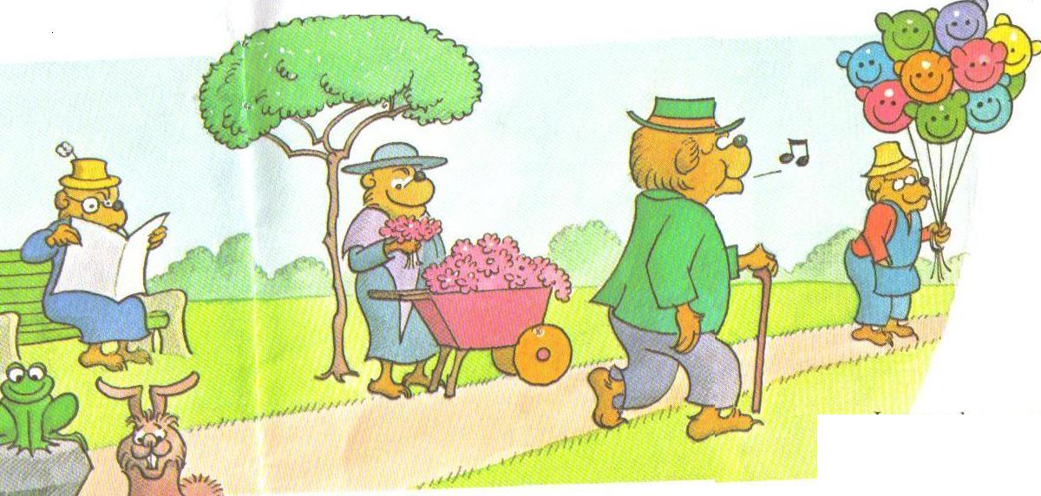
Notes:
I have visited Philly. And I don’t have a trauma history. I was never abused or bullied there. I was never neglected as a child there.
So when I visited, this could be a representation of how I was viewing the city. I got to go to Geno’s Cheesesteaks, check out the Liberty Bell, experience the history of the town.
But if Jane were to go to Philly…

Slide 14
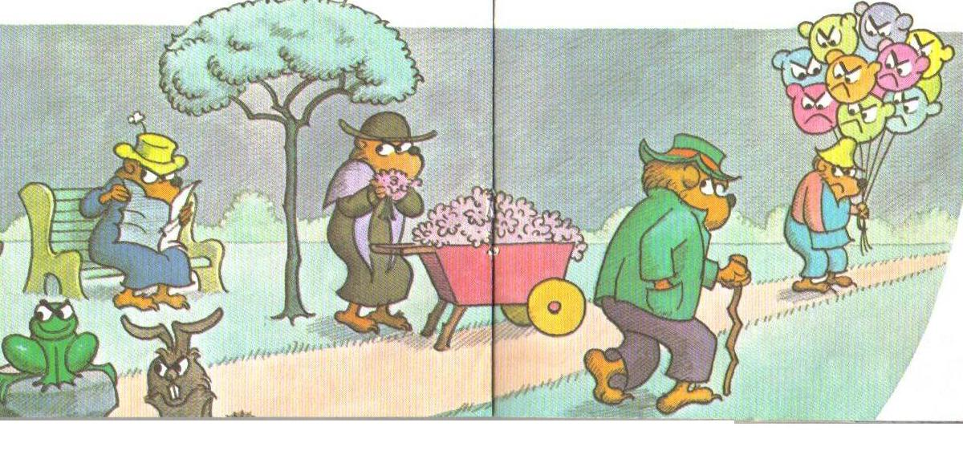
Notes:
…She would likely see the city differently because of the impact her trauma history has had on her.
And the same can be said for some of the students in the schools in your districts.
If students in your district walk into one of your schools and see this, do you think they have learning on their mind? Do you think they feel comfortable and safe? Would they be willing to build friendships and relationships with peers and adults?

Slide 15
ACES and School Performance
Students dealing with trauma:
Are 2 ½ times more likely to fail a grade
Score lower on standardized assessments
Have more receptive & expressive language difficulties
Are suspended or expelled more often
Found eligible for special education more frequently

Slide 16
Trauma Exposure vs Trauma Impact
Protective/Resiliency Factors
Traumatic Event/Events
Traumatic Impact

Slide 17
Resiliency
Resiliency contextualizes a child’s strengths (individual, familial, community) against her/his adverse experiences
Protective Factors
Individual characteristics
Self-regulation
Self-concept
Family conditions
Community supports
Other factors
(Zolkoski & Bullock, 2012)
Notes:
Individual characteristics
Differences in the developmental personality between children
Resilient children have a “pronounced autonomy and a strong social orientation.”
Self-regulation
Having an “easy-going temperament and good self-regulation” is linked to being resilient
Self-concept
Having positive self-esteem
Family conditions
Authoritative parenting style increases odds of being resilient
Community supports
Role models outside the family can be buffers for children at risk
Other factors
Resilience factors may be dependent on culture (e.g., faith may serve as a bigger resiliency factor in some cultures)

Slide 18
What exactly IS a trauma-sensitive school?
All staff understand the prevalence and impact of trauma on their students and themselves
School strives for physical, emotional, social, academic safety for all
The school addresses holistic student needs
The school is inclusive and connects students to the community instead of excluding them
The school staff work collaboratively to support students
School leaders adapt services and supports based on contemporary needs of students
Notes:
The focus of Trauma Informed Care is in the recognition, understanding, and responsiveness to trauma with explicit efforts made in restoring emotional safety, building healthy relationships, and creating positive opportunities where students can practice self-regulation strategies and prosocial skills.

Slide 19
Turn to your neighbor…
1. What are the similarities between PBIS, SEL, and Trauma Informed Practices?

Slide 20
Integration
Notes:
Make point that most of them know what PBIS is so I won’t go over it in detail but I will provide a different way to think about it when we consider integration.

Slide 21
Connecting it all together
In order to be successful with PBIS, SEL, and Trauma Informed Practices, an integrated approach is needed.
Otherwise…
Different Initiatives fight for resources
Difficult to get down to student-teacher interactions
Sustainability becomes near impossible
Notes:
Some have characterized PBIS as the structure and SEL as the support within the umbrella of positive school climate
Same have said that PBIS is an evidence-based PBIS program. SEL coordinators do not know how to do the work effectively. Must be taught like you would teach any skill

Slide 22
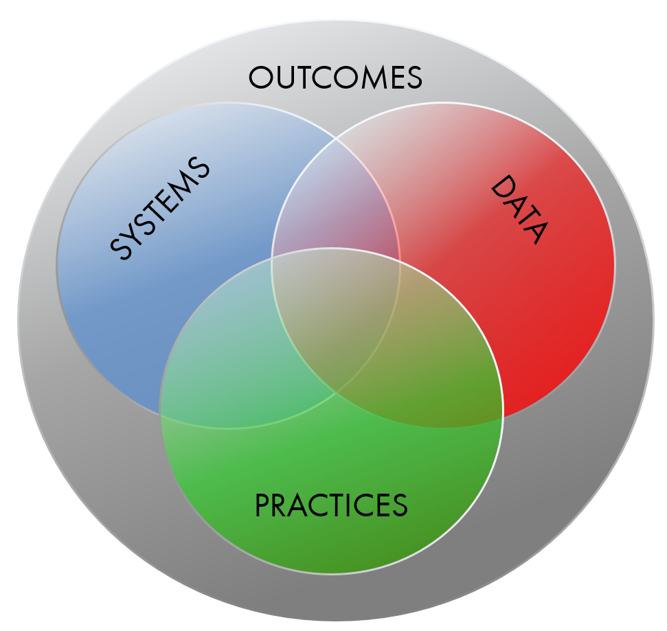
Supporting Social Competence & Academic Achievement
Supporting Staff Behavior
Supporting Decision Making
Supporting Student Behavior
Notes:
When we think of implementing a practice in a school, we want to consider 4 key elements.
Let’s start with outcomes. What do we want to achieve by using PBIS, for example? They are likely similar to what we want to achieve from SEL and trauma-informed practices. These are valued by staff, community and they support social competence and academic achievement.
Then we have Data. What data will we use to inform that outcome? This can be your culture-climate data at schools.
Then practices…what will we ask staff to do to reach the outcomes?
Then…what systems will we put in place to support staff behavior and allow them to implement the practices and gather the data needed? How do we put into place systems that create structure and consistency. This is the key piece…we tend to be really good at behavior and data…and maybe we have a general idea of outcomes…but systems is the issue.
This is how you get sustainability. This is MTSS

Slide 23
CO-MTSS Formula for Success
How do we make meaningful Integration Happen?
What
How
Where
Effective Interventions
Effective Implementation Methods
Enabling Contexts
Integrated PBIS, SEL, and Trauma Informed
Implementation Science
Supportive Infrastructure
Why
Socially Significant Outcomes
Adapted from 2012 Dean Fixen and Karen Blasé, National Implementation Research Network
Notes:
We are considering implementation science and infrastructure as systems design. Talking about both in this section

Slide 24
Traditional Representation of each Approach
SEL
Self-Awareness
Self-Management
Social Awareness
Relationship Skills
Responsible Decision Making
PBIS
Team/School-Wide implementation
Define and teach expectations
Acknowledge and reward positive behavior
Monitor and correct behavior
Use data for progress monitoring and decision making
Trauma-Informed Practices
All staff understand the prevalence and impact of trauma on their students and themselves
School strives for physical, emotional, social, academic safety for all
The school addresses holistic student needs
The school is inclusive and connects students to the community instead of excluding them
The school staff work collaboratively to support students
School leaders adapt services and supports based on contemporary needs of students

Slide 25
Questions Your Teams Ask:
 | Systems | Student
Implementation
Impact
Systems-Implementation:
Who is on each team? When/where do the teams meet?
What interventions are available?
What training and support is provided to staff?
Fidelity of interventions overall is at least 90%?
Student-Implementation:
How does a student receive Tier 2/3 services and supports?
What is the process?
What paperwork is needed? Who completes it?
Systems-Impact:
At least 80% of students are successful at Tier 1?
10-15% of student population need Tier 2/3?
At least 80% of students in Tier 2/3 are successful?
Student-Impact:
Which students need interventions?
What intervention does a given student need?
What is the progress of a given student?
Is a given group of students successful with level of support?
Can’t just live here Must address all other tasks/cells
Notes:
When you consider systems and student along with implementation and impact, it creates a matrix. Questions that you ask/data to gather for each cell.
Thinking about our previous slide and how we could integrate different initiatives, these are some of the questions we may end up asking ourselves.

Slide 26
Action Plan…
What are some small actionable steps your district can take to begin the integration of PBIS, SEL, and Trauma Informed Practices?

