Slide 1
2018 BPEG Symposium
Adam Collins, Ph.D.
Scott Ross, Ph.D.
May 7, 2018

Slide 2
Welcome and Opening Remarks

Slide 3
Opening Remarks
Governor’s Grant
CDE received funds from the Governor’s Office of State Planning and Budgeting
BPEG Senior Implementation Consultant hired
Keely Garren

Slide 4
Housekeeping
PowerPoint Online
Coffee/Tea/Water
Restrooms
Take care of your needs
Signal
Limit side conversations
Silence cell phone

Slide 5
Outcomes for the Day
Engage with CDE and peers to celebrate successes, gain insights on how to overcome barriers, and learn new strategies to improve bullying prevention efforts.
Objective 1: Reflect on progress made since the start of the BPEG
Objective 2: Engage with peers to share experiences to overcome current barriers
Objective 3: Participate in professional development to take actionable ideas back to your school

Slide 6
Agenda
8:30AM-8:50AM | Welcome and Opening Remarks
8:50AM-9:35AM | State of the Grant
9:35AM-10:35AM | BPEG Panel
10:35AM-10:45AM | Break
10:45AM-11:15AM | Roundtable Discussions
11:15AM-12:15PM | Team Time
12:15PM-1:15PM | Lunch
1:15PM-2:00PM | Breakout Session 1
2:00PM-2:10PM | Transition/Break
2:10PM-2:55PM | Breakout Session 2
3:00PM-3:30PM | Wrap Up

Slide 7
Teacher Appreciation Week

Slide 8
State of the Grant

Slide 9
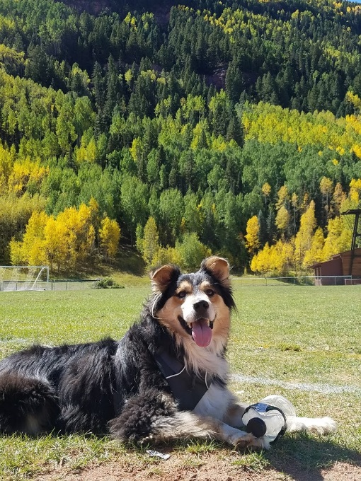
State of the Grant
2017
2018
Since the Last Time Around
School teams attended the BPEG Kickoff in March 2017
School teams completed their first BPEG Self-Assessment
Schools administered first student survey
Implementation of bullying prevention curricula began
Site visits

Slide 10
State of the Grant
2017
2018
2016 – 2017 School Year
27,244 Students Impacted by BPEG
11,433 Students Surveyed

Slide 12
This makes sense!

Slide 13
State of the Grant
2017
2018
2017 – 2018 School Year
34,423 Students Impacted by BPEG
Increase of 7,179 over the previous year

Slide 16
Preliminary Reduction in Bullying
Students reporting being the target of bullying
9%
Students reporting witnessing bullying
21%

Slide 17
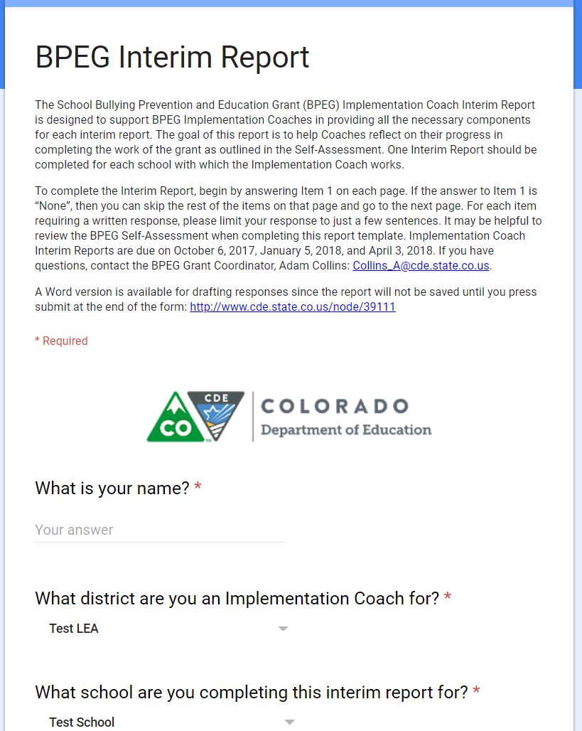
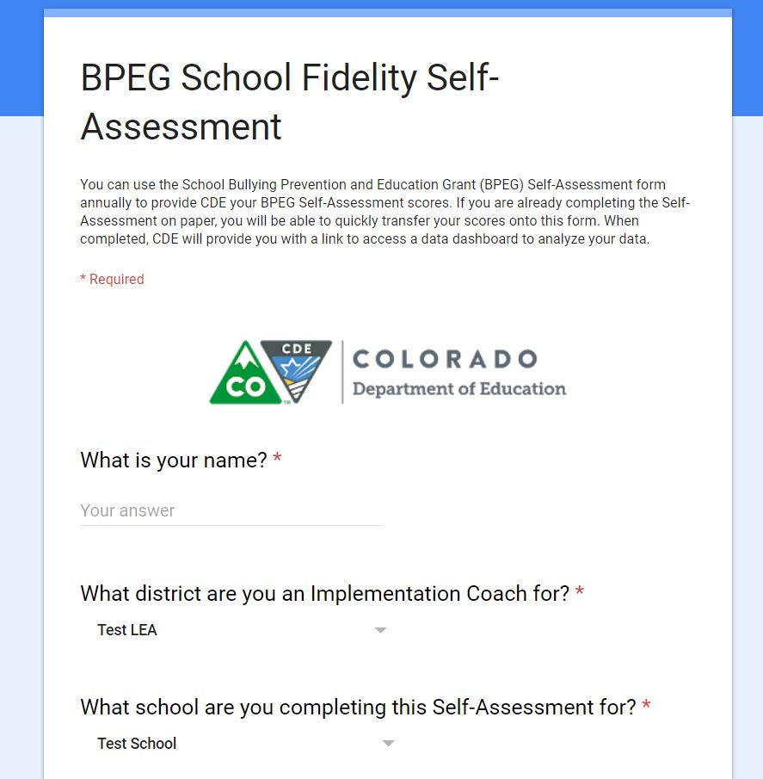
State of the Grant
2017
2018
How did we make these improvements?

Slide 21
Bullying Prevention Committee
65%
43%

Slide 22
School Climate and Culture
85%

Slide 23
Bullying Prevention Curriculum
64%
20%

Slide 24
66%
28%

Slide 25
FSCP
37%

Slide 26
53%

Slide 27
Bullying Prevention Policy
75%

Slide 28
Improvement in BPEG Self-Assessment
The school has a parent education program that addresses bullying prevention best practices and how to support their children if they’re involved in bullying.
34%
Common area supervision staff have been trained in active supervision techniques and provide consistent behavioral reports.
34%
All staff have received training on the bullying prevention program.
66%
Program lessons have been taught to all students.
66%

Slide 29
Turn and Talk
Turn to a shoulder partner
Tell your partner the top 1 or 2 improvements your school has made in the past year in reducing bullying.
Tell your partner the biggest next steps for next year to improve even more.

Slide 30
State of the Grant
2017-2018 saw several of our BPEG schools getting positive media coverage for their work

Slide 31
State of the Grant
BPEG Cohort 2
Request for Proposals available in Fall 2018

Slide 32
BPEG Panel

Slide 33
Panelists
Stephanie Lerner
Poudre School District – Blevins Middle
School Climate/Bully Prevention Counselor
Amanda Novak
Adams 12 Five Star Schools - Westgate Community School
Dean of Culture
Tara Roybal
Pueblo School District 60 – District Level
Specialist – School Bullying Prevention and Education
Laura Thomas
Montrose School District – Cottonwood & Oak Grove Elementary
Restorative Justice Facilitator
Lee Rains Thomas
Denver Public Schools – Eagleton Elementary
Principal

Slide 34
BPEG Panel
Introductions
Prepared questions for the panelists
Questions from the audience
Write down any questions that come to mind on a notecard
If the question is for a specific panelist, please write that panelist’s name
We will collect the notecards after the prepared questions section

Slide 35
BPEG Panel
Introductions
Describe
Your role at your school/district
Your role in the BPEG
The curriculum being used at your school/district
The specific concerns that led to you joining the grant

Slide 36
BPEG Panel
Prepared Questions
What have you found to be the best ways to get buy in from school staff?
Tara: What is a common theme in the schools that are doing the best work in your district?
How have you incorporated student voice into the BPEG work?
Laura: How have you used data to inform your prevention efforts?
What are some of the unique parts of your grant work?
Lee: From the lens of a Principal, what are the most critical elements that can make the grant work successful?
What is the number one way we can make a substantial impact in the final year of the grant?

Slide 37
BPEG Panel
Audience Questions

Slide 38
Return from Break in
10
8
6
5
4
3
7
1
2
9
Minutes

Slide 39
Roundtable Discussions

Slide 40
Roundtable Discussions
7 Different Topics
1 for each section of the BPEG Self-Assessment
Move to a table where you can best contribute to the discussion
Need help and have questions; Can offer some advice
School teams should split up to get the most value from the activity

Slide 41
Roundtable Discussions - Process
Facilitator:
Person with the earliest birthday
Prompts discussion points as needed
Recorder:
Person with the latest birthday
Writes down main points on the provided note catcher

Slide 42
Roundtable Discussions – Share Out
What was your topic?
What is one major takeaway from your table?

Slide 43
Debrief/Team Time

Slide 44
Debrief / Team Time
Debrief with your team on the discussion at your roundtable
What ideas did you get from other teams?
What can you take back and implement right away?

Slide 45
Debrief / Team Time
Debrief with your team on the discussion at your roundtable
What ideas did you get from other teams?
What can you take back and implement right away?
Team Time
Time to complete the BPEG Self-Assessment
Time to plan for the start of next year
Year 3 Timeline

Slide 46
Breakout Sessions
Breakout Session 1
Get Them Started and Build Them Up: The Power of LGBTQ Student Clubs (GSAs)
Keri Smith, One Colorado
Trauma-Informed Approaches Across the Tiers
Lynne DeSousa, CDE
Unmarked screening (across both breakouts)
Alec Ybarra, Student
Breakout Session 2
BP-PBIS Follow Up and Problem Solving
Scott Ross, CDE
Best Practices in Classroom Management
Jason Harlacher, CDE
Unmarked screening (across both breakouts)
Alec Ybarra, Student

Slide 47
Breakouts

Slide 48
Survey
Please complete the survey online to provide us with feedback
www.surveymonkey.com/r/R63JZNV

Slide 49
This CDE guidance document is meant for clarification, is not legally binding, and is not to be confused with legal advice. This guidance reflects CDE’s recommendations, but Administrative Units (AUs) may have developed their own policies or procedures that differ from those described herein. Be sure to refer to your local AU’s policies and procedures through the Director of Special Education. If you are seeking legal advice, please contact your legal counsel.

