Slide 1

Bullying Prevention Committee Kickoff
Adam Collins, Ph.D.
Scott Ross, PhD
March 10, 2017

Slide 2
Housekeeping
PowerPoint & supplemental packet
Parking lot
Coffee/Tea/Water
Restrooms
Take care of your needs
Signal
Limit side conversations
Silence cell phone

Slide 3
Outcomes for the Day
Establish a system of bullying prevention that will effectively and efficiently reduce bullying in your school
  Objective 1: Understand the grant and work of the BPC
  Objective 2: Understand the foundations and need for bullying prevention
  Objective 3: Know universal approaches to developing a positive school climate
  Objective 4: Get started on Bullying Prevention Grant Procedures

Slide 4
Icebreaker Part 1
Think about the event today and write down the answer to this question:
What do I hope to learn or gain from this experience?

Slide 5
Icebreaker Part 2
Grab a piece of candy
[TWIX]
What was the last movie you saw or book you read?
What is your favorite thing about your children or pets?
[SNICKERS]
[MILKY WAY]
How did you end up living where you do?
[3 MUSKETEERS]
Where is the farthest you have ever traveled?
Now share both of your answers with the table

Slide 6
Bullying Prevention and Education Grant

Slide 7
Purpose of the BPEG
The Colorado School Bullying Prevention and Education Grant Program (BPEG) is authorized by C.R.S. 22-93-101 to provide funding to reduce the frequency of bullying incidents. This includes:
Implementing evidence-based bullying prevention practices with fidelity;
Family and community involvement in school bullying prevention strategies; and
Adopting specific policies concerning bullying education and prevention.

Slide 8
Eligible Applicants
Eligible applicants include:
  School districts and the Charter School Institute (on behalf of a school or a collaborative group of schools);
  Charter Schools*;
  Boards of Cooperative Educational Services (on behalf of a school or a collaborative group of schools); and
  Facility schools approved pursuant to C.R.S. 22-2-402 (1).
Note: Individual charter school applicants must obtain signatures from their authorizing district or the Charter School Institute (CSI). If awarded a grant, the charter school’s authorizer or CSI will be the fiscal agent.

Slide 9
Available Funds
Three Year Grant Cycle
Year | Total Funds Available | Maximum Funds per School | Activities
2016-2017 | $2.9 Million | $40,000 | Purchasing evidence-based bullying prevention curriculum Training on bullying prevention curriculum Needs assessment Development of foundational systems Hiring an Implementation Coach Baseline bullying assessment
2017-2018 & 2018-2019 | $2 Million | $40,000 | Purchasing bullying prevention curriculum refresher materials Follow up training on the bullying prevention curriculum Salary for Implementation Coach Educating parents on bullying prevention strategies Annual bullying assessment administration

Slide 10
Allowable Use of Funds
The cost of the evidence-based bullying prevention best practices
Other bullying prevention programs can be used; however:
  They must be evidence based
  The evidence must be provided as part of the application
  Grant funds can only be used to supplement not supplant bullying prevention efforts already in place

Slide 11
Allowable Use of Funds
Educating students’ parents and legal guardians regarding
      The policies concerning bullying prevention and education
      Ongoing efforts to reduce the frequency and intensity of bullying incidents
      Strategies for involving families and the community in school bullying prevention
      Developing student leadership and voice in the creation and implementation of bullying prevention strategies.

Slide 12
Allowable Use of Funds
Monitoring and execution of:
      The processes for surveying students about bullying;
      The processes for implementing the evidence-based
      bullying prevention best practices with fidelity; and
      Procedures that ensure the confidentiality of each
      student’s answers to the annual survey.
      Hiring or designating an Implementation Coach that will be qualified to provide support, ongoing progress monitoring, data analysis, and reporting to CDE at a minimum of 0.2 FTE.
      A maximum of 5% of awarded funds may be used for administrative costs.

Slide 13
Allowable Use of Funds Review
Evidence-Based bullying prevention program
Educating parents and legal guardians about bullying prevention efforts
Developing student leadership and voice in bullying prevention efforts
All aspects of measuring the impact of bullying prevention efforts
Hiring an Implementation Coach
Maximum of 5% for administrative costs
Note: Funds must be expended by June 30, 2017. There will be no carryover of funds. Unobligated funds at the end of the fiscal year will be returned to the Colorado Department of Education.

Slide 14
Data Requirement
The website provides guidance on the required survey questions:
  How frequently do students witness bullying
  How frequently do students perceive themselves to be a victim of bullying.
There are four different surveys that can be used to evaluate bullying behaviors in schools:
  Snapshot Survey
  Peer Relations Survey
  Two-Item Survey
  Other Survey

Slide 15
Timeline
1. | BPC formed and Implementation Coach hired by district
2. | 60% of families (grade 3+) have signed permission form for their children to take annual survey
3. | 60% of students (grade 3+) have taken the annual survey
4. | All staff have been trained on the curriculum to be used
5. | Bullying prevention efforts have been informed by students through focus groups and/or leadership groups
6. | At start of next school year, staff are prepared to implement lessons

Slide 16
Duration of Grants
Grants will be awarded for a three-year term beginning in the 2016-2017 school year.
Funded applicants will be eligible for continued funding in the second and third years of the grant cycle after successfully demonstrating the following:
  Submission of all required evaluation materials;
  Adequate progress toward successfully meeting annual objectives;
  Completed program development report after the first year to demonstrate fidelity to proceed with years two and three; and
  Completed budgets and funding amounts for years two and three following the first year.
Note: Each year of grant funding is contingent upon annual appropriations by the State Legislature.

Slide 17
Evaluation and Reporting
An evaluation report (see Attachment D) that includes:
  The evidence-based best practices in bullying prevention that the applicant(s) implemented using the grant moneys;
  The number and grade levels of students who participated in each of the bullying prevention practices or services provided;
  The progress made in including families and communities in school bullying prevention strategies;
  The progress made in adopting specific policies concerning bullying education and prevention;
  The progress made in implementing the evidence-based best practices in bullying prevention with fidelity; and
  The progress made in reducing the frequency of bullying as indicated by school surveys and other relevant measures.
An annual financial report
If continuation funds are appropriated by the state legislature, submission of a continuation application with a continuation budget will be required.
*Note: Sites receiving a grant through the Bullying Prevention and Education Grant Program may be selected for a site visit by CDE program staff during the 2016-2017 school year.

Slide 18
Bullying

Slide 19
What is Bullying
In Colorado/CDE:
  "Bullying" means any written or verbal expression, or physical or electronic act or gesture, or pattern thereof, that is intended to coerce, intimidate, or cause any physical, mental, or emotional harm to any student.

Slide 20
What is Bullying?
Three components that define bullying
  Intent to harm
  Behavior is repeated or likely to be repeated
  Imbalance of power
Four types of bullying
  Physical
  Verbal
  Relational
  Damage to property
Two modes of bullying
  Direct
  Indirect
Four roles in bullying
  Perpetrator
  Victim
  Bully-Victim
  Bystander
  (See Gladden et al., 2014)

Slide 21
Components
Intent to harm
Repeated or likely to be repeated
Imbalance of power

Slide 22
Types
Physical
Verbal
Relational
Destruction
of property

Slide 23
What about Cyberbullying?
NOT a type of bullying
Spans across the other types of bullying
CDC considers cyberbullying a context or location

Slide 24
Modes
Direct
  The target of the bullying is present
Indirect
  The target of the bullying is not present

Slide 25
Roles
Perpetrator
Victim
Bully-Victim
Bystander

Slide 26
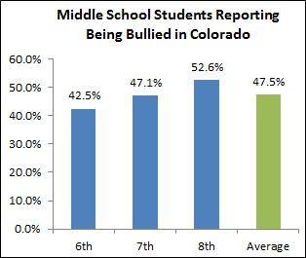
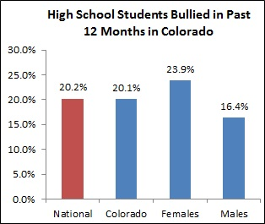
Who Gets Bullied?
Bullying affects thousands of students each year. About 15% - 30% of students report being a part of bullying as either a victim or perpetrator (see Rivara & Le Menestrel, 2016)
  In Colorado (Healthy Kids Colorado Survey, 2015)

Slide 27
Who Gets Bullied?
  (National Crime Victimization Survey)

Slide 28
Who Gets Bullied?
  (National Crime Victimization Survey)

Slide 29
Who Gets Bullied?
  (National Crime Victimization Survey)

Slide 30
Impact of Bullying
Somatic symptoms (Gini & Pozzoli, 2013; Hunter et al., 2014)
Symptoms of depression (see Ttofi et al., 2011)
Anxiety and self-harming behavior (Kidger et al., 2015; Klomek et al., 2009; 2015)
Suicidal ideation (Patchin, 2006; Ybarra et al., 2006)
Alcohol and drug abuse (Radliff et al., 2012)
Aggression (Reijntjes et al., 2011)
Truancy and delinquency (Reijntjes et al., 2011)
Lower grades and standardized test scores (Espelage et al., 2013; Nakamoto & Schwartz, 2010)
These symptoms can last for years (Bowes et al., 2015)
Most severe consequences are often for students who are bully-victims (Arseneault et al., 2006)

Slide 31
Why Do Students Bully?
Bullying behavior typically involves student-student interactions
  Bullying seldom occurs without other students around
What rewards bullying behavior?
  At the most basic level
    Attention from bystanders
    Attention and reaction of victim

Slide 32
Why Do Students Bully?
Get the ABC table from your packet
Watch the following video clip
  Complete the ABC table after the video ends
A | B | C

Slide 33
Learning to Bully
A | B | C
NEXT OPPORTUNITY
Tracy sits with popular peers
Pro-social behavior: saying hello, trying to share etc.
Peers roll eyes and ignore the student
Punishing Consequence
Reinforcement
Achieved!!!
What happens?
Tracy was just ignored.
Another Unpopular Peer Sits Down
Tracy: Teases or “bullies”
Popular peers laugh

Slide 34
Your own Example
Identify an example of bullying you have encountered
Consider the function of the behavior
Fill in the three boxes
Rewarding
Consequence
Trigger/Antecedent
Bullying Behavior

Slide 35
Chronosystem
Macrosystem
Chronosystem
Exosystem
Microsystem
Neighbors
Friends
Mesosystem
Values
Immediate
Family
Individual
School
Disability
Gender
Race
Age
Community
Services
Mesosystem
Mass
Media
Mesosystem
Neighborhood
Play Area
Laws
Workplace
Chronosystem
Chronosystem
  Bronfenbrenner (1979)

Slide 36
Chronosystem
Macrosystem
Chronosystem
Societal Conditions: Generally
positive
Exosystem
Microsystem
Friends Outside
of School?:
None
+ Relationship w/ Neighbors?:
Neighbors complain
about
noise
Mesosystem
SES:Middle-Low
Size: 4; Mom, Dad, younger
brother
Loss: None significant
Education: Mom HS
grad; Dad not; student held back 1 year
+ or – Relationships: Strained relationship with all family members, especially dad
Relationship w/ Teachers:
Poor; disruptive behaviors
Relationship w/ Peers: Poor; physically & verbally aggressive
In Clubs?: No
Guardians Involved?: Mother but
not father; only comes to
school when student in
trouble
Cultural
Values
Affecting
Student:
Individual
Student is overweight; target is Muslim
Disability: SED
Gender: Male
Race: White
Age: 10
In Youth Sports?:
No
Watch Violent Media?:
Yes; with father
Safety: Relatively safe
# of Playgrounds: Just 1 or 2
Playgrounds Close?: Bike ride away
In After School Care?: Yes
Mesosystem
Mesosystem
Play Violent Games?:
No; Minecraft
Guardians’ Work Flexible w/ School Schedule?: No; stated reprimands from work for leaving multiple times
Laws
Directly
Affecting
Student: Indicator 4
Time Since Major Life Event: Moved to new school 1 year ago
Chronosystem
Chronosystem

Slide 37
Chronosystem
Macrosystem
Chronosystem
Societal Conditions:_____________
______________________
Exosystem
Microsystem
Friends Outside
of School?:
__________
+ Relationship w/ Neighbors?:
__________
Mesosystem
SES:_____________________
Size:____________________
Loss:__________________
Education:____________
______________________
+ or – Relationships: _________________________
_________________________
Relationship w/ Teachers:
__________________________
Relationship w/ Peers: _________
____________________________
In Clubs?:___________________
Guardians Involved?: ________
________________________
Cultural
Values
Affecting
Student:
Individual
_______
_______
______
Disability: ____________
Gender:______________
Race:________________
Age:_______________
Consider the bullying incident you described in the previous activity (A-B-C).
Fill in at least 3 areas of the Meso-, Micro-, Exo-, Macro-, or Chronosystems you should keep in mind when strategizing.
In Youth Sports?:
____________
Watch Violent Media?:
________
Safety:___________________________
# of Playgrounds:___________________
Playgrounds Close?:________________
In After School Care?:_______
Mesosystem
Mesosystem
Play Violent Games?:
_______
Guardians’ Work Flexible w/ School Schedule?:___________
Laws
Directly
Affecting
Student:____________________________________
Time Since Major Life Event: _____________________________
Chronosystem
Chronosystem

Slide 38
Return from Break in
10
8
6
5
4
3
7
1
2
9
Minute
Minutes

Slide 39
Bullying Prevention Committee

Slide 40
Roles and Responsibilities
Implementation Coach
  Leads BPC
Teachers, Administrators, Families, Students, and Community Members
  Each member provides a unique insight into the school
Working together, the BPC guides the school work of the grant:
  Organizing selected curriculum and training
  Organizing and administering the annual survey
  All of the items laid out in the self-assessment

Slide 41
Before we jump into our first activity…
Lets start by setting some roles and responsibilities for team work (you are welcome to rotate roles)
  Who is going to be the facilitator for discussions (make sure everyone gets a chance to talk, synthesize ideas, etc.)?
  Who is going to take notes and fill out the forms?
  Who is going to be the task master and keep everyone on task?

Slide 42



Building Consensus
Primary Decision Rule
Secondary Decision Rule
If your vote is not 75% one way, what will you do to reach a consensus?
Set Aside Rule
If you can’t come to consensus on an item in 2 minutes, put it aside and return to it once you’ve finished the other items
Simple Voting
Thumbs Up/Down/Sideways
Fist to Five

Slide 43
Bullying Prevention Committee
Complete the Bullying Prevention Committee Self-Assessment (just the 1st section of the tool)
  Its ok to have low scores!
First, complete the section on your own, scoring each item with a 0,1, or 2
Next, as a team discuss your scores and come to consensus in one official document

Slide 44
Improving Decision-Making
Problem
Data-Based
Problem Solving &
Decision Making
Solution
Out of Time
Adapted from TIPS/Rob Horner

Slide 45
Step 1: Problem Identification
What is the problem?
Step 4:
Plan
Evaluation
Step 2: Problem Analysis
Did it work?
Why is it occurring?
Step 3: Plan Implementation
What can we do about it?

Slide 46
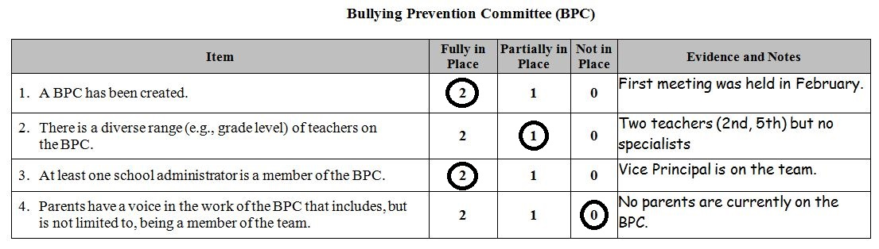
Step 1: Define the Problem
  As a team…
    Put a square around at least 1 strength.
    Put a circle around at least 1 weakness that you’d like to target immediately for improvement.

Slide 47
Step 2: Problem Analysis
Seeking a clear, agreed-upon
understanding of why the problem is occurring.
  It should be something over which we have control.
As a BPC, we have not systematically informed parents of the grant or their chance to contribute.

Slide 48
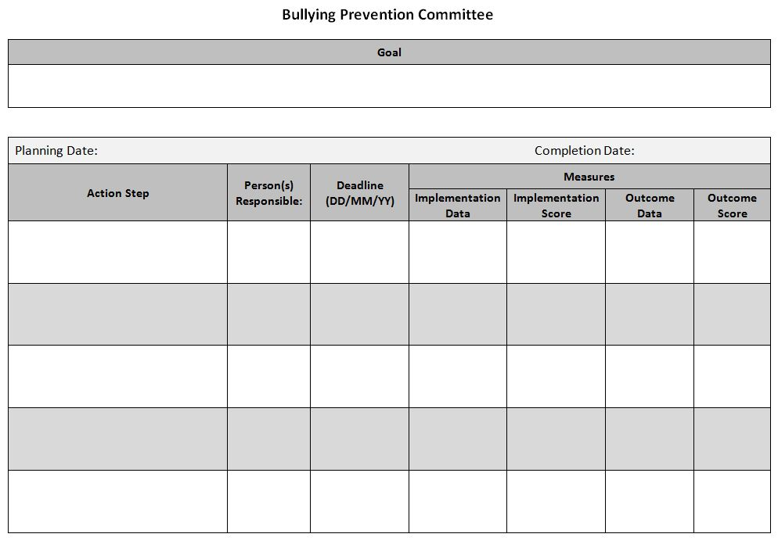
Step 3: Plan Implementation Example
Bullying Prevention Committee #4: “Parents have a voice in the work of the BPC that includes, but is not limited to, being a member of the team.”
2/16/2017
Brainstorm strategies to reach out to parents about the grant, how they can voice their opinions, and solicit volunteers.
BPC members
03/13/2017 (BPC Meeting)
Meeting minutes and list of strategies
100%
Come up with 3 viable ideas
Only 2 ideas
Develop necessary materials and implement strategies developed by BPC.
Sam
03/27/2017
Permanent products, action plan
All permanent products collected
Get 5 parent responses of interest
Got 7 parents
Review list of interested parents/guardians and select which will be members.
Susie and Sally
04/10/2017 (BPC Meeting)
Meeting minutes and list of parents
100%
3 parents agree to join BPC
100%
Welcome selected parents/guardians at the next BPC meeting.
Kim
05/08/2017 (BPC Meeting)
Meeting minutes
100%
All parents indicate they were welcomed
Parents give voice at each meeting
Regularly review feedback and input from parents/guardians at BPC meetings.
Sam
Monthly meetings
Meeting minutes, feedback forms
100%
Climate survey results
80% of parents say they have voice at school

Slide 49

Step 4: Evaluate
Set a review date
Check implementation and impact of our plan/action steps
  Adjust as needed

Slide 50
Summary
Step 1: Problem Identification (Precise Statement)
Step 2: Problem Analysis
Step 3: Plan Implementation (Goal and Plan)
Step 4: Plan Evaluation (Review Date, Implementation and Impact of Plan/Action Steps)

Slide 51
School
Climate and Culture

Slide 52
Problems with Traditional Approaches to Preventing Bullying
Problem #1: Blame the bully
Problem #2: Inadvertent teaching of bullying
Problem #3: Inadvertent reinforcement of
bullying
Problem #4: Ignore role of bystanders
Problem #5: Efforts are not sustained
  Craig, Pepler, & Atlas, 2000; Merrell, Gueldner, Ross, & Isava, 2008

Slide 53
What do we Need?
Positive climate as a foundation
Bullying PREVENTION that stops bullying before it becomes bullying
Bullying prevention that equips students to address the problem (bystanders are the key!)
Bullying prevention that is sustainable
Bullying prevention that “fits” within a tiered approach
  Merrell, Gueldner, Ross, & Isava, 2008

Slide 54
School Climate and Culture Self-Assessment
Complete the School Climate and Culture section of the Self-Assessment (2nd section of the tool)
Complete the section on your own, scoring each item with a 0,1, or 2
As a team discuss your scores and come to consensus in the official document
Finally, as a team, action plan around 1 item

Slide 55
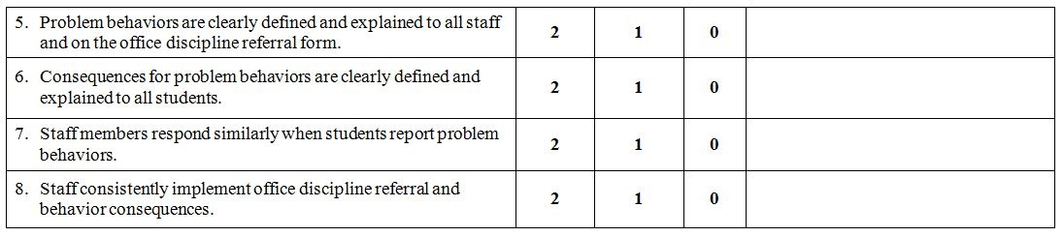
Staff Response

Slide 56
Example of Staff Response in Bullying Prevention

Slide 57
Wellington Middle School Responding to Disrespectful Language Staff Alignment Matrix
Not severe enough to interrupt every time they happen | Interrupt (re-teach) without an Office Discipline Referral | Complete Office Discipline Referral for disciplinary action
Teasing where both students are smiling or not showing signs of distress
“That’s so gay”
“That’s retarded”
Rumor spreading – moderate intensity
Exclusion or ganging up on someone (could be ODR if behavior is chronic)
Horesplay (could be ODR if chronic)
Hitting someone in the private parts
Calling someone “faggot” or “dyke”
Calling someone “retard”
Racial slurs
Using technology to spread vicious rumors
Retaliation
Threats or intimidation

Slide 58
Bullying Prevention Curriculum

Slide 59
Bullying Prevention Curriculum
Four levels of teacher’s use of a bullying prevention program
  Level 1: Initial orientation to the curriculum
  Level 2: Preparation for administering the curriculum
  Level 3: Initial use of the curriculum
  Level 4: Routine use of the curriculum
Self-Concern
Task Concern
Impact Concern
“Will I have the skills
to do this?”
“How should I organize and prepare for this?”
“Will this even make a difference?”
(Hall, Loucks, Rutherford, & Newlove, 1975)

Slide 60
How to Address Concerns
Self-Concern
Task Concern
Impact Concern
Dedicated time for training on the program
Time for teachers to become familiar with the materials
Inform teachers of student opinions about bullying
Time for teachers to plan the program lessons
Time for teachers to plan the program lessons
Regularly report out on successes of the program
School leadership promoting teachers’ efficacy for implementation
School leadership scheduling and monitoring program delivery
Review data related to the program goals
Lack of principal support is one of the top reasons programs are not implemented.
(See Haataja, Ahtola, Poskiparta, & Salmivalli, 2015)

Slide 61
Bullying Prevention Curriculum Self-Assessment
Complete the Bullying Prevention Curriculum section of the Self-Assessment (3rd section of the tool)
Complete the section on your own, scoring each item with a 0,1, or 2
As a team discuss your scores and come to consensus in the official document
As a team, action plan around 1 item

Slide 62
Return from Break in
10
8
6
5
4
3
7
1
2
9
Minute
Minutes

Slide 63
Surveys and Data

Slide 64
Surveys and Data
The BPEG puts critical importance on the collection and use of data
  Implementation data
  Outcome data

Slide 65
Importance of Outcome Data
Outcome data
  Annual survey
  Parent buy-in is essential to accurate data
  High and low impact strategies for parent buy in

Slide 66
Surveys and Data
Getting Parent Opt-in
What strategies do you use to get 60% parent opt-in?
Write each strategy on a sticky note
Place the sticky notes on the chart paper according to their level of impact
Discuss additional high impact strategies that could better result in the 60% buy-in you need

Slide 67
Surveys and Data Self-Assessment
Complete the Surveys and Data section of the Self-Assessment (4th section of the tool)
Complete the section on your own, scoring each item with a 0,1, or 2
As a team discuss your scores and come to consensus in the official document
As a team, action plan around 1 item

Slide 68
Family, School, and
Community Partnering

Slide 69

Family, School, and Community Partnering
  Definition:
  The collaboration of families, schools, and communities as active partners in improving learner, classroom, school, district, and state outcomes.
Family, School, and Community Partnering is….
______________________________________

Slide 70
Colorado Data
On the Colorado TELL Survey, the teaching condition with the strongest connection to high student achievement and growth is:
Community Support and Involvement
Parents/guardians in the community are engaged, influential, and supportive of teachers and schools
Across all school levels
In each year: 2009, 2011, 2013, and 2015
(New Teacher Center, 2015)

Slide 71
Family, School, and Community Partnering Self-Assessment
Complete the Family, School, and Community Partnering section of the Self-Assessment (5th section of the tool)
Complete the section on your own, scoring each item with a 0,1, or 2
As a team discuss your scores and come to consensus in the official document
As a team, action plan around 1 item

Slide 72
Student Voice

Slide 73
Why Student Voice?
Benefits of Student Voice
  Getting students to buy-in to bullying prevention is half the battle (or more than half)
  Students observe bullying that adults do not
  Students understand the context around bullying incidents
  Students know what would be seen as valuable or not valuable by other students
  Student attention is what drives the behavior (remember the video)!
How to Get Student Voice
  Develop positive relationships with students as a foundation
  Have students on your BPC
  Build a student leadership team or hold a focus group with student leaders
(Cunningham et al., 2016)

Slide 74
Implementation Activities
  Create a student leadership team
  Conduct a pre-post survey
  Leadership team considers survey data
  Leadership team develops intervention strategies
    SfC Box
    School-wide stop response
    Assemblies
  Leadership team reinforces students for standing up for each other
    The team develops a reinforcement system
    The team uploads nominations to the national site
      www.standforcourage.org
  Leadership team reports results of their efforts

Slide 75
Student Voice Self-Assessment
Complete the Student Voice section of the Self-Assessment (6th section of the tool)
Complete the section on your own, scoring each item with a 0,1, or 2
As a team discuss your scores and come to consensus in the official document
As a team, action plan around 1 item

Slide 76
Bullying Prevention Policy

Slide 77
Bullying Prevention Policy
Colorado requirements:
  School districts must have an anti-bullying policy
  Part of this policy must include “disciplinary consequences for students who bully other students and for any person who takes any retaliatory action against a student who reports…an incident of bullying.”
Colorado encouragements:
  Incorporation of a survey of students’ impressions of bullying
  “Character building” programs
  Having a team of people at each school who advise administration on bullying
  Age-appropriate internet safety plan

Slide 78
Bullying Prevention Policy
Enumeration of protected classes
  Colorado Association of School Boards
    Recommended to enumerate protected classes in anti-bullying policies
    Recently added the recommendation of enumerating transgender status
Impact on LGBT students
  Students in districts that enumerate LGBT status report:
    Greater school safety
    Less victimization based on their sexual orientation and gender expression
    Less social aggression
(Kull, Greytak, Kosciw, & Villenas, 2016)

Slide 79
Bullying Prevention Policy
Recent federal guidance
  Leaves decision on transgender student restroom use up to states
Colorado law
  SB08-200 pass in 2008
    Requires all school programs and activities to be free from discrimination based on sexual orientation (including transgender status)
  Colorado Civil Rights Division
    In 2013 ruled that transgender students are allowed to use the restroom of the gender with which they identify

Slide 80
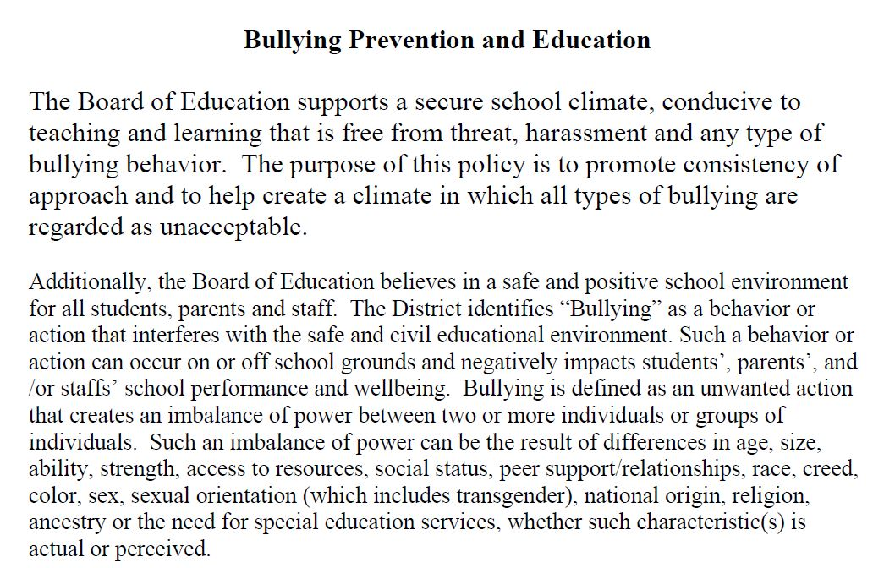
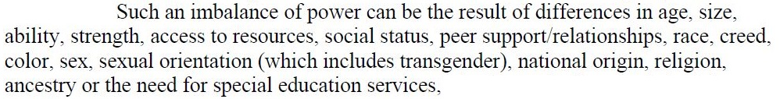
Bullying Prevention Policy

Slide 81
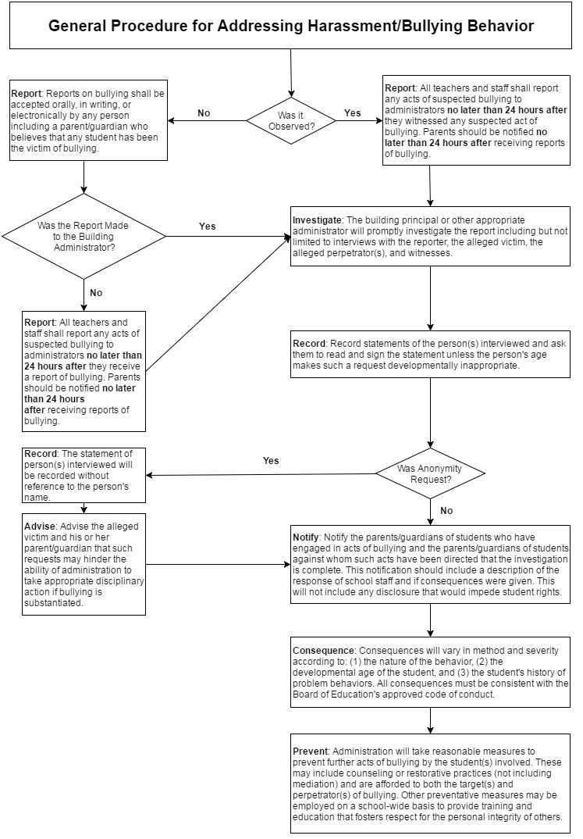
Bullying Prevention Policy
Adapted from Thompson School District Bullying Prevention Policy

Slide 82
Policy Self-Assessment
Complete the Policy section of the Self-Assessment (7th section of the tool)
Complete the section on your own, scoring each item with a 0,1, or 2
As a team discuss your scores and come to consensus in the official document
As a team, action plan around 1 item

Slide 83
Objectives
Discuss what comes next
Schedule our next meeting(s)
Assess the day

Slide 84
Bullying Prevention Grant Program Next Steps
Baseline Self Assessment (Done!)
Discuss big takeaways
Considering the activities of the day as well as the needs of your school, plan your next meetings
Moodle for Implementation Coaches

Slide 85
Thank you for all your hard work today!
We are excited to partner with you in moving Bullying Prevention forward in Colorado!
For More Info:
Colorado Department of Education, Office of Learning Supports
https://www.cde.state.co.us/mtss/bullying

Slide 86
This CDE guidance document is meant for clarification, is not legally binding, and is not to be confused with legal advice. This guidance reflects CDE’s recommendations, but Administrative Units (AUs) may have developed their own policies or procedures that differ from those described herein. Be sure to refer to your local AU’s policies and procedures through the Director of Special Education. If you are seeking legal advice, please contact your legal counsel.

