Slide 1
Twice-Exceptional (2e/3e) Students
Who They Are and How to Support Their Needs
<Insert District/BOCES name>
Notes:
The intent of this presentation is to provide districts/BOCES an informational overview presentation about our 2e/3e Students. Our 2e Team at CDE provides classes that are foundational and in depth about the 2e/3e population online and information is on our webpage. This presentation contains general information slides from as well as slides for Districts to add more personalized information. Feel free to use slides or eliminate based on your needs.
Disclaimer: The Colorado Department of Education (CDE) is responsible for ensuring that Administrative Units meet the requirements of Part B of the Individuals with Disabilities Education Act (IDEA) and the Exceptional Children’s Education Act (ECEA), which includes the administration of Gifted Education. To fulfill its obligation, the CDE provides guidance to support Administrative Units in implementing IDEA and ECEA requirements. This guidance is not binding and should not be construed as legal advice. Administrative Units are encouraged to review their policies, procedures, and practices to ensure alignment with state and federal requirements and make changes, as needed. For legal advice, Administrative Units should consult with legal counsel.

Slide 2
CDE Note for Permission of Use
The information provided here by the Colorado Department of Education’s Twice Exceptional Cadre within the Office of Gifted Education is intended to be used within this presentation only.
Please note that slides with text that is highlighted in neon green is meant for the presenting organization to modify and add specific district data.
Any slides, text, or graphs not highlighted in green, including the narration provided by CDE within the notes section should not be modified. By using this presentation AUs promise not to misrepresent CDE and the information provided today. Any information not in the original presentation is not endorsed by CDE.
8/2022

Slide 3
Objectives
Describe 2e and 3e students
Highlight characteristics
Share data on 2e/3e population
Outline identification
Emphasize collaboration
Address emotional and behavior supports
Address dual differentiation
List supports provided by CDE/Twice Exceptional
Notes:
The intent of this presentation is to provide districts/BOCES with an informational overview presentation that can be customized by districts for their educational community to address the needs of our 2e/3e Students

Slide 4
Who Are Our 2e and 3e
Learners?
Notes:
Photo by a daiga_ellabyutm_source=unsplash

Slide 5
Gifted - Defined
Those persons between the ages of four and twenty-one whose aptitude or competence in abilities, talents, and potential for accomplishment in one or more domains are so exceptional or developmentally advanced that they require special provisions to meet their educational programming needs.
Gifted students include gifted students with disabilities (i.e. twice exceptional) and students with exceptional abilities or potential from all socio-economic, ethnic, and cultural populations.
Areas of Gifted Identification:
General or specific intellectual ability
Specific academic aptitude
Creative or productive thinking
Leadership abilities
Visual arts, performing arts, musical or psychomotor abilities
The Exceptional Children's Education Act (ECEA)
CDE Gifted Identification
Notes:
ECEA defines "identification" as:
The assessment process used by the AU for identifying students who meet the definition specified in section 12.01(16) and for identifying the educational needs of gifted students. 12.02(2)(c)

Slide 6
Twice Exceptional (2e) - Defined 12.01(30)
According to the Colorado Department of Education, twice-exceptional students are those who are identified as gifted according to state criteria in one or more of the categories of giftedness
AND
identified with a disability according to federal/state
criteria - and the disability qualifies the student for either an
Individual Education Plan (IEP) or a Section 504 Plan.
Specific Learning Disability (SLD)
Serious Emotional Disability (SED)
Autism Spectrum Disorder (ASD)
Orthopedic Impairment
Other Health Impaired (including ADHD*)
Traumatic Brain Injury
Hearing or Vision Impairment or Deaf-Blindness
Speech or Language Impairment
Notes:
Colorado has a legal definition of twice-exceptionality. Our state definition includes learners who are both identified as gifted and qualify for an IEP or a 504 plan.

Slide 7
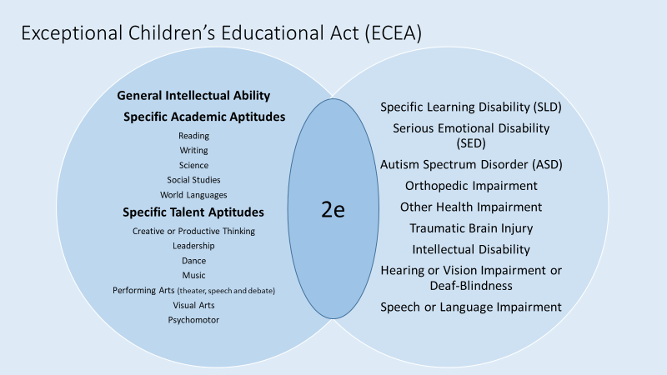
Exceptional Children’s Educational Act (ECEA)

Slide 8
Culturally Diverse 2e Learners (3e Students)
“The 3e label signifies three exceptional conditions: being culturally diverse (members of socially oppressed group); being gifted or having high potential, and simultaneously being LD (learning disabled) or having another disabling condition (such as dyslexia)” (Lawson-Davis & Robinson 2018) (Bonner 2019). Considerations:
Giftedness is found in all language, race, cultural and ability groups.
Assessments should be culture-fair and inclusive of any accommodations necessary.
Develop a robust body of evidence that includes examples of student's culture as an asset.
Students are not less intellectual or less gifted if they do not speak the majority language or are not from the majority culture
Assessments and their instructions should be accessible in the student’s heritage language when possible and always meet 504 and IEP accommodations
(DuBois, M.P., & Greene, R.M., 2021; Lewis, et.al., 2012)
Notes:
Considerations are for all students, including twice -exceptional are: Gender, Race, Class, Culture, Ethnicity, and Socioeconomic Status. In research, there are three different labels/terms (3e, Gifted Cubed, and Tw(y)ce-exceptionality) used to define 2e students from marginalized groups, and their definitions vary (Bonner & Goings, 2019 p. 120; Davis & Robinson,2018, p. 279).

Slide 9
 | Potential Gifted Characteristics | Potential Gifted-with-Disabilities Characteristics
Basic Skills | Ability to learn basic skills quickly and easily and retain information with less repetition | May struggle to learn basic skills due to cognitive processing difficulties/ executive function; need to learn compensatory strategies in order to acquire basic skills and information
Verbal Skills | May have high verbal ability | May have high verbal ability but extreme difficulty in written language area; may use language in inappropriate ways and at inappropriate times
Ability | Exhibit early signs of ability in area of talent before same age peers (e.g. reading early, solving math problems, music, art, creativity, etc.) | May have reading (academic instead of reading?) problems due to cognitive processing or a specific learning disability such as dyslexia/dysgraphia
Observational Skills | Keen powers of observation | May have strong observation skills but may have deficits in memory skills due to executive functioning
Problem Solving | Strong critical thinking, problem-solving and decision-making skills | May excel in solving “real-world” problems; outstanding critical think and decision-making skills; often independently develop compensatory skills
Persistence | Long attention span – persistent, intense concentration | May have attention deficit problems but may concentrate for long periods in areas of interest
Asynchrony | Mismatch between cognitive, emotional, and physical development of gifted individuals (NAGC, n.d.) | “Mismatch” may manifest in more extreme fashion or may be less apparent because of masking
Notes:
Level 1 of our class goes into depth about characteristics
Asynchrony is the term used to describe the mismatch between cognitive, emotional, and physical development of gifted individuals.

Slide 10
2e/3e Students Present in Many Ways
Identified as Gifted: their exceptional ability may dominate, hiding their disability;
Identified with a Disability: their disability may dominate, hiding their exceptional ability;
Not Identified as Gifted or a Disability: each may mask the other so that neither is recognized or addressed
Identified as Twice Exceptional–our Goal!
Notes:
2e students can be hidden by their identification and/or lack of it. Keep in mind that the purpose of identification is to support the student’s needs and support should not be withheld because of formal identification. Our goal it to make sure 2e students are supported for both their strengths and challenges. Experts believe that the largest group of unidentified students of these groups are the students whose abilities and disabilities are masking each other.

Slide 11
Masking
Twice-exceptional students, whose gifts and disabilities often mask one another, are difficult to identify. Students with dual exceptionalities tend to fall into two categories:
Those with mild disabilities whose gifts generally mask their disabilities and
Those whose disabilities are so severe that they mask the gift
(Baum & Owen, 2004. Twice Exceptional: Gifted Students with Learning Disabilities Considerations Packet
Notes:
What’s not often well-known or well-understood is that students who are gifted may also have a special need or disability— just as students with disabilities may also be gifted. The term “twice-exceptional,” also referred to as “2e,” is used to describe gifted children who, have the characteristics of gifted students with the potential for high achievement and give evidence of one or more disabilities as defined by federal or state eligibility criteria. These disabilities may include specific learning disabilities (SpLD), speech and language disorders, emotional/behavioral disorders, physical disabilities, autism spectrum, or other impairments such as attention deficit hyperactivity disorder (ADHD) NAGC: Twice Exceptional Students
This opens up the need to explore our 3e population and our at risk students.

Slide 12
By the Numbers
Notes:
joshua-sortino-LqKhnDzSF-8-unsplash

Slide 13
Colorado Data
In the state of Colorado, in 2021, there were approximately 886,517 pk-12 students.
Of the 886,517 identified students, 7.1% were identified as gifted.
Of the population identified as gifted, 9% were identified as twice-exceptional.
1,922 were gifted with an IEP
3,793 were gifted with a 504
78 were gifted with an IEP and a 504
Notes:
Colorado Department of Gifted Education 2022

Slide 14
Data From Your District
Include what the 2e data in your district looks like
Provide breakdown by demographics if possible.
Analyze: What is your data telling you?
Notes:
Suggestions for guiding questions about data:
How many students are in your AU?
If those identified students, how many are identified as gifted?
Of the population identified as gifted, how many were identified as twice-exceptional?
How many were gifted with an IEP?
How many were gifted with a 504?
How many were gifted with an IEP and a 504?

Slide 15
Identification
Notes:
riccardo-annandale-7e2pe9wjL9M-unsplash

Slide 16
2e/3e Identification
Although CDE provides guidance about identification, each District/BOCES provides their identification guidelines. The following are points for research based best practice to keep in mind:
Provide Universal Screening/Cognitive Testing for all students to become part of their body of evidence
Look for students who score well above the mean in one area (reading, math, writing) but who also have a significant discrepancy in one of the other areas
Look for students on an IEP/504 who have characteristics of giftedness (and check their cognitive testing score)
Use the RtI model to access specific skills attainment early when intervention will be most effective and provide a body of evidence over time
Use individualized testing to students suspected of 2e
Notes:
Research based best practice notes the following points mentioned in this slide to keep in mind for identification of 2e/3e students. It takes a collaborative team of both gifted and special education to gather information. As previously mentioned our population may present as asynchronous and this demonstrates the need to look closer at the student.
)

Slide 17
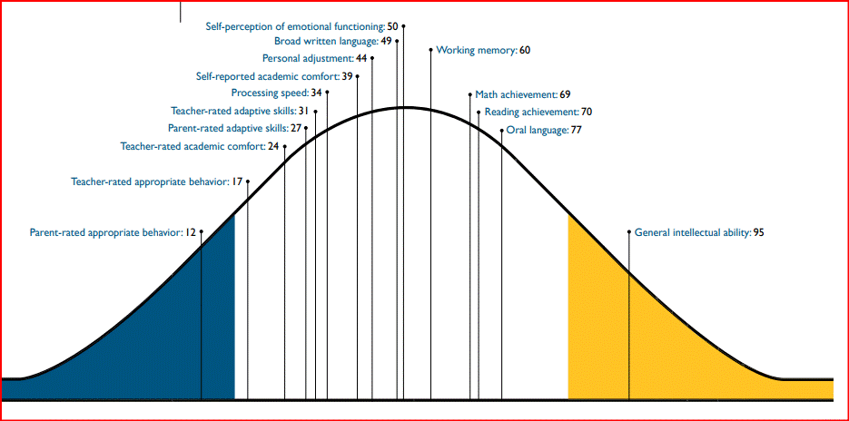
Graphic Representation of the Paradox of Strengths and Difficulties - SLD
The Paradox of Twice-Exceptionality • Figure • 3
Notes:
This figure provides a visual display of students’ abilities, and emphasizes the significant differences in the cognitive, academic and adaptive functioning skills of twice-exceptional students with SLD. The Belin-Blank Center is an active leading contributor to this body of research and several recent publications have been included in this document (see Annotated Bibliography). https://belinblank.education.uiowa.edu/research/docs/pip2.pdf

Slide 18
Process for Identification in your District/Boces
Provide a flow chart or list the process in your District/BOCES to identify students as 2e.
Include information about your talent pool if you have one
Share how this information is reviewed and evaluated on a timely basis.

Slide 19
Finding Your 2e/3e Students -Universal Screening
Dig into scores from your district’s Universal Screening/Cognitive Testing.
Look at specific subtests on cognitive assessments: The full score might be in the average range, and it's important to make sure there are no big discrepancies in the subtests. For example, processing speed that is very low might pull down scores in another area.
Look for students on an IEP/504 who have subtests that may indicate giftedness.
Notes:
Characteristics of giftedness are key indicators. With our 2e students you may see a “scatter” with their scores: some scores will be high in areas, as well as low in others. It’s important not to focus on just the composite scores but look at all information available. Analyze specific subtests on cognitive assessments: The full score might be in the average range, and it's important to make sure there are no big discrepancies in the subtests. For example, if processing speed that is very low, it might pull down scores in another area.

Slide 20
Data You May Already Have
Both
Group Administered
i-Ready (Achievement)
Individual Testing
Wechsler Intelligence Scale for Children (WISC-V, Cognitive)
Woodcock-Johnson IV (Cognitive)
DAS-II
ACCESS
Special Education Tests
Individual Administered
Informal classroom assessments
Nationally normed assessments that provide data for the suspected disability
Gifted
Group Administered
CogAT (Cognitive)
NNAT (Cognitive, non-verbal)
Iowa Tests of Basic
Skills (Achievement)
Individual Testing
K-BIT2 – untimed,
no reading
Colorado Office of Gifted Education Commonly Used Assessments
Notes:
We collect a lot of information on our students. CDE/Gifted provides information on assessments, but your district/AU decides what assessments are used. Other than your students with severe cognitive impairment, consider doing a data dive for your students on IEPs. Your students are likely to have a CogAT(Cognitive Abilities Test) or an NNAT(Nagalari) and it’s possible to have a WISC or a Woodcock-Johnson. CDE/GT has compiled a list of commonly used assessments as well as descriptions about those listed. It’s important to remember that if you suspect a strength in a student which does not show up on a general assessment, look deeper to find an assessment that works for the student.

Slide 21
Culturally Responsive Assessment Practices
These are the guiding principles for equitable and culturally responsive assessment practices:
Every school system must be committed to equity in finding potentially gifted students.
Test bias and test fairness should be explored. Just because a test is unbiased doesn’t always mean it is fair.
Other relevant information should be taken into account if it will enhance the overall validity of the decision of the test score.
A wide range of information about the test taker should be taken into consideration on their performance, (i.e. cultural background, language, racial ethnicity, socioeconomic background).
Test scores should be used to help students, not hurt them.
Every effort must be made to eliminate prejudice, racism, and inequities.
(Ford, D. Y., 2005)
Notes:
Donna Ford has been a leader on culturally responsive assessments and her points here need to be emphasized.

Slide 22
Collaboration: Taking a Team Approach
Notes:
christina-wocintechchat-com-rg1y72eKw6o-unsplash

Slide 23
Collaborate with Colleagues
Strategies for Supporting Students Who Are Twice-Exceptional. Janet Josephson, Charlton Wolfgang and Rich Mehrenberg. 2018.
Notes:
Remember that a stakeholder can be anyone who supports the student’s strength. This can include: specials' teachers (music, art, PE), interventionists, for example ELL teachers, mental/behavioral health specialists (school psychologists, counselors, speech/language) as well as community mentors. Checking with the student to make sure they have a voice in collaboration will help to ensure their needs are being met. Collaborating all stakeholders to support students requires a community effort as evidenced by these questions.

Slide 24
Your District 2e Team
Some considerations:
Who will serve as a support team for the 2e student during the identification process as well as support needs for strengths and weaknesses?
What is the process to contact and review progress?
Notes:
Each District/BOCES has an identification process and providing a flow chart/process with names of contacts will support the lines of communication.

Slide 25
Supporting Academic and Affective Needs
Notes:
joshua-woroniecki-lzh3hPtJz9c-unsplash

Slide 26
Support - Best Practice
Support Disability
Identification
MTSS 5 Components
Specialized Methods of Identification that Consider the Possible Interaction of the Exceptionalities and of Culture
Advanced Educational Opportunities to Develop Area of Giftedness
Academic & Affective Support: Accommodations, Interventions & Specialized Instruction
ALPs, IEPs, 504 Plans
Infrastructure
Develop Giftedness
Monitor & Adjust
Adapted from NAGC Special Populations Newsletter Nov 2021
Notes:
This is a graphic of the big picture of how to support 2e learners. To be clear, one might think of the last 4 boxes as within the first MTSS or infrastructure box. All supports for all students are within the MTSS framework. We’ve separated them here to create the clarity and emphasis needed for 2e learners.

Slide 27
Supporting Academic Needs through
Dual Differentiation
Supporting Strengths
Supporting Disabilities
Provide choice and ownership of learning when possible
Provide access to advanced and accelerated classes
Pretest to eliminate what students already know
Provide opportunities for “real world” investigations and topics of interest
Emphasize strengths
Utilize inspiring biographies of talented/creative individuals and their characteristics
Utilize assistive technology
Allow extended time
Emphasize mastery of concepts instead of home practice (most difficult first)
Differentiate the task
Adapt environment
Encourage multiple ways to demonstrate knowledge
Provide IEP and 504 accommodations in advanced classes
Notes:
Supporting strengths first honors the student and provides an opportunity to engage them in learning. Supporting their disabilities allows them to take an active role in their involvement.Research shows that 2e children are quite capable of high-level abstract thinking, demonstrate significant creativity, and are able to take unique problem-solving approaches to tasks (Trail, 2000). Offering learning opportunities that draw on these abilities is likely to engage these students and give them opportunities for success. At the same time, caution is essential when setting the level of challenge for 2e students. It needs to be appropriate – high enough so that they must stretch to meet the challenge, but not so high that they will fail.

Slide 28
Addressing Social Emotional (Affective) Needs
Students need tools to overcome these issues and to see themselves as successful learners. It is important for twice-exceptional students to:
Have an emotionally safe learning environment
Have an opportunity to develop a healthy self-concept
Recognize their emotional vulnerability
Have occasions to interact with twice-exceptional peers
Visualize a positive personal future.
The Twice-Exceptional Dilemma
Notes:
https://www.nagc.org/sites/default/files/key%20reports/twiceexceptional.pdf

Slide 29
Addressing Behavioral Needs/Concerns
“Difficult” behavior typically has two purposes: avoidance or attention-gaining. These behaviors are often viewed as aggressiveness, laziness, or manipulation. In order to address these issues, educators need to:
Be attuned to the function or purpose of the behavior
Provide a consistent environment with limits and expectations
Teach self-regulation skills
Teach appropriate behaviors to use in place of inappropriate behavior
Provide positive behavioral supports not focused on negative consequences.
The Twice-Exceptional Dilemma
Notes:
All too often our 2e/3e students experience frustration because they know what they want to express in their mind, but struggle to share their ideas. Twice-exceptional students may exhibit poor behavior as a result of intense frustration and low self-esteem caused by the discrepancy between high intellectual ability and comparatively poor academic performance and blame themselves as a result.

Slide 30
Professional Development Provided by the CDE/2e Team
2e Professional Development
Twice Exceptional Classes
2e Course 1 Foundations
2e Course 2
Foundational Class
Provides framework to identify and support
2e Students with ASD, ADHD and OHI
IEP/504: Anxiety and Depression
Customized Professional Development for Districts
Notes:
Part 1 Class in Foundations of Twice-Exceptional Learners provides a framework to identify and support 2e/3e
Part 2 Class provides:
An overview of neurodiversity
Looks at specific populations of 2e students including autism spectrum disorder (ASD), other health impairments (OHI), or specific learning disabilities (SLD)
Considers 504 plans in terms of anxiety and depression
Provides tools to become a catalyst for change
Training for mental health workers who provide services for 2e learners
2e Presentations for Principals with emphasis on identification and team approach
District customized professional development and consultation

