Slide 1
Local Access Manager (LAM) User Access Administration Training

Slide 2
Agenda
LAM gains Access to the new Grant Management System
Create a User in GAINS
Roles within GAINS
Add a Role to a User

Slide 3
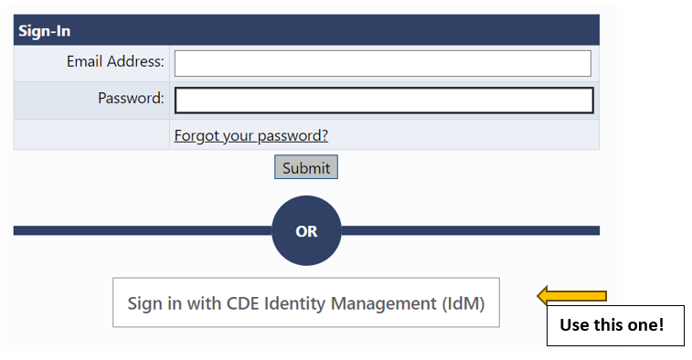
Welcome to GAINS, LAMs!
CDE has uploaded all known LAMs within CDE. You won't have to login to the IdM to provide access to users in your organization. It will be through GAINS!
Visit https://colorado.egrantsmanagement.com/. Click on the GAINS Sign-In icon in the upper right side of the screen.
2. Click on the Sign in with CDE Identity Management (IdM) link.

Slide 4
Login to GAINS
3. The next page you will see is where you enter your Single Sign-on credentials. The username will be your full email and the password will align to other CDE logins.
If you are unable to login to GAINS, please email gains@cde.state.co.us
If you are having IdM issues, please email cdeidm@cde.state.co.us

Slide 5
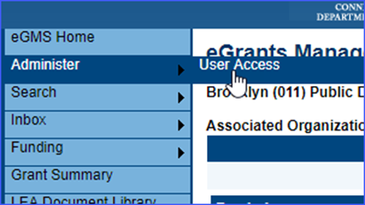
Create a User
Once logged in, you will be taken to the home screen again. But you'll notice that the left navigation bar has changed with additional options.
As the "User Access Administrator Role," you can now see "Administer."
Hover over Administer and select "User Access."

Slide 6
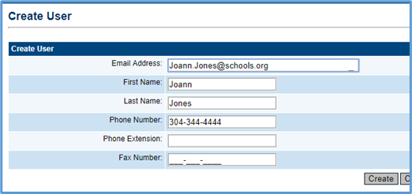
Find a User or Create One!
You'll be able to search for existing users by entering name, role, and/or organization.
If the user you are looking for is not in the system, select "Create User."
You will be led to a screen that will tell you to enter the email address, first name, and last name. Please also enter the phone number.
Notes:
It is possible that folks have already tried to access the system but don't have a role. That is why we search for the role first before adding new users.

Slide 7
User Notification
Once the user is created, the user will receive an email permitting the new user to set a password. Since your districts are through the IdM, they can ignore this email.
Your users within the district will now be able to access GAINS through the IdM.
However, they will not be able to do much because they don't have an assigned ROLE.

Slide 8
Roles within GAINS
Before we assign a Role, we need to know what kind of Roles are available!
Please keep in mind the following:
A user can have more than one role.
A role can be assigned to more than one user.
A user can have roles in multiple organizations.
And, every organization must have, at a minimum, an LEA Fiscal Representative and LEA Authorized Representative.

Slide 9
Type of Roles
LEA [Application Name] Director
Authorized to create and complete named grant
LEA [Application Name] Update
Authorized to edit but cannot change statuses
LEA ALL Funding Applications Update
Has the authority to edit any funding application but cannot change statuses
LEA Fiscal Representative
The Fiscal Representative is authorized to approve grants, complete and submit requests for funds and will receive fiscal related communication regarding the application.
LEA Authorized Representative
The Authorized Representative is the individual authorized provide final LEA approval and submit the application to CDE on behalf of the LEA. This individual will receive the Grant Award Letter (GAL).
LEA Data View
Has the authority view all district content but no editing or status changes
User Access Administrator
Has the authority to manage LEA user roles (that's you!)

Slide 10
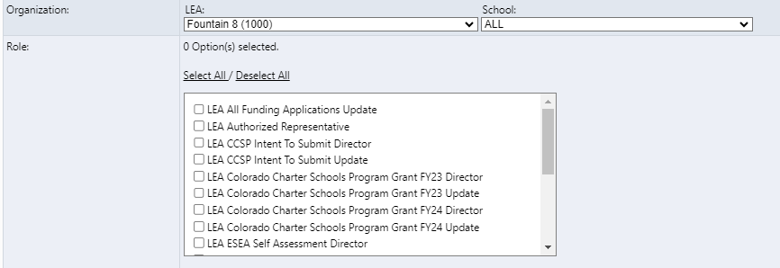
Assign a Role
When you create a role, a list of options appear for the individual. As the User Access Administrator, you can select the role this individual needs based on the list of options.
You may recall from the previous slide that we had "LEA [Application Name] Director." You can now see an example with the charter school application. " LEA Colorado Charter School Program Grant FY23 Director.

Slide 11
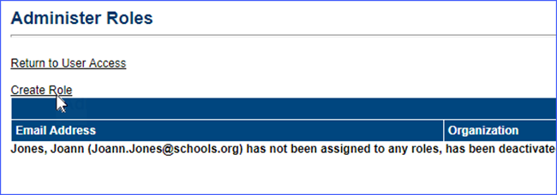
Create a Role
Once you've created a user, the person will appear, but the system will indicate that they don't have a role assigned.
To create a role, select "Create Role" which is above the individual's email address.

Slide 12
Created User
Once created, you'll be able to see the various roles you selected.
If you return to User Access, you will see additional information related to the user.

Slide 13
Modifying and Deleting a User
On this screen, you can edit a role!
Please keep in mind that you won't be able to edit the name, email and phone since it is through the IdM.
You'll also note that there isn't a "delete" for an individual. Users cannot be deleted from the system to preserve the integrity of audit records. However, by deleting all roles, they no longer have access to any funding applications. Click on the “Delete All Roles” trashcan icon to disable a user.

Slide 14
Password Problems?
If IdM users forget their password, use the password reset form on the CDE Identity Management webpage.
Non-IdM users can click on the “Forgot your password?” link on the GAINS Sign On screen or, if they are logged in and wish to change their password, they can find the link by clicking on their name to bring up the user profile.
User Access administrators can also generate a new password email by searching for the user and clicking on “Reset Password.” This is sometimes necessary if the first email was lost, or the email address was incorrect.

Slide 15
Upcoming Grants within GAINS!
Two pilot grants are about to open:
Colorado's Charter Schools Program Grant (Opening 10/13)
Colorado's Computer Science Education Grants for Teachers Program (Opening 10/12)
People within your organization may begin to reach out regarding access to these grants. Please ensure you have created the user and assigned the appropriate role for these grants.
Remember, your LEA will need the following roles:
At least ONE LEA Authorized Representative
At least ONE LEA Fiscal Representative
You can also add specific application roles such as:
LEA Colorado's Charter Schools Program Grant Director
LEA Colorado's Charter Schools Program Grant Update

Slide 16
Technical Assistance and Support
You can reach out to the Grants Program Administration team in a variety of ways, including:
Emailing us at gains@cde.state.co.us
Filling out a GAINS Help Desk Ticket
Attending new GAINS Office Hours
Occurring every Tuesday at 12pm to 1pm, starting on October 24th
[Zoom Link information coming soon!]

Slide 17
Questions?

Slide 18
Grants Program Administration Office
GPA Staff | Program Expertise | E-mail | Upcoming Application GAINS Administrator
DeLilah Collins | Director of Grants Program Administration Office | Collins_D@cde.state.co.us
Jessica Hollingshead | Operations Supervisor | Hollingshead_J@cde.state.co.us
Kim Burnham | Competitive Grants and Awards Supervisor | Burnham_K@cde.state.co.us | Colorado's Charter Schools Program Grant (Opening 10/13)
Megan Allen | Program Assistant I | Allen_M@cde.state.co.us
Brittany Jimenez | Program Support | Jimenez_B@cde.state.co.us
Mandy Christensen | Principal Consultant | Christensen_A@cde.state.co.us
Patty Gleason | Senior Consultant | Gleason_P@cde.state.co.us
Michelle Prael | Senior Consultant | Prael_M@cde.state.co.us | Colorado's Computer Science Education Grants for Teachers Program (Opening 10/12)

Slide 19
Office of Grants Fiscal
Grants Fiscal Staff | Program Expertise | E-mail | Upcoming Application Grants Fiscal Analyst
Jennifer Austin | Grants Fiscal Management Director | Austin_J@cde.state.co.us
Evan Davis | Federal Fiscal Grants Supervisor | Davis_E@cde.state.co.us
Robert Hawkins | Lead Grants Fiscal Analyst | Hawkins_R@cde.state.co.us
Sondra Vela | Grants Fiscal Analyst | Vela_S@cde.state.co.us | Colorado's Charter Schools Program Grant (Opening 10/13)
Tricia Miller | State Fiscal Grants Supervisor | Miller_T@cde.state.co.us
Steven Kaleda | Grants Fiscal Analyst | Kaleda_S@cde.state.co.us
Gloria Kochan | Grants Fiscal Analyst | Kochan_G@cde.state.co.us | Colorado's Computer Science Education Grants for Teachers Program (Opening 10/12)
Patrick Mueller | Grants Fiscal Analyst | Mueller_P@cde.state.co.us
Anna Friedman | Grants Fiscal Analyst | Friedman_A@cde.state.co.us
Anissa El Bialy | Grants Fiscal Analyst | El-bialy_A@cde.state.co.us

