Slide 1

LEA Fund Requests
Grants Programming Administration Office, CDE

Slide 2
Disclaimer!
LEAs will not use the Request for Funds process in GAINS until prompted to do so.

Slide 3
Fund Request Highlights
Fund Request Page
  Provides the available budget, total available amount, received amount, net available amount and pending amount.
Project Summary
  Provides a list of requests that have been made, and the status of the request.
Expenditure Details Page
  Report year-to-date Expenditures by Object and Program code
  Automatically populates expenditures from previous request
Validation
  System automatically validates Fund Requests as they are completed

Slide 4
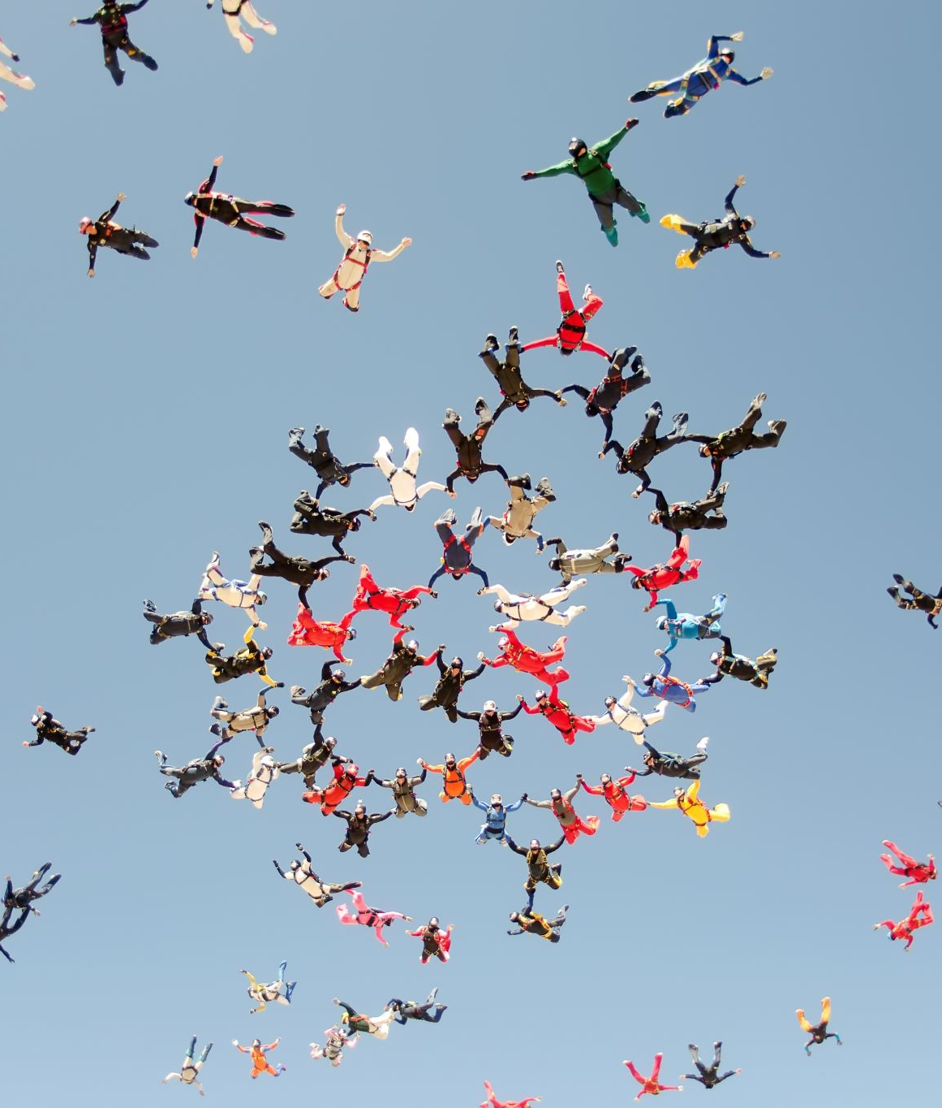
Fund Request Highlights cont.
Submission and Review
  The LEA Fiscal Representative is authorized to approve grants, complete and submit requests for funds, and will receive fiscal related communication regarding the application. Usually the district Fiscal Manager, but other personnel can also have this role in your budgeting office.

Slide 5
Timeline for Requesting Funds Through GAINS
Requesting funds in GAINS will begin with the USDA NSLP Equipment Assistance Grant program.
  Earliest request will occur after the new year.
Follow up training for requesting funds will occur closer to when applicants will begin to use the system to request funds.
  CDE is still working on workflows for approvals in the system.
CDE is developing a process to bring over existing grant budgets.
  Process development starts March 2024

Slide 6
Questions?

Slide 7
Important Dates
Grant Application Deadlines
  USDA NSLP Equipment Assistance Grant – Due December 14, 2023, at 4:00pm
Grant Applications Open Now / Coming Soon
  21st Century Community Learning Centers – Opens December 15, 2023
  Colorado Academic Accelerator Program – Opens December 15, 2023

Slide 8

Technical Assistance and GAINS Resources
GAINS Help Desk Ticket
GAINS CDE Resources
GAINS Training Webpage
Catch up on past trainings provided by CDE!
Ask for help and indicate a time that works best for you through this ticketing system!
Any additional resources will be posted in GAINS!

Slide 9

Application Evaluation Survey
Did you recently complete the Charter Schools Program Grant and/or the Computer Science Grant? Please complete the survey to tell us how we can improve applications within GAINS for the future!

Slide 10
GPA and Grants Fiscal Contacts
GPA Staff | Program Expertise | E-mail | GAINS Administrator by Application
DeLilah Collins | Director, Grants Program Administration | Collins_D@cde.state.co.us
Jess Hollingshead | Operations Supervisor | Hollingshead_J@cde.state.co.us | Building Excellent Schools Today (BEST), 21st CCLC, CO-AAP
Kim Burnham | Competitive Grants and Awards Supervisor | Burnham_K@cde.state.co.us | Colorado Charter Schools Program Grant
Megan Allen | Program Assistant I | Allen_M@cde.state.co.us
Brittany Jimenez | Program Support | Jimenez_B@cde.state.co.us
Mandy Christensen | Principal Consultant | Christensen_A@cde.state.co.us | USDA NSLP Equipment Assistance Grant, 21st CCLC, CO-AAP, Auto Enrollment
Patty Gleason | Senior Consultant | Gleason_P@cde.state.co.us
Michelle Prael | Senior Consultant | Prael_M@cde.state.co.us | Computer Science Education Grants for Teachers Program
Grants Fiscal Staff | Program Expertise | E-mail | Grants Fiscal Analyst by Application
Jennifer Austin | Director, Grants Fiscal Management | Austin_J@cde.state.co.us
Evan Davis | Federal Fiscal Grants Supervisor | Davis_E@cde.state.co.us
Robert Hawkins | Lead Grants Fiscal Analyst | Hawkins_R@cde.state.co.us
Sondra Vela | Grants Fiscal Analyst | Vela_S@cde.state.co.us | Colorado Charter Schools Program Grant
Tricia Miller | State Fiscal Grants Supervisor | Miller_T@cde.state.co.us | 21st CCLC, CO-AAP
Steven Kaleda | Grants Fiscal Analyst | Kaleda_S@cde.state.co.us
Gloria Kochan | Grants Fiscal Analyst | Kochan_G@cde.state.co.us | Computer Science Education Grants for Teachers Program
Patrick Mueller | Grants Fiscal Analyst | Mueller_P@cde.state.co.us | USDA NSLP Equipment Assistance Grant
Anna Friedman | Grants Fiscal Analyst | Friedman_A@cde.state.co.us
Anissa El Bialy | Grants Fiscal Analyst | El-bialy_A@cde.state.co.us

Slide 11
Thank You!

