Slide 1
Title IV, Part A: Student Support and Academic Enrichment
Notes:
Tammy Giessinger, Title IV-A Consultant
During today’s session, I will be providing an overview of Title IV and reviewing the revisions to the Title IV section of the Consolidated Application. In general, Title IV has stayed the same. I will also be sharing some information about the CARES Act waivers aligned to Title IV.

Slide 2
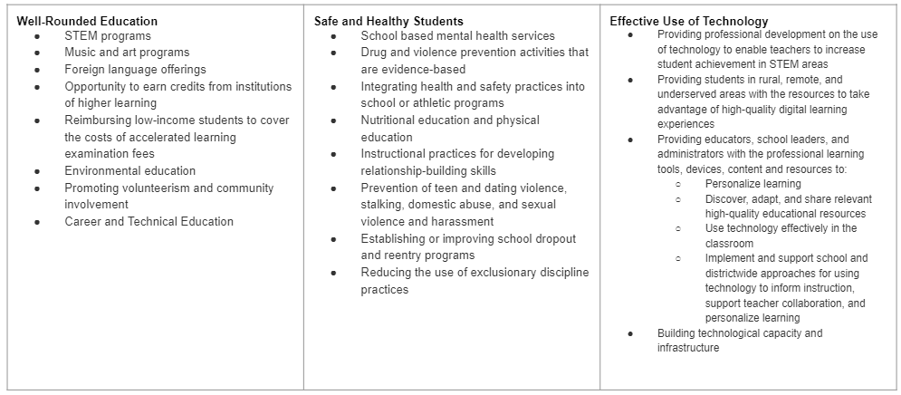
Title IV, Part A
Purpose & Allowable Uses of Funds
https://www.cde.state.co.us/fedprograms/tivpaallowableuses
Notes:
Title IV, Part A of the Every Student Succeeds Act of 2015 is intended to improve students’ academic achievement by increasing the capacity of States, local educational agencies (LEAs), schools, and local communities to:
provide all students with access to a well-rounded education,
improve school conditions for student learning, and
improve the use of technology in order to improve the academic achievement and digital literacy of all students.

Slide 3
Title IV, Part A
Distribution of Funds
LEAs can allocate funds directly to a school or fund a program that supports all schools.
The LEA has discretion in how funds are distributed to schools, but must prioritize:
Schools with the greatest need
Schools with the highest percentages or numbers of children counted in the Title I, Part A calculation
Schools identified as Comprehensive or Targeted Support and Improvement
Schools identified as persistently dangerous public elementary or secondary schools

Slide 4
Title IV, Part A Comprehensive Needs Assessment
Similarly to Title I, II, III, Title IV also requires the LEA to conduct a Comprehensive Needs Assessment.
LEAs that receive at least $30,000 must conduct a comprehensive needs assessment once every three years. The needs assessment must focus on the three content areas: well-rounded educational opportunities, safe and healthy students, and effective use of technology.
Based on the results of the needs assessment, the LEA must use:
At least 20% of funds for activities to support well-rounded educational opportunities
At least 20% of funds for activities to support safe and healthy students and
A portion of funds for activities to support effective use of technology
U.S. Department of Education Needs Assessment Tool
Notes:
One of the CARES Act waivers applies to the needs assessment for 2019-2020. If a district’s needs have changed, revisions can be made to activities, even if they were not identified in a prior needs assessment. The district should include an explanation of the change in needs in their revision request.

Slide 5
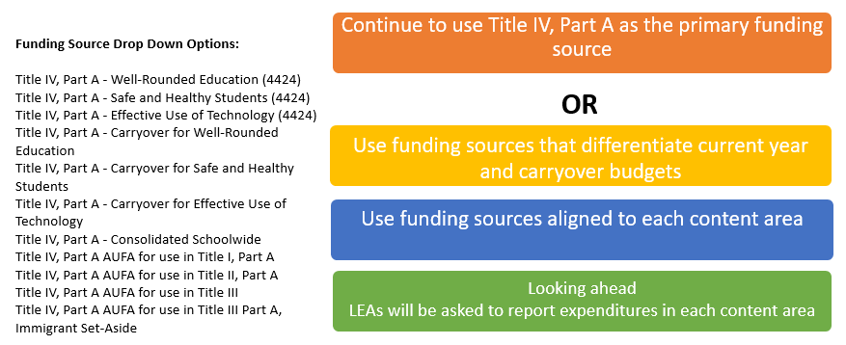
Title IV, Part A
2020-2021 Consolidated Application Updates
Narrative:
Added reference numbers for each response
Funding Sources:
Added Content Area to Activity Categories
Included differentiated Funding Sources
Notes:
If using the Standards and Indicators activity category codes, the Title IV content area will need to be provided in the activity description.
We are working on guidance about reporting expenditures of funds within each category.

Slide 6
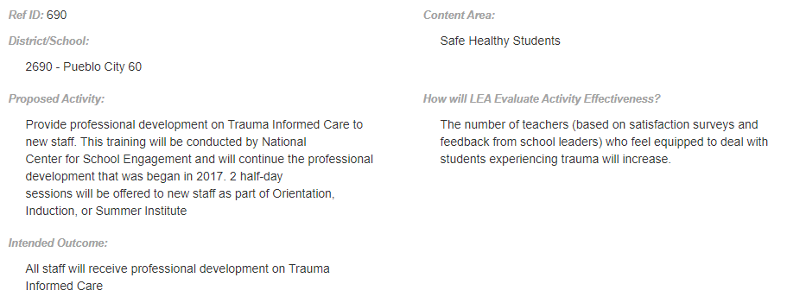
Title IV, Part A
Narrative

Slide 7
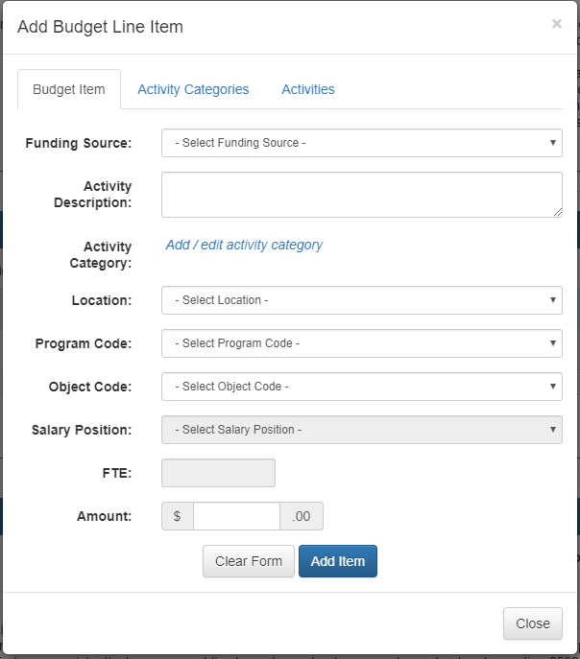
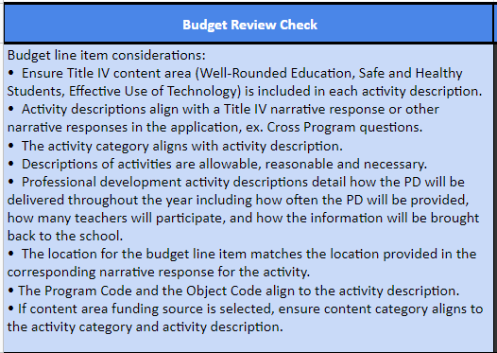
Title IV, Part A
Budget
Notes:
Purpose of activity category codes:
Support planning and reporting
Aligned to:
Title IV, Part A Statute
Colorado Standards and Indicators for School Improvement
Activity Categories in the Consolidated Application

Slide 8
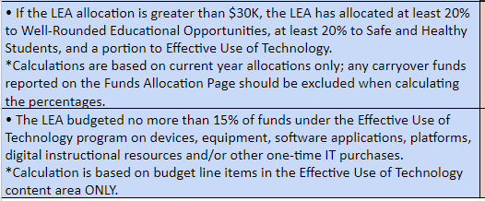
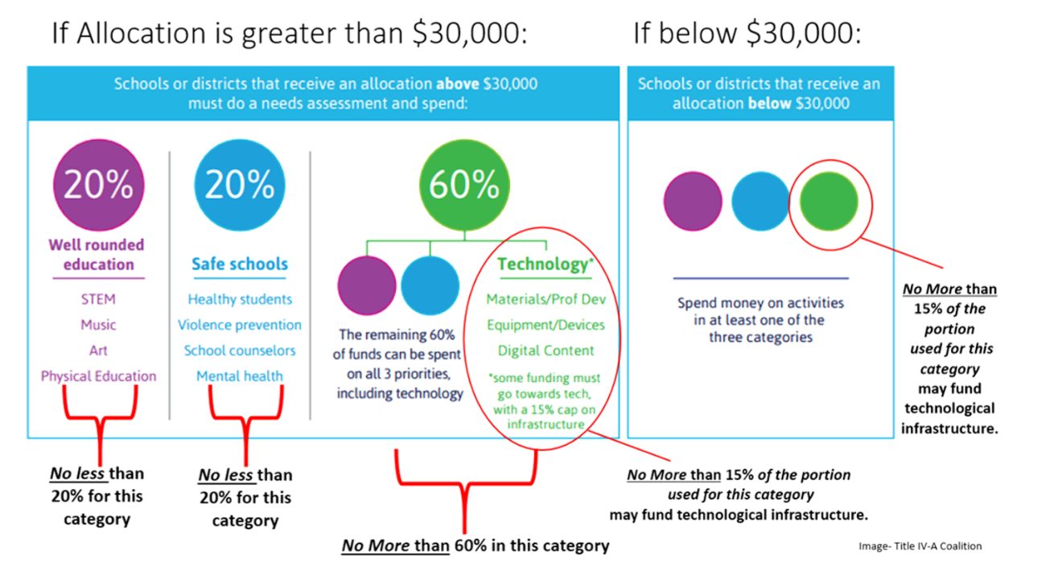
Title IV, Part A
Budget Check
These requirements have been waived for carryover from 2018-2019 and 2019-2020 funds. Meeting the percentage requirements will also be waived for any carryover funds budgeted in the 2020-2021 Consolidated Application.
Notes:
The 20%, 20%, and a portion calculation will be based on the 2020-2021 allocation.
The CARES Act waiver applies to any funds that are budgeted in the 2019-2020 application. It will also apply to any carryover funds that are budgeted in the 2020-2021 application.
All activities still need to be aligned to a Title IV content area.

Slide 9
Additional Resources
Colorado Department of Education
T4PA Center
National Center on Safe Supportive Learning Environments
Federal School Safety Clearinghouse
Colorado School Safety Resource Center
Office of Educational Technology
Notes:
All of the Title IV resources are linked on the Title IV-A page of CDE’s website.

Slide 10
Questions??
Notes:
The CARES Act waiver for the percentage requirements applies to the 2019-2020 application and any funds that are carried over into the 2020-2021 application.
The 20%, 20%, and a portion calculations are only based on the 2020-2021 allocation. Any carryover funds still need to be aligned to a Title IV content area. The activities using carryover funds would not factor into the 20%, 20%, and a portion calculations.
When budgeting professional development activities, we recognize that not all information may be available. Work with your Regional Contact for how to include the information in the application.
There is no percentage requirement on the use of 2019-2020 funds for Effective Use of Technology. 100% of funds could be used for infrastructure purchases.
We recommend that LEAs use the Carryover funding source to differentiate carryover from current year funds. The LEA should be tracking expenditures by fiscal year.
Reach out to Tammy Giessinger, your Regional Contact, or Grants Fiscal with any additional questions.

Slide 11
ESEA Office
ESEA Office | Position | Phone | E-mail
Nazie Mohajeri-Nelson | Director of ESEA Office | 303-866-6205 | Mohajeri-nelson_n@cde.state.co.us
DeLilah Collins | Assistant Director of ESEA Office | 303-866-6850 | Collins_d@cde.state.co.us
Michelle Prael | Program Support | 303-866-6998 | prael_m@cde.state.co.us
ESEA Team | Region & Program Expertise | Phone | E-mail
Brad Bylsma | Director of Support Coordinators | 303-866-6937 | bylsma_b@cde.state.co.us
Kristen Collins | Northwest & West Central, Title V and Stakeholder Engagement | 303-866-6705 | collins_k@cde.state.co.us
Tammy Giessinger | Pikes Peak & Southeast, Title IV and School Improvement | 303-866-6992 | giessinger_t@cde.state.co.us
Karen Ingalls | North Central & Northeast, Title I Lead | 303-866-3897 | Ingalls_k@cde.state.co.us
Jeremy Meredith | Southwest, Title II | 303-866-3905 | meredith_j@cde.state.co.us
Laura Meushaw | Pikes Peak & Southeast, Titles I and School Improvement | 303-866-6618 | meushaw_l@cde.state.co.us
Robert Thompson | Northwest & West Central, Title III | 303-866-6842 | thompson_r@cde.state.co.us
Barb Vassis | North Central & Northeast, Titles I and II | 303-866-6065 | vassis_b@cde.state.co.us
Joey Willett | Southwest, Titles I and ID, Monitoring | 303-866-6700 | willett_j@cde.state.co.us
Notes:
Nazie – Note changes in assignments

Slide 12
ESEA Office (Cont.)
ESEA Office | Position | Phone | E-mail
Nazie Mohajeri-Nelson | Director of ESEA Office | 303-866-6205 | Mohajeri-nelson_n@cde.state.co.us
DeLilah Collins | Asst. Director of ESEA Office | 303-866-6850 | Collins_d@cde.state.co.us
CGA Team | Program Expertise | Phone | E-mail
Kim Burnham | Competitive, Grants & Awards Supervisor | 303-866-6916 | Burnham_K@cde.state.co.us
Patricia Gleason | Senior Consultant, Grants & Awards | 303-866-6143 | Gleason_P@cde.state.co.us
Mandy Christensen | Senior Consultant, Grants & Awards | 303-866-6250 | Christensen_m@cde.state.co.us
Brittany Jimenez | Program Support | 303-866-6813 | Jimenez_B@cde.state.co.us
DARE Team | Expertise | Phone | Email
Tina Negley | ESSA Accountability, Program Evaluation, and Reporting | 303-866-5243 | negley_t@cde.state.co.us
Alan Shimmin | ESEA Reporting and Data Collections | 303-866-6209 | shimmin_a@cde.state.co.us
Mary Shen | ESEA Program Evaluation, Research, and Accountability | 303-866-4571 | shen_m@cde.state.co.us

Slide 13
Grants Fiscal Contacts
Grants Fiscal Staff | Program Expertise | Phone | E-mail
Jennifer Austin | Director of Grants Fiscal | 303-866-6689 | Austin_j@cde.state.co.us
Robert Hawkins | Grants Fiscal Analyst | 303-866-6775 | Hawkins_r@cde.state.co.us
Steven Kaleda | Grants Fiscal Analyst | 303-866-6724 | kaleda_s@cde.state.co.us

