Slide 1
Title III: Language Instruction for English Learners and Immigrant Students

Slide 2
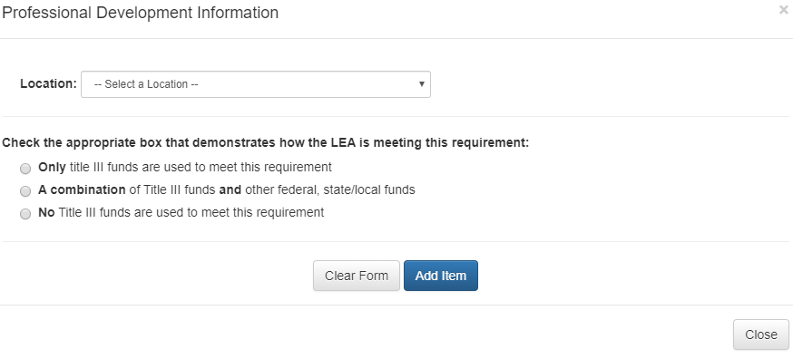
Professional Development Narrative Question
1. Complete the tables to describe how professional development is funded.
The LEA must provide high-quality professional development to classroom teachers (including teachers in classroom settings that are not designed for only language instruction educational programs), principals, administrators, and other school or community-based organizational personnel. The professional development must:
Improve the instruction of ELs;
Enhance the ability of teachers to understand and use curricula, assessment measures, and instructional strategies for ELs;
Be scientifically research-based and of sufficient duration and intensity (Section 3115 (c) (2))
Notes:
Before we get into the platform changes, we want to briefly remind you of the major requirements with Title III: Parent and Family Engagement of ELs, Professional Development, and Programmatic and Fiscal Supplement, Not Supplant. For both the parent and family engagement and professional development requirements, LEAs may use TIII funds to meet these requirements, but they may also use state/local funds, or a combination of both. However, LEAs must address how they are meeting these requirements in the Consolidated Application narrative questions.
We have reduced the number of narrative questions for Title III, and moved the family engagement collection to the cross-program questions. LEA’s will only need to describe the professional development implemented in the district for there are not any Title III funds being used or if Title III funds and other federal, state or local funds are being used.
If only Title III funds are selected, the details needed will be further described in the budget. This description should still satisfy the statutory requirements around Professional Development detailing that the PD is of sufficient (ongoing) duration (length and time throughout year) and intensity (amount of time).

Slide 3
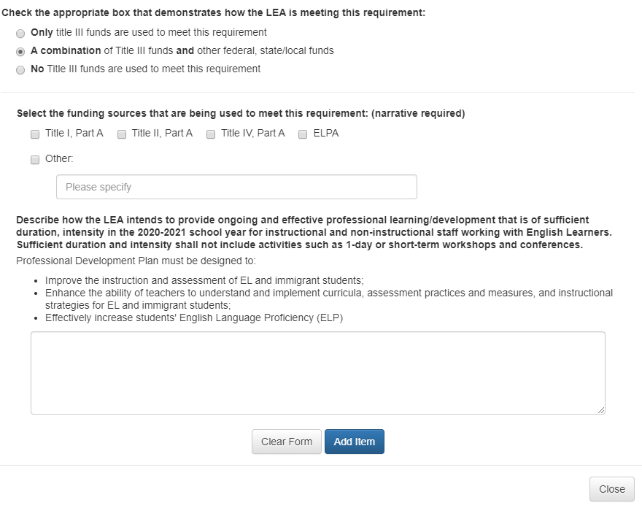
Professional Development Narrative Question
*New*
Notes:
In order for CDE to determine if the LEA is meeting the professional development under Section 3115 ( c ) (2), please describe the professional development that other state, local or federal allocations fund the PD activity.
If the LEA checks the last two radio buttons as described in the previous slides regarding how the PD is funded, an additional narrative check will display.
Please keep in mind, if a combination of Title III funds is selected, the applicant should have an affiliated line item reflected in the Title III budget on the next page.
This additional narrative helps CDE understand what funding sources are used to meet the PD requirement, including general or state funds. The professional development component of Title III is required whether the LEA chooses to use Title III funding or other funding sources. This will be part of the checklist for the CDE reviewer, which we will cover shortly.

Slide 4
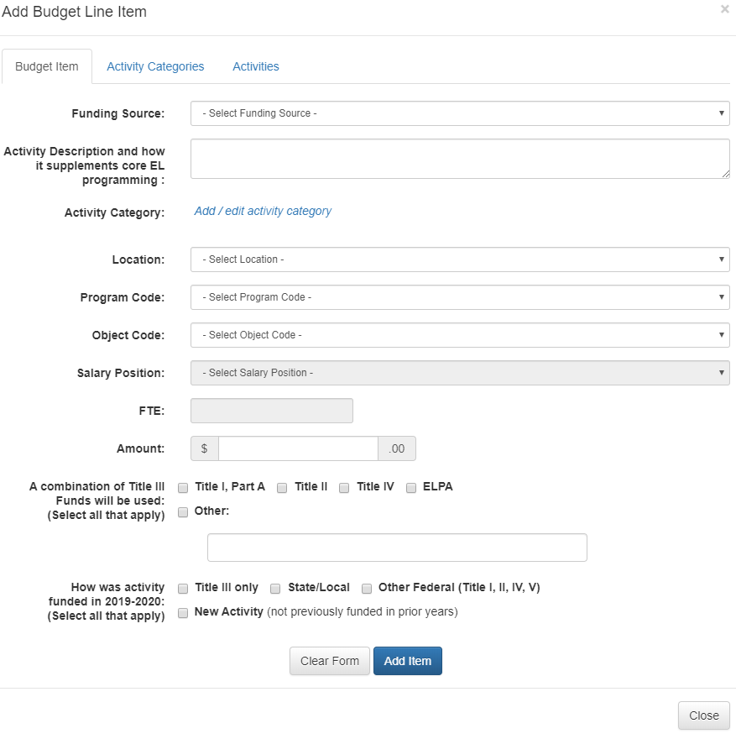
Title III, Part A Budget
**New Functionality**
Notes:
Additional language has been added to guide responses and detail provided in the activity description. Due to the extra Civil Rights components of Title III it is important that CDE has an adequate understanding of how each proposed activity/program/service is supplemental to the school and districts core EL programming.
We have also added two additional collections in the budget pop-up for Title III to determine programmatic and fiscal supplement not supplant requirements.
The first one is to determine whether the district is leveraging other funding streams to support the proposed activity. We are asking that all applicable funding sources be selected and if other Title funds are selected to ensure that that programs budget section reflects the same activity description.
The final addition to the budget is regarding the previous (if any) funding sources used to support the proposed activity. Keep in mind, if it was fully funded with a competitive grant, state, local, ELPA or other Federal funds ex. Title Ill last year, Title III funds cannot be used to pay for it in the 20-21 fiscal year.
As Kristen mentioned in Day 1 functionality, it will be confusing for the reviewer if it reads that a combination of Title III funds were used in the past and that it is a new activity, so if it is a new activity, please just click that button.
Again The purpose of these questions are to address the funding source as an SNS check. This was a common comment that would be submitted back to LEA’s in previous year reviews and has been added as a collection to streamline submissions and reviews.

Slide 5
Title III, Part A Budget
2019-2020 Consolidated Application
2020-2021 Consolidated Application
*New Functionality*
Notes:
You will see here that the additional questions collected through the moodle pop up will display in the budget once activities are added. There is now a ‘Combined Funds’ column and ‘2019-2020 Funding’ column. If the activity is ONLY FUNDED WITH TITLE III, the combined funds column should be blank, and no selection should be made in the moodle pop up.

Slide 6
Title III, Part A Accepting Funds
An LEA may apply on their own only if their allocation is $10,000 or more. An LEA may apply on behalf of a consortium of LEAs (district or BOCES) if the sum of all the current year sign over in addition to the LEA funds equals or exceeds $10,000 (34 CFR § 76.303).
The option of joining a consortium may be especially relevant to a small LEA that does not, on its own, have a sufficient allocation to meet the requirement in ESEA Section 3114(b) that a Title III subgrant be at least $10,000.
Notes:
In order for districts to create a ‘consortium’ and partner to combine Title III funds and provide services to EL students, a lead district must be identified, in which all other partners would ‘sign over’ their Title III allocation that is less than $10,000 to the lead district identified.
The lead district would then budget all proposed activities for themselves and member (partnering) districts in their own Consolidated Application. If interested in partnering with nearby districts that also receive less than $10,000, please work with your Regional Contact to complete application.
*Note Title III Immigrant Set-Aside has no minimum amount requirements in order to accept

Slide 7
Workshop and Reviewer Checklist
Notes:
REMEMBER IT IS ALL ABOUT CONTEXT! Some of this
Budget Really depends upon context--
If you paid for your coordinator with ELPA funds last year, you will need to do the same this year.
There are a lot of scenarios that the reviewer will just need as much information as you can provide. For example, because of COVID need to fund additional teacher to provide additional teacher for ELD - Describe what the core program is in order to determine allowability.
If last year you paid for summer school materials with ELPA funds, then you wouldn't use it this year

Slide 8
Professional Development Narrative Question
The professional development must:
Improve the instruction of ELs;
Enhance the ability of teachers to understand and use curricula, assessment measures, and instructional strategies for ELs;
Be scientifically research-based and of sufficient duration and intensity (Section 3115 (c) (2)
Example:
All instructional staff including paraprofessionals will engage in a year-long professional development.
Non-Example
The district will offer a one-day professional development focused on the National Geographic EDGE curriculum used in our core programming model for English learners.
The training will be a three-part tiered series to strengthen and build academic vocabulary in the classroom.
the WIDA Features
of Academic Language
The training will be built from
and will explore linguistic complexity, language forms and conventions, and vocabulary usage in different content classes throughout the school year.
Notes:
Once again, this is all about local context
Make sure it has
who is providing PD, ----all content teachers learning -expands on
programming and has a plan on engaging teachers throughout the year
Color-coded and the non-example is short on purpose because while brevity is the essence of wit, if you are missing some of the elements above or the 5W’s, you might not have what you need. It’s possible, but you want to cover all of your bases.

Slide 9
Professional Development Review Checklist
Title III Narrative response includes:
Professional development activity descriptions detail how the PD will be delivered throughout the year and who/what/where/when.
All fields requested are complete (if combination of funds was selected, LEA has indicated other funding sources).
If LEA has selected federal funds are being used to meet PD requirement (Title I, II, IV, V) ensure PD described is budgeted in program indicated.
Provides high-quality professional development to classroom teachers (including teachers in classroom settings that are not designed for only language instruction educational programs), principals, administrators, and other school or community-based organizational personnel.
Response includes a description of how professional development will be scientifically research-based and specific to the needs of ELs/ELD.
PD is of sufficient (ongoing) duration (length and time throughout year) and intensity (amount of time).
Response includes a description of how professional development will improve the instruction of ELs and meet the linguistic needs of EL students.
Response includes a description of how professional development will enhance the ability of teachers to understand and use curricula, assessment measures, and/or instructional strategies for EL (response does not need to include all three goals).
Notes:
CDE reviewers will use the following criteria to approve a narrative response describing the district/schools PD requirements. Take some time to read through the checks, I want to bring your attention to the priorities of the PD being of sufficient intensity and duration and meet the specific linguistic needs of English Learners. Sometimes the questions are open-ended and the checklist is designed to clarify what we are looking for as reviewers.
Professional development that is scientifically research-based is directly linked to how the intervention or practice facilitates language instruction or helps English learners meet challenging academic outcomes. This can be from clearinghouse or proven programs designed for English learners. Typically a question that will go back for this item will be related to how is this meant for English learners rather than just a literacy intervention? Generally the scientific or research-base will be related to how the program is tied to language instruction.
Professional Development Question:
Describe how the LEA intends to provide ongoing and effective professional learning/development that is of sufficient duration, intensity in the 2020-2021 school year for instructional and non-instructional staff working with English Learners. Sufficient duration and intensity shall not include activities such as 1-day or short-term workshops and conferences.
Professional Development Plan must be designed to:
•Improve the instruction and assessment of EL and immigrant students;
•Enhance the ability of teachers to understand and implement curricula, assessment practices and measures, and instructional strategies for EL and immigrant students;
•Effectively increase students' English Language Proficiency (ELP)

Slide 10
Title III, Part A Budget Responses
Title III, Part A Activities funded under Title III must include activities in support of high quality LIEP/ELD programs and parent, family and community engagement, as well as provision of high-quality professional development. Activities may include:
Improving ELD programs
Providing community participation programs, family literacy services, and parent outreach and training activities
Providing tutoring and intensified instruction
Improving instruction for EL students by providing educational technology or instructional materials
Example:
Title III funds are used for additional summer school program materials utilizing language instruction materials targeted for English Learners.
EL Family Informational night to explain programming and build community.
EL Coordinator develops and delivers professional learning after school or during in-service days
Non-Example
Title III funds will be used to purchase translation services during parent/teacher conferences.
Funding for 1.0 ELD teacher for 2020-2021 school year
Purchase headsets with microphones for WIDA ACCESS 2.0 assessment
Notes:
DEPENDS ON CONTEXT and FISCAL SNS
Title III funds must only be used to provide additional services, staff, programs, or materials that are not provided with State or local resources absent federal funds; federal funds cannot pay for resources that would otherwise be purchased with State and/or local funds.
Title III funds cannot be used to pay for an activity (supplies, curricular resources, FTE, stipends, etc.) that was previously paid for with another funding source.
Considerations:
How was it funded in the past? Other federal or state and local funds?
Core ELD program varies by schools and districts, so it’s up to the LEA to describe the supplemental nature in the narrative question or the budget line item
I would add: Does ELPA, IDEA, READ Act other grants require the activity?
ELPA requires assessment and identification
Example 1 – An ELD teacher is funded for 0.5 FTE with ELPA funds. Your district requests to use Title III to increase FTE for the teacher to provide additional ELD support, professional development, or family outreach. Can the district use Title III funding for the increased FTE?
Example 2: An ELD teacher in your district was funded with ELPA, but ELPA funding decreased because of lower EL student counts. Can the district use Title III funding to make up the difference?

Slide 11
Budget Review Checklist
Budget line item contains information below:
Activities' proposed are effective, research-based programs/strategies to help English learners increase their English language proficiency and meet Colorado Academic Standards and/or access to grade level content.
Activity describes how item is supplemental to core ELD programming, if applicable.
Previously Funded Section: If LEA has indicated item is 'New Activity' then no other funding sources are selected.
Professional development activity descriptions detail how the PD will be delivered throughout the year (unless captured in narrative).
If LEA has indicated federal funds used (Title I, II, III, IV or IV) ensure activities described are budgeted in program indicated.
Descriptions of activities are allowable, reasonable and necessary.
Expenditures are supplemental to core ELD programming. Was it paid for out of other funds in previous years? Is it required to meet core ELD program requirements under Civil Rights Act/EEOA? Is it required under other funding sources/OCR agreements/DOJ consent decree?
If purchased service, activity description includes who/what/where/when (i.e. length of contract, etc.)/why.
Notes:
Again, CDE reviewers will use this criteria to approve proposed budget activities as applicable. Please ensure that any activities supporting professional development whether that be contracted services, conferences, or stipends for staff to facilitate or participate in trainings--include content of training, who and how many staff will participate, the duration of the training, and how the skills/information obtained will be implemented.
Budget line item considerations:
Activities and strategies outlined in Consent Decree or OCR agreement are not proposed to be funded with Title III
W-APT and WIDA Screener--ELPA requires LEAs to identify, provide services, and annually evaluate ELs. LEAs cannot use Title III to purchase these materials, train teachers, or provide FTE/subs/release time to administer
ACCESS 2.0: annual ELP assessment is required under state law, therefore no cost associated with its administration or training of teachers to administer is allowed.
READ Act approved Resources: Some intervention resources that have been approved by the READ Act may be approved for funding with Title III, but the LEA must provide additional information regarding how the proposed purchase is supplemental to the interventions required by the READ Act.

Slide 12
Title III Immigrant Set-Aside
Updates
New Page-No longer combined with the Title III Budget page
No Immigrant Set-Aside Narrative Collected
Only Budget Page
Budget line item contains information below:
Descriptions of activities are allowable and reasonable.
Title III ISA funds must be used to provides enhanced instructional and supplemental support opportunities for immigrant students and their families.
Professional development activity descriptions detail how the PD will be delivered throughout the year and who/what/where/when.
If purchased service, activity description includes who/what/where/when (i.e. length of contract, etc)/why.
Notes:
Again, unlike Title III, Part A-there is no minimum amount required in order to accept Title III Immigrant set-aside funds. But keep in mind not all districts receive an immigrant set-aside, in which they won’t see this section in their application.
The Title III Immigrant Set-Aside grant is designed to support school districts that have experienced a significant increase in immigrant students over the past two years. This program provides enhanced instructional and supplemental support opportunities for immigrant students and their families.
So, let’s say your allocation jumped from 200-12000 this is a real scenario and you are wondering, what should I do?
The Title III Immigrant Set-Aside has a few more flexibilities than the general Title III, Part A, therefore we have seperated the budget due to the expanded collection of information in Title III, Part A
We received feedback that the information collected and provided in the Immigrant Set-Aside narrative was the same information provided in the budget, therefore we are only collecting programs/services/and activities in the budget.
Just because you are an immigrant, does not mean that you are an English Learner and vice versa
Immigrant Children and Youth
Immigrant children and youth, as defined by Title III for the use of Title III – Immigrant Set-Aside funds and reporting requirements, include children and youth that:
Are between the ages of three years old and twenty-one years old;
Were not born in the United States or any U.S. Territory; and,
Have not attended school in the United States for more than three full academic years.*
To determine the number of “full academic years” a student has been enrolled in U.S. schools, count only the cumulative amount of time a child has been enrolled in U.S. schools. If a student leaves the U.S. and returns, the time out of the country does not count toward the three years.
An LEA receiving Title III immigrant subgrant funds under ESEA Section 3114(d)(1) may use those funds—
o For family literacy, parent and family outreach, and training activities designed to assist parents and families to become active participants in the education of their children; and
o To provide activities, in coordination with community-based organizations, institutions of higher education, private sector entities, or other entities with expertise in working with immigrants, to assist parents and families of immigrant children and youth by offering comprehensive community services. (ESEA Section 3115(e)(1)(A), (G)).
o For all of these activities, an LEA may not use Title III funds to meet its obligations under Title VI and the EEOA, as described in question E-1. Title III funds may be used to supplement an LEA’s activities if the LEA is already meeting its obligation to ensure meaningful communication with LEP parents in a language they can understand.

Slide 13
Questions??

Slide 14
ESEA Office
ESEA Office | Position | Phone | E-mail
Nazie Mohajeri-Nelson | Director of ESEA Office | 303-866-6205 | Mohajeri-nelson_n@cde.state.co.us
DeLilah Collins | Assistant Director of ESEA Office | 303-866-6850 | Collins_d@cde.state.co.us
Michelle Prael | Program Support | 303-866-6998 | prael_m@cde.state.co.us
ESEA Team | Region & Program Expertise | Phone | E-mail
Brad Bylsma | Director of Support Coordinators | 303-866-6937 | bylsma_b@cde.state.co.us
Kristen Collins | Northwest & West Central, Title V and Stakeholder Engagement | 303-866-6705 | collins_k@cde.state.co.us
Tammy Giessinger | Pikes Peak & Southeast, Title IV and School Improvement | 303-866-6992 | giessinger_t@cde.state.co.us
Karen Ingalls | North Central & Northeast, Title I Lead | 303-866-3897 | Ingalls_k@cde.state.co.us
Jeremy Meredith | Southwest, Title II | 303-866-3905 | meredith_j@cde.state.co.us
Laura Meushaw | Pikes Peak & Southeast, Titles I and School Improvement | 303-866-6618 | meushaw_l@cde.state.co.us
Robert Thompson | Northwest & West Central, Title III | 303-866-6842 | thompson_r@cde.state.co.us
Barb Vassis | North Central & Northeast, Titles I and II | 303-866-6065 | vassis_b@cde.state.co.us
Joey Willett | Southwest, Titles I and ID, Monitoring | 303-866-6700 | willett_j@cde.state.co.us
Notes:
Nazie – Note changes in assignments

Slide 15
ESEA Office (Cont.)
ESEA Office | Position | Phone | E-mail
Nazie Mohajeri-Nelson | Director of ESEA Office | 303-866-6205 | Mohajeri-nelson_n@cde.state.co.us
DeLilah Collins | Asst. Director of ESEA Office | 303-866-6850 | Collins_d@cde.state.co.us
CGA Team | Program Expertise | Phone | E-mail
Kim Burnham | Competitive, Grants & Awards Supervisor | 303-866-6916 | Burnham_K@cde.state.co.us
Patricia Gleason | Senior Consultant, Grants & Awards | 303-866-6143 | Gleason_P@cde.state.co.us
Mandy Christensen | Senior Consultant, Grants & Awards | 303-866-6250 | Christensen_m@cde.state.co.us
Brittany Jimenez | Program Support | 303-866-6813 | Jimenez_B@cde.state.co.us
DARE Team | Expertise | Phone | Email
Tina Negley | ESSA Accountability, Program Evaluation, and Reporting | 303-866-5243 | negley_t@cde.state.co.us
Alan Shimmin | ESEA Reporting and Data Collections | 303-866-6209 | shimmin_a@cde.state.co.us
Mary Shen | ESEA Program Evaluation, Research, and Accountability | 303-866-4571 | shen_m@cde.state.co.us

Slide 16
Grants Fiscal Contacts
Grants Fiscal Staff | Program Expertise | Phone | E-mail
Jennifer Austin | Director of Grants Fiscal | 303-866-6689 | Austin_j@cde.state.co.us
Robert Hawkins | Grants Fiscal Analyst | 303-866-6775 | Hawkins_r@cde.state.co.us
Steven Kaleda | Grants Fiscal Analyst | 303-866-6724 | kaleda_s@cde.state.co.us

