Slide 1
Every Student Succeeds Act (ESSA)
Standards Spoke Committee Meeting #1
August 29, 2016
1

Slide 2
Agenda
Welcome and introductions
Quick review of context
Standards section development work plan and process
Discuss first committee task
Wrap-up

Slide 3
Welcome and Introductions

Slide 4
CDE Staff
Melissa Colsman, Ph.D, Teaching and Learning Executive Director
Karol Gates, Standards and Instructional Support Director
Raymond Johnson, Mathematics Content Specialist

Slide 5
Committee Membership
ESSA Standards Spoke Committee Stakeholder Representation
School administrators 1%
Professional educator organization
Parent or parent
3%
Other 10%
organization 3%
Education advocacy
Educators 28%
organization 3%
Business 3%
Institutions of higher education
6%
CDE staff 15%
School district administrators 28%
5

Slide 6
Committee Responses:
What Do You Hope to Contribute?
Perspective and Experience
Geographic perspective: rural, outside of the urban corridor
District size: small district
Role: parent, business, educator, district leader, informal education, higher education, professional educator organizations, educator preparation, early childhood education
Experience on standards committee, state assessment work, other state committees Student Focus
English learners
Students with disabilities
Low SES
At-risk Content Area
Value all ten content areas
Representation of specific content areas
6
Notes:
Presenter
2016-08-29 22:41:31
--------------------------------------------
Geographic:
Content areas:
All ten content areas
physical education and health education

Slide 7
Committee Responses: What Do You Hope to Gain?
Standards
To better understand how all 10 content areas standards can be viewed as interdisciplinary perspective to learning.
I hope to gain better understanding of the ESSA requirements and how it intersects with Colorado law.
Understand what is being changed or adjusted to the CAS [Colorado Academic Standards].
Greater insight as to what standards are best for Colorado. ESSA in General
Additional insight and opportunity to weigh in on the state's ESSA plan.
A better understanding of where we are all headed in education. Process and Involvement
Discovering the views of all the other members of the committee.
An understanding of the process, clear and high standards for our public schools, and increased parent engagement and participation.
Greater involvement in public education.
Involvement in education policy.
7

Slide 8
What Questions Do You Have?
Logistics
Is there a replay of the August 18th webinar available?
What is the time commitment and how will meetings be set?
How do we give feedback to or join other spoke committees? Content and Process
How do we honor the standards from the other 7 core contents that are not addressed in the Standards section of ESSA and still value the "well- rounded" education that ESSA mentions in other sections?
Will we have various tasks between meetings, or will this be more of a feedback role?
Will you have all perspective parties involved in this work? How will we be communicating to all parties involved to provide clarity and reduce fears and anxiety?
8

Slide 9
What Questions Do You Have? (Contined)
Relationship of ESSA State Plan to Standards Revision Process
How will this committee work with the more intensive state- required standards committee that was mentioned on the webinar interact?
How else can I help? I am very interested in becoming more involved at the state level.
I'm curious about how much change to the current standards is needed/anticipated?
Will participation on this committee prevent me from being considered for the standards review process?
9

Slide 10
Contrasting the Process for Meeting Federal and State Standards Requirements
 | ESSA | Senate Bill 08-212 (CAP4K)
Timeline for process | Full ESSA Plan Development: January 2016 – March 2017 Spoke Committee Milestones: 9/30/16: First draft of spoke plan due 12/14/16: First combined spoke drafts provided to State Board In between milestones will be set by the Spoke Committees | On or before July 1, 2018, and every six years thereafter, the State Board shall review and adopt any appropriate revisions Anticipated: The State Board to consider the plan for conducting the review process at their November meeting
Committee participation process | Committee sign-up needed by Monday, August 22 | Anticipated: Application process opens in late fall of 2016
Committee commitment | Provide input on the standards section Provide feedback on drafts of the standards section | Anticipated: Committee meetings throughout 2017
10

Slide 11
Context Reminders
Notes:
Presenter
2016-08-29 22:41:32
--------------------------------------------
13 committee members did not participate in the informational webinar

Slide 12
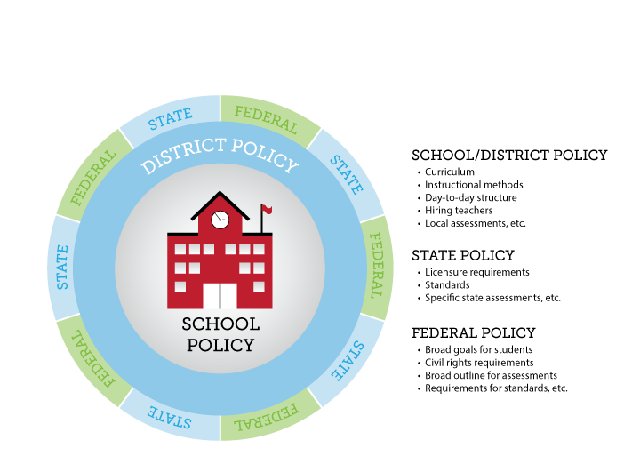
Current Context: Differentiating
Between Federal, State and Local Policies
Existing Colorado Education Law

Slide 13
Current State Context for Standards: CAP4K Timeline
2008: CAP4K passes; school readiness and postsecondary workforce readiness defined by the State Board of Education
2009: Standards revision process conducted; new standards adopted in all ten content areas (called the Colorado Academic Standards)
2010: Assessment system attributes defined; Common Core State Standards in mathematics and English/language arts adopted; standards in these two content areas reissued
2011-2013: Transition process to new standards and assessments
2013-14: Full implementation of standards and continued transition to new assessment system
July 1, 2018: The first review and revision cycle for the Colorado Academic Standards is set to conclude (and every six years thereafter)
13

Slide 14
Current Context: Differentiating
Between Federal, State and Local Policies: Existing CO Law
Existing Colorado Education Law
14
Notes:
Presenter
2016-08-29 22:41:32
--------------------------------------------
Reauthorization of Elementary and Secondary Education Act (ESEA) – Every Student Succeeds Act (ESSA) Signed into Federal law on December 10, 2015
Replaces the No Child Left Behind Act
Replaces Colorado’s ESEA Flexibility Waiver, expired on August 1st – largely used state law to meet federal requirements ESSA establishes broad policy requirements for states and school districts:
Academic standards Aligned assessments School accountability School improvement Teacher quality
Creates programs and provides funding to support state and local implementation of the requirements

Slide 15
ESSA State Plan Development Process
1
5

Slide 16
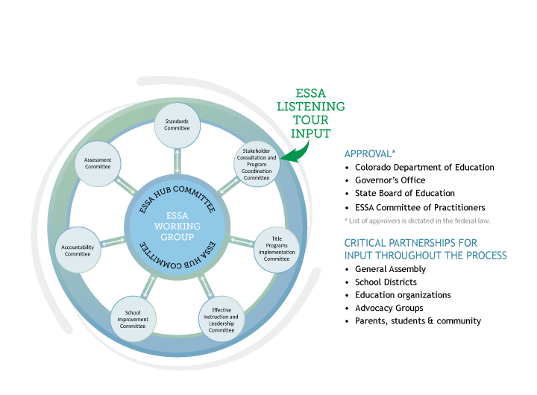
ESSA State Plan Development
Notes:
Presenter
2016-08-29 22:41:32
--------------------------------------------
Under the guidance of the State Board of Education, the Colorado Department of Education (CDE) will utilize a Hub/Spoke Committee structure for ESSA state plan development. A formal, central Hub Committee that will have an oversight role in the development of a draft of our state plan to be submitted to the State Board in early 2017.
ESSA topical spoke committees will be responsible for developing and appropriately vetting sections of the state plan. Spoke committees
Standards Committee Assessment Committee Accountability Committee
Effective Instruction and Leadership Committee School Improvement Committee
Title Program Plans/Assurances Committee
Stakeholder Consultation/Program Coordination Committee Spoke committee membership and meeting process
2-3 CDE Leads identified in mid-July. Leads are responsible for keeping the work on track, acting as subject area experts, maintaining records and assignments, organizing spoke work and meetings, and submitting final drafts and decisions points to the Hub.
CDE has a number of existing stakeholder and committee groups that will be called upon as part of this process. For example, the ESEA Committee of Practitioners will be the foundation of the Title Programs group, but we will supplement membership wherever possible and feasible.
Spoke leads are still developing materials; organizing the committee work and schedule; and crafting a work plan timeline. As a result, some committees are closer to finalizing membership than others and it may take some time to completely finalize spoke committee membership. We will make every effort to include all interested applicants and we ask for your patience as we take the time to be as inclusive as possible.

Slide 17
ESSA State Plan Requirements

Slide 18
Standards Requirements
ESSA Requirements:
Challenging statewide standards in math, reading or language arts, and science
Aligned with higher education and CTE expectations
Alternate achievement standards for students with the most significant cognitive disabilities
Standards for English-language proficiency
Colorado Requirements:
Colorado’s Academic Standards include comprehensive health and physical education; dance; drama and theatre arts; mathematics; music; personal financial literacy*; reading, writing, and communicating; science; social studies; visuals arts; and world languages
English language proficiency and alternative achievement standards
Colorado Academic Standards must be reviewed by July 2018
36
▪ Will include computer science (voluntary at the secondary level)
Notes:
Presenter
2016-08-29 22:41:33
--------------------------------------------
In the last couple of years the Board has expressed a consistent belief in state/local control and concerns about federal overreach Title 1-Section 1111-State Plans
‘‘(1) CHALLENGING STATE ACADEMIC STANDARDS.—
‘‘(A) IN GENERAL.—Each State, in the plan it files under subsection (a), shall provide an assurance that the State has adopted challenging academic content standards and aligned academic achievement standards (referred to in this Act as ‘challenging State academic standards’) ‘‘(C) SUBJECTS.—The State shall have such academic standards for mathematics, reading or language arts, and science, and may have such standards for any other subject
determined by the State.
‘‘(E) ALTERNATE ACADEMIC ACHIEVEMENT STANDARDS FOR STUDENTS WITH THE MOST SIGNIFICANT COGNITIVE DISABILITIES.— ‘‘(F) ENGLISH LANGUAGE PROFICIENCY STANDARDS.—
Each State plan shall demonstrate that the State has adopted English language proficiency standards that— ‘‘(H) EXISTING STANDARDS.—Nothing in this part shall prohibit a State from revising, consistent with this section, any standards adopted under this part before or after the enactment of the Every Student Succeeds Act.
‘‘(2)Assessment ‘‘(v)(I) in the case of mathematics and reading or language arts, be administered— ‘‘(aa) in each of grades 3 through 8; and (bb) at least once in grades 9 through 12;
‘‘(II) in the case of science, be administered not less than one time during—(aa) grades 3 through 5; (bb) grades 6 through 9; and (cc) grades 10 through 12; and ‘‘(III) in the case of any other subject chosen by the State, be administered at the discretion of the State;
The Secretary cannot:
Require a state to submit its standards for review.
In any way mandate, direct or coerce, or exercise any control or supervision over state standards. ESSA Requirements:
Challenging statewide standards in math, reading or language arts, and science. Aligned with higher education and career and technical education standards.
Alternate achievement standards for students with the most significant cognitive disabilities.
Standards for English-language proficiency that address speaking, listening, reading, and writing - aligned with the state’s academic standards. Colorado Requirements:
In addition to the standards required by ESSA, Colorado has standards for dance, drama, music, visuals arts, theater arts, social studies, physical education, and world languages. SB 08-212 provides for the regular review of the Colorado Academic Standards. The first review and revision cycle is set to conclude by July, 2018.
CDE will disseminate an outline of the timeline and review process in fall, 2016.
1% state cap for alternate assessments. No cap for districts but if they exceed 1% they have to justify it.

Slide 19
Contrasting Federal and State Standards Requirements
 | Federal Requirements within ESSA | State Requirements with Senate Bill 08-212 (CAP4K)
Content areas included | Math, reading or language arts, science, English language proficiency, alternative achievement standards | Reading, writing, mathematics, science, history, geography, visual arts, performing arts, physical education, world languages, English language competency, economics, civics, financial literacy, computer science, alternative achievement
Criteria for standards | “Challenging” The U.S. Secretary of Education cannot: Require a state to submit its standards for review. In any way mandate, direct or coerce, or exercise any control or supervision over state standards. | Align with career and technical education (CTE) to the extent practicable Include development of a number of skills* Ensure that the standards are comparable in scope, relevance, and rigor to the highest national and international standards
19
Notes:
Presenter
2016-08-29 22:41:33
--------------------------------------------
This is the only place where alternate assessments and alternate achievement standards are addressed in ECEA.
4.03(6)(f) Benchmarks and Short-Term Objectives.
4.03(6)(f)(i) Consistent with 34 CFR §300.320(a)(2)(ii), for students with disabilities who take alternate assessments aligned to alternate achievement standards, the IEP shall contain a description of benchmarks or short-term objectives.

Slide 20
What Will the Standards Section of the ESSA Look Like?
Because of the restrictions placed on the U. S. Department of Education by ESSA, CDE anticipates that the standards section of the ESSA state plan will be minimal and will include only information pertaining to:
The current status of federally required content areas within Colorado’s Academic Standards (i.e., math, reading or language arts, science, English language proficiency, alternative achievement standards)
Requirements of existing state law that ensure Colorado’s standards are “challenging”
20

Slide 21
Standards Spoke Committee Work Plan and Process
21

Slide 22
Process for ESSA State Plan
Development: Standards Section
Committee input for draft outline
CDE drafts outline from input
Committee provides feedback on outline
CDE drafts narrative from outline
Public draft narrative shared with Hub Committee and State Board of Education
Committee provided with public version of draft narrative
CDE revises narrative based on committee feedback
Committee provides feedback on draft narrative
Public draft narrative shared with the public for feedback
Proposed revisions are shared with committee
Final draft narrative completed
22

Slide 23
How and When Will the Standards Spoke Committee Meetings Be Conducted?
Timeline | Tasks
August 18, 3:30 – 4:30 | Informational webinar about the Standards Spoke Committee
August 22 | Sign-up deadline for committee
August 24 | Committee members are announced and added to standards spoke committee webpage Committee members have access to draft outline
August 29; 3:30 – 4:30 | Virtual committee meeting to discuss questions regarding draft outline
September 1 | Input due for section outline*
September 8; 3:00 – 4:30 | Virtual committee meeting to review draft outline
September 15 | Committee members have access to the first draft of the section
September 22; 3:00 – 4:30 | Virtual committee meeting to review first draft of the section
September 29 | Feedback due for first draft of the section
October 6 | Committee members have access to second draft of the section
23

Slide 24
Task 1: Input for the
Standards Section Outline
24

Slide 25
Section Components
Challenging Academic Content Standards and Aligned Academic Achievement Standards.
Alternate Academic Achievement Standards.
English Language Proficiency Standards.

Slide 26
Component A
Provide evidence at such time and in such manner specified by the Secretary that the State has adopted challenging academic content standards and aligned academic achievement standards in the required subjects and grades consistent with section 1111(b)(1)(A)-(D) of the ESSA.
Requirements to address: (1) assurance that the state has adopted challenging standards, (2) the standards apply to all public schools, (3) the standards include at minimum the subject areas of mathematics, reading or language arts, and science, and (4) the standards are aligned with credit- bearing coursework and state career and technical education standards.
CDE: In this section we plan to include information about CAP4K, how the requirements from CAP4K meet federal requirements, and how implementation of CAP4K assures Colorado’s compliance with federal law.
26

Slide 27
Component B
If the State has adopted alternate academic achievement standards for students with the most significant cognitive disabilities, provide evidence at such time and in such manner specified by the Secretary that those standards meet the requirements of section 1111(b)(1)(E) of the ESSA.
Requirements to address: The alternative achievement standards must: (1) be aligned with the state academic standards, (2) promote access to the general education curriculum, (3) reflect professional judgment as to the highest possible standards achievable by such students, (4) are designated in the individualized education program for each such student as the academic achievement standards that will be used for the student, and (5) are aligned to ensure that a student who meets the alternate academic achievement standards is on track to pursue postsecondary education or employment.
CDE: Colorado state has adopted alternative academic achievement standards (the Extended Evidence Outcomes) so this section will need to
27
address these requirements.

Slide 28
Component C
Provide evidence at such time and in such manner specified by the Secretary that the State has adopted English language proficiency standards that meet the following requirements:
(1) are derived from the four recognized domains of speaking, listening, reading, and writing, (2) address the different proficiency levels of English learners; and (3) align with the State’s challenging academic standards.
CDE: In this section we plan to include information about the requirements within CAP4K for Colorado to have English language proficiency standards, how the requirements from CAP4K meet federal requirements, how implementation of CAP4K assures Colorado’s compliance with federal law, and
evidence for meeting the federal requirements.
28

Slide 29
Committee Resources and Process for Providing Input
Standards Spoke Webpage
Word version of initial section outline
Work plan
ESSA standards requirements
Online input form
29

Slide 30
Q&A
Q & A
30

Slide 31
Wrap Up

