Slide 1
Spring Consolidated Application Training Thursday, May 1st 2025
Federal Programs and Supports Unit &
Grants Program Administration Office
1

Slide 2
Agenda
Due Dates and Reminders
Updated Consolidated Application Planning Resource
Title IV Objects Update
GAINS Systems Trainings Information

Slide 3
Due Dates and Reminders
3

Slide 4
Upcoming Due Dates and Reminders
The Consolidated Application will be collected in two parts in GAINS, the application supplement and the application. These two parts look a little different this year. ​
ESEA Acceptance, Relinquishment, Assignment, and Certification (ARAC) (Application Supplement): This collects -
The Assignment of Funds (Accept, Decline, Assign To), ​
Approval and Transmittal Certification ​
ESEA Consolidated Application (Funding Application): This collects,
The Non-Public School Consultation Form (if applicable),​
The Retention of Funds Form* (if applicable),​
The Tribal Consultation Attestation* (if applicable), ​
General Assurances*​
Program Narratives ​
Program Budgets ​
*Previously in the application supplement​

Slide 5
Consolidated Application Opening
The structure of the Consolidated Application will also be different:​
The Cross Program Section is currently open for LEAs and BOCES to edit.​
Please do not submit your application if you are done with the Cross Program section! ​
The Title Sections will open once we receive the allocations for this year and the ARAC. ​
The ARAC is also pending allocations.

Slide 6
Timeline for Substantial Approval
The following needs to be completed to received Substantial Approval:​
Activity​ | Due Date​ | Submission Location ​
LEA ESEA ARAC​ | Pending allocations– This impacts when the BOCES ARAC can be opened. ​ | ESEA ARAC: FY 2025-2026 Consolidated Application for ESEA Program Funds Approval and Transmittal​
BOCES ESEA ARAC​ | Depends on when member districts complete LEA ARAC.​ | BOCES ESEA ARAC: FY 2025-2026 Consolidated Application for ESEA Program Funds Approval and Transmittal​
Non-Public School Consultation Forms​ | June 30​ | ESEA Consolidated: Non-Public Schools page​
School Improvement Retention of Funds Form​ | June 30​ | ESEA Consolidated: School Improvement Retention of Funds page​
Native American Education Tribal Consultation Form​ | June 30​ | ESEA Consolidated: Submit form to Georgina Owen and complete Attestation in GAINS​
Completed Narratives and Balanced Budgeted in the Online Application | June 30​ | http://colorado.egrantsmanagement.com​

Slide 7
Extension Requests
If the LEA/BOCES is unable to submit all the requirements for Substantial Approval by June 30 the LEA or BOCES may request an extension by submitting a completed extension request form through the GAINS platform.
The LEA/BOCES may not encumber funds until a complete application has been submitted to CDE and granted Substantial Approval. Once the extension request has been submitted and approved, the LEA/BOCES has until the last business day in July to submit requirements for Substantial Approval.

Slide 8
Consolidated Application Planning Resource
8

Slide 9
Consolidated Application Planning Document
Revised from last year (first bullet under Quick Links on the Consolidated Application webpage)
Designed to be a side-by-side support for completing the Consolidated Application
Minimum Required for Approval
Guidance and Helpful Resources
Links
Definitions
NEW - General Budget Guidance
Allowable uses
Considerations
Information to include with Narrative Description

Slide 10
Planning Document Example
Questions listed are the same as in the application.
Minimum required for Approval outlined requirements.
BOCES specific guidance is in red throughout the document.
Response Guidance and Helpful Resources will support that section of the application.

Slide 11
New: General Budget Guidance Section
The general budget guidance section applies to the budgets for Title I, II, III and IV.

Slide 12
Title IV Objectives Updates
12

Slide 13
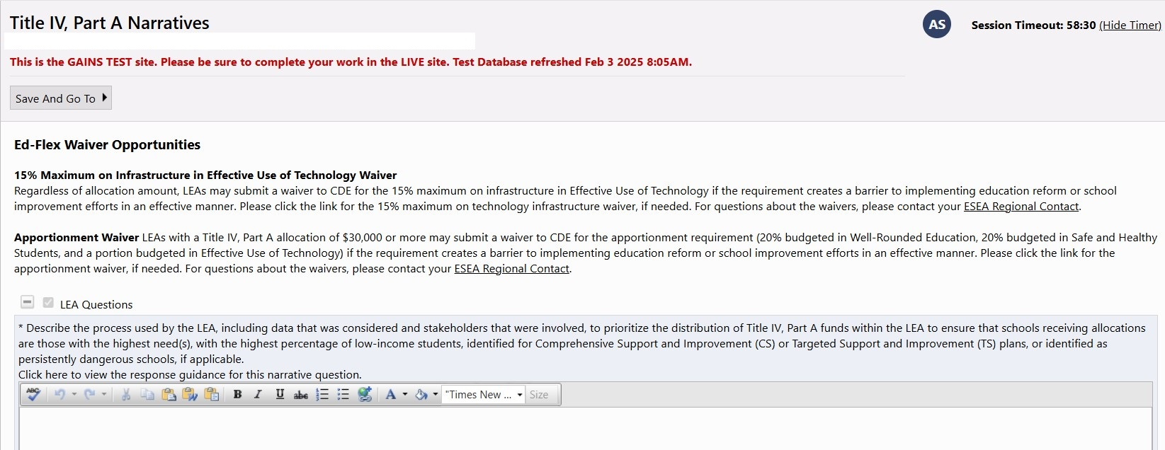
Title IV Narrative Page: Waivers Added
Change from
24-25 Consolidated Application

Slide 14
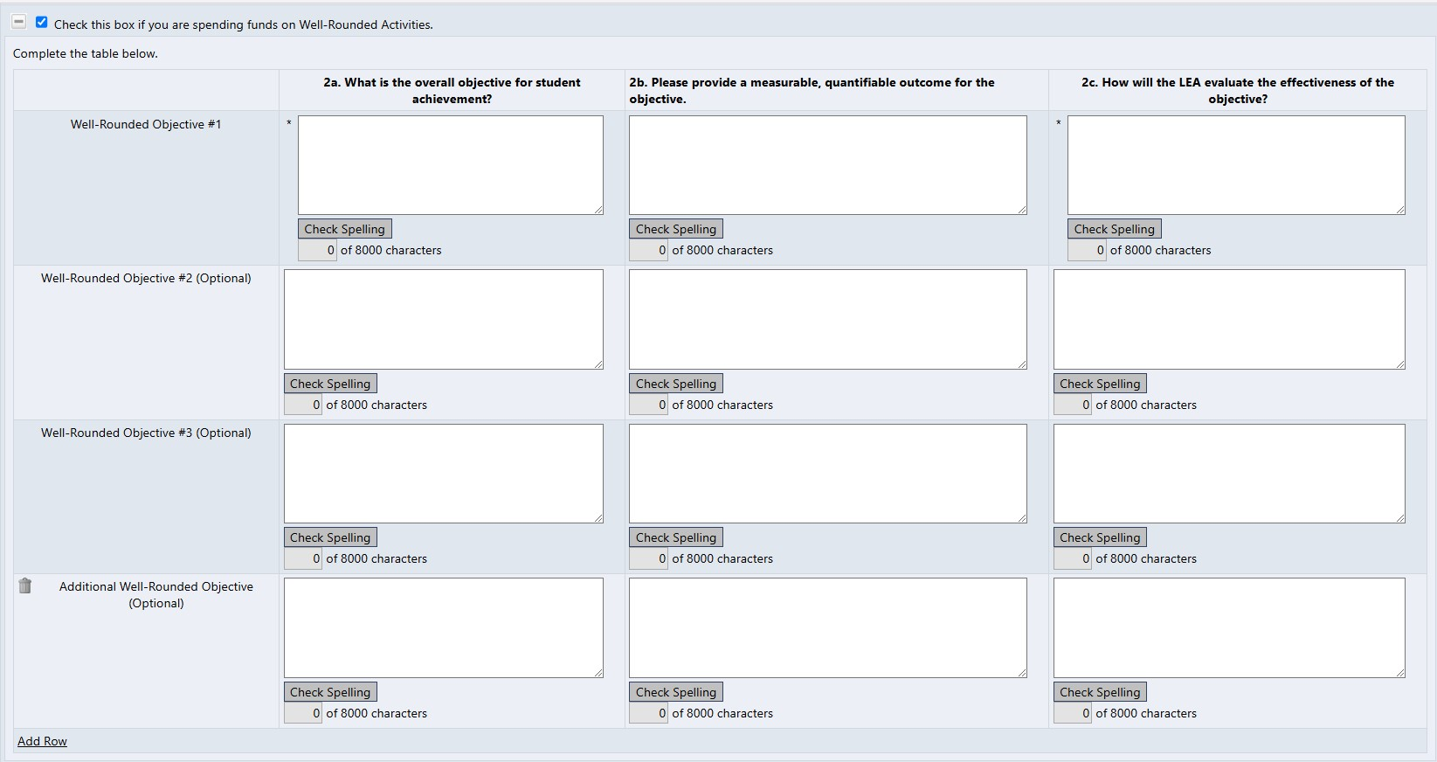
Title IV Narrative Page: Objectives and Outcomes Separated

Slide 15
Title IV Objectives and Outcomes: Example #1
Example for Safe and Healthy Students
2a. What is the overall objective for student achievement?
The LEA will increase the perception of support for social emotional learning and mental health needs by increasing the number of on-site mental health counselors for secondary students.
2b. Please provide a measurable, quantifiable outcome for the objective.
School climate survey scores will increase from an average of 1 on the previous year’s survey, on a 3-point scale, to a 2 on the current year’s survey.
2c. How will the LEA evaluate the effectiveness of the objective?
Survey students and families once per school year to evaluate their perceptions of support for student social emotional learning and mental health needs.

Slide 16
Title IV Objectives and Outcomes: Example #2
Example for Well-Rounded Education
2a. What is the overall objective for student achievement?
The LEA will increase access to higher level coursework (IB, AP, CE) by paying for testing fees associated with those courses for students who are experiencing financial hardship.
2b. Please provide a measurable, quantifiable outcome for the objective.
Increase the amount of students who enroll in higher level coursework by 20%.
2c. How will the LEA evaluate the effectiveness of the objective?
Compare previous three-year enrollment numbers to current year enrollment for each semester.

Slide 17
Title IV Objectives and Outcomes: Example #3
Example for Effective Use of Technology
2a. What is the overall objective for student achievement?
Middle school teachers will attend monthly School AI Champion trainings, which will equip staff with the knowledge and tools needed to effectively integrate Artificial Intelligence (AI) technology into their teaching practices and curricula, in order to teach students to utilize AI in a way that encourages critical thinking.
2b. Please provide a measurable, quantifiable outcome for the objective.
70% of eighth grade students will score a 3 or higher on a rubric with a 5-point scale for one project where students demonstrate using AI in a way that encourages critical thinking.
2c. How will the LEA evaluate the effectiveness of the objective?
Grade band summative assessment: Teachers will utilize a rubric to measure the effectiveness of students using AI to complete a project.

Slide 18
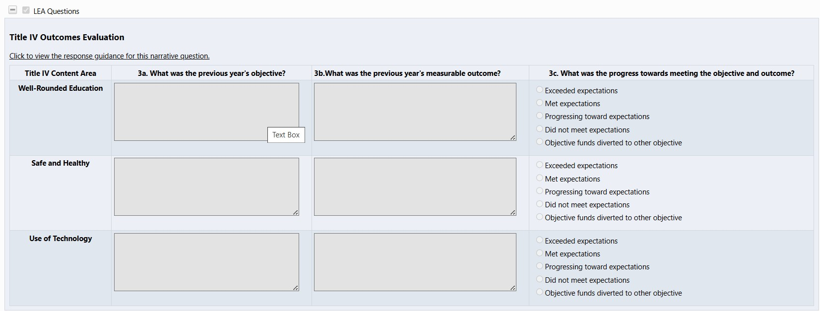
Title IV Evaluations and Effectiveness

Slide 19
GAINS System Trainings
19

Slide 20
Locate the ESEA ARAC
Find the login button on the top right of your screen. Login to the GAINS through the Identity Management System.
The next page you will see is where you enter your Single Sign-on credentials. The username will be your full email, and the password will align to other CDE logins.
In the left navigation menu, hover over the Applicant Supplement and select Application Supplements.
Ensure the Fiscal Year is "2026."
Select “ESEA ARAC” or "BOCES ESEA ARAC" if you are a BOCES and the Member Districts have completed their ESEA ARAC.
Change status to Draft Started to begin filling out the ESEA ARAC.

Slide 21
ESEA ARAC Reminders
It is imperative that the ESEA ARAC is filled out as soon as allocations are available! This will notify CDE to open the rest of the Consolidated Application (Title Sections).
The ESEA ARAC also informs the BOCES ARAC and the BOCES ESEA Consolidated.

Slide 22
Locate the ESEA Consolidated
Find the login button on the top right of your screen. Login to the GAINS through the Identity Management System.
The next page you will see is where you enter your Single Sign-on credentials. The username will be your full email, and the password will align to other CDE logins.
In the left navigation menu, hover over Funding Application and select Funding Applications.
Ensure the Fiscal Year is "2026."
Select “ESEA Consolidated”
Change status to Draft Started to begin filling out the ESEA Consolidated Application.

Slide 23
GAINS Systems Trainings
The Grants Program Administration Office (GPA) has recorded trainings to support GAINS users in the completion of the Consolidated Application. The Title specific trainings and the Cross Program training will cover what has changed within GAINS. Recordings have been created on the following sections:
Cross Program
Title IA
Title ID
Title II
Title III
Title IV
BOCES Training - This training will cover what needs to happen in both the Member District Application and the BOCES Application.
You can also find these trainings posted on the Consolidated Application Training Center website!

Slide 24
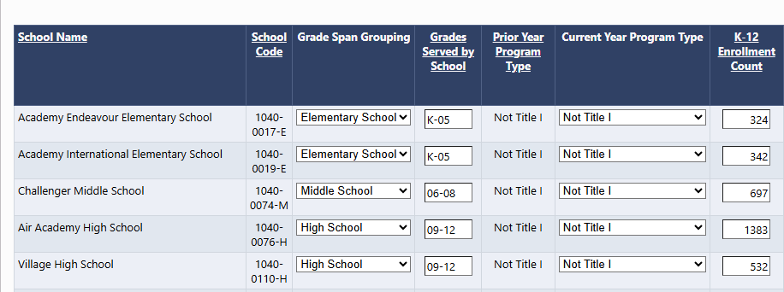
NEW! School Ranking Page Features
Applicants may now edit the Grade Span Grouping, Grades Served by School, and K-12 Enrollment Count fields.
See the Title I, Part A training recording for more information.

Slide 25
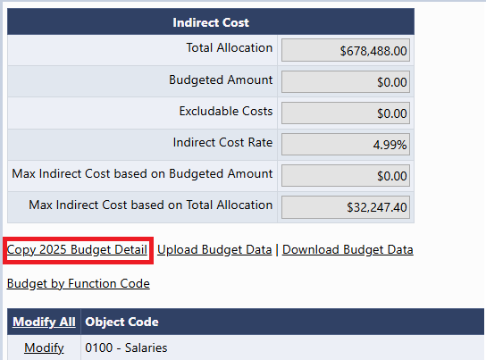
NEW! Copy 2025 Budget Detail
A new link now appears in all budgets! Copy 2025 Budget Detail
This will copy last year's budget and place it in the 2026 budget.
Please be aware that you should consider using this feature before entering any line items. Once a line item is entered, this feature will disappear as an option!
Notes:
JH

Slide 26
Accessing the GAINS Systems Trainings
The recordings, along with the PowerPoints, can be found on the Consolidated Application Training Center.
If you access the trainings and feel something is missing or unclear about GAINS, please fill out the Small Bites Training Request Form so we can build additional trainings around the Consolidated Application!

Slide 27
System Technical Assistance and GAINS Resources
GAINS Help Desk Ticket
GAINS Training Webpage
Catch up on past trainings provided by CDE!
Ask for help and indicate a time that works best for you through this ticketing system!
GAINS Small Bites Trainings
Watch short videos on various aspects of the GAINS platform!

Slide 28
Thank you!
28

