Slide 1
ESEA Title I, Part A
Schoolwide Programming
Notes:
Evita Speaker Notes
Welcome to the Elementary and Secondary Education Act (ESEA), reauthorized as the Every Student Succeeds Act (ESSA), Title I, Part A Schoolwide Programming 101 webinar. The intended audience is education and financial professionals who work with schools that receive Title I, Part A funding. This is an overview of Schoolwide programming for those who are new to Schoolwide programs as well as those with Title I experience.

Slide 2
Objectives
Know the purpose of Title I, Part A and the difference between Schoolwide and Targeted Assistance programs.
Understand the eligibility and program requirements for Schoolwide programs.
Be familiar with the Schoolwide program development cycle in order to plan, implement, and evaluate a Schoolwide program.
Notes:
Evita Speaker Notes
By the end of this presentation, you will:
Know the purpose of Title I, Part A and the difference between Schoolwide and Targeted Assistance programs.
Understand the eligibility and program requirements for Schoolwide programs.
Be familiar with the Schoolwide program development cycle in order to plan, implement, and evaluate a Schoolwide program.

Slide 3
Purpose of Schoolwide Programming vs. Targeted Assistance
A Title I, Part A schoolwide program is a comprehensive reform strategy designed to upgrade the entire educational program in a Title I school with a poverty percentage of 40-percent or more in order to improve the achievement of the lowest-achieving students.
A Title I, Part A targeted assistance program is designed to provide extra educational assistance beyond the regular classroom to at-risk students, identified as having the greatest need for special assistance.
Notes:
Rachel Speaker Notes: The purpose of a schoolwide program is to upgrade the entire educational program of a Title I school. The goal of this programming is to provide opportunities for all children to meet the challenging State academic standards, increase the amount and quality of learning time, help provide an enriched and accelerated curriculum, provide a well-rounded education; and address the needs of all children in the school, but particularly the needs of those at risk of not meeting the State academic standards.
In comparison, schools that are ineligible to operate a schoolwide program, or choose not to, may use their Title I funds to operate a Targeted Assistance program. In a Targeted Assistance program, the school may use their Title I funds for programs that provide services to eligible children identified as having the greatest need for special assistance.

Slide 4
Schoolwide Program Eligibility
School Eligibility
Title I schools must meet the required poverty threshold of 40%
  Schools in which less than 40% of the students are from low-income families can apply for a waiver to be eligible to operate a Schoolwide program.
Student Eligibility
Comprehensive reform strategy to upgrade entire educational program of a Title I school
  All students are eligible for services
Notes:
Rachel Speaker Notes: In order to be eligible for schoolwide programming, Title I schools must meet the required poverty threshold of 40%. This means that at least 40% of the children in the eligible school attendance area are from low-income families. If a school does not meet the 40% poverty threshold, but would like to operate a schoolwide program, they can apply for a waiver. This waiver is linked on the slide or can be found on CDE’s Schoolwide Programming website. Since schoolwide programming is considered a comprehensive reform strategy to upgrade the entire educational program of a school, all students who attend that school are eligible to receive services.

Slide 5
Schoolwide Program Requirements
A school operating a schoolwide program must:
Conduct a comprehensive needs assessment (CNA) using academic achievement and growth data, process data, and stakeholder perception data. For example, the Unified Improvement Plan (UIP), Strategic Plan, 90 Day plan, S-CAP, etc. can be used as the CNA.
Prepare a comprehensive schoolwide plan (through consultation with stakeholders) that describes how the school will improve academic achievement overall, but particularly for the lowest-achieving students by addressing the needs identified in the CNA.
Annually review and regularly monitor the schoolwide plan to determine the program’s effectiveness in addressing the needs identified in the CNA and increasing student achievement.
Notes:
Rachel Speaker Notes: There are several requirements for operating a schoolwide program. First, a school must conduct a comprehensive needs assessment. This CNA must include various sources of data. In Colorado, many districts use the Unified Improvement Plan, Strategic Plan, 90-Day plan, or S-CAP as their CNA. Next, a school must prepare and develop a comprehensive schoolwide plan to meet the needs identified in the CNA. It is very important that various stakeholders be consulted throughout the development of the schoolwide plan. After the plan has been developed and implemented, a school must annually review and regularly internally monitor the progress of their schoolwide plan to determine the program’s effectiveness in addressing their needs and increasing student achievement.

Slide 6
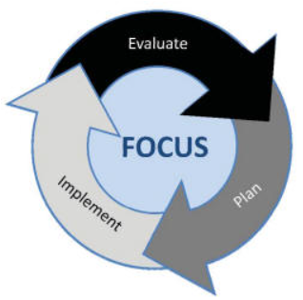
Schoolwide Program Development Cycle
Conduct Comprehensive Needs Assessment
Monitor effectiveness of programming and adjust if needed
Consider evidence-based strategies to create Schoolwide Plan
Implement Comprehensive Schoolwide Plan
Use guiding questions to determine allowability
Notes:
Evita Speaker Notes
The planning, implementation, and evaluation of a Schoolwide program is a cycle, as you see in the graphic here. The steps to developing a Schoolwide program are [Read the boxes]. We’ll walk through each step in more detail in the following slides.

Slide 7
Schoolwide Program Development Cycle – CNA
Conduct Comprehensive Needs Assessment
Monitor effectiveness of programming and adjust if needed
Consider evidence-based strategies to create Schoolwide Plan
Implement Comprehensive Schoolwide Plan
Use guiding questions to determine allowability
Notes:
Evita Speaker Notes
First, LEAs will conduct a comprehensive needs assessment.

Slide 8
Conduct Comprehensive Needs Assessment
What is a
Comprehensive Needs Assessment?
How does the CNA relate to
ESEA Title I, Part A?
A CNA is a process that is used to identify needs and performance challenges in a school or district, determine their root causes, and set priorities for future action.
Title I, Part A requires LEAs to conduct a CNA annually to identify needs and connect performance challenges to the purposes of Title I funding.
How can CNA data inform planning for Title I Schoolwide programs?
How can CNA data inform local Schoolwide program evaluation?
The CNA is a source for several data points including data related to performance challenges, root causes, and actions to address those challenges.
Schools and districts can use data associated with the challenges and actions chosen to address those challenges to evaluate the program.
Notes:
Evita Speaker Notes
Let’s look at the yellow questions in each box. The first question is: What is a Comprehensive Needs Assessment (or CNA for short)? A CNA is a documented process used to identify an LEAs needs and performance challenges, determine their root causes, and create a plan for addressing those needs.
The second question is: How does the CNA relate to ESEA Title I, Part A? The CNA is an annual requirement according to statute. Also, the strategies and interventions funded with Title I, Part A must relate to the needs identified in the CNA.
The third question is: How can CNA data inform planning for Title I Schoolwide programs? The CNA data used depends on the LEAs needs. For example, Science assessment scores in the CNA would be meaningful to planning a Schoolwide program if the LEA has identified a need to increase student achievement in Science and plans to fund strategies to increase student achievement in Science using Title I funding.
The fourth question is: How can CNA data inform local Schoolwide program evaluation? LEAs can use data from the CNA and data throughout the school year to evaluate if the Schoolwide program is achieving the intended goals.

Slide 9
Schoolwide Program Development Cycle - Strategies
Conduct Comprehensive Needs Assessment
Monitor effectiveness of programming and adjust if needed
Consider evidence-based strategies to create Schoolwide Plan
Implement Comprehensive Schoolwide Plan
Use guiding questions to determine allowability
Notes:
Rachel Speaker Notes: The second step in the schoolwide program development cycle is considering evidence-based strategies to create a schoolwide plan.

Slide 10
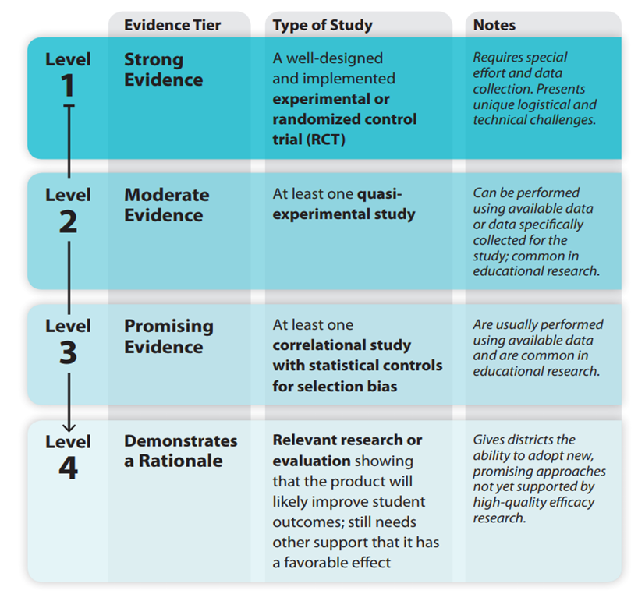
Evidence-Based Interventions and Strategies
ESSA requires that evidence-based interventions and strategies be incorporated into the comprehensive schoolwide plan.
Notes:
Rachel Speaker Notes: ESSA requires that evidence-based interventions and strategies be incorporated in the schoolwide plan. The graphic on the left side of this slide outlines the ESSA Levels of Evidence. More information and resources regarding EBI can be found on the resources slide toward the end of this presentation.

Slide 11
Comprehensive Schoolwide Plan Strategies
Consider the strategies and interventions the school will implement to address school needs and how those strategies will:
  Provide equitable opportunities for all children, including low-income students, students from major racial and ethnic groups, students with disabilities, and English learners
  Use methods and instructional strategies that strengthen the academic program in the school, increase the amount and quality of learning time, and help provide an enriched and accelerated curriculum, which may include programs, activities, and courses necessary to provide a well-rounded education
  Address the needs of all children in the school, but particularly the needs of those at risk of not meeting State Academic and English Language Proficiency standards
Notes:
Rachel Speaker Notes: When selecting the evidence based strategies and interventions the school will implement, it is necessary to consider several important factors such as:
Will this strategy provide equitable opportunities for all children?
Will these interventions use methods and instructional strategies that strengthen the academic program in the school, increase the amount and quality of learning time, and help provide an enriched and accelerated curriculum to provide a well-rounded education?
And, will these strategies address the needs of all children in the school, but particularly the needs of those at risk of not meeting academic and English Language Proficiency standards?

Slide 12
Schoolwide Program Development Cycle – Guiding Questions
Conduct Comprehensive Needs Assessment
Monitor effectiveness of programming and adjust if needed
Consider evidence-based strategies to create Schoolwide Plan
Implement Comprehensive Schoolwide Plan
Use guiding questions to determine allowability
Notes:
Evita Speaker Notes
The next step is to use guiding questions to determine allowability.

Slide 13
Allowable Uses of Funds and Guiding Questions
Use these guiding questions to determine allowable uses of Title I schoolwide funds:
Is there a clear, identifiable connection between this use of funds and a need identified on your Comprehensive Needs Assessment?
Does this use of funds address the needs of all students, but particularly those at risk of not meeting State academic standards?
Does this use of funds strengthen the academic program at your school through evidence-based instructional methods and strategies?
Does this use of funds increase the amount of quality learning time for students?
Does this use of funds provide an enriched or accelerated curriculum contributing to a well-rounded education?
Is this use of funds supplemental to the strategies and methods available to the LEA through non-federal funds?
Is this use of funds reasonable and necessary?
Notes:
Evita Speaker Notes
Here are some guiding questions to determine the allowable uses of Title I funds for a Schoolwide program. Let’s look at a couple of examples where an LEA is making a plan for their Title I funds using these guiding questions.

Slide 14
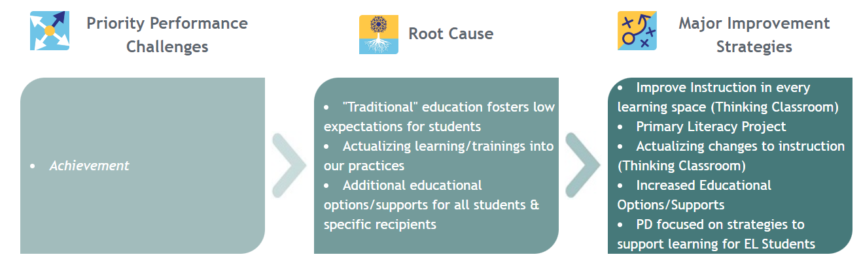
Example
An example district’s needs are identified with their UIP.
Low ELA and math achievement
Instructor-focused teaching fosters low expectations for students
Lack of actualizing trainings into teaching practices
Lack of educational options/supports for all students
Implement math “Thinking Classrooms” with fidelity
Teachers will have ongoing PD to ensure they have the needed strategies for effective implementation
PD focused on literacy and strategies to support learning for EL students
This district would like to fund an additional math instructional coach for an elementary school with low achievement in math.
Notes:
Evita Speaker Notes
Here the LEA has already completed their CNA, which is the UIP in this case. The Priority Performance Challenge identified is low ELA and math achievement. The LEA believes that the Root Causes of low academic achievement are instructor-focused teaching that fosters low expectations for students, lack of actualizing professional development trainings into teaching practices, and lack of educational options and supports for all students. The evidence-based Major Improvement Strategies chosen to address the Root Causes are to implement the Thinking Classrooms approach for math with fidelity, ongoing professional development for teachers, and professional development focused on literacy and strategies to support multilingual learners. Now the LEA wonders: “How can we use funds to meet our needs?” The LEA decides to fund an additional math instructional coach for an elementary school with low achievement in math. Let’s use the guiding questions to determine if hiring an instructional coach would be allowable and the most impactful use of Title I funds for this LEA.

Slide 15
Example - Guiding Questions
CNA
Academic Standards
Academic Program
Quality Learning
Well Rounded Education
Is there a clear, identifiable connection between this use of funds and a need identified in your Comprehensive Needs Assessment?
Does this use of funds provide an opportunity for all students to meet State academic standards?
Does this use of funds strengthen the academic program at your school through instructional methods and strategies?
Does this use of funds increase the amount and quality of learning time for students?
Does this use of funds provide an enriched or accelerated curriculum contributing to a well-rounded education?
No
YES
YES
YES
YES
Notes:
Evita Speaker Notes
CNA - [read question] Yes, the instructional coach is connected to two of the Major Improvement Strategies: Using the math Thinking Classrooms approach to engage students which will lead to increased math achievement as well as PD for teachers with a focus on actualizing the trainings in the classroom.
Academic Standards - [read question] Yes, the instructional coach will help math teachers improve their math instruction which will provide an opportunity for all students to meet State academic standards.
Academic Program - [read question] Yes, the instructional coach will add to the math teachers’ toolbox of evidence-based instructional methods and strategies.
Quality Learning - [read question] No, there won’t be additional learning time.
Well Rounded Education - [read question] Yes, the instructional coach will help teachers to provide an enriched and accelerated math curriculum.

Slide 16
Example - Guiding Questions Continued
At-Risk Students
Evidence- Based
Evaluation
Supplemental
Reasonable
Does this use of funds address the needs of all students, but particularly those at risk of not meeting challenging State academic standards?
Is this use of funds an evidence-based strategy or intervention?
Will you be able to provide evidence that this use of funds was effective in increasing student achievement of academic standards?
Is this use of funds supplemental to the strategies and methods available to the LEA through non-federal funds?
Is this use of funds reasonable and necessary?
YES
YES
YES
YES
YES
Notes:
Evita Speaker Notes
At-Risk - [read question] In short, yes.
Evidence-based - [read question] Yes.
Evaluation - [read question] Yes, evidence will be provided through formative and summative assessments.
Supplemental - [read question] Yes. The district has math instructional coaches funded by state and local funds, however this would be an additional coach at an elementary school who does not have a coach. This position could not be funded without federal funds.
Reasonable - [read question] Yes, the cost of the instructional coach is reasonable and comparable to other salaries in the district. The cost is necessary to improve math instruction and therefore, student performance in math.

Slide 17

Example – Result of Guiding Questions
Therefore, an additional math instructional coach for an elementary school with low achievement in math would be an allowable and impactful use of Title I funds for this example district.
Image by kreativkolors on Freepik.com
Notes:
Evita Speaker Notes
[Read slide] Notice that I did not answer yes to every guiding question. An LEA should just use the questions as a guide to thinking about how to use funds. An LEA must say yes to the questions that ask if an activity is based on the CNA, ultimately results in students meeting State academic standards, evidence-based, supplemental, and reasonable.

Slide 18
Example #2
An example district’s needs are identified with their UIP.
Low ELA and math achievement
Instructor-focused teaching fosters low expectations for students
Lack of actualizing trainings into teaching practices
Lack of educational options/supports for all students
Implement math “Thinking Classrooms” with fidelity
Teachers will have ongoing PD to ensure they have the needed strategies for effective implementation
PD focused on literacy and strategies to support learning for EL students
This district would like to fund an overnight science and literacy-based field trip for all of their 8th grade students.
Notes:
Rachel Speaker Notes: The same example district has proposed another program using their Title I funds. The district would like to take all of their 8th grade students on an overnight field trip that will provide a unique science and literacy learning experience. This program is expensive, and the district has allocated a significant amount of their Title I funds to pay for this activity. Let’s revisit our guiding questions to help this district determine whether this program is allowable and will be the most impactful use of Title I funds for this LEA.

Slide 19
Example #2 - Guiding Questions
CNA
Academic Standards
Academic Program
Quality Learning
Well Rounded Education
Is there a clear, identifiable connection between this use of funds and a need identified in your Comprehensive Needs Assessment?
Does this use of funds provide an opportunity for all students to meet State academic standards?
Does this use of funds strengthen the academic program at your school through instructional methods and strategies?
Does this use of funds increase the amount and quality of learning time for students?
Does this use of funds provide an enriched or accelerated curriculum contributing to a well-rounded education?
YES
NO
NO
MAYBE
MAYBE
Notes:
Rachel Speaker Notes:
CNA - While there is a vague relationship between this proposed use of funds and the identified need to reduce instructor-focused teaching, there is not a clear connection.
Academic Standards - While this plan does offer a unique learning experience, there is no clear evidence that the proposed field trip will provide an opportunity for students to meet state academic standards.
Academic Program - This field trip may provide a supplemental academic experience, but is it strongly tied to content and standards? We do not have enough information to know whether this is an evidence-based instructional strategy.
Quality Learning - Yes, since the field trip is an overnight, it technically would be increasing learning time.
Well Rounded Education -This experience may enrich learning, but we would need more justification on how the field trip connects to academic standards.

Slide 20
Example #2 - Guiding Questions Continued
At Risk Students
Evidence-
Based
Evaluation
Supplemental
Reasonable
Does this use of funds address the needs of all students, but particularly those at risk of not meeting challenging State academic standards?
Is this use of funds an evidence-based strategy or intervention?
Will you be able to provide evidence that this use of funds was effective in increasing student achievement of academic standards?
Is this use of funds supplemental to the strategies and methods available to the LEA through non-federal funds?
Is this use of funds reasonable and necessary?
NO
NO
MAYBE
YES
MAYBE
Notes:
At-Risk - This plan is inclusive of the entire grade level.
Evidence-based - There is no evidence based justification included in the plan.
Evaluation - Depending on the documentation and data collected, it might be possible to provide evidence or a connection that this activity helped increase student achievement.
Supplemental - It is unclear whether this program could be paid for using state or local funds.
Reasonable- Since the cost of this activity is a significant portion of this LEA’s Title I allocation, it would not be considered reasonable or necessary to spend this much money on this activity.

Slide 21

Example #2 – Result of Guiding Questions
Due to the uncertainty of this use of funds highlighted by the guiding questions, this school may want to consider using their schoolwide funds in a different way.
Image by StuartMiles on freerangestock.com
Notes:
Rachel Speaker Notes: Due to the uncertainty of this use of funds highlighted by the guiding questions for the use of ESEA Title I funds, this district may want to consider using their schoolwide funds in a different way. While this field trip sounds like a great experience for these students, the district might consider how they could fund this activity using State or Local funds.

Slide 22
Schoolwide Program Development Cycle - Plan
Conduct Comprehensive Needs Assessment
Monitor effectiveness of programming and adjust if needed
Consider evidence-based strategies to create Schoolwide Plan
Implement Comprehensive Schoolwide Plan
Use guiding questions to determine allowability
Notes:
Evita Speaker Notes
The next step is to implement the Comprehensive Schoolwide Plan.

Slide 23

Implement Comprehensive Schoolwide Plan
Implement Schoolwide plan strategies and activities that have been determined to be:
  Evidence-based,
  Allowable,
  Reasonable, and
  Necessary.
Notes:
Evita Speaker Notes
We want to reiterate that LEAs should implement activities that are evidence-based, allowable, reasonable, and necessary.

Slide 24
Schoolwide Program Development Cycle - Monitor
Conduct Comprehensive Needs Assessment
Monitor effectiveness of programming and adjust if needed
Consider evidence-based strategies to create Schoolwide Plan
Implement Comprehensive Schoolwide Plan
Use guiding questions to determine allowability
Notes:
Rachel Speaker Notes: The last step in the cycle is monitoring the effectiveness of programming and adjusting if needed.

Slide 25

Progress Monitoring Program Implementation
Internally monitor program implementation to:
  Determine if desired outcomes have been achieved
  Assist decision making on how to adjust or improve the program
  Answer questions about the value of the program and the investments being made
Image by pressfoto on Freepik.com
Notes:
Rachel Speaker Notes: LEAs should annually review and regularly monitor their schoolwide programs. Through progress monitoring, the LEA will be able to determine if desired outcomes have been achieved, assist decision making on how to adjust or improve the program and answer questions about the value of the program and the investments being made.

Slide 26
Progress Monitoring Program Implementation Trainings
CDE co-developed 6 program evaluation training modules with Marzano Research.
Module Topics:
Logic Models and Evaluation Questions
Assessing the Availability and Quality of Existing Data
Identifying and Developing Data Collection Instruments
Coding, Cleaning, and Analyzing Data
Interpreting and Presenting Findings
Request individualized training or technical assistance by contacting your
ESEA regional contact.
Notes:
Rachel Speaker Notes: To support schools and districts with evaluating the impact of programs supported with ESEA funds, the Federal Programs and Supports Unit partnered with the Regional Educational Laboratory to develop and deliver a series of Program Evaluation Trainings. The program evaluation training modules are sequential and build upon each other. These trainings are linked to this slide and can also be found on CDE’s program evaluation training website.

Slide 27
Misunderstandings about Schoolwide Programming
Misunderstanding | Explanation
Title I, Part A funds may only be used for: Reading or math instruction. Remedial instruction. Instruction in general. | Title I funds may be used to support activities that improve student academic achievement, particularly at-risk students, as identified in the LEA’s comprehensive needs assessment and articulated in the LEA’s comprehensive schoolwide plan.
Title I, Part A programming is only: For low achieving students. Based on the pull-out model. | A Title I, Part A schoolwide program upgrades the entire educational program in a Title I school to improve the achievement of the lowest-achieving students. All students may benefit. Title I services are not limited to the pull-out model.
Source: United States Department of Education, Office of Elementary and Secondary Education. (2016, September). Supporting School Reform by Leveraging Federal Funds in a Schoolwide Program. oese.ed.gov. Retrieved October 17, 2022, from https://oese.ed.gov/files/2020/02/essaswpguidance9192016.pdf
Notes:
Evita Speaker Notes
There are some misunderstandings about Schoolwide programming. The first misunderstanding is that Title I funds may only be used for reading or math instruction, remedial instruction, or instruction in general. Actually, funds can be used to support any activities that address the needs identified in the CNA and improve student academic achievement. Another misunderstanding is that Title I programming is only for low achieving students or delivered through the pull out model. Really, all students can benefit from a Schoolwide program and a variety of instructional models can be utilized.

Slide 28
Misunderstandings about Schoolwide Programming Continued
Misunderstanding | Explanation
Title I, Part A funds may not be used to support preschool-aged students. | A schoolwide program may use Title I funds to operate a preschool program to improve cognitive, health, and social-emotional outcomes for children from birth to the age at which the LEA provides a free public elementary education. These preschool programs prepare children, who reside in the school’s attendance boundaries, for success in kindergarten.
Source: United States Department of Education, Office of Elementary and Secondary Education. (2016, September). Supporting School Reform by Leveraging Federal Funds in a Schoolwide Program. oese.ed.gov. Retrieved October 17, 2022, from https://oese.ed.gov/files/2020/02/essaswpguidance9192016.pdf
Notes:
Evita Speaker Notes
The final misunderstanding is that Title I funds may not support preschool-aged students. Actually, a Schoolwide program may include a preschool that prepares children for success in Kindergarten.

Slide 29
Tips for the Comprehensive Schoolwide Plan
The plan must be developed annually in coordination with other Federal, State, and local programs and with meaningful consultation with stakeholders (district leaders, teachers, students, families, and community.)
Annual
Regularly monitor and revise the plan to ensure all students are provided opportunities to meet Colorado Academic Standards (CAS) and Colorado English Language Proficiency Standards(CELP).
Monitor
The plan should be based on the comprehensive needs assessment and must describe the evidence-based strategies and interventions the school will implement to address school needs.
CNA
The plan must be made available to the public in an understandable and uniform format, and to the extent practicable, provided in a language that parents can understand.
Public
Notes:
Rachel Speaker Notes: To wrap up this presentation, we have several tips regarding schoolwide program planning. First, here are several tips and reminders about the comprehensive schoolwide plan:
The plan must be developed annually
The plan must be regularly monitored internally
The plan must be based on needs identified in the CNA
The plan must be made available to the public in an understandable and uniform format in a language parents can understand

Slide 30
Tips for the Consolidated Application
Title I schools must be served in rank order by poverty percentage unless the method of serving is district less than 1,000 students or there is only one K-12 school in the district.
School Profiles
Answer all parts of the narrative questions, using the response requirements and guidance for assistance. Connect all responses back to the comprehensive needs assessment and schoolwide plan.
Narratives
Make sure activities support the needs identified in the comprehensive needs assessment and schoolwide plan. Meet the requirements for set-asides, maximum direct administration percentages and indirect costs, and minimum per pupil allocation (PPA), where applicable.
Budget
Notes:
Evita Speaker Notes
Here are a few tips for the Consolidated Application. Make sure Title I schools are served in rank order, connect narrative responses to the CNA and Schoolwide plan, and ensure that activities in the budget support the needs identified in the CNA.

Slide 31
Tips for CDE Monitoring
Include and maintain documentation of the involvement of parents, other community members, and relevant stakeholders in the development of the schoolwide plan.
Stakeholders
Monitor and evaluate the implementation of the schoolwide plan to ensure that Title I program goals are being met and make revisions, when necessary.
Implementation
Ensure that the Title I schoolwide plan is available to stakeholders in a format and language that the parents in the school community can understand.
Accessibility
Notes:
Rachel Speaker Notes: Some years, your school may be monitored by CDE. Here are some tips for CDE monitoring. Be sure to document the involvement of various stakeholders during the development of your schoolwide plan. Internally monitor your programming and make revisions, when necessary. Finally, ensure that your plan is accessible to your school community.

Slide 32
Now, you:
Know the purpose of Title I, Part A and the difference between Schoolwide and Targeted Assistance programs.
Understand the eligibility and program requirements for Schoolwide programs.
Are familiar with the Schoolwide program development cycle in order to plan, implement, and evaluate a Schoolwide program.
Notes:
Evita Speaker Notes
This is the end of our presentation. [Read slide]

Slide 33
Resources for Schoolwide Programs
Federal Laws and Regulations
Foundation of schoolwide programs: ESSA § 1114, 34 C.F.R. 200.25‐200.29
USDE Non-Regulatory Guidance
Supporting School Reform by Leveraging Federal Funds in a Schoolwide Program (2016)
CDE Guidance
Title I, Part A Schoolwide Programs
Evidence Based Interventions and Strategies
CDE Evidence Based Interventions
Institute of Education Sciences What Works Clearinghouse
Notes:
Evita Speaker Notes
Here are some useful resources if you would like more information about Schoolwide programs.

Slide 34

Contacts
If you have any questions, please contact your ESEA Regional Contact.
Image by starline on Freepik.com
Notes:
Evita Speaker Notes
[Read slide] Thank you for your time and best wishes to you as you implement your schoolwide plans.

