Slide 1
ESEA 2024-2025 Monitoring Schedule
District Number | Local Education Agency (LEA) Name | ESEA Monitoring Year | ESSER Monitoring Year
0250 | Springfield RE-4 | 2024-25 | 2022-23
0260 | Vilas RE-5 | 2024-25 | 2021-22
0890 | Dolores County RE No.2 | 2024-25 | 2021-22
1030 | Manitou Springs 14 | 2024-25 | 2022-23
1060 | Peyton 23 Jt | 2024-25 | 2022-23
1120 | Edison 54 JT | 2024-25 | 2021-22
1330 | Gilpin County RE-1 | 2024-25 | 2021-22
1380 | Hinsdale County RE 1 | 2024-25 | 2021-22
1430 | Eads RE-1 | 2024-25 | 2021-22
1400 | La Veta Re-2 | 2024-25 | 2023-24
1440 | Plainview RE-2 | 2024-25 | 2022-23
1590 | Primero Reorganized 2 | 2024-25 | 2021-22
1760 | Kim Reorganized 88 | 2024-25 | 2021-22
1850 | Frenchman RE-3 | 2024-25 | 2021-22
1860 | Buffalo RE-4J | 2024-25 | 2021-22
1870 | Plateau RE-5 | 2024-25 | 2021-22
2535 | Manzanola 3J | 2024-25 | 2022-23
2620 | Holyoke Re-1J | 2024-25 | 2022-23
2630 | Haxtun RE-2J | 2024-25 | 2021-22
2750 | Sargent RE-33J | 2024-25 | 2021-22
2840 | Norwood R-2J | 2024-25 | 2021-22
2862 | Julesburg Re-1 | 2024-25 | 2021-22
2865 | Revere School District | 2024-25 | 2021-22
3030 | Akron R-1 | 2024-25 | 2021-22
3050 | Otis R-3 | 2024-25 | 2021-22
3060 | Lone Star 101 | 2024-25 | 2021-22
3210 | Wray RD-2 | 2024-25 | 2021-22
9040 | Northeast BOCES | 2024-25 | 2021-22

Slide 2
Federal Programs Monitoring Overview
September 12, 2024
Notes:
Sue
Welcome!

Slide 3
Outcomes for Today’s Training
Review the Federal Programs monitoring purpose and process
Understand what happens during each step of the timeline
Preview examples of resources and tools
Know how to get additional support
Meet members of the monitoring team
Acronyms used today:
LEA: Local Education Agency
PMSA: Program Monitoring Self-Assessment
FPSU: Federal Programs and Supports Unit
GAINS: Grants Administration Implementation and Navigation System
Notes:
Sue
Our main goal today is to provide LEAs with the information needed to have a successful and positive monitoring experience. We will review what the Federal Programs monitoring purpose is and what the process will look like, break down the timeline into steps, provide examples of resources and tools, and provide monitoring team contact information if any support is needed. Additionally, we have our monitoring team presenting today so that you can put faces with names.
There are a few acronyms you will see throughout today’s presentation and throughout the monitoring process, so we want to make sure everyone is aware of what these acronyms mean. [go through list]
Lastly, before we begin, we realize many questions may arise during this training. Please feel free to ask questions in the chat. We will also have a time at the end of the presentation for additional questions and discussion.

Slide 4
Overview
Monitoring formalizes the integral relationship between CDE and Colorado LEAs in implementing effective programs using Federal funds.
Program monitoring is implemented from a program perspective and meant to accomplish the following objectives:
  Focus on What Matters (Improving Outcomes for Students)
  Reduce Burden on LEAs
  Improve Communication with LEAs
  Differentiate and Customize Support for LEAs
  Ensure Basic Requirements Are Met
Notes:
Sue
The Federal Programs and Supports Unit and Grants Fiscal vision for monitoring is to help build awareness of the requirements associated with accepting federal funds, capacity to self-assess against the requirements of the grants, and enhance understanding of how school districts and BOCES can best utilize grant funding to improve services for students. Monitoring is an opportunity to identify LEAs’ effective practices already in place, identify technical assistance and support needs, and leverage Federal funds in support of better outcomes for all students.

Slide 5
Purpose and Components
Purpose of Monitoring
Application Reviews
To ensure that federal funds are used appropriately to implement programs that meet the intent of each program
Site Visits
Federal Programs Monitoring
Communications, Training and Technical Assistance
ESEA Program Intent
To ensure all students, particularly underserved students, have equitable access to a high-quality education
Evidence Submission and Review
Self-Assessment
Notes:
Sue
During federal programs program monitoring, reviewers are looking to ensure that federal funds have been used appropriately to implement programs that meet the intent of the program being monitored. For 2024-2025, the focus will be on ESEA programs, most recently reauthorized as ESSA. ESEA program monitoring includes many components such as communication between Federal Programs and Grants Fiscal and the field, Consolidated Application reviews, training and technical assistance (such as Office Hours and Regional Network Meetings), the Program Monitoring Self-Assessment and questionnaire, evidence submission and review, and site visits and interviews with stakeholders.
Sue: Federal Program Monitoring is an ongoing cycle, not just a single event. The purple graphic provides examples of the many components of ongoing monitoring and support to ensure all students have access to high quality education. Our focus for today will be the formal monitoring process for selected LEAs in which you will complete a self-assessment, submit evidence, and receive feedback.

Slide 6
Lessons from 2023-2024
23-24 Key Takeaways
All LEAs submitted the PMSA and all reviews complete
FPSU is continuing the final review of reports
Exemplars for use in future training opportunities
Identified opportunities to clarify expectations, purpose, and process for the LEAs completing the Program Monitoring Self-Assessment (PMSA)
Moving Forward
Submitting and reviewing program monitoring self-assessments in GAINS
Will continue to identify areas for additional training and technical assistance based on common recommendations (best practices) and corrective actions (required by statute/guidance)
Notes:
Sue
Each year we take time to reflect on our processes to identify successes and areas for improvement. We would like to celebrate that all LEAs being monitored during the 2023-2024 school year submitted their self-assessments. The review process for all submissions has been completed, and all monitoring reports have been sent or are in the final review phase. The submissions for several LEAs have provided us examples and exemplars that we will be able to use moving forward. We encourage all LEAs to continue submitting effective practices that we can share. We also found that, in some cases, the responses on the PMSA did not always include the level of detail we needed. In order to support LEAs moving forward, we have made additional revisions for clarification on the self-assessment, and we have identified areas for our team to provide better support through our explanations and training. Our team will continue to identify the need for additional trainings and guidance and will work to provide those as needed.
Moving forward, we have built additional guidance and will be providing training to support the self-assessment process, especially as we migrate to GAINS this year. Our team will also be focusing on finding common recommendations and best practices to inform our training and technical assistance.
Sue: findings from the monitoring process is a way to also identify areas in which we need to provide more clarity and assistance to LEAs.

Slide 7
Program Monitoring Timeline
and Notification
Notes:
Kristin

Slide 8
Timeline
Late Summer/Early Fall
Early Fall
Late Fall/Winter
Spring/Summer
Notification
Training
Program Monitoring Self-Assessment (due October 28, 2024)
Technical Assistance
Evidence Review
Additional Evidence Requests
Potential Site Visits for Tier II and Tier III
Reports
Corrective Action Plans
Notes:
Kristin
As shared before, one of the primary components of the Federal Programs monitoring process is the submission of a self-assessment. The Federal Programs and Supports Unit uses the Program Monitoring Self-Assessment, also known as the PMSA. During their year of monitoring, LEAs are notified of their participation in the monitoring process through a letter. FPSU also provides an initial training for LEAs being monitored, and all other interested LEAs. This typically happens in September.
The timeline then allows time for LEAs to complete and submit the self-assessment. We will be sharing information about how to access the self-assessment during today’s training. We have set October 28, 2024, as the submission deadline, however, we encourage LEAs to reach out to us if a different timeline is needed. Technical assistance is available as needed to support LEAs in submitting the self-assessment.
As self-assessments start coming in, the FPSU monitoring team will be reviewing submissions, determining what, if any, additional evidence is needed, and will begin planning site visits if needed for tier II and III LEAs. Once all evidence has been submitted and reviewed, FPSU monitoring team members will draft and send reports to LEAs. For tier II and III LEAs with corrective actions, the FPSU monitoring team will set up a meeting with the LEA and begin the corrective action planning process. More information about these steps is included in the next several slides. The goal each year is to have reports completed by the end of June.

Slide 9
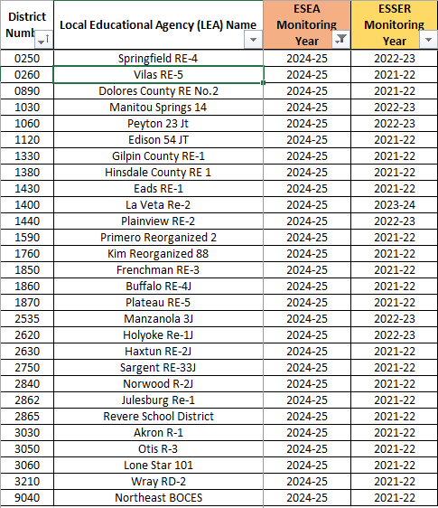
Monitoring Schedule
All LEAs will participate in ESEA program monitoring during a multi-year cycle
Monitoring Schedule is posted on the Federal Programs Monitoring website.
28 LEAs, including 1 BOCES, will be monitored in 2024-2025
Notes:
Kristin
All LEAs that accept ESEA funds will participate in monitoring during a multi-year cycle established by CDE’s Federal Programs and Supports Unit (FPSU). This cycle is posted on CDE’s website for reference. One thing that is different for 2024-2025 is that the program monitoring for ESSER has been completed, so we will be returning to ESEA-only monitoring.
27 LEAs, including 1 BOCES, will be monitored in 2024-2025. All LEAs should have received an email on Monday, September 10th, containing the program monitoring notification letter. The email was sent to the authorized representative and monitoring contact, if added, in the Consolidated Application through GAINS, based on which programs are being monitored. If you are someone who should have received that letter, please check with your authorized representative about receiving a copy. If you ARE the authorized representative, please reach out directly to me, crumley_k@cde.state.co.us for a copy, then ensure the contact information in the Consolidated Application application is up-to-date.
Please read through the entirety of the notification letter for important details.

Slide 10
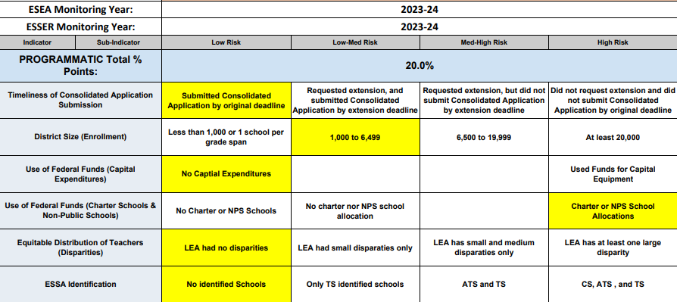
Risk Assessment - Program Indicators
Completed each year
Rank risk from low to high for each indicator
Used to identify program monitoring tier
Snapshots are shared with LEAs being monitored*
* LEAs not being monitored this year may request a copy of their risk assessment snapshot for 24-25.
Notes:
Kristin
Each year, CDE also completes a risk assessment as a component of the monitoring process. The risk assessment includes several different programmatic risk factors, including the LEA’s enrollment, uses of funds for charter schools and non-public schools, and the number of schools identified for Support and Improvement under ESSA. The level of risk for each LEA is ranked from low to high on each indicator. Based on the risk assessment, some LEAs will be selected for Tier II and Tier III monitoring. The risk assessment results will be shared with each LEA that is being monitored. LEAs not being monitored may request a copy of their risk assessment snapshot. Please note, all LEAs, regardless of tier, will begin the process by submitting the PMSA.

Slide 11
Completing the
Program Monitoring Self-Assessment
(PMSA)
Notes:
Kim

Slide 12
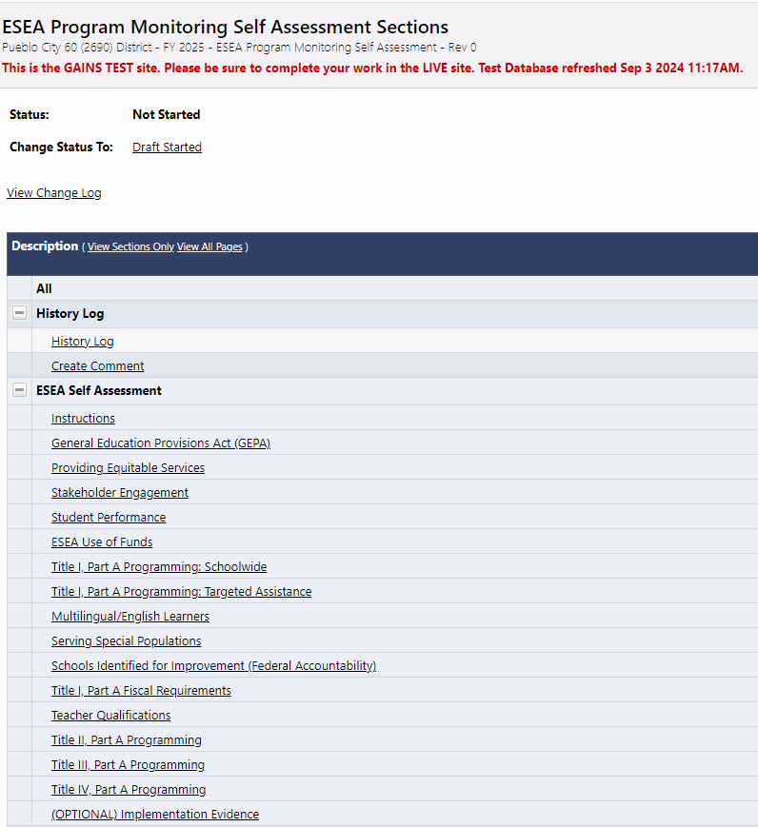
Getting Started
The ESEA Program Monitoring Self-Assessment (PMSA) will be completed and submitted within GAINS.
A working copy of the PMSA is available in PDF format for LEA’s reference on CDE’s Federal Programs Monitoring Page.
Notes:
Kim: The ESEA Program Monitoring Self-Assessment, or PMSA, will need to be completed and submitted in GAINS. We have a working copy of the PMSA posted on the Federal Programs Monitoring Page (https://www.cde.state.co.us/fedprograms/esea_program_monitoring_self-assessment) which may be useful if multiple staff are working on different sections. But please note that the final submission must be through GAINS.

Slide 13
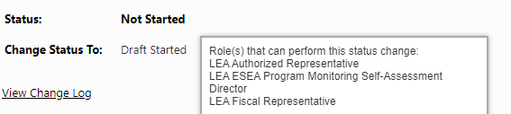
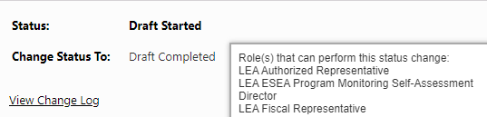
GAINS User Roles
Who can begin the Program Monitoring Self-Assessment?
LEA Authorized Representative
LEA Fiscal Representative
LEA ESEA Program Monitoring Self-Assessment Director
Who can edit and submit the PMSA?
LEA Authorized Representative
LEA Fiscal Representative
LEA ESEA Program Monitoring Self-Assessment Director
Who can assign additional access to a team member as a Program Monitoring Self-Assessment Director?
LEA User Access Administrator
Notes:
Kim - As we’re learning in GAINS, different roles have different functionality. For the PMSA, the LEA Authorized Representative, LEA Fiscal Representative and the LEA ESEA Program Monitoring Self-Assessment Director can all begin the PMSA by changing to “Draft Started”. In the first screenshot, you can see the assigned roles that can perform various status changes by hovering over the “Change Status To” link. Those 3 roles also have the functionality to edit and submit the PMSA. If you discover that your LEA needs to adjust or assign additional access, please work with your LEA User Access Administrator.

Slide 14

Time Commitment for the PMSA
How much time should this take?
A reasonable expectation for completing the PMSA in GAINS is approximately two hours.
If additional team members are needed to support different programs, time to check in with those team members will need to be considered.
Notes:
Kim: You may be wondering how long will it take to complete the PMSA? A reasonable expectation is about two hours. If additional team members will be providing information for different sections of the PMSA, that time will need to be considered before submitting the PMSA in GAINS. It may also be helpful to download the working copy of the PMSA and provide it to all relevant team members for their contributions. The working copy of the PMSA can be found on the Federal Programs Monitoring webpage…the link can be found in the chat.

Slide 15

PMSA Deadline
Program Monitoring Self-Assessment (PMSA) due
October 28, 2024
(final submission via GAINS)
Notes:
Kim: The deadline to submit the PMSA via GAINS is October 28th, which is 6 weeks and 4 days from today!

Slide 16

Sections of the Self-Assessment
What is included in each section of the self-assessment?
Overview of statutory requirements
  Checklist of requirements
Self-Rating
Required Narrative
Requested Support
Section to upload supporting documentation
Notes:
Kim: The PMSA is divided into sections and each section begins with the overview of statutory requirements of the categories as a checklist, followed by the self-rating, the required narrative, requested support, and a section to upload supporting documentation - all of which I’ll discuss in the next slides.

Slide 17
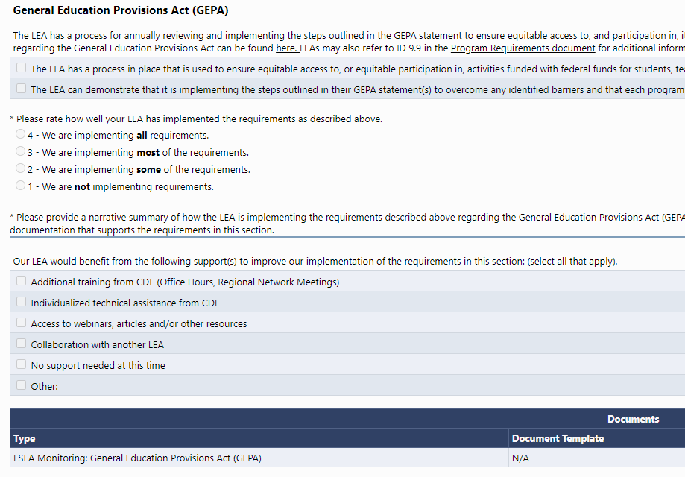
Sample Section View
Notes:
Using the GEPA section as an example, you will see an overview of the section, followed by assurances that will need to be selected, then the self-rating section, the required narrative response section, and finally options of support that CDE can provide for further assistance. You’ll notice in the overview there are links to more information related to each section, and also to the Program Requirements document.

Slide 18
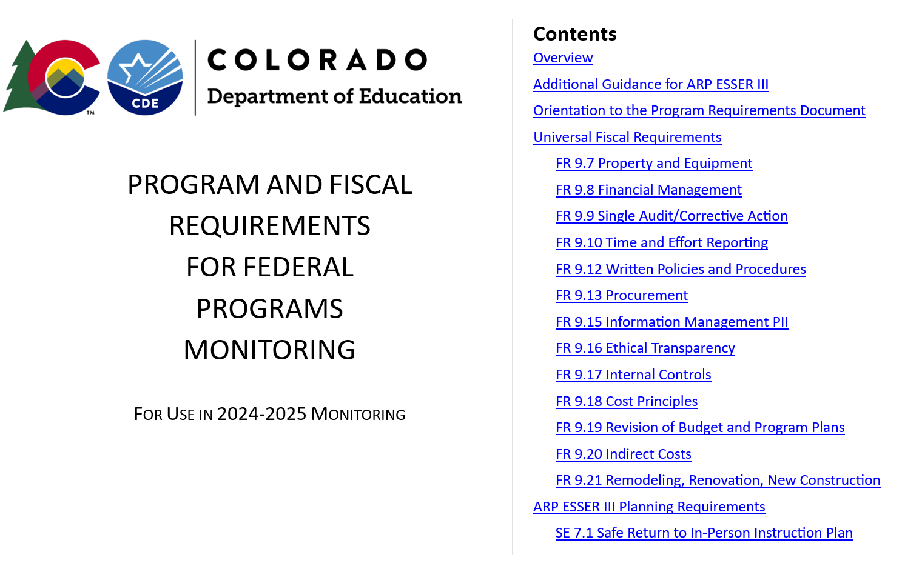
Program Requirements Document
Please refer to the Program Requirements Document for use in 2024-2025 when completing the PMSA
Indicators are arranged in alignment with the PMSA
Each category includes a link to the Program Requirements Document and lists applicable indicators for that category.
Notes:
Kim: The Program Requirements document is linked throughout the sections of the PMSA. The Indicators are separated into categories to align with the PMSA sections.

Slide 19
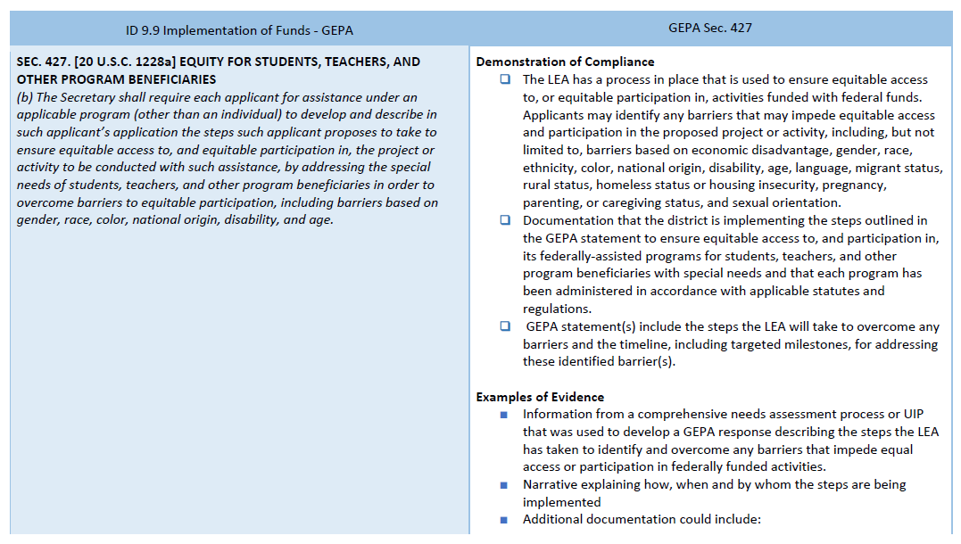
Program Requirements
The left column of the Program Requirements document references the indicator number and name, and statutory and regulatory citations that delineates the requirement(s).
The right column of the Program Requirements document provides Demonstration of Compliance checklist, and Examples of Evidence LEAs may provide to demonstrate compliance.
Notes:
Kim: Throughout the Program Requirements document, you’ll see that it is arranged in columns. The left column references the indicator numbers and names (in this case, it’s ID 9.9 Implementation of Funds - GEPA), and the statutory and regulatory citations that delineates the requirements. The right column provides the Demonstration of Compliance checklist, followed by Examples of Evidence that LEAs may provide to demonstrate compliance. When uploading supporting documentation into GAINS, consider the bulleted items under Examples of Evidence.

Slide 20
Self-Rating Based on Statutory Requirements
Notes:
Kim: The LEA should review each requirement and use the checkbox to indicate if the LEA is compliant. When selecting the self-rating for each section of the PMSA, the LEA should examine how well the requirements are being implemented. As a reminder, the requirements are the checkbox items above the self-rating section.

Slide 21

Self-Ratings
Is there a penalty if our LEA selects a lower self rating?
No. The Federal Programs monitoring team uses these ratings to plan technical assistance to the field. If your LEA requests individualized support, the Federal Programs monitoring team can provide this.
Notes:
Kim: Is there a penalty for selecting a lower self-rating? NO. The Federal Programs monitoring team uses these ratings to inform our technical assistance to the field. If your LEA requests individualized support, our team can provide this. So, have no fear!

Slide 22
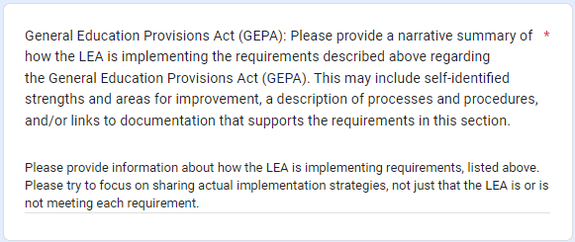

Required Narrative
Focus on Implementation
Consider uploading supporting documentation within GAINS.
Notes:
Kim: Following the self-rating section is the Required Narrative section. This is where the LEA can further discuss and describe how the program requirements are being implemented, we really want to know about your processes.. We ask that LEAs try to focus on sharing actual implementation strategies, not just that the LEA is, or is not meeting each requirement. Consider uploading supporting documentation to GAINS for each category, or provide links to documents within the narrative. Submitting documentation with the PMSA responses will likely minimize the need for follow-up requests.

Slide 23
Overview of Statutory Requirements
Questions to Consider when Reviewing Requirements:
What is the LEA’s process for identifying system barriers, mitigation strategies, and desired outcomes?
How are mitigation strategies being implemented?
Notes:
Kim: Using the PMSA GEPA section as an example…Questions to consider when reviewing the requirements - what is the LEA’s process for annually reviewing and implementing its GEPA statement? Has the statement been updated? Are there budget activities that align with the GEPA statement? How do federal funds of each program being monitored support the GEPA statement?
Narrative Response Guidance: with the LEA’s Consolidated Application GEPA statement(s) in mind, please discuss
the LEA’s process for identifying system barriers, mitigation strategies, and desired outcomes (include stakeholder input, progress monitoring/evaluation procedures, and timelines), and
the LEA’s implementation of the steps outlined in the GEPA statement. We’re really looking for those throughlines.

Slide 24
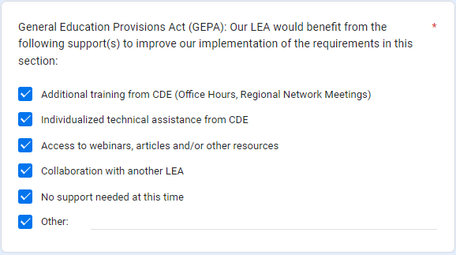

Requested Support
Please select any support that would benefit your LEA for each section.
Notes:
Kim: After the Required Narrative, the LEAs can select any support that would be beneficial to fully implement program requirements. And now I’ll turn it back over to Kristin for a walkthrough in GAINS.

Slide 25
GAINS Walkthrough
Tour of Monitoring Instrument in GAINS

Slide 26
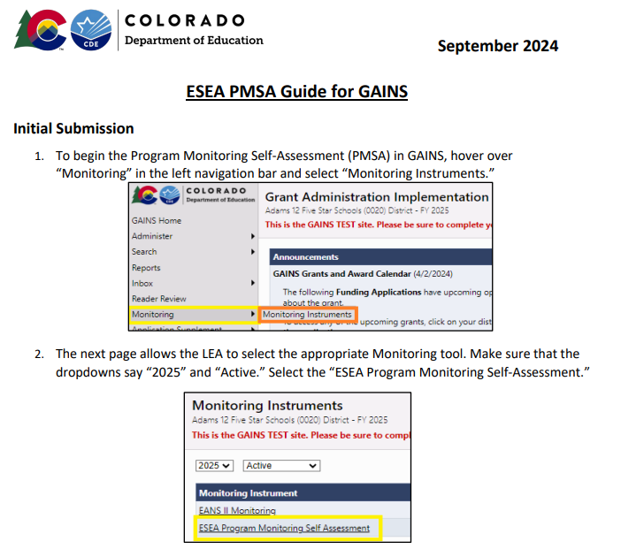
Resource
ESEA PMSA Process Guide for GAINS
Notes:
To support LEAs as we transition to GAINS, the Program Monitoring Office team, in collaboration with the Grants Program Administration team has developed a step-by-step process tool for the full PMSA process. This resource will be shared with LEAs being monitored and will be posted on the Program Monitoring website for reference.

Slide 27
BOCES and Member Districts
To determine who should submit the PMSA, consider the following:
  Which organization is using the funds for each Title program?
    If funds are being used for BOCES-level activities, the BOCES will complete that section of the PMSA. Member districts will indicate that information can be found in the BOCES PMSA for these sections.
    If funds are being used for member district-level activities, the member district will complete that section of the PMSA. The BOCES will indicate that information can be found in specific member district PMSAs for these sections.
    If funds are being used for both BOCES-level and member district-level activities, both entities will complete that section of the PMSA for their funded activities.
  Which organization is implementing the activities for other categories, such as GEPA or Serving Special Populations?
    The organization using the funds and implementing the activities will complete these sections of the PMSA.

Slide 28
Next Steps

Slide 29
After the PMSA…
Tier I
Tier II
Tier III
If further action is needed, a follow-up call will be scheduled between the LEA and CDE’s FPSU monitoring team to discuss next steps. If no further action is needed, the FPSU monitoring team will notify the LEA in writing that the program monitoring process has concluded. The report may contain recommendations that the LEA should consider implementing beyond the monitoring process.
In addition to Tier I components, Tier II may include requests for additional information or submission of evidence. LEAs will use GAINS to submit any additional documentation. CDE’s FPSU monitoring team will provide a written report to summarize any recommendations, corrective actions, or next steps identified through the program monitoring process.
In addition to Tier I and II components, CDE’s FPSU monitoring team will work with LEAs to identify additional program requirements and potential site visit dates to review implementation practices. In Tier III monitoring, the LEA will have an opportunity to co-develop the monitoring plans and help determine which indicators would be helpful and relevant.

Slide 30
Report Terms to Know…
Commendation: The FPSU monitoring team may highlight any exemplary practices that were identified through the monitoring process.
Recommendation: The FPSU monitoring team may identify recommendations that the LEA should implement to improve practices in certain areas for the LEA.
Corrective Action: The FPSU monitoring team may identify corrective actions that the LEA must implement to meet statutory requirements. Corrective actions require a corrective action plan developed and submitted by the LEA and approved by the FPSU monitoring team.

Slide 31
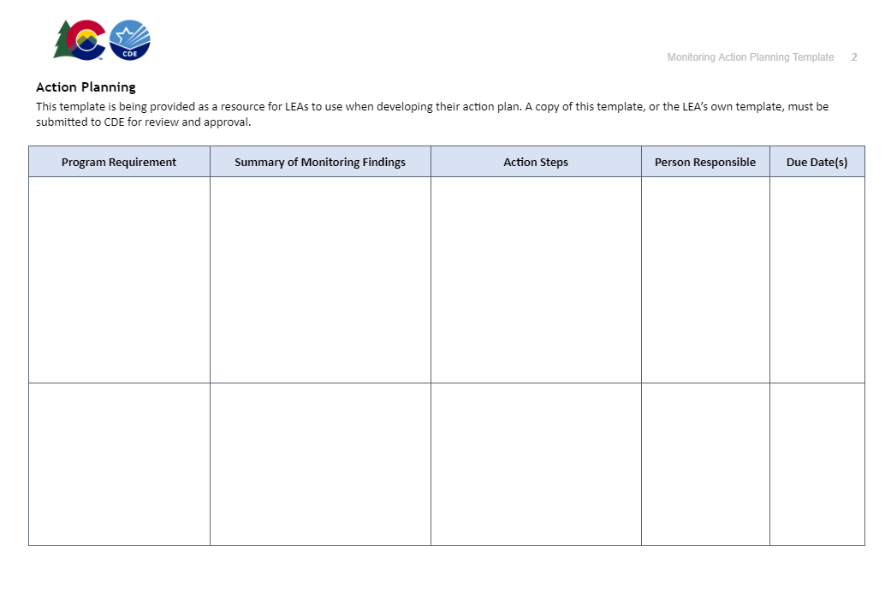
Corrective Action Planning (Tiers II and III only)
If the report includes corrective actions, the FPSU monitoring team will work with the LEA to create and implement a corrective action plan.

Slide 32
Questions at this Point?
?

Slide 33

CDE Program Monitoring Team Contacts
Tammy Giessinger
720-827-5291 (c)
giessinger_t@cde.state.co.us
Kristin Crumley
720-660-1369 (c)
crumley_k@cde.state.co.us
Kim Boylan
720-354-7031 (c)
boylan_k@cde.state.co.us
Nathan Hickman
720-833-8194 (c)
hickman_n@cde.state.co.us
Sue Miller-Curley
720-990-4987 (c)
miller-curley_s@cde.state.co.us
Notes:
Michelle

