Slide 1
ESEA Fall Regional Network Meeting
November 15, 2022

Slide 2
ESEA and ESSER Monitoring Work Group
Notes:
Kristin

Slide 3
Presenter Introductions
Federal Programs and Supports Unit
ESSER Programs Team
Kristin Crumley
Kim Boylan
Office of Grants Fiscal
Bill Parsley
Hilery Morris
Notes:
Skip this slide if no new people are present

Slide 4
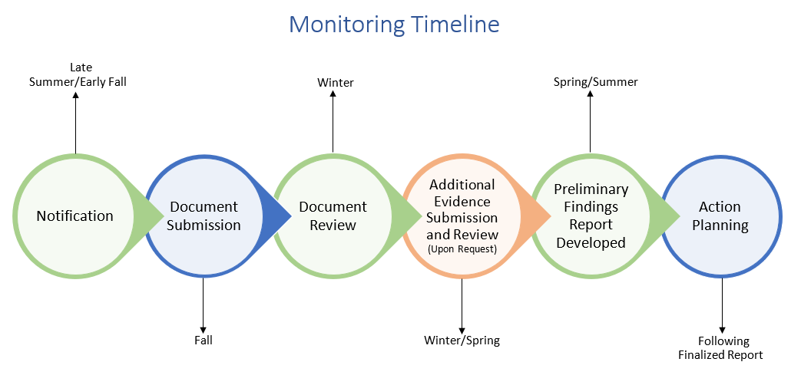
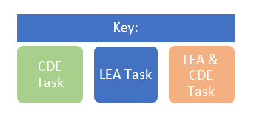
Monitoring Overview
Monitoring formalizes the integral relationship between CDE and Colorado LEAs in implementing effective programs using Federal funds.
Monitoring is implemented from a programmatic and fiscal perspective and meant to accomplish the following objectives:
Focus on What Matters
Reduce Burden on LEAs
Improve Communication with LEAs
Differentiate and Customize Support for LEAs
Ensure Basic Requirements Are Met
Notes:
Federal Programs monitoring formalizes the important relationship between CDE and Colorado LEAs in implementing effective programs using federal funds. The monitoring process utilizes both a programmatic and a fiscal lens with CDE teams working alongside LEAs to ensure they have proper processes and procedures in place to meet federal requirements. The timeline begins in late summer or early fall, and the goal is to have monitoring completed by the following spring or summer.

Slide 5
CDE’s Monitoring Process Includes…
Application Reviews
Other (i.e. Beeline, Scoop, email communications, etc.)
Federal Programs Monitoring
Training and Technical Assistance
Evidence Submission and Review
Self-Assessment
Notes:
CDE strives to include as many elements into monitoring as possible, including the application review process, training and technical assistance, the self-assessment, evidence submission and review if requested by CDE, and other communications.

Slide 6
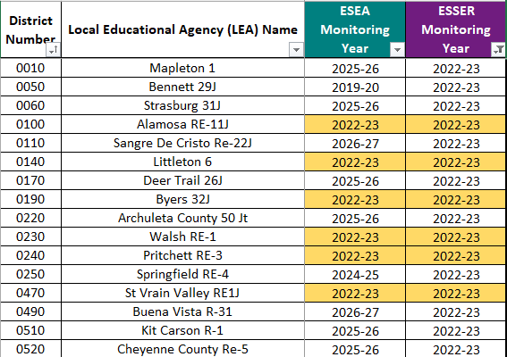
ESEA and ESSER Monitoring
ESEA Program Intent
ESSER Program Intent
Purpose of Monitoring
To ensure all students, particularly underserved students, have equitable access to a high-quality education
To respond to, prepare for, or prevent the spread of COVID-19 and address the impact on education
To ensure that federal funds are used appropriately to implement program intent
Number of LEAs being monitored in 22-23
82 Total
62 ESSER-Only
20 ESEA and ESSER
Monitoring Schedule for ESEA and ESSER is located on our Monitoring Website.
Notes:
The current round of monitoring includes both ESEA and ESSER monitoring. 82 total districts are being monitored this year, with 62 being ESSER-only, and 20 being dually monitored for ESSER and ESEA. To view your LEA’s monitoring year, please utilize the monitoring schedule, and for more information on monitoring in general, please view CDE’s monitoring website. Both are linked here.

Slide 7
ESEA vs ESSER Monitoring
How ESEA and ESSER Monitoring are Similar
Conducted by CDE fiscal and program teams
3-tiered approach based on risk assessment
Same process and protocols
Use of data and documentation that CDE already collects to minimize LEA burden
Iterative process to allow multiple opportunities to demonstrate compliance
Fiscal compliance measured against Uniform Grant Guidance, EDGAR
How ESSER Monitoring is Different
Must complete all monitoring prior to 9/30/24 (within the ESSER III performance period)
Additional, separate indicators
ESSER III
Maintenance of Equity
20% Set Aside
LEA ARP-ESSER III Use of Funds Plan
Safe Return to In-Person Instruction Plan
Includes ESSER State Reserve Funds
Notes:
While many similarities exist between ESEA and ESSER monitoring, there are some key differences to note. ESSER has a much tighter deadline, which is why so many LEAs are being monitored for ESSER in each monitoring cycle. Additionally, ARP-ESSER III introduced requirements that were not part of ESSER I or II. ESSER monitoring also includes ESSER state reserve funds.

Slide 8
Monitoring Tiers
All LEAs that accept ESEA and ESSER funds will participate in monitoring during a multi-year cycle established by CDE.
Monitoring provides a basic level of oversight to ensure compliance with standard procedures required of all LEAs operating ESEA and ESSER programs.
A limited number of LEAs will be selected for Tier II and Tier III monitoring each year based on a set of selection criteria developed by CDE.
Monitoring activities are conducted primarily through a desk review. Onsite monitoring activities may occur during Tier III monitoring.
Notes:
When being monitored, LEAs are assigned as Tier 1, Tier 2, or Tier 3. These determinations are based on criteria developed by CDE and a risk assessment run by CDE. CDE will conduct most monitoring through a desk review, but onsite monitoring activities may also occur.

Slide 9
Using the Risk Assessment to Assign Tiers
Beginning with the 2022-2023 year, tier levels are assigned separately for program and fiscal monitoring based on the results of the risk assessment.
Multiple tier combinations are possible
For example, an LEA could be tier 2 for program and tier 1 for fiscal, OR
An LEA could be tier 1 for program and tier 3 for fiscal, OR
Other combinations are possible, based specifically on risk assessment results.
Breakdown of Tier Assignments for 2022-2023
Notes:
The 21-22 monitoring cycle led to many discoveries about which processes and procedures need the most programmatic support and the most fiscal support. For the 22-23 monitoring cycle, CDE utilized both programmatic and fiscal criteria to determine monitoring tiers. The result is that each LEA has been assigned two tiers: 1 for programs, and 1 for fiscal. While many LEAs have the same tier for both programs and fiscal, some also have different tiers. Your notification letter includes specific language outlining the LEA’s responsibilities when participating in the tier assigned for both programmatic and fiscal monitoring.

Slide 10
Notification Letters: Tier I
Program Monitoring Tier I: The Program Monitoring Self-Assessment (PMSA) will be emailed to the LEA by October 21, 2022. The LEA will complete and submit the PMSA for CDE staff to review. If further action is needed, a follow-up call will be scheduled between the LEA and CDE. If no further action is needed, CDE will notify the LEA by email that the program monitoring process has concluded.
Fiscal Monitoring Tier I: The Fiscal Self-Assessment (FSA) will be emailed to the LEA by October 21, 2022. The LEA will complete and submit the FSA for CDE staff to review. If further action is needed, CDE will send an email or schedule a follow-up call between the LEA and CDE. If no further action is needed, CDE will notify the LEA by email that the fiscal monitoring process has concluded.
Notes:
If you are tier 1 for program or fiscal monitoring, you will see this language. Please keep in mind you COULD be tier 1 for only one department, so you may only see this language for program OR fiscal if you have a tier 1 assignment.

Slide 11
Notification Letters: Program Tier II and III
Program Monitoring Tier II: The Program Monitoring Self-Assessment (PMSA) will be emailed to the LEA by October 21, 2022. The LEA will complete and submit the PMSA. CDE staff will review the program self-assessment and then schedule a phone call or video call with the LEA to review next steps. The next steps could include requests for additional information or submission of evidence. LEAs will use Syncplicity to submit any additional documentation. CDE will provide a written report to summarize any recommendations, corrective actions, or next steps identified through the program monitoring process.
Program Monitoring Tier III: The Program Monitoring Self-Assessment (PMSA) will be emailed to the LEA by October 21, 2022. The LEA will complete and submit the PMSA. When CDE has reviewed the self-assessment, a planning meeting between CDE and the LEA will be scheduled to outline the process for determining which indicators will be included in the program monitoring process and provide a more detailed explanation of the LEA’s complete program monitoring process. LEAs will use Syncplicity to submit any additional documentation. CDE will provide a written report to summarize any recommendations, corrective actions, or next steps identified through the program monitoring process.
Notes:
If you are tier 2 or 3 for program monitoring, you will see this language. The process for tier II and III monitoring will be customized for each LEA. CDE will partner with the LEA to develop the plans and support them with knowing what to submit and when to submit on the program side.

Slide 12
Notification Letters: Fiscal Tier II and III
Fiscal Monitoring Tier II and III: The Fiscal Self-Assessment (FSA) will be emailed to the LEA by October 21, 2022. The LEA will complete and submit the FSA. The following documents will also need to be submitted through Syncplicity in the General Submissions folder:
Detailed general ledger(s) by award (4-digit code) showing all ESEA and ESSER activity in the period being monitored. The report(s) should show individual transactions with totals by object code, which will be used to select samples for testing.
A list of employees, including titles, paid with ESEA and ESSER funds, if any. This will help identify any time and effort documentation CDE may need to request during follow up.
Website link to written board policies or contact information for the person who can provide board policies upon request
Procedure documents describing, in detail, the steps used by the LEA to process ESEA and ESSER transactions. Note, these documents are different from the board policies noted above. Procedures should be provided for each of the processes listed below if the LEA incurred expenditures related to those processes during the period under monitoring:
Procurement
Time and Effort (Payroll)
Capital Property and Equipment
Construction
After review of the Syncplicity documentation, CDE will send an email or schedule a follow-up call between the LEA and CDE to discuss any questions and request the necessary additional documentation/information.
Notes:
If you are tier 2 or 3 for fiscal monitoring, you will see this language. Please note that you will need to utilize Syncplicity to submit required documentation, listed here, and also listed in your notification letter.

Slide 13
Evidence Submission
What does CDE mean when they say, “the following documents will also need to be submitted through Synplicity?”
•CDE uses Syncplicity, a secure file platform, for all evidence uploads.
•CDE will be sharing a Syncplicity folder with the Authorized Representative(s).
•Once the Authorized Representative(s) receives the Syncplicity access email, the LEA can begin to upload any requested evidence.
If someone other than the Authorized Representative needs access to the Syncplicity folder, please request this through Kristin Crumley at Crumley_K@cde.state.co.us.
Notes:
If you need to utilize Syncplicity, a folder will be shared with you where you can upload the requested documentation. If someone other than the authorized representative needs access to the Syncplicity folder, please request access from Kristin Crumley. This request should come from the authorized representative or include the authorized representative in an email request.

Slide 14
Updated Timeline
The notification letters indicated that the self-assessments would be sent on October 21, 2022.
We anticipate sending the self-assessments to LEAs being monitored during the 22-23 school year by the end of November.
Notes:
CDE’s initial goal was to have the self-assessments ready to be sent on October 21st. We anticipate sending the self-assessments to LEAs being monitored this year by the end of November…and we do thank you for your patience!

Slide 15
Program Monitoring Self-Assessment (PMSA)
Notes:
Kim

Slide 16
Introduction to the
Program Monitoring Self-Assessment
The Program Monitoring Self-Assessment is a tool that provides an additional level of oversight for all LEAs receiving federal funds to ensure compliance with program requirements.
For Tier I monitoring, CDE will use the self-assessment results to determine what additional training, guidance, and technical support is needed and should be provided. For Tier II and III the self-assessment will be used as a starting place for the remainder of the monitoring process.
The self-assessment asks for responses to a condensed list of program requirements.
LEAs are asked to:
Reflect on implementation of required elements
Provide additional information to CDE through a narrative response
Identify types of support that might be provided to the LEA
For most LEAs, once the self-assessment is complete and reviewed, the monitoring process will conclude and we will transition into providing technical assistance and support based on the self-assessment results.
For those participating in more detailed monitoring, CDE will reach out with next steps.
Steps are outlined in more detail within the notification letter that was sent on September 8th.
All monitoring communication will be sent to the Authorized Representative(s) in the Consolidated Application for ESEA monitoring and the ESSER III application for ESSER monitoring.
Please update your Contacts if needed.
Notes:
The self-assessment is a tool that provides an additional level of oversight for all LEAs to ensure compliance with federal program requirements. It’s important to note that for Tier 1 monitoring, CDE will use the information provided to determine what additional technical assistance is needed. For Tiers II and III, the self-assessment will be a starting point for the remainder of the monitoring process. We ask that all of the LEAs being monitored reflect on how required elements are being implemented, provide additional information through a narrative response, and identify types of support needed from CDE. For Tiers II and III, CDE will then reach out with information on next steps. Please refer to the LEA’s monitoring notification letter sent on September 8th for more information. It also bears repeating that all communications will be sent to the Authorized Representative listed in the Consolidated Application for ESEA, and the ESSER III application for ESSER monitoring. Please ensure the contact information is up to date.

Slide 17
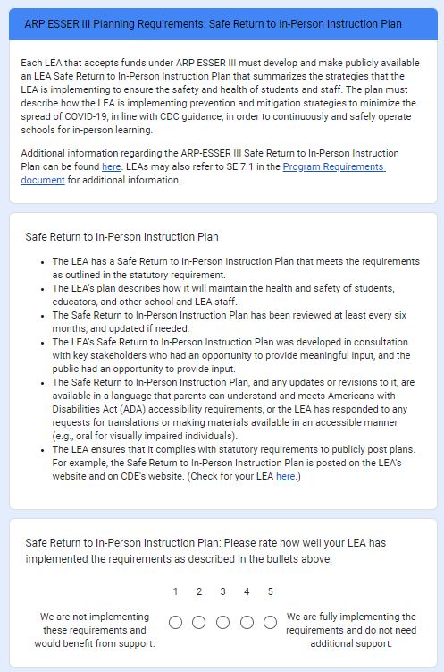
Reflection on Implementation
Notes:
Each section includes a reflection piece. The requirements of the section are listed, and a 1-5 rating scale is included. A self-rating of 1 indicates that the LEA is not implementing the requirements and would benefit from support, and a 5 indicates that the LEA is fully implementing the requirements and does not need additional support at this time.

Slide 18
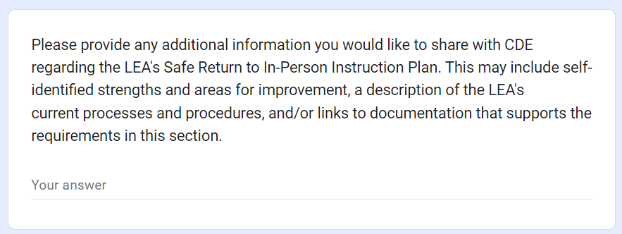
Narrative Responses
Notes:
Each section also includes a narrative piece. Please be as thorough with this section as you need to be in order to really analyze your LEA’s processes and how the requirements of each section are being met. CDE would like a very holistic view of what is working for your LEA and what isn’t in order to guide future technical assistance and training so that all LEAs can ultimately fully address federal requirements.

Slide 19
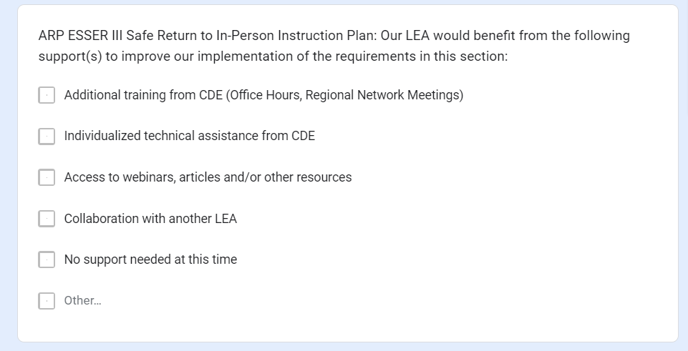
Identification of Support(s)
Notes:
The final task in each section includes checkboxes for the LEA to identify what types of support would be beneficial to them moving forward. Please select any and all that apply.

Slide 20
How can I get started?
LEAs can begin to review the requirements that will be included in the self-assessment, including, but not limited to, the following:
Safe Return to In-Person Instruction Plan [SE 7.1]
LEA Use of Funds Plan [SE 7.2]
ESSER III Learning Loss Set-Aside [ID 7.1]
Use of Funds [ID 9.1]
ESSER I Equitable Services [SE 9.11, FR 9.4]
https://www.cde.state.co.us/fedprograms/2020essaprogramrequirements
All 82 LEAs will be monitored for ESSER in 22-23 so we are prioritizing our work on the ESSER portion of the self-assessment. Additional information about ESEA monitoring will be provided soon.
Notes:
If LEAs want to prepare for the self-assessment, they can refer to the Program Requirements document for additional information. The requirements in this document will be included in the self-assessment. All 82 LEAs will be ESSER monitored in 22-23. We will be providing additional information and training on ESEA monitoring in the near future.
The indicator numbers are listed in brackets for easy search on the Program Requirements document. Searching for “ESSER” will also help direct you to the pertinent sections of the document.

Slide 21
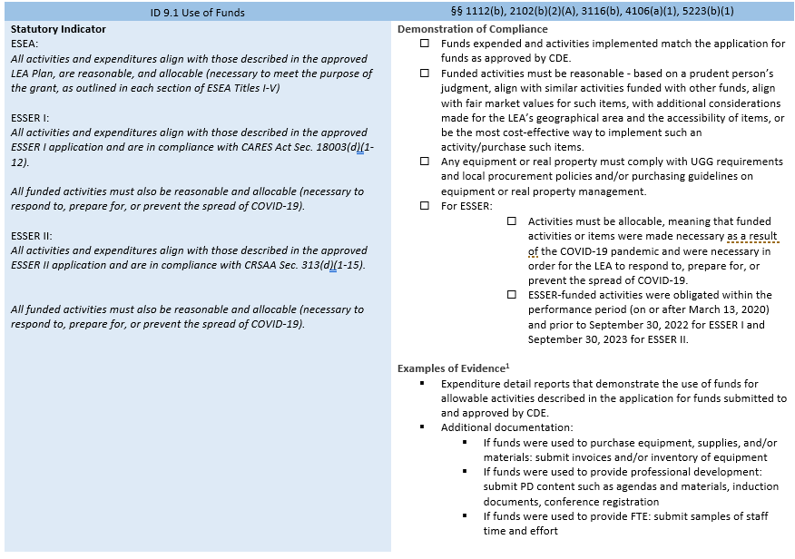
How to Read Each Indicator
Any information gathered now will support the completion of the self-assessment when it is available.
Notes:
Each of the program requirements includes the statutory requirement(s) on the left, and descriptions of how LEAs can demonstrate compliance, and examples of evidence for the LEA to consider when completing the PMSA on the right side of the document. And, again we thank you for your patience while we finalize and send the self-assessment. (last slide).

Slide 22
Discussion

Slide 23
Fiscal Self-Assessment Training
Notes:
<in best Movie Phone guy voice> Hello!
My name is Bill Parsley and I am the ESSER Fiscal Monitoring Supervisor working with the Grants Fiscal team. I am joined by my colleague Hilery Morris for today’s journey into the fiscal self-assessment. Hopefully this will prove to be a useful tool for both us at CDE and for you, not only during the monitoring review, but in development and fine tuning of your grants management process.

Slide 24
Introduction to Fiscal Self-Assessment (FSA)
The FSA is a series of questions to help gauge the control environment at the LEA
The form is not used to self-identify strengths and weaknesses or provide a rating but rather gather responses related to general fiscal compliance
LEAs are asked questions pertaining to:
Documented policies/procedures
Federal grant experience
General categories of award expenses for period under monitoring
Answers certified via attestation by official representative of LEA
Every self-assessment is reviewed for opportunities for specific technical assistance
For LEAs in Tier I, the monitoring engagement ends after this step
For LEAs in Tier II or III, CDE will reach out with any clarification questions and transaction sample requests
Notes:
We’d like to start by setting the stage regarding the purpose of the form. As part of CDE’s role, we seek to identify areas within an LEA where we can provide the most technical assistance. Knowing the rules around federal fiscal compliance are not always the most user friendly to implement, we need to get a sense of the current control environment at the LEA to know best how we can help. This form is simply our way of collecting some baseline information about the process within your LEA. It also serves as a good indicator of the types of activities we will review during the monitoring reviews. There is no self rating for this form. Instead, we are asking questions related to the policies and procedures for various fiscal processes such as procurement, time and effort and capital equipment tracking. Note every LEA selected for monitoring will need to complete this self-assessment. For those in Tiers II or III, there will be a follow-up request related to this information (most common requests will be sample documentation for transactions related to these processes. The following slides run through the actual form and provide context for each of the sections.

Slide 25
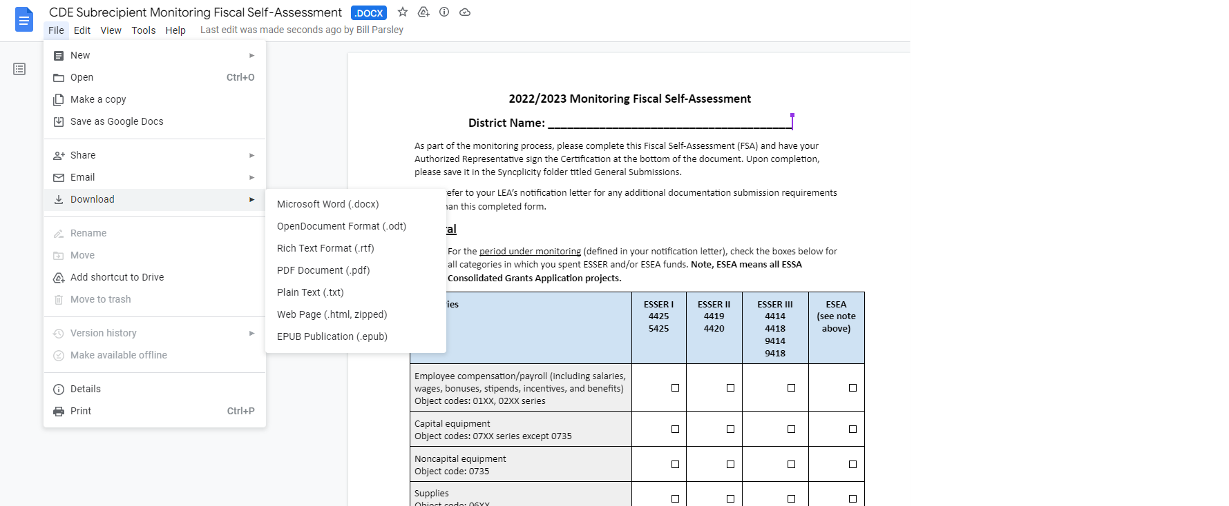
Save a Copy of the Fiscal Self-Assessment for Your LEA
Open link from CDE (do not request access) and save a copy for your LEA
Can be copied into a Google Drive, saved as a Google Doc, or downloaded into a variety of formats
Final document submitted via Syncplicity
Notes:
The FSA will be distributed via email (hopefully this week or next as Kristin mentioned) with a link to a Google Doc. By design, you will have read only access to the document. Please do not request edit access; instead, your first step will be to save a copy of the FSA for your LEA. Do this by going through the File menu option and choosing the format you prefer (Google Doc, Word, PDF, etc.). This will allow you to work on the document in whatever format is most convenient for you. As you decide what format to use, keep in mind that a copy of the completed FSA will need to be submitted in Syncplicity, and that version will need a Certification signature, which we will cover in an upcoming slide.

Slide 26
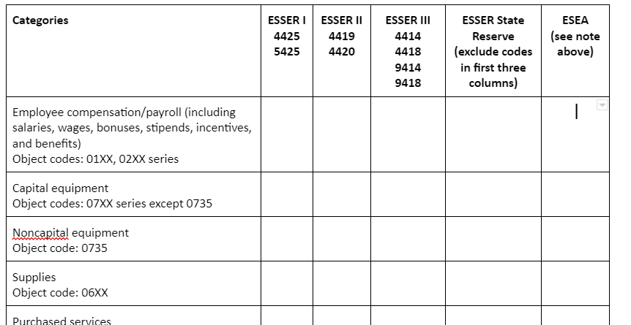
General Section - Categories
Add an “X” to show your activity for the period under monitoring - refer to notification letter
Chart rows indicate expenditure categories for ESSER and/or ESEA activity - note typical object codes
Chart columns indicate each award - note grant award codes (ESEA means all ESSA Consolidated Grants Application projects)
Populate this table based on actual activity as posted in the LEA’s General Ledger
Notes:
The first section of the form contains more general questions starting with a table of the actual expenditures your LEA had during the period under monitoring. Note this period can be found at the beginning of your notification letter (for this monitoring year it is all activity during FY22). The table helps CDE ensure we have all relevant general ledgers and other documentation for our monitoring reviews.
Please populate this table using actual expenditure activity your LEA had during FY22 for ESSER (all buckets of funding) and, for those LEAs selected for both, all expenditure activity for ESEA. The columns across the top of the table include the applicable grant award codes as much as possible (ESEA and State reserve have quite a few possible - please reach out if you are unsure on any awards to include). The rows along the side are the categorical breakouts for activity. These should be based on the object codes in which your LEA posts the activity in the general ledger. CDE does note not every allowable object code is an option within the award applications (they are based on what we call the “roll to the bold” process). Please populate this table based on how the activity is actually posted in the financial records. During the review, CDE will note any differences between the application and the financial records related to these application limitations and they do not end up in any report comments.

Slide 27
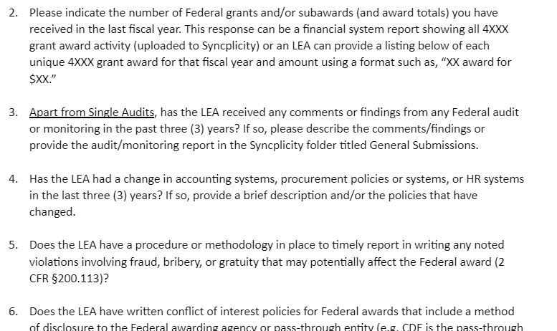
General Section - Questions
Detailed answers help CDE identify opportunities for technical assistance and to help LEAs strengthen the control environment for fiscal compliance
Notes:
This slide is just a snippet of the remainder of the FSA’s General section. We use the questions in this section to better understand your LEA’s federal grant process so that we can gauge things like the control environment, the experience with and exposure to federal grants, and the understanding of fiscal compliance requirements. Helps us identify areas of need and ways that we can come along side LEAs to offer technical assistance. Once you have the FSA, please feel free to reach out with any questions. Our hope is that information needed to answer these questions will be readily available in places like your Board policies, internal procedure documents, and financial records.

Slide 28
Time and Effort
These questions focus on Time & Effort policies and procedures as well as documentation.
Notes:
After the General portion of the form, the Time and Effort section focuses on questions related to your LEA’s written policies/procedures as well as the actual time & effort documentation. We are looking for something that walks us through the process from A-Z. That is most likely documented through both broad Board approved policies as well as written procedures detailing the day-to-day functions. Note we have already identified written policies/procedures as a very common area for technical assistance. We are looking for the environment as it currently exists so, if your LEA does not currently have anything documented, please answer accordingly on this form. For those in monitoring tiers II and III, you can provide a brief narrative to help us get an idea of the process as the additional submission requirements noted in the notification letter.
We’ve included a few citations from the Uniform Grant Guidance (2 CFR part 200) for your reference. We also have a Resources section towards the end of the form which we will discuss shortly.

Slide 29
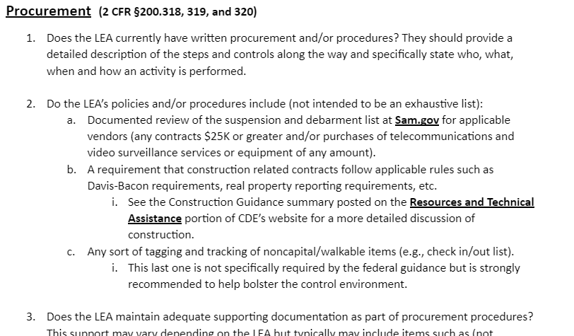
Procurement
Procurement questions focus on policies and procedures as well as the LEA’s supporting documentation demonstrating the procedures were followed.
Notes:
Much like Time and Effort, the Procurement questions focus on written policies/procedures and documentation that demonstrates your compliance with federal procurement requirements. A few questions are specific to compliance requirements that we hope are addressed as part of your LEA’s procurement process. For example, do you have additional steps in your procedures for construction related purchases or contracts that require a review for suspension or debarment? We’ve included procurement specific citations from 2 CFR part 200 for your reference as well as some construction guidance.

Slide 30
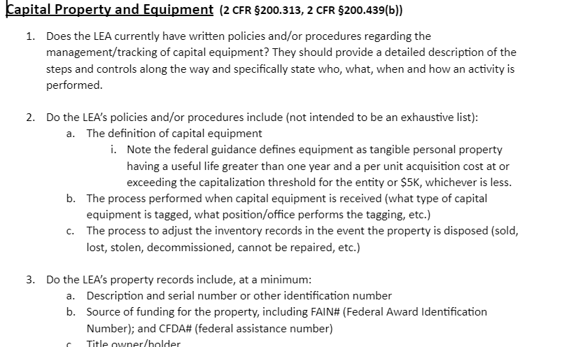
Capital Property and Equipment
These questions focus on property records and policies and procedures.
Notes:
As with the Time & Effort and Procurement sections preceding this one, the first question focuses on the current written process. However, the rest of the questions for Capital Property and Equipment build upon those in the procurement portion, namely, now that your LEA has purchased capital items, how are they tracked? Those subsequent questions walk through various criteria surrounding the “How” and “What” related to tracking capital items. As in other sections, we also include citations for reference.

Slide 31
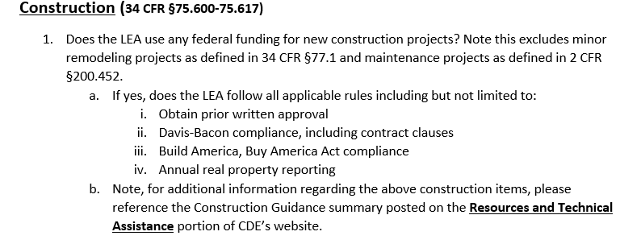
Construction
This section focuses on criteria unique to construction
Notes:
The use of Federal funding for construction triggers some unique compliance requirements. This section’s questions attempt to assess your LEA’s compliance with those requirements. As you are completing this, please keep in mind that there is a difference between construction and minor remodeling or maintenance projects. Additional information is available at the listed citations in 34 CFR part 75 as well as in the previously mentioned Construction Guidance found on the Resources and Technical Assistance portion of CDE’s website.

Slide 32
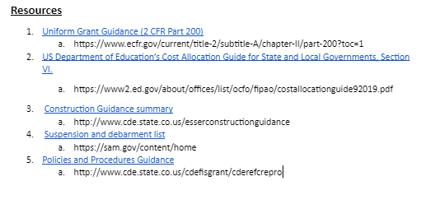
Resources
We have included a resource guide section, towards the end of the assessment.
These websites are a great resource for quick questions!
Notes:
The form itself includes some helpful resources not only when completing the form but in general when your LEA is looking to the fiscal controls around federal grants. We also encourage you to reach out to us directly with any questions (contact info at the end of the presentation).

Slide 33
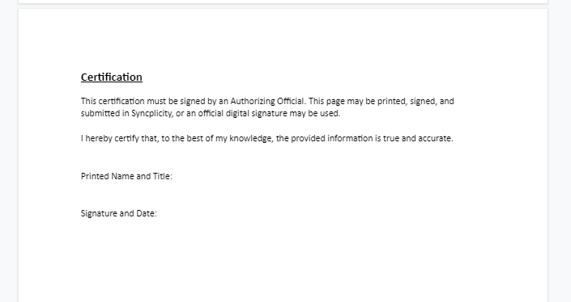
Certification of Answers
Last page of FSA signed by Authorized Representative (someone with signature authority)
Printed then signed or digital signature are both options
Depending on format chosen, can be submitted separately via Syncplicity
Notes:
As mentioned previously, the last section of the FSA does need the signature of an individual with signature authority at your LEA. Various options are available when uploading this page to Syncplicity. You may print then sign the page or do a digital signature. Depending on the format chosen, it may be easier to submit the Certification page separately.

Slide 34
More information coming soon!

Slide 35
CDE Contact Information
FPSU Executive Director
Nazie Mohajeri-Nelson
720-626-3895 (c)
mohajeri-nelson_n@cde.state.co.us
ESEA Monitoring Team
Tammy Giessinger
720-827-5291 (c)
giessinger_t@cde.state.co.us
Nathan Hickman
720-833-8194 (c)
hickman_n@cde.state.co.us
Karen Bixler
720-827-5291 (c)
bixler_k@cde.state.co.us
Grants Fiscal Team
Bill Parsley
303-910-5163 (c)
parsley_b@cde.state.co.us
Hilery Morris
720-471-4877 (c)
morris_h@cde.state.co.us
Kristina Jones
720-601-0031 (c)
jones_kristina@cde.state.co.us
Werner Hagemann
720-262-0870 (c)
hagemann_w@cde.state.co.us
ESSER Monitoring Team
Kristin Crumley
720-660-1369 (c)
crumley_k@cde.state.co.us
Jonathan Schelke
720-388-0842 (c)
schelke_j@cde.state.co.us
Kim Boylan
720-354-7031 (c)
boylan_k@cde.state.co.us

