Slide 1
Exploring Solutions: Using research clearinghouses in your search for quality EBIs
Federal Programs Unit | 2020

Slide 2
Clearinghouses: What Are They and Which Ones To Use?

Slide 3
What is a clearinghouse?
A collection of research studies that gauges strength of evidence for a strategy or intervention.
Provide practitioners access to research findings in simple language.
Most set high standards of rigor for a study to be included.
A clearinghouse may have been helpful here…
Notes:
Mary’s notes:
*Basically, a clearinghouse is an easily accessible and user friendly collection of research studies that have been vetted by experts in the field, who have rated the strength of evidence for each intervention or strategy. Most clearinghouses set a high standard for inclusion.*
So this means some studies that lack rigor are left out. This also means rigorous studies that happen to have neutral or negative findings are included because it’s equally important to know when a strategy has been proven to not work.

Slide 4
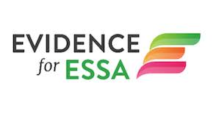
9 Commonly Used Clearinghouses
Results First Clearinghouse | Evidence for ESSA | What Works Clearinghouse
National Center on Intensive Intervention | Doing What Works | Campbell Collaboration
Blueprints for Healthy Youth | Middle School Matters | Education Resources Information Center
Notes:
Mary’s notes:
* Here are a sample of 9 commonly used clearinghouses on educational interventions. The one we will focus on today is the WWC, located in the top right-hand corner. This clearinghouse has been around for years and includes a lot of studies. It’s curated by the Institute for Educational Sciences, which is a federally funded project. *
Results First Clearinghouse Database – This database, developed by PEW Charitable Trust, is an online resource that brings together information on the effectiveness of social policy programs from nine national clearinghouses – a one-stop shop for evidence-based studies.
Evidence for ESSA – This website curates math and reading interventions which have been shown to have significant statistical impact on student learning.
What Works Clearinghouse – This clearinghouse has been around for years and includes a lot of studies. It’s curated by the Institute for Educational Sciences, a federally funded project. We’ll explore this one today.
Middle School Matters – Provides decades of high-quality research results focused on middle grade schools across the nation, with particular focus on instructional practices.
Doing What Works Library - DWW content is based on research reviews conducted or endorsed by the Institute of Education Sciences, usually practice guides.
Education Resources Information Center (ERIC) -- ERIC is a free, online library of education research, sponsored by the Institute of Education Sciences (IES) of the U.S. Department of Education. It includes abstracts of research studies and some full-text documents
Campbell Collaboration -- This website provides access to reviews and research syntheses to support evidence based decision and policymaking.
Blueprints for Healthy Youth Development -- This website provides a registry of evidence-based youth development programs designed to promote the health and well-being of children and teens. Programs in the registry are family-, school-, and/or community-based.

Slide 5
Navigating Clearinghouses
Notes:
To set up our conversation about how to explore a clearinghouse, we’ll quickly run through a hypothetical district context to ground our conversation about strength, fit, and capacity.

Slide 6
Example District: Mountain Top 300
Geography: Located in a mountainous, rural region of NW CO
Size: 1,150 students
Schools: 2 Elementary, 2 Middle, 1 High School
Demographics:
40% White, 35% Hispanic, 15% Native American, 5% Black, 5% Other
18% students w IEPs, 25% English Learners
76% Free and Reduced Lunch (FRL)
School Quality:
1 Comprehensive Support school, 2 Priority Improvement Schools
Overall academic underperformance in elementary ELA, esp. among ELs.
Notes:
The district is rural, small, has a handful of schools, the majority of its students are white and Hispanic, experiences high poverty, and is struggling academically, especially in its K-5 English Language Arts.

Slide 7
Mountain Top 300: Comprehensive Needs Assessment findings
Level | Priority Performance Challenge | Root Causes | Possible Solutions
District | Lack of consistent and high quality instruction to meet CO learning standards | Inexperienced teachers Lack of data driven instruction Lack of school structures that protect teacher collaboration and planning time | Data driven instruction Professional learning communities Mentorships
School (Elementary) | Low reading scores in elementary grades, particularly among ELs | Lack of rigorous academic interventions in reading Lack of tiered academic supports to support struggling students Inconsistent parent and family engagement | Reading curriculum intervention tools/packages to support ELs Processes to engage parents/families in learning
School (High School) | High dropout rate Low graduation rate (62% @ HS) | Inconsistent college and career engagement and planning Weak data systems to identify students off track | Early warning indicator system High impact strategies to engage students in career goals and build plans to meaningfully pursue goals
Notes:
If we think of EBIs in the process of improvement planning, such as the UIP process, this becomes very concrete.
Here’s a few examples of district and school level identified PPCs, root causes, and possible solutions.
For our purposes today, we’ll look at possible EBIs in response to the identified need of the Elementary School.

Slide 8
Let’s Explore What Works Clearinghouse!
WWC Landing Page

Slide 9
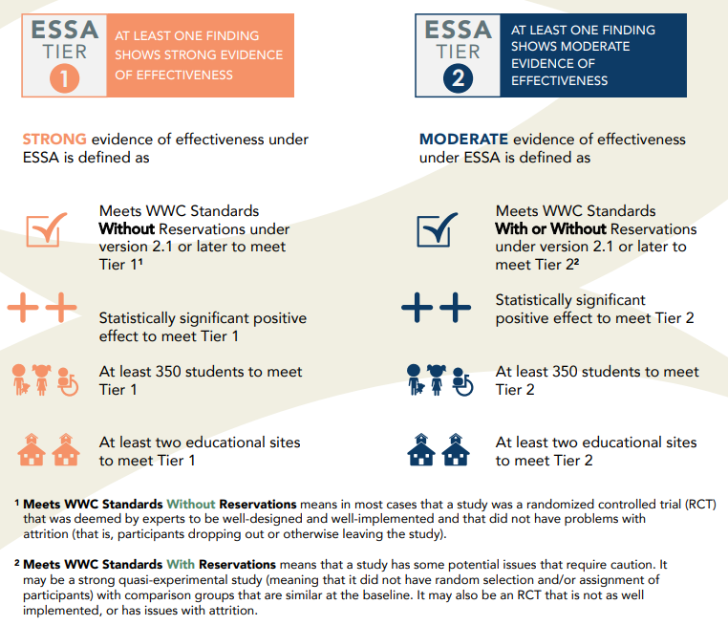
What Works Clearinghouse and ESSA Tiers of Evidence
Source: What Works Clearinghouse, https://ies.ed.gov/ncee/wwc/essa, downloadable version.
Notes:
Here is a resource published by the WWC that shows its alignment with ESSA Tier 1 and Tier 2 of evidence.
Without getting mired in the details of study design and statistical significance, this graphic tells us that interventions that received a + or ++ effectiveness rating on WWC, and examined the effects for at least 350 students over at least two educational sites, will meet Tier 1 or Tier 2 evidence.
However, for the purposes of today’s presentation on introducing EBIs and clearinghouses, we will not focus on differentiating between tiers 1 through 3.

Slide 10
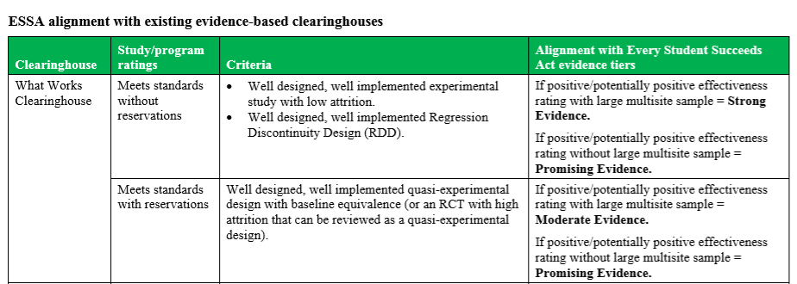
What Works Clearinghouse and ESSA Tiers of Evidence Continued
Source: REL Midwest, https://ies.ed.gov/ncee/edlabs/regions/midwest/pdf/eventhandout/ESSA-Clearinghouse-Crosswalk-Jan2018-508.pdf
Notes:
This table is published by the REL Midwest and is a great resource for understanding how WWC ratings fit into the context of ESSA tiers of evidence.
Using this table, we can infer that any intervention listed on WWC with at least 1 study that “meets WWC standards” and has a + or ++ effectiveness rating can qualify as ESSA Tier 1-3 evidence, Promising to Strong.
Using this information, we can move forward in citations.

Slide 11
Thank You!
Jeremy Meredith
ESEA Programs Senior Consultant
Title II Specialist
Meredith_J@cde.state.co.us
(303) 866-3905
Mary Shen
Data, Reporting, Accountability, and Evaluation Consultant
Shen_M@cde.state.co.us
(303) 866-4571

