Slide 1







ESSA Hub Committee – Sept 12, 2016
September 12, 2016
1

Slide 2

Agenda
Welcome and Introductions
  Hub Member Updates
  CDE ESSA Updates
    Response to USDE Rule-Making
      Assessment/Assessment Pilot – Comments Due September 9th
      Data Collection Package – Comments due late October
      Supplement Not Supplant – Comments due early November
ESSA Spoke Committees
ESSA Hub Committee Support
Review and Approval of Meeting Minutes
Deep Dive- School and District Accountability
Deep Dive- School Improvement
Wrap-Up
2

Slide 3






School Accountability - ESSA
3

Slide 4
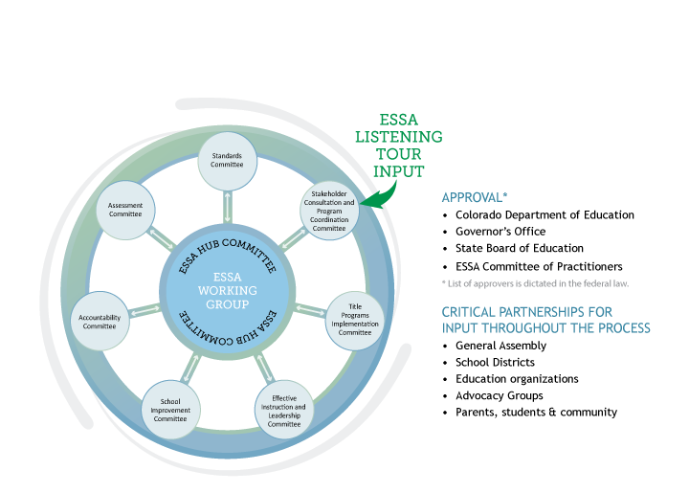
ESSA State Plan
4

Slide 5


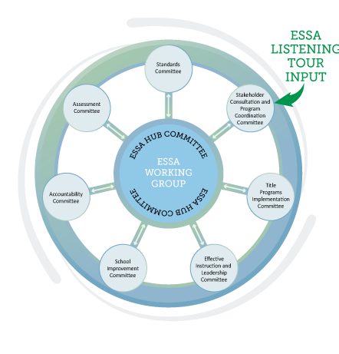
Charge
Draft, review, and revise sections of Colorado’s ESSA State Plan;
Provide recommendations on content specific decision points
Identify possible areas for additional flexibility in state legislation
Propose responses to and provide justifications for decisions made concerning stakeholder feedback; and,
Present and submit draft sections, recommendations , and summaries of the ESSA state plan work to the Hub committee.
5

Slide 6
Purpose:
To gather input and research on the accountability decision points in the Every Student Succeeds Act (ESSA) in order to provide options/recommendations and considerations on those decision points for the ESSA state plan.
The work is focused on school and district accountability, which is tied closely to and dependent
upon state assessments. However, assessment options will not be the focus of this work.
End Goal:
Provide options and considerations for the accountability decision points for the ESSA state plan, to be shared with the hub committee, the Committee of Practitioners (CoP) and the State Board of Education (SBE), and ultimately submitted to the U.S. Department of Education on March 6, 2017.
6

Slide 7
Goal of Accountability
Why do we have an accountability system?
  State?
  Federal?
What do we want it to accomplish?
What can it accomplish?

Slide 8

ESSA Requirements
8

Slide 9
Components of Accountability System
ESSA Requirements
  Indicators
    Achievement on state tests (overall & disaggregated)*
    Growth on state tests (overall & disaggregated)*
    Graduation rates (overall & disaggregated)*
    English language proficiency of English learners*
    Other School Quality and Student Success (overall & disaggregated)
      Valid, reliable, same state-wide and differentiates performance
  95 percent participation requirement
* Colorado components

Slide 10
Accountability Decision Points
English learner progress measure(s)
“Other indicator” of school quality or student success
Participation requirements
Long-term goals and interim measures
N size and reporting rules
Decision
Points
Method for identifying and exiting comprehensive and targeted support schools
English learner assessment policy (1st year in US) (shared with
assessment spoke)

Slide 11

Opportunities
Measures for the “other indicator”
District accountability
Other measures/indicators not specified in ESSA (but will need to address weighting of those indicators)

Slide 12

Concerns
“A single statewide accountability system” §200.12(a)(1)
  Participation/opt-out/achievement calculations
  Alternative Education Campus frameworks
  READ Act bonus points
Timeline for Implementation
  2017-18 school year for identification (with 2016-17 data)
  State plan due dates - March 2017 or July 2017
Reporting and Privacy Concerns
  Privacy vs. reporting- needs clarification

Slide 13


Misalignment
Reporting for “each” major racial and ethnic group
Must use 4-year grad rate (and then can also use extended)
Parent excuses counted as non-proficient and non-participants
95% participation (including parent excusals) included as an impact in accountability ratings
Requirements on weighting of indicators
Alternative Education Campus Frameworks

Slide 14






Proposed Accountability Regulations
14

Slide 15

Comparison of policy – academic achievement
 | Colorado Frameworks 2.0 | ESSA Requirements | Proposed Regulations
Academic Achievement | Mean scale score Elementary, middle, high English language arts, math and science All students and by disaggregated group | “As measured by proficiency” Elementary, middle, high English language arts, math and science All students and by disaggregated group Same assessment for all students Assessments measure standards Newly arrived English learner testing policy | 200.14(a)(i) Same weight to reading/math 200.16(a) Students from “each” major racial and ethnic group Decision Point

Slide 16
Comparison of policy – academic growth
 | Colorado Frameworks 2.0 | ESSA Requirements | Proposed Regulations
Academic Growth | Median growth percentiles (not including adequate growth) Elementary, middle, high English language arts, math, language proficiency All students and by disaggregated group | “A measure of student growth” Elementary and middle High school growth optional English language arts and Math “Progress in achieving English language _{De} proficiency” for ELs All students and by disaggregated group | Same as law cision Point

Slide 17
Comparison of indicators – post secondary & workforce readiness
 | Colorado Frameworks 2.0 | ESSA Requirements | Proposed Regulations
Post- secondary & Workforce Readiness/ Graduation Rate | Best-of 4-,5-,6-,7- year graduation rate (or completion rate) All students and by disaggregated group Dropout rate Average ACT score Matriculation Rate | 4-year graduation rate 5-,6-,7-year graduation rates optional All students and by disaggregated group | Same as law (with details on graduation rate calculations)

Slide 18
Comparison of indicators – school quality or student success
 | Colorado Frameworks 2.0 | ESSA Requirements | Proposed Regulations
Indicator of School Quality or Student Success Decision Point | For high schools use: Dropout rate (overall) Composite ACT (overall) Matriculation rate (overall) | State determined, applicable and valid for all schools by EMH level May include measures of - student engagement; educator engagement; student access to and completion of advanced coursework; postsecondary readiness; school climate and safety All students and by disaggregated group Valid, reliable, comparable, and statewide | 200.14(d): Measure must be “supported by research that performance or progress on such measures is likely to increase students’ achievement…or graduation rates”

Slide 19
Comparison of indicators – participation
 | State Law | ESSA Requirements | Proposed Regulations
Participation: Requirements | HB15-1323 requires districts to have a policy to allow parents to excuse their students from state assessments | §1111(c)(4)(E)(i): "Annually measure the achievement of not less than 95 percent of all students, and 95 percent of all students in each subgroup of students, who are enrolled in public schools on the assessment“ §1111(b)(2)(K): “Nothing in this paragraph shall be construed as preempting a State or local law regarding the decision of a parent to not have the parent’s child participate in the academic assessments.” | 200.15(a)(1) same as law Proposed regulations do not address this section of the law to reconcile it with the other requirements.
19

Slide 20
Colorado
Frameworks 2.0
ESSA
Requirements
§1111(c)(4)(E)(iii) “The 95%
participation requirement must be factored into the statewide accountability system”
Proposed
Regulations
Regs
Participation: Accountability Impact
Ratings lowered for schools/ districts that missed the 95% participation target in two or more subject areas (not counting parent excuses)
200.15(b)(2): gives 4 options
Lower rating
Lowest performance on academic achievement
Identified for targeted support and improvement plan
Equally rigorous state- determined action
Decision Point
200.15(c): all schools not meeting 95%
requirements overall or for a disaggregated group must develop an improvement plan
20

Slide 21
Comparison of indicators – participation achievement
 | Colorado Frameworks 2.0 | ESSA Requirements | Proposed Regulations
Participation: Achievement Reporting | Non-participants are not included in performance denominators | §1111(c)(4)E(ii): Non-participants (below 95%) are counted as non- proficient Law | Same as law

Slide 22



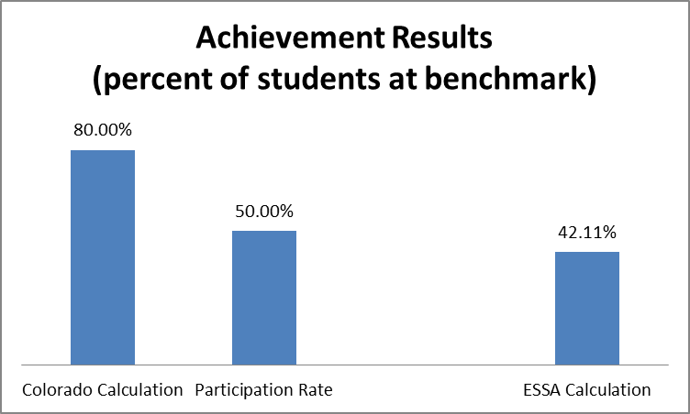
Ex of Non-participant

Slide 23
Comparison of data reporting - comparbility
 | Colorado Frameworks 2.0 | ESSA Requirements | Proposed Regulations
Data Compar- ability, and Privacy | Minimum n of 16 for Achievement, and post- secondary workforce readiness measures Minimum n of 20 for Growth measures Decision Point | §1111(c)(3): “(i) the minimum number of students that the State determines are necessary… and how that number is statistically sound, which shall be the same State-determined number of all students and for each sub-group of students in the State… (iii) how the State ensures that such minimum number is sufficient to not reveal any personally identifiable information." | 200.14(c): demonstrate that each measure “(1) Is valid, reliable, and comparable across all LEAs in the State; (2) Is calculated in the same way for all schools…(3) Is able to be disaggregated for each subgroup of students... and (4) Is used no more than once in its system of annual meaningful differentiation 200.17(a)(3): Same minimum N for all measures and indicators, “(iii) Must not exceed 30 students, unless the State provides a justification for doing so in its State plan”
23

Slide 24
Comparison of scoring - targets
 | Colorado Frameworks 2.0 | ESSA Requirements | Proposed Regulations
Targets & Ratings | Framework Achievement and Growth ratings set at 15- 50-85, with percentiles baselined in first year. Framework post-secondary and workforce readiness ratings based on state average and external criteria. | §1111(c)(4)(A): "Establish ambitious State-designed long-term goals, which shall include measurements of interim progress toward meeting such goals" for (I)(aa) "academic achievement as measured by proficiency on the annual assessments“ §1111(c)(4)(A)(i): (II) Timeline for goals should be the same for all student groups/subgroups, and (III) for subgroups of students behind on academic achievement or high school graduation "take into account the improvement necessary on such measures to make significant progress in closing statewide proficiency and graduation rate gaps" | 200.13(a) Same as law Decision Point
24

Slide 25
Comparison of weighting: weighting of indicators
 | Colorado Frameworks 2.0 | ESSA Requirements | Proposed _{Regs} Regulations
Weighting of Indicators | Weightings: Elementary & Middle Schools- 40% Achievement 60% Growth High Schools & Districts- 30% Achievement 40% Growth 30% PWR | §1111(c)(4)(C)(ii): "afford-- (I) substantial weight to each such indicator" (II) with much less weight given to the school quality/success indicator - "include differentiation of any such school in which any subgroup of students is consistently underperforming" §1111(e)(1)(B)(iii)(IV): The Secretary of Education cannot prescribe "the weight of any measure or indicator used to identify or meaningfully differentiate schools“ | 200.18(d): Other indicator may not be used to change the identification of schools that would otherwise be identified for comprehensive and improvement support 200.18(d)(3): Must differentiate ratings between schools earning the lowest level on any indicator and schools performing at the highest level on all indicators. 200.18(e)(3): If indicators are missing, then must adjust so same relative
25

Slide 26
Comparison of outcomes
 | Colorado Frameworks 2.0 | ESSA Requirements | Proposed Regulations
Ratings | District Accreditation Ratings and School Plan Types Turnaround Priority Improvement Improvement Performance Distinction (Districts only) | School Ratings Comprehensive Support and Improvement Plan lowest 5 percent of Title I schools all public high schools failing to graduate one third or more of their students Long-term targeted schools Targeted support and improvement plan schools where "any subgroup of students is consistently underperforming" | 200.19(d): identification for the 2017-18 school year; 200.21(a): identification no later than the beginning of the school year Decision Point
26

Slide 27
School Improvement
27

Slide 28
Agenda: Overview of expectations
Overview of expectations for School Improvement Spoke Committee
Work of School Improvement Spoke Committee to date
Discussion
28

Slide 29
Plan Development
2
9

Slide 30



Decision points – school improvement
SEA supports for identified schools
  Definitions, timelines, interventions, and supports
    Comprehensive Support Schools
    Targeted Support Schools
    Additional interventions for schools not making progress
Identify and define “evidence-based” interventions
  Definition
  List of approved interventions?
Allocation of School Improvement resources
  CDE must reserve 7% of the state Title I allocation to support identified schools
    Formula v. Competitive
  Direct services to districts with identified schools
30

Slide 31

Defintions
Comprehensive Schools:
  Includes at least the bottom 5% of lowest performing Title I schools
  Includes any high school failing to graduate at least 1/3 of students
  Identified at least every three years starting in 2017-18
Targeted Schools:
  Any schools that is consistently underperforming for one or more disaggregated groups of students
  Additional Targeted schools (schools with subgroups that would meet the lowest 5% definition)

Slide 32

Definitions continued
Evidence-based Strategy (based upon sec. 8002(21)(A)) is an
activity, strategy, or intervention that
  Has a research base (e.g., experimental design, promising evidence)
  Is likely to improve student outcomes or other relevant outcomes
  Includes ongoing efforts to examine the effects

Slide 33
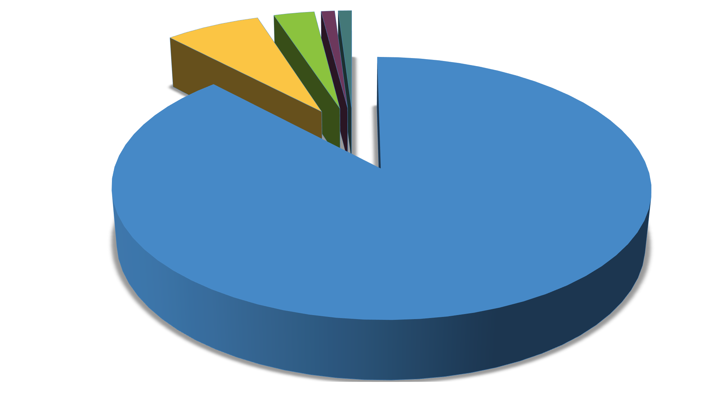
ESSA Title I Funds ~ $150M Annually (Estimates only)
Distibution to schools 132M 3% Dir Serv (Optional) 4.5M Delinquent Alloc. 1.5M
7% SI Funds (Required)10.5M State Admin 1.5M

Slide 34




7 % Must be set aside to support schools identified for ESEA School Improvement.
Eligibility for access to set aside
  Lowest 5% of Title I schools in the state
  High Schools with grad rate less than 67%
  Schools with underperforming Subgroups
Estimated ~ $10,500,000
95% of set-aside must go to LEAs with identified schools
SEA must
  Prioritize LEAs with large numbers of identified schools
  Take into account the geographic diversity of the LEAs in the state
Decision Points
  Award funds by formula?
  Award funds competitively (as under NCLB)?
  Hybrid (formula and competitive)?
  Should SEA retain funds to provide direct services?

Slide 35




SEAs may, after consultation with stakeholders, withhold an additional 3% for
Direct Services to students.
Estimated ~ $4,500,000
99% of set-aside must go to LEAs with low performing schools
  HS student supports, such as:
    GED
    Concurrent enrollment
    Credit recovery
  After school tutoring
  Title I School Choice options
Decision Point
  Should CDE retain an additional 3% of Title I funds to LEAs to provide direct services to students in low performing schools?

Slide 36
Agenda: work of school improvement committee
Overview of expectations for School Improvement Spoke Committee
Work of School Improvement Spoke Committee to date
Discussion
36

Slide 37
Assumptions
The Accountability Spoke Committee is recommending how to identify comprehensive and targeted schools – and exit criteria. This will inform our committee work.
We plan to use the ESSA plan as an opportunity to re-vision supports for low performing systems.
State laws are still in effect – we will note and maintain a list of needed policy changes, if necessary.
We seek to clarify specific roles for state, districts and schools in supports and school improvement.
37

Slide 38

Current practices
Alignment of ESEA accountability requirements and state
accountability requirements
  School and district performance frameworks and identification of low performing districts/schools
  Unified Improvement Planning
  Title I Focus Schools and Priority Schools
  State and Title I requirements for parent notification
State and Federally Funded Supports
  Differentiated supports to districts and schools, including: Tiered Intervention Grant, Turnaround Network, Connect for Success grant, Turnaround Learning Academy, Diagnostic Review and Improvement Planning grant, School Turnaround Leaders Development grant,
38
Pathways for Early Action grant

Slide 39

Structure for Spoke
Groups | Roles
Committee Leads | Leadership for the committee and final decision making
Working Group | Create draft plan based upon feedback
Internal Advisory Group | Advise, design thinking, draft specific sections, provide feedback
External Advisory Group | Advise, design thinking, provide feedback

Slide 40
Membership
Variety of districts and organizations represented – superintendents, district administrators, advocacy organizations, community members
Urban and rural voices from across the state
Committee membership is included with the School Improvement Spoke Committee report

Slide 41

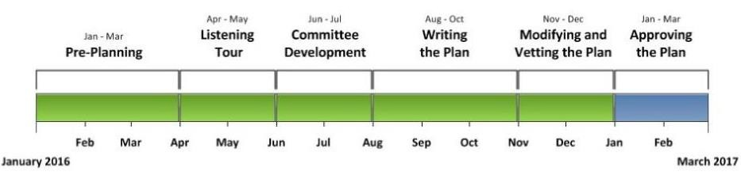
Timeline
Colorado must submit an ESSA state plan by March 6 or July 3, 2017, per the
proposed regulations.
4
1

Slide 42
Timeline and focus for advisory
Timeline | Focus
Aug 17 Meeting | Orientation Design thinking on support structures
Sept 23 Meeting | Feedback on draft of support structures Design thinking on resource allocation
Oct (Meeting date TBD) | Feedback on draft of resource allocation Review of overall recommendations
End of Oct | Submit proposed plan for School Improvement and Supports to CDE and Hub Committee
Nov – Dec | Vet plan with your constituents and colleagues and provide general comments

Slide 43
Outcome from meeting
Creating a resource of the features to include in the design of the SEA supports.
Gathering input from advisory committee, State Board of Education, Hub Committee and feedback from Listening Tour.
Will use resource to review initial drafts.
CDE staff still sorting through responses.
Some examples of the categories include:
  Resource equity
  Menu of options
  Diagnostic tools and planning
  Performance management and progress monitoring
  Leadership development

Slide 44
Agenda: discussion
Overview of expectations for School Improvement Spoke Committee
Work of School Improvement Spoke Committee to date
Discussion
44

Slide 45
Discussion questions
In designing systems of support, what are the features that
need to be in place?
  From CDE to districts with identified schools?
  From districts to identified schools?
  From other stakeholders?

Slide 46

Contact
For more information, contact the School Improvement Spoke
Committee leads:
  Brad Bylsma, Federal Programs bylsma_b@cde.state.co.us
  Lisa Medler, Improvement Planning
medler_l@cde.state.co.us
  Peter Sherman, School and District Performance sherman_p@cde.state.co.us

Slide 47



Wrap-up
47

Slide 48
Concluding remarks
48

Slide 49



Meeting evaluation
What worked?
What would make the
meeting more effective?
49

Slide 50

Next meeting
₃rd
ESSA Hub Committee Meeting details
Monday, October 10, 2016
Location: State Board Room -201 E. Colfax Ave., Denver, CO 80203
Time: 12:00 PM – 4:00 PM
Agenda and materials will be provided a week in advance and will also be posted on our website: http://www.cde.state.co.us/fedprograms/essa_stateplandevelopment
50

Slide 51




Upcoming meeting dates
Monday, October 10, 2016
Monday, November 7, 2016
Monday, December 12, 2016
Location: State Board Room -201 E. Colfax Ave., Denver, CO 80203 Time: 12:00 PM – 4:00 PM
51

