Slide 1
CDE Office Hours
September 23, 2021

Slide 2
CDE Team!
CDE Contacts!
Emails: LastName_FirstInital@cde.state.co.us
ESSER/ESEA Program Partners
Nazie Mohajeri-Nelson, Director of ESEA Office (mohajeri-nelson_n@cde.state.co.us)
DeLilah Collins, Assistant Director of ESEA Office (collins_d@cde.state.co.us)
ESEA Regional Contacts assigned by district
  Title I: Laura Meushaw, Kathryn Wisner, Niko Kaloudis
  Title II: Jeremy Meredith, Niko Kaloudis
  Title III: Lorenzo Moreno, Kathryn Wisner
  Title IV: Tammy Giessinger, Michelle Prael
  Title V: Kristen Collins
ESSER Team
  Kristin Crumley, ESSER Monitoring Specialist (Crumley_k@cde.state.co.us)
  Jonathan Schelke, ESSER Monitoring Specialist (schelke_j@cde.state.co.us)
  Shannon Wilson, ESSER/ESEA Grants Administration Coordinator (Wilson_s@cde.state.co.us)
  Mackenzie Owens, ESSER Reporting Specialist (owens_m@cde.state.co.us)
Data, Accountability, Reporting, and Evaluation
  Tina Negley, Alan Shimmin, Mary Shen, and Mackenzie Owens
Fiscal Partners
Jennifer Okes, Chief Operating Officer (okes_j@cde.state.co.us)
Kate Bartlett, Executive Director of School District Operations (Bartlett_k@cde.state.co.us)
Jennifer Austin, Director of Grants Fiscal Management (Austin_j@cde.state.co.us)
Robert Hawkins, Grants Fiscal Analyst (Hawkins_s@cde.state.co.us)
Steven Kaleda, Grants Fiscal Analyst (Kaleda_s@cde.state.co.us)
ESSER Team
  Bill Parsley, ESSER Fiscal Monitoring Supervisor (parsley_w@cde.state.co.us)
  Hilery Morris, ESSER Fiscal Monitoring (morris_h@cde.state.co.us)
  Sharon Mackey, ESSER Fiscal Monitoring (mackey_s@cde.state.co.us)

Slide 3
ESSER Office Hours
Topics
CRF Monitoring Q&A
Indirect Cost Rate Training ~ Grants Fiscal Management Unit
Evidence-Based Curricula and Resources ~ Standards and Instructions Unit
Updates and Announcements
Notes:
Nazie

Slide 4
CRF Monitoring
Notes:
The info shared in other segments of this Office Hour on homelessness and workforce also related to Preschool

Slide 5
KPMG Risk Assessment
Overview

Slide 6
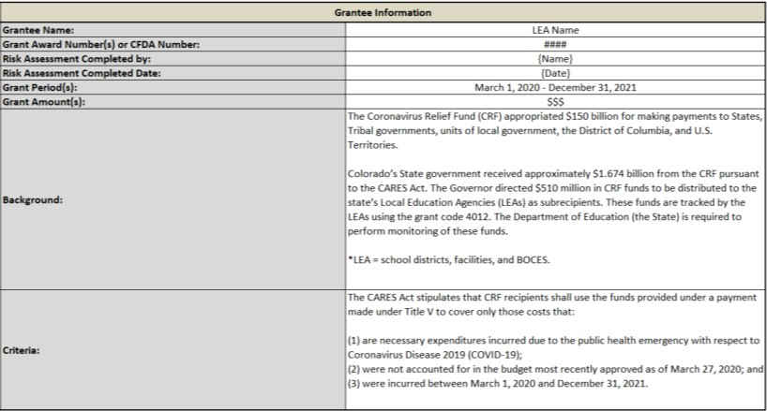
Grantee Information
Grantee Information
Purpose: to provide a high-level overview of the grant requirements and fiscal background
Section Requirements: 1. Enter the name of the LEA official completing the risk assessment and the date of completion
2. Verify the Grant Amount that was prepopulated in the assessment is accurate
3. If the Grant Amount is inaccurate, report the correct amount

Slide 7
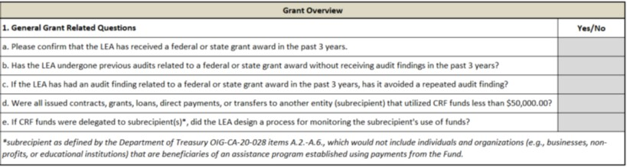
Grant Overview
Grant Overview
Purpose: to identify risks associated with both past audit findings and the distribution of funds to your LEA’s subrecipients, if applicable. This section helps to identify patterns of potential risk, which may have been observed in past audit findings. Additionally, understanding the extent to which subrecipients are receiving CRF funds from your LEA helps to tailor our review of your monitoring procedures.
Section Requirements: 1. Utilize the drop-down menus in the “Yes/No” column to answer each question
2. If necessary, provide additional information in the “Comments for Consideration” box of the below section

Slide 8
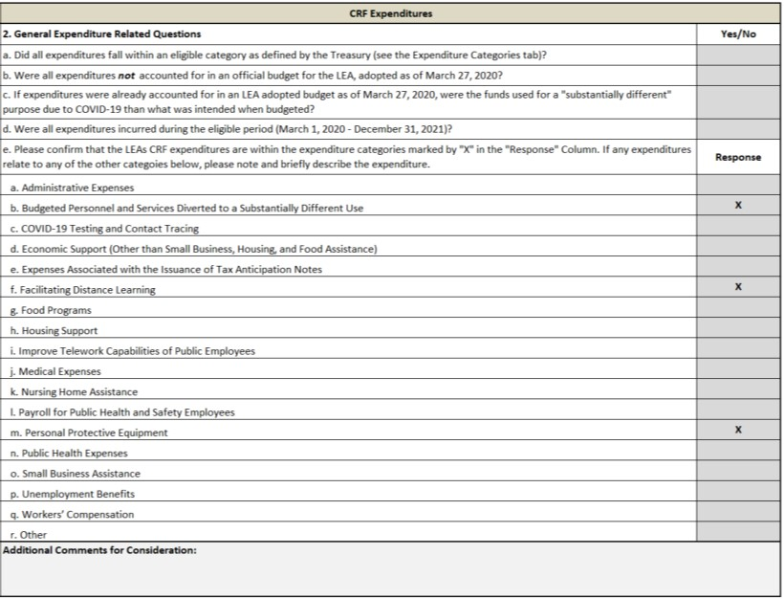
CRF Expenditures
CRF Expenditures
Confirm
Purpose: to identify compliance risks associated with Federal grant criteria, and to verify previously reported spend categories. This section assesses your compliance with the baseline grant criteria and the type of expenditures your LEA incurred with CRF funds. This will help us clarify the necessary monitoring and tracking procedures.
Section Requirements: 1. Utilize the drop-down menus in the “Yes/No” column to answer each question
2. Confirm the spend categories utilizing the drop-down menu in the “Response” box
3. If necessary, note the correct spend categories in the “Comments for Consideration” box

Slide 9
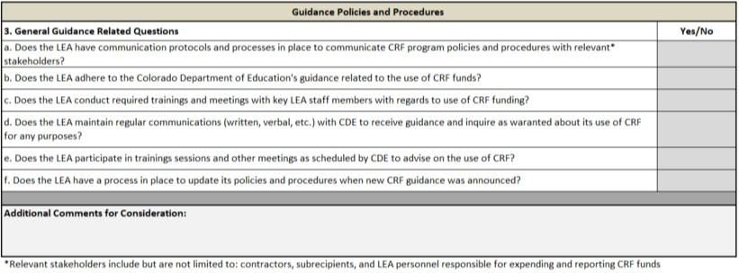
Guidance Policies and Procedures
Guidance Policies and Procedures
Purpose: to assess your LEA’s procedures for updating and disseminating CRF guidance and trainings. Having up-to-date information on grant criteria is essential for remaining compliant with Federal and State requirements. This section evaluates your LEA’s policies for staying informed on updated guidance
Section Requirements: 1. Utilize the drop-down menus in the “Yes/No” column to answer each question
2. If necessary, provide additional information in the “Comments for Consideration” box of the below section

Slide 10
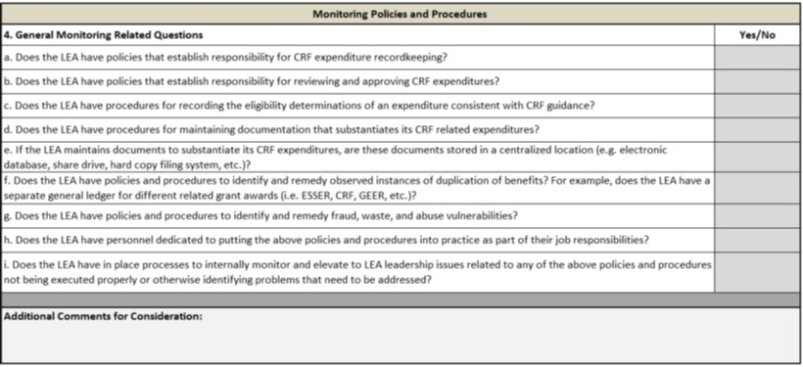
Monitoring Policies and Procedures
Monitoring Policies and Procedures
Purpose: to assess your LEA’s policies and procedures (“P&P”) for reviewing and tracking CRF related expenditures. Proper review and reporting P&P will assist in maintaining the necessary expense documentation. This sections helps to assess your P&P’s for reviewing and reporting CRF related expenses, as required by Federal and State guidance
Section Requirements: 1. Utilize the drop-down menus in the “Yes/No” column to answer each question
2. If necessary, provide additional information in the “Comments for Consideration” box of the below section

Slide 11
Indirect Cost Training

Slide 12
Indirect Cost (IDC) and Indirect Cost Rate (ICR)
According to the USDOE:
“Indirect costs represent the expenses of doing business that are not readily identified with a particular grant, contract, project function or activity, but are necessary for the general operation of the organization and the conduct of activities it performs.”
Total costs = indirect costs + direct costs
“An indirect cost rate represents the ratio between the total indirect costs and benefiting direct costs, after excluding and or reclassifying unallowable costs, and extraordinary or distorting expenditures. (i.e., capital expenditures and major contracts and subgrants).”
https://www2.ed.gov/about/offices/list/ocfo/intro.html
“Indirect (F&A) costs means those costs incurred for a common or joint purpose benefitting more than one cost objective, and not readily assignable... “ § 200.56 Indirect (facilities & administrative (F&A)) costs.
Notes:
Kate
Bill P added verbiage from USDOE. It’s a bit lengthy so we can pare it down but the top one definitely speaks to the point I think we are driving home

Slide 13
Typical Costs associated with ICR
Indirect costs may include expenses from areas such as:
Accounting
Payroll
Auditing
Personnel Management
Purchasing
Employee Relations
Facilities
Utilities
Executive compensation (cabinet level)
Costs not readily assigned to a particular cost objective for the grant become part of the indirect cost “pool”
Note, any costs from the areas noted above directly attributed to the grant would not be included as direct costs as well. No double dipping.
Notes:
Kate

Slide 14
Additional Costs excluded from ICR
May include but are not limited to:
Capital Outlays (building, land, equipment)
Debt Service
Large Subawards/Contracts (above $25K)
Rental Costs
Notes:
Kate
Bill P - not sure if subawards are necessary to add to this conversation as I’m guessing Districts aren’t turning around and subawarding from the funds they receive
Exclude costs that tend to distort the cost pool (i.e. - large land or building purchase) as the idea is to have indirect cost rate be an equitable distribution of these types of costs.

Slide 15
IDC Costs vs Direct Admin Costs
Generally, direct administration costs differ from indirect charges in that the latter are considered organization-wide costs.
Examples of direct administration are salaries, benefits, and other expenses of the recipient's staff that perform the following functions:
• overall program management, program coordination, and office management functions
• preparing program plans, budgets schedules, and related amendments
• monitoring of programs, projects, subrecipients and related systems and processes
• developing systems and procedures, including management information systems, for assuring compliance with program requirements
• preparing reports and other documents related to the program requirements
• evaluating program results against stated objectives
• divisional level administrative services such as program specific accounting, auditing or legal activities

Slide 16
Indirect Costs are an Allowable Grant Activity in General
An entity may take ICR unless prohibited by the grant program or because the AU/District/BOCES internal policies and procedures disallow the use of ICR. Taking ICR may be a viable route that frees up other General Funds. These General Funds can then be used for other purchases not restricted by federal funding (subject to internal policies).
Direct and Indirect (F&A) Costs (§§ 200.412 - 200.415)
The Department of Education takes the view that indirect cost reimbursement loses its identity after it is received and deposited in the "General Fund." This means the host institution can use that money to pay the services of a grant writer or for any other costs as long as the activities and reimbursement are consistent with the organization's own policy. However, by doing so, the organization essentially is "eating" the indirect costs this reimbursement was meant to replace. These costs cannot be shifted to other Federal sources.
Department of Education FAQ Link: https://www2.ed.gov/about/offices/list/ocfo/fipao/faq.html

Slide 17
Types of ICR
Unrestricted Rate - An indirect cost rate calculated for use on programs without limitations on indirect costs.
Examples:
ESSER
Local Grants
Restricted Rate - Certain ED grant programs have statutory requirements prohibiting the use of federal funds to supplant non-federal funds. These programs require the use of a restricted indirect cost rate. Adjustments to the unrestricted rate calculation are made and result in a lower rate to claim indirect reimbursement on restricted rate programs.
Examples:
Title I
Title II
Title III
IDEA Part B

Slide 18
How is IDC Calculated
The following formula should be used to determine the amount that could be budgeted for indirect cost reimbursement.
Indirect Cost Rate% X (Total Award Less Capital outlay, sub-awards,
(1.0 + Indirect Cost Rate %) rental costs & other excluded expenses)
Note: You also may elect to waive all or a portion of indirect cost claims.
Notes:
Kate

Slide 19
How is IDC Calculated (Example)
An example of using the formula is to assume your award amount is $258,000, Capital Outlay is $5,000, Rental Costs are $3,000. Since your rate is 3.1%:
0.031 X ($258,000-$5,000-$3,000)
1.031
This equals 0.030067895 (rounds to 3.1%) times $250,000.
The product of these two figures is 7,516.9725, or $7,516.97 rounded.
This means that for a grant of $258,000, the following results:
BUDGET
Grant Amount: $ 258,000
Capital Outlay: $ 5,000
Rental Costs: $ 3,000
Indirect Costs: $ 7,516.97
Base of Application: $ 242,483.03
Sum: $ 258,000

Slide 20
How Do I recover IDC
Indirect Costs can be requested as part of the monthly RFF (Request For Funds) process from the GFMU (Grants Fiscal Management Unit).
Indirect Costs do not need to be requested separately and can be included in the “lump” request for each federal award for which an indirect cost rate is allowable.
As with direct costs it is the responsibility of the LEA to retain the back up detail for all Indirect Costs requested for reimbursement through the GFMU RFF process.

Slide 21
ICR Use in Multi-Year Awards
The rate should be used in the fiscal year the funds are expended, which is not necessarily the same as the fiscal year the funds are appropriated, received, or encumbered. For instance, if money for a program is received in May 2020, which is part of fiscal year 2019–20, but the funds are not expended until fiscal year 2020–21, then the indirect cost rate approved for use in 2020–21 should be used when claiming indirect costs. This is because the indirect cost rate is meant to allow for recovery of costs in the fiscal year the expenditures are incurred, not the year the money may have become available.
If more than one fiscal year is involved in a project, the indirect cost rate used to recover indirect costs should change as the fiscal year changes. For instance, using a 24-month program starting July 1, 2021, the indirect cost rate approved for use in fiscal year 2021–22 would be used for expenditures incurred July 1, 2021, through June 30, 2022, and a new indirect cost rate approved for use in fiscal year 2022–23 would be used for expenditures incurred from July 1, 2022, until January 31, 2023.

Slide 22
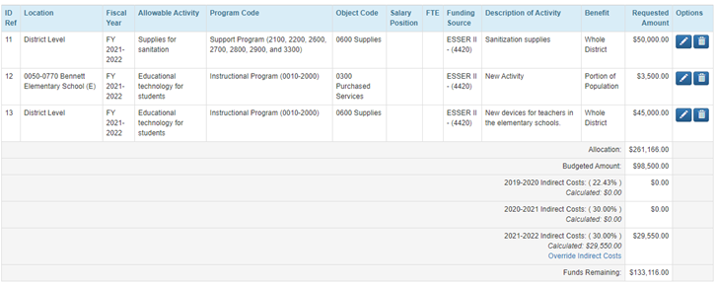
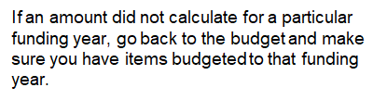

Override Indirect Costs Link
At the bottom of the budget table, districts will see the indirect cost rates and amounts calculated for each funding year.

Slide 23
Chart of Accounts
Indirect Cost accounts are considered Internal Charge Reimbursement Accounts. The recording of transactions to allow for charging of internal services from one department within a district to another department.
Expenditure Account
0869 Indirect Costs. Used with federal grants/projects.
Revenue Account
1972 Indirect Cost Revenue. Revenue internal to the district which is generated by charging for costs of a general nature that cannot be readily or accurately identified with specific services.
Chart of Accounts .pdf found at this link: https://www.cde.state.co.us/cdefinance/sfcoa

Slide 24
Chart of Accounts - Continued
Chart of Accounts - Appendix G - Indirect Costs
A district has two options for recording indirect costs
The Expenditure/Revenue Method: the total expenditures (0869) should equal the total revenues (1972).
The Abatement Method: the district’s internal charge reimbursement account (0869) must net to zero
When booking the indirect costs ensure that the rate is within the allowable rate for your district determine if you have direct administrative costs charged to the grant.

Slide 25
Chart of Accounts - Continued
The Expenditure/Revenue Method (example)
The Abatement Method (example)
Indirect costs may be recorded monthly, quarterly or annually
When Calculating must be based on actual expenditures incurred less previous recorded indirect costs including administrative costs.
Fund | Location | SRE | Program | Object/Source | Job | Grant | Amount
10 or 22 | 600 | 29 | 2900 | 0869 | 000 | 4xxx | 4,510.50
10 | 000 | 00 | 0000 | 1972 | 000 | 0000 | 4,510.50
Fund | Location | SRE | Program | Object/Source | Job | Grant | Amount
10 or 22 | 600 | 29 | 2900 | 0869 | 000 | 4xxx | 4,510.50
10 | 600 | 29 | 2900 | 0869 | 000 | 0000 | - 4,510.50

Slide 26
Additional Resources
USDOE Cost Allocation Guide for State and Local Governments:
https://www2.ed.gov/about/offices/list/ocfo/fipao/costallocationguide92019.pdf
Uniform Grant Guidance (UGG):
2 CFR Subpart E - Cost Principles (§ 200.400 - 200.476)
Indirect cost rate calculations: http://www.cde.state.co.us/cdefinance/icrc

Slide 27
CDE Contacts
Evan​ Davis
Federal Fiscal Grants Supervisor
Office of Grants Fiscal Management
Email: Davis_E@cde.state.co.us
Yolanda​ Lucero
Financial Data Coordinator
School Finance Division
Email: Lucero_y@cde.state.co.us
Hilery Morris
Fiscal Monitoring Specialist
Office of Grants Fiscal Management
Email: Morris_h@cde.state.co.us
Bill Parsley
ESSER Fiscal Monitoring Supervisor
Office of Grants Fiscal Management
EMAIL: Parsley_b@cde.state.co.us

Slide 28
Evidence-Based Curricula and Resources
Notes:
The info shared in other segments of this Office Hour on homelessness and workforce also related to Preschool

Slide 29

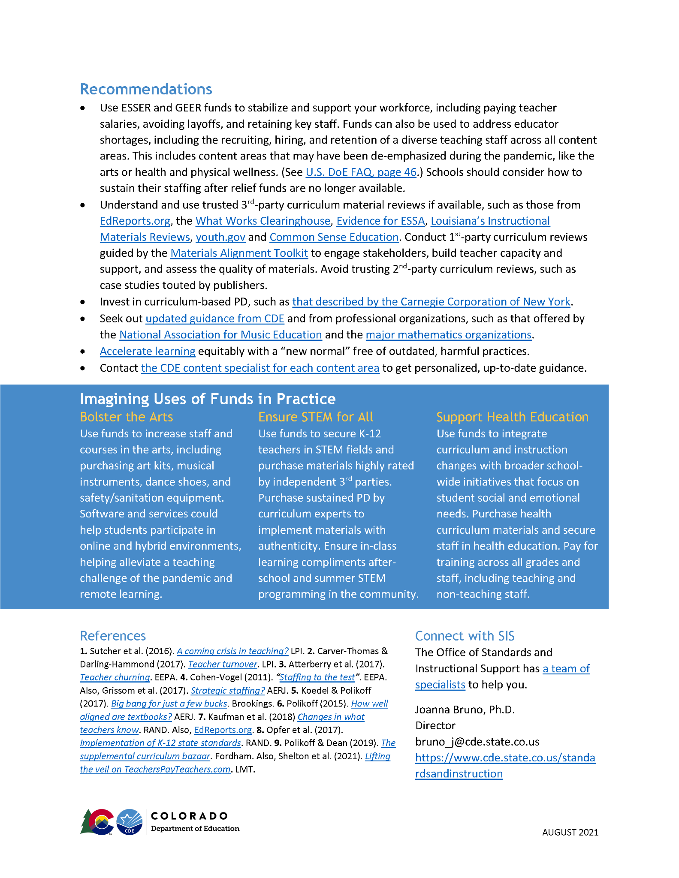
How should schools use COVID relief funds to make long-term investments in curriculum and instruction?
How are you addressing staffing issues?
Are your curricular materials high-quality? If not, do you have a high-quality process to replace them?
Are teachers well-supported to use their materials?
https://www.cde.state.co.us/standardsandinstruction/sis-covid-spending-guidance

Slide 30













#1 recommendation: Talk to your state content specialists!
Office of Standards and
Instructional Support
Joanna Bruno, Ph.D.
Director
bruno_j@cde.state.co.us
Maya Garcia
Science Specialist
garcia_maya@cde.state.co.us
Judi Hofmeister
Dance & Drama and Theatre Arts Specialist
hofmeister_j@cde.state.co.us
Stephanie Hartman, Ph.D.
Social Studies Specialist
hartman_s@cde.state.co.us
Jamie Hurley, Ph.D.
Comprehensive Health & Physical Education Specialist
hurley_j@cde.state.co.us
Raymond Johnson, Ph.D.
Mathematics Specialist
johnson_r@cde.state.co.us
Donna Goodwin, Ph.D.
Visual Arts Specialist
goodwin_d@cde.state.co.us
Carla Aguilar, Ph.D.
Music Specialist
aguilar_c@cde.state.co.us
Vacant
Financial Literacy Specialist
World Languages Specialist
bruno_j@cde.state.co.us
Chris Summers
Computer Science Specialist
summers_c@cde.state.co.us
Olivia Gillespie
Reading, Writing, & Communicating Specialist
gillespie_o@cde.state.co.us

Slide 31

Don’t lose sight of the bigger picture!
There’s more to life than ELA and math.
  What are you doing for science? For physical education? For social studies? For computer science?
  What are you doing for the arts? (Dance, drama & theatre arts, music, visual arts, etc.)
There’s more to curriculum than textbooks.
  Think about all forms of materials, activities, resources, etc. that your teachers need.
  Recognize that forms differ greatly across content areas.
  Prioritize material needs for Tier 1/universal instruction before spending your budget on intervention materials.
There should be more to your plans than just the stuff you’re spending money on.
  How are you investing in teachers and their professional development, both with money and without?
  What high-quality free resources are available, allowing you to spend more money elsewhere?

Slide 32
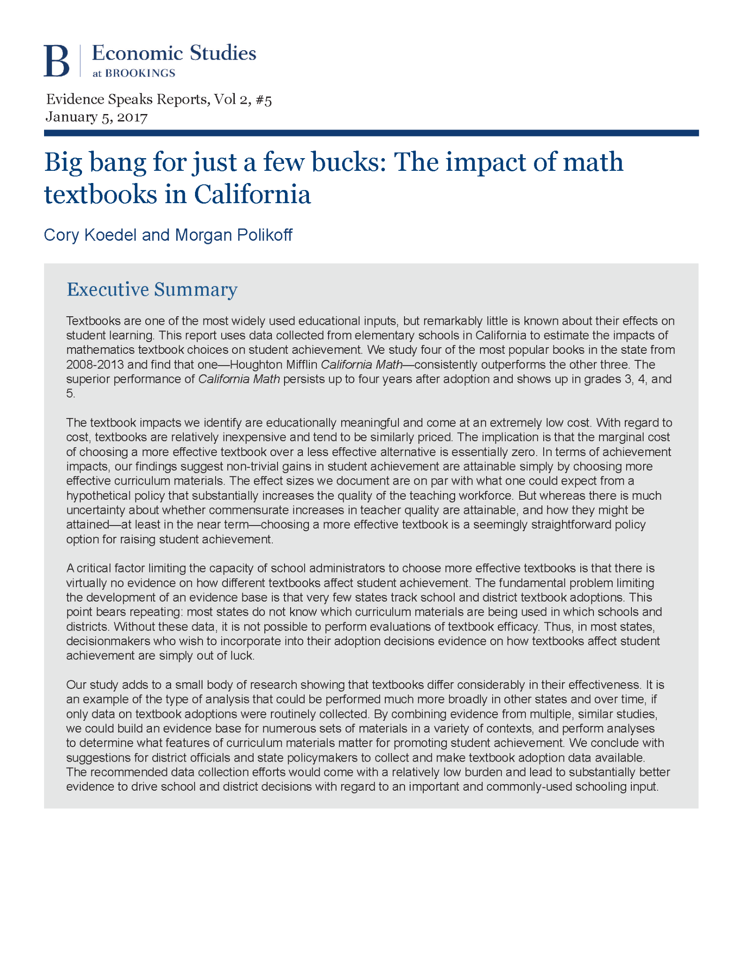
Why invest in curriculum?
Changes to materials scale over time and place.
Investing in high-quality materials may* be a good bang for the buck (Koedel & Polikoff, 2017)
The number of schools using highly-rated materials is improving, but is still surprisingly low in places
Ways of thinking about reviewing and adopting materials:
First-person reviews
Second-person reviews
Third-person reviews
More guided
Less guided
K-3 Reading
(READ Act)
4-12 ELA,
K-12 Math
K-12 Science
K-12 Social Studies, K-12 Health
Content areas typically less reliant on textbooks
Notes:
Raymond say: The READ Act requires the Department to create an advisory list of evidence-based or scientifically-based instructional programming in reading for use by local education agencies. This review of core, supplemental, and intervention programming for K-3 reading instruction is conducted by CDE staff and LEAs.

Slide 33

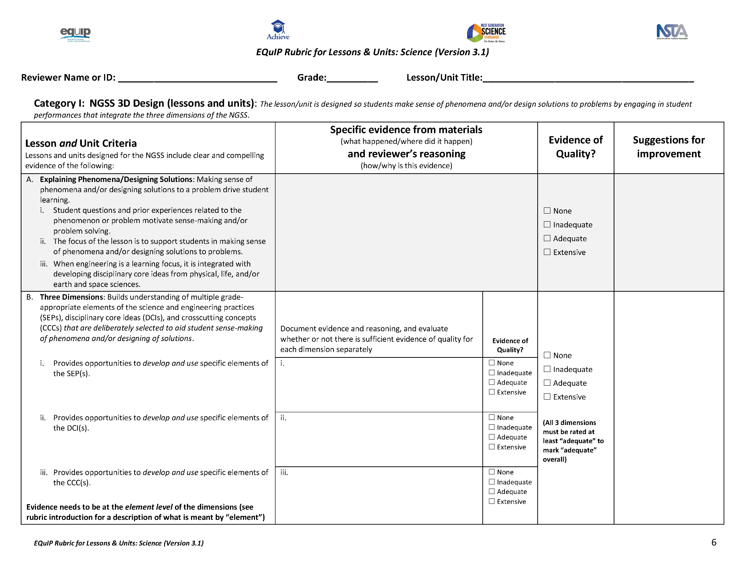
First-person curriculum reviews
(Look for yourself!)
Materials Alignment Toolkit Portfolio, including:
IMET for evaluating the alignment of a comprehensive textbook or textbook series
GIMET-QR for evaluating the quality of instructional materials at each grade level
EQuIP quality review rubric for evaluating the alignment of lessons, units, and modules
EQuIP student work protocol for relating student work to the quality and alignment of materials
Others for assessments and supports for learners of English
DOES: Give you structure to review ELA, math, and science materials while building stakeholder support
DOESN’T: Apply to all content areas, nor predict what materials you’ll choose, which raises reliability questions

Slide 34
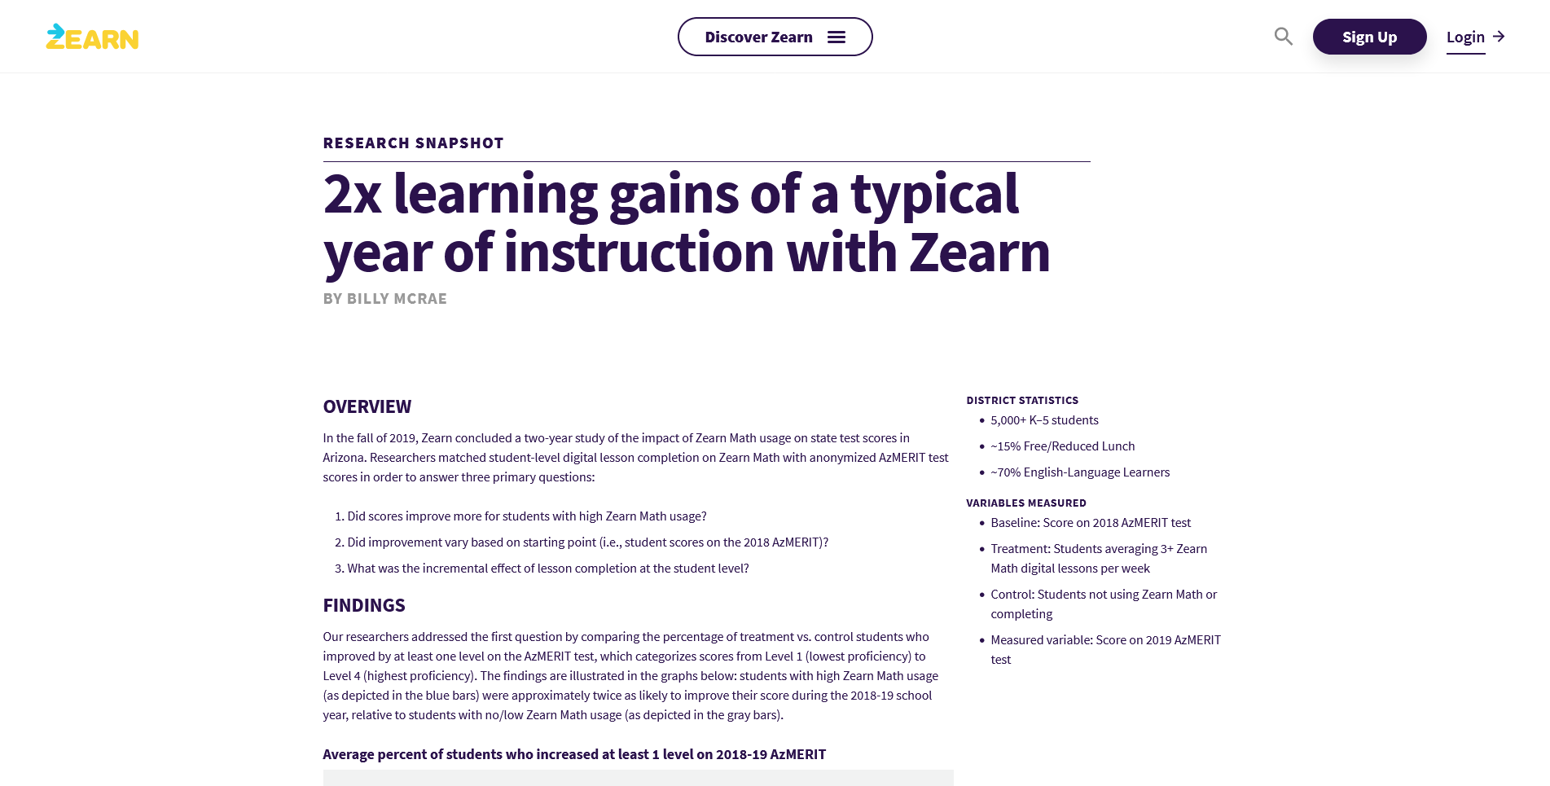

Second-person curriculum reviews
(Take their word for it?)
Use with caution! If at all!
Who are the researchers?
Who pays for the research?
How are the research subjects selected?
How sound and sophisticated are the methods?
Does the study have an external evaluator?
Was the report subject to peer review?
DOES: Give you some context for how materials might be used and implemented
DOESN’T: Inspire as much confidence as 1st-person and 3rd-person reviews

Slide 35




Third-person curriculum reviews
(Trust an impartial expert)
EdReports.org
Independent nonprofit with foundation support
DOES: Rate ELA, math, and science materials based on alignment and design
DOESN’T: Review other content areas or consider student achievement data
https://www.edreports.org/
WWC
A project of the U.S. Department of Education
DOES: Uses strict criteria to summarize peer-reviewed research about effects of materials
DOESN’T: Consider many research studies of non-RCT designs or keep up with marketplace
Evidence for ESSA
A project of the Center for Research and Reform in Education (CRRE) with foundation support
DOES: Rates studies about reading, math, science, writing, attendance, and social-emotional programs based on study design and achievement
DOESN’T: Review other content areas
https://www.evidenceforessa.org/
Louisiana Believes
A project of the Louisiana Department of Ed
DOES: Reviews and rates ELA, math, science, and social studies materials based on alignment and design
DOESN’T: Review other content areas or consider student achievement data
https://www.louisianabelieves.com/academics/ONLINE-INSTRUCTIONAL-MATERIALS-REVIEWS/curricular-resources-annotated-reviews

Slide 36



Other sources
Specialized sites:
https://youth.gov/ for health education resources
https://www.commonsense.org/ for reviews and ratings of digital tools
CDE resource banks:
Comprehensive health
Computer science
Financial literacy
Social studies (specifically genocide and holocaust materials)
Media literacy (forthcoming)
Talk to content specialists to get a better understanding of what’s listed and why!

Slide 37
#1 recommendation: Talk to your state content specialists!
Office of Standards and
Instructional Support
Joanna Bruno, Ph.D.
Director
bruno_j@cde.state.co.us
Maya Garcia
Science Specialist
garcia_maya@cde.state.co.us
Judi Hofmeister
Dance & Drama and Theatre Arts Specialist
hofmeister_j@cde.state.co.us
Stephanie Hartman, Ph.D.
Social Studies Specialist
hartman_s@cde.state.co.us
Jamie Hurley, Ph.D.
Comprehensive Health & Physical Education Specialist
hurley_j@cde.state.co.us
Raymond Johnson, Ph.D.
Mathematics Specialist
johnson_r@cde.state.co.us
Donna Goodwin, Ph.D.
Visual Arts Specialist
goodwin_d@cde.state.co.us
Carla Aguilar, Ph.D.
Music Specialist
aguilar_c@cde.state.co.us
Vacant
Financial Literacy Specialist
World Languages Specialist
bruno_j@cde.state.co.us
Chris Summers
Computer Science Specialist
summers_c@cde.state.co.us
Olivia Gillespie
Reading, Writing, & Communicating Specialist
gillespie_o@cde.state.co.us

Slide 38
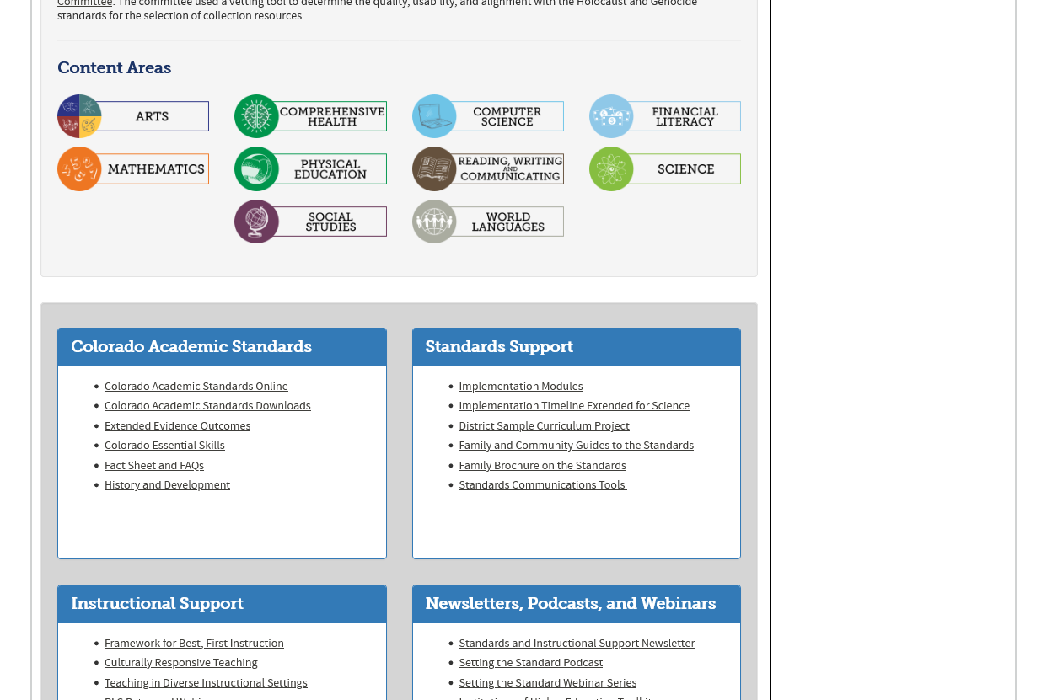
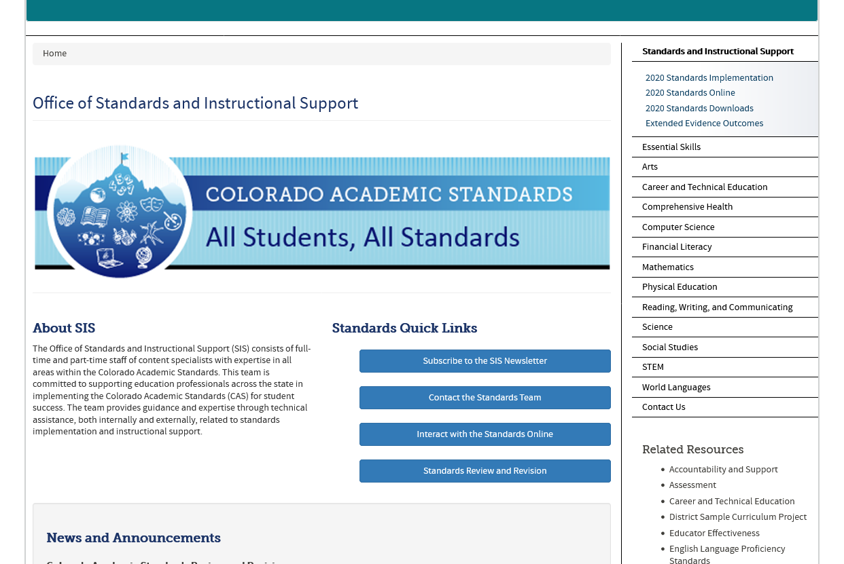
What SIS can offer you
Standards implementation help, including:
  disciplinary literacy PD
  standards literacy PD
  curriculum alignment and gap analysis
  instructional alignment
Best, first instruction PD, including:
  culturally responsive teaching PD
  PD in the practices and strategies for teaching each content area covered by standards
We reach out through:
  Newsletters (both general and for each content area)
  Webinars
  Podcast

Slide 39
Updates and Reminders

Slide 40
Reminders
ESSER II Application is closing in a week – September 30, 2021.
Please help us ensure we’ve reached the AU’s that have been allocated ESSER II funds.

Slide 41

Reminder and Upcoming Topics!
09/30/21 ~ Maintenance of Equity ~ BruMan
10/07/21 ~ ESSER Program Monitoring – How to Prep ~ Program Office ESSER Team
10/14/21 ~ ESSER Fiscal Monitoring – How to Prep ~ Grants Fiscal Unit ESSER Team

Slide 42
Questions?

Slide 43
Thank you!
Enjoy the Breakout Room Conversation!
We’ll See You Next Week!

Slide 44
CDE Team!
CDE Contacts!
Emails: LastName_FirstInital@cde.state.co.us
ESSER/ESEA Program Partners
Nazie Mohajeri-Nelson, Director of ESEA Office (mohajeri-nelson_n@cde.state.co.us)
DeLilah Collins, Assistant Director of ESEA Office (collins_d@cde.state.co.us)
ESEA Regional Contacts assigned by district
  Title I: Laura Meushaw, Kathryn Wisner, Niko Kaloudis
  Title II: Jeremy Meredith, Niko Kaloudis
  Title III: Lorenzo Moreno, Kathryn Wisner
  Title IV: Tammy Giessinger, Michelle Prael
  Title V: Kristen Collins
ESSER Team
  Kristin Crumley, ESSER Monitoring Specialist (Crumley_k@cde.state.co.us)
  Jonathan Schelke, ESSER Monitoring Specialist (schelke_j@cde.state.co.us)
  Shannon Wilson, ESSER/ESEA Grants Administration Coordinator (Wilson_s@cde.state.co.us)
  Mackenzie Owens, ESSER Reporting Specialist (owens_m@cde.state.co.us)
Data, Accountability, Reporting, and Evaluation
  Tina Negley, Alan Shimmin, Mary Shen, and Mackenzie Owens
Fiscal Partners
Jennifer Okes, Chief Operating Officer (okes_j@cde.state.co.us)
Kate Bartlett, Executive Director of School District Operations (Bartlett_k@cde.state.co.us)
Jennifer Austin, Director of Grants Fiscal Management (Austin_j@cde.state.co.us)
Robert Hawkins, Grants Fiscal Analyst (Hawkins_s@cde.state.co.us)
Steven Kaleda, Grants Fiscal Analyst (Kaleda_s@cde.state.co.us)
ESSER Team
  Bill Parsley, ESSER Fiscal Monitoring Supervisor (parsley_w@cde.state.co.us)
  Hilery Morris, ESSER Fiscal Monitoring (morris_h@cde.state.co.us)
  Sharon Mackey, ESSER Fiscal Monitoring (mackey_s@cde.state.co.us)

