Slide 1
CDE Office Hours
August 5, 2021

Slide 2
CDE Team Introductions!
ESSER/ESEA
Nazie Mohajeri-Nelson, Director of ESEA Office (mohajeri-nelson_n@cde.state.co.us)
DeLilah Collins, Assistant Director of ESEA Office (collins_d@cde.state.co.us)
Kristin Crumley, ESSER Monitoring & Reporting Specialist (Crumley_k@cde.state.co.us)
ESEA Regional Contacts assigned to your district
Fiscal Experts
Jennifer Okes, Chief Operating Officer (okes_j@cde.state.co.us)
Kate Bartlett, Executive Director of School District Operations (Bartlett_k@cde.state.co.us)
Jennifer Austin, Director of Grants Fiscal Management (Austin_j@cde.state.co.us)
Robert Hawkins, Grants Fiscal Analyst (Hawkins_s@cde.state.co.us)
Steven Kaleda, Grants Fiscal Analyst (Kaleda_s@cde.state.co.us)

Slide 3
ESSER Office Hours
Topics
Updates and Reminders
Committee of Practitioners Membership
Vaccines, testing, and incentives
Behavioral/SEL Supports using ESSER Funds
Notes:
Nazie

Slide 4
Updates

Slide 5
Reminders and Clarifications
ESSER II – applications due September 30, 2021
  Including Supplemental Funds
ARP ESSER III – Two Plans
  The Safe In-Person Plans have to be posted on the LEA’s website within 30-days of receipt of funds (we are checking these as part of the application reviews). If they don’t have a safe in-person plan posted, we are asking them to let us know the plans for posting the plan.
  The Use of Funds Plans must include plans for both the use of funds (the 20% and 80%) and how funded activities will meet the needs of students. This is the plan that USDE had previously required within 90-days and is now allowing SEA’s to determine the date, but USDE recommends/prefers 90-days.
    Plans were previously due on August 22, 2021; however, CDE got an extension from USDE until December 16, 2021
ARP ESSER III – Required Narrative Question
  How the LEA will ensure that the interventions it implements, including but not limited to the interventions under section 2001(e)(1) of the ARP Act to address the academic impact of lost instructional time, will respond to the academic, social, emotional, and mental health needs of all students, and particularly those students disproportionately impacted by the COVID-19 pandemic, including students from low-income families, students of color, English learners, children with disabilities, students experiencing homelessness, children and youth in foster care, and migratory students.
    How will the LEA know the needs of students, in order to know if they are being met?
    Has the LEA looked at and plan to address the needs of all student groups?
    What evidence will the LEA have at the end of the grant to demonstrate the impact that the funds have had?

Slide 6
Introducing New Team Members
Jonathan Schelke, ESSER Monitoring Specialist
Shannon Wilson, ESEA and ESSER Specialist
Mackenzie Owen, ESSER Reporting Specialist

Slide 7
Updates
Letter from the U.S. Department of Education, Secretary Cardona
  Requests of LEAs to consider while determining how to address the impact that the COVID-19 pandemic has had on your LEA –
    Consider adding/keeping a vaccination clinic at your school sites
    Encourage eligible staff, parents, and students to get vaccinated
      Create incentives and initiatives to boost vaccination numbers
    Work with state and county health officials to have easy access to screening tests
    Set up students for success in the fall
      Long entry ramp to fall over the summer
      Meet students where they are
      Help address social, emotional, mental health, and academic needs of students
Notes:
Nazie

Slide 8
Committee of Practitioners (CoP)

Slide 9
Members Needed for Committee of Practitioners (CoP)
The Committee of Practitioners (CoP) is a critical stakeholder group for the Federal Programs Unit at the Colorado Department of Education (CDE).
  Primary purpose is to advise CDE regarding its implementation of the Elementary and Secondary Education Act (ESEA), reauthorized as the Every Student Succeeds Act (ESSA)
  Operates to identify issues across regions of the state and facilitate two-way communication between CDE and the preK-12 education community throughout Colorado
Membership includes a variety of stakeholders:
  representatives from local education agencies, non-public schools, and charter schools
  school and district administrators, teachers, parents, and members of local school boards
  participants from each of the state-defined regions
Committee members serve for an initial three-year term with the opportunity to extend.
A minimum of four meetings will be held per year.
To apply for a position, fill out the 2021-22 Application(PDF) and submit to Emily Owen.
For additional information, please reach out to Tammy Giessinger or Jeremy Meredith.

Slide 10
Supporting Student Social, Emotional, and Behavioral Needs
Federal Programs Office Hours
Notes:
AP
Introduce everyone

Slide 11
Why Student Support is Essential

Slide 12

The Foundation of Development
The Science of Learning and Development tells us that:
Children learn when they are:
  Healthy
  Safe
  Supported
Children’s learning is impaired when their/they’re:
  Physical needs are not met
  Fearful
  Traumatized
  Overcome with emotion
Darling-Hammond, D., & Cook-Harvey, C. M. (2018).
Notes:
AP
Before we dive into what we mean by utilizing a whole child approach in education, it’s important to understand the roots of whole child. The science of learning and development (led by the Learning Policy Institute) tells us that Children learn when they are healthy, safe and supported, and their learning is impaired when they are fearful, traumatized, or overcome with emotion. Thus, they need both supportive environments and well-developed abilities to manage stress and cope with the inevitable conflicts and frustrations of school and life beyond school.

Slide 13

Children’s learning depends on schools to shape a child’s growth and development:
Shaping Development at School
3 external factors schools must address:
Instructional
Relational
Environmental
3 internal developmental processes schools must foster:
Cognitive
Social
Emotional
Fischer, K. W., & Bidell, T. R. (2006).
Notes:
AP
Children’s learning requires a focus on what is external to the child as well as what is internal to the child. External to the child includes a combination of instructional, relational, and environmental factors the child experiences, such as quality instruction (which may include: Student-centered instruction, differentiating instruction, Culturally-responsive teaching, and Supporting academic mindsets of students
Relational which includes, strong relationships with teachers and other staff that is built on trust and a genuine interest in the student as a whole person.
Environmental has to do with the extent to which the school and classrooms are supportive and safe. When thinking about safety, it’s important that we expand our notion of safety to include not just physical safety which is often described as being free from violence and harassment and bullying but to also feel safe socially, emotionally, meaning safe to feel and express emotions as well as identity safety, meaning students feel safe and affirmed in their unique identities whether those relate to race, class, gender, gender-identity or any other unique characteristic they may have.
Additionally, it requires schools to foster the development of 3 internal processes within students. These are:
Cognitive skills, - which is the process involving thought, rationale and perception. This is an area that schools tend see as their responsibility.
Social skills – the process of establishing a sense of identity and establishing a role and purpose.
and emotional - refers to the ability to recognize, express, and manage feelings
All of these internal developmental processes influence one another as they shape the child’s growth and development and because they are inextricably linked, schools cannot focus on only one.

Slide 14


Sense of belonging
Ensures students feel:
Accepted
Respected
Included
Supported
Improved behavior
Improved attendance
Increased engagement
Increased school connected-ness
Decreased drop out rates
Decreased discipline issues
Increased academic achieve-ment
Cohen, J., et al. (2009).
Taylor, R. D., et al. (2017).
Loukas, A. (2007).
Notes:
AP
When both the external factors and the internal developmental processes are successfully addressed at school, it results in student sense of belonging which is defined as The extent to which studentsfeel personally accepted, respected, included, and supported by others in the school social environment.
Sense of belonging is linked to outcomes such as improved behavior and attendance, increases in engagement and school connectedness, and decreases in drop out rates, and disciplinary infractions. All of which positively impact academic achievement.
Improved behavior
Improved attendance
Increased engagement
Increased school connectedness
Decreased drop out rates
Decreased discipline issues

Slide 15
Positive School Climate
A positive school climate is foundational to the academic promise of the school and refers to the work of a school community to create a quality experience for all students, staff, and families. This is done by collectively fostering social-emotional, physical, academic and identity safety and promoting a supportive academic environment that encourages and maintains respectful, empathetic, and trusting, relationships; resulting in a sense of belonging for all.
Notes:
AP

Slide 16

Whole Child as a Focus
Whole Child Approach in Schools is defined by policies, practices, and relationships that focus on the comprehensive and interconnected needs of students that ensure that each child is healthy, safe, engaged, supported, and challenged.
-CDE
Notes:
AP
Now that we have a sense for why it’s important to focus on a whole child approach, let’s talk about what it is. At CDE, we define a Whole Child Approach in schools as the policies, practices and relationships that focus on the comprehensive and interconnected needs of students that ensure each child is healthy, safe, engaged, supported, and challenged.
The first tenet states that Each student enters school healthy and learns about and practices a healthy lifestyle. Entering school healthy means that schools support students and families to be healthy in and outside of the school day through things like universal breakfast programs, physical activity recommendations and challenges and wrap around supports.
Moving on, the second tenet states that Each student learns in an environment that is physically and emotionally safe for students and adults. this tenet is essentially saying that students must feel safe from violence, harassment, bullying and other threats. Our next module will focus specifically on safety and goes beyond the notions of physical and emotional safety.
The third tenet states that Each student is actively engaged in learning and is connected to the school and broader community. student engagement refers to the degree of attention, curiosity, interest, optimism, and passion that students show when they are learning or being taught, which extends to the level of motivation they have to learn and progress in their education
The fourth tenet states: Each student has access to personalized learning and is supported by qualified, caring adults. This tenet emphasizes how each student is different and has different needs and also how important it is to have trusting and caring relationships between students and the adults in the building.
The fifth tenet is speaks to the academic mission of the school but also emphasizes communities in which a student will be a part after their K-12 experience.

Slide 17
Policies and Practices that Supports the Whole Child
Assess
Assess perceptions of school climate, connectedness, safety, etc. with students to best support student sense of belonging. (Resource: Measuring School Climate and SEL)
Implement
Implement school-wide practices and instruction to develop students’ social, and emotional skills (e.g., CASEL’s Schoolwide SEL)
Promote
Promote educative and restorative disciplinary practices that support students’ development and fosters positive relationships. (Resource: Restorative Practices – A Guide for Educators)
Create
Create predictable environments where behavior expectations are clear and modeled by adults in the building (e.g., Positive Behavior Interventions and Supports)
Establish
Establish the expectation that all staff work to develop trusting relationships with students that care about their wellbeing. (Resource: Developmental Relationships Framework)
Notes:
AP – will go into these in more depth..
Assess
Assess perceptions of school climate, connectedness, safety, etc. with students to best support student sense of belonging. (Resource: Measuring School Climate and SEL)
Implement
Implement school-wide practices and instruction to develop students’ social, and emotional skills (e.g., CASEL’s Schoolwide SEL)
Promote
Promote educative and restorative disciplinary practices that support students’ development and fosters positive relationships. (Resource: Restorative Practices – A Guide for Educators)
Create
Create predictable environments where behavior expectations are clear and modeled by adults in the building (e.g., Positive Behavior Interventions and Supports)
Establish
Establish the expectation that all staff work to develop trusting relationships with students that care about their wellbeing. (Resource: Developmental Relationships Framework)

Slide 18
Best Practices for Supporting Students

Slide 19
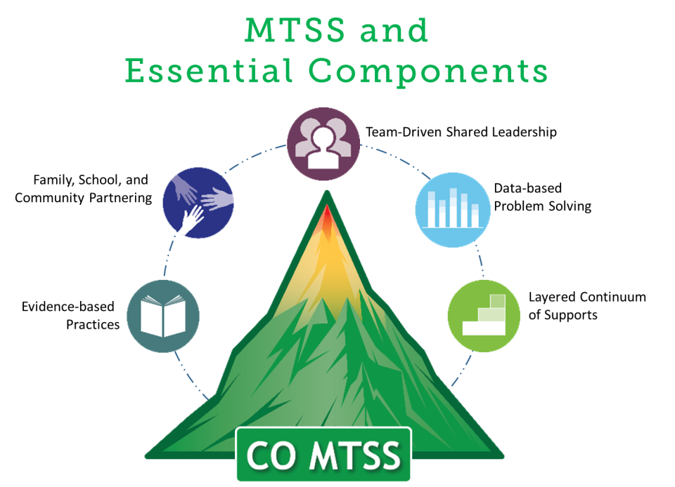
Where does SEL Fit into MTSS/PBIS
Tier 1: Integrated curriculum and School Culture/Climate.
Tier 2: Intensive Classroom and Small Group Instruction
Tier 3: Individualized Social Skill Instruction
Notes:
BB

Slide 20
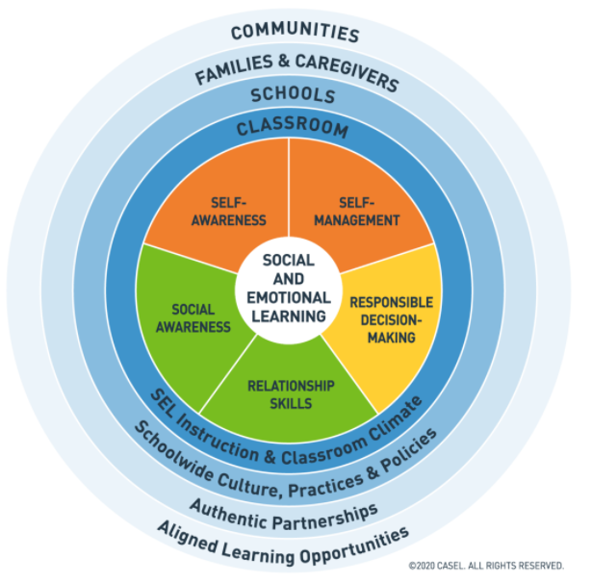
Social Emotional Skills
Self-awareness involves identifying emotions and accurate self-perceptions.
Self-management includes managing stress and controlling impulses, which includes aspects of executive function and draws on mindsets.
Social awareness entails perspective taking, empathy, and appreciation for diversity.
Relationship skills involve communication and cooperation to establish and maintain healthy relationships.
Responsible decision making focuses on skills such as identifying problems, evaluating, reflecting, and acting with consideration for the well-being of oneself and others.
https://casel.org/
Notes:
BB

Slide 21
Two Types of SEL Programs
Notes:
BB

Slide 22
Tier 2: Intensive Classroom and Small Group Instruction
Increased frequency (higher repetitions) of teaching behavioral expectation
Increased duration, providing a more detailed(example and non-example) explanation of expected behaviors and why those behaviors are important. Discussion about expected behaviors
Looking for Teachable Moments: Re-teaching behavioral expectation
Small group based in identified need
  Why Try
  Anger group
  Brain Wise
  Problem Solving
  Second Step
  Coping Skills Group
Notes:
BB

Slide 23
Tier 3: Individualized Social Skill Instruction
Individual instruction (pull out) time with a Teacher, Para, Mental Health provide 15-20 minutes a week.
Application/Practice of skills in a small group (Tier 2 intervention group).
Generalization takes place when the use of the skill is supported is the classroom setting (Tier 1) where the student receives feedback and is reinforced for the use of the skill.
Notes:
BB

Slide 24
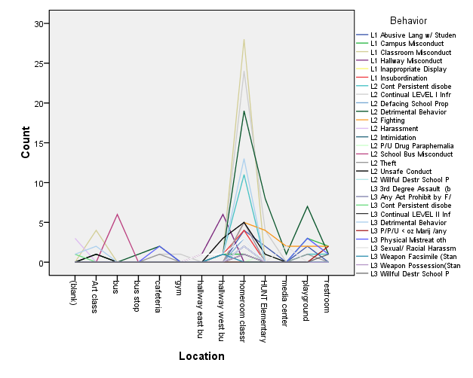
Where does FBA and BIP Fit into MTSS/PBIS
Tier 1: Whole School, grade levels, individual classes.
Tier 2: Brief FBA
Tier 3: Full FBA
What behaviors is the teacher, student, and parent willing to accept short term?
Teacher, student, and parent report on:
Why student is demonstrating these behaviors?
What does the student get (i.e. avoidance, attention, etc.)?
Teacher, student, and parent insight on outside factors that impact the student (i.e. home, community, etc.)
Teacher, student, and parent reported triggers of behavior(s)
Teacher, student, and parent report of student behavior
Observation of student
Record/file review
What are the teacher, student, and parent ideal behavior(s)?
Teacher, student, and parent reported strengths, student interests
Notes:
BB

Slide 25
Parent Permission for FBA
Colorado law requires that the parent be notified of any test in the area of behavior.
The recommended testing must be described along with how the results will be used
Special Education and/or Section 504 Consent should not be used unless the child has been referred.
*”School personnel shall not test or require a test for a child’s behavior without prior written permission from the parents or guardians of the child and prior written disclosure as to the disposition of the results or the testing there from.”
  (C.R.S 22-32-109 [1][ee].
Notes:
BB
A distinguishing factor that may help guide teams in whether parental consent is required is whether a student is the only one receiving a particular assessment.
Professional judgment that depends on the context and purpose should be utilized in determining whether parent permission is needed for a behavioral observation
If an observation is being conducted for an FBA, this would be considered a behavioral assessment and permission should be obtained.

Slide 26

3 Types of Functional Behavior Assessments
Brief functional behavior assessment
  Goal: to define the challenging behavior
  Process typically only involves a short interview with teachers, staff or parents who have dealt with or witnessed the challenging behavior previously.
Full functional behavior assessment
  Most commonly used
  Goal: to build an understanding of when, how, and why a problem behavior occurs, includes a summary statement describing the function of the behavior
  Process typically involves short and extended interviews, a record review, and direct observations of the challenging behavior.
Functional analysis
  Goal: to test the hypothesis generated by a full functional behavioral assessment so that an effective intervention can be implemented
  Combines direction observations and systematic experimental manipulations of the environment (antecedents and consequences) to confirm an understanding of the function of a specific behavior.
Notes:
BB

Slide 27
PBIS Guidelines
0-2 office referrals Tier 1
3-5 office referrals Tier 2
6+ office referrals Tier 3
Notes:
BB

Slide 28
IDEAS for ESSER Funding
Notes:
KK

Slide 29
General Funding Ideas
Assess social, emotional, mental health needs of students and staff
Invest in effective strategies to address social, emotional, and mental health needs of students. Provide professional development for educators and staff to address these needs
Invest in school counselors and mental health professionals in schools
Ensure restorative, equitable, and inclusive approaches to school discipline
Provide extracurricular opportunities to build school community and advance academic and emotional development of students
Build School Communities, and Support Students’ Social, Emotional, and Mental Health
https://sites.ed.gov/roadmap/landmark2/
Notes:
KK

Slide 30

Funding Ideas to Foster Positive Relationships
Focus on relationships. Sustained and strong adult-student relationships can result in higher attendance and better student outcomes;
  Mentors
  Check-In and Check- Out
https://www2.ed.gov/documents/coronavirus/reopening-2.pdf
Notes:
KK

Slide 31
Funding Ideas for Social Emotional Supports
Contract/Hire/Pay for Services
  Assess needs/perceptions as well as policies and practices and analyze data to drive action planning
  Coordination of whole child, school climate, family engagement, and/or prevention efforts
  Staff professional development on: integrating social emotional skill building; trauma responsiveness; positive behavior supports; student engagement/relationship building
    Pay for substitutes to cover PD
Notes:
KK

Slide 32
Funding Ideas for Mental Health Support
Contract/Hire to provide intervention and support
  Paraprofessionals or teachers
    Implement executive functioning and organizational interventions
    Support teachers with additional demands
  School-Based Mental Health Professionals
    Wrap around services
    Direct intervention
  Evaluations or Private Contractors
    Reduce load on school team to focus on intervention and support
    Conduct mental health screenings to demtermine need and guide service and intervention
Notes:
KK

Slide 33
Interventions that Support Mental Health
Meet basic needs
Expand Out-of-School time programs
Partner with families
Ensure there is a tangible benefit for students
Include enrichment opportunities that support social, emotional, and academic development
Make programs free, inclusive, and supportive of families
Provide flexibility to increase access
Scale up existing programs that have demonstrated results. Build in frequent program assessment and evaluation
Build in frequent program assessment and evaluation
Implement policies that support the enrollment, placement, and credit accrual for students who are highly mobile
https://www2.ed.gov/documents/coronavirus/reopening-2.pdf
Notes:
KK
Meet basic needs: providing school meals regardless of educational setting
Out-of-School Time Programs: To support students, districts and schools have long offered programming before and after the regular school day, as well as on weekends or during school breaks. These programs may help students get back into an educational routine; feel connected to their peers, schools, and instructors; augment instruction of academic content they may not yet have mastered; and provide enrichment opportunities.
Partner with families. Give family members specific resources and strategies to support their children’s learning, consistent with legal requirements to communicate in a language and format they can understand. For example, ourBRIDGE for KIDS in North Carolina focuses on supporting immigrant and refugee families, with assistance that includes translating COVID-19 resources into many languages. Other programs incorporate parent classes focusing on nutrition, computer literacy, career development, or college preparation;
Ensure there is a tangible benefit for students. For older students, this could mean offering course credit; providing career exploration; arranging for pre-employment transition services for students with disabilities, as applicable; and offering apprenticeships or internships;
Include enrichment opportunities that support social, emotional, and academic development. The activities provided can include tutoring and homework help, along with a broad array of enrichment activities ranging from science, technology, engineering, and mathematics (STEM) activities, career and technical programs, youth development, physical fitness and health education, and arts programs;
Make programs free, inclusive, and supportive of families. Programs should not charge fees for families to participate, should include free transportation and meals, and be available to students with disabilities, English learners, and other underserved students;
Provide flexibility to increase access. For example, summer programs can be provided in full-day or partial day options, with flexible drop off and pick up times. If students can only participate in afterschool or summer programs for some of the time, this kind of participation should be allowed for and supported;
Build in frequent program assessment and evaluation. Continuous quality improvement and frequent evaluations of the program assist the providers in analyzing and making improvements to better provide students with engaging opportunities that improve their lives. Use early warning indicator systems to identify students with the greatest needs (see section on “Using data about students’ opportunity to learn to help target resources and support”); and

Slide 34
Education Considerations and Factors
Notes:
KK

Slide 35
Child Find Consideration
4.02(1)(b) State-Operated Programs – Part B Child Identification. For children for whom a state-operated program is responsible, as established in Section 8.00 of these Rules, each state-operated program shall adopt and implement procedures for locating, identifying and evaluating all children who may have a disability and be eligible for special education, even though they are advancing from grade to grade. Child identification, when used in connection with state-operated programs, includes relevant components of child find; special education referral; initial evaluation; and determination of disability and eligibility.
Notes:
KK

Slide 36
Child Find Consideration
If you are saying students need specially designed instruction due to their significant area of need or concern, that would indicate the possibility of the need for special education.
This could trigger the child find consideration, and the need for a special education evaluation.
Notes:
KK

Slide 37
LRE Considerations
It is important to note that strategies like in-school acceleration, tutoring programs, out-of-school time programs, and summer learning and enrichment are supplemental instruction and cannot replace a program of special education and related services based on a student’s IEP and the decisions of the IEP Team.
Similarly, these types of strategies cannot replace the special education and related services and other supports included in an IDEA-eligible student’s IEP as determined by the student’s IEP Team or the regular or special education and related aids and services documented in a 504 plan, or the decisions made by a group of people who are knowledgeable about the child, the meaning of evaluation data, and placement options as required by Section 504.
Notes:
KK

Slide 38
Contacts
Andrea Pulskamp at pulskamp_a@cde.state.co.us
Bill Brown at brown_w@cde.state.co.us

Slide 39
Questions?

Slide 40
CDE Team Introductions!
ESSER/ESEA
Nazie Mohajeri-Nelson, Director of ESEA Office (mohajeri-nelson_n@cde.state.co.us)
DeLilah Collins, Assistant Director of ESEA Office (collins_d@cde.state.co.us)
Kristin Crumley, ESSER Monitoring & Reporting Specialist (Crumley_k@cde.state.co.us)
ESEA Regional Contacts assigned to your district
Fiscal Experts
Jennifer Okes, Chief Operating Officer (okes_j@cde.state.co.us)
Kate Bartlett, Executive Director of School District Operations (Bartlett_k@cde.state.co.us)
Jennifer Austin, Director of Grants Fiscal Management (Austin_j@cde.state.co.us)
Robert Hawkins, Grants Fiscal Analyst (Hawkins_s@cde.state.co.us)
Steven Kaleda, Grants Fiscal Analyst (Kaleda_s@cde.state.co.us)

