Slide 1
CDE Office Hours
July 29, 2021

Slide 2
CDE Team Introductions!
ESSER/ESEA
Nazie Mohajeri-Nelson, Director of ESEA Office (mohajeri-nelson_n@cde.state.co.us)
DeLilah Collins, Assistant Director of ESEA Office (collins_d@cde.state.co.us)
Kristin Crumley, ESSER Monitoring & Reporting Specialist (Crumley_k@cde.state.co.us)
ESEA Regional Contacts assigned to your district
Fiscal Experts
Jennifer Okes, Chief Operating Officer (okes_j@cde.state.co.us)
Kate Bartlett, Executive Director of School District Operations (Bartlett_k@cde.state.co.us)
Jennifer Austin, Director of Grants Fiscal Management (Austin_j@cde.state.co.us)
Robert Hawkins, Grants Fiscal Analyst (Hawkins_s@cde.state.co.us)
Steven Kaleda, Grants Fiscal Analyst (Kaleda_s@cde.state.co.us)

Slide 3
ESSER Office Hours
Topics
Updates and Reminders
100% Remote Learning Guidance
Notes:
Nazie

Slide 4
Updates, Clarifications, and Follow-Ups

Slide 5
Updates
CDC has changed requirements again. The Safe In-Person Plans must be reviewed and updated as necessary no later than every 6-months.
  Resources on our website are being updated: https://www.cde.state.co.us/fedprograms/resourcesandtechnicalassistance
ESSER II applications must be finalized by September 30, 2021! Please don’t miss this deadline!!!
August 5, 2021 – Syncplicity training on how to submit monitoring documentation and evidence
  Designed for all LEAs
  Prioritized for LEAs being monitored in 2021-2022
    Federal Programs Monitoring website, including the multi-year monitoring schedule: https://www.cde.state.co.us/fedprograms/monit/index
    ESEA Monitoring website : https://www.cde.state.co.us/fedprograms/universalreview
    ESSER Monitoring website: https://www.cde.state.co.us/caresact/essermonitor

Slide 6
Remote and Blended/Supplemental Online Learning Guidance for 2021-2022
Online and Blended Learning Office
ESEA Office Hours
July 29, 2021

Slide 7
Agenda
100% Remote Learning due to COVID-19 Health Concerns Guidance Overview
Blended and Supplemental Online Learning Guidance Overview
Variance Waiver Request
Blended Learning Initiative
Resources
Questions

Slide 8
100% Remote Learning Due to COVID-19 Health Concerns

Slide 9
Purpose
To allow districts and schools the ability to provide a 100% remote learning option in a brick-and-mortar school.
In direct response to public health and safety concerns associated with the COVID-19 pandemic.
This flexibility allows districts to:
  Create and implement a 100% remote learning option
  Provide a 100% remote learning option by using an existing CDE-approved or recognized online school or program.
Assurances for this option are due by August 31, 2021

Slide 10
Disclaimer
Districts and schools are not required to offer this option.
Districts will be expected to complete and submit Assurances (Instructional, Pupil Count Audit, and Data Reporting) confirming their understanding and implementation of the minimum requirements.
2021-2022 is likely the last year CDE will offer these types of flexibilities in response to COVID-19.

Slide 11
Existing Online Schools and Programs
As long as the option is in response to the COVID-19 pandemic, districts can use their existing, CDE-approved or recognized online program to provide a 100% remote learning option for brick-and-mortar students.
Complete all assurances, except instructional assurance #4.
Students must meet funding requirements for an existing online school or program.

Slide 12
Assurances

Slide 13
Assurances—When are assurances required?
No assurances required
Assurances required
Scenario 3: A district is offering a 100% Remote Learning Option to its brick-and-
mortar students through its CDE-approved or recognized Online School or Program.
Scenario 4: A district is offering a 100% Remote Learning Option to its brick-and- mortar students not through its CDE-approved or recognized Online School or Program.
Scenario 5: A district is providing multiple 100% Remote Learning Options to its brick- and-mortar students.
Scenario 1: A district is not offering a 100% Remote Learning Option to its brick-and- mortar students.
Scenario 2: A district is not offering a 100% Remote Learning Option to its brick-and- mortar students but must temporarily offer remote learning to students for COVID-19 reasons.

Slide 14
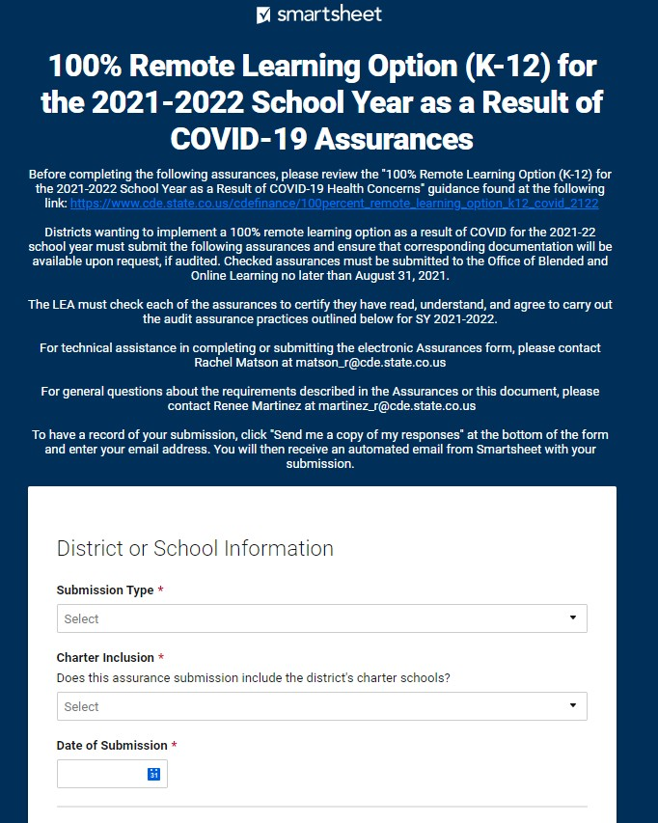
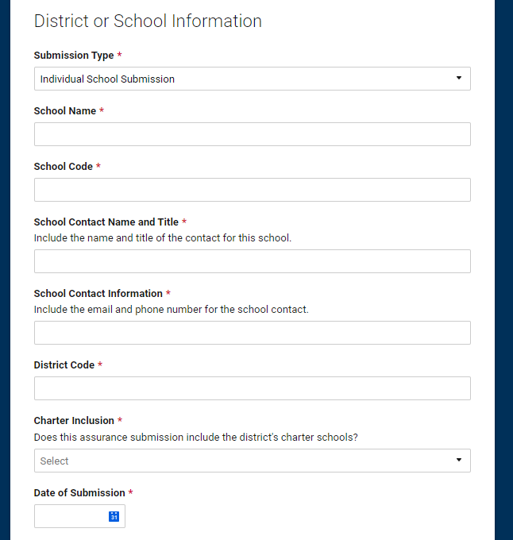
Assurances - Smartsheet Form

Slide 15
Audit Documentation Requirements

Slide 16
Audit Documentation Requirements
Districts or schools must submit 100% Remote Learning Option Assurances (via Smartsheet) by August 31, 2021 and all documentation listed in Audit Assurances #1 through #6.
Audit Assurance #1
  Definition of “education process” applied to remote learning planned in response to COVID-19.
  Description of how instruction will be delivered in remote learning (include asynchronous and synchronous instruction.
  Attendance documentation during asynchronous learning.
Audit Assurance #2
  100% Remote Learning Option Calendar
Audit assurance #3
  Instructional Hours Equivalencies
Audit Assurance #4
  Documentation evidencing Colorado residency within 365 days preceding or on the pupil enrollment date.

Slide 17
Audit Documentation Requirements Continued
Audit Assurance #6
  Individual student schedules that lists all courses.
  Clearly identify which students are participating in the 100% remote learning option
    Non-school program code of 05 in the Student October Count Snapshot
Audit Assurance #5
  Attendance Funding Requirement
    Participate on the pupil enrollment count date or if absent for any reason.
  Track daily attendance regardless of learning model

Slide 18
Blended Learning and Supplemental Online Course Guidance for Brick-and-Mortar Schools for 2021-2022

Slide 19
Blended Learning and Supplemental Online Courses Guidance Overview
Instructional time at brick-and-mortar schools is determined by the # of minutes of teacher-pupil instruction and contact time.
  Blended learning and/or supplemental online courses may be included in this calculation.
Courses are meant to supplement or augment a student’s brick-and-mortar schedule.
  Brick-and-mortar students should never have a schedule consisting of blended learning and/or supplemental online courses only (exception: variance waiver request)
Courses that are offered 100% on-site are not considered blended or supplemental.
Courses offered to brick-and-mortar students through a CDE-approved and recognized online school or program are evaluated as “supplemental online” courses.

Slide 20
CLARIFICATION: Blended Learning and Supplemental Online Courses
These courses can be offered through an existing online school or program, or through a course developed independently (or purchased) by a brick-and- mortar school.
Courses offered through an existing approved or recognized CDE online school or program:
Courses not offered through an existing approved or recognized CDE online school or program:
• will be evaluated like any other course offered by the approved ore recognized online school/program
• will not be subject to the minimum in-person/synchronous learning requirement
• must meet the requirements outlined in the posted guidance included in the 2021 Student October Count Audit Resource Guide
• this includes CDLS courses

Slide 21
Course Requirements
Course Requirement #1: Limit on Total # of Courses
  Any student enrolled in a brick-and-mortar school may take 1 supplemental online or blended learning course.
  Two courses in a semester is allowable if the second course does not result is a semester schedule consisting of more than 40% of blended or supplemental online learning courses.
Course Requirement #2: Student Schedules
  These courses must occupy unique positions on a student’s schedule.
  Individual courses only- “study blocks” or multi-use periods may not be considered as supplemental online courses.
Course Requirement #3
  Each blended learning and supplemental online course will require a minimum threshold of in-person or synchronous online instruction per course, per week.
    20% in-person instruction (for blended learning courses)
    20% synchronous instruction (for supplemental online courses)

Slide 22
Course Requirements Continued
Course Requirement #4: Access to Equipment and Sufficient Internet Access
  Electronic equipment and resources
  Ensure that courses meet the needs of students with disabilities, English Learners, and historically underserved populations.
  Instruction must align to CAS and CELP standards.
  Students with IEPs must receive special education and related services.

Slide 23
Variance Waiver to the Blended Learning and Supplemental Online Course Guidance for 2021-22

Slide 24
Variance Waiver Overview
When a district/school has implemented a learning model that falls outside the blended learning and/or supplemental online course guidance, they may request a variance waiver.
  Course requirements 1 and 3 only.
This does not waive required audit documentation requirements.
Districts/schools may not request a variance waiver to:
  Student schedules
  Access to equipment and sufficient internet access

Slide 25
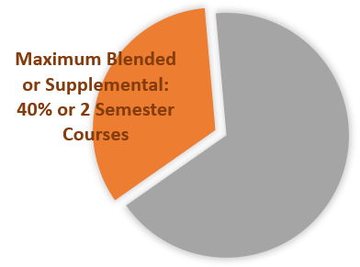


Course Requirements That Can Be Waived
Districts and schools may request a variance waiver to the following course requirements:
1. Limits on number of courses
3. Instruction
Minimum In-Person or Synchronous Instruction 20%
30

Slide 26
Variance Waiver Process
Initial Variance Waiver: Smartsheet Form
  Due August 31, 2021
Formal Variance Waiver
  Due December 17, 2021
  Ask for additional documentation and information
All districts and schools who request a variance waiver will receive the waiver.

Slide 27
Blended Learning Initiative

Slide 28
Blended Learning Initiative - Overview
Shift in instructional models
Opportunity to re-look at what works in instruction and seat time/funding requirements
Collective Conversation
Districts and school leaders are encouraged to participate.
Fall 2021-May 2022
Contact matson_r@cde.state.co.us to join the Blended Learning Initiative

Slide 29
Resources
Auditing Office Recorded Webinars: https://www.cde.state.co.us/cdefinance/auditunit_trainings
Guidance Location: https://www.cde.state.co.us/cdefinance/auditunit_pupilcount
Blended Learning Initiative: https://www.cde.state.co.us/onlinelearning/blendedlearninginitiative

Slide 30
Contact Information
Online and Blended Learning Office
  Renee Martinez
    Martinez_r@cde.state.co.us
  Rachel Matson
    Matson_r@cde.state.co.us
School Auditing Office
  Rebecca McRee
    Mcree_r@cde.state.co.us
  Kate Bartlett
    Barlett_k@cde.state.co.us

Slide 31

Questions

Slide 32
Questions?

Slide 33
CDE Team Introductions!
ESSER/ESEA
Nazie Mohajeri-Nelson, Director of ESEA Office (mohajeri-nelson_n@cde.state.co.us)
DeLilah Collins, Assistant Director of ESEA Office (collins_d@cde.state.co.us)
Kristin Crumley, ESSER Monitoring & Reporting Specialist (Crumley_k@cde.state.co.us)
ESEA Regional Contacts assigned to your district
Fiscal Experts
Jennifer Okes, Chief Operating Officer (okes_j@cde.state.co.us)
Kate Bartlett, Executive Director of School District Operations (Bartlett_k@cde.state.co.us)
Jennifer Austin, Director of Grants Fiscal Management (Austin_j@cde.state.co.us)
Robert Hawkins, Grants Fiscal Analyst (Hawkins_s@cde.state.co.us)
Steven Kaleda, Grants Fiscal Analyst (Kaleda_s@cde.state.co.us)

