Slide 1
CDE Office Hours
June 17, 2021

Slide 2
CDE Team Introductions!
ESSER/ESEA
Nazie Mohajeri-Nelson, Director of ESEA Office (mohajeri-nelson_n@cde.state.co.us)
DeLilah Collins, Assistant Director of ESEA Office (collins_d@cde.state.co.us)
Kristin Crumley, ESSER Monitoring & Reporting Specialist (Crumley_k@cde.state.co.us)
ESEA Regional Contacts assigned to your district
Fiscal Experts
Jennifer Okes, Chief Operating Officer (okes_j@cde.state.co.us)
Kate Bartlett, Executive Director of School District Operations (Bartlett_k@cde.state.co.us)
Jennifer Austin, Director of Grants Fiscal Management (Austin_j@cde.state.co.us)
Robert Hawkins, Grants Fiscal Analyst (Hawkins_s@cde.state.co.us)
Steven Kaleda, Grants Fiscal Analyst (Kaleda_s@cde.state.co.us)

Slide 3
ESSER Office Hours
Topics
ARP ESSER III Requirements and Plans
Supporting Students in Foster Care with ESSER Funds
Notes:
Nazie

Slide 4
ARP ESSER III Requirements and Plans

Slide 5
Safe Return to School Plans
Safe Return to School Plans
Notes:
This is the information you’ll need as you design your Safe Return to School Plans. Within the ESSER III application, the last assurance you checked included a placeholder for a link to your safe return to school plan. The link you included for that assurance should take reviewers to the information included in these slides.

Slide 6

Safe Return to School Plan
1. Plan for Safe Return to In-Person Instruction and Continuity of Services
2. Layered Prevention Strategies
3. Levels of Community Risk and Phased Prevention
What if our district has been in-person all year?
If your district has been in person all year with no or few closures, you still must post the plan to meet the federal statute requirement. Explain how your district has ensured the safety of its students and how learning has continued. You also must still post required elements under ARP-ESSER III including social/emotional/mental health and other needs, what prevention strategies you are using, and how decisions are being made based on CDC and health department guidance.

Slide 7
1. Plan for Safe Return to In-Person Instruction and Continuity of Services
Important Dates
  Required:
    When plan will be reviewed (must be within 6 months of posting plan)
  Best Practice:
    Return to School
    Board Meeting Dates
Academic Needs
  What learning options are available?
    i.e. in-person, remote, hybrid
Social, Emotional, Mental Health, or Other Needs
  Student AND staff
  What resources are available?
  Other needs may include student health or food services
  USDE Resource
Notes:
When plan will be reviewed: It is an ARP-ESSER III requirement that this plan be reviewed and updated if needed within 6 months of posting. Please put this information and the proposed review date on the plan.
It is also a best practice to include dates of when in-person, remote, and/or hybrid learning will begin or resume. It is also a best practice to list dates of board meetings at which important COVID procedures or decisions have been or will be discussed.
Academic needs: Please provide information to your community and families about what types of learning options are available. Will you offer in-person, remote, hybrid, or a combination of these options?
Social, Emotional, Mental Health, or Other Needs: Please list how you will support students and staff regarding these needs. The USDE Resource link provides great guiding information if you need some idea starters.

Slide 8
2. Layered Prevention Strategies
CDC Recommendations
Universal and correct use of masks
Physical distancing
Handwashing and respiratory etiquette
Cleaning and Maintaining healthy facilities
Contact tracing in combination with isolation and quarantine
Notes:
The Center for Disease Control recommends using these layered prevention strategies.
You may include a description of each of these prevention strategies and how they will be addressed in your district. You may also include the links with your description. If you feel your community would benefit best from following CDC guidance directly, you can include only the links. These go to the CDC COVID webpage which is continually updating.

Slide 9
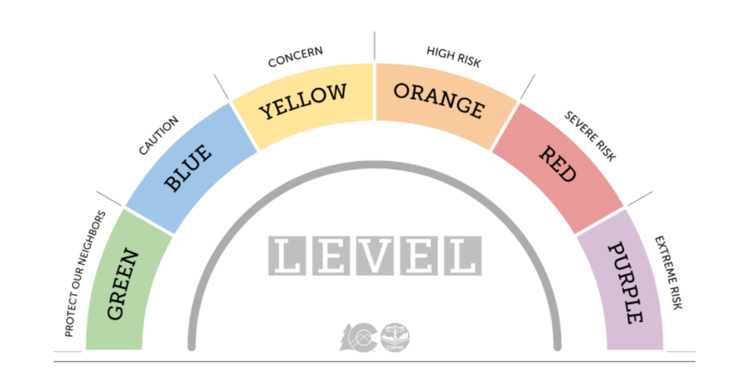
3. Phased Prevention
Include information about state or local health department.
  CDPHE Link to COVID-19 Dial Dashboard
Describe how you will make decisions about preventative actions
  Clearly describe how decisions will be made about school closures, quarantines, etc. in the event of increased levels of risk.
  Some districts are using the “colored levels” of the state’s Dial Framework to show this. Based on a county’s risk level, it is assigned a corresponding color and recommendations range from “using caution” (low risk, protect our neighbors/green) to “staying at home” (extreme risk/purple). Describe your plan for continued instruction in the event of a change in risk level.
Notes:
To cover phased prevention, you can include a brief narrative sharing how the district is working with local health officials, a link to the district’s local or state health department COVID website, or other health information that would benefit your district’s community and families. Use the information from the health department to guide you as your district determines how it will make decisions about preventative actions—for example, how many new, positive cases have been identified in the area? How many of these positive cases are within the school or district? How do these factors affect the risk levels for the district’s students and staff? A good option is to use the Colorado Department of Public Health and Environment’s COVID-19 Dial Dashboard, linked in the PowerPoint.

Slide 10
Checklist
1. Plan for Safe Return to In-Person Instruction and Continuity of Services
Important Dates
Academic Needs (in-person and remote learning options)
Student and Staff Social, Emotional, Mental Health, or Other Needs (may include student health and food services)
2. Layered Prevention Strategies
Universal and Correct Use of Masks
Physical Distancing
Handwashing and Respiratory Etiquette
At least 3 feet between students/students and 6 feet between adults/adults and adults/students
Cohort Model
Visitor Policy
Transportation Policy
Staggered Scheduling (suggested)
Alternate Schedules (suggested)
Cleaning and Maintaining Healthy Facilities
Ventilation
Modified Layouts
Cleaning Processes
Communal Spaces
Food Service
Water Systems
Contact Tracing
Collaboration with Health Department
Staying Home when Appropriate
Isolation Guidelines
Quarantine Guidelines
3. Levels of Community Risk and Phased Prevention
Collaboration with Public Health Department Officials to Determine the Risk of Transmission:
Total new cases per 100,000 persons in past 7 days*
Percentage of Nucleic Acid Amplification Tests (NAATs) that are positive in past 7 days*
*No data needs to be published within your posting. It simply needs to be clear that the LEA is collaborating with local health officials concerning this information.
How Decisions are Made about Preventative Actions
The Number of COVID-19 Cases amongst Students, Teachers, and Staff, and Number of People in Quarantine
Compliance with Prevention Strategies
Levels of Community Transmission
When this plan will be reviewed (and updated if needed) within 6 months of original posting
Returning to School (best practice)
Board meeting dates (best practice)
ADDENDUM OPTION FOR PREVIOUS PLAN:
If a district has already posted a plan that meets most of these requirements, an addendum may be added to satisfy remaining components.
Notes:
This checklist is the resource CDE reviewers will use when looking at your Safe Return to School Plans. This resource will soon be available on the CDE ESSER monitoring webpage.

Slide 11
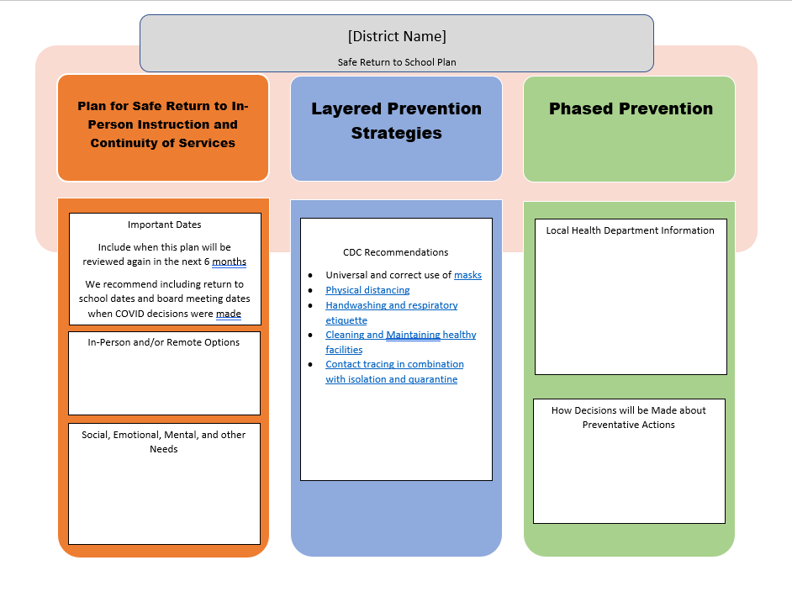
Sample Template
Notes:
This template is NOT a requirement. This is a courtesy sample for you to use if you need a springboard as you work with these plans.

Slide 12
Example of Plan that meets requirements
Sheridan School District No. 2
Please note that this district’s plan is an example that meets all requirements. Your plan may include more information or less information. The plan simply needs to meet the requirements and the needs of your district community.
Notes:
This is an example of a plan that meets the required elements of the Safe Return to School plan. If you’re looking for a springboard to get started or need ideas, consider collaborating with other districts. This district, Sheridan, adapted another district’s plan to create theirs. There are also some districts in NE Colorado who worked together with their local health department and other agencies to create their plans. Reach out to other districts or to us if you need help with these plans.

Slide 13
Questions?
Please contact me if you need assistance or would like me to work with the checklist alongside you to review your Safe Return to School plan!
Crumley_k@cde.state.co.us

Slide 14
ESSER and GEER Funds for Students in Foster Care

Slide 15
How may an LEA use ESSER and GEER funds to serve children and youth in foster care?
Question C-8 (p. 36) Non-Regulatory Guidance on ESSER and GEER from US Department of Education
  The COVID-19 pandemic has caused unique challenges for students in foster care and their caregivers.
    Increased disruptions in students’ living placements
    Increased school mobility
    Inconsistent access to schoolwork and classes
    Foster caregivers do not have knowledge about the technology needed for virtual instruction
    Schools face challenges in providing the supplemental education services required by students in foster care
non-regulatory guidance on the ESSER and GEER programs

Slide 16
How LEAs can support students in foster care through ESSER and GEER Funds
Transporting students in foster care to their respective schools of origin where LEAs are offering in-person learning, hybrid learning, or supplemental instruction/coaching opportunities;
Purchasing technology (including laptops, Wi-Fi hotspots, or tablets) that enable students in foster care to consistently access instruction;
Providing academic supports—including tutoring or supplemental instructional opportunities—to meet the unique learning needs of students in foster care;
Helping students and/or caregivers meet their basic needs, including access to meals and hygienic supplies (such as masks or hand sanitizer); and
Meeting rising mental health and behavioral needs (for example, contracting with community mental health providers to support students virtually and/or on-site at school).

Slide 17
Next steps
LEAs should coordinate with State and local child welfare agencies to identify and streamline, where possible, the supports provided to students in foster care and their caregivers. As always, intentional coordination between educational agencies and child welfare agencies remains essential to supporting students in foster care and their caregivers during the COVID-19 pandemic.

Slide 18
Connecting with LEAs and Child Welfare
Each school district has a Child Welfare Education Liaison (CWEL).
  CWELs are responsible for connecting with child welfare agencies to coordinate educational needs for students in foster care.
Each county child welfare agency has an educational point of contact.
For a list of both CWELs and county child welfare points of contacts, visit:
  http://www.cde.state.co.us/dropoutprevention/fostercare_index

Slide 19
Questions?

Slide 20


Contact Us!
Kristin Myers, Ph.D.
Foster Care Education Coordinator
Office of Student Supports
P 720-576-8506
201 East Colfax Avenue, Room 300, Denver, CO 80203
Myers_K@cde.state.co.us
Samantha Garrett, LCSW
Education Specialist
P 303-866-2005 I C 720-512-7344
1575 Sherman Street, Denver CO 80203
samantha.garrett@state.co.us

Slide 21
Questions?
Future Topics?

Slide 22
Upcoming Office Hours
  Future Topics:
    June 24, 2021
      Family, School, and Community Partnerships (stakeholder engagement)
    ARP IDEA
    IDEA MOE
    Maintenance of Equity
    Requests for Other Topics?

Slide 23
CDE Team Introductions!
ESSER/ESEA
Nazie Mohajeri-Nelson, Director of ESEA Office (mohajeri-nelson_n@cde.state.co.us)
DeLilah Collins, Assistant Director of ESEA Office (collins_d@cde.state.co.us)
Kristin Crumley, ESSER Monitoring & Reporting Specialist (Crumley_k@cde.state.co.us)
ESEA Regional Contacts assigned to your district
Fiscal Experts
Jennifer Okes, Chief Operating Officer (okes_j@cde.state.co.us)
Kate Bartlett, Executive Director of School District Operations (Bartlett_k@cde.state.co.us)
Jennifer Austin, Director of Grants Fiscal Management (Austin_j@cde.state.co.us)
Robert Hawkins, Grants Fiscal Analyst (Hawkins_s@cde.state.co.us)
Steven Kaleda, Grants Fiscal Analyst (Kaleda_s@cde.state.co.us)

