Slide 1
CDE Office Hours
June 3, 2021

Slide 2
CDE Team Introductions!
ESSER/ESEA
Nazie Mohajeri-Nelson, Director of ESEA Office (mohajeri-nelson_n@cde.state.co.us)
DeLilah Collins, Assistant Director of ESEA Office (collins_d@cde.state.co.us)
Kristin Crumley, ESSER Monitoring & Reporting Specialist (Crumley_k@cde.state.co.us)
ESEA Regional Contacts assigned to your district
Fiscal Experts
Jennifer Okes, Chief Operating Officer (okes_j@cde.state.co.us)
Kate Bartlett, Executive Director of School District Operations (Bartlett_k@cde.state.co.us)
Jennifer Austin, Director of Grants Fiscal Management (Austin_j@cde.state.co.us)
Robert Hawkins, Grants Fiscal Analyst (Hawkins_s@cde.state.co.us)
Steven Kaleda, Grants Fiscal Analyst (Kaleda_s@cde.state.co.us)

Slide 3
ESSER Office Hours
Topics
Updates and Clarification
Migrant Education
FTE Calculation
Time and Effort Reporting
Notes:
Nazie

Slide 4
Updates, Clarifications, and Follow-Ups

Slide 5
Updates
Request for extension of ARP ESSER III State Application for the remaining 1/3 of funds has been granted.
  SEA Application for Funds moved from June 7, 2021 → September 30, 2021
  LEA Plan due date moved from August 22, 2021 → December 16, 2021
Clarification – spending time in an upcoming office hours to go over the requirements
  ARP ESSER III requires
    20% set aside to provide evidence-based interventions to address the academic impact of lost instructional time (or impact of the pandemic)
      Evidence-based interventions (ESSA Section 8101(21)(A)) – Resources
        Summer Learning Programs
        Summer Enrichment Programs
        Extended Day/School Year
        Comprehensive afterschool programs
    Safe Return/Remain In-Person = within 30 days of award; must be posted on website
    LEA Plan = due by December 16
      Mitigation strategies to ensure safety and health of students and staff
      Use of 20% set aside
      Use of 80%
      Ensuring that evidence-based interventions are addressing the academic, social, emotional, and mental health needs of students

Slide 6
Summer Services for Migrant Children,
Students and Youth

Slide 7
The Education of Migratory Children
The Migrant Education Program (MEP) is a federally funded, state-operated program under the Elementary and Secondary Education Act (ESEA) that provides supplemental program services to children/youth, ages 0 through 21, of seasonal or temporary agricultural workers.

Slide 8
Migrant Education Program Funding
(1) the sum of—
  the average number of identified eligible migratory children aged 3 through 21 residing in the State, based on data for the preceding 3 years; and
  (B) the number of identified eligible migratory children, aged 3 through 21, who received services under this part in summer or intersession programs provided by the State during the previous year; multiplied by
(2) 40 percent of the average per-pupil expenditure in the State, except that the amount determined under this paragraph shall not be less than 32 percent, nor more than 48 percent, of the average per-pupil expenditure in the United States.

Slide 9
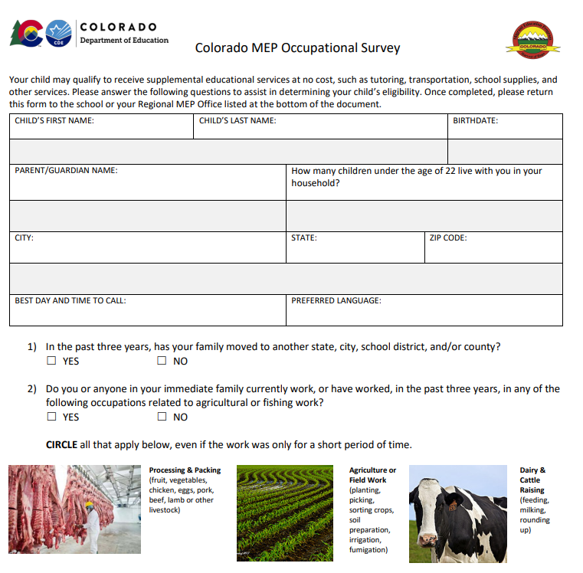
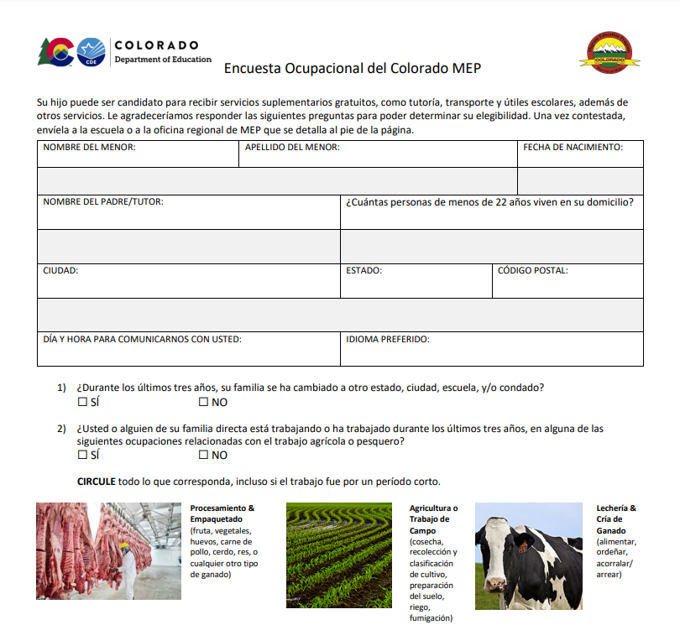
Finding Migrant Children, Students , and Youth
https://www.cde.state.co.us/migrant/mep-occupational-survey-en
https://www.cde.state.co.us/migrant/mep-occupational-survey-sp

Slide 10
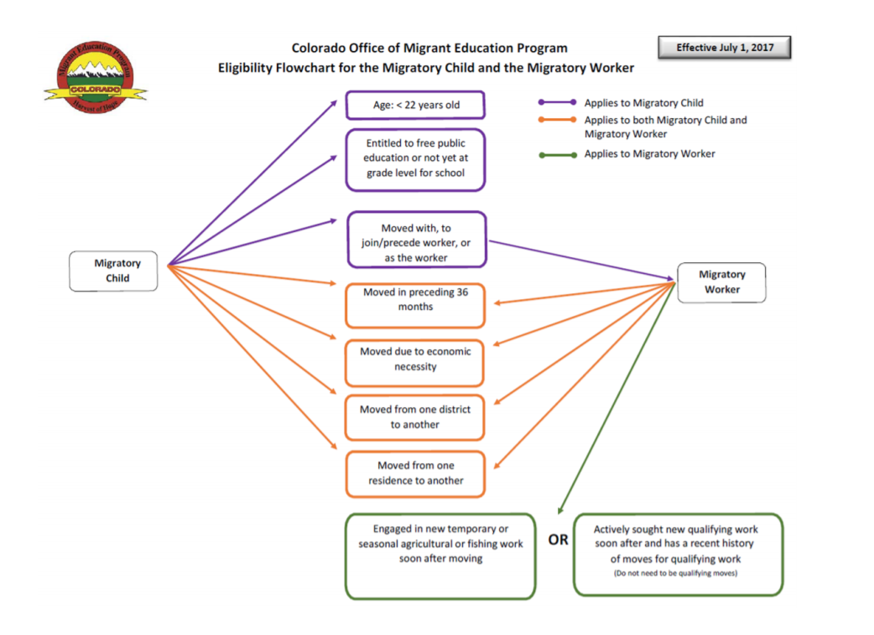
Eligible Flowchart for Migratory Child and Migratory Worker
https://www.cde.state.co.us/migrant/mepeligibilityflowchartpdf

Slide 11
Summer Services
Summer dates are June 1, 2021 – August 31, 2021
All services follow the Service Delivery Plan https://www.cde.state.co.us/migrant/migranteducationprogramservicedeliveryplanupdateenglish
Services must be migrant funded to be included in our data submissions
Services must supplement not supplant other local, state and federal funds
Birth -2 years old services do not count towards funding

Slide 12
Migrant Early Learners
Birth to 5 years old, not in a formal education setting
Early Learning Observation and Assessment Tool
LENA Home- Support Early Language Development https://www.lena.org/
Ready Rosie https://www.readyrosie.com/
Kids Play Math- A bilingual, English and Spanish, program that provides online classes. A partnership between Kids Play Math and the University of Denver. Integrated as part of the Parent Engagement Grant

Slide 13
Services for Secondary Students
STEAM: A hands-on exploration of science, technology, engineering, arts and mathematics. STEAM offers .5 STEM credit to high school students.
SMYLI: A mentor-based leadership program designed to support graduation and postsecondary enrollment. SMYLI offers .5 Language Arts credits to high school students this summer.
LDZ: Lorenzo de Zavala is a National Hispanic Institute program focusing on leadership, government, community organization for high school students.
CalPoly: Virtual STEM classes for elementary through high school including robotics, engineering, coding, game design, electronics, and creating a virtual reality.
Penn State Camp Brain-STEM: Students create and program animations, games, and interactive stories. This program encourages students how to think creatively, reason systematically, and work collaboratively which are all essential skills in today’s world.

Slide 14
Opportunities for Collaboration
Children, students and youth
Make sure there is room for MEP students in summer schools
Extended hours of summer school for MEP students
Include Fridays for MEP programs
Migrant Health/ vision gatherings
If district teachers would like to tutor MEP students in the summer
If the district has materials that need to get to migrant kids during the summer
Parent and Families
Providing space for Migrant parent meetings that are informational and educational
Math or literacy nights for migrant parents and families
Summer orientation school walk throughs for migrant students and their families
Sessions on parent communication tools (Power school, Infinite campus etc.)

Slide 15

Connect and Collaborate with Your Regional Director!
MEP REGION | NAME/ TITLE | ADDRESS | PHONE NUMBER | E-MAIL
Northern | Maria Castillo Director | Centennial BOCES 2020 Club House Dr. Suite 230 Greeley, CO 80634 | Office: 970-352-7404 ext. 1110 Cell: 970.405.4451 | mcastillo@cboces.org
Metro | Jesus Escarcega Grant Director | 14707 E.2nd Avenue, Suite 180 Aurora, CO 80011 | Office: 303-365-5817 | jdescarcega@aurorak12.org
Metro | Guillermo Barriga Project Manager | 14707 E.2nd Avenue, Suite 180 Aurora, CO 80011 | Office: 303-365-5817 Cell: 720-810-6700 | gbarriga@aurorak12.org
Southeast | Manuel Calderon Director | 24951 Hwy 50 East Pueblo, CO 81006 | Office: 719-671-4663 | mcalderon@district70.org
Southwest | Esmeralda Martinez Director | Adams State University 1424 Second Street Alamosa, CO 81101 | Office: 719-587-7635 Cell: 719-480-1015 | etmartinez@adams.edu
West Central | Tracy Gallegos Director | Basil T. Knight Center 596 North Westgate Dr. Grand Junction, CO 81505 | Office: 970-254-5495 Cell: 970-216-3825 | tracy.gallegos@d51schools.org

Slide 16
Connect with the CDE Migrant Office
Office of Migrant Education
Colorado Department of Education
1560 Broadway Street, Suite 1100
Denver, CO 80202
Phone: 303-866-6963
https://www.cde.state.co.us/migrant
Tomas Mejia
State Director
mejia_t@cde.state.co.us
Noemi Aguilar
Supervisor
aguilar_n@cde.state.co.us
Aaron Thompson
Senior Consultant, ID&R Coordinator
thompson_a@cde.state.co.us
Laura Leyva
Senior Consultant, Binational Coordinator
leyva_l@cde.state.co.us
Jenny Lerner
Migrant Education Early Learning Senior Consultant
lerner_j@cde.state.co.us
Lauren Radin
Senior Consultant, Secondary Programs
radin_l@cde.state.co.us
Juanita Arias
Data Specialist, Title I, Part C Migrant Program
arias_j@cde.state.co.us
Marissa Gonzales
Program Support
gonzales_m@cde.state.co.us
Silvia Saldivar
Administrative Assistant
saldivar_s@cde.state.co.us

Slide 17
FTE Calculation

Slide 18
FTE Calculation
Pro-Rate, Pro-Rate, Pro-Rate
An employee makes $50,000 annual salary - if charging $10,000 to ESSER, then you would divide $10,000/$50,000 to determine that is 20% of the employee’s salary, and you would then enter .2 FTE in the budget.
District is paying 10% of the annual salary of 100 teachers using ESSER. This is .1 FTE per individual. Multiply .1 x 100, and enter 10 FTE in the budget.
District is paying teachers to work 8 weeks over the summer to deliver summer school/program, which is outside of their annual contract. In this case, use Stipends and do not enter an FTE amount.

Slide 19
Questions?
Future Topics?

Slide 20
Upcoming Office Hours
  Future Topics:
    June 10, 2021
      Evidence-based Interventions and School Improvement Tools
        20% set aside for using evidence-based interventions to address learning loss
    June 17, 2021
      ARP ESSER III Requirements and Plans
      Supporting Student in Foster Care with ESSER Funds
    June 24, 2021
      Family, School, and Community Partnerships (stakeholder engagement)
    ARP IDEA
    IDEA MOE

Slide 21
CDE Team Introductions!
ESSER/ESEA
Nazie Mohajeri-Nelson, Director of ESEA Office (mohajeri-nelson_n@cde.state.co.us)
DeLilah Collins, Assistant Director of ESEA Office (collins_d@cde.state.co.us)
Kristin Crumley, ESSER Monitoring & Reporting Specialist (Crumley_k@cde.state.co.us)
ESEA Regional Contacts assigned to your district
Fiscal Experts
Jennifer Okes, Chief Operating Officer (okes_j@cde.state.co.us)
Kate Bartlett, Executive Director of School District Operations (Bartlett_k@cde.state.co.us)
Jennifer Austin, Director of Grants Fiscal Management (Austin_j@cde.state.co.us)
Robert Hawkins, Grants Fiscal Analyst (Hawkins_s@cde.state.co.us)
Steven Kaleda, Grants Fiscal Analyst (Kaleda_s@cde.state.co.us)

