Slide 1
CDE Office Hours
May 6, 2021

Slide 2
CDE Team Introductions!
ESSER/ESEA
Nazie Mohajeri-Nelson, Director of ESEA Office (mohajeri-nelson_n@cde.state.co.us)
DeLilah Collins, Assistant Director of ESEA Office (collins_d@cde.state.co.us)
Mary Ann Caterina, ESSER Monitoring & Reporting Specialist (caterina_m@cde.state.co.us)
Kristin Crumley, ESSER Monitoring & Reporting Specialist (Crumley_k@cde.state.co.us)
ESEA Regional Contacts assigned to your district
Fiscal Experts
Jennifer Okes, Chief Operating Officer (okes_j@cde.state.co.us)
Kate Bartlett, Executive Director of School District Operations (Bartlett_k@cde.state.co.us)
Jennifer Austin, Director of Grants Fiscal Management (Austin_j@cde.state.co.us)
Robert Hawkins, Grants Fiscal Analyst (Hawkins_s@cde.state.co.us)
Steven Kaleda, Grants Fiscal Analyst (Kaleda_s@cde.state.co.us)
Adam Williams, Financial Data Coordinator (Williams_a@cde.state.co.us)

Slide 3
ESSER Office Hours
Topics
Updates, Clarifications, and Follow UPs
Q&A for this Week
Notes:
Nazie

Slide 4
Updates, Clarifications, and Follow-Ups

Slide 5
ARP Homeless Children and Youth Fund
U.S. Department of Education (Department) under section 2001(b)(1) of the American Rescue Plan Act of 2021 (ARP) for the purposes of identifying homeless children and youth, providing wraparound services in light of the impact of the COVID-19 pandemic, and providing assistance needed to enable homeless children and youth to attend school and participate fully in school activities, including in-person instruction this spring and summer learning and enrichment programs.
$199,750,000 (25% of the $799 million) is available to States now. This first disbursement is designed to provide funding to States immediately as a supplement to their McKinney-Vento Education for Homeless Children and Youth (EHCY) funds, so that States can address urgent needs of homeless children and youth—including academic, social, emotional, and mental health needs—and so States and local educational agencies (LEAs) can increase capacity by hiring staff, dedicating resources, and planning partnerships with community-based organizations, among other strategies. Funds must be administered by the Office of the State Coordinator for the Education of Homeless Children and Youth, consistent with the requirements for EHCY funds.
$599,250,000 (75% of the $799 million) will be made available as soon as June after the Department completes necessary regulations to change EHCY’s required competitive subgrant process for the purpose of the second allocation of funding. The Department anticipates that the new regulation would require States to distribute funds that they will receive in the second phase to LEAs via a formula that uses the LEA’s allocation under Title I, Part A (Title I) of the Elementary and Secondary Education Act of 1965 (ESEA) and the number of identified homeless children and youth in 2018-19.

Slide 6
Construction Clarifications
MUST be necessary to respond to, prepare for, or prevent the spread of COIVD-19!
MUST be within the award period – so please include date of contract for the construction and the date(s) construction will be done.
Prior Written Approval – when the rest of the budget is not ready
Can give substantial approval on the specific budget item
If construction has been reviewed as part of the BEST grant or had an assessment by our Capital Construction Unit, that will be considered prior written approval
It is the LEA’s responsibility to comply with all federal regulations that apply to construction and capital expenditures
2 CFR §§ 200.403-200.405, 2 CFR § 200.439(b)(1)
34 CFR § 76.600, 20 U.S.C. 1232b Labor Standards
Must also comply with state and local procurement policies regarding capital expenditures
We highly recommend using contractors/vendors with experience in dealing with federal grants and regulations

Slide 7
Construction (Continued)
In the application for funds:
Date of the contract for construction
Date(s) construction has/will occur
Description of the work being done
Detail of how the total cost was calculated so that we can determine reasonableness (or a statement regarding how the LEA assessed and determined reasonableness)
Relationship to COVID-19 (why the construction is necessary to respond to, prepare for, or prevent the spread of COVID-19)

Slide 8
Modifications for ESSER I Facility School Awards
Due to the short time for applications, we have changed the system so that Facility Schools can submit Acceptance and Transmittal Form, assurances, and GEPA statement now and then budget later – but still need them ASAP.

Slide 9
When It Rains…
We are experiencing technical difficulties with the online application system!
We are still awaiting USDE guidance on backfilling activites that require prior written approval!
For now, have made systems changes so that you can submit construction and capital equipment items (e.g., buses) for prior written approval without have to submit full budget
We have additional data collections and components of ESSER III that we need to build into the system!
LEA plans
Thank you for your patience and grace with our team!

Slide 10
Reminders

Slide 11
Examples to Share
HR Policies to Address Impact of a Pandemic/Emergency
Accounting Policies to Address Impact of a Pandemic
Plans for a Safe Return to In-Person Instruction and Continuity of Services

Slide 12
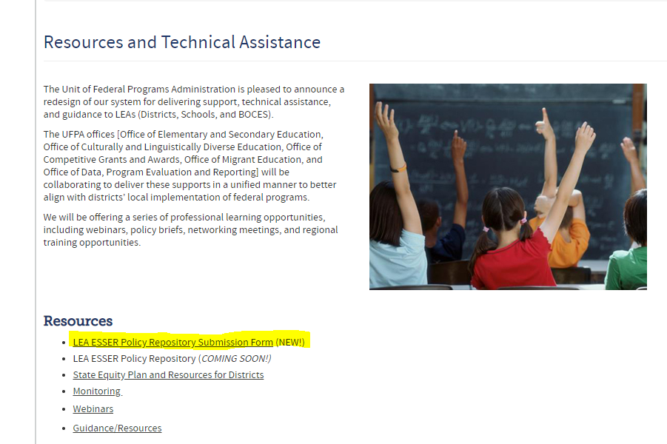
Examples to Share

Slide 13
Upcoming Office Hours
No Office hours next week – May 13th due to a conflicting meeting
Changed times
May 20 – 11 to noon
May 27 – 11 to noon
Future Topics:
ARP Homeless Grants
ARP IDEA
IDEA MOE
Migrant Education
20% set aside for using evidence-based interventions to address learning loss
LEA Plans

Slide 14
Questions? Future Topics?

Slide 15
CDE Team Contact Information
ESSER/ESEA
Nazie Mohajeri-Nelson, Director of ESEA Office (mohajeri-nelson_n@cde.state.co.us)
DeLilah Collins, Assistant Director of ESEA Office (collins_d@cde.state.co.us)
Mary Ann Caterina, ESSER Monitoring & Reporting Specialist (caterina_m@cde.state.co.us)
Kristin Crumley, ESSER Monitoring & Reporting Specialist (Crumley_k@cde.state.co.us)
ESEA Regional Contacts assigned to your district
Fiscal Experts
Jennifer Okes, Chief Operating Officer (okes_j@cde.state.co.us)
Kate Bartlett, Executive Director of School District Operations (Bartlett_k@cde.state.co.us)
Jennifer Austin, Director of Grants Fiscal Management (Austin_j@cde.state.co.us)
Robert Hawkins, Grants Fiscal Analyst (Hawkins_s@cde.state.co.us)
Steven Kaleda, Grants Fiscal Analyst (Kaleda_s@cde.state.co.us)
Adam Williams, Financial Data Coordinator (Williams_a@cde.state.co.us)

