Slide 1
CDE Office Hours
May 26, 2022

Slide 2
ESSER Office Hours
Topics
Updates and Reminders
  Consolidated Application Deadlines
    Non-public School Consultation and School Improvement Retention Forms
    21-22 PAR Deadline
  Deadline to Draw Down Funds by End of Fiscal Year
  ESSER Reporting Survey
Strategy Guides
IDEA Maintenance of Effort and Other Requirements for ESSER Fund Recipients

Slide 3
Updates, Reminders, and Clarifications

Slide 4
U.S. Department of Education (USDE) Universal Monitoring of ESSER I, II, & III
•USDE monitoring:
•Comprehensive - full federal program
•Targeted - focused on a specific component of a federal program
•Universal - broad oversight of a federal program
•Colorado has been selected for universal monitoring of ESSER; Quarterly meetings with Program Officer
•Area of focus:
•May 2022 Meeting -
•CDE’s oversight of the 20% Set-Aside and LEA Uses of Funds Plans
•Timeline:
•Desk Review on May 5, 2022
•Self-assessment and evidence submitted to USDE on April 21, 2022
•What will this mean for our LEAs?
•No LEAs selected for participation
•No evidence or documentation asked of or on behalf of LEAs
•Evaluating CDE’s oversight; could have long-term implications on LEAs if we have findings
•Area of concern - LEA plans not available on the CDE website
•Results:
•No findings! But we do need to make plans available on our website!

Slide 5
21-22 Consolidated Application PAR
2021-2022 Consolidated Application PAR requests must be submitted by June 15, 2022.
  Any outstanding comments from previously submitted PAR requests must also be addressed by June 15, 2022.
If you want to draw down funds prior to the end of the fiscal year, CDE must receive your Request for Funds (RFF) by June 1.
Keep in mind that expenditures (including carryover activities) that occur in FY 22-23 cannot be requested for reimbursement until final approval is granted in the ConsApp.
Reminder: Draw down funds before they expire!!!
Notes:
Steven discussing RFF deadline.

Slide 6
22-23 Consolidated Application Updates
Now open and accepting applications!
  Online application
  Requires a login username and password through the CDE Identity Management System; work with your Local Access Manager (LAM)
The Year at a Glance indicates the following should be happening right now (Note: Some tasks listed should be close to completion):
  Declare participation in Community Eligibility Provision to School Nutrition, if applicable. CEP is an optional poverty measure used for serving Title I schools.
  Evaluate English learner redesignation status including Els with disabilities.
  Have LEA budget discussions that include staff assignments to ensure compliance with Title I, Part A comparability and EDT requirements for the following school year.
  Plan and collaborate with local neglected or delinquent facilities to plan activities for Consolidated Application, if applicable.
  Preliminary ESEA allocations available for following school year. Update any plans or draft budgets with posted allocation amounts prior to planning and submission of the Consolidated Application.
  All public school code changes for the 2022-23 school year must be submitted to CDE no later than June 30, 2022. The forms for making changes can be found under “School Code Change Request Forms” on CDE’s Directory Webpage.
Non-Public Consultation form and the School Improvement Retention of Funds form are both available on the website and are due on May 31st.
  These will need to be uploaded in the application.
Applications are due June 30, 2022!
For questions or assistance, please contact your ESEA Regional Contact.

Slide 7
Upcoming Training
Equitable Distribution of Teachers Series Training #4: Building an EDT Plan
This training helps LEAs build an EDT plan that addresses gaps and adequately answers the EDT question of the Consolidated Application.
Target Audience: LEAs with medium or large EDT gaps (district leadership, HR, hiring managers, principals); LEAs with small gaps also welcome.
Prep: LEAs will need access to their 20-21 EDT data from Syncplicity. Recommended to watch the recording of at least training #3 of the EDT Training Series and come to the training with some possible strategies to address gaps ready.
Date: Tuesday, May 31, 2022
Time: 10am-12pm
Register HERE
Agenda
Small vs Med/Large Gaps
Alternative Calculator Assurance
Walkthrough of the EDT Plan Narrative Question
EDT Monitoring Indicators
Contact Wilson_S@cde.state.co.us for any logistics questions or Kaloudis_N@cde.state.co.us with questions about the training.
Notes:
Niko

Slide 8
Reporting Reminder
All LEAs received an ESSER survey question about student engagement and if you allocated ESSER funds in 2020-2021 to schools, including charters, you also received a survey question about method used to determine school allocations.
Thank you to those of you who have already submitted your ESSER data on student engagement and school level allocations.
If you have not yet submitted, please submit data by May 27, 2022!
Notes:
Mackenzie

Slide 9
Strategy Guides
How to use Strategy Guides
in the Improvement Planning Process
Notes:
Lauren Hesse

Slide 10

Objectives
This presentation will answer the following questions:
What are Strategy Guides, and where can they be found?
How can Strategy Guides be used in improvement planning?

Slide 11
What are Strategy Guides?

Slide 12
What are Strategy Guides?
CDE has created a number of Major Improvement Strategy Guides to help schools and districts better understand what research says about strategies that are commonly used in improvement planning and the UIP.
These Strategy Guides…
highlight commonly used, high-impact strategies
synthesize core components from research (with a focus on research meeting ESSA Levels 1-3)
connect leaders to research and other supporting resources available

Slide 13
Why do Strategy Guides focus on research-based practices?
All students deserve access to high-quality educational experiences.
Research based strategies...
Have been tested and vetted in the field.
Have a demonstrated track record of effectiveness.
Have been clearly defined and carefully refined over time.
Focusing our Strategy Guides on research- and evidence-based practices is one way that we can support schools and districts in providing these high-quality educations to students.

Slide 14
Structure of Strategy Guides
Introduction
Gives a brief overview of the strategy, including the definitions of any key terms.
Evidence Base
Describes the level of research available supporting the effectiveness of the strategy (all strategy guides meet ESSA Level 3 or higher).
Considerations
Contains some guiding questions to help assess whether the strategy is the right fit for the school
Implementation Guide
Outlines the Core Components of the strategy, broken down into Elements or Action Steps of greater detail and granularity.
Sources Consulted
Lists research and implementation sources synthesized in the Strategy Guide.
*May be titled “Academic Studies Leading to ESSA Rating”

Slide 15
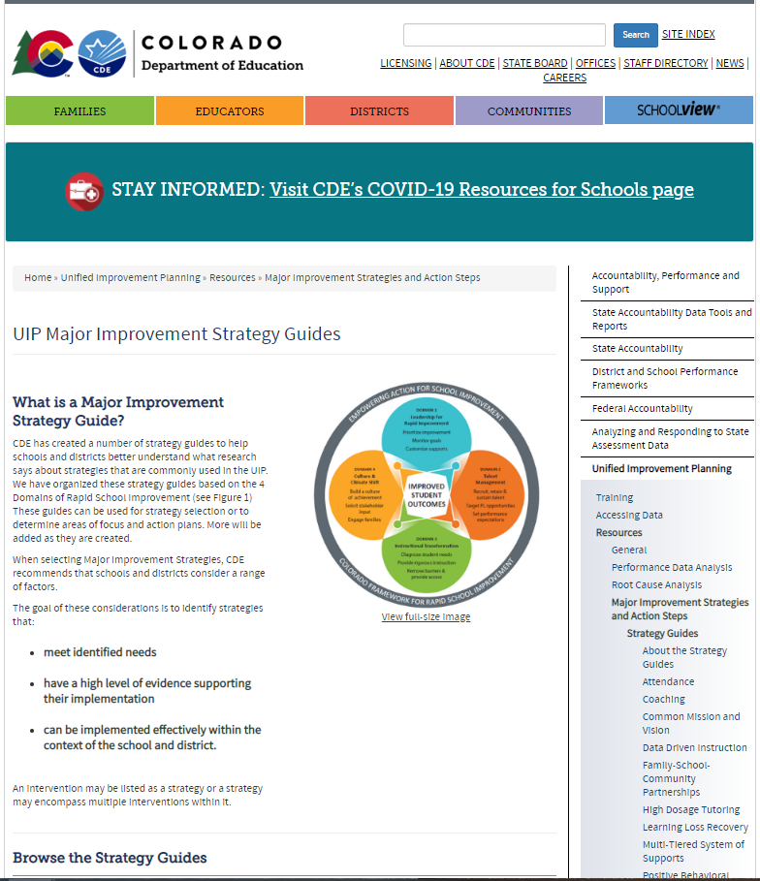
Where to find the Strategy Guides
Access the strategy guides here: https://www.cde.state.co.us/uip/strategyguides
Or, from the CDE main page (www.cde.state.co.us), search for “Strategy Guides.”

Slide 16
Available Strategy Guides
The Strategy Guides are currently available are listed here:
We add guides to this list on an ongoing basis, so check back later if what you want isn’t listed.
Attendance
Coaching
Common Mission & Vision
Data-Driven Instruction
Family-School-Community Partnerships
High Dosage Tutoring
Learning Loss Recovery
Multi-Tiered System of Supports
Positive Behavioral Interventions and Supports
Professional Learning Communities
Summer School
Supporting ELs in GenEd
Trauma-Informed Education

Slide 17
How can Strategy Guides be used in improvement planning?

Slide 18
The role of strategies in Improvement Planning
Prepare to
Plan
Target
Setting
Action
Planning
Data
Analysis
Review Current Performance
Describe Notable
Trends
Prioritize Performance Challenges
Identify
Root
Causes
Set Student Centered Targets
ID Major Strategies & Action Steps
The UIP Flow-Map
Progress Monitoring
Identify
Interim Measures
Identify Implementation Benchmarks

Slide 19
The role of strategies in Improvement Planning
Data Analysis
Performance Challenge Prioritization
The Improvement Planning Process
Root Cause Identification
Effective Implementation
results in Improvement
Strategy Selection

Slide 20
Selecting a Strategy
Considerations for Contextual Fit: The following questions and considerations can help you to evaluate whether or not a strategy is a good fit for your school:
Does the strategy address an identified root cause of a performance challenge?
Does the strategy have support from school leadership?
Does the school have the resources needed to implement the strategy?
Does the team have adequate capacity (time and bandwidth) for making changes?
Do systems and structures to support changes exist or will they need to be created?
Does the school have adequate resources to support changes (e.g., internal expertise or ability to contract with external partner)?

Slide 21
Selecting a Strategy
Considerations
You can find some strategy-specific information to help you select a strategy in the “Considerations” section of the Strategy Guide. This section provides a list of possible root causes that may be addressed by the strategy, along with some specific questions to help you assess contextual fit (i.e., whether the strategy is the right fit for your school or system). This information can help you decide whether to adopt one of these strategies.

Slide 22
Using the Strategy Guide to determine focus for year
Introduction
Robust strategies generally take more than one year to implement fully.
Whether you are adopting an entirely new strategy or building on a strategy that is already in place, the Strategy Guide can help you to determine the best next step for your school.
Strategy

Slide 23
Using the Strategy Guide to determine focus for year
Review the Implementation Guide (Core Components and Elements or Action Steps) section of the Strategy Guide.
Implementation Guide
Note the essential components or elements of the strategy
Determine where the school already has components or elements in place, and where work is needed.
Select next steps to focus improvement efforts for the coming plan cycle (1-2 years).

Slide 24
Examples
1
2
3
4
Example:
Coaching Strategy Guide
Core Components:
Establish Roles, Systems, and Structures
Implement Concrete Data Analysis
Collaborate with Coaches
Monitor Coaching Impact
School 1: New to Strategy
Focus of Year 1
Focus of Year 2
School 2: Building on initial progress
Already in place
Focus of Year 1
Focus of Year 2
Focus of Year 2

Slide 25
Further Reading
Sources Consulted
If you have additional questions about your strategy, or you simply want to learn more about it, consult the list of Sources at the end of the Strategy Guide. That section will list resources to help you deepen your understanding or provide additional guidance on how to use and refine the strategy.

Slide 26
Q&A

Slide 27
Thank you for your time!
Email any questions to
uiphelp@cde.state.co.us

Slide 28
ESSER and IDEA MOE
Evan Davis
Colorado Department of Education
Office of Grants Fiscal
Notes:
Evan Davis

Slide 29
ESSER and State and Local Special Education expenses
    Ordinarily required under ESEA grants, but not under ESSER:
    Based on a Comprehensive Needs Assessment
    Supplemental supports & services
    Serving eligible schools and students
    Still required under ESSER:
    Reasonable and Necessary
    Funding considerations
    LEAs can use the ESSER funds to cover declines in state/local funds. However, ESSER will provide only temporary support and will not be a permanent replacement for lost state funds. – avoid the funding cliff!
    SNS for Titles IA, IIA, IVA do not implicate federal funds, only state/local. However, Title IC (Migrant Education) and Title IIIA do reference federal funds, so be careful, these could present SNS issue.
Reminder: ESSER Funds were calculated using LEAs’ Title I, Part A funding formula. However, ESSER Funds are not Title I funds. There are important flexibilities related to ESEA-type activities under ESSER.

Slide 30
ESSER and State and Local Special Education expenses
Question:
  Is there a “supplement not supplant” requirement for ESSER and GEER funds?
Answer:
  No. The ARP Act, the CRRSA Act, and the CARES Act, however, include detailed provisions requiring States to maintain effort for elementary and secondary education and higher education. (See the Maintenance of Effort FAQs.) Maintenance of effort provisions are designed to keep States from substantially reducing their support for K–12 education and higher education. While these Acts do not address maintenance of effort requirements associated with other Federal funds, such as those for IDEA and ESEA, States and LEAs must be mindful that these requirements continue to apply.
  https://oese.ed.gov/files/2021/05/ESSER.GEER_.FAQs_5.26.21_745AM_FINALb0cd6833f6f46e03ba2d97d30aff953260028045f9ef3b18ea602db4b32b1d99.pdf

Slide 31
ESSER and State and Local Special Education expenses
Question:
  Can federal ESSER I, II, III funds be used to replace state and/or local Special Education expenses (Grant Code 3130 and/or 3131)
Answer:
  For the purposes of the IDEA, CARES Act (ESSER I), CRRSA Act (ESSER II), and ARP Act (ESSER III) funds are considered Federal funds and may not replace State and local funds in LEA MOE calculations. As a result, if an LEA uses CARES Act, CRRSA Act, or ARP Act funds to replace State or local funding for the education of children with disabilities, this may result in a failure of the LEA to meet the budget and/or expenditure requirements for LEA MOE under IDEA.

Slide 32
ESSER and State and Local Special Education expenses
IDEA contains an LEA MOE requirement in addition to the State MOE requirements in the CARES Act, CRRSA Act, and ARP Act, and the State and LEA maintenance of equity requirements in the ARP Act.
Under section 613(a)(2)(A)(iii) of IDEA and 34 CFR § 300.203, an LEA must both:
      (1) budget, for the education of children with disabilities, at least the same amount as the LEA spent for that purpose from the same source (either local funds or a combination of State and local funds, on an aggregate or per capita basis) in the most recent fiscal year for which information is available; and
      (2) expend, for the education of children with disabilities, at least the same amount as the LEA spent for that purpose from the same source (either local funds or a combination of State and local funds, on an aggregate or per capita basis) for the preceding fiscal year.
Under IDEA, these budget and expenditure requirements for LEA MOE are termed “eligibility” and “compliance” standards, respectively.

Slide 33
ESSER and State and Local Special Education expenses
While IDEA does not provide for MOE waivers, there are exceptions and an adjustment to the LEA MOE requirements that may allow an LEA to reduce its MOE budget and expenditures below the level of expenditures for the education of children with disabilities made by the LEA for the appropriate comparison years (for the eligibility standard) and the preceding fiscal year (for the compliance standard)). (See 34 CFR §§ 300.204 and 300.205.)
Make sure all possible and appropriate state and local expenditures related to Special Education services are properly coded to grant code 3130/3131
If you are a BOCES/AU that transfer Special Education funding between member districts and/or other AUs please ensure you are utilizing the proper Object Codes. For examples, please review the following CDE Chart of Accounts link (Appendix D Page 183)
https://www.cde.state.co.us/cdefinance/2021-22chartofaccount

Slide 34
Allowable Exceptions
Voluntary departure or departure for just cause of special education staff
  If the employee was replaced, calculate the difference in salary and benefits from the more senior staff to the new staff, this is the amount of the allowable exception
  If the employee was not replaced, and the position was not eliminated, use the entire salary and benefits amount of the employee who left the AU
  Reduction in Force, furlough days, across the board pay cuts are not allowable reductions for MOE
Termination of high cost obligation to a particular child with a disability because:
  The child has moved out of the district
  The child no longer needs the program
  The child has aged out of or graduated from the program

Slide 35
Allowable Exceptions
(continued)
Termination of costly expenditures for long-term purchases
  One time expenditures are not allowable exceptions
  Expenditures that occur all in one year are not an allowable exception
  An allowable example would be if an AU had undertaken the refurbishing of its existing bus fleet with wheel chair lifts, gates and tie-downs. If the AU purchased these items, on a single, multi-year contract, the AU could reduce its MOE by the annual amount of the contract once that contract is completed.
If after researching and submitting to CDE all allowable exceptions, the AU still fails MOE, the shortfall must be paid back to CDE, who then pays back the US Department of Education
The repayment to CDE must be from non-Federal funds
https://cifr.wested.org/wp-content/uploads/2021/04/CIFR-LEA-MOE-QRG.pdf

Slide 36
Current MOE
MOE Potential Shortfall Workbook
  Sent out in early April
MOE Certifications
  Sent out in mid April
MOE Certificate Due Date
  Friday July 1st
  Must be signed by a Board President
  Future IDEA Funds cannot be accessed until signed Certificate received by CDE

Slide 37
Questions
Any Questions?

Slide 38

Contact
Resources:
https://sites.ed.gov/idea/regs/b/c
CDE Contact:
Evan​ Davis
Federal Fiscal Grant Supervisor
Office of Grants Fiscal Management
Phone 720.616.9163
Davis_E@cde.state.co.us

Slide 39
Upcoming Meetings

Slide 40

Any Requests for Upcoming Topics or Questions!
Upcoming Office Hours
June 9
  GEPA Requirements for ESSER Grants
  Late liquidation waiver opportunity from the U.S. Department of Education

Slide 41
CDE Contacts!
Emails: Lastname_Firstinital@cde.state.co.us
(e.g., Smith_a@cde.state.co.us)
Federal Programs & Supports (ESEA/ESSER Program Supports) | School Finance & Operations (Fiscal and Systems Supports)
Nazie Mohajeri-Nelson, Federal Programs & Supports Unit ESEA Programs Specialists and ESEA Regional Contacts (assigned by district) Title I: Laura Meushaw, Kathryn Wisner, Niko Kaloudis, Evita Byrd Title II: Niko Kaloudis, Karen Bixler Title III: Kathryn Wisner, Rachel Temple Title IV: Tammy Giessinger Title V: TBD ESEA and ESSER: Shannon Wilson ESSER Program Monitoring Specialists Kristin Crumley Jonathan Schelke Kim Boylan ESEA and ESSER Data and Reporting Specialists Tina Negley Alan Shimmin Mary Shen Mackenzie Owens | Kate Bartlett, Executive Director of School District Operations Unit Fiscal Specialists Jennifer Austin, Director of Grants Fiscal Management ESEA Robert Hawkins, Grants Fiscal Analyst Steven Kaleda, Grants Fiscal Analyst ESSER Fiscal Specialist Steven Kaleda Grants Fiscal Analyst ESSER Monitoring Bill Parsley, ESSER Fiscal Monitoring Supervisor Hilery Morris, ESSER Fiscal Monitoring Application Systems Specialists DeLilah Collins, Director of Grants Program Administration Online Applications Systems Technical Support Michelle Prael

