Slide 1
CDE Office Hours
May 5, 2022

Slide 2
ESSER Office Hours
Topics
Updates and Reminders
Teaching and Learning CoLabs
22-23 Consolidated Application Updates
ESSER III LEA Plans Deadline
Use of Funds Requirement: PDF Application
Upcoming Consolidated Applications Workshops
Upcoming EDT Training
Workforce Supports
ESSER Reporting Surveys
Notes:
Nazie

Slide 3
Updates, Reminders, and Clarifications
Notes:
Nazie

Slide 4
Professional Learning Opportunities June 2022
A collaboration with Colorado’s State Teacher Organizations and Institutions of Higher Education
Notes:
Launching a collaborative approach to PL to increase access to high quality instructional practice for educators across the state. Sessions and institute design is adapted to support the community needs. We are tapping local talent to design and lead sessions.

Slide 5
2022 Teaching and Learning CoLabs
Notes:
We have three host sites this summer, and in future years, we hope to partner with other sites and locations. We are so thankful to our partners at Colorado Mesa, UNC, and CSU Pueblo for hosting us this summer.

Slide 6
Registration closes at the end of May for all sessions cde.state.co.us/colab
High Impact Instructional Practices
COVID Recovery Support
Supporting All Students (CLDE, UDL, MTSS)
Lunch provided at all locations
No cost to attend
8.0 certificate hours
We are hosting sessions for the following content areas
Math
ELA
Science
Health and PE
School Leadership and Administration
Notes:
For questions, please contact

Slide 7
22-23 Consolidated Application Updates
• Non-Public Consultation form and the School Improvement Retention of Funds form are both available on the website and are due on May 31st.
These will need to be uploaded in the application.

Slide 8
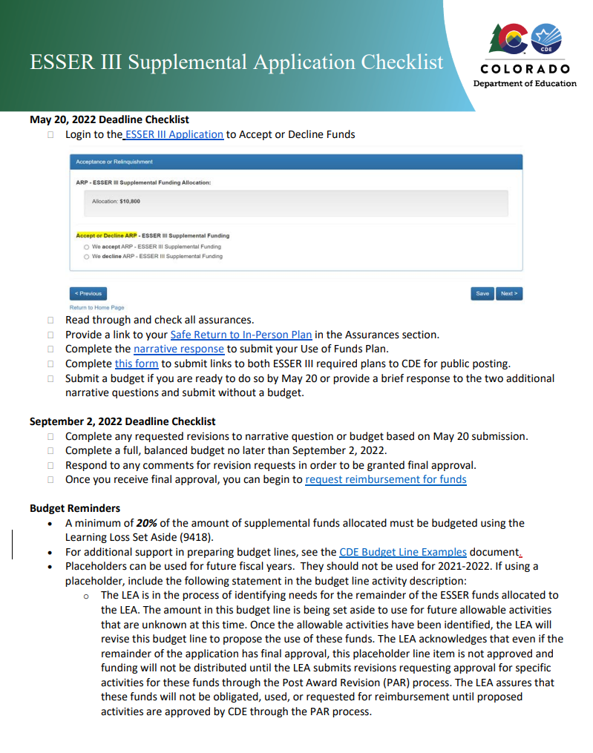
ESSER III LEA Plans for Supplemental Funds
Due May 20 for Supplemental Funds (with separate applications)
Safe In Person Plan
Use of Funds Plan
For LEAs who received additional supplemental funds:
Use of Funds plan must include how you are using your supplemental funds
Please submit hyperlinks to your Use of Funds Plan using this form by May 20
New Resource: ESSER III Supplemental Application Checklist
Notes:
Mackenzie
Focusing on supplemental funds with a separate application.
For districts who received additional supplemental funds, they should already have these submitted with the original

Slide 9
Resources to support meeting this May 20 Deadline
Safe Return to In-Person Instruction Plan (Safe Return to School) Checklist
For guidance on how to answer Narrative Question 1, see CDE's Narrative Question Guidance or see the office hours presentation and slides (PPT) from August 26, 2021.
For guidance on how and what to post on the LEA website to meet statutory requirements, see the Use of Funds Plan Guidance (PDF).
List of LEA Plans
Full list of deadline and additional resources
Notes:
Mackenzie

Slide 10
Use of Funds Plans Update
For all LEAs that received a 90% allocation of ESSER III funds, the Safe In-Person and Use of Funds plans are due May 13th.
The Use of Funds plan requirements can be fulfilled by posting a PDF of your budget on your website.
The Safe In-Person plan must follow the requirements listed on the previous slide.
Please submit the URLs for both via the Smartsheet form.
Notes:
M

Slide 11
Upcoming In-Person Consolidated Application Work Sessions
CDE staff will be available to walk you through filling out the application and answer any questions you have.
Pikes Peak and Southeast: Tuesday, May 10 from 12:30-3:30 at Pikes Peak BOCES – Register Here
Metro Region: Friday, May 13 from 9:30-12:30 at Bemis Public Library in Littleton – Register Here
North Central and Northeast: Thursday, May 19 from 12:30-3:30 at Greeley School District Family Center – Register Here
Southwest: Thursday, May 19 from 8:30-11:30 at Durango School District Administration Building – Register Here
Northwest and West Central: Wednesday, May 25 from 8:30-11:30 at Basil T. Knight Center in Grand Junction – Register Here
Notes:
Shannon & Karen

Slide 12
Upcoming Training
Equitable Distribution of Teachers Series Training #4: Building an EDT Plan
This training helps LEAs build an EDT plan that addresses gaps and adequately answers the EDT question of the Consolidated Application.
Target Audience: LEAs with medium or large EDT gaps (district leadership, HR, hiring managers, principals); LEAs with small gaps also welcome.
Prep: LEAs will need access to their 20-21 EDT data from Syncplicity. Recommended to watch the recording of at least training #3 of the EDT Training Series and come to the training with some possible strategies to address gaps ready.
Date: Tuesday, May 31, 2022
Time: 10am-12pm
Register HERE
Agenda
Small vs Med/Large Gaps
Alternative Calculator Assurance
Walkthrough of the EDT Plan Narrative Question
EDT Monitoring Indicators
Contact Wilson_S@cde.state.co.us for any logistics questions or Kaloudis_N@cde.state.co.us with questions about the training.
Notes:
Niko

Slide 13
Using Federal Funds to Assist with Educator Recruitment and Retention Efforts
Karen Bixler, ESEA Title II Specialist Niko Kaloudis, ESEA Title I & II Specialist Jenn Burgess, Educator Workforce Development Manager
Notes:
[Niko]

Slide 14
Refresher
USDE had previously emphasized using ESSER funds to help address staffing shortages, recruitment, and retention.
CDE included information in a previous Office Hours.
Sept 16 - Using ESSER to Address Educator Workforce Needs PowerPoint | Recording
Nov 11 - Staff Recruitment & Retention from Ed Talent PowerPoint | Recording
Jan 13 - Strategies for Hiring and Retaining Qualified and Effective Educators PowerPoint | Recording
Notes:
[Niko] As USDE has released guidance, we’ve shared that with you all at previous office hours.

Slide 15
Update
States and districts are facing significant challenges in attracting and retaining teachers.
These shortages have a direct impact on educational opportunity.
Research shows that educator shortages disproportionately impact students of color, students from low-income backgrounds, students with disabilities, and students from rural communities.
President Biden encouraged leaders to use pandemic relief and recovery funds from the American Rescue Plan Act of 2021 (ARP) and other federal funds to address teacher shortages.
Notes:
[Transition to Karen]

Slide 16
Call to Action
Secretary Cardona is calling on state policymakers, higher education leaders, and school districts to use pandemic relief and recovery funds to increase the number of teacher candidates prepared to enter the profession as early as possible.
Waiting too long to address the educator shortage will have exponential consequences.
Secretary Cardona is calling on district leaders to commit to:
Increase the number of partnerships between Educator Preparation Programs (EPPs) and districts that support teaching residencies.
Increase the availability of qualified teacher residents to support educators, students, and staff.
Establish or expand loan payment and forgiveness or service scholarship programs.

Slide 17
Make Investments in Your Educator Pipeline
Teaching residents currently enrolled in EPPs are:
Serving as substitute teachers.
Providing classroom support to students and educators.
Gaining valuable clinical experience.
Consider using federal funds (ex. Title II and ESSER) to support:
Make monthly payments on behalf of college graduates from low-income backgrounds when entering teaching and enroll in a federal income-driven repayment plan to pay student loans through 2024.
Tuition assistance or reimbursement under certain conditions.
Forgiveness of institutional debts, which include costs that are necessary to afford EPP such as residency programs.
Notes:
Karen - Federal Funding a state or district: A state or district may condition these payments on a commitment to serve in a high-need field or school (e.g., special education with a 4-year commitment). Data shows zero student loan payment commitments while on a path to total forgiveness through Public Service Loan Forgiveness is a powerful retention incentive.

Slide 18
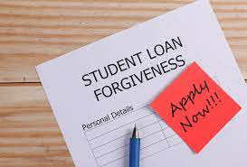
Continuing Investments in Your Educators
Providing loan forgiveness, grants, or service scholarship programs that significantly underwrite the cost of postsecondary education in exchange for a commitment to teach in a high-need field or school for a minimum number of years.
Robust mentoring programs for student teachers or teachers in residence.
Grow your own programs with local partnership (IHEs, EPPs, DAs).
Clearly defined pathways to licensure.
19 different pathways
Notes:
[Transition to Jenn on the last bullet point]

Slide 19
State Resources & Higher Ed Connections
Educator Recruitment & Retention Program - Grant funds available to assist with tuition expenses for alternative licensure candidates in rural areas
Up to $10K per candidate
Pathways to licensure
Para to teacher
Alternative teacher
TOR
Adjunct
Notes:
[Jenn]

Slide 20
Educator Recruitment and Retention Team
Educator Workforce Development Unit
Regional and 1:1 support for recruitment and retention efforts
Pathway creation and communication of current pathways
Connecting people and resources (individuals through Superintendents)
Research and Impact–program evaluation
Using real time data around EPP programs, matriculation, retention, job satisfaction, etc.
Supporting all EPPs with authorization/reauthorization of programming in partnership with the Department of Higher Education
Notes:
[Jenn]

Slide 21
ERR Team Current Initiatives
Current Initiatives
SB21-185 Supporting Educator Workforce
Increase support for educator pathways and recruitment (19 pathways)
TEE/TOR/Alternative teacher/alternative principal/CTE to name a few…Do we want to list all the pathways under here?
Para-professional and SSP initial BA licensure
Support workforce development
Retention strategy–Educator/Leadership Development
Support for rural educator program stipends
Close collaboration with TEACH Colorado
Notes:
[Jenn]

Slide 22
Next Steps
Schedule a conversation with your ERR regional specialist to discuss how to strengthen your educator pipeline.
Educator_recruitment@cde.state.co.us
Use local data to determine any HR needs.
Consider school-level and district-level EDT data for any identified gaps in human capital.
Notes:
[Niko]

Slide 23
Contacts
For questions about using Title II funds to strengthen/build your pipeline: Niko Kaloudis kaloudis_n@cde.state.co.us Karen Bixler bixler_k@cde.state.co.us
For questions about using ESSER funds to strengthen/build your pipeline: ESSER Programs Team
For questions about connecting with EPPs: Educator Recruitment & Retention Team educator_recruitment@cde.state.co.us
Notes:
[Niko] If you have any questions on how to incorporate programs or activities from this list into your ESSER applications, reach out to your ESSER team lead or me.

Slide 24
ESSER Reporting Surveys
Notes:
Mackenzie

Slide 25
ESSER Surveys
The U.S. Department of Education (USDE) has been authorized by Congress to collect data from all ESSER I, II, and III grantees, including but not limited to the uses and impact of funds.
CDE is able to use the ESSER I, II, and III applications to provide the vast majority of the requested data (809 data elements total) on behalf of our LEAs, with the exception of the two following data points:
How students with poor attendance or participation have been re-engaged; and
How school level allocations were determined.
All other data elements required for the 2020-2021 school year can be reported based on the online applications.
CDE created two short surveys for these data elements that have been reviewed by COP and EDAC.
CDE will be sending out one of the two surveys to LEAs at the beginning of May, depending on whether or not your LEA allocated funds to schools in your ESSER budgets.
Please be on the lookout for the survey and complete by May 27th.
Notes:
Mackenzie

Slide 26
Allocating Funds Question
According to the LEA's application submitted to CDE, the LEA has budgeted funds at the school level (to all public schools, including charter schools) during the 2020-2021 fiscal year. How did your LEA allocate ESSER (I, II, or III) funds?
Check as many boxes below that apply to indicate whether the below criteria were used to allocate ESSER funds to schools. For example, if your LEA allocated funds using a weighted formula of total number of enrollments and total number of enrolled students with disabilities, please check both options a and b below. If other data was used, please describe in the "other" box below (1500 character limit).
Flat amount per school or per pupil
Number or proportion of students at the school with specific curricular needs, such as students with disabilities or English language learners
Number or proportion of students at the school who are eligible for Free or Reduced-Price Lunch and/or other indicators of low-income background
Measure(s) of lost instructional time (“learning loss”)
Stakeholder or community input
Title I status
Other: please describe
Will only be sent to LEAs whose applications included school level budget line items.
Notes:
Mackenzie

Slide 27
Re-engaging Students Questions
Every LEA will receive these questions:
Did your LEA seek to re-engage students with poor attendance or participation?
Yes
No
How did the LEA seek to re-engage students with poor attendance or participation? Check as many boxes as apply. For example, if both direct outreach to students occurred and the school district homeless liaison was engaged, please check both a and b. Please answer regardless of whether ESSER funds were used for this purpose. If you answered "other", please describe (1500 character limit).
Direct outreach to students
Engaging the school district homeless liaison
Partnering with community-based organizations
Offering home internet service and/or devices
Implementing new curricular strategies to improve student engagement
Offering credit recovery and/or acceleration strategies
Other: please describe
Will be sent to ALL LEAs.
Notes:
Mackenzie

Slide 28
Upcoming Meetings
Notes:
Nazie

Slide 29
Any Requests for Upcoming Topics or Questions!
Upcoming Office Hours
May 12
EL Redesignation Protocols
May 26
ESSER III Evidence-Based Interventions
GEPA Requirements for ESSER Grants
Notes:
Nazie

Slide 30
CDE Contacts!
Emails: Lastname_Firstinital@cde.state.co.us
(e.g., Smith_a@cde.state.co.us)
Federal Programs & Supports (ESEA/ESSER Program Supports) | School Finance & Operations (Fiscal and Systems Supports)
Nazie Mohajeri-Nelson, Federal Programs & Supports Unit ESEA Programs Specialists and ESEA Regional Contacts (assigned by district) Title I: Laura Meushaw, Kathryn Wisner, Niko Kaloudis, Evita Byrd Title II: Niko Kaloudis, Karen Bixler Title III: Kathryn Wisner, Rachel Temple Title IV: Tammy Giessinger Title V: TBD ESEA and ESSER: Shannon Wilson ESSER Programs Specialists Kristin Crumley Jonathan Schelke Kim Boylan ESEA and ESSER Data and Reporting Specialists Tina Negley Alan Shimmin Mary Shen Mackenzie Owens | Kate Bartlett, Executive Director of School District Operations Unit Fiscal Specialists Jennifer Austin, Director of Grants Fiscal Management ESEA Robert Hawkins, Grants Fiscal Analyst Steven Kaleda, Grants Fiscal Analyst ESSER Fiscal Specialist Steven Kaleda Grants Fiscal Analyst ESSER Monitoring Bill Parsley, ESSER Fiscal Monitoring Supervisor Hilery Morris, ESSER Fiscal Monitoring Application Systems Specialists DeLilah Collins, Director of Grants Program Administration Online Applications Systems Technical Support Michelle Prael
Notes:
Nazie

