Slide 1
CDE Office Hours
April 14, 2022

Slide 2
ESSER Office Hours
Topics
Updates and Reminders
  CDE Re-organization
  Requesting Reimbursement of Federal Funds
  ESSER Supplemental Applications (LEA funds from the State Reserve)
  Using placeholders in ESSER applications
  ESSER Curricula Grant Changes
  ESEA Consolidated Application Reminders
  Upcoming Consolidated Applications Workshops
Title I Educator Requirements
ESSER III Data Collection
Fiscal Monitoring Q&A
Notes:
Nazie

Slide 3
Updates, Reminders, and Clarifications
Notes:
Nazie

Slide 4
Federal Programs and Support Unit
In order to better support and meet the needs of the LEAs that we serve, CDE is undergoing re-organization, including changes to the Unit of Federal Programs Administration, which housed the Office of ESEA Programs.
The ESEA Office will be the Federal Programs and Supports Unit
Responsible for the administration of ESEA and ESSER programs
  Application review and approval
  Technical assistance, guidance, and support to LEAs (ESEA Regional Contacts) on use of federal funds
  Monitoring
  Evaluation
  Reporting
Notes:
Nazie

Slide 5
Grants Program Administration Office
CDE launched the new Grants Program Administration office, directed by DeLilah Collins, staffed by existing staff from the Unit of Federal Programs Administration.
Located in the School Finance & Operations Division
Allows greater coordination with the Grants Fiscal Management Unit
Oversees the implementation of a new grants management system
Continue to support competitive grant applications
Notes:
DeLilah

Slide 6
New Structures of Support
What should you expect from CDE?
Joint Responsibility and Collaboration
Clear, frequent, and coordinated communication
Continuity of services
Application development
Support on system functionality or systems issues
Grants Program Administration Office (GPA)
Review process and timelines
Federal Programs & Support Unit (fka ESEA Programs Office)
Grants Fiscal Management Unit (GFMU)
Support on fiscal requirements and regulations; GALs, RFFs, AFRs
Support on program requirements, content within ESEA & ESSER applications, application & PAR approvals
ESEA & ESSER Monitoring
Technical assistance on fiscal matters (allowable uses of funds, fiscal reporting, chart of accounts, object codes)
Technical assistance and guidance pertaining to effective and allowable uses of funds & program requirements
Notes:
Nazie

Slide 7
CDE Contacts!
Emails: Lastname_Firstinital@cde.state.co.us
(e.g., Smith_a@cde.state.co.us)
Federal Programs & Supports (ESEA/ESSER Program Supports) | School Finance & Operations (Fiscal and Systems Supports)
Nazie Mohajeri-Nelson, Federal Programs & Supports Unit ESEA Programs Specialists and ESEA Regional Contacts (assigned by district) Title I: Laura Meushaw, Kathryn Wisner, Niko Kaloudis, Evita Byrd Title II: Niko Kaloudis, Karen Bixler Title III: Kathryn Wisner, Rachel Temple Title IV: Tammy Giessinger Title V: TBD ESEA and ESSER: Shannon Wilson ESSER Programs Specialists Kristin Crumley Jonathan Schelke Kim Boylan ESEA and ESSER Data and Reporting Specialists Tina Negley Alan Shimmin Mary Shen Mackenzie Owens | Kate Bartlett, Executive Director of School District Operations Unit Fiscal Specialists Jennifer Austin, Director of Grants Fiscal Management ESEA Robert Hawkins, Grants Fiscal Analyst Steven Kaleda, Grants Fiscal Analyst ESSER Fiscal Specialist Steven Kaleda Grants Fiscal Analyst ESSER Monitoring Bill Parsley, ESSER Fiscal Monitoring Supervisor Hilery Morris, ESSER Fiscal Monitoring Application Systems Specialists DeLilah Collins, Director of Grants Program Administration Online Applications Systems Technical Support Michelle Prael
Notes:
Nazie

Slide 8
Reminder: Requesting Reimbursement of Federal Funds
CDE must award and distribute federal funds within specific timelines; otherwise, federal funds expire and must be reverted back to the U.S. Department of Education.
Best cash management practice is to request reimbursement once per month, or at the very least quarterly.
Whether formula or competitive funds, please pay attention to the award period included on the Grant Award Letter (GAL) and draw down funds as quickly as possible to avoid the risk of the funds expiring!
  For example, if the award Periods end on September 30th, the last day to request reimbursement is November 1!
  Grants Fiscal Management Unit recommends making RFFs by June 1 in order to receive funds before the end of the fiscal year
Keep carryover limits in mind (e.g., Title I is capped at 15% or a waiver is needed)
Reminder!
To draw down funds, an LEA must have final approval of the budgeted activity and expenses must have been incurred!
In other words, cannot request reimbursement for placeholders items in ESSER and/or funds that have not been spent yet!
Notes:
Steven

Slide 9
Clarification on Obligating ESSER Funds!
ESSER funds are available for obligation by LEAs and other subrecipients through the Tydings period.
See USDE FAQ E-1 through E-3.
Funds must be spent and requested by the of end the tydings period!
 | ESSER I (CARES Act) | ESSER II (CRSSA Act) | ARP ESSER III (ARP Act) | ARP ESSER III – State Reserve Funds (ARP Act)
Award Period | 03/13/20 – 09/30/21 | 03/13/20 – 09/30/22 | 03/13/20 – 09/30/23 | 03/13/20 – 09/30/23
Tydings Period - will end and funds must be spent by | 9/30/22 | 9/30/23 | 9/30/24 | 09/30/24
Final day to submit a Request for Funds | 11/1/22 | 11/1/23 | 11/1/24 | 11/1/24
ESSER I, II, and III Timelines
Notes:
Nazie

Slide 10
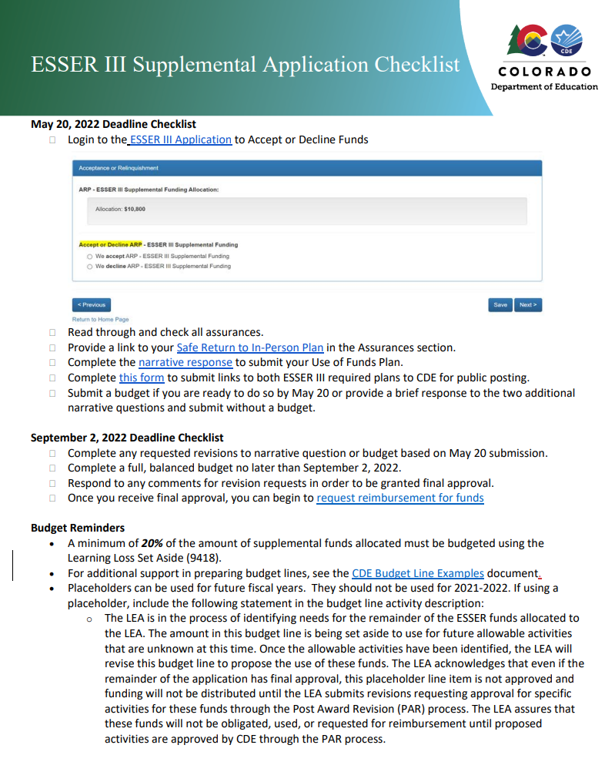
ESSER III LEA Plans for Supplemental Funds
Due May 20 for Supplemental Funds (with separate applications)
Safe In Person Plan
Use of Funds Plan
For LEAs who received additional supplemental funds:
Use of Funds plan must include how you are using your supplemental funds
Please submit hyperlinks to your Use of Funds Plan using this form by May 20
New Resource: ESSER III Supplemental Application Checklist
Notes:
Shannon
Focusing on supplemental funds with a separate application.
For districts who received additional supplemental funds, they should already have these submitted with the original

Slide 11
Resources to support meeting this May 20 Deadline
Safe Return to In-Person Instruction Plan (Safe Return to School) Checklist
For guidance on how to answer Narrative Question 1, see CDE's Narrative Question Guidance or see the office hours presentation and slides (PPT) from August 26, 2021.
For guidance on how and what to post on the LEA website to meet statutory requirements, see the Use of Funds Plan Guidance (PDF).
List of LEA Plans
Full list of deadline and additional resources
Notes:
Shannon

Slide 12
ESSER II and III FY 21-22 Placeholders
There are still FY 21-22 placeholders remaining in ESSER II and III. All items for 21-22 should be budgeted.
An email will be sent out regarding 21-22 placeholders. If you receive this email, you have placeholder activities remaining in your budget.
If you have a 21-22 placeholder remaining in your budget:
  Please revise your application in PAR to detail what the placeholder funds will be used for, or
  If you still no not know how you will spend the money, change the fiscal year on the placeholder.
Notes:
Shannon

Slide 13
Updates to the ESSER K-8 Mathematics Curricula and K-3 READ Act Instructional Programming Grant
Applicants for the ESSER K-8 Mathematics Curricula and K-3 READ Act Instructional Programming Grant should be aware of these updates:
  Applying for reimbursement of past purchases: The grant program has been updated to include allowed expenses back to March 13, 2020. Applicants applying for funds to pay for past purchases should consider the following: (1) As this program is part of Colorado’s pandemic recovery efforts, covered purchases should address impacts related to the pandemic; (2) If you're requesting reimbursement for expenses made in prior fiscal years, it is your LEA's responsibility to ensure proper accounting and reporting; (3) If you're in the process of purchasing you can still apply, but be prepared to cover your costs should you not be awarded the grant; and (4) Double-dipping (accounting for an expense more than once on multiple funding sources) is not allowed.
  Multiple applications: CDE strongly encourages LEAs to submit a single application. However, if you are purchasing both math and reading materials and the 500-word limits in the application are too restrictive, you may choose to submit separate applications for each content area. The per-applicant maximum funding of $500,000 still applies regardless of the number of applications submitted.
  Newly added materials: Additional mathematics and reading materials have been added to the list of eligible curricula for this grant program. As EdReports.org continues to review new mathematics materials, CDE's list will be updated and grant application reviewers will be provided the most up-to-date list for the scoring of applications.
  Updated Budget Template: The originally posted budget template did not allow applicants to include indirect cost recovery (ICR). A new budget template has been posted that includes that option.
  The application deadline for this grant program is Friday, April 29, 2022, by 11:59 PM MDT. If you have questions about this grant program or any of the updates above, please contact Raymond Johnson (johnson_r@cde.state.co.us).
Notes:
DeLilah

Slide 14
Consolidated Application Reminders!
The last day to submit Post Award Revision (PAR) requests for the 21-22 (current) Consolidated Application is June 15, 2022.
As usual, the last day to submit 22-23 Consolidated Application without a request for an extension, is June 30, 2022. At this time during the application preparation process, remember to:
Plan how funded-activities will be evaluated to determine if the same activities address the identified needs, have achieved desired impact, and should be continued into subsequent years.
Plan for time and effort reporting for any federally-funded employees in the application - most likely your existing time and effort reporting meets all requirements - remember to ensure any newly funded employees understand the T&E requirements.
Have LEA budget discussions that include staff assignments to ensure compliance with Title I, Part A comparability and EDT requirements for the following school year (beneficial to include HR Departments and person(s) responsible for the Staff Interchange/HR Data Collection in the conversations).
For additional information and to track tasks, please visit the
ESEA Launch Pad where you can review the Year-at-a-Glance
Notes:
Nazie

Slide 15
Consolidated Application Reminders (Cont.)!
As usual, the last day to submit Consolidated Application without a request for an extension, is June 30, 2022. At this time during the application preparation process, remember to:
Coordinate with any early childhood centers to plan transition of preschool students to Title I schools.
  If you have Head Start agencies in your LEA, you must coordinate with the agency to support students in transitioning. If feasible, include all other entities carrying out early childhood development programs.
  If using ESEA funds to provide services to low-income children below the age of compulsory education (in Colorado, 6 by August 1):
    Must ensure that ECE adheres to Head Start framework, early develop guidelines, and/or the CAS preschool standards
    Have a plan to support, coordinate, and integrate services with early childhood education programs at the local educational agency or individual school level, including plans for the transition of participants in such programs to local elementary school programs
Declare participation in Community Eligibility Provision to School Nutrition, if applicable. CEP is an optional poverty measure used for serving Title I schools.
Evaluate English learner redesignation status including ELs with disabilities.
Plan and collaborate with local neglected or delinquent facilities to plan activities for Consolidated Application, if applicable.
Notes:
Evita
SEC. 1119. [20 U.S.C. 6322] COORDINATION REQUIREMENTS.
IN GENERAL.—Each local educational agency receiving assistance under this part shall carry out the activities described in subsection (b) with Head Start agencies and, if feasible, other entities carrying out early childhood development programs. Each local educational agency shall develop agreements with such Head Start agencies and other entities to carry out such activities.
ACTIVITIES.—The activities referred to in subsection (a) are activities that increase coordination between the local educational agency and a Head Start agency and, if feasible, other entities carrying out early childhood education programs serving children who will attend the schools of the local educational agency, including—
developing and implementing a systematic procedure for receiving records regarding such children, transferred with parental consent from a Head Start program or, where applicable, another early childhood education program;
establishing channels of communication between school staff and their counterparts (including teachers, social workers, and health staff) in such Head Start agencies or other entities carrying out early childhood education programs, as appropriate, to facilitate coordination of programs;
conducting meetings involving parents, kindergarten or elementary school teachers, and Head Start teachers or, if appropriate, teachers from other early childhood education programs, to discuss the developmental and other needs of individual children;
organizing and participating in joint transition-related training of school staff, Head Start program staff, and, where appropriate, other early childhood education program staff; and
linking the educational services provided by such local educational agency with the services provided by local Head Start agencies.
COORDINATION OF REGULATIONS.—The Secretary shall work with the Secretary of Health and Human Services to coordinate regulations promulgated under this part with regulations promulgated under the Head Start Act.

Slide 16
Consolidated Application Training Resources
22-23 Consolidated Application Training: Recording and Slides posted on the Regional Networking Meeting webpage
Trainings for each Title program in the Consolidated Application are included in our new (refurbished) Consolidated Application Virtual Training Library
Notes:
Shannon

Slide 17
Upcoming In-Person Consolidated Application Work Sessions
CDE staff will be available to walk you through filling out the application and answer any questions you have.
Metro Region: Friday, May 13 from 9:30-12:30 at Bemis Public Library in Littleton– Register Here
North Central and Northeast: Thursday, May 19 from 12:30-3:30 at Greeley School District Family Center– Register Here
Pikes Peak and Southeast: Tuesday, May 10 from 12:30-3:30 at Pikes Peak BOCES– Register Here
Southwest: Thursday, May 19 from 8:30-11:30 at Durango School District Administration Building– Register Here
Northwest and West Central: Wednesday, May 25 from 8:30-11:30 at Basil T. Knight Center in Grand Junction– Register Here
Notes:
Shannon

Slide 18
Title I Educator Qualification Requirements
Niko Kaloudis
ESEA Senior Consultant, Titles I & II Specialist
Notes:
The hope is that as schools begin hiring for the following school year, you can use this guidance to inform hiring practices and staffing decisions.

Slide 19
Federal Statute
Every Student Succeeds Act (ESSA) Sec. 1112 (b)(6) - Each local educational agency plan shall provide assurances that the LEA will…ensure that all teachers and paraprofessionals working in a program supported with funds under [Title I, Part A] meet applicable State certification and licensure requirements, including any requirements for certification obtained through alternative routes to certification.
Notes:
Let’s start by getting grounded in the statute.

Slide 20
Colorado’s Requirements for Paraprofessionals
The Every Student Succeeds Act (ESSA) of 2015 defers teacher and paraprofessional qualification requirements in Title I programs to applicable State law.
A shift from NCLB resulting in changes to paraprofessional requirements.
No qualification or credentialing requirements for paraprofessionals or teaching assistants have been written into Colorado law. C.R.S. 23-1-121.7 (1, e-g)
  No paraprofessional or teaching assistant license offered.
Local Education Agencies (LEAs) and charter schools have discretion in setting local hiring policies for these positions.
Paraprofessionals are still required to pass CBI background checks and fingerprinting (as for all school personnel).
Notes:
Starting with paraprofessionals:

Slide 21
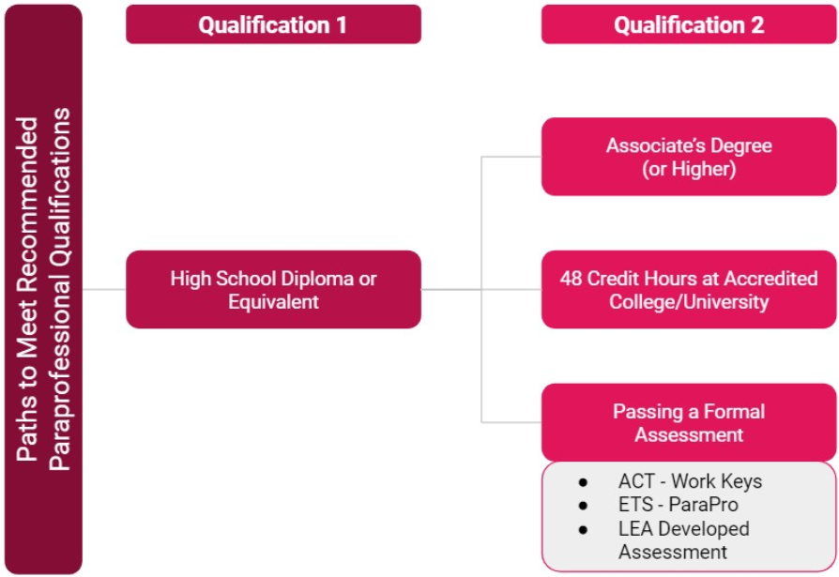
Recommended Best Practices for Instructional Paraprofessionals
CDE recommends that LEAs and charter schools adopt local hiring policies that set requirements for paraprofessionals similar to the NCLB standard.
LEAs may set more specific and rigorous standards to meet local needs.
CDE ESSA Paraprofessional Guidance page
Notes:
While there currently aren’t any required qualifications in statute for paraprofessionals, CDE does have recommended best practices for LEAs to follow in Title I schools.
[walk through the recommendations then bullets]

Slide 22
Teacher Qualification Requirement #1: Right-to-Know
LEAs are required to inform parents at Title I schools annually that federal law gives them the right to request specific information about the professional qualifications of their children's classroom teachers.
  Template letter
If information is requested, the LEA must give parents this information "in a timely manner."
Parents are entitled to receive the following types of information:
  Whether the teacher has met the state's certification criteria for the grade levels and subject matter they teach;
  Whether the state has waived its qualification and licensing criteria to permit the teacher to teach on an emergency or other provisional basis;
  Whether the teacher is teaching coursework in the field or discipline of his/her certification;
  Whether teachers' aides or similar paraprofessionals provide services to the parents' children, and if they do, their qualifications.
Notes:
Build into annual processes at your district or school level
There is wiggle room here but using professional judgement and what a prudent person would consider “timely” is key
Any questions about the requirements for paras?

Slide 23
Teacher Qualification Requirement #2: Unlicensed or Out-of-Field
ESSA requires LEAs to notify families at a Title I school if their student has been assigned to or has been taught for at least four weeks by a teacher who does not meet applicable State certification or licensure requirements at the grade level and subject area in which the teacher has been assigned.
Applies to all schools receiving Title I funds, both Schoolwide and Targeted Assistance for job codes 201-206.
LEAs are permitted to hire staff that do not meet “in-field status”, but must notify parents of students after 4 consecutive weeks of instruction.
LEAs should include all steps they are taking to address the qualifications of staff in the letter.
  Template letter
Notes:
Now moving on to teachers:
Should be on district/school annual cycle in around September but also when staffing changes. Build into HR processes.
This is they key part of the statutory requirement.
Feel free to add as much context as you’d like to each letter.

Slide 24
CDE Reporting Codes
Applicable Job Codes
201: Teacher, Regular - Staff holds a valid teaching license.
202: Teacher, Special Education - Staff holds a valid special education teaching license.
204: Teacher, Permanent Substitute - Staff holding a valid sub authorization not a valid teaching license.
206: Teacher, Title I - Staff holding a valid teaching license providing services to specifically Title I at-risk students.
If a staff member’s license expires and they aren’t renewing, code them 204 and make sure they have a sub authorization.
Job Code and Demonstrates In-Field Status coding also impacts EDT and Comparability.
Remember, one staff member may have multiple assignments. The Title I Parent Notification Requirement applies to each of their assignments.
Notes:
So who does the notification req apply to?
[review job codes then scenario]
[give examples of the multiple assignments scenario]
[gray box]
[orange box]
The HR coding can be nuanced so please feel free to reach out to myself or Dawna Gudka who handles HR reporting.

Slide 25
How to Determine if a Parent Notification Letter is Required
&
Must hold one of the following:
CO Teacher License
CO Teacher Authorization
(CDE Licensing Website)
Must meet one or more ways to “demonstrate in-field status”:
01 - License in grade level and subject area
02 - Bachelors or higher in subject area
03 - 36+ college credit hours in subject area
04 - Passed PRAXIS in subject area
Parent notification letter would need to be sent after 4 or more consecutive weeks of instruction if either of these two rules are not met.
Notes:
[Red box first] Both checks in the blue boxes must be met. If either of the two aren’t met, you need to send a letter home after 4 weeks.
[left blue box] …These include initial, professional, alternative licences, sub authorization, CTE authorizations, and emergency authorizations.
[discuss the links in the in-field box and why they are there]
Any questions for the two teacher related requirements?

Slide 26
Next Steps
Use this guidance to inform hiring practices and processes.
  Include applicable licensure and in-field status in applications.
  Prepare for staff reporting to CDE by aligning coding and ensuring accuracy.
Prepare Parent Right-to-Know Letters for all Title I schools.
Have hiring managers apply the guidance when making staffing decisions.
  Get template letters ready for unlicensed/out-of-field parent notification.
Work to ensure current staff are progressing towards licensure and “in-field”.
  Proactively remind staff of their expiring licensure by regularly uploading Staff Interchange files into Data Pipeline and pulling Cognos reports.
    Once they expire, they require new fingerprinting.
Notes:
Collect all the information from applicants and help it to drive placement decisions in TItle I schools
Use CDE codes/terminology internally whenever possible
Use CDE template
Use CDE template
The should also get notifications in the COOL licensing system

Slide 27
Resources & Contacts
Paraprofessional Guidance Webpage
Educator Qualifications Under ESSA Webpage
For questions about paraprofessional and teacher qualifications under ESSA:
Niko Kaloudis
kaloudis_n@cde.state.co.us
(720) 284-4356
If reviewing this slide deck after the live presentation, feel free to contact the above staff, visit our unit Contacts Page, or send questions to ESSAquestions@cde.state.co.us

Slide 28
ESSER III Data Collection
Notes:
Nazie

Slide 29
ESSER Surveys
The U.S. Department of Education (USDE) has been authorized by Congress to collect data from all ESSER I, II, and III grantees, including but not limited to the uses and impact of funds.
CDE is able to use the ESSER I, II, and III applications to provide the vast majority of the requested data (809 data elements total) on behalf of our LEAs, with the exception of the two following data points:
  How students with poor attendance or participation have been re-engaged; and
  How school level allocations were determined.
All other data elements required for the 2020-2021 school year can be reported based on the online applications.
CDE created two short surveys for these data elements that were reviewed by COP and will be sent out shortly to be reviewed by EDAC.
CDE will be sending out one of the two surveys to LEAs at the beginning of May, depending on whether or not your LEA allocated funds to schools in your ESSER budgets.
Please be on the lookout for the survey and complete by May 27th.
Notes:
Mackenzie

Slide 30
Allocating Funds Question
According to the LEA's application submitted to CDE, the LEA has budgeted funds at the school level (to all public schools, including charter schools) during the 2020-2021 fiscal year. How did your LEA allocate ESSER (I, II, or III) funds?
Check as many boxes below that apply to indicate whether the below criteria were used to allocate ESSER funds to schools. For example, if your LEA allocated funds using a weighted formula of total number of enrollments and total number of enrolled students with disabilities, please check both options a and b below. If other data was used, please describe in the "other" box below (1500 character limit).
  Flat amount per school or per pupil
  Number or proportion of students at the school with specific curricular needs, such as students with disabilities or English language learners
  Number or proportion of students at the school who are eligible for Free or Reduced-Price Lunch and/or other indicators of low-income background
  Measure(s) of lost instructional time (“learning loss”)
  Stakeholder or community input
  Title I status
  Other: please describe
Will only be sent to LEAs whose applications included school level budget line items.
Notes:
Mackenzie

Slide 31
Re-engaging Students Questions
Every LEA will receive these questions:
Did your LEA seek to re-engage students with poor attendance or participation?
  Yes
  No
How did the LEA seek to re-engage students with poor attendance or participation? Check as many boxes as apply. For example, if both direct outreach to students occurred and the school district homeless liaison was engaged, please check both a and b. Please answer regardless of whether ESSER funds were used for this purpose. If you answered "other", please describe (1500 character limit).
  Direct outreach to students
  Engaging the school district homeless liaison
  Partnering with community-based organizations
  Offering home internet service and/or devices
  Implementing new curricular strategies to improve student engagement
  Offering credit recovery and/or acceleration strategies
  Other: please describe
Will be sent to ALL LEAs.
Notes:
Mackenzie

Slide 32
Fiscal Monitoring Document Submission Q&A
Bill Parsley and Hilery Morris
Notes:
Bill and Hilery

Slide 33
Upcoming Meetings
Notes:
Nazie

Slide 34

Any Requests for Upcoming Topics or Questions!
Upcoming Office Hours
April 28: No Office Hours (CoP Meeting)
May 5 ~ Please submit requests for topics
Notes:
Nazie

Slide 35
CDE Contacts!
Emails: Lastname_Firstinital@cde.state.co.us
(e.g., Smith_a@cde.state.co.us)
Federal Programs & Supports (ESEA/ESSER Program Supports) | School Finance & Operations (Fiscal and Systems Supports)
Nazie Mohajeri-Nelson, Federal Programs & Supports Unit ESEA Programs Specialists and ESEA Regional Contacts (assigned by district) Title I: Laura Meushaw, Kathryn Wisner, Niko Kaloudis, Evita Byrd Title II: Niko Kaloudis, Karen Bixler Title III: Kathryn Wisner, Rachel Temple Title IV: Tammy Giessinger Title V: TBD ESEA and ESSER: Shannon Wilson ESSER Programs Specialists Kristin Crumley Jonathan Schelke Kim Boylan ESEA and ESSER Data and Reporting Specialists Tina Negley Alan Shimmin Mary Shen Mackenzie Owens | Kate Bartlett, Executive Director of School District Operations Unit Fiscal Specialists Jennifer Austin, Director of Grants Fiscal Management ESEA Robert Hawkins, Grants Fiscal Analyst Steven Kaleda, Grants Fiscal Analyst ESSER Fiscal Specialist Steven Kaleda Grants Fiscal Analyst ESSER Monitoring Bill Parsley, ESSER Fiscal Monitoring Supervisor Hilery Morris, ESSER Fiscal Monitoring Application Systems Specialists DeLilah Collins, Director of Grants Program Administration Online Applications Systems Technical Support Michelle Prael
Notes:
Nazie

