Slide 1
CDE Office Hours
March 31, 2022

Slide 2
CDE Team!
CDE Contacts!
Emails: LastName_FirstInital@cde.state.co.us
ESSER/ESEA Program Partners
Nazie Mohajeri-Nelson, Director of ESEA Office (mohajeri-nelson_n@cde.state.co.us)
ESEA Regional Contacts assigned by district
  Title I: Laura Meushaw, Kathryn Wisner, Niko Kaloudis, Evita Byrd
  Title II: Niko Kaloudis, Karen Bixler
  Title III: Kathryn Wisner, Rachel Temple
  Title IV: Tammy Giessinger
  Title V: TBD
ESSER Team
  Kristin Crumley, ESSER Monitoring Specialist (Crumley_k@cde.state.co.us)
  Jonathan Schelke, ESSER Monitoring Specialist (schelke_j@cde.state.co.us)
  Shannon Wilson, ESSER/ESEA Grants Administration Coordinator (Wilson_s@cde.state.co.us)
  Mackenzie Owens, ESSER Reporting Specialist (owens_m@cde.state.co.us)
  Kim Boylan, ESSER Monitoring Specialist (Boylan_k@cde.state.co.us)
Data, Accountability, Reporting, and Evaluation
  Tina Negley, Alan Shimmin, Mary Shen, and Mackenzie Owens
  Application System Partner
DeLilah Collins, Director of Grants Program Administration (collins_d@cde.state.co.us)
Fiscal Partners
Jennifer Okes, Chief Operating Officer (okes_j@cde.state.co.us)
Kate Bartlett, Executive Director of School District Operations (Bartlett_k@cde.state.co.us)
Jennifer Austin, Director of Grants Fiscal Management (Austin_j@cde.state.co.us)
Robert Hawkins, Grants Fiscal Analyst (Hawkins_s@cde.state.co.us)
Steven Kaleda, Grants Fiscal Analyst (Kaleda_s@cde.state.co.us)
ESSER Team
  Bill Parsley, ESSER Fiscal Monitoring Supervisor (parsley_b@cde.state.co.us)
  Hilery Morris, ESSER Fiscal Monitoring (morris_h@cde.state.co.us)
  Laurie Feedle, ESSER Fiscal Monitoring (feedle_l@cde.state.co.us)

Slide 3
ESSER Office Hours
Topics
Updates and Reminders
  ESSER Review Teams moving forward
  Supplemental Funds Application Clarifications
ESSER Data Collections
Department of Labor Training on Davis-Bacon Act
Cons App Updates
Notes:
Nazie

Slide 4

First and Foremost!
The ARP ESSER III direct allocation funds have been fully awarded to all LEAs by the deadline!
Thank you to all of the LEA personnel who helped meet this deadline!
Shout out to our ESSER Review Teams for their expedited reviews and feedback!

Slide 5
Updates, Reminders, and Clarifications

Slide 6
Transition of Work to ESSER Teams
All Hands-on-Deck approach for ESSER application reviews!
As of April 1, transitioning to only ESSER Team members reviewing PAR requests.
  Districts have been assigned to ESSER Team Members to provide TA and support for any PAR requests and monitoring.
  List of assignments on the website Coming Soon!
ESSER Team
  Kristin Crumley, ESSER Monitoring Specialist (Crumley_k@cde.state.co.us)
  Jonathan Schelke, ESSER Monitoring Specialist (schelke_j@cde.state.co.us)
  Shannon Wilson, ESSER/ESEA Grants Administration Coordinator (Wilson_s@cde.state.co.us)
  Mackenzie Owens, ESSER Reporting Specialist (owens_m@cde.state.co.us)
  As of April 1, Kim Boylan, ESSER Monitoring Specialist (Boylan_k@cde.state.co.us)

Slide 7


Clarification on Supplemental ESSER III Applications!
During our haste to get all of the ESSER III direct allocation applications to final, I inadvertently said that Supplement Fund awardees have until September 30, 2022! But that application is due on September 2, 2022.
…for any confusion that I caused!
Please submit FULL Supplemental Apps by September 2, 2022!
Wait! Is she talking to me? Did we get supplemental funds?
Check the CDE website!
ESSER III Supplemental Allocations

Slide 8
ESSER III LEA Plans for Supplemental Funds
Due May 20 for Supplemental Funds (with separate applications)
Safe In Person Plan
Use of Funds Plan
For LEAs who received additional supplemental funds:
Use of Funds plan must include how you are using your supplemental funds
Please submit hyperlinks to your Use of Funds Plan using this form by May 20
Steps to Meet Deadline
Log into Application
Read through and accept the application assurances;
Submit a hyperlink to your Safe In-Person Plan on the assurance that asks for the link
Submit a response to the Narrative Question. The narrative question response serves as CDE’s way of checking your Use of Funds Plan
Post Use of Funds Plan on your organization’s website and submit link to CDE through this form
Either submit a budget if you are ready to do so by May 20th or respond to the two additional narrative questions and complete the budget at a later date.
Notes:
Focusing on supplemental funds with a separate application.
For districts who received additional supplemental funds, they should already have these submitted with the original

Slide 9
Resources to support meeting this May 20 Deadline
Safe Return to In-Person Instruction Plan (Safe Return to School) Checklist
For guidance on how to answer Narrative Question 1, see CDE's Narrative Question Guidance or see the office hours presentation and slides (PPT) from August 26, 2021.
For guidance on how and what to post on the LEA website to meet statutory requirements, see the Use of Funds Plan Guidance (PDF).
List of LEA Plans
Full list of deadline and additional resources

Slide 10
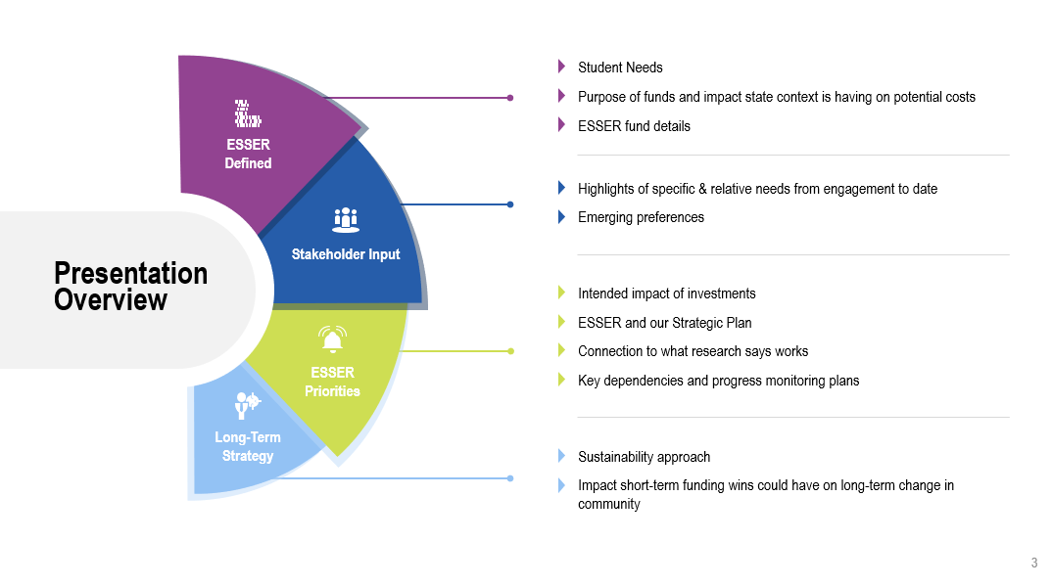
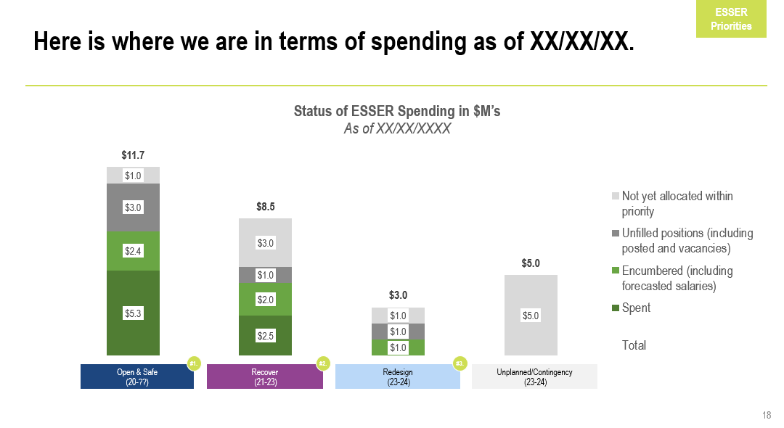
ESSER Resources from ERS
Three new ESSER resources from Educational Resource Strategies
Report: Adapting District and School Budget Development Processes for FY23 to Optimize Your ESSER Investment
  Strategies for adjusting your ESSER budget for upcoming fiscal years
Report: Communicating Your ESSER Plans: 5 Actions to Build Alignment Among District Leaders, School Boards, and Cabinets
  Strategies for communicating ESSER plans with stakeholders, based on study of several large school districts
Resource: ESSER Messaging Slide Deck
  Slides and graphics to use for ESSER presentations
Notes:
Nazie

Slide 11
Supplemental Funds for AU
Indirect Cost Rates
  Administrative Units use the rate of the District/BOCES the AU is assigned with.
  CDE programmers will update the system with the rates and the system will calculate the amount based on the items directly charged to the grant.
  Rates are based on the districts FY 2020-2021 financial data submissions
    If the data submission is not complete, and IDC will not be available
In the meantime…
  If you know the District/BOCES rate, you can calculate the amount that would be available for indirect costs
    Multiply the direct charges (minus any items categorized as capitalized equipment (0730) by the rate for each funding year
    Use the Override Indirect Cost link in on the ESSER Fund Budget page and enter the calculated amount for the appropriate funding year
    Once the system is updated, you may need to go back and make corrections if you used a different rate than what was populated in the system.
More information on indirect costs to come!

Slide 12
ESSER State Reserve Funding
Curricula & Instructional Programming
Applications are due Friday, April 29, 2022, by 11:59 pm MDT
Education Workforce Program
The application window for the Education Workforce Program Grant is currently open.
Learning and Transparency Technical Assistance Program (Note: Application closed)
Mentor Grant Program (Application closed March 28)
Rural Coaction Program
The application window for the Rural Coaction Grant is now open. Applications will be due Friday, April 1, 2022, at 11:59pm for Cohort 1, and Monday, May 2, 2022, at 11:59 pm for Cohort 2.
Rural Program Development
The application window for the ESSER Rural Program Development Grant is now open. Applications are due Friday, September 30, 2022, at 11:59pm.
http://www.cde.state.co.us/caresact/esser-statereserve

Slide 13
ESSER Data Collections

Slide 14
ESSER Surveys
The U.S. Department of Education (USDE) has been authorized by Congress to collect data from all ESSER I, II, and III grantees, including but not limited to the uses and impact of the funds.
CDE is able to use the ESSER I, II, and III applications to provide the vast majority of the requested data (809 data elements total) on behalf of our LEAs, with the exception of the two following data points:
  How students with poor attendance or participation have been re-engaged; and
  How school level allocations were determined.
All other data elements required for the 2020-2021 school year can be reported based on the online applications.
CDE will be sending out one of two short surveys to LEAs at the beginning of May, depending on whether your LEA allocated funds to schools in your ESSER budgets.
Please be on the lookout for the survey and complete by May 27th.

Slide 15
Department of Labor Training on
Davis-Bacon Act!

Slide 16
Never Did We Realize that We All Had to Be Davis-Bacon Act Experts!!!!
The Department of Labor will be conducting an online conference on the Davis-Bacon requirements. The seminars are part of the Department of Labor's ongoing effort to increase awareness and improve compliance with federal prevailing wage requirements. The seminars will include video trainings and multiple Q & A sessions.
Target Audience: Contracting agencies, contractors, unions, workers and other stakeholders
Presenters: DOL Wage and Hour Division
Recorded Webinars available after you register
  While attendance is free, registration is required!
Helpful Websites: Davis-Bacon and Related Acts and McNamara-O’Hara Service Contract Act
Q&A Sessions:
  Davis-Bacon Act compliance Q&A’s are scheduled for June 14 and Sept. 13.
  Service Contract Act compliance Q&A’s are scheduled for June 15 and Sept. 14.

Slide 17
Consolidated Application Planning

Slide 18
Allocations!
U.S. Department of Education has released 2022-2023 ESEA Allocations!!!
Please keep in mind that CDE must calculate the final allocations based on the numbers shared by the U.S. Department of Education.
  There are other organizations that use the USDE spreadsheet to project allocations for LEAs. They are often in correct! Please do not rely on any projects from any other entity to make plans!
  Official preliminary allocations to be released by end of April from CDE. Only use these for planning purposes.

Slide 19
22-23 Consolidated Application Updates
•The Year at a Glance indicates the following should be happening right now:
•Start consulting with non-public schools.
•Convene with stakeholder groups to begin planning for the 2022-2023 Consolidated Application – determine method of serving and eligible schools for Title I.
•The Paper Application for the 2022-2023 Consolidated Application is now available on our website.
•Non-Public Consultation form and the School Improvement Retention of Funds form are both available on the website and are due on May 31st.
•These will need to be uploaded in the application once it is open.
TLCC Survey - Check the live tracker to find out your LEA’s participation rate. TLCC results can be helpful in identifying areas of need to be addressed with Title II funds.

Slide 20
April Cons App RNM
Save the Date: April 12, 2022
Time: 12:00 to 1:30 pm
Registration Here
Training will provide an overview of the application and highlight changes from the previous year's application. At the end of the training, regional contacts will be available in breakout rooms to answer questions regarding the application and/or Title programs. Additional resources will be emailed prior to the training.
We are planning to offer In-Person regional work sessions after the training. Please fill out the survey letting us know if you would attend if these were offered in your area.
If you are willing to host an in-person work training session, please indicate this in your survey

Slide 21
Upcoming Meetings

Slide 22

Any Requests for Upcoming Topics or Questions!
Upcoming Office Hours
April 14th
April 28th
Notes:
Niko can speak to the EDT trainings

Slide 23
CDE Team!
CDE Contacts!
Emails: LastName_FirstInital@cde.state.co.us
ESSER/ESEA Program Partners
Nazie Mohajeri-Nelson, Director of ESEA Office (mohajeri-nelson_n@cde.state.co.us)
ESEA Regional Contacts assigned by district
  Title I: Laura Meushaw, Kathryn Wisner, Niko Kaloudis, Evita Byrd
  Title II: Niko Kaloudis, Karen Bixler
  Title III: Kathryn Wisner, Rachel Temple
  Title IV: Tammy Giessinger
  Title V: TBD
ESSER Team
  Kristin Crumley, ESSER Monitoring Specialist (Crumley_k@cde.state.co.us)
  Jonathan Schelke, ESSER Monitoring Specialist (schelke_j@cde.state.co.us)
  Shannon Wilson, ESSER/ESEA Grants Administration Coordinator (Wilson_s@cde.state.co.us)
  Mackenzie Owens, ESSER Reporting Specialist (owens_m@cde.state.co.us)
  Kim Boylan, ESSER Monitoring Specialist (Boylan_k@cde.state.co.us)
Data, Accountability, Reporting, and Evaluation
  Tina Negley, Alan Shimmin, Mary Shen, and Mackenzie Owens
  Application System Partner
DeLilah Collins, Director of Grants Program Administration (collins_d@cde.state.co.us)
Fiscal Partners
Jennifer Okes, Chief Operating Officer (okes_j@cde.state.co.us)
Kate Bartlett, Executive Director of School District Operations (Bartlett_k@cde.state.co.us)
Jennifer Austin, Director of Grants Fiscal Management (Austin_j@cde.state.co.us)
Robert Hawkins, Grants Fiscal Analyst (Hawkins_s@cde.state.co.us)
Steven Kaleda, Grants Fiscal Analyst (Kaleda_s@cde.state.co.us)
ESSER Team
  Bill Parsley, ESSER Fiscal Monitoring Supervisor (parsley_b@cde.state.co.us)
  Hilery Morris, ESSER Fiscal Monitoring (morris_h@cde.state.co.us)
  Laurie Feedle, ESSER Fiscal Monitoring (feedle_l@cde.state.co.us)

