Slide 1
CDE Office Hours
March 17, 2022

Slide 2
CDE Team!
CDE Contacts!
Emails: LastName_FirstInital@cde.state.co.us
Fiscal Partners
Jennifer Okes, Chief Operating Officer (okes_j@cde.state.co.us)
Kate Bartlett, Executive Director of School District Operations (Bartlett_k@cde.state.co.us)
Jennifer Austin, Director of Grants Fiscal Management (Austin_j@cde.state.co.us)
Robert Hawkins, Grants Fiscal Analyst (Hawkins_s@cde.state.co.us)
Steven Kaleda, Grants Fiscal Analyst (Kaleda_s@cde.state.co.us)
ESSER Team
  Bill Parsley, ESSER Fiscal Monitoring Supervisor (parsley_b@cde.state.co.us)
  Hilery Morris, ESSER Fiscal Monitoring (morris_h@cde.state.co.us)
  Sharon Mackey, ESSER Fiscal Monitoring (mackey_s@cde.state.co.us)
ESSER/ESEA Program Partners
Nazie Mohajeri-Nelson, Director of ESEA Office (mohajeri-nelson_n@cde.state.co.us)
DeLilah Collins, Director of Grants Program Administration (collins_d@cde.state.co.us)
ESEA Regional Contacts assigned by district
  Title I: Laura Meushaw, Kathryn Wisner, Niko Kaloudis, Evita Byrd
  Title II: Niko Kaloudis, Karen Bixler
  Title III: Kathryn Wisner, Rachel Temple
  Title IV: Tammy Giessinger, Michelle Prael
ESSER Team
  Kristin Crumley, ESSER Monitoring Specialist (Crumley_k@cde.state.co.us)
  Jonathan Schelke, ESSER Monitoring Specialist (schelke_j@cde.state.co.us)
  Shannon Wilson, ESSER/ESEA Grants Administration Coordinator (Wilson_s@cde.state.co.us)
  Mackenzie Owens, ESSER Reporting Specialist (owens_m@cde.state.co.us)
Data, Accountability, Reporting, and Evaluation
  Tina Negley, Alan Shimmin, Mary Shen, and Mackenzie Owens

Slide 3
ESSER Office Hours
Topics
Updates and Reminders
New Unique Entity Identifiers (UEIs)
Overview of FERPA and PPRA
2023 Consolidated Application Planning
Fiscal Monitoring Submission Update
Notes:
Nazie

Slide 4
Updates, Reminders, and Clarifications

Slide 5
Clarification: ESSER III March 24 Deadline
ESSER III applications need final approval from CDE by March 24
Please submit revisions as soon as possible!
You can include Placeholders in your budget [only for 2022-2023 or later]
  Should only be a small portion of your budget
  Should not be for the current fiscal year (any 2020-2021 or 2021-2022 Placeholders MUST be revised through PAR or changed to 2022-2023)
  Must submit specific detail through PAR in order to draw down funds
  Include placeholder language in the activity description
Placeholder - “The LEA is in the process of identifying needs for the remainder of the ESSER funds allocated to the LEA. The amount in this budget line is being set aside to use for future allowable activities that are unknown at this time. Once the allowable activities have been identified, the LEA will revise this budget line to propose the use of these funds. The LEA acknowledges that even if the remainder of the application has final approval, this placeholder line item is not approved and funding will not be distributed until the LEA submits revisions requesting approval for specific activities for these funds through the Post Award Revision (PAR) process. The LEA assures that these funds will not be obligated, used, or requested for reimbursement until proposed activities are approved by CDE through the PAR process.”

Slide 6
Reminder!
ARP ESSER III requires two types of plans that have to be posted on your website and linked on our website:
LEA Use of Funds Plan
Safe In-Person Plan
We are linking to your plans on this page: https://www.cde.state.co.us/fedprograms/esser3-leaplans.
If we do not yet have the links to your plan posted, please submit the links to us as soon as possible using the Smartsheet Form. Required for compliance with ARP!
Resources
For guidance on how to answer Narrative Question 1, see CDE's Narrative Question Guidance or see the office hours presentation and slides (PPT) from August 26, 2021.
For guidance on how and what to post on the LEA website to meet statutory requirements, see the Use of Funds Plan Guidance (PDF).
List of LEA Plans
Safe Return to In-Person Instruction Plan (Safe Return to School) Checklist
More Resources

Slide 7
Unique Entity Identifiers (UEIs)

Slide 8
SAM.gov DUNS Number Transition
GSA will be transitioning from the use of DUNS numbers to Unique Entity ID (UEI) on April 4, 2022.
Used to identify entities registered/receiving Federal funds, either as a Prime Recipient or a subawardee.
CDE is required to report ALL federal awards above $30,000 for each entity we award.
DUNS/UEIs are required for all federal fund recipients, regardless of type of business (i.e., district, nonpublic school, non-profit, etc).
Beginning April 4th, only the UEI will be required for federal award applications and award letters. A DUNS number will no longer be required for federal awards, however, your entity may require the use of the number for other financial transactions.
The transition will not impact your renewal date.
Please log in to SAM.gov to ensure that you have been assigned a UEI, as ALL DUNS NUMBERS will be removed after 4/4/2022. Not registering for SAM.gov and ensuring you have been assigned or requested a UEI could result in a delay of federal awards.
Two ways to manage the transition:
If your entity already has a DUNS number (prior to this transition, in order to receive federal funds through CDE, you must already have one) AND you are registered with SAM.gov website, you don’t need to do anything additional. Your transition will happen seamlessly.
  You will want to login to SAM.gov and verify your Unique ID as well as the other information.
  You MUST continue to renew your registration annually. CDE cannot award a grant if your DUNS/UEI is expired.
If you have a DUNS number but you have NOT registered within SAM.gov, you must do so BEFORE APRIL 1!
  Choose Register Your Entity and enter your DUNS number and other required information, then indicate request UEI.
  Video for instructions: https://www.youtube.com/watch?v=4Hqs_L0B5kI

Slide 9

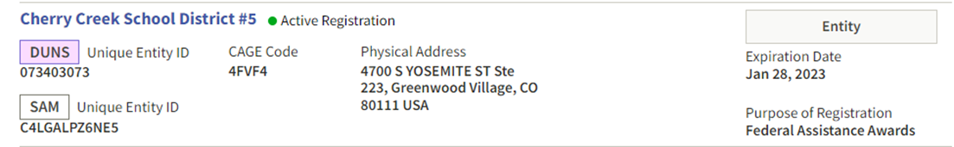
SAM.gov DUNS Number Transition
Login to view your SAM.gov registration by visiting SAM.gov. Below is what you will see when you login to your SAM.gov account for your entity, you will want to record your UEI.
RESTRICTED REGISTRATIONS
Many entities, when initially registering their DUNS with SAM.gov, indicated their registration was RESTRICTED. This does not allow anyone to search the entity’s DUNS number and see any exceptions or expiration dates and may also affect our FFATA reporting.
If possible, please remove the restricted indicator. If your entity remains restricted, CDE will not be able to award any federal funds until the entity sends us a screenshot of their registration showing there are no exceptions and current registration.

Slide 10
SAM.gov DUNS Number Transition
Questions?
How to view your UEI?
How to view my Unique Entity Identifier?
Jennifer Austin, Director GFMU
Austin_j@cde.state.co.us
Patrick Mueller, GFMU Analyst
Mueller_p@cde.state.co.us

Slide 11
FERPA and PPRA Requirements
and
Related Pandemic Guidance
Federal Programs
Office Hours Presentation
Thursday, March 17, 2022

Slide 12

FERPA and PPRA Requirements and
Related Pandemic Guidance
Est. 1974
The Family Educational Rights and Privacy Act (FERPA) is a federal law that affords parents the right to have access to their children’s education records, the right to seek to have the records amended, and the right to have some control over the disclosure of personally identifiable information from the education records.

Slide 13

FERPA and PPRA Requirements and
Related Pandemic Guidance
The purpose of the Family Educational Rights and Privacy Act (FERPA) is to set out requirements for the protection of privacy of parents and students.

Slide 14

FERPA and PPRA Requirements and
Related Pandemic Guidance
FERPA applies to educational agencies or institutions that receive funds from programs administered by the U.S. Department of Education.

Slide 15
FERPA and PPRA Requirements and
Related Pandemic Guidance
State Education Agencies (SEAs) are Obligated by FERPA to:
Allow Parents and Eligible Students to Inspect and Review Their Student’s/Own Education Records
**Typically, these requests (to inspect and review one’s Education Records) will go through the Districts or LEAs (at least in Colorado).

Slide 16
FERPA and PPRA Requirements and
Related Pandemic Guidance
State Education Agencies (SEAs) are Obligated by FERPA to:
Disclose Data Appropriately
Obtain Written Consent
(from Parents or Eligible Students)
OR
Employ an appropriate FERPA Exception

Slide 17
FERPA and PPRA Requirements and
Related Pandemic Guidance
FERPA Exceptions
Generally, FERPA requires written consent from parents or “eligible students” (students who are at least 18 years of age or attending a postsecondary institution) in order to release PII from education records. In the absence of the written consent, FERPA permits an educational agency or institution to disclose PII from an education record of a student if the disclosure meets one or more of the conditions outlined in 20 U.S.C. § 1232g(b) and (h) – (j) and 34 CFR § 99.31.

Slide 18
FERPA and PPRA Requirements and
Related Pandemic Guidance
Studies FERPA Exception
SEAs Typically Use the Studies and Audit or Evaluation Exceptions to legally release PII from education records without written consent.
Audit or Evaluation FERPA Exception

Slide 19
FERPA and PPRA Requirements and
Related Pandemic Guidance
The Studies Exception Conditions
(that must be met)
1. The disclosure of PII from student education records must be for, or on behalf of, an educational agency or institution, in order to
      Develop, validate, or administer predictive tests;
      Administer student aid programs; or
      Improve instruction.

Slide 20
FERPA and PPRA Requirements and
Related Pandemic Guidance
The Studies Exception Conditions
(that must be met)
2. An educational agency or institution may disclose PII from education records, and a “FERPA-permitted entity” may redisclose PII only if
      The disclosing educational entity enters into a written agreement with the organization;
      The study does not permit identification of individual parents and students by anyone other than representatives of the organization with legitimate interests in the information; and
      The information is destroyed when no longer needed for the study purposes

Slide 21
FERPA and PPRA Requirements and
Related Pandemic Guidance
The Audit or Evaluation Exception Conditions
(that must be met)
1. The disclosure of PII from education records must be to Audit or evaluate
  a. Federal- or State-supported education program; or
  b. Enforce or comply with Federal legal requirements related to the program.

Slide 22
FERPA and PPRA Requirements and
Related Pandemic Guidance
The Audit or Evaluation Exception Conditions
(that must be met)
2. The receiving entity must be a State or local educational authority or other FERPA-permitted entity or must be an authorized representative of a State or local educational authority or other FERPA-permitted entity.

Slide 23
FERPA and PPRA Requirements and
Related Pandemic Guidance
The Audit or Evaluation Exception Conditions
(that must be met)
The party disclosing the PII from education records
  a. Must enter into a written agreement to designate anyone other than its employee as its authorized representative (each new audit, evaluation, or enforcement effort requires an agreement); and

Slide 24
FERPA and PPRA Requirements and
Related Pandemic Guidance
The Audit or Evaluation Exception Conditions
(that must be met)
  b. Is responsible for using reasonable methods to ensure to the greatest extent practicable that the authorized representative
  i. Uses the PII only for the authorized purpose;
  ii. Protects the PII from further unauthorized disclosures or other uses; and
  iii. Destroys the PII when no longer needed for the authorized purpose and in accordance with any specified time period set forth in a written agreement.

Slide 25
FERPA and PPRA Requirements and
Related Pandemic Guidance
The Audit or Evaluation Exception Conditions
(that must be met)
State and local educational authorities and other FERPA permitted entities may redisclose the PII on behalf of the educational agency or institution. In particular,
    a. The disclosure must meet the requirements of an exception to consent in § 99.31 and either the educational agency or institution or other FERPA- permitted entity has complied with the recordkeeping requirements.

Slide 26
FERPA and PPRA Requirements and
Related Pandemic Guidance
The Audit or Evaluation Exception Conditions
(that must be met)
5. Authorized representatives of the FERPA-permitted entities may only redisclose the PII when expressly authorized in the parties’ written agreement (assuming that the redisclosure by the authorized representative on behalf of the FERPA-permitted entity would be permissible under FERPA).

Slide 27
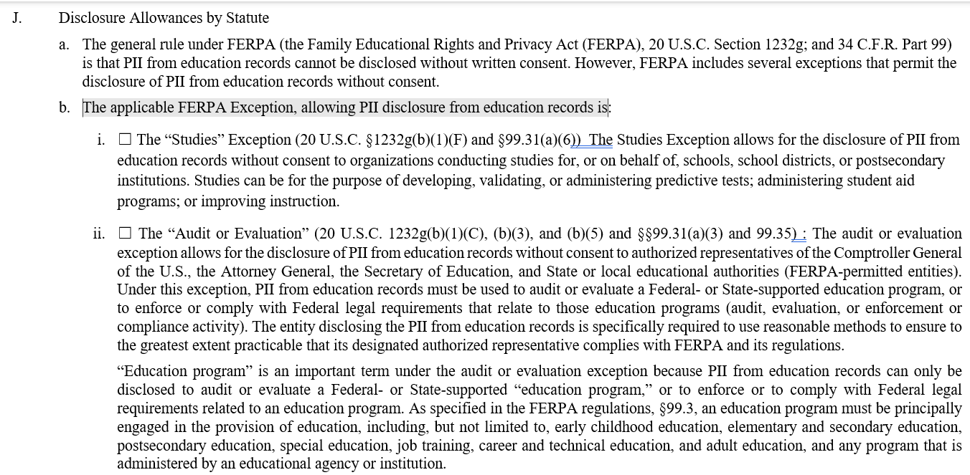
FERPA and PPRA Requirements and
Related Pandemic Guidance
CDE Employs the Studies and Audit or Evaluation FERPA Exceptions with the PII Education Data Exhibit (a form that relays the expectations CDE has for its Data when shared with Contractors/Vendors.

Slide 28
FERPA and PPRA Requirements and
Related Pandemic Guidance
State Education Agencies (SEAs) are Obligated by FERPA to:
Maintain a record of each request for access to and each disclosure of personally identifiable information from the education records of each student, as well as the names of State and local educational authorities and Federal officials and agencies listed in §99.31(a)(3) that may make further disclosures of personally identifiable information from the student's education records without consent under §99.33(b).

Slide 29
FERPA and PPRA Requirements and
Related Pandemic Guidance
State Education Agencies (SEAs) are Obligated by FERPA to:
Employ Disclosure Avoidance
Disclosure avoidance refers to the efforts made to de-identify the data in order to reduce the risk of disclosure of personally identifiable information (PII).

Slide 30
FERPA and PPRA Requirements and
Related Pandemic Guidance
State Education Agencies (SEAs) are Obligated by FERPA to:
Employ Disclosure Avoidance
Under FERPA, educational agencies and institutions reporting or releasing data derived from education records are responsible for protecting PII in the reports from disclosure. The U.S. Department of Education also states, in reporting achievement results under section 1111(h) of the Elementary and Secondary Education Act of 1965, as amended (ESEA), to “not use disaggregated data for one or more subgroups… to report achievement results… if the results would reveal personally identifiable information about an individual student” and to “implement appropriate strategies to protect the privacy of individual students” (34 CFR §200.7). Further, “to determine whether disaggregated results would reveal personally identifiable information about an individual student” (34 CFR §200.7), States are instructed to follow FERPA requirements (34 CFR §99).

Slide 31
FERPA and PPRA Requirements and
Related Pandemic Guidance
Local Education Agencies (LEAs) are Obligated by FERPA to:
Provide an Annual Notification of FERPA Rights
Each educational agency or institution shall annually notify parents of students currently in attendance, or eligible students currently in attendance, of their rights under the Act .

Slide 32
FERPA and PPRA Requirements and
Related Pandemic Guidance
Local Education Agencies (LEAs) are Obligated by FERPA to:
Allow Parents and Eligible Students to Inspect and Review Their Student’s/Own Education Records

Slide 33
FERPA and PPRA Requirements and
Related Pandemic Guidance
Local Education Agencies (LEAs) are Obligated by FERPA to:
Disclose Data Appropriately
Obtain Written Consent
(from Parents or Eligible Students)
OR
Employ an appropriate FERPA Exception

Slide 34
FERPA and PPRA Requirements and
Related Pandemic Guidance
Directory Information FERPA Exception
LEAs Typically Use the Directory Information and School Official Exceptions to legally release PII from education records without written consent.
School Official FERPA Exception

Slide 35
FERPA and PPRA Requirements and
Related Pandemic Guidance
The Directory Information Exception Conditions (that must be met)
A school and/or LEA must properly designate “directory information”:
  a. Directory information may only include PII that is generally not considered harmful or an invasion of privacy if disclosed.
  b. The policy must clearly detail the types of PII that have been designated as directory information, the parent’s or eligible student’s right to refuse to let any or all of these types of PII be designated as directory information, and the period of time that the parent or eligible student has to opt out of such a disclosure of directory information.

Slide 36
FERPA and PPRA Requirements and
Related Pandemic Guidance
The Directory Information Exception Conditions (that must be met)
2. A school and/or LEA must give a public notice to parents of students in attendance and eligible students in attendance prior to disclosing directory information.
3. Subject to a few exceptions, parents or eligible students must not have opted out of the disclosure of directory information.

Slide 37
FERPA and PPRA Requirements and
Related Pandemic Guidance
The School Official Exception Conditions (that must be met)
A school and/or LEA must
  a. Establish criteria in the annual notification of FERPA rights about who is a “school official” and what constitutes a “legitimate educational interest”;
  b. Determine that the disclosure is to a school official who has a legitimate educational interest in the education records; and
  c. Use reasonable methods to ensure that school officials obtain access to only those education records in which they have a legitimate educational interest.

Slide 38
FERPA and PPRA Requirements and
Related Pandemic Guidance
The School Official Exception Conditions (that must be met)
If outsourcing institutional services or functions to a third party, outside parties may be considered “school officials” if the outside party
  a. Performs an institutional service or function for which the school would otherwise use employees;
  b. Is under the direct control of the school with respect to the use and maintenance of education records; and
  c. Complies with the PII from education records use and redisclosure requirements.

Slide 39
FERPA and PPRA Requirements and
Related Pandemic Guidance
Local Education Agencies (LEAs) are Obligated by FERPA to:
Maintain a record of each request for access to and each disclosure of personally identifiable information from the education records of each student, as well as the names of State and local educational authorities and Federal officials and agencies listed in §99.31(a)(3) that may make further disclosures of personally identifiable information from the student's education records without consent under §99.33(b).

Slide 40
FERPA and PPRA Requirements and
Related Pandemic Guidance
Local Education Agencies (LEAs) are Obligated by FERPA to:
Employ Disclosure Avoidance
Disclosure avoidance refers to the efforts made to de-identify the data in order to reduce the risk of disclosure of personally identifiable information (PII).

Slide 41
FERPA and PPRA Requirements and
Related Pandemic Guidance
Local Education Agencies (LEAs) are Obligated by FERPA to:
Employ Disclosure Avoidance Methods
Under FERPA, educational agencies and institutions reporting or releasing data derived from education records are responsible for protecting PII in the reports from disclosure. The U.S. Department of Education also states, in reporting achievement results under section 1111(h) of the Elementary and Secondary Education Act of 1965, as amended (ESEA), to “not use disaggregated data for one or more subgroups… to report achievement results… if the results would reveal personally identifiable information about an individual student” and to “implement appropriate strategies to protect the privacy of individual students” (34 CFR §200.7). Further, “to determine whether disaggregated results would reveal personally identifiable information about an individual student” (34 CFR §200.7), States are instructed to follow FERPA requirements (34 CFR §99).

Slide 42
FERPA and PPRA Requirements and
Related Pandemic Guidance
Est. 1978
PPRA originally started as a single line in the 1974 reauthorization of the Elementary and Secondary Education Act (ESEA) about experimental education practices and allowing parents the ability to inspect the materials in advance. This legacy remained in the law when the eight sensitive categories were added in 1978.
The Protection of Pupil Rights Amendment (PPRA) gives parents and students (18 years or older or emancipated) certain rights when a school conducts student surveys, collects and uses information for marketing purposes, and administers certain physical exams to students.

Slide 43
FERPA and PPRA Requirements and
Related Pandemic Guidance
Specifically, the Protection of Pupil Rights Amendment (PPRA) governs surveys, analyses, or evaluations, given to students, that concern one or more of the following eight protected areas:
political affiliations or beliefs of the student or the student’s parent;
mental or psychological problems of the student or the student’s family;
sex behavior or attitudes;
illegal, anti-social, self-incriminating, or demeaning behavior;
critical appraisals of other individuals with whom respondents have close family relationships;
legally recognized privileged or analogous relationships, such as those of lawyers, physicians, and ministers;
religious practices, affiliations, or beliefs of the student or student’s parent; or
income (other than that required by law to determine eligibility for participation in a program or for receiving financial assistance under such program).

Slide 44
FERPA and PPRA Requirements and
Related Pandemic Guidance
The Protection of Pupil Rights Amendment (PPRA) also concerns marketing surveys and other areas of student privacy, parental access to information, and the administration of certain physical examinations to minors.
The rights under PPRA transfer from the parents to a student who is 18 years old or an emancipated minor under state law.

Slide 45

FERPA and PPRA Requirements and
Related Pandemic Guidance
Essentially, the purpose of the Protection of Pupil Rights Amendment (PPRA) is to protect students from overly intrusive and personal data collection and to protect the sensitive personal information collected from students.

Slide 46
FERPA and PPRA Requirements and
Related Pandemic Guidance
The Protection of Pupil Rights Amendment (PPRA) applies to the K-12 programs and activities of a state education agency (SEA), local education agency (LEA), or other recipient of funds under any program funded by the U.S. Department of Education.

Slide 47
FERPA and PPRA Requirements and
Related Pandemic Guidance
State Education Agencies (SEAs) and Local Education Agencies (LEAs) are Obligated by PPRA to:
Gather written consent from parents for federally funded surveys, allow a parent to opt a child out of non-federally funded surveys, and allow parents to opt a child out of any non-emergency physical exam administered by the institution.

Slide 48
FERPA and PPRA Requirements and
Related Pandemic Guidance
State Education Agencies (SEAs) and Local Education Agencies (LEAs) are Obligated by PPRA to:
Allow parents to inspect any instructional materials—including teacher’s manuals, films, tapes, or supplemental materials—that will be used in connection with a survey or evaluation from a US Department of Education sponsored program.

Slide 49
FERPA and PPRA Requirements and
Related Pandemic Guidance
The definition for the instructional materials parents must be allowed to inspect explicitly excludes student assessments or tests. For all other surveys and evaluations, the LEA should develop a policy that explains the procedure a parent can follow to inspect the instructional materials being presented to the student in conjunction with the survey.
Many states have passed laws that add to PPRA’s initial requirements of providing notice and collecting consent when a survey covers any of the eight sensitive categories. These state laws generally add onto PPRA by either requiring parental consent for any survey or examination that cover sensitive information (even if it is not required by a federal program) or by adding sensitive items to the list. For example, several states restrict asking about family gun ownership.

Slide 50
FERPA and PPRA Requirements and
Related Pandemic Guidance
What Has Changed with the Pandemic:
Remote and Hybrid Learning – Recording of Classroom Sessions for Asynchronous Learning
New Ways to Collecting Consent – Electronic Signatures
Prolonged Use of the FERPA Health or Safety Emergency Exception
Less Focus on Application/Tool Vetting

Slide 51
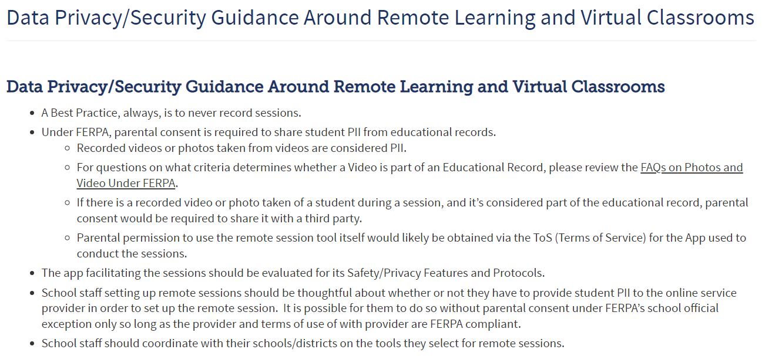
FERPA and PPRA Requirements and
Related Pandemic Guidance
https://www.cde.state.co.us/dataprivacyandsecurity/dataprivacysecurityguidancearoundremotelearningandvirtualclassrooms

Slide 52
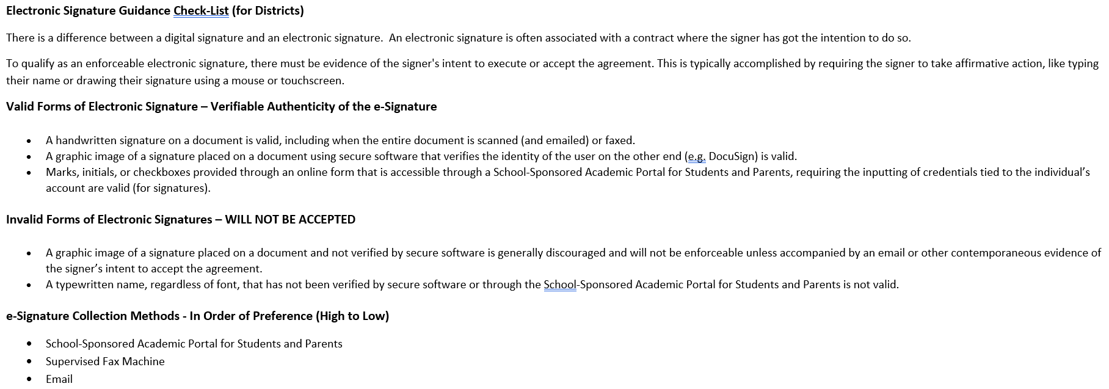
FERPA and PPRA Requirements and
Related Pandemic Guidance

Slide 53

FERPA and PPRA Requirements and
Related Pandemic Guidance
Questions

Slide 54
FERPA and PPRA Requirements and
Related Pandemic Guidance
Resource Links/PDF/PowerPoint
Overview of CIPA, COPPA, and FERPA https://www.spps.org/cms/lib/MN01910242/Centricity/Domain/11270/OverviewofCIPACOPPAandFERPA12.2015.pdf
PTAC’s FERPA Exceptions Summary https://studentprivacy.ed.gov/sites/default/files/resource_document/file/FERPA%20Exceptions_HANDOUT_horizontal_0.pdf
CDE’s PII Education Data Exhibit Form http://mycde.cde.state.co.us/accountingpurchasing/piieducationdataexhibitform
Disclosure Avoidance FAQ’s (put out by PTAC) https://studentprivacy.ed.gov/sites/default/files/resource_document/file/FAQs_disclosure_avoidance.pdf
Protection of Pupil Rights Amendment (PPRA) https://studentprivacy.ed.gov/sites/default/files/resource_document/file/20-0379.PPRA_508_0.pdf
FERPA and the Coronavirus Disease 2019 (COVID-19) https://studentprivacy.ed.gov/sites/default/files/resource_document/file/FERPA%20and%20Coronavirus%20Frequently%20Asked%20Questions.pdf

Slide 55
FERPA and PPRA Requirements and
Related Pandemic Guidance
Resource Links/PDF/PowerPoint – Continued
When is it permissible to utilize FERPA’s health or safety emergency exception for disclosures? https://studentprivacy.ed.gov/faq/when-it-permissible-utilize-ferpa%E2%80%99s-health-or-safety-emergency-exception-disclosures
FERPA and Virtual Learning During Covid-19 https://studentprivacy.ed.gov/sites/default/files/resource_document/file/FERPAandVirtualLearning.pdf
Protecting Student Privacy While Using Online Educational Services: Requirements and Best Practices https://studentprivacy.ed.gov/sites/default/files/resource_document/file/Student%20Privacy%20and%20Online%20Educational%20Services%20%28February%202014%29_0.pdf
Electronic Signature Guidance_03.24.2021 PDF
Leveraging Computer Programs and Applications to Meet Educational Needs PowerPoint

Slide 56
Consolidated Application Planning

Slide 57
22-23 Consolidated Application Updates
•The Year at a Glance indicates the following should be happening right now:
•Start consulting with non-public schools.
•Convene with stakeholder groups to begin planning for the 2022-2023 Consolidated Application – determine method of serving and eligible schools for Title I.
•The Paper Application for the 2022-2023 Consolidated Application is now available on our website.
•Non-Public Consultation form and the School Improvement Retention of Funds form are both available on the website and are due on May 31st.
•These will need to be uploaded in the application once it is open.

Slide 58
22-23 Consolidated Application Updates
•We have very minor changes to the application that we will go into detail at the April Regional Networking Meeting.
•One big change is that the LEA will be able to select from three years of Poverty Data on the LEA Profile page including:
2019-2020, 2020-2021, 2021-2022.
•We are still waiting on allocations and Grants Fiscal will post those preliminary allocations once available on their website, as well as, uploaded in the new application.

Slide 59
April Cons App RNM
Save the Date: April 12, 2022
Time: TBD
Registration: Will be posted ASAP on the Regional Network Meetings webpage
We are considering offering In-Person regional work sessions after the training. Please fill out the survey letting us know if you would attend if these were offered.

Slide 60
Fiscal Monitoring Submission Update

Slide 61
Fiscal Monitoring Document Submission
CDE Grants Fiscal team created two documents to help clarify the necessary fiscal documents for submission
Subrecipient Monitoring Questionnaire –list of common questions asked of every district as part of our internal risk assessment
Monitoring Document Request – list of necessary documents for fiscal review along with a timeline for submission (e.g. – GL first and then we will request a sample)
Recorded Webinar – step by step walkthrough of these two documents
LEAs currently under monitoring for this cycle received an email with the documents and a link to the recording
LEAs are encouraged to attend one of the Q&A sessions offered for any questions on these forms and the expectations
LEAs selected for monitoring in subsequent years will get documents as part of the notification
Links are live now and available for review
Also welcome at Q&A sessions but additional training will be provided in late summer and early fall

Slide 62
Fiscal Monitoring Document Submission
Three Q&A sessions to answer any questions as you review the recording and documents
Tuesday, March 22nd at 10 – 11 AM – reach out for link
Wednesday, March 23rd at 2 – 3 PM – reach out for link
Thursday, March 31st during normal Office Hours
Feel free to reach out directly to any of us on the ESSER Fiscal Monitoring team
Bill Parsley at parsley_b@cde.state.co.us or 303-910-5163
Hilery Morris at morris_h@cde.state.co.us or 720-471-4877
Laurie Freedle at freedle_l@cde.state.co.us or 720-593-2324

Slide 63
Upcoming Meetings

Slide 64
Upcoming Training
Equitable Distribution of Teachers Series Training #3: Implementing Changes Using EDT Data Workshop
This training will provide LEAs with a range of strategies that can be implemented to positively impact an LEA’s equitable distribution of teachers.
Target Audience: LEAs with small, medium, or large EDT gaps (district leadership, HR, hiring managers, principals); LEAs without gaps also welcome.
Prep: LEAs will need access to their 20-21 EDT data from Syncplicity. Recommended to watch the recordings of trainings 1 & 2 of the EDT Training Series.
Date: March 29, 2022
Time: 10am-12pm
Register HERE
Agenda
Best Practices to Ensure Data Accuracy
Strategies to Improve EDT Data
Leveraging Funds
Contact Wilson_S@cde.state.co.us for any logistics questions or Kaloudis_N@cde.state.co.us with questions about the training.

Slide 65

Any Requests for Upcoming Topics or Questions!
Upcoming Office Hours
March 31st
Notes:
Niko can speak to the EDT trainings

Slide 66
CDE Team!
CDE Contacts!
Emails: LastName_FirstInital@cde.state.co.us
ESSER/ESEA Program Partners
Nazie Mohajeri-Nelson, Director of ESEA Office (mohajeri-nelson_n@cde.state.co.us)
DeLilah Collins, Director of Grants Program Administration (collins_d@cde.state.co.us)
ESEA Regional Contacts assigned by district
  Title I: Laura Meushaw, Kathryn Wisner, Niko Kaloudis, Evita Byrd
  Title II: Niko Kaloudis, Karen Bixler
  Title III: Kathryn Wisner, Rachel Temple
  Title IV: Tammy Giessinger, Michelle Prael
ESSER Team
  Kristin Crumley, ESSER Monitoring Specialist (Crumley_k@cde.state.co.us)
  Jonathan Schelke, ESSER Monitoring Specialist (schelke_j@cde.state.co.us)
  Shannon Wilson, ESSER/ESEA Grants Administration Coordinator (Wilson_s@cde.state.co.us)
  Mackenzie Owens, ESSER Reporting Specialist (owens_m@cde.state.co.us)
Data, Accountability, Reporting, and Evaluation
  Tina Negley, Alan Shimmin, Mary Shen, and Mackenzie Owens
Fiscal Partners
Jennifer Okes, Chief Operating Officer (okes_j@cde.state.co.us)
Kate Bartlett, Executive Director of School District Operations (Bartlett_k@cde.state.co.us)
Jennifer Austin, Director of Grants Fiscal Management (Austin_j@cde.state.co.us)
Robert Hawkins, Grants Fiscal Analyst (Hawkins_s@cde.state.co.us)
Steven Kaleda, Grants Fiscal Analyst (Kaleda_s@cde.state.co.us)
ESSER Team
  Bill Parsley, ESSER Fiscal Monitoring Supervisor (parsley_b@cde.state.co.us)
  Hilery Morris, ESSER Fiscal Monitoring (morris_h@cde.state.co.us)
  Sharon Mackey, ESSER Fiscal Monitoring (mackey_s@cde.state.co.us)

