Slide 1
CDE Office Hours
March 4, 2021

Slide 2
CDE Team Introductions
ESSER
Nazie Mohajeri-Nelson, Director of ESEA Office (mohajeri-nelson_n@cde.state.co.us)
DeLilah Collins, Assistant Director of ESEA Office (collins_d@cde.state.co.us)
Fiscal Experts
Jennifer Okes, Chief Operating Officer (okes_j@cde.state.co.us)
Kate Bartlett, Executive Director of School District Operations (Bartlett_k@cde.state.co.us)
Adam Williams, Financial Data Coordinator (Williams_a@cde.state.co.us)
Jennifer Austin, Director of Grants Fiscal Management (Austin_j@cde.state.co.us)
Robert Hawkins, Grants Fiscal Analyst (Hawkins_s@cde.state.co.us)
Steven Kaleda, Grants Fiscal Analyst (Kaleda_s@cde.state.co.us)
…in partnership with the Governor’s Office and Office of the State Controller

Slide 3
ESSER Office Hours
Topics
Updates and Reminders
CRF Reporting
EANS Update
ESSER II Application
Indirect Costs Rates
Notes:
Nazie

Slide 4
Updates

Slide 5
Timelines Associated with ESSER I and II
 | ESSER I | ESSER II
Period of Funds Availability | 03/13/20 – 09/30/22 | 03/13/20 – 09/30/23
USDE Award to CDE | 05/07/20 | 01/06/21
CDE Must Make Subgrants to LEAs (90%) – LEAs must have final approval | 05/07/21 | 01/06/22
CDE Must Make Subgrants via Contract or Grants (10%) | 05/07/21 | 01/06/22
CDE Application Opened | 05/31/20 | 02/12/21
CDE Application Closed/Closes | 12/31/20 | 09/30/21
PAR Open – Rolling Basis | Date of Final Approval | Date of Final Approval
PAR Closes | 06/30/21 | 06/30/22
Carryover Application Will Open (Unexpended Funds Carried Over to Next Year) | 07/01/21 | 07/01/22
Carryover Application Will Close | 06/30/22 | 06/30/23
Monthly Deadline for Requesting Funds (LEA’s Request for Funds, RFF) | First Day of Each Month | First Day of Each Month
Deadline for Final Spending | 09/30/22 | 09/30/23
Deadline for Final Draw Down of Funds (RFF) | October/November 2022 | October/November 2023

Slide 6
Guiding Questions to Determine Reasonableness, Necessity, and Allocability
What process was used to identify the needs of students, educators, and staff?
What activities, supports, or services would help meet those needs the best?
Are these activities/items listed as allowable under ESSER?
  [CARES Act 18003(d); CRRSA 313(d)]
How does this activity/item help prevent, prepare for, or respond to COVID-19?
Is this a cost-effective way to do this work?
Would a prudent person say this was a reasonable expense? What is the fair market value for this activity/item?
Does this activity/item meet district policies?
Does this activity/item meet state requirements?
For capital expenditures, was prior written approval obtained?
Is proper documentation in place to demonstrate the above in the event of monitoring or an audit?
Notes:
Nazie

Slide 7
CRF Reporting
Kate Bartlett
Notes:
Nazie

Slide 8
CRF Reporting Update
There are ~30 districts/BOCES/facility schools that have not yet reported the full expenditure of all of their CRF funds. This update is primarily for those entities.
CDE learned that the Office of the State Controller needs the Q4 CRF data from the department on March 31
This means:
  Districts that still need to report expenditure data will now only report expenditures through February 28, 2021 in this cycle
  The new deadline to submit to CDE will be March 19, 2021
We are asking reporting entities to net out any change to previous quarters in Q4—rather than editing previous quarters
If you are one of the ~30 entities whose expenditure data is not closed, you will receive an email with instructions tomorrow.
If your expenditure data is closed but you need to revise your CRF data, please contact Grants Fiscal (mueller_p@cde.state.co.us) for instructions.

Slide 9
EANS Update
DeLilah Collins
Notes:
On the books ~ online schools/programs

Slide 10
EANS Update
Thank you for sharing our email to your non-public school contacts. We have approx. 93 schools that have signed up to receive information regarding the funds.
Grant application is in development
  We are working with stakeholders to finalize application
Communication regarding EANS grant applications
  Going directly to those that signed up to receive updates
  LEAs will not receive the ongoing communication regarding this grant opportunity
  If you receive questions, send them to CDE at eansapplications@cde.state.co.us

Slide 11
ESSER II Application
DeLilah Collins
Notes:
On the books ~ online schools/programs

Slide 12
ESSER II Application - Updates
ESSER II was released on February 12, 2021
  Application due September 30, 2021
ESSER I | ESSER II
Acceptance/Relinquishment | Acceptance Relinquishment
Supplemental funding option | TBD
Contacts | Contacts
Non-public schools proportionate share | N/A
Fund Budget* | Fund Budget*
Approval and Signature Form | Approval and Signature Form
*Changes made to options in the fund budget section.
Notes:
Adam

Slide 13
New Data Field: Benefits
Purpose
  Reporting requirement
    Elementary versus secondary schools
    Student Groups
Response Options ~ Paired with Location
  Whole population at the selected location
  Portion of the population at the selected location
Guiding Questions
  Is the purpose of each budgeted activity to benefit the whole school/district or a portion?
  If a portion, then which students are intended to benefit from this activity (e.g., only elementary schools, students of poverty, students experiencing homelessness)?

Slide 14
Example 1: Summer School Program to Address Learning Opportunity Loss
Allowable Activity: Activities to address learning loss
Description of Activity: During the school year, our elementary and middle schools had to transition between online, in-person, and hybrid learning. Each time we transitioned, learning was disrupted and students of poverty were most significantly impacted by the disruptions. A districtwide summer program is being offered to elementary and middle school students who qualify for free and reduced lunch. Salaries of X number of instructional staff working the summer program for a total of Y FTE. Benefits of X number of instructional staff working the summer program.
Location: Districtwide
Will this activity benefit the entire or a portion of the population at this location? Portion of the population
Rationale: Students of poverty were eligible for this support (activity is intended to benefit students of poverty)

Slide 15
Example 2: Materials Necessary for Social Distancing
Allowable Activity: Facility repairs and improvements to enable operations of schools to reduce risk of virus transmission and exposure
Description of Activity: In-person instruction has been resumed at all schools and plexiglass shields are being installed to create social distancing and safe learning environments for all students and educators. X number of plexiglass shields to be used in Y number of schools/classrooms between desks and workspaces to reduce the risk of spreading the COVID-19 virus among students and staff; each shield costs $___.
Location: Districtwide
Will this activity benefit the entire or a portion of the population at this location? Whole population
Rationale: The intent of the activity is to protect all students and staff from the risk of spreading COVID-19

Slide 16
Example 3: After School Program to Enhance ELD Instruction
Allowable Activity: Summer learning and supplemental after school programming
Description of Activity: Supplemental ELD instruction will be provided in an afterschool program to enhance linguistic instruction offered to English learners. Due to disruptions caused by school closures, our English learners have experienced disruptions in their access to ELD programming, with the greatest impact on secondary school students. X number of ELD teachers will provide afterschool evidence-based ELD instruction to supplement supports for Y number of secondary school English leaners.
Location: ABC High School
Will this activity benefit the entire or a portion of the population at this location?: Portion of the Population at that location
Rationale: The intent of the activity is to supplement ELD instruction and support for English learners in secondary school

Slide 17
ESSER I Indirect Cost Rate:
Requesting Change to Unrestricted Rate
DeLilah Collins and Grants Fiscal Management Unit
Notes:
On the books ~ online schools/programs

Slide 18
Indirect Costs
The ratio of indirect costs to direct costs is expressed as a percentage. Indirect costs are those elements of cost necessary in the provision of a service which are of such nature that they cannot be readily or accurately identified with the specific service. Direct costs are those elements of cost which can be easily, obviously, and conveniently identified with specific activities or programs.
  https://www.cde.state.co.us/cdefinance/icrc
Look Up Available Rates
  Indirect Cost Rates 20-21 (XLS)
Understanding Indirect Cost Rates
  https://www.cde.state.co.us/cdefinance/understandingindirectcostratefy2020-21

Slide 19
ESSER I - Requesting changes to indirect costs in the ESSER I application
Not every LEA took indirect costs
LEAs that did and want to take the unrestricted rate will need to complete a simple request form
Once request is received, we will update the online platform with the new unrestricted rate
  LEAs will be able to make adjustments to their budget using the PAR process
https://app.smartsheet.com/b/form/0c46cb7f2a6548cd860bba4d3847a616
Website (under Quick Links): http://www.cde.state.co.us/caresact/esserapplication
Note: Par window will remain open until June 30, 2021.

Slide 20
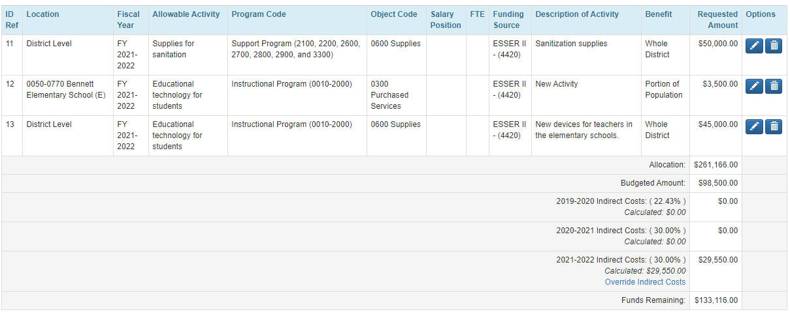
ESSER II - How to manage / edit indirect costs in the ESSER II application
At the bottom of the budget table, districts will see the indirect cost rates and amounts calculated for each funding year.
If an amount did not calculate for a particular funding year, go back to the budget and make sure you have items budgeted to that funding year.
The Override Indirect Costs link will allow you to override the indirect costs for each funding year.

Slide 21
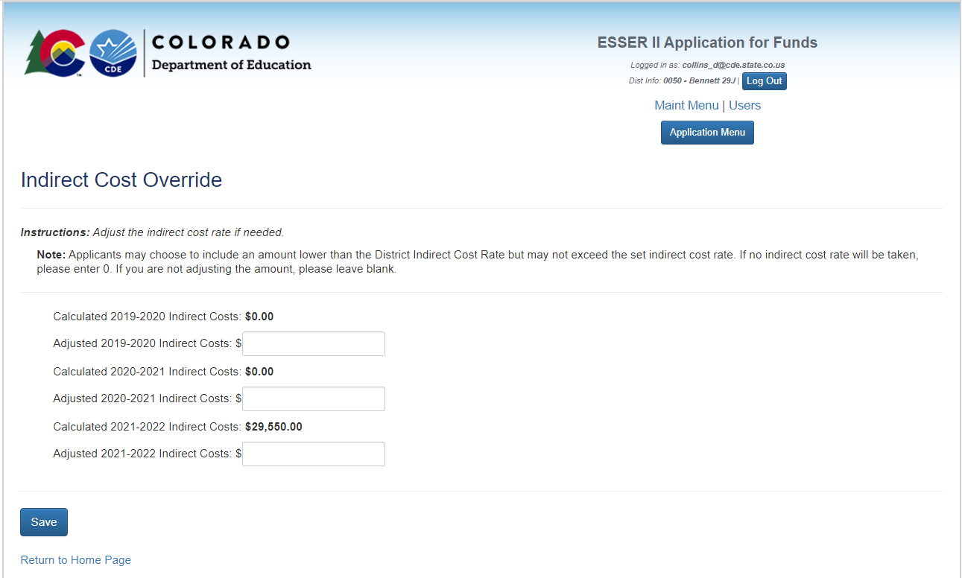
ESSER II Indirect Override

Slide 22
Questions?
Future Topics?
February 11, 2021 ~ Using ESSER Funds to Support SWDs

Slide 23
CDE Team Contact Information
ESSER
Nazie Mohajeri-Nelson, Director of ESEA Office (mohajeri-nelson_n@cde.state.co.us)
DeLilah Collins, Assistant Director of ESEA Office (collins_d@cde.state.co.us)
Fiscal Experts
Jennifer Okes, Chief Operating Officer (okes_j@cde.state.co.us)
Kate Bartlett, Executive Director of School District Operations (Bartlett_k@cde.state.co.us)
Jennifer Austin, Director of Grants Fiscal Management (Austin_j@cde.state.co.us)
Robert Hawkins, Grants Fiscal Analyst (Hawkins_s@cde.state.co.us)
Steven Kaleda, Grants Fiscal Analyst (Kaleda_s@cde.state.co.us)
Adam Williams, Financial Data Coordinator (Williams_a@cde.state.co.us)
…in partnership with the Governor’s Office and Office of the State Controller

