Slide 1
CDE Office Hours
February 3, 2022

Slide 2
CDE Team!
CDE Contacts!
Emails: LastName_FirstInital@cde.state.co.us
ESSER/ESEA Program Partners
Nazie Mohajeri-Nelson, Director of ESEA Office (mohajeri-nelson_n@cde.state.co.us)
DeLilah Collins, Assistant Director of ESEA Office (collins_d@cde.state.co.us)
ESEA Regional Contacts assigned by district
  Title I: Laura Meushaw, Kathryn Wisner, Niko Kaloudis
  Title II: Niko Kaloudis
  Title III: Kathryn Wisner
  Title IV: Tammy Giessinger, Michelle Prael
  Title V: Tina Negley
ESSER Team
  Kristin Crumley, ESSER Monitoring Specialist (Crumley_k@cde.state.co.us)
  Jonathan Schelke, ESSER Monitoring Specialist (schelke_j@cde.state.co.us)
  Shannon Wilson, ESSER/ESEA Grants Administration Coordinator (Wilson_s@cde.state.co.us)
  Mackenzie Owens, ESSER Reporting Specialist (owens_m@cde.state.co.us)
Data, Accountability, Reporting, and Evaluation
  Tina Negley, Alan Shimmin, Mary Shen, and Mackenzie Owens
Fiscal Partners
Jennifer Okes, Chief Operating Officer (okes_j@cde.state.co.us)
Kate Bartlett, Executive Director of School District Operations (Bartlett_k@cde.state.co.us)
Jennifer Austin, Director of Grants Fiscal Management (Austin_j@cde.state.co.us)
Robert Hawkins, Grants Fiscal Analyst (Hawkins_s@cde.state.co.us)
Steven Kaleda, Grants Fiscal Analyst (Kaleda_s@cde.state.co.us)
ESSER Team
  Bill Parsley, ESSER Fiscal Monitoring Supervisor (parsley_b@cde.state.co.us)
  Hilery Morris, ESSER Fiscal Monitoring (morris_h@cde.state.co.us)
  Sharon Mackey, ESSER Fiscal Monitoring (mackey_s@cde.state.co.us)

Slide 3
ESSER Office Hours
Topics
Updates, Reminders, and Clarifications
ESSER State Reserve Grant Opportunities
McKinney-Vento ARP Funding
Afghan Refugee Funding Options and Resources
Notes:
Nazie

Slide 4
Updates, Reminders, and Clarifications

Slide 5

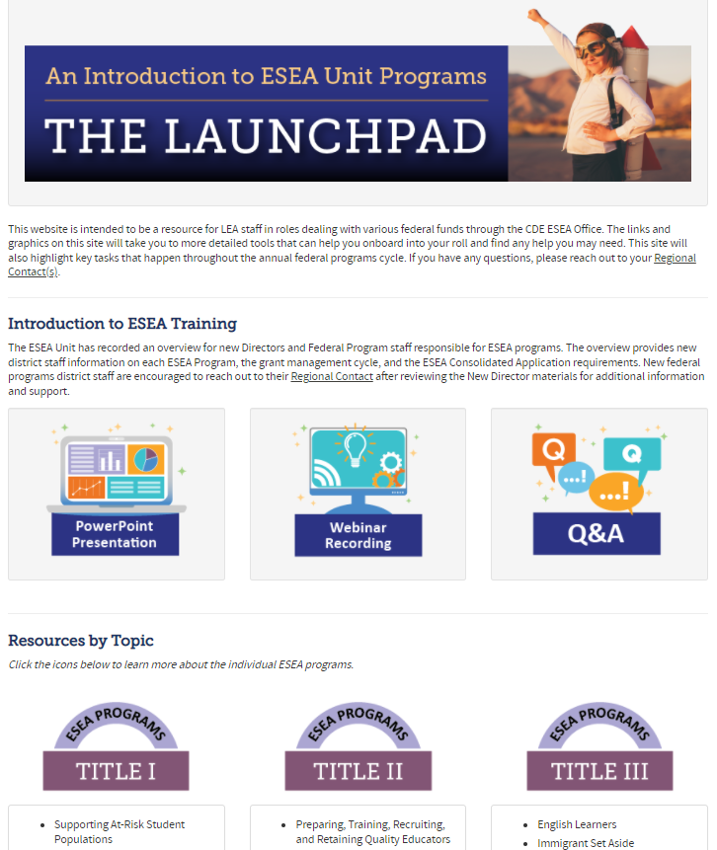
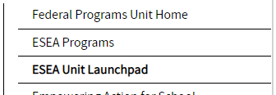

Introducing the ESEA Programs Launchpad
Phase I is complete and you can now access the Launchpad
Current uses:
  Starting point to access ESEA Programs information
  Year at a Glance
Year at a Glance deep dive
  March 3rd
More to come with Phase II

Slide 6

About TLCC
Every 2 years, CDE & partner organizations solicit the feedback of educators across the entire state.
  Teachers, Specialists, Interventionists, Special Service Providers (SSPs), School Leaders
Goal: Provide data for school & district needs assessments and improvement efforts. Also, inform state-level policy and research.
New this year: Education Support Professionals are included.
  Paraprofessionals, Teaching Assistants, Student Monitors, Health Techs, and more
Learn all about the TLCC Survey HERE or by reviewing the FAQs.
DEADLINE
Feb. 21st, 2022
Notes:
CDE has worked with partner organizations for years to gain insight about teaching conditions across the state through the TLCC survey (formerly TELL survey).

Slide 7

Benefits of Investing in TLCC Completion
Schools with more than 50% completion rate get access to the data.
  Access historical data here
Data can help inform the budgeting of Title II funds.
  Professional development
  Staff retention
  Induction programming
Questions about TLCC? Click HERE
Notes:
If you have questions or want to brainstorm how to you can use TLCC data to inform Title II buggetting, contact Niko Kaloudis kaloudis_n@cde.state.co.us

Slide 8
ESSER State Reserve Grant Opportunities
Scott Jones
Chief Strategic Recovery Officer
Jones_s@cde.state.co.us

Slide 9
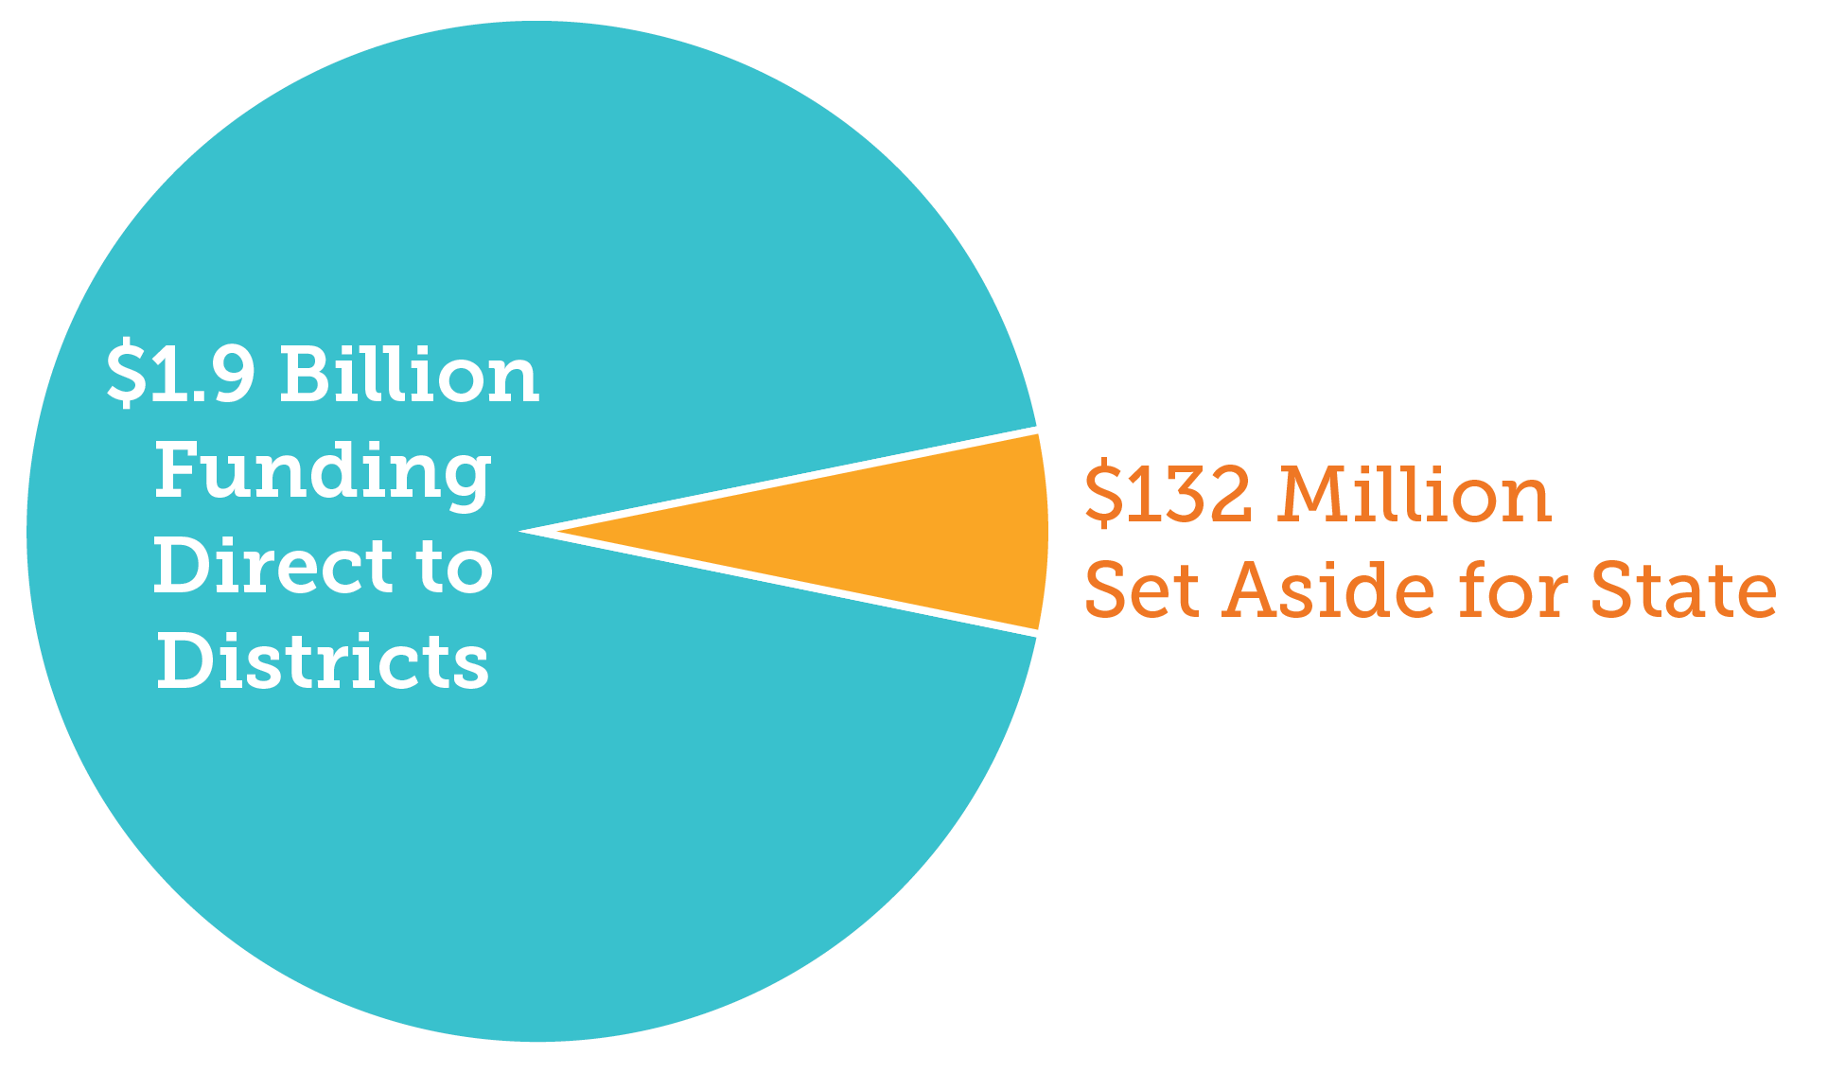
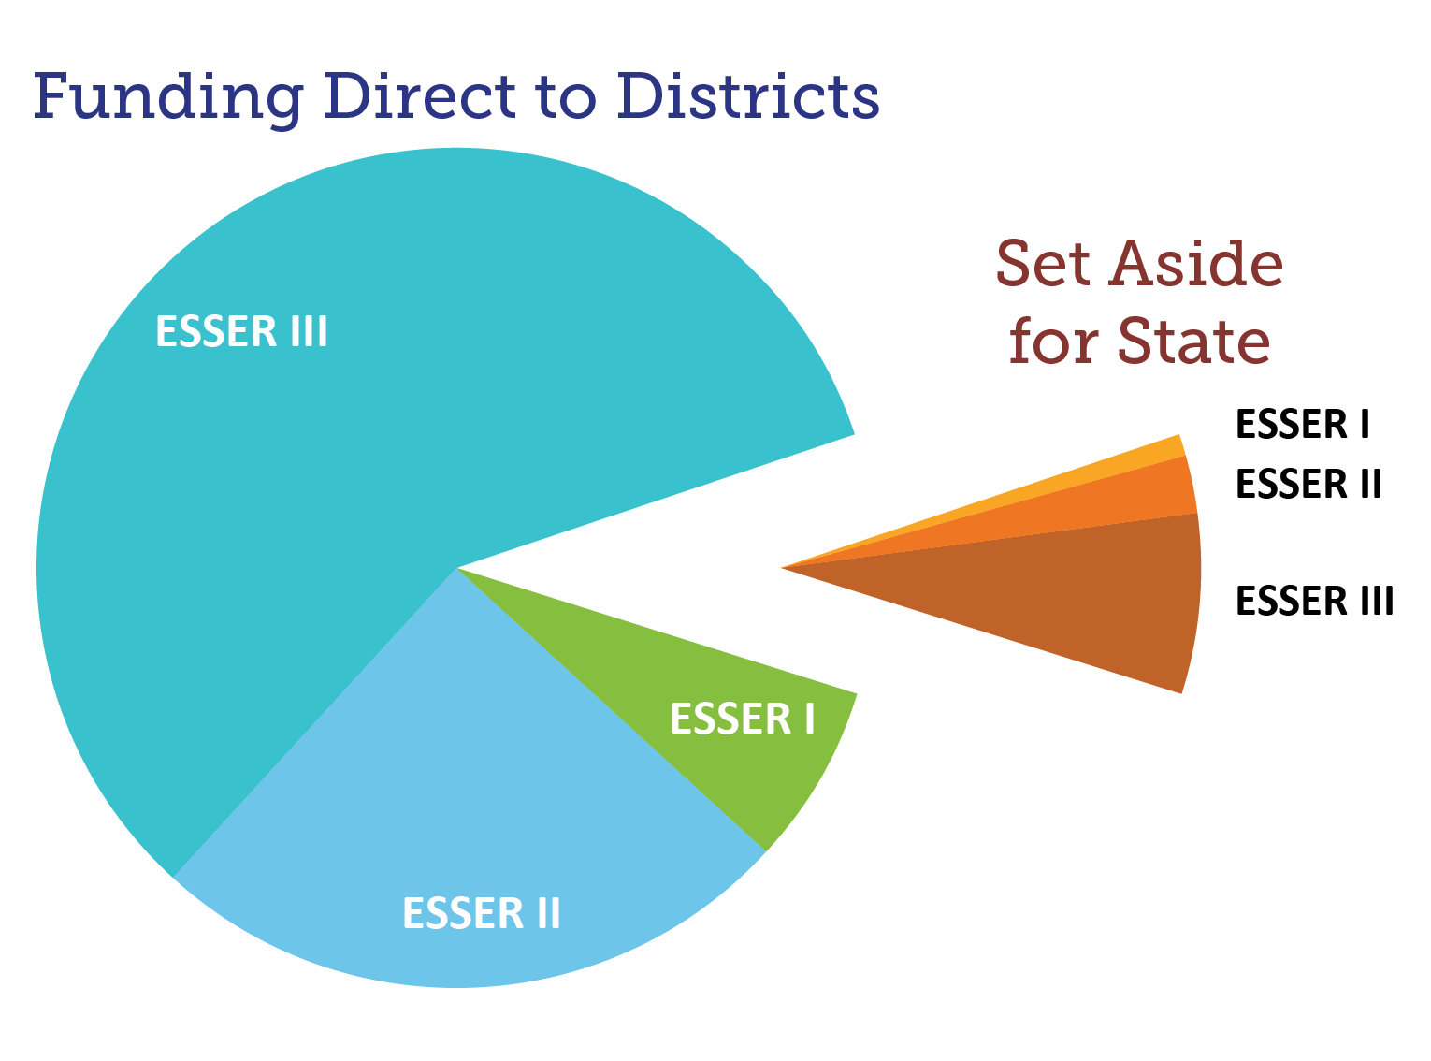
Colorado ESSER Funds
LEA ESSER Funding $1.6 Billion
State ESSER Funding $180 Million
Total ESSER Funding $1.8 Billion
Notes:
State set aside, Esser 1 +2+3 = 180,747,205
Right now we have 132 million left to allocate
Funding directly to districts via Title 1 formula = 1,626,724, 849 (1.6 billion)

Slide 10
ESSER State Set-Aside Focus Areas
1
ACADEMIC ACCELERATION
2
ENGAGE & EXPAND LEARNING
3
STRENGTHEN STATE CAPACITY

Slide 11




ESSER State Set-Aside Focus Areas
1
Academic acceleration for students most impacted by the pandemic
with a focus on math and literacy for students in grades K-8.
$30 million – high-dosage tutoring, summer school, before and after-school
$10 -12 million – high-quality instructional materials and curriculum bank
$25 million – supplemental for districts, BOCES, SPED, tribal nations, high-risk populations
$15 million – tutoring corps, preservice, recruitment, mentoring retention grants
$5 million – professional development learning modules
$6 million – additional support for Empowering Action through School Improvement (EASI), proactive grants for schools
OUR STRATEGIC PLAN
IS STILL FOUNDATIONAL.

Slide 12

ESSER State Set-Aside Focus Areas
2
Engage and expand learning opportunities to strengthen student engagement in learning in both the traditional school day and beyond.
$12 million – before and after-school, summer school, enrichment, academic innovation, school climate and other supports
$2 million – technical assistance for developing partnerships across schools, districts and/or with community partners
$15 million – career connected learning (Career and Technical Education, rural collaboration zones)
OUR STRATEGIC PLAN
IS STILL FOUNDATIONAL.

Slide 13

ESSER State Set-Aside Focus Areas
3
Strengthen state capacity to best support the state’s districts and schools in accelerating and expanding learning opportunities for all students – both now and in the future.
$7-10 million – data pipeline for improved district and state decision making, customer relations and grant management tool, with data visualization
$4 million – reserved for future emergency, recovery needs
$1 million – Data and Evaluation Office (includes blended learning facilitator and communicating to field on results)
OUR STRATEGIC PLAN
IS STILL FOUNDATIONAL.

Slide 14
ESSER State Set-Aside
Program Update
ALREADY
LAUNCHED
IN DEVELOPMENT &
LAUNCHING SOON
IN-DEVELOPMENT &
LAUNCHING LATER 2022
High-Impact Tutoring (HIT)
Learning and Transparency Technical Assistance
Supplemental Funding
Empowering Action for School Improvement (EASI) Grants
Rural Coaction (Career-Connected Learning)
Curriculum & Instructional Resources
Educator Workforce
Expanded Learning Opportunities & Additional HIT
Professional Learning
CDE Integrated Data Systems
Additional Technical Assistance

Slide 15
ESSER Program Updates
Educator Workforce
Tutoring
Corps
Peer Mentoring Program
Principal Leadership Institute
Educator Workforce Funds
$5M
$10M
$2M
$3M
Substitute Stipend Supports
Tutoring & Substitute Support
Statewide
Recruitment & Retention
$200K
$1M
$500K

Slide 16
McKinney-Vento ARP Funding

Slide 17
ARP-HCY II & Title IA Set-Asides to Serve Homeless Children & Youth
February 3, 2022
Paula Gumina, State Coordinator
Education of Homeless Children and Youth

Slide 18
American Rescue Plan–Homeless Children & Youth (ARP-HCY) Formula Grants
The U.S. Department of Education under section 2001(b)(1) of the American Rescue Plan Act of 2021 is providing additional funding to help support school districts in serving students experiencing homelessness.
The purposes of this funding include:
  increasing the outreach, identification, enrollment and retention of students experiencing homelessness
  providing wraparound services for these students considering the impact of the COVID-19 pandemic
  providing assistance needed to enable homeless children and youth to attend school and participate fully in school activities

Slide 19
ARP-HCY I and II
CDE received two grants specifically focused on supporting the needs of students experiencing homelessness
  ARP-HCY I- competitive competition held in July/August 2021
      Grants to 23 LEAs/BOCES as supplemental funding
      Notifications made in late August and early September
  ARP-HCY II - formula grant released early September
      $4,300,318 is available for this funding opportunity
      All allowable EHCY and ARP-HCY I uses apply to these funds
      Applications must be completed and submitted through the online application and will be accepted and reviewed on a rolling basis until March 1, 2022 by 11:59 p.m.

Slide 20
ARP-HCY II
First time ever for a formula allocation
The formula is based equally on:
  The proportional share of an LEA's allocation under Title I, Part A of the Elementary and Secondary Education Act of 1965 (ESEA) for the most recent fiscal year and
  The LEA's proportional share of the number of homeless children and youth identified by each LEA relative to all LEAs in the State, using the greater of the number of homeless children and youth in either the 2018-19 or 2019-20 school year in each LEA.
The funding application, budget template and formula amounts can be found at: http://www.cde.state.co.us/studentsupport/homeless_index

Slide 21
Authorized Activities under 723(d) of the McKinney-Vent Homeless Assistance Act
Referral services for medical, dental, mental or other health services
Before and after school and summer programs
Payment of fees and other costs associated with record transfers including birth certificates, health records, etc.
Education and training for parents and guardians of homeless children and youth about rights and resources available
School supplies
See complete list on the ARP-HCY application: https://www.cde.state.co.us/studentsupport/homeless_index

Slide 22
Everything Authorized under the McKinney-Vento Act PLUS…
Any expenses necessary to facilitate the identification, enrollment, retention or educational success of homeless children and youth to enable homeless children and youth to attend school and participate fully in school activities.
providing wraparound services (which could be provided in collaboration with and/or through contracts with community-based organizations, and could include academic supports, trauma-informed care, social-emotional support, and mental health services);
purchasing needed supplies (e.g., personal protective equipment, eyeglasses, school supplies, personal care items);
providing transportation to enable homeless children and youth to attend school and participate fully in school activities;
purchasing cell phones or other technological devices for unaccompanied, homeless children and youth to enable such children and youth to attend school and fully participate in school activities;
providing access to reliable, high-speed internet for students through the purchase of internet-connected devices/equipment, mobile hotspots, wireless service plans, or installation of Community Wi-Fi Hotspots (e.g., at homeless shelters), especially in underserved communities;
paying for short-term, temporary housing (e.g., a few days in a motel) when such emergency housing is the only reasonable option for COVID-safe temporary housing and when necessary to enable homeless children and youth to attend school and participate fully in school activities (including summer school); and
For store cards/prepaid debit cards to purchase materials necessary for students to participate in school activities. Per Colorado requirements, store-specific debit cards must be used toward allowable uses of funds or specific intended purposes outlined above. Further, the recipient(s) should be able to provide to the LEA the receipt(s) for items for their files for audit purposes

Slide 23
ARP-HCY II
The U.S. Department of Education establishes in paragraph (c)(2) that an LEA must have an allocation of at least $5,000 under the formula to be eligible for an ARP Homeless II subgrant on its own.
Per the U.S. Department of Education, this $5,000 minimum will enable each subgrantee to have sufficient ARP Homeless II funds to address the needs of homeless children and youth.
If an LEA's allocation is less than $5,000, in order to receive an ARP Homeless II subgrant, the LEA must join a consortium of LEAs/BOCES in which the sum of its members' allocations meets the $5,000 threshold. For LEAs/BOCES with an allocation less than $5,000, the rule encourages the use of consortia to create favorable economies of scale.

Slide 24
District Examples
Fees associated with extracurriculars and testing
Contracts to provide dental care
Technology: Laptops, cell phones, internet hotspots
Stipends for school level contacts, enrollment staff and/or family services staff for extra support in identification and outreach
Contracts for wrap around services
Professional development and training in Trauma informed care for district and school staff
Contracts for support services for traditionally underserved populations

Slide 25
Title I, Part A and McKinney-Vento Homeless Assistance Act
Title IA
Providing all children with fair, equitable and high-quality education and close educational achievement gaps
Meet educational needs in schools with the highest levels of poverty
Provides financial assistance to LEAS and schools with high numbers or percentage of children from low-income families
McKinney-Vento
Access to the same free, appropriate public education, including preschool, as their permanently housed peers
Defines homelessness as individuals who lacks a fixed, regular and adequate primary nighttime residence.
Subgrantee program and ARP_HCY Funding
Notes:
includes — i. children and youths who are sharing the housing of other persons due to loss of housing, economic hardship, or a similar reason; are living in motels, hotels, trailer parks, or camping grounds due to the lack of alternative adequate accommodations; are living in emergency or transitional shelters; or are abandoned in hospitals; ii. children and youths who have a primary nighttime residence that is a public or private place not designed for or ordinarily used as a regular sleeping accommodation for human beings…; iii. children and youths who are living in cars, parks, public spaces, abandoned buildings, substandard housing, bus or train stations, or similar settings; and iv. migratory children…who qualify as homeless for the purposes of this subtitle because the children are living in circumstances described in clauses (i) through (iii).

Slide 26
Why?
Over 20,000 children and youth in Colorado were reported in the 2019-2020 school year as experiencing homelessness
Support academic achievement in schools with highest levels of low-income families.
Statutory Requirement
Optimized resource allocations
  American Rescue Plan Funding – Homeless Children and Youth Funding
    Greater awareness and documentation of needs
    Sustainability
Notes:
10% of those living in poverty are experiencing homelessness and Federal government is requesting more information on the coordination between programs and will be looking to this for state and local level monitoring

Slide 27
Allowable Uses
Comparable services to students experiencing homelessness who do not attend a Title I School
Provide services that are not ordinarily provided to Title I students including:
  Local Liaison Position
  Transportation
Governing Principles
The services must be reasonable and necessary to assist students experiencing homelessness to take advantage of education opportunities
The funds must be used only as a last resort when funds or services ar not available for other public or private sources
Notes:
tems of clothing, particularly if necessary to meet a school’s dress or uniform requirement; • clothing and shoes necessary to participate in physical education classes; • student fees that are necessary to participate in the general education program; • personal school supplies; • birth certificates necessary to enroll in school; • immunizations; • food; • medical and dental services; • eyeglasses and hearing aids; • counseling services to address anxiety related to homelessness that is impeding learning; • outreach services to students living in shelters,
Homeless set-aside funds may be used to provide comparable services to students experiencing homelessness who do not attend a Title I school, but also may be used to provide services to students experiencing homelessness, including those attending Title I schools, that are not ordinarily provided to other Title I students, including funding the local liaison position, and funding transportation to and from the school of origin [ED, 2017, p. 40, 20 U.S.C. § 6313(c)(3)(C)(ii)].

Slide 28
Budgeting
Sufficient Title I funds to provide services to students experiencing homelessness that are comparable to those provided to students in Title I schools
Based on an assessment of need
  Affects of COVID
  Impacts of disasters
Planned interventions of sufficient time and intensity
Coordination and collaboration in determining set-asides
Required match for McKinney-Vento Subgrants

Slide 29
Title IA Set-Aside Webinar Series
Designed to support McKinney-Vento District Liaisons and Title I district partners in planning and coordinating services for students in their district.
Topics: Allowable usages of set-asides funds, determining Title I, Part A Set-Aside amounts, and strategies for collaboration and coordination at the district level.
Save the Dates!
Monday, February 28th 2:00 – 3 pm
Tuesday, March 1st 2:00 – 3 pm
Wednesday, March 2nd 2:00 – 3 pm

Slide 30
Afghan Refugee Funding Options and Resources

Slide 31
Overview of New Afghan Refugees
In the 2021-22 school year and beyond, schools across the United States will enroll significant numbers of children and youth from Afghanistan. These students fled the country after the withdrawal of American military troops and the subsequent fall of the Afghan government on August 15, 2021. While many schools and communities have a long history of welcoming refugee and immigrant students, given the large number of arriving Afghan students and recent traumatic events, educators and school districts may want to do additional preparation.
The United States is in the process of resettling our Afghan allies and their families to our country. There is an immediate and urgent need for providing high-quality, culturally responsive education to newcomer Afghan students as they move from safe havens into destination communities.
In the last year Colorado welcomed 765 new neighbors, 43 % of which are under the age of 18.

Slide 32
Colorado Refugee Structure
The lead organization in colorado is The Colorado Refugee Services Program (CRSP), which is a program of the Colorado Department of Human Services and is responsible for the statewide coordination of refugee resettlement under the authority of the Refugee Act of 1980. Here is there website.
Resettlement organizations:
ECDC/African Community Center
International Rescue Committee
Lutheran Family Services Rocky Mountains
Jewish Family Services
Project Worthmore
CRSP funds many programs across colorado including
EL CLasses
Youth services
Health and Wellness
ELder and other services
Career and Pathway Planning

Slide 33
Federal Funding - Title Funding
Title 1 ~ The purpose of Title I, Part A (Title I-A) is to provide all children significant opportunity to receive a fair, equitable, and high-quality education, and to close educational achievement gaps.
These activities may include, for example, providing direct instruction, improving school climate, counseling, mentoring, and school-based mental health programs, or providing positive behavioral interventions and supports that would benefit Afghan evacuees enrolled in public schools as well as other newly arrived students.
A school must not consider a student’s immigration status in determining eligibility for Title I services.
Under ESEA section 1115(e)(2), a targeted assistance school may use a portion of its Title I funds to provide comprehensive services, such as health, nutrition, and other social services, if such services are not otherwise available to eligible students.

Slide 34
Federal Funding - Title Funding
Title 3 ~ Title III, Part A of ESEA includes two types of subgrants to LEAs: English Language Acquisition formula subgrants (see ESEA section 3111 and 3114(a)) and immigrant children and youth subgrants (ESEA section 3114(d)).
Therefore, in LEAs that receive Title III-A English Language Acquisition subgrants, any immigrant student who meets the definition of EL, as defined in ESEA section 8101(20), is entitled to language services under the civil rights laws and also may receive supplementary services under Title III-A.
Under the statute, an LEA must use the immigrant subgrant to provide enhanced instructional opportunities for immigrant children and youth (ESEA section 3115(e)). Activities may include:
  Family literacy, parent and family outreach, and training activities designed to assist parents and families to become active participants in the education of their children;
  Recruitment of and support for personnel, including teachers and paraprofessionals who have been specifically trained, or are being trained, to provide services to immigrant children and youth;
  Provision of tutorials, mentoring, and academic or career counseling for immigrant children and youth
  Identification, development, and acquisition of curricular materials, educational software, and technologies to be used in the program;
  Basic instruction services that are directly attributable to the presence of immigrant children and youth in the LEA, including the payment of costs of providing additional classroom supplies;
  Costs of transportation, or such other costs as are directly attributable to such additional basic instruction services;
  Other instruction services that are designed to assist immigrant children and youth to achieve in elementary and secondary schools in the U.S., such as programs of introduction to the educational system and civics education; and
  Activities, coordinated with community-based organizations, institutions of higher education, private sector entities, or other entities with expertise in working with immigrants, to assist parents and families of immigrant children and youth by offering comprehensive community services.

Slide 35
Federal Funding - Title Funding Contd.
Title 4 ~ Title IV, Part A program is intended to help increase the capacity of SEAs, LEAs, schools, and local communities to— A) provide all students with access to a well-rounded education; B) improve school conditions for student learning; and C) improve the use of technology in order to improve the academic achievement and digital literacy of all students.
LEAs have substantial flexibility in how they utilize Title IV-A program funds to provide all students, including recently arrived students, access to a well-rounded education, improve school conditions for student learning (e.g., provide supports to students who are new to the American educational system),
The Nita M. Lowey 21st Century Community Learning Centers (21st CCLC) program, authorized under Title IV, Part B of the ESEA, provides opportunities for communities to establish or expand activities in community learning centers that— A) provide opportunities for academic enrichment, including providing tutoring services; B) offer students, including recently arrived students, a broad array of additional services, programs, and activities; and C) offer families of students served by community learning centers opportunities for active and meaningful engagement in their children’s education, including opportunities for literacy and related educational development.

Slide 36
Federal Funding - Title Funding Contd.
Title 5 ~ Title V of ESEA is intended to address the unique needs of rural school districts that frequently lack the personnel and resources needed to compete effectively for Federal competitive grants and receive formula grant allocations in amounts too small to be effective in meeting their intended purpose. REAP is comprised of two formula grant programs:
The Rural, Low-Income School (RLIS) program [ESSA, Title V, Part B, Subpart 2]. The RLIS program targets rural LEAs that serve large numbers of low-income students.
The Small, Rural School Achievement (SRSA) Program [ESSA, Title V, Part B, Subpart 1]. The SRSA program provides funds to very small, rural LEAs.
Title V, Part B funds for both RLIS and SRSA programs can be used flexibly and in various ways to support any activities authorized under ESEA, including:
Parental Involvement activities.
Activities authorized under:
  Student Support and Academic Achievement (Title IV, Part A)
  Title I, Part A:
    Improving basic programs operated by local educational agencies.
    Activities for schools identified with the highest needs.
  Title III Language Instruction for limited English proficient and immigrant youth.

Slide 37
Federal Funding - Other Programs
McKinney Vento ~ Recently arrived students may qualify a MKV students. For the first 90 days after arriving in their first new community families are supported by federal dollars. However, once students and families have transitioned out of resettlement services and sites, they may be eligible to receives services provided by these funds if they meet the criteria.
living in a shelter, motel, inadequate trailer, or house;
is staying temporarily with relatives or friends due to economic hardship or loss of housing; or
is living in any other homeless situation.
For more information on McKinney Vento funds and their allowable uses plese see the CDE Program page .

Slide 38
Federal Funding - Other Programs
IDEA ~ The purpose of Part B of the IDEA is to ensure that a free appropriate public education (FAPE) is made available to eligible children with disabilities (ages 3 through 21) and that those children are provided special education and related services, including supplementary aids and services, at no cost to their parents and in conformity with an individualized education program.
In response to the needs of recently arrived students and their families, LEAs might consider using IDEA Part B funds in the following ways:
to invest in the capacity building and development of tools and materials that will allow LEAs to conduct special education evaluations in a linguistically and culturally appropriate manner for recently arrived students;
hiring personnel with expertise in serving linguistically and culturally diverse students;
using assistive technology to improve communication with recently arrived children with disabilities; and
increasing the LEA’s capacity to effectively engage with families of eligible children with disabilities who have recently arrived.
ESSER/ GEER
LEAs may use funds under the Elementary and Secondary School Emergency Relief (ESSER) Fund and the Governor’s Emergency Education Relief (GEER) Fund to address the impact of the COVID-19 pandemic on recently arrived children. Furthermore, SEAs and LEAs may be able to leverage these funds to develop culturally and linguistically relevant instructional materials for recently arrived students, as well as materials to assess children in their native language, including assessments used in special education evaluations, if needed as part of the response to the COVID-19 pandemic.

Slide 39
State Funding
State Funding
English Language Proficiency Act (ELPA) The purpose of ELPA is to support the requirement to provide an evidence-based English language development program for all identified English learners.
In response to the needs of recently arrived students and their families, LEAs might consider using ELPA funds in the following ways:
Jump start, summer school and newcomer programs;
Hiring personnel with expertise in serving linguistically and culturally diverse students, and/or supporting personnel in pursuing continuing education in CLDE programs;
Support for EL and newcomer data analysis, strategic planning, and implementation;
Updating curricular resources to support ELD program models, including native language texts, if appropriate;
Professional learning to support all staff in supporting the needs of recently arrived students and their families; and,
WIDA Screener/W-APT and ACCESS for ELLs Administration and Training.
For more information, visit: http://www.cde.state.co.us/cde_english/elpa.
English Language Learner Count As provided for under SB21-268 and beginning with fiscal year 2021-2022, there is a new English Language Learner funding factor that will be included in the calculated total program funding for each district. This new funding factor includes additional funding to districts related to the total number of English language learners included in the district’s funded pupil count for the current year. For more information, visit: http://www.cde.state.co.us/cdefinance/auditunit_ell_count.

Slide 40
Toolkit to Support Afghan Students & Families
Understanding the circumstances of newly arrived Afghan students and families
Includes challenges students and families may face as they seek to adapt to the American education system
Gaining a better understanding of the Afghan educational systems and possible educational experiences of students
Presents skills and strategies that may be helpful in working with Afghan students and families
The toolkit can be found here
Notes:
https://switchboardta.org/resource/supporting-afghan-students-in-schools-youth-programs-the-united-states/

Slide 41
Students and Family Engagement Resources for Schools
Welcoming
Supporting
Communicating
Notes:
https://www2.ed.gov/about/inits/ed/keeping-the-promise/student-and-family-resources.html

Slide 42
Educational Resources
Educational Resources
Stories, workbooks, flashcards
Learning Materials in English, Dari, and Pashto
Notes:
Digital or paper formats
https://www2.ed.gov/about/inits/ed/keeping-the-promise/educational-resources.html

Slide 43
Resources from CLDE
Resource Category | Resource Title | Publisher/Organization
Refugee | Refugee Child Welfare: Guidance for Schools | Bridging Refugee Youth & Children's Services (BRYCS)
Newcomers | Issues Guidance on Federal Funds to Support Afghan and Other Newcomer Students | U.S. Department of Education
Refugee | K-12-Resources-for-Afghan-Evacuees | Office of Elementary and Secondary Education
Newcomers | USED Newcomer Toolkit | U.S. Department of Education
Refugee | Working with Refugees | Cultural Orientation Resource Exchange
Refugee | Afghan Resettlement Resources | Department of Health and Human Services
Refugee | Services for Minor Refugees | Office of Refugee Resettlement
Refugee | Colorado Refugee Services Program | CO Department of Human Services

Slide 44
Upcoming Meetings

Slide 45

Any Requests for Upcoming Topics or Questions!
Upcoming Office Hours:
February 10: No Office Hours
February 17: BruMan Training [Working with BruMan to see if we can change this date to February 24th to avoid conflict with the NAESPA Conference]
  Preparing for monitoring on allocability and salary documentation
March 3:
  Tracking and Management of Federally-funded Equipment

Slide 46
CDE Team!
CDE Contacts!
Emails: LastName_FirstInital@cde.state.co.us
ESSER/ESEA Program Partners
Nazie Mohajeri-Nelson, Director of ESEA Office (mohajeri-nelson_n@cde.state.co.us)
DeLilah Collins, Assistant Director of ESEA Office (collins_d@cde.state.co.us)
ESEA Regional Contacts assigned by district
  Title I: Laura Meushaw, Kathryn Wisner, Niko Kaloudis
  Title II: Niko Kaloudis
  Title III: Kathryn Wisner
  Title IV: Tammy Giessinger, Michelle Prael
  Title V: Tina Negley
ESSER Team
  Kristin Crumley, ESSER Monitoring Specialist (Crumley_k@cde.state.co.us)
  Jonathan Schelke, ESSER Monitoring Specialist (schelke_j@cde.state.co.us)
  Shannon Wilson, ESSER/ESEA Grants Administration Coordinator (Wilson_s@cde.state.co.us)
  Mackenzie Owens, ESSER Reporting Specialist (owens_m@cde.state.co.us)
Data, Accountability, Reporting, and Evaluation
  Tina Negley, Alan Shimmin, Mary Shen, and Mackenzie Owens
Fiscal Partners
Jennifer Okes, Chief Operating Officer (okes_j@cde.state.co.us)
Kate Bartlett, Executive Director of School District Operations (Bartlett_k@cde.state.co.us)
Jennifer Austin, Director of Grants Fiscal Management (Austin_j@cde.state.co.us)
Robert Hawkins, Grants Fiscal Analyst (Hawkins_s@cde.state.co.us)
Steven Kaleda, Grants Fiscal Analyst (Kaleda_s@cde.state.co.us)
ESSER Team
  Bill Parsley, ESSER Fiscal Monitoring Supervisor (parsley_b@cde.state.co.us)
  Hilery Morris, ESSER Fiscal Monitoring (morris_h@cde.state.co.us)
  Sharon Mackey, ESSER Fiscal Monitoring (mackey_s@cde.state.co.us)

