Slide 1
CDE Office Hours
December 17, 2020

Slide 2
ESSER Office Hours
Topics:
CRF
Monitoring – KPMG
Reporting
Audit and Pipeline Deadlines
Staff Reporting Guidance
Connecting Colorado Students Grant (CCSG)
ESSER Reminders
Q&A Session

Slide 3
CRF Monitoring Update from KPMG

Slide 4
CRF FINAL REPORTING Jennifer Austin

Slide 5
CRF REPORTING DUE JAN 4, 2021 – NO EXCEPTIONS
CRF FINAL reporting will be due to the GFRFF@cde.state.co.us mailbox NO LATER THAN end of day 1/4/2021.
You are required to submit your Q3 4012, Q3 5012 and Q3 6012 (should you be awarded). If you have already fully expended any of the grant funds, please submit early.
Workbooks have been emailed out to awardees of all three grant codes. Separate workbooks for each.
Grant 4012: Review your Q1 and Q2 expenditures in the workbook. If you have revisions to Q1 and Q2, please net those corrections against Q3 expenditures on the Q3 tab in this final report. NO EXPENDITURES are to be reported in category R. You will need to identify and record them in one of the other categories.
Grant 5012: Complete the FINAL tab for all expenditures to date for this grant code.
Grant 6012: Complete the FINAL tab for all expenditures to date for this grant code (if your entity receives the award).
We can ONLY accept the EXCEL Workbook sent to you, no GOOGLEDOCS/SHEETS.
Your General Ledger (in detail, not summary) must be submitted along with the reports for the periods in which you are reporting (FY20 and FY21 for these grant codes).

Slide 6
CRF REPORTING DUE JAN 4, 2021 – NO EXCEPTIONS
Any remaining unspent funds?
Your entity will be required to notify they plan to submit reimbursement to CDE for the unobligated amount no later than 1/8/2021.
These deadlines were not imposed by CDE, they are from OSC and US Treasury.
WE HAVE NO CUSHION or LEEWAY for receipt of these reports.

Slide 7
Audit and Pipeline Deadlines Adam Williams

Slide 8
FY 19-20 Finance December Data Pipeline
FY19-20 Financial December Pipeline and Audit Submission
Due to CDE on December 31st, 2020
Please email to CDE at: schoolfinance@cde.state.co.us
FY19-20 Audit
All FY19-20 Charter School Audits
FY19-20 Assurances for Financial Accreditation Form – with all required signatures and form A if any statutory violations have been identified with a “No” answer
Any reconciliations for “W” warning errors

Slide 9
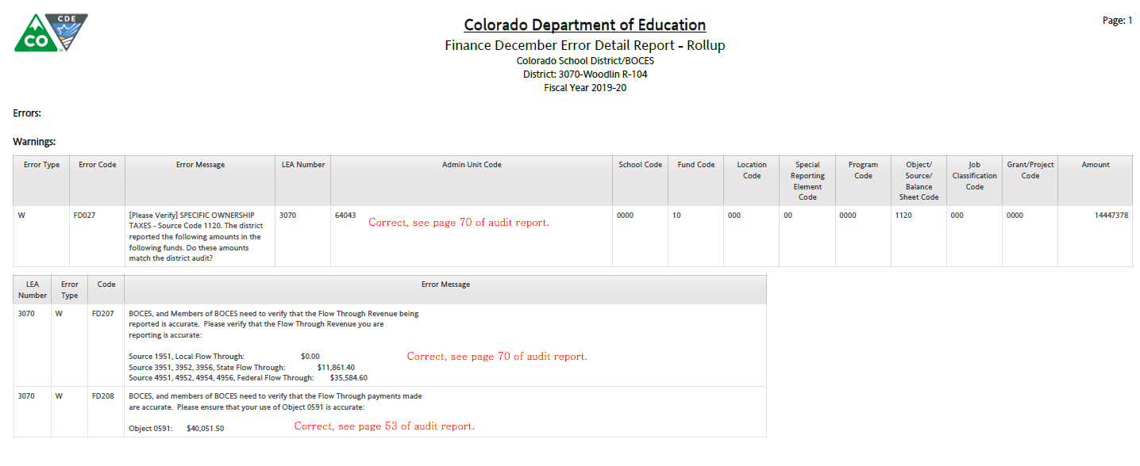
Finance-December
What does an acceptable edit error reconciliation look like:
Print off your Edit Error Roll-Up Report
Type/Write in your reconciliations & Email to CDE with Audit etc.

Slide 10
Finance-December
Extensions for FY19-20 Financial December Pipeline and Audit Submission
CDE does not grant extensions.
The Office of the State Auditor grants extensions, and CDE honors them.
The link to the OSA form is towards the bottom of the page here: https://leg.colorado.gov/agencies/office-state-auditor/local-government The link to the form itself:
https://leg.colorado.gov/content/request-extension-time-file-december-31-2019-audit
Note: Ideally the district should see if a board member can submit the form. Statute is specific that an extension must be requested by the governing body. OSA will still approve the extension if a non-board member submits the form, but the district will still have to get board member approval and submit that form with the audit. It will save the district a step if a board member makes the request.
Ensure you request an extension with OSA prior to December 31, 2020

Slide 11
Staff Reporting Guidance Jeremy Meredith

Slide 12
Staff Reporting Guidance
COVID-19 has changed how schools are delivering instruction, impacting staffing assignments.
Strategies like remote and hybrid learning and student cohorts to mitigate transmission of the virus have created situations where atypical staffing assignments have been implemented to meet needs and promote the health and safety of students. To name a few:
Teacher teaching multiple subjects outside areas of endorsement and/or in-field status
Principal, Assistant Principal, or other non-instructional staff stepping in to provide direct instruction
Substitute teacher leading instruction due to teacher illness, quarantine, or separation from school.
District education leaders have voiced questions about how to report staff in the CDE Staff Interchange Data Pipeline due to unique circumstances

Slide 13
New Guidance Available [https://www.cde.state.co.us/datapipeline/staffreportingduringcovidguidancedec2020]
Guidance has been developed that addresses various atypical staffing scenarios.
The guidance highlights appropriate coding and use of FTE %.
EDT in-field: CDE is working on offering opportunity for LEAs to exercise waiver in 20-21 year if needed. More to come soon.

Slide 14
Questions or Comments?
Thank You!
Jeremy Meredith, Senior Consultant, Title II Specialist, Federal Programs Unit [Meredith_J@cde.state.co.us]
Annette Severson, Principal Consultant, Data Specialist, Information Management Systems Unit [Severson_A@cde.state.co.us]

Slide 15
Connecting Colorado Students Grant (CCSG) DeLilah Collins

Slide 16
HB 20B-1001 Connecting Colorado Students Grant
Grant Release Date: December 18, 2020
Grant Due: January 8, 2021
Amount available: $20,000,000
Award period: February 1, 2021 – January 31, 2022
Application is largely the same with three new questions:
Description of how services will be prioritized for student who are most at risk of learning loss.
Indicate the additional funding that will be available to support the proposed solution
Timeline for implementation of proposed solution

Slide 17
ESSER Reminders Nazie Mohajeri-Nelson

Slide 18
ESSER Reminders
Application is Due December 31, 2020
Must have an application to CDE by this due date
Plan accordingly – December 31st is a state mandated furlough day for CDE employees
If you need an extension, please submit a request form
Due to Holidays and CDE closures, there will be no Office Hours on
December 24, 2020 [CDE closed for Christmas Eve]
January 31, 2020 [CDE employee furlough day – skeleton crew]
Next Office Hours: Thursday, January 7, 2021

Slide 19
Questions? Requests for Future Topics?

Slide 20
CDE Team Contact Information
CRF
Jennifer Okes, Chief Operating Officer (okes_j@cde.state.co.us)
Adam Williams, Financial Data Coordinator (Williams_a@cde.state.co.us)
Kate Bartlett, Turnaround Program Manager (Bartlett_k@cde.state.co.us)
…in partnership with the Governor’s Office and Office of the State Controller
ESSER
Nazie Mohajeri-Nelson, Director of ESEA Office (mohajeri-nelson_n@cde.state.co.us)
DeLilah Collins, Assistant Director of ESEA Office (collins_d@cde.state.co.us)
Grants Fiscal
Jennifer Austin, Director of Grants Fiscal Management (Austin_j@cde.state.co.us)
Robert Hawkins, Grants Fiscal Analyst (Hawkins_s@cde.state.co.us)
Steven Kaleda, Grants Fiscal Analyst (Kaleda_s@cde.state.co.us)

