Slide 1
CDE Office Hours
December 15, 2022

Slide 2
ESSER Office Hours
Topics
Updates and Reminders
Fiscal Distribution Tool
At-risk Indicator Measure
FY23 Fiscal Syncplicity Tutorial
Monitoring Updates and Q&A
Notes:
Nazie

Slide 3
Updates, Reminders, and Clarifications
Notes:
Nazie

Slide 4
Updates and Reminders
Thank you to everyone who has submitted their MoEquity Exception Forms for FY 2023!
Signed form submitted through Smartsheet
List of LEAs that meet the exception criteria
Using applications for ESSER reporting and evaluation
As you submit PARs, please correct any outstanding items
Please remember to update/revise placeholders. Must have final approval before funds are obligated.
Emails from our ESSER Team to check in
Revisions to Colorado’s ESSA State Plan are currently open for public comment until December 19
Recorded webinar to explain proposed changes
Survey to collection feedback
Website: https://www.cde.state.co.us/fedprograms/essa

Slide 5
Reminder of Construction Guidance
As we move forward with ESSER-funded activities, please keep the CDE construction guidance in mind when funding construction projects through ESSER.
Reasonable and Necessary
Prior Written Approval
Davis-Bacon Act
Construction Regulations under Part 75 (34 CFR §§ 75.600-75.618)
Insurance and Disposition of Property
Unnecessary and Duplicative Items
Buy American Act (Construction Projects after November 12, 2020)
Cost Price Analysis
Applicable Provisions
Reporting on Real Property
Monitoring
Attorney Consultation
Most recent USDE ESSER and GEER FAQ from 12/7/22.

Slide 6
ESEA Final Allocations
Are the ESEA/ESSA final allocations available?
FY22-23 ESEA (or ESSA) final allocations posted on Grants Fiscal’s State and Federal Grants Allocations website
Slight changes in allocations for Title I-A, Title II, and Title III (English Language Learners and Immigrant Set-Aside)
No changes in allocations for Title IV-A or V-B
Email notification after the final allocations populated into consolidated application
Notice a change in allocations? Make sure the consolidated application budget is balanced, rank order is intact for Title I, and set asides still meet requirements in Module C.
Submit changes as a Post-Award Revision (PAR)
Contact your regional contact if you have questions.

Slide 7
Fiscal Distribution Tool Demonstration
Joe Shields

Slide 8
At-risk Measure
Kate Bartlett

Slide 9
HB22-1202 At-Risk Measure Working Group
Beginning in FY 2023-24, HB 22-1202 creates a new at-risk measure in the school finance formula to identify students who are at risk of below-average academic outcomes due to socioeconomic disadvantage or poverty.
Created a working group to consider and make recommendations about:
collecting the necessary data to implement the measure;
developing the neighborhood socioeconomic status index and determining index factors;
determining how a student’s neighborhood socioeconomic index value should be incorporated;
conducting pre-implementation modeling and testing with actual data;
considering the impact of the new measure on other programs;
determining the distribution of at-risk funding, how districts and charter schools will demonstrate that at-risk funding is being used to serve at-risk students, the process for initially identifying students, and the design of a hold-harmless provision.
Follow our work here:
https://www.cde.state.co.us/cdefinance/atriskmeasureforschoolfinanceworkinggroup

Slide 10
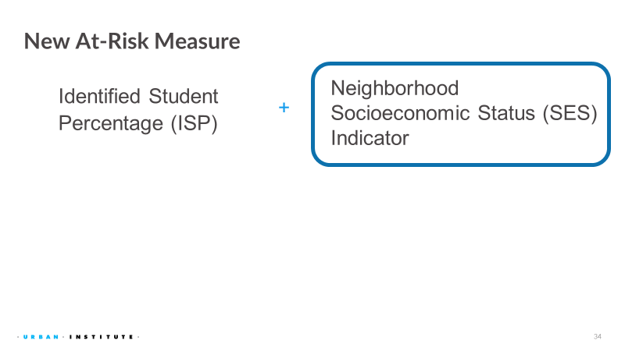
HB22-1202 At-Risk Measure Working Group

Slide 11
HB22-1202 At-Risk Measure Working Group

Slide 12
HB22-1202 At-Risk Measure Working Group
Socio-economic status (SES) Index Components selected by the working group from the American Community Survey:
Same residence (mobility)
BA or higher
median HH income
child living with non-biological parents
living in more crowded conditions
income to rent/mortgage
non-English language at home

Slide 13
HB22-1202 At-Risk Measure Working Group

Slide 14
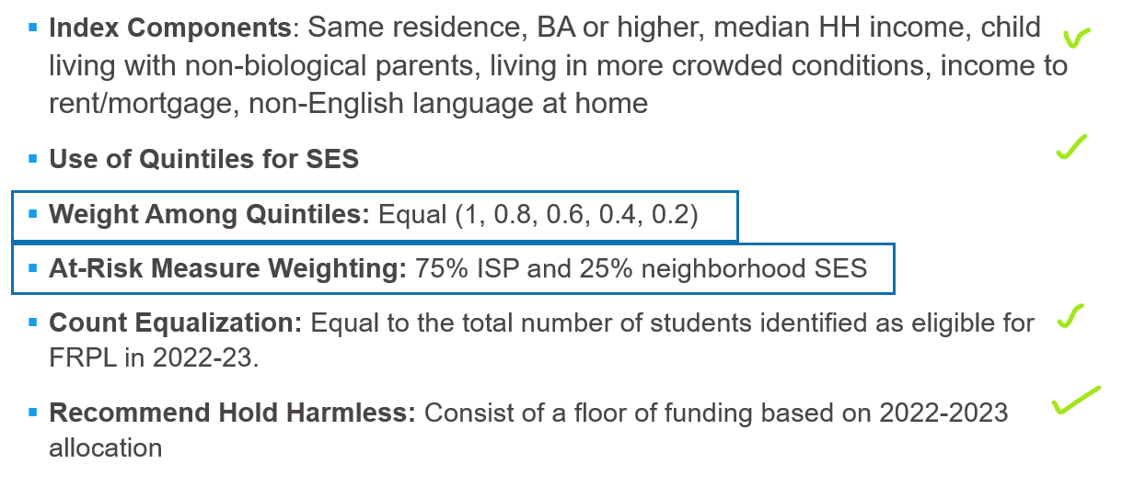
HB22-1202 At-Risk Measure Working Group
No consensus on these two elements. We will present a general range of alignment and options considered.

Slide 15
HB22-1202 At-Risk Measure Working Group

Slide 16
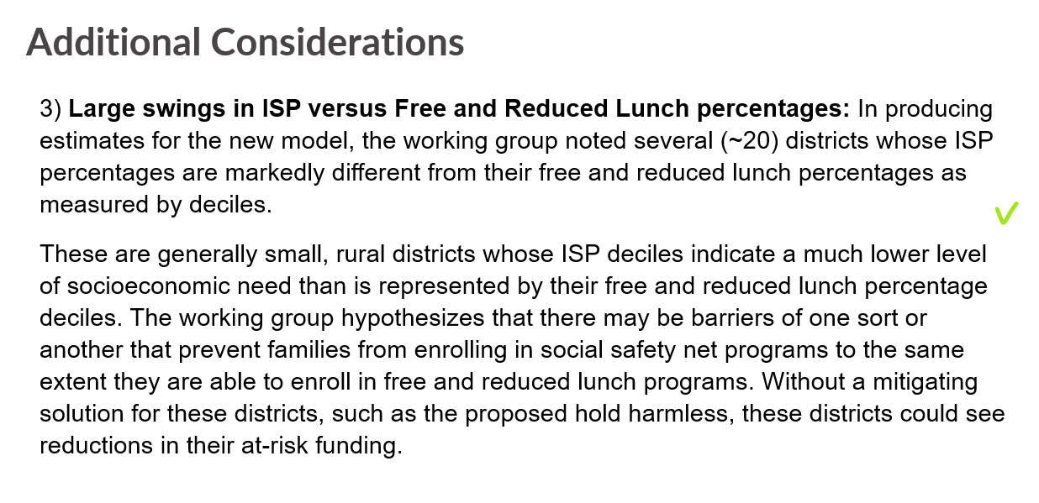
HB22-1202 At-Risk Measure Working Group

Slide 17
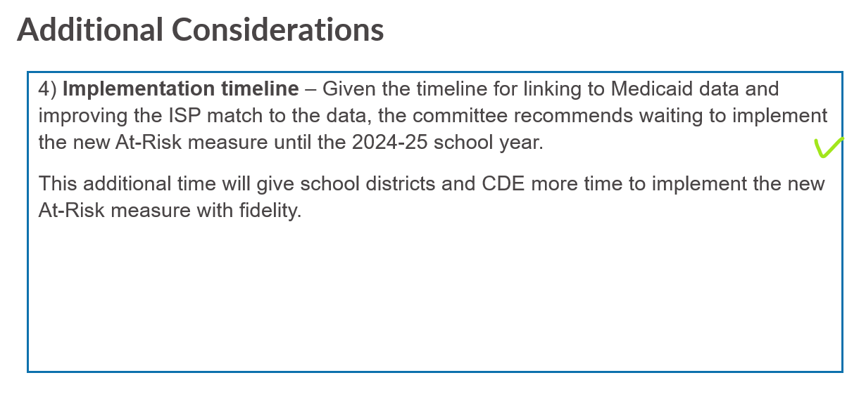
HB22-1202 At-Risk Measure Working Group

Slide 18
HB22-1202 At-Risk Measure Working Group
Next Steps:
Draft memo to present working group recommendations to Legislature
Memo due to Legislature end of January 2023

Slide 19
Monitoring
Notes:
Bill

Slide 20
FY23 Fiscal Syncplicity Tutorial
Notes:
Bill

Slide 21
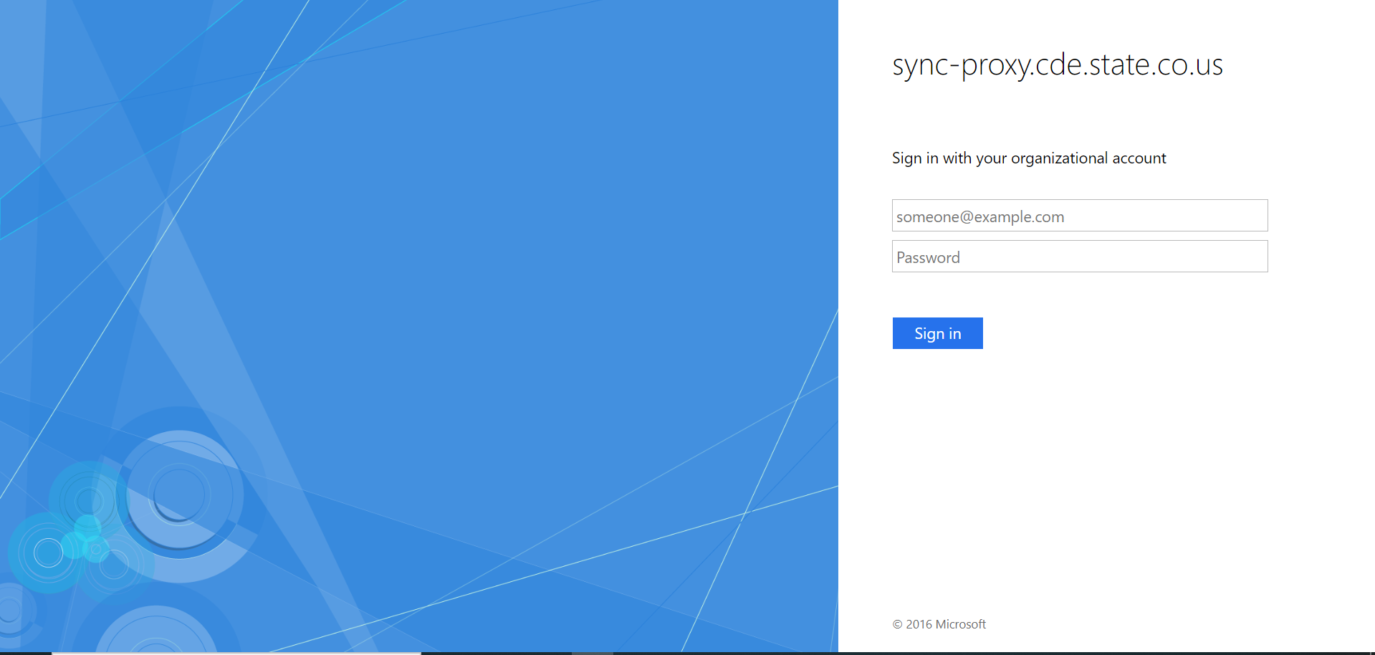
Step 1: Login to Syncplicity
Note, your access may look slightly different
If you need access to Syncplicity, please reach out to Kristin Crumley

Slide 22
Resetting Password if Needed
If you cannot remember your password, click on Reset Password

Slide 23
Resetting Password continued
Enter your email address, then click on Request Reset

Slide 24
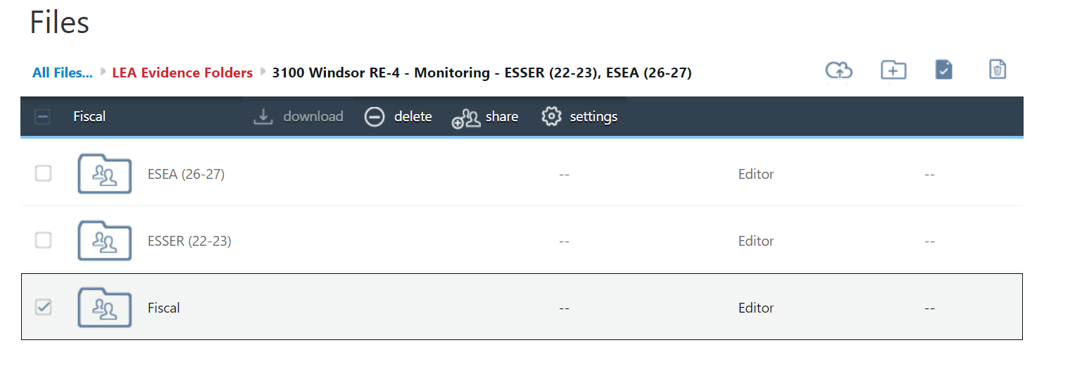
Step 2a: Ensure you are using the Fiscal folder
Note, your LEA may have more folders than shown
All Fiscal requests should be uploaded to the subfolders within the Fiscal folder

Slide 25
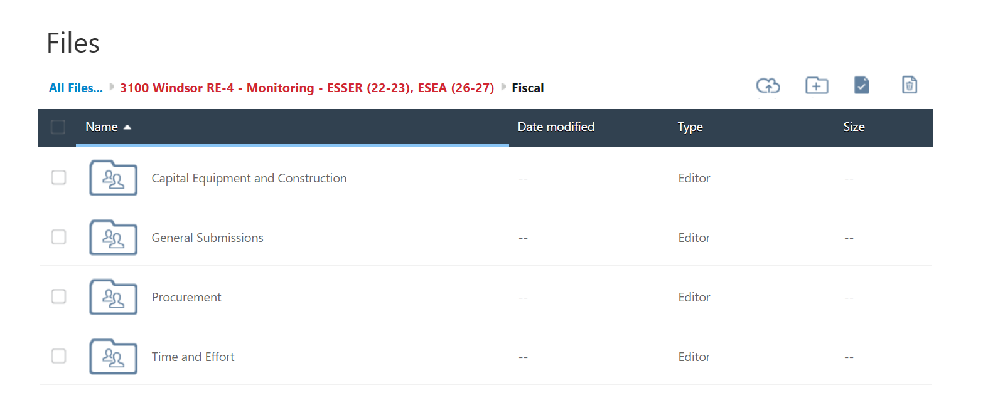
Step 2b: Fiscal subfolders
Every LEA should see these same four subfolders under Fiscal
Please reach out if you do not see these folders
Look to your Notification Letter for what documents should be uploaded initially
The next few slides will discuss each folder individually

Slide 26
Step 3a: Documents for General Submissions
Completed Fiscal Self Assessment
Signature page for Fiscal Self Assessment if completed separately
Anything not included in Steps 3b - 3d
The following only apply to Tier II and III monitoring
Detailed general ledger(s) by award (4-digit code) showing all ESSER (and ESEA as applicable) activity during FY22
Website link to written board policies or contact information for the person who can provide board policies upon request

Slide 27
Step 3b: Documents for Time and Effort
Applies to LEAs who:
Were selected for tier II or III monitoring and
Had FY22 expenditures for employee compensation
Initial document submission includes:
A list of employees, including titles, paid with ESSER (and ESEA as applicable) funds during FY22, if any
Can be a payroll register of ESSER (and ESEA as applicable) funded employees if that is easier
Procedure documents describing, in detail, the steps used by the LEA to document employee compensation
Note, these documents are different from the board policies

Slide 28
Step 3c: Documents for Procurement
Applies to LEAs who:
Were selected for tier II or III monitoring and
Had FY22 expenditures for anything other than employee compensation
Initial document submission includes:
Written documents (procedures, desk manual, etc) describing, in detail, the procurement process

Slide 29
Step 3d: Documents for Capital Equipment and Construction
Applies to LEAs who:
Were selected for tier II or III monitoring and
Had FY22 expenditures the met the capital threshold or were used as part of a construction project
Initial document submission includes:
Written documents (procedures, desk manual, etc) describing, in detail, the inventory management/tracking process

Slide 30
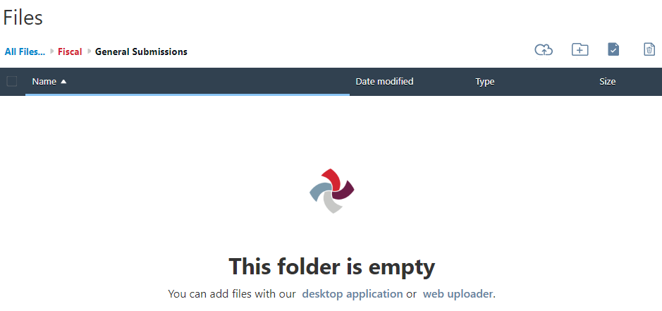
Step 4: How to upload
Use the web uploader or the cloud image to upload files

Slide 31
Any Questions?
Policies and Procedures Guide
http://www.cde.state.co.us/cdefisgrant/cderefcrepro
Any others?

Slide 32
Monitoring Q&A
Notes:
Nathan

Slide 33
LEA Questions
Q: Do I submit my self-assessments through Syncplicity?
A: The Program Monitoring Self-Assessment is submitted as a Google form. The Fiscal Self-Assessment will be submitted through Syncplicity.

Slide 34
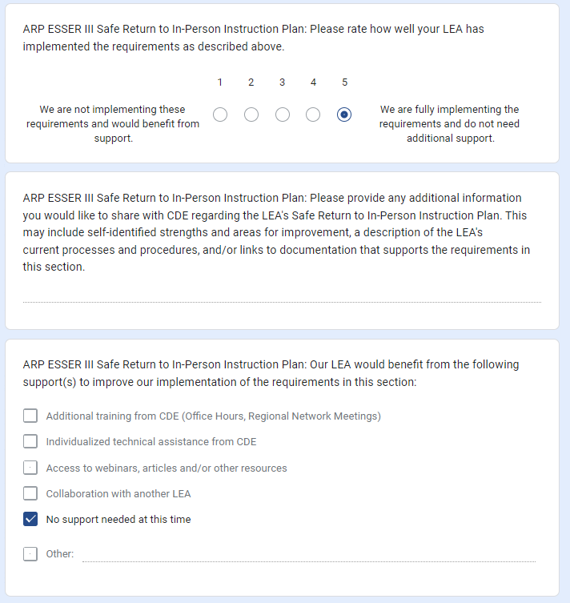
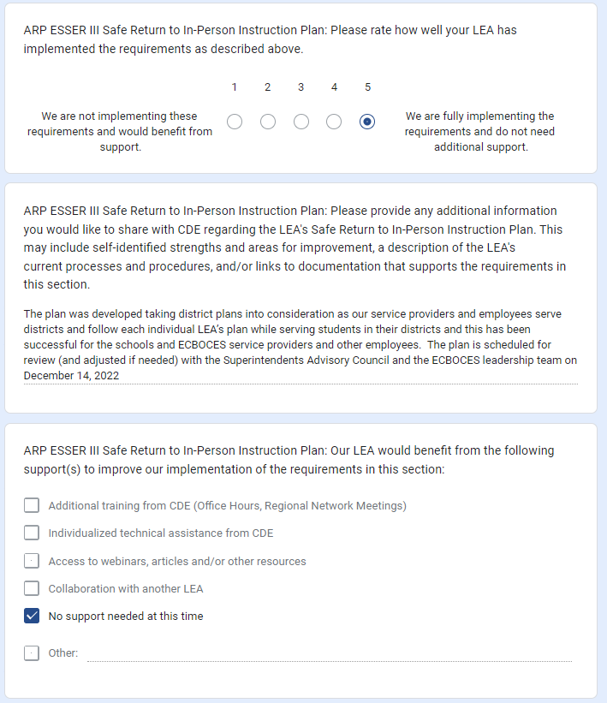
Program Monitoring Self-Assessment (PMSA)
THANK YOU for submitting!
Reminder: Please ensure that you are providing enough information for our team to determine how your rating was determined.
LEA 1 | LEA 2

Slide 35
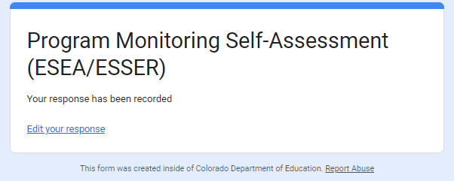
Using Google Forms for the PMSA
Responses are saved in the form until you submit.
Once you submit, you will have the opportunity to edit your responses.

Slide 36
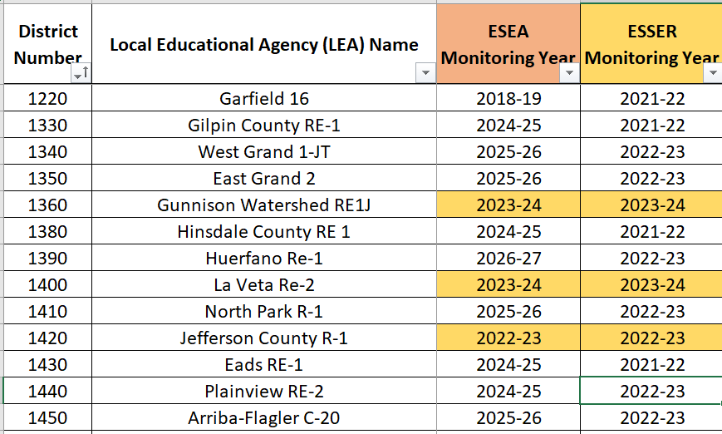
LEA Questions
Q: Our LEA is being monitored for both ESEA and ESSER, correct?
A: Please refer to the Monitoring Schedule or the LEA’s monitoring notification letter.

Slide 37
LEA Questions
Q: Both Title and ESSER need to fill out self assessments for both (a) fiscal and (b) program, correct? So, this would mean four different self assessments?
A: Each LEA being monitored will complete 2 self-assessments–the Program Monitoring Self-Assessment and the Fiscal Self-Assessment.

Slide 38
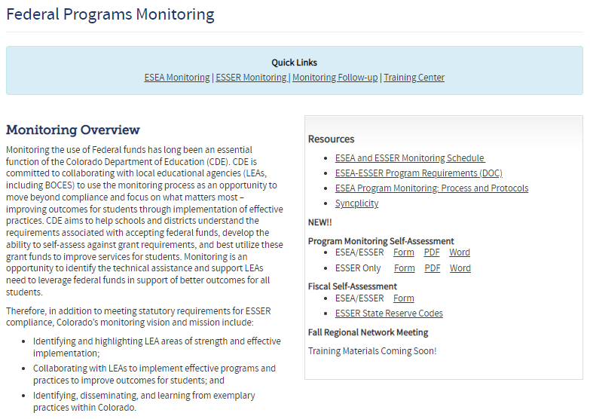
LEA Questions
Q: Where can I find the self-assessments?
The Program Monitoring and Fiscal Self-Assessments are now available on the Monitoring website.

Slide 39
When are the self-assessments due to CDE?
Please refer to the email your LEA received on 11/18/2022.
Your letter will include one of the following:
Upon completion, the PMSA and the FSA, as well as any supporting documentation identified in the LEA’s notification letter, will need to be submitted to CDE by January 13, 2023. Early submission is permitted. If you need additional time, please contact us to request an extension of the deadline.
Upon completion, the PMSA and the FSA, as well as any supporting documentation identified in the LEA’s notification letter, will need to be submitted to CDE by February 3, 2023. Early submission is permitted. If you need additional time, please contact us to request an extension of the deadline.

Slide 40
Time for Q&A
I need help with…
I would like CDE to provide…
I am wondering…
I would like to share…

Slide 41
Upcoming Meetings
Notes:
Nazie

Slide 42
Any Requests for Upcoming Topics or Questions!
Upcoming Office Hours
December Changes!
December 29 - Cancelled
January Changes!
January 12
January 26 - BruMan Training
February Changes!
February 9
February 23

Slide 43
CDE Contacts!
Emails: Lastname_Firstinitial@cde.state.co.us
(e.g., Smith_a@cde.state.co.us)
Federal Programs & Supports (ESEA/ESSER Program Supports) | School Finance & Operations (Fiscal and Systems Supports)
Nazie Mohajeri-Nelson, Executive Director of Federal Programs & Supports Unit Program Specialists Program Implementation Supervisor: Laura Meushaw Program Monitoring Supervisor: Tammy Giessinger Program Effectiveness Supervisor: Tina Negley ESEA Programs Specialists and ESEA Regional Contacts (assigned by district) Title I: Laura Meushaw, Evita Byrd, Rachel Echsner Title II: Karen Bixler Title III: Rachel Temple Title IV: Tammy Giessinger, Nathan Hickman Title V: Shannon Wilson ESSER Program Specialists Kristin Crumley Jonathan Schelke Kim Boylan Shannon Wilson ESEA and ESSER Data and Reporting Specialists Tina Negley Mary Shen Mackenzie Owens | Kate Bartlett, Executive Director of School District Operations Unit Fiscal Specialists Jennifer Austin, Director of Grants Fiscal Management ESEA Robert Hawkins, Grants Fiscal Analyst Steven Kaleda, Grants Fiscal Analyst ESSER Fiscal Specialist Steven Kaleda Grants Fiscal Analyst ESSER Monitoring Bill Parsley, ESSER Fiscal Monitoring Supervisor Hilery Morris, ESSER Fiscal Monitoring Kristina Jones, Federal Fiscal Monitoring and Reporting Specialist Werner Hagemann, ESSER Fiscal Monitoring Specialist Application Systems Specialists DeLilah Collins, Director of Grants Program Administration Online Applications Systems Technical Support Michelle Prael

