Slide 1
CDE Office Hours
December 14, 2023

Slide 2
ESSER Office Hours
Topics
Updates and Reminders
  ESSA Report Cards
  ESSER Reporting Requirements
  Title IV CSPR
Federally Funded Construction
SCG Call for Reviewers
Recent Federal Guidance on Non-public Schools
Welcome! In the chat:
Please enter your name, district, and the dates your offices will be closed for winter break!

Slide 3
Updates and Reminders

Slide 4
Reminders
Mark your calendars about the BruMan Training on January 25, 2024, starting at 1:00 p.m.
The Stronger Connection Grant Applications deadline has been extended to
Friday, December 22, 2023.
News from U.S. Department of Education:
Beware of emails soliciting payment for SAM.gov registration or renewal: Grantees and other entities are reporting they have received sophisticated emails that appear to be from SAM.gov. These emails include a phone number that is not the GSA Help Desk, but rather will solicit payment to renew registration. SAM.gov is free and will never ask for payment. Please see this article from GSA, Don’t Take the Bait: Beware of Misleading Marketing, Imposters, and Phishing for more information.

Slide 5
ESSA Report Cards
Annual reports are required to be posted on CDE’s and each LEA’s website about the performance of each school on a variety of school and student performance indicators, including ESSA identification results, and per-pupil expenditures.
Two options for meeting requirements:
Link to CDE’s ESSA Local Reports Webpage on your website; OR
Post a local report card that meets all ESSA requirements on your website and submit the link to Tina Negley.

Slide 6
ESSER Reporting Survey Deadline Extended
The deadline for all three FY 22-23 ESSER surveys was extended from December 1, 2023 to January 31, 2024.
To request technical assistance, email Mackenzie Owens or Tina Negley
LEA Participation in ESSER Activities Survey (submitted via Syncplicity).
  All LEAs, including AUs, BOCES, etc., must submit.
Re-engaging Students Survey (Google form)
  All LEAs who received an ESSER 90% allocation (districts) must submit.
School-Level Allocation Survey (Google form)
  All LEAs who received an ESSER 90% allocation (districts) and allocated funds to schools in their ESSER applications during FY 22-23 must submit.
Our reporting website contains the surveys and helpful resources for completing them. Annotated and example versions of the participation survey templates are now available.

Slide 7
22-23 Title IV-A Content Area Expenditures
Title IV-A Content Area Expenditures required by United States Department of Education
Expenditures reported in Annual Financial Reports (AFR)
Email to LEAs sent 11/28/23 and 12/1/23
As AFRs are closed, please send expenditures to hickman_n@cde.state.co.us by 12/15/23 in the following format:
LEA Name:
LEA Number:
Well Rounded Education: $
Safe and Healthy Students: $
Effective Use of Technology: $

Slide 8
Federally-Funded Construction
Requirements

Slide 9
New Final Rules from the U.S. Department of Labor
The Department of Labor has released Final Rules that update regulations issued under the Davis-Bacon and Related Acts, and apply to all construction contracts entered into on or after October 23, 2023.
The new rules are explained in a recorded webinar on the DOL’s website, which also includes an FAQ and comparison chart of the existing and new regulations that apply.

Slide 10
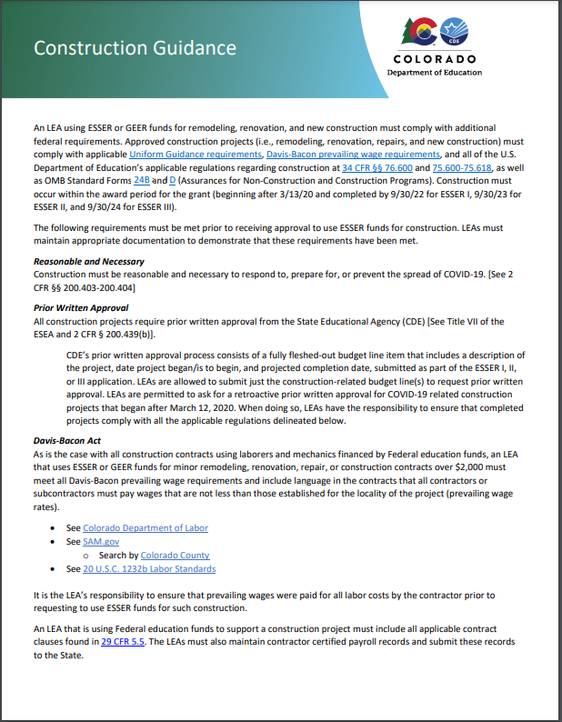
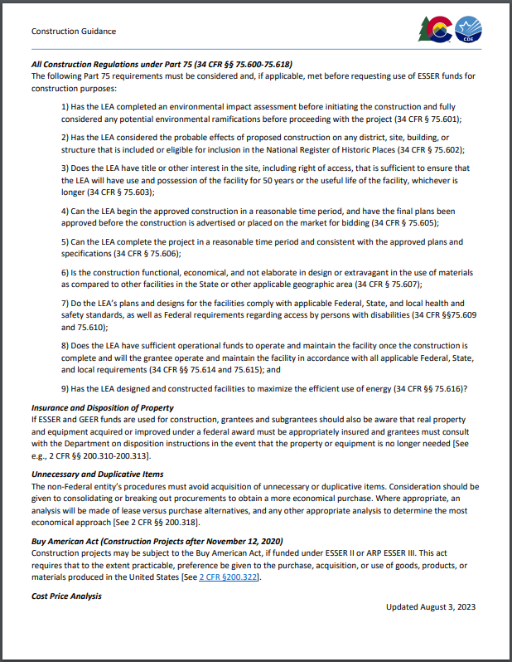
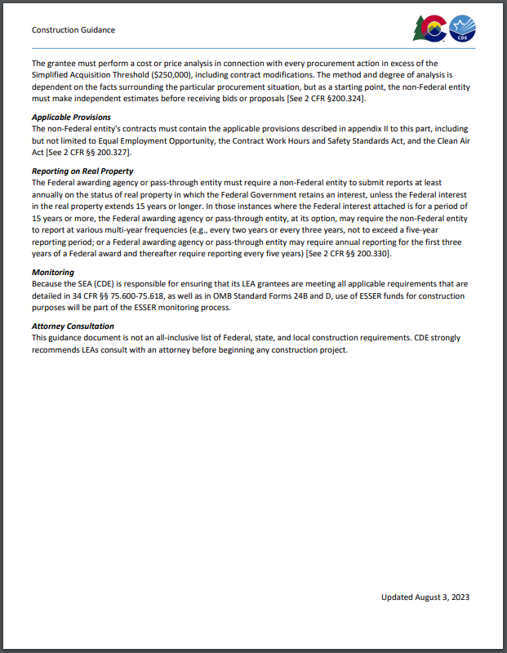
Construction Guidance
All construction projects must comply with applicable regulations, including Davis-Bacon prevailing wage requirements, as outlined in CDE’s Construction Guidance Document.

Slide 11
Helpful Links
Questions about construction requirements in general?
  View CDE’s Construction Guidance (includes link to Construction Program Assurances form, 424D).
Questions about legal standpoints on some ESSER hot topics?
  View the January 26, 2023 BruMan Training.
Questions about federally-funded equipment and requirements?
  View the March 3, 2022 Office Hours on Federally-Funded Equipment.
Questions about Davis-Bacon requirements?
  View the Davis-Bacon webinar provided by US DOL and hosted by ED and the Davis-Bacon Webinar 4.26.23 Attendee Questions and Answers.pdf.

Slide 12
Stronger Connections Grant (SCG)
Call for Reviewers

Slide 13
SCG Call for Reviewers
The Colorado Department of Education (CDE) is seeking volunteer peer reviewers for Stronger Connections Grant (SCG) applications. More information about this grant is available on CDE’s Stronger Connections Grant website.
It is preferred that reviewers have knowledge of physical education; mental health; social emotional wellness; sexual health; drug or violence prevention; chronic absenteeism; counseling services; promotion of a healthy school environment; health education; health services; and/or parent and community involvement.
If you are available and interested in participating in this virtual review process, please complete a brief survey regarding your experience and areas of expertise as soon as possible, but no later than Tuesday, January 9, 2024.
This review will be completed virtually, and there is no in-person review component. Reviewers should have a reliable internet connection.
Review Timeline:
Thursday, January 11, 2024: Reviewers receive materials
Thursday, January 11 – Thursday, February 1, 2024: Reviews
Reviewers will read and assess their assigned applications individually and then collaborate with their team members to determine consensus scores and feedback for each of their assigned applications.
Thursday, February 1, 2024: Scores due to CDE by noon
Team consensus scores and feedback for each assigned application are due to CDE. CDE staff will review team feedback and contact readers within the following week if any clarification is needed.

Slide 14
Equitable Services in Non-Public Schools
Update
New Guidance, Big Ideas, and Upcoming Learning Opportunity

Slide 15
Equitable Services Big Ideas:
In the spring and summer of 2023, updated guidance was issued by the US DE for both Title I and Title VIII Equitable Services.
Students in both Public and Non-Public Schools drive funds.
The LEA must maintain control of the funds, as well as being responsible for the design, implementation, and measuring academic impact of equitable services. (cannot only be provision of materials).
Consultation must be meaningful, timely and ongoing.

Slide 16
Meaningful Consultation:
The Answer to MOST Questions related to TI and TVIII
Meaningful Consultation does not apply to for-profits, stand alone Pre-K’s (typically), or home daycares.
Meaningful Consultation must be timely, occurring before the LEA is making final decisions about budgeting funds or transferring funds. The LEA can set reasonable, explicitly communicated deadlines for receiving information or input from NPS.
Meaningful Consultation is ongoing to ensure that needs of students in NPS are met in an equitable manner.
Meaningful Consultation is critical for most equitable services decisions. Both initiation of Contact and final service decisions are the responsibility of the LEA.
Written Affirmation that Meaningful Consultation has occurred is required and must be signed by the LEA and the NPS if equitable services will be provided.
The Complaint Process is a last resort for unresolvable issues and are sent to the Federal Programs Ombudsman to facilitate conversations. Informal facilitation is available without filing a complaint.

Slide 17
RESOURCES
Title I, Part A of the Elementary and Secondary Education Act Within District Allocations 2022
Title I, Part A of the Elementary and Secondary Education Act Equitable Services Non-Regulatory Guidance 2023
Title VIII, Part F of the Elementary and Secondary Education Act Equitable Services Non-Regulatory Guidance 2023
CDE Equitable Services Web Page (Updates in progress)

Slide 18
If this applies to you, watch for our targeted training opportunity to explore equitable services on January 18, 2024 from 9:30-11am.
Thank You!

Slide 19
Upcoming Meetings

Slide 20

Looking Ahead…
Any requests for topics or questions?
Upcoming Office Hours:
  January 11
  January 25, 1-2:30pm
    BruMan Training: SNS & Transitioning from ESSER to ESEA and/or IDEA
Happy Holidays! And Best Wishes for the New Year!!

Slide 21
CDE Contacts!
Emails: Lastname_Firstinitial@cde.state.co.us (e.g., Smith_a@cde.state.co.us)
Federal Programs & Supports (ESEA/ESSER Program Supports) | School Finance & Operations (Fiscal and Systems Supports)
Nazie Mohajeri-Nelson, Executive Director of Federal Programs & Supports Unit Program Specialists Program Implementation Supervisor: Laura Meushaw Program Implementation Coordinator: Christina Adeboye Sullivan Program Monitoring Supervisor: Tammy Giessinger ESEA/ESSER Monitoring Coordinator: Kristin Crumley Program Effectiveness Supervisor: Tina Negley Program Evaluation & Research Coordinator: Mary Shen ESEA Programs Specialists and ESEA Regional Contacts (assigned by district) Title I: Laura Meushaw, Evita Byrd, Rachel Echsner, Kim Boylan Title II: Rachel Echsner, Sue Miller-Curley Title III: Rachel Temple, Kim Boylan Title IV & Stronger Connections Grant: Nathan Hickman, Evita Byrd Title V: Christina Adeboye-Sullivan, Rachel Echsner ESSER Program Specialists Jonathan Schelke Kim Boylan Kriselda Craven ESEA and ESSER Data and Reporting Specialists Mackenzie Owens (ESSER) Melissa Chaffin (ESEA) Jerry Ring (ESEA) | Amy Carman, Executive Director of School District Operations Unit Fiscal Specialists Jennifer Austin, Director of Grants Fiscal Management ESEA Robert Hawkins, Grants Fiscal Analyst Steven Kaleda, Grants Fiscal Analyst ESSER Fiscal Specialist Steven Kaleda Grants Fiscal Analyst ESSER Monitoring Hilery Morris, ESSER Fiscal Monitoring Kristina Jones, Federal Fiscal Monitoring and Reporting Specialist Werner Hagemann, ESSER Fiscal Monitoring Specialist Application Systems Specialists DeLilah Collins, Director of Grants Program Administration Online Applications Systems Technical Support Michelle Prael

