Slide 1
CDE ESEA and ESSER Office Hours
December 12, 2024

Slide 2
ESEA/ESSER Office Hours
Topics:
Updates and Reminders
ESEA/ESSA Consolidated Application Post Award Revision (PAR) Training

Slide 3
ESEA Reminders and Updates

Slide 4
Updates and Reminders
Thank you for all the Requests for Funds in November!
Remaining ARP ESSER III Funds
ARP ESSER III Closeout
Final ESEA/ESSA Allocations ~ less than a 1% change across the board
  Uploaded in GAINS

Slide 5
Application Revision Process and Requirements
December 2024
Notes:
Hello! My name is Laura Meushaw for those of you who I have not had the pleasure of meeting. Today, I am going to facilitate a conversation about revisions to LEAs and BOCES Consolidated Applications. I say facilitate because my teammates are going to jump in if I miss anything and I would like you all to feel free to jump in if you have any questions or pop your questions into the chat.

Slide 6
Introduction
Purpose:
To discuss when an application revision is necessary.
To review how to submit a revision.
To share tips on how to format revision requests.
Notes:
The goal for our time today is to discuss when a revision to your application is necessary, how to submit a revision and share some tips on how to format revision requests so that we can get you approved quickly. For those who have been around the Consolidated Application for awhile, the revision process and requirements around when to submit have not really changed from previous years. However, with this being the first year for revisions in GAINS and the direct tie to request for funds, the system is prompting revisions where it hasn’t in the past so we wanted a time to collectively discuss the process.

Slide 7
Consolidated Application Grant Cycle
CDE grants Substantial Approval upon the submission of the ESEA Consolidated Application.
  LEAs can obligate funds for proposed activities in the budget.
  LEAs cannot request reimbursement yet.
Final Approval is granted after the application is reviewed by CDE and the LEA addresses CDE’s comments.
  LEAs can now request reimbursement.
Post Award Revisions can be submitted after Final Approval has been granted. An application revision is commonly referred to at CDE as a Post Award Revision (PAR).
Note: If CDE determines an activity is not allowable, the LEA will be asked to reallocate the funds to an allowable activity.
Notes:
Wanted to start by briefly discussing the Consolidated Application grant cycle and where we currently are in the flow. During the summer when your LEA or BOCES submitted a complete application, the application was immediately given Substantial Approval. Substantial approval allowed the LEA begin to obligate funds for proposed activities. Once the application was completely reviewed by CDE staff and given final approval, the LEA could begin requested reimbursement for approved expenditures. After Final Approval, an LEA may delete activities, add activities, make adjustments to the approved budget. We call this process Post Award Revisions or PAR for short.

Slide 8
Purpose of the Post Award Revision
The PAR process is an opportunity for LEAs and BOCES to:
revise the activities and budgets that were approved in the initial Consolidated Application.
receive approval for additional activities that more align with the current needs and available funding.
ensure that the activities being implemented by the LEA match the activities in the Consolidated Application.
Notes:
As I mentioned, the PAR process is an opportunity for LEAs and BOCES to (READ)
The Consolidated Application should supplement current programming to ensure that the students for which these funds are designed have the supports and resources necessary to be successful. The plan the LEA had for that in June might not be meeting the current needs. Or it could be just right. The PAR process allows the LEA to adjust as needed.

Slide 9
When To Submit Post Award Revision
  To add new activities that better align with current context or account for changes from preliminary to final allocations.
  To reflect changes in the project/program scope or objective, such as:
    Professional development activities to purchasing Instructional materials or
    Professional development activities to hiring an Interventionist.
  Changes among direct cost programs (Instructional, Support, Improvement of Instructional Services, or Administrative) or object categories (Salaries, Benefits, etc.) that exceed, or are expected to exceed, 10% of the total budget for that object category as last approved.
  If users would like to request an amount under an Object Code or Function Code that is currently unavailable, the grantee will need to complete a revision and have it approved by CDE before a request can be created.
  Any changes to equipment purchases require program approval.
  To update indirect costs amounts
    A change in direct costs may impact indirect costs
Note: All PARs need to be approved by CDE prior to drawing down funds.
Notes:
As I mentioned the “when to submit” has not changed but we did want to spend some time for our new folks. Keep in mind this list is likely not exhaustive but it does cover the most common reasons to submit. First reason an LEA may submit a PAR is to

Slide 10
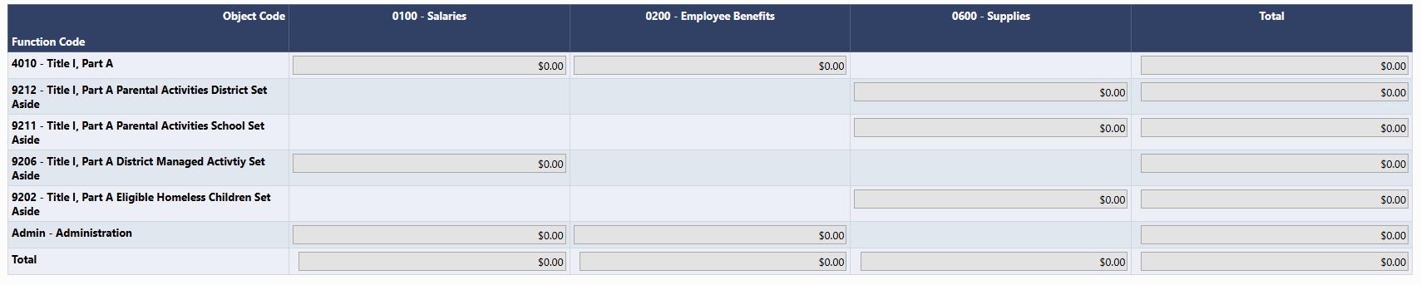
Example of a Request for Funds
This example illustrates the object codes that have available funds. A revision would be required if this no longer represents the needs of the LEA.
Notes:
Putting a placeholder thought here...we should show an example of needing a PAR when there aren't enough funds in a function code/object code to complete a request for funds
Any district that has an open revision will not stop them from submitting a fund request.
Can’t submit with a request in the hopper for a particular title.

Slide 11
How to Complete
a Revision in GAINS

Slide 12
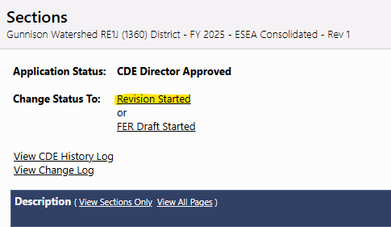
Submitting a Revision in GAINS
Before an LEA or BOCES can begin making changes, the Application Status must be changed to Revision Started.
Note: The following roles can start a revision.
LEA All Funding Applications Director
LEA Authorized Representative
LEA ESEA Consolidated Director
LEA Fiscal Representative.
Note: Hovering over the status change will allow someone to view who in the organization has the appropriate roles to change the status.

Slide 13
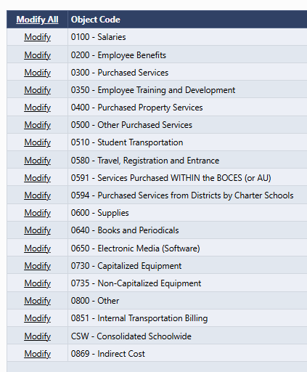
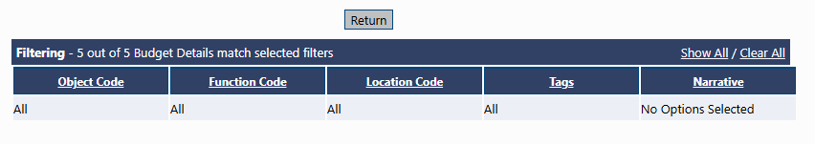
Locating Budget Line Items to Update
There are different ways to access the budget line items for revisions:
Clicking “Modify All” will bring up all budget line items within the Title program. To narrow the view, utilize the Filter options at the top of the screen.
Or, click on the specific Object Code and click “Modify” to begin the revision process.

Slide 14
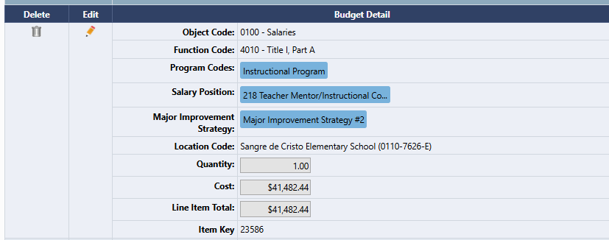
Modifying Budget Line Items
Once the line item is located, click on the Pencil icon to make changes:

Slide 15
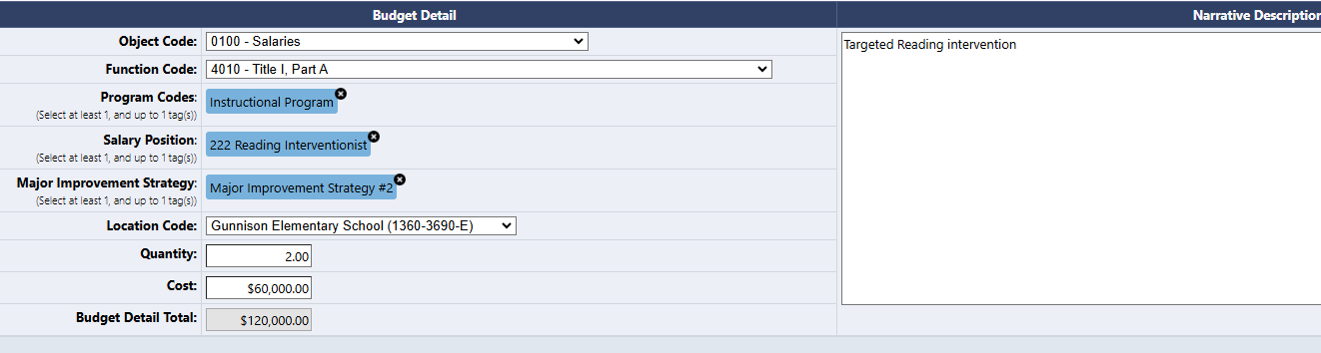
Modifying Budget Line Items, continued
The line item is now open and ready for changes:

Slide 16
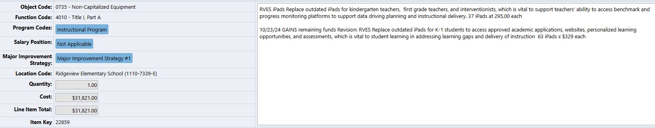
What To Include in a Revision
Include the date of the revision
Summarize what has been changed in the line item including any dollar amount adjustment, FTE adjustment and/or number of supply items
  The detail will allow the reviewer to determine reasonableness of the expense.
  Provide a rationale for the revision.
Ensure that any codes or tags are adjusted accordingly.
Notes:
Reviewers use information to determine reasonableness.

Slide 17
Examples
Replace outdated iPads for kindergarten teachers, first grade teachers and interventionists, which is vital to support teachers’ ability to access benchmark and progress monitoring platforms to support data driving planning and instructional delivery. 37 iPads at $295.00 each.
10/23/24 GAINS remaining funds Revision: Replace outdated iPads for K-1 students to access approved academic applications, websites, personalized learning opportunities, and assessments, which is vital to student learning gaps and delivery of instruction 63 iPads x $329 each.
EES Hourly Tutor - Hire a reading tutor to support instruction and interventions for students with content gaps. 1 FTE. $30 hr, 5 hours a day, 5 days a week, approx. 180 days a year 10/22/24 GAINS remaining funds Revision. Hire an additional part-time tutor to support instruction and interventions for students with content gaps during the school day. FTE. $30 hr, 5 hours a day, 5 days a week, approx 130 days this year.

Slide 18
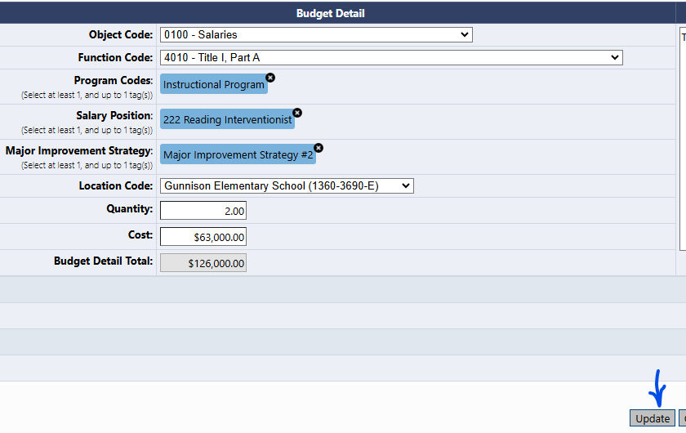
Modifying Budget Line Items Continuation
When revisions to a line item is complete, click “Update” at the bottom of the screen.

Slide 19
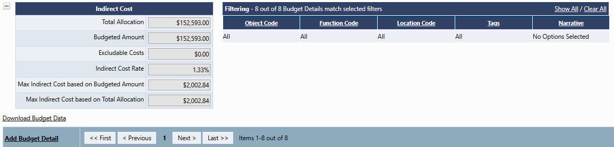
Adding a New Budget Item
An LEA/BOCES that is no longer planning on implementing an approved line item will need to delete the entire line rather than zeroing it out.
To add a new budget line item,
On the Budget Detail page, the LEA can add a new budget line item. Include the following
  Include the date of the added line item.
  Indicate the line item that was adjusted or deleted that created the funding.
  Summarize the purpose of the expenditure including any detail to determine reasonableness (i.e., FTE, number of items, number of staff involved).
  Ensure that any necessary codes or tags are included.

Slide 20
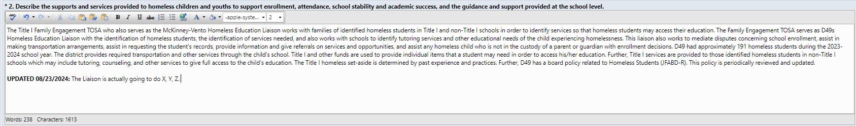
Narrative Revisions
Narratives are open and editable
Examples of when a narrative change may be necessary
  New or Adjustment to Major Improvement Strategy
  New Title IV budget line that is not captured in the LEA’s current objectives
  Significant shift in an LEA’s processes
For edits to the narrative, we are asking other applications that they indicate changes by emphasizing the location and date of the change.

Slide 21
Considerations Before Submitting
This week final allocations were populated into the LEAs/BOCES budget.
  Balance the budget to adjust for allocation changes from preliminary to final.
  Allocations will be posted on the Grants Fiscal website.
Update any necessary district contact information.
  CDE uses the Consolidated Application contact page to communicate important information related to the application, school improvement requirements, and accountability.
Review Rank Order and any applicable set-aside requirements.
Notes:
We also ask that you take this opportunity to review your district contact information and make any necessary changes necessary. This will help facilitate communication between LEAS, BOCES, and CDE.

Slide 22
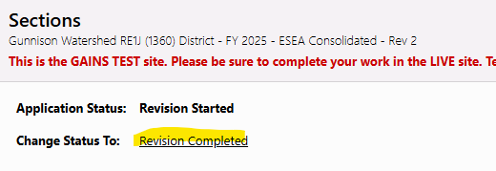
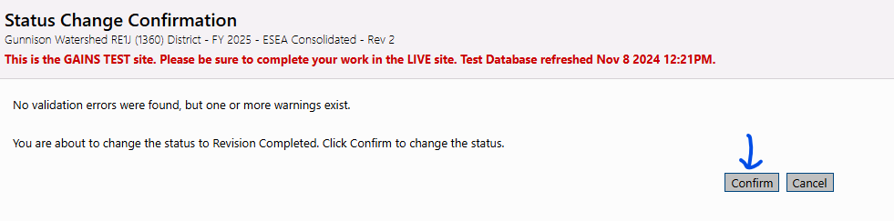
Re-submission Process
Once all changes have been made, return to the Sections page and change the Status to Revision Completed.
After clicking Revision Completed, a message will appear to confirm the change in status. Click “Confirm.”

Slide 23
Complete Revision
Once the revisions are completed, the approval steps will follow the same workflow as the original application.
Once the application is at LEA Authorized Representative Approved, it will be ready for CDE’s review and approval.
Draft Completed
LEA Fiscal Representative Approved
LEA Authorized Representative Approved.

Slide 24
Next Steps
After Revision Submission

Slide 25
PAR Review and Approval
CDE program staff will review revision requests on a continuous basis.
An LEA can anticipate a response within two weeks of submission.
  If more information is needed prior to approval, CDE will return application for revisions.
  Any comments will be captured in the ESEA Consolidated Checklist.
Notes:
You should anticipate a response with approval or a request for additional information no later than two weeks after submitting a revision request.
As always, please feel free to reach out to your ESEA Regional Contact with questions. Our contact information is included on the this slide. Please note that the ESSER Contact link downloads an Excel file with a list of all the ESSER contacts by LEA. You can also send general questions to consolidatedapplications@cde.state.co.us.
We are here to help! Please call us if you need support or have any questions.
We look forward to working with you during the Post-Award Revision process.
Thank you for your time!

Slide 26
Resources
For program specific questions, contact the LEA’s ESEA Regional Contact.
GAINS Roles
Guidance on Grant Fund Requests in GAINS

Slide 27
Questions?

Slide 28
Upcoming Meetings

Slide 29
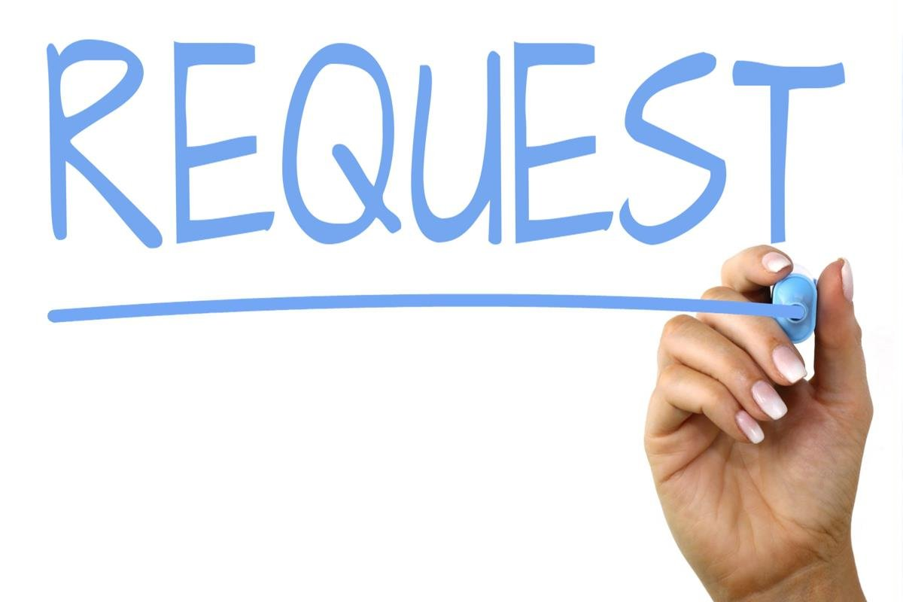
Looking Ahead…
Any requests for topics or questions?
Upcoming Office Hours
  January 2 - Cancelled
  January 16
  January 30

Slide 30
CDE Contacts!
Emails: Lastname_Firstinitial@cde.state.co.us (e.g., Smith_a@cde.state.co.us)
Federal Programs & Supports (ESEA/ESSER Program Supports) | School Finance & Operations (Fiscal and Systems Supports)
Nazie Mohajeri-Nelson, Executive Director of Federal Programs & Supports Unit Program Specialists Program Implementation Supervisor: Laura Meushaw Program Implementation Coordinator: Christina Adeboye Sullivan Program Monitoring Supervisor: Tammy Giessinger ESEA/ESSER Monitoring Coordinator: Kristin Crumley Program Effectiveness Supervisor: Tina Negley Program Evaluation & Research Coordinator: Anna Rowan Strategic Recovery Office (ESSER State Reserve): Matt Koziol ESEA Programs Specialists and ESEA Regional Contacts (assigned by district) Title I: Laura Meushaw, Evita Byrd, Rachel Echsner, Kim Boylan Title II: Rachel Echsner, Sue Miller-Curley Title III: Rachel Temple, Kim Boylan Title IV & Stronger Connections Grant: Nathan Hickman, Evita Byrd Title V: Christina Adeboye-Sullivan, Rachel Echsner ESSER Program Specialists Kriselda Craven Nadine Penn ESEA and ESSER Data and Reporting Specialists Melissa Chaffin (ESEA) Jerry Ring (ESEA) Anna Rowan (ESEA) | Vacant, Executive Director of School District Operations Unit Fiscal Specialists Jennifer Austin, Director of Grants Fiscal Management ESEA Robert Hawkins, Grants Fiscal Analyst Steven Kaleda, Grants Fiscal Analyst ESSER Fiscal Specialist Steven Kaleda Grants Fiscal Analyst ESSER Monitoring Bill Parsley, ESSER Fiscal Monitoring Supervisor Hilery Morris, ESSER Fiscal Monitoring Application Systems Specialists DeLilah Collins, Director of Grants Program Administration Online Applications Systems Technical Support Jessica Hollingshead Michelle Prael

