Slide 1
CDE Office Hours
December 9, 2021

Slide 2
CDE Team!
CDE Contacts!
Emails: LastName_FirstInital@cde.state.co.us
ESSER/ESEA Program Partners
Nazie Mohajeri-Nelson, Director of ESEA Office (mohajeri-nelson_n@cde.state.co.us)
DeLilah Collins, Assistant Director of ESEA Office (collins_d@cde.state.co.us)
ESEA Regional Contacts assigned by district
  Title I: Laura Meushaw, Kathryn Wisner, Niko Kaloudis
  Title II: Niko Kaloudis
  Title III: Kathryn Wisner
  Title IV: Tammy Giessinger, Michelle Prael
  Title V: Kristen Collins
ESSER Team
  Kristin Crumley, ESSER Monitoring Specialist (Crumley_k@cde.state.co.us)
  Jonathan Schelke, ESSER Monitoring Specialist (schelke_j@cde.state.co.us)
  Shannon Wilson, ESSER/ESEA Grants Administration Coordinator (Wilson_s@cde.state.co.us)
  Mackenzie Owens, ESSER Reporting Specialist (owens_m@cde.state.co.us)
Data, Accountability, Reporting, and Evaluation
  Tina Negley, Alan Shimmin, Mary Shen, and Mackenzie Owens
Fiscal Partners
Jennifer Okes, Chief Operating Officer (okes_j@cde.state.co.us)
Kate Bartlett, Executive Director of School District Operations (Bartlett_k@cde.state.co.us)
Jennifer Austin, Director of Grants Fiscal Management (Austin_j@cde.state.co.us)
Robert Hawkins, Grants Fiscal Analyst (Hawkins_s@cde.state.co.us)
Steven Kaleda, Grants Fiscal Analyst (Kaleda_s@cde.state.co.us)
ESSER Team
  Bill Parsley, ESSER Fiscal Monitoring Supervisor (parsley_w@cde.state.co.us)
  Hilery Morris, ESSER Fiscal Monitoring (morris_h@cde.state.co.us)
  Sharon Mackey, ESSER Fiscal Monitoring (mackey_s@cde.state.co.us)

Slide 3
ESSER Office Hours
Topics
Updates and Reminders
ARP HCY – Q&A
IDEA Maintenance of Effort
Data Reporting Requirements
Notes:
Nazie

Slide 4
Updates, Reminders, and Clarifications

Slide 5
Reminders
Upcoming deadlines!
ESSER II – Applications must have final approval by 1/6/22
Please submit as soon as possible
ARP ESSER III – LEA Use of Funds Plans due to CDE by 12/16/21
Online application
Submit responses to all narrative questions
Submit link to the Safe In-Person and LEA Use of Funds Plans posted on the LEA website [as soon as possible]
Submit response to narrative question 1 and full budget (zero balance; can include placeholders)

Slide 6
Narrative Question 1 Reminders

Slide 7
Narrative Question 1
Narrative response should be a concise paragraph that answers the four guiding questions
Do not need to include specific data; rather, summarize sources used
Feel free to copy and paste from the provided template
If your process has been more detailed, keep record of your process for use in monitoring and reporting

Slide 8
Narrative Example
1. In what ways have students been impacted by lost instructional time (the pandemic)?
•Exemplary Education Agency has analyzed [insert your LEA data]. Based on data results, EEA has determined that all students experienced [insert identified student needs].
•Data has been disaggregated for the groups listed in this question. Data shows [insert student needs] for [insert identified student groups] compared to the general student population.
•In selecting our evidence-based interventions, we focused on research-based approaches to address [insert high level priorities based on students needs] in order to respond to the identified student academic, social, emotional, and mental health needs. These interventions are detailed in the budget.
•EEA schools will be [insert methods for measuring impact of interventions] in order to measure the impact of our interventions on students’ academic, social, and behavioral needs.
2. Have any student groups been disproportionately impacted? If so, which ones?
3. How were the evidence-based interventions selected to respond to identified A.S.E.M. needs and any identified disproportionate impact?
4. How will we measure the success of the interventions on students’ academic, social, emotional, and mental health needs?

Slide 9
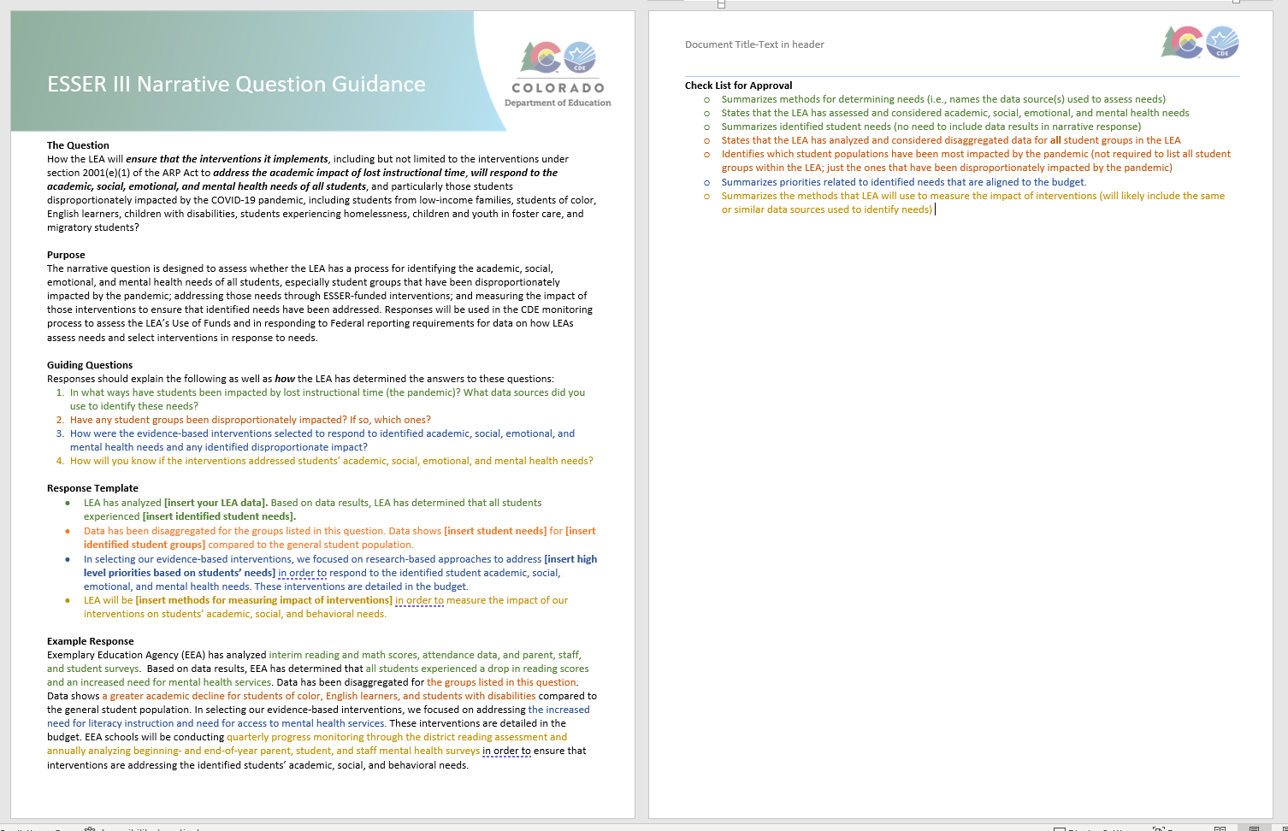
Narrative Question Guidance

Slide 10
Example 1
Example District 1 has analyzed interim reading and math scores, attendance data, and parent, staff, and student surveys. Based on data results, Example District 1 has determined that all students experienced a drop in reading and math scores and an increased need for mental health services. Data has been disaggregated for the groups listed in this question. Data shows a greater academic decline for students of color, English learners, and students with disabilities compared to the general student population. In selecting our evidence-based interventions, we focused on addressing the increased need for literacy and math instruction and need for access to mental health services. These interventions are detailed in the budget. All Example District 1 schools will be conducting NWEA assessments beginning, middle, and end of year in both literacy and math and annually analyzing beginning- and end-of-year parent, student, and staff mental health surveys in order to ensure that interventions are addressing the identified students’ academic, social, and behavioral needs.

Slide 11
Example 2
Example District 2 has analyzed interim reading and math scores using NWEA and iStation data; attendance data collected from our database by the Truancy Prevention Specialist; and staff, parent and student input. Based on data results, Example District 2 has determined that all students experienced a decrease in reading and math scores and an increased need in mental health services. Data has been disaggregated for the groups listed in this question. Data shows a greater academic decline for students with disabilities, English Learners and homeless compared to the general student population. In selecting our evidence-based interventions, we focused on research-based approaches to addressing the increased need for reading and math instruction and the need for access to mental health services. In order to respond to the identified student academic, social, emotional and mental needs, these interventions are detailed in the budget. Example District 2 will be conducting beginning, middle and end of year progress monitoring through the district reading and math assessments to be sure interventions are addressing the identified student academic, social, emotional and behavioral needs.

Slide 12
ARP HCY II
Any Questions?

Slide 13
ARP HCY
Application Deadline for Formula Funding to Support McKinney Students Has Been Extended
The applications to apply for the U.S. Department of Education section 2001(b)(1) of the American Rescue Plan Act of 2021 funding to help support school districts in serving students experiencing homelessness has been extended to Tuesday, March 1, 2022.
The purposes of this funding include increasing the identification of homeless children and youth, providing wraparound services considering the impact of the COVID-19 pandemic, and providing assistance needed to enable homeless children and youth to attend school and participate fully in school activities.
Applications must be completed and submitted through an online application. Please see complete details and additional information on the McKinney-Vento Homeless Education Webpage.
Our HCY Colleagues will be here next week to answer any questions! In the meantime, please don’t hesitate to contact Dana Scott or Paula Gumina.

Slide 14
ESSER and IDEA MOE
Evan Davis
Colorado Department of Education
Office of Grants Fiscal

Slide 15
ESSER and State and Local Special Education expenses
    Ordinarily required under ESEA grants, but not under ESSER:
    Based on a Comprehensive Needs Assessment
    Supplemental supports & services
    Serving eligible schools and students
    Still required under ESSER:
    Reasonable and Necessary
    Funding considerations
    LEAs can use the ESSER funds to cover declines in state/local funds. However, ESSER will provide only temporary support and will not be a permanent replacement for lost state funds. – avoid the funding cliff!
    SNS for Titles IA, IIA, IVA do not implicate federal funds, only state/local. However, Title IC (Migrant Education) and Title IIIA do reference federal funds, so be careful, these could present SNS issue.
Reminder: ESSER Funds were calculated using LEAs’ Title I, Part A funding formula. However, ESSER Funds are not Title I funds. There are important flexibilities related to ESEA-type activities under ESSER.

Slide 16
ESSER and State and Local Special Education expenses
Question:
  Is there a “supplement not supplant” requirement for ESSER and GEER funds?
Answer:
  No. The ARP Act, the CRRSA Act, and the CARES Act, however, include detailed provisions requiring States to maintain effort for elementary and secondary education and higher education. (See the Maintenance of Effort FAQs.) Maintenance of effort provisions are designed to keep States from substantially reducing their support for K–12 education and higher education. While these Acts do not address maintenance of effort requirements associated with other Federal funds, such as those for IDEA and ESEA, States and LEAs must be mindful that these requirements continue to apply.
  https://oese.ed.gov/files/2021/05/ESSER.GEER_.FAQs_5.26.21_745AM_FINALb0cd6833f6f46e03ba2d97d30aff953260028045f9ef3b18ea602db4b32b1d99.pdf

Slide 17
ESSER and State and Local Special Education expenses
Question:
  Can federal ESSER I, II, III funds be used to replace state and/or local Special Education expenses (Grant Code 3130 and/or 3131)
Answer:
  For the purposes of the IDEA, CARES Act (ESSER I), CRRSA Act (ESSER II), and ARP Act (ESSER III) funds are considered Federal funds and may not replace State and local funds in LEA MOE calculations. As a result, if an LEA uses CARES Act, CRRSA Act, or ARP Act funds to replace State or local funding for the education of children with disabilities, this may result in a failure of the LEA to meet the budget and/or expenditure requirements for LEA MOE under IDEA.

Slide 18
ESSER and State and Local Special Education expenses
IDEA contains an LEA MOE requirement in addition to the State MOE requirements in the CARES Act, CRRSA Act, and ARP Act, and the State and LEA maintenance of equity requirements in the ARP Act.
Under section 613(a)(2)(A)(iii) of IDEA and 34 CFR § 300.203, an LEA must both:
      (1) budget, for the education of children with disabilities, at least the same amount as the LEA spent for that purpose from the same source (either local funds or a combination of State and local funds, on an aggregate or per capita basis) in the most recent fiscal year for which information is available; and
      (2) expend, for the education of children with disabilities, at least the same amount as the LEA spent for that purpose from the same source (either local funds or a combination of State and local funds, on an aggregate or per capita basis) for the preceding fiscal year.
Under IDEA, these budget and expenditure requirements for LEA MOE are termed “eligibility” and “compliance” standards, respectively.

Slide 19
ESSER and State and Local Special Education expenses
While IDEA does not provide for MOE waivers, there are exceptions and an adjustment to the LEA MOE requirements that may allow an LEA to reduce its MOE budget and expenditures below the level of expenditures for the education of children with disabilities made by the LEA for the appropriate comparison years (for the eligibility standard) and the preceding fiscal year (for the compliance standard)). (See 34 CFR §§ 300.204 and 300.205.)
https://cifr.wested.org/wp-content/uploads/2021/04/CIFR-LEA-MOE-QRG.pdf

Slide 20
Questions
Any Questions?

Slide 21

Contact
Resources:
https://sites.ed.gov/idea/regs/b/c
CDE Contact:
Evan​ Davis
Federal Fiscal Grant Supervisor
Office of Grants Fiscal Management
Phone 303.866.6129
Davis_E@cde.state.co.us

Slide 22
ESSER Data Reporting Requirements

Slide 23
ESSER Reporting Form
USDE has asked each state to collect and report data on all three ESSERs through four reporting periods
The information collected is gathered from the ESSER applications, including the budgets, plans, and narrative statements
The first reporting period has already ended
  CDE sent back the first reporting form to USDE in early 2021
The current reporting form that CDE will complete and send to USDE in early 2022 is located here:
  https://www.reginfo.gov/public/do/PRAViewIC?ref_nbr=202106-1810-006&icID=242779

Slide 24
ESSER I Reporting Period
ESSER I under the Coronavirus Aid, Relief, and Economic Security (CARES) Act:
Annual Report | Due Date | Applicable Reporting Period
Second Annual Report | Early 2022 | October 1, 2020-September 30, 2021
Third Annual Report | Early 2023 | October 1, 2021-September 30, 2022
Fourth Annual Report | Early 2024 | October 1, 2022-September 30, 2023

Slide 25
ESSER II Reporting Period
ESSER II under the Coronavirus Response and Relief Supplemental Appropriations (CRRSA) Act:
Annual Report | Due Date | Applicable Reporting Period
First Annual Report | Early 2022 | October 1, 2020-September 30, 2021
Second Annual Report | Early 2023 | October 1, 2021-September 30, 2022
Third Annual Report | Early 2024 | October 1, 2022-September 30, 2023
Fourth Annual Report | Early 2025 | October 1, 2023-September 30, 2024

Slide 26
ESSER III Reporting Period
ARP ESSER under the American Rescue Plan (ARP) Act:
Annual Report | Due Date | Applicable Reporting Period
First Annual Report | Early 2022 | October 1, 2020-September 30, 2021
Second Annual Report | Early 2023 | October 1, 2021-September 30, 2022
Third Annual Report | Early 2024 | October 1, 2022-September 30, 2023
Fourth Annual Report | Early 2025 | October 1, 2023-September 30, 2024

Slide 27
ESSER Reporting Form Elements
Data elements of the form include:
  Section 1: Overall ESSER Fund Grants for SEA
  Section 2: ESSER SEA Reserve
  Section 3: Mandatory Subgrants to LEAs
  Section 4: Equitable Support for Learning Recovery and/or Acceleration
  Section 5: Full-Time Equivalent (FTE) Positions
  Section 6: Maintenance of Equity

Slide 28
Section 1: Overall Fund Grants for SEA
Total grant amount allocated to SEA
Total grant amount expended by SEA and all State subrecipients in prior and current reporting period
Total amount of remaining grant funds
Amount of remaining funds planned for specific purpose

Slide 29
Section 2: ESSER SEA Reserve
Total amount reserved by SEA
Total amount retained by SEA for implementation of evidence-based interventions (EBIs) specifically targeting lost instructional time, including:
  Summer learning, extended day or year, afterschool programs, etc.
Total amount retained by SEA for administrative costs and emergency needs
Total amount awarded to LEAs and non-LEA entities
Total amount awarded and expended by LEAs, plan for remaining funds, and use of LEA funds under three categories:
  Addressing Physical Health and Safety
  Meeting Students’ Academic, Social, Emotional, Mental Health, and Other Needs
  Operational Continuity and Other Uses
  For ARP ESSER III, EBI activities are reported upon
Narrative questions

Slide 30
Section 3: Mandatory Subgrants to LEAs
Total subgrant amount awarded to each LEA
LEA use of funds, expended and planned, for each ESSER under three broad categories, split up into 25 subcategories:
  Addressing Physical Health and Safety
  Meeting Students’ Academic, Social, Emotional, Mental Health, and Other Needs
  Operational Continuity and Other Uses
  For ARP ESSER III, EBI activities are reported upon
Other LEA use of fund categories reported upon:
  Internet Access
  Maintaining Safe-In Person Instruction
  Reengaging Students
  Staff Salaries and Benefits and Hiring and Retention
  Equitable Allocations to Title I Schools
  Percentage of expenditures providing targeted supports to students disproportionately impacted by COVID-19

Slide 31
Section 4: Equitable Support for Learning Recovery and/or Acceleration
Methods used by each LEA to identify which students were most impacted by COVID-19 and how the LEA allocated funds to schools
Methods used by each LEA to support learning recovery or acceleration for subpopulations who were disproportionately impacted by the COVID-19 pandemic (in table on right)
Count of FTE staff assigned to serve each school in LEA, regardless of funding source
Students with one or more disabilities
Low-income students
English learners
Students in foster care
Migratory students
Students experiencing homelessness
American Indian/Alaska Native
Asian/Pacific Islander
Hispanic
Black, non-Hispanic
White, non-Hispanic
Other student subpopulation (Please specify): __________________

Slide 32
Section 4 Reporting Table:

Slide 33
Section 5: FTE Positions
Provide the number of full-time equivalent (FTE) positions for the LEA, or non-LEA Entity as of the listed reporting dates. (The number of FTE positions includes all staff regardless of whether the position is funded by Federal, State, local, or other funds—and equals the sum of the number of full-time positions plus the full-time equivalent of the number of part-time positions.)

Slide 34
Section 6: Maintenance of Equity
The statewide per-pupil amount of State funds allocated or appropriated to all LEAs in the State in FY 2021
The statewide per-pupil amount of State funds allocated or appropriated to all LEAs in the State in FY 2022
Per-pupil reduction of overall State funds for FY 2022
Provide the per-pupil amount of State funding appropriated or allocated by fiscal year for each high-need LEA as identified by the SEA
Provide the per-pupil amount of State funding appropriated or allocated by fiscal year for each highest-poverty LEA as identified by the SEA

Slide 35
Filling Out the Form
With the data from the ESSER applications, CDE can fill out large portions of the form
Some data elements, such as the Table 4 reporting table, may require additional surveys or forms sent to LEAs to collect more information in the future
Please keep in mind these reporting requirements as you collect your own data and records
These are based on proposed reporting! Once finalized, we will determine if/what data elements would be needed from LEAs moving forward and will update you at a future office hours

Slide 36
Upcoming Meetings

Slide 37

Any Requests for Upcoming Topics or Questions!
Upcoming Office Hours:
12/16/21 ~ Funding construction with ESSER funds and the strings attached
12/23/21 ~ No Office Hours in observance of Christmas holiday
12/30/21 ~ No Office Hours – CDE will be closed between the Christmas and New Year’s holidays

Slide 38
CDE Team!
CDE Contacts!
Emails: LastName_FirstInital@cde.state.co.us
ESSER/ESEA Program Partners
Nazie Mohajeri-Nelson, Director of ESEA Office (mohajeri-nelson_n@cde.state.co.us)
DeLilah Collins, Assistant Director of ESEA Office (collins_d@cde.state.co.us)
ESEA Regional Contacts assigned by district
  Title I: Laura Meushaw, Kathryn Wisner, Niko Kaloudis
  Title II: Niko Kaloudis
  Title III: Kathryn Wisner
  Title IV: Tammy Giessinger, Michelle Prael
  Title V: Kristen Collins
ESSER Team
  Kristin Crumley, ESSER Monitoring Specialist (Crumley_k@cde.state.co.us)
  Jonathan Schelke, ESSER Monitoring Specialist (schelke_j@cde.state.co.us)
  Shannon Wilson, ESSER/ESEA Grants Administration Coordinator (Wilson_s@cde.state.co.us)
  Mackenzie Owens, ESSER Reporting Specialist (owens_m@cde.state.co.us)
Data, Accountability, Reporting, and Evaluation
  Tina Negley, Alan Shimmin, Mary Shen, and Mackenzie Owens
Fiscal Partners
Jennifer Okes, Chief Operating Officer (okes_j@cde.state.co.us)
Kate Bartlett, Executive Director of School District Operations (Bartlett_k@cde.state.co.us)
Jennifer Austin, Director of Grants Fiscal Management (Austin_j@cde.state.co.us)
Robert Hawkins, Grants Fiscal Analyst (Hawkins_s@cde.state.co.us)
Steven Kaleda, Grants Fiscal Analyst (Kaleda_s@cde.state.co.us)
ESSER Team
  Bill Parsley, ESSER Fiscal Monitoring Supervisor (parsley_w@cde.state.co.us)
  Hilery Morris, ESSER Fiscal Monitoring (morris_h@cde.state.co.us)
  Sharon Mackey, ESSER Fiscal Monitoring (mackey_s@cde.state.co.us)

