Slide 1
CDE Office Hours
December 2, 2021

Slide 2
CDE Team!
CDE Contacts!
Emails: LastName_FirstInital@cde.state.co.us
ESSER/ESEA Program Partners
Nazie Mohajeri-Nelson, Director of ESEA Office (mohajeri-nelson_n@cde.state.co.us)
DeLilah Collins, Assistant Director of ESEA Office (collins_d@cde.state.co.us)
ESEA Regional Contacts assigned by district
  Title I: Laura Meushaw, Kathryn Wisner, Niko Kaloudis
  Title II: Niko Kaloudis
  Title III: Kathryn Wisner
  Title IV: Tammy Giessinger, Michelle Prael
  Title V: Kristen Collins
ESSER Team
  Kristin Crumley, ESSER Monitoring Specialist (Crumley_k@cde.state.co.us)
  Jonathan Schelke, ESSER Monitoring Specialist (schelke_j@cde.state.co.us)
  Shannon Wilson, ESSER/ESEA Grants Administration Coordinator (Wilson_s@cde.state.co.us)
  Mackenzie Owens, ESSER Reporting Specialist (owens_m@cde.state.co.us)
Data, Accountability, Reporting, and Evaluation
  Tina Negley, Alan Shimmin, Mary Shen, and Mackenzie Owens
Fiscal Partners
Jennifer Okes, Chief Operating Officer (okes_j@cde.state.co.us)
Kate Bartlett, Executive Director of School District Operations (Bartlett_k@cde.state.co.us)
Jennifer Austin, Director of Grants Fiscal Management (Austin_j@cde.state.co.us)
Robert Hawkins, Grants Fiscal Analyst (Hawkins_s@cde.state.co.us)
Steven Kaleda, Grants Fiscal Analyst (Kaleda_s@cde.state.co.us)
ESSER Team
  Bill Parsley, ESSER Fiscal Monitoring Supervisor (parsley_w@cde.state.co.us)
  Hilery Morris, ESSER Fiscal Monitoring (morris_h@cde.state.co.us)
  Sharon Mackey, ESSER Fiscal Monitoring (mackey_s@cde.state.co.us)

Slide 3
ESSER Office Hours
Topics
Updates and Reminders
ARP HCY II
Notes:
Nazie

Slide 4
Updates, Reminders, and Clarifications

Slide 5
Status Update on ESSER Applications (I, II, and ARP III)
All ESSER grants are reimbursement grants!
Substantial approval – can obligate funds
Final approval – can request reimbursement for expended funds
ESSER I
Carryover / Tydings year
Any unexpended funds – submit budget items via online application
ESSER II
29 application on the LEA side, waiting for revisions from the LEA ~ cannot request reimbursement until final approval – please submit revisions ASAP
ARP ESSER III
35 districts have not yet submitted online application / LEA Use of Funds Plans (due 12/16/21)
21 have submitted budget, but are missing the narrative question (also due 12/16/21)
Funds must be spent and drawn down by 9/30/22
All applications must have final approval by 1/6/22!!

Slide 6
Reminders and Clarifications
ARP ESSER III
LEA Use of Funds Plans
Must be developed with stakeholder input
Must be submitted to CDE by 12/16/21
Must be posted on the LEA’s website as soon as possible (but no set deadline)
Must describe (respond to narrative questions in the online application):
  Plans for ensuring that the evidence-based interventions are responding to the social, emotional, mental health, and academic needs of students
  Plans for the 20% set aside for addressing impact of lost instructional time
  Plans for the 80%, including any strategies for preventing or mitigating the impact of COVID-19 on safety and health of students
Option 1
Ready to
Submit Budget
Respond to first narrative question in the online application
Submit a full budget
Option 2
Need Time to
Develop Budget
Respond to all three narrative questions in the online application by 12/16/21
Submit a full budget by beginning of March 2022
Can include placeholder items for future years
Submit both by 12/16/21
Caution! Would not be able to draw down funds until final approval!

Slide 7
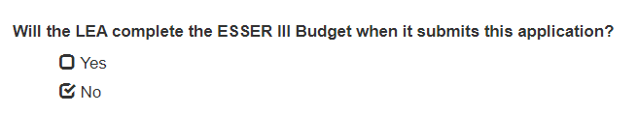
Narrative Questions
If your budget will not be ready to submit by 12/16/21, then the following narrative questions must be responded to in the online application by 12/16/21:
  How will the LEA ensure that the interventions it implements, including but not limited to the interventions under section 2001(e)(1) of the ARP Act to address the academic impact of lost instructional time, will respond to the academic, social, emotional, and mental health needs of all students, and particularly those students disproportionately impacted by the COVID-19 pandemic, including students from low-income families, students of color, English learners, children with disabilities, students experiencing homelessness, children and youth in foster care, and migratory students?
  Will the LEA complete the ESSER III Budget when it submits this application? [Select ‘No’ to submit other narrative responses]
  How will the LEA use the funds it reserves under section 2001(e)(1) of the ARP Act (totaling not less than 20 percent of the LEA’s total allocation of ARP ESSER funds) to address the academic impact of the pandemic/lost instructional time through the implementation of evidence-based interventions, such as summer learning or summer enrichment, extended day, comprehensive afterschool programs, or extended year programs?
  How will the LEA spend its remaining ARP ESSER funds (not to exceed 80%) consistent with section 2001(e)(2) of the ARP Act?
Option 1 =
Q1 + Budget by 12/16/21
All Applicants Respond
Option 2 = All questions by 12/16/21; Budget submitted later

Slide 8
Updates on Resources and Webpages
ARP ESSER III Requirements
  LEA Use of Funds Plans Resources
    For guidance on how to answer Narrative Question 1, see CDE's Narrative Question Guidance or see the office hours presentation and slides (PPT) from August 26, 2021.
    For guidance on how and what to post on the LEA website to meet statutory requirements,
    see the Use of Funds Plan Guidance (PDF).
    List of LEA Plans
Other trainings that might be helpful with LEA Use of Funds plan development:
Resources and Technical Assistance Page where all previous office hour PowerPoints and recordings can be found.
                ARP ESSER III LEA Plan Requirements
            On August 26th, CDE recorded a presentation on ARP ESSER III LEA plan requirements, and the narrative question. The recording and PowerPoint are included below.
            PowerPoint | Recording

Slide 9
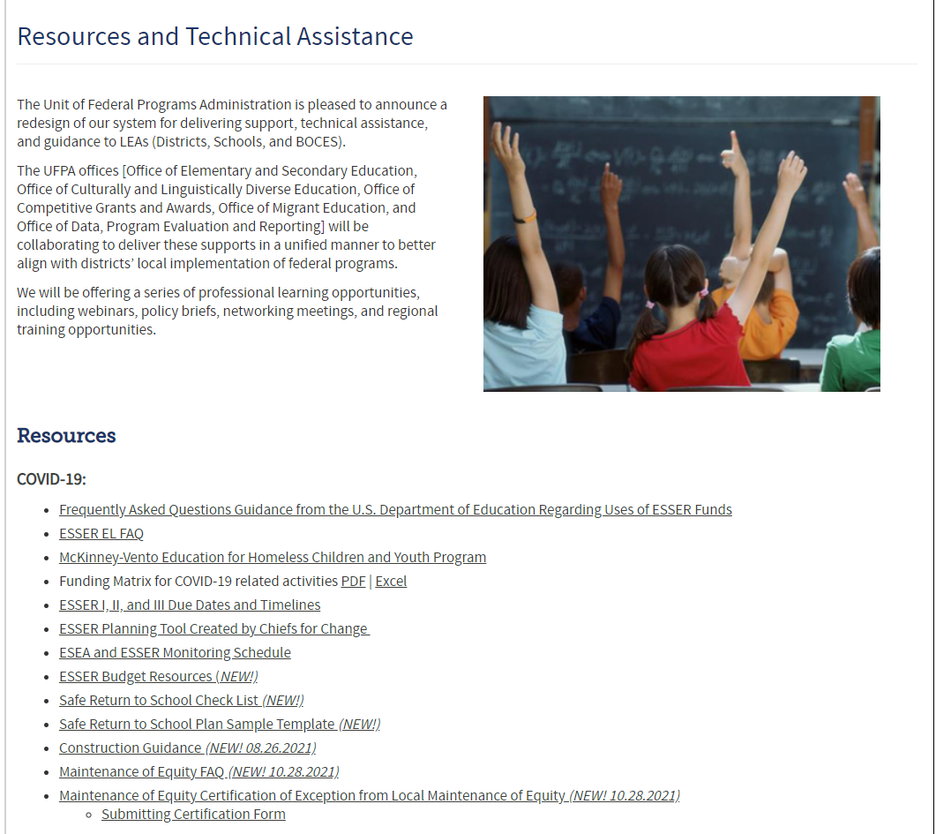
Updates on Resources and Webpages
Resources webpage
COVID-19:
Frequently Asked Questions Guidance from the U.S. Department of Education Regarding Uses of ESSER Funds
ESSER EL FAQ
McKinney-Vento Education for Homeless Children and Youth Program
Funding Matrix for COVID-19 related activities PDF | Excel
ESSER I, II, and III Due Dates and Timelines
ESSER Planning Tool Created by Chiefs for Change
ESEA and ESSER Monitoring Schedule
ESSER Budget Resources (NEW!)
Safe Return to School Check List (NEW!)
Safe Return to School Plan Sample Template (NEW!)
Construction Guidance (NEW! 08.26.2021)
Maintenance of Equity FAQ (NEW! 10.28.2021)
Maintenance of Equity Certification of Exception from Local Maintenance of Equity (NEW! 10.28.2021)
  Submitting Certification Form

Slide 10

Updates on Resources and Webpages
Federal COVID Education Funding

Slide 11
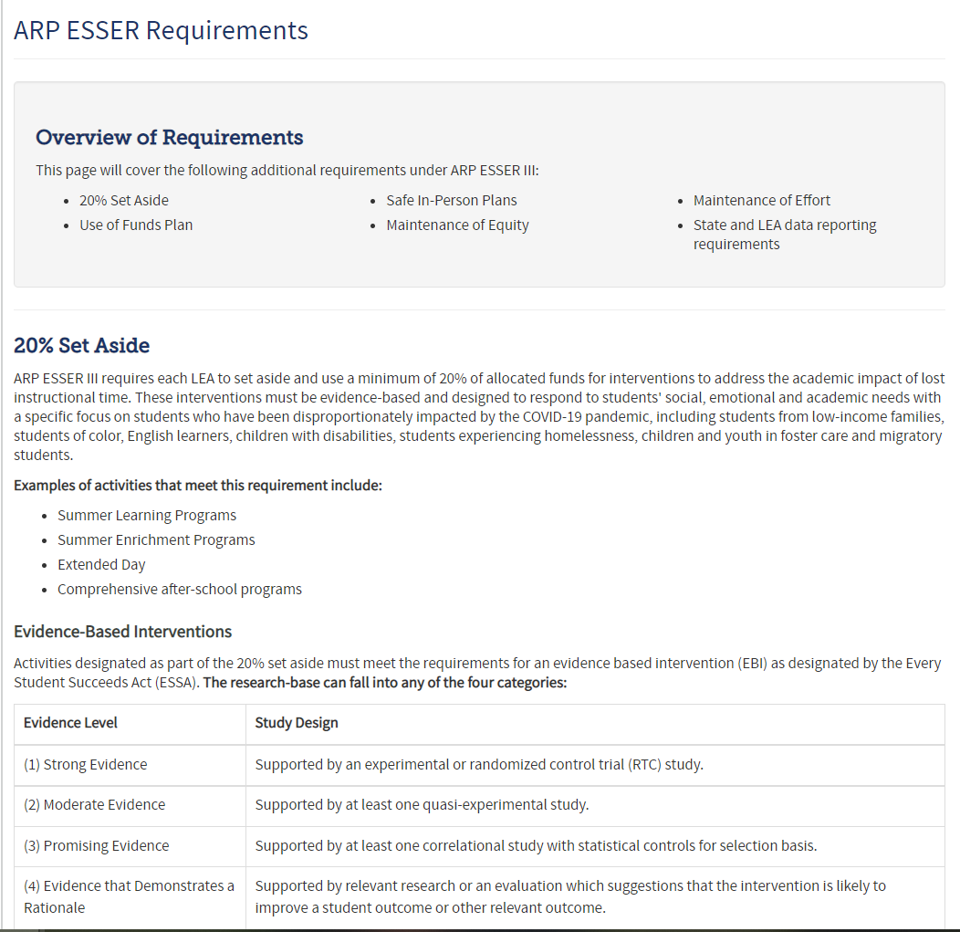
Updates on Resources and Webpages
ARP ESSER III Requirements

Slide 12
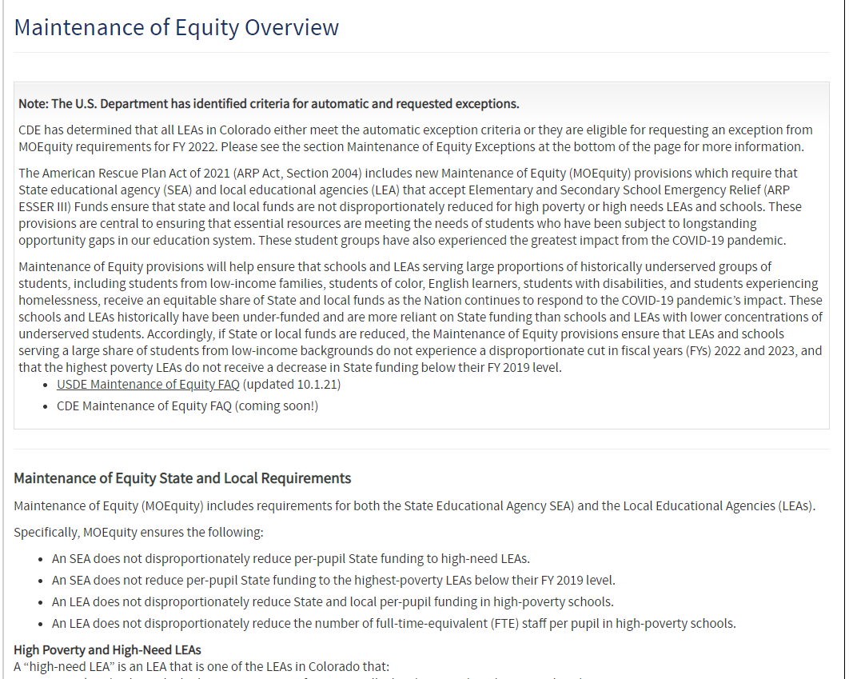
Updates on Resources and Webpages
Maintenance of Equity

Slide 13
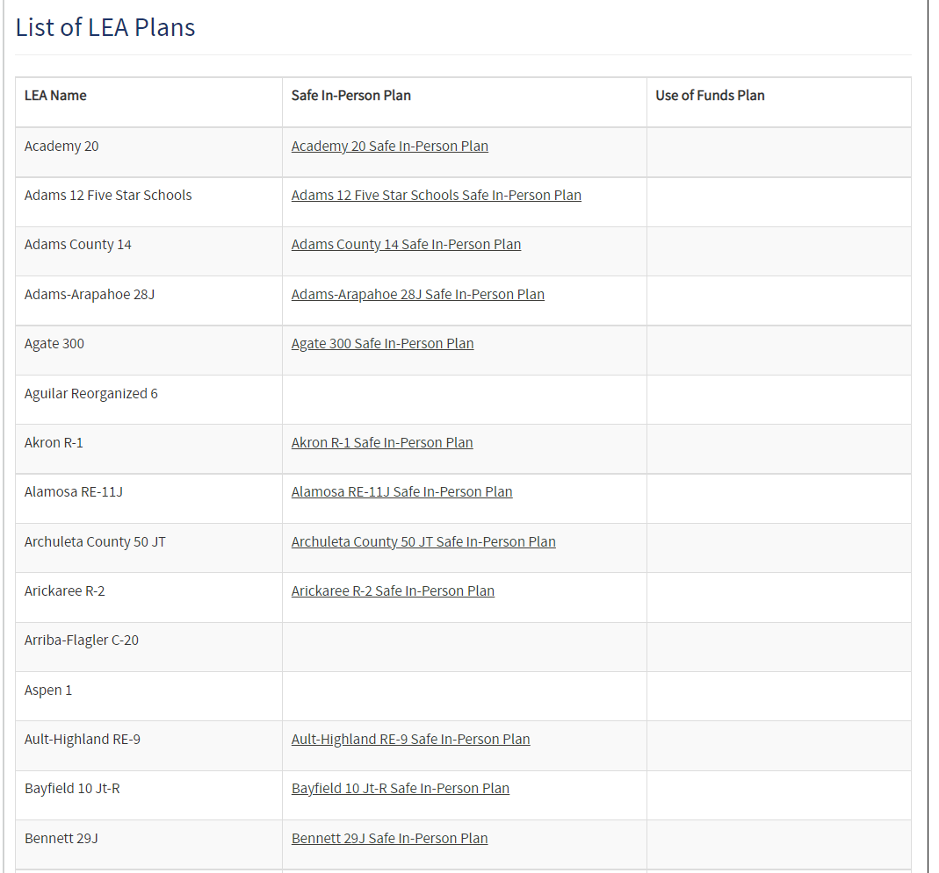
Updates on Resources and Webpages
List of LEA Plans
  CDE is required to have a link to all LEA webpages.
    Safe In-Person Plans
    LEA Use of Funds Plans
  Please submit links as soon as possible using the Smartsheet form if we don’t already have it listed on our website.

Slide 14
ARP HCY II

Slide 15
ARP HCY
Application Deadline for Formula Funding to Support McKinney Students Has Been Extended
The applications to apply for the U.S. Department of Education section 2001(b)(1) of the American Rescue Plan Act of 2021 funding to help support school districts in serving students experiencing homelessness has been extended to Tuesday, March 1, 2022.
The purposes of this funding include increasing the identification of homeless children and youth, providing wraparound services considering the impact of the COVID-19 pandemic, and providing assistance needed to enable homeless children and youth to attend school and participate fully in school activities.
Applications must be completed and submitted through an online application. Please see complete details and additional information on the McKinney-Vento Homeless Education Webpage.
Our HCY Colleagues will be here next week to answer any questions! In the meantime, please don’t hesitate to contact Dana Scott or Paula Gumina.

Slide 16
Upcoming Meetings

Slide 17

Any Requests for Upcoming Topics or Questions!
Upcoming Office Hours:
12/9/21 ~ ARP HCY – Q&A and Data Reporting Requirements
12/16/21 ~ Funding construction with ESSER funds and the strings attached
12/23/21 ~ No Office Hours in observance of Christmas holiday
12/30/21 ~ No Office Hours – CDE will be closed between the Christmas and New Year’s holidays

Slide 18
Small Group Technical Support on
ESSERs

Slide 19
Small Group Topic Areas
Please self-select into one of the following small groups
  ARP ESSER III – need support on budget and narrative question 1 (option 1) ~ [Kristin Crumley]
  ARP ESSER III – need support on narrative questions; won’t have budget ready by 12/16/21 (option 2) ~ [Shannon Wilson]
  Programmatic or Fiscal questions on ESSER I, II, or III [Jonathan Schelke and Fiscal Experts]
  Monitoring questions [Tammy Giessinger, Michelle Prael, and Mackenzie Owens]

Slide 20
CDE Team!
CDE Contacts!
Emails: LastName_FirstInital@cde.state.co.us
ESSER/ESEA Program Partners
Nazie Mohajeri-Nelson, Director of ESEA Office (mohajeri-nelson_n@cde.state.co.us)
DeLilah Collins, Assistant Director of ESEA Office (collins_d@cde.state.co.us)
ESEA Regional Contacts assigned by district
  Title I: Laura Meushaw, Kathryn Wisner, Niko Kaloudis
  Title II: Niko Kaloudis
  Title III: Kathryn Wisner
  Title IV: Tammy Giessinger, Michelle Prael
  Title V: Kristen Collins
ESSER Team
  Kristin Crumley, ESSER Monitoring Specialist (Crumley_k@cde.state.co.us)
  Jonathan Schelke, ESSER Monitoring Specialist (schelke_j@cde.state.co.us)
  Shannon Wilson, ESSER/ESEA Grants Administration Coordinator (Wilson_s@cde.state.co.us)
  Mackenzie Owens, ESSER Reporting Specialist (owens_m@cde.state.co.us)
Data, Accountability, Reporting, and Evaluation
  Tina Negley, Alan Shimmin, Mary Shen, and Mackenzie Owens
Fiscal Partners
Jennifer Okes, Chief Operating Officer (okes_j@cde.state.co.us)
Kate Bartlett, Executive Director of School District Operations (Bartlett_k@cde.state.co.us)
Jennifer Austin, Director of Grants Fiscal Management (Austin_j@cde.state.co.us)
Robert Hawkins, Grants Fiscal Analyst (Hawkins_s@cde.state.co.us)
Steven Kaleda, Grants Fiscal Analyst (Kaleda_s@cde.state.co.us)
ESSER Team
  Bill Parsley, ESSER Fiscal Monitoring Supervisor (parsley_w@cde.state.co.us)
  Hilery Morris, ESSER Fiscal Monitoring (morris_h@cde.state.co.us)
  Sharon Mackey, ESSER Fiscal Monitoring (mackey_s@cde.state.co.us)

