Slide 1
CDE Office Hours
January 20, 2022
Notes:
Michelle

Slide 2
Update: School-Based COVID-19 Testing Program

Slide 3
Special Office Hours Session
Devoted to Supporting ARP ESSER III Grantees
Who Received Funds from State Reserve Funds

Slide 4
Agenda
ARP ESSER III Funding – State Reserve
ARP ESSER III Additional Requirements
ARP ESSER Important Deadlines
ARP ESSER III Application Training
Requesting Reimbursement of Funds
On all guidance and training documents, as well as the online application, the term “LEA” represents any grantees that receives ESSER funds, including facility schools
Notes:
Michelle

Slide 5
ESSER State Reserve (10%)
Grantees | ESSER I | ESSER II | ESSER III
Formula grants to BOCES with gaps in their special education funding: Any activity allowable under ESSER in support of students w disabilities | X | X | X
Formula grants to BOCES with brick-and-mortar schools: Any activity allowable under ESSER to support the operation of the school | X | X | X
Formula grants to Colorado Tribes: any activity allowable under ESSER | X | X | X
Formula grants to Districts with small or no allocation: any activity allowable under ESSER | X | X | X
Competitive grants for connectivity to districts, BOCES, and Tribes: connectivity | X
Formula grant to Colorado Digital BOCES for online courses: online courses | X
Formula grants to facility schools: any activity allowable under ESSER | X |  | X
Formula grants to districts with Native American students: any activity allowable under ESSER in support of Native American students | X | X | X
Formula grants to Administrative Units: any activity allowable under ESSER in support of students with disabilities |  | X | X
All ESSER-funded activities, including the above, must be reasonable and necessary to respond to, prepare for, or prevent the spread of COVID-19

Slide 6
Intent of ESSER Funds
Overall Purpose of All ESSER Funds
To address the impact that COVID-19 has had on education
Priorities of Each ESSER Funding Stream
ESSER I – Crisis Response
To provide schools, staff and students with the technology and infrastructure to accommodate remote learning environments caused by COVID-19.
ESSER II – Resuming/Sustaining In-Person
To provide schools staff and students with the resources and equipment to safely return to in-person learning environments for students.
ESSER III – Recovery
To support schools, educators and students with resources and programming that address learning loss caused by COVID 19 and remote learning environments.

Slide 7
Allowable Use of Funds
Any allowable activity under ESEA, IDEA, Adult Education, Perkins CTE
Coordination of COVID preparedness and response, including training of staff, purchasing of supplies to prevent the spread of COVID-19, and facilities improvement
Activities that are necessary to maintain the operation of and continuity of services
Addressing learning loss, including through assessment, evidence-based activities, parent engagement, tracking attendance, summer and after-school learning, and improving student engagement
Purchasing educational technology
Providing mental health services and supports
Reasonable and Necessary to Respond to Prepare for, or Prevent the Spread of COVID-19
Notes:
DeLilah

Slide 8
ARP ESSER III – Additional Requirements
ARP ESSER III has three additional requirements that were not in ESSER I or II
Set Aside for Evidence-Based Interventions [Collected in the ARP ESSER III Budget (Funding Code)]
  A minimum of 20% set aside to provide evidence-based interventions to address the academic impact of lost instructional time (or impact of the pandemic)
  Evidence-based interventions (ESSA Section 8101(21)(A)] – EBI Explanation and Resources
    Summer Learning Programs
    Summer Enrichment Programs
    Extended Day/School Year
    Comprehensive afterschool programs
Safe Return/Remain In-Person Plan [Provide the URL in the ARP ESSER III Application Assurances]
  Mitigation strategies to ensure safety and health of students and staff
  Posted on LEA website within 30 days of award
  Must be updated at least every 6 months
LEA Use of Funds Plan [Collected in the ARP ESSER III Application]
  Description of plans for the set aside to address academic impact (at least 20%) [Full Budget OR Narrative Question]
  Description of plans for using the rest of funds (most 80%) [Full Budget OR Narrative Question]
  Ensuring that evidence-based interventions are addressing the academic, social, emotional, and mental health needs of students [Narrative Question]

Slide 9
Safe Return to In-Person Instruction Plan
The LEA shall develop and make publicly available on the local educational agency’s website, not later than 30 days after receiving the allocation of funds, a plan for the safe return to in-person instruction and continuity of services. Additionally, the LEA shall make the plan publicly available and shall seek public comment on the plan and take such comments into account in the development of the plan.
If the LEA has already created a plan to return to in-person instruction, provide a link to the website where the plan is located in the box below:
Or
If the LEA is in the process of developing and/or collecting public comment on the plan, in the box below, please provide an explanation of the progress on posting the plan, the date by which the plan will be available, and the link where it will be posted.
Notes:
Mackenzie

Slide 10

Safe Return to School Plan
1. Plan for Safe Return to In-Person Instruction and Continuity of Services
2. Layered Prevention Strategies
3. Levels of Community Risk and Phased Prevention
What if our school has been in-person all year?
If your school has been in person all year with no or few closures, you still must post the plan to meet the federal statute requirement. Explain how your school has ensured the safety of its students and how learning has continued. You also must still post required elements under ARP-ESSER III including social/emotional/mental health and other needs, what prevention strategies you are using, and how decisions are being made based on CDC and health department guidance.
Notes:
Mackenzie

Slide 11
1. Plan for Safe Return to In-Person Instruction and Continuity of Services
Important Dates
  Required:
    When plan will be reviewed (must be within 6 months of posting plan)
  Best Practice:
    Return to School
    Board Meeting Dates
Academic Needs
  What learning options are available?
    i.e. in-person, remote, hybrid
Social, Emotional, Mental Health, or Other Needs
  Student AND staff
  What resources are available?
  Other needs may include student health or food services
  USDE Resource
Notes:
Mackenzie
When plan will be reviewed: It is an ARP-ESSER III requirement that this plan be reviewed and updated if needed within 6 months of posting. Please put this information and the proposed review date on the plan.
It is also a best practice to include dates of when in-person, remote, and/or hybrid learning will begin or resume. It is also a best practice to list dates of board meetings at which important COVID procedures or decisions have been or will be discussed.
Academic needs: Please provide information to your community and families about what types of learning options are available. Will you offer in-person, remote, hybrid, or a combination of these options?
Social, Emotional, Mental Health, or Other Needs: Please list how you will support students and staff regarding these needs. The USDE Resource link provides great guiding information if you need some idea starters.

Slide 12
2. Layered Prevention Strategies
CDC Recommendations
Universal and correct use of masks
Physical distancing
Handwashing and respiratory etiquette
Cleaning and Maintaining healthy facilities
Contact tracing in combination with isolation and quarantine
Notes:
Mackenzie
The Center for Disease Control recommends using these layered prevention strategies.
You may include a description of each of these prevention strategies and how they will be addressed in your district. You may also include the links with your description. If you feel your community would benefit best from following CDC guidance directly, you can include only the links. These go to the CDC COVID webpage which is continually updating.

Slide 13
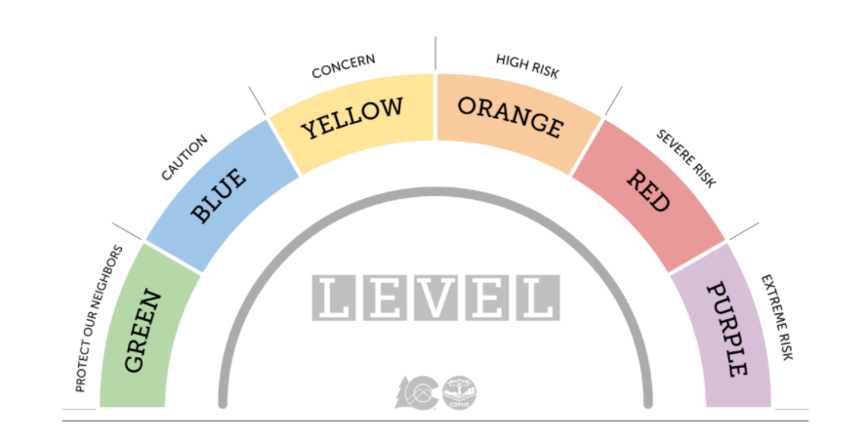
3. Phased Prevention
Include information about state or local health department.
  CDPHE Link to COVID-19 Dial Dashboard
Describe how you will make decisions about preventative actions
  Clearly describe how decisions will be made about school closures, quarantines, etc. in the event of increased levels of risk.
  Some districts are using the “colored levels” of the state’s Dial Framework to show this. Based on a county’s risk level, it is assigned a corresponding color and recommendations range from “using caution” (low risk, protect our neighbors/green) to “staying at home” (extreme risk/purple). Describe your plan for continued instruction in the event of a change in risk level.
Notes:
Mackenzie
To cover phased prevention, you can include a brief narrative sharing how the district is working with local health officials, a link to the district’s local or state health department COVID website, or other health information that would benefit your district’s community and families. Use the information from the health department to guide you as your district determines how it will make decisions about preventative actions—for example, how many new, positive cases have been identified in the area? How many of these positive cases are within the school or district? How do these factors affect the risk levels for the district’s students and staff? A good option is to use the Colorado Department of Public Health and Environment’s COVID-19 Dial Dashboard, linked in the PowerPoint.

Slide 14
Checklist
1. Plan for Safe Return to In-Person Instruction and Continuity of Services
2. Layered Prevention Strategies
3. Levels of Community Risk and Phased Prevention
Important Dates
  When this plan will be reviewed (and updated if needed) within 6 months of original posting
  Returning to School (best practice)
  Board meeting dates (best practice)
Universal and Correct Use of Masks
Collaboration with Public Health Department Officials to Determine the Risk of Transmission:
  Total new cases per 100,000 persons in past 7 days*
  Percentage of Nucleic Acid Amplification Tests (NAATs) that are positive in past 7 days*
  *No data needs to be published within your posting. It simply needs to be clear that the LEA is collaborating with local health officials concerning this information.
Physical Distancing
  At least 3 feet between students/students and 6 feet between adults/adults and adults/students
  Cohort Model
  Visitor Policy
  Transportation Policy
  Staggered Scheduling (suggested)
  Alternate Schedules (suggested)
Academic Needs (in-person and remote learning options)
Student and Staff Social, Emotional, Mental Health, or Other Needs (may include student health and food services)
Handwashing and Respiratory Etiquette
Cleaning and Maintaining Healthy Facilities
  Ventilation
  Modified Layouts
  Cleaning Processes
  Communal Spaces
  Food Service
  Water Systems
How Decisions are Made about Preventative Actions
  The Number of COVID-19 Cases amongst Students, Teachers, and Staff, and Number of People in Quarantine
  Compliance with Prevention Strategies
  Levels of Community Transmission
ADDENDUM OPTION FOR PREVIOUS PLAN:
If a district has already posted a plan that meets most of these requirements, an addendum may be added to satisfy remaining components.
Contact Tracing
  Collaboration with Health Department
  Staying Home when Appropriate
  Isolation Guidelines
  Quarantine Guidelines
Notes:
Mackenzie
This checklist is the resource CDE reviewers will use when looking at your Safe Return to School Plans. This resource will soon be available on the CDE ESSER monitoring webpage.

Slide 15
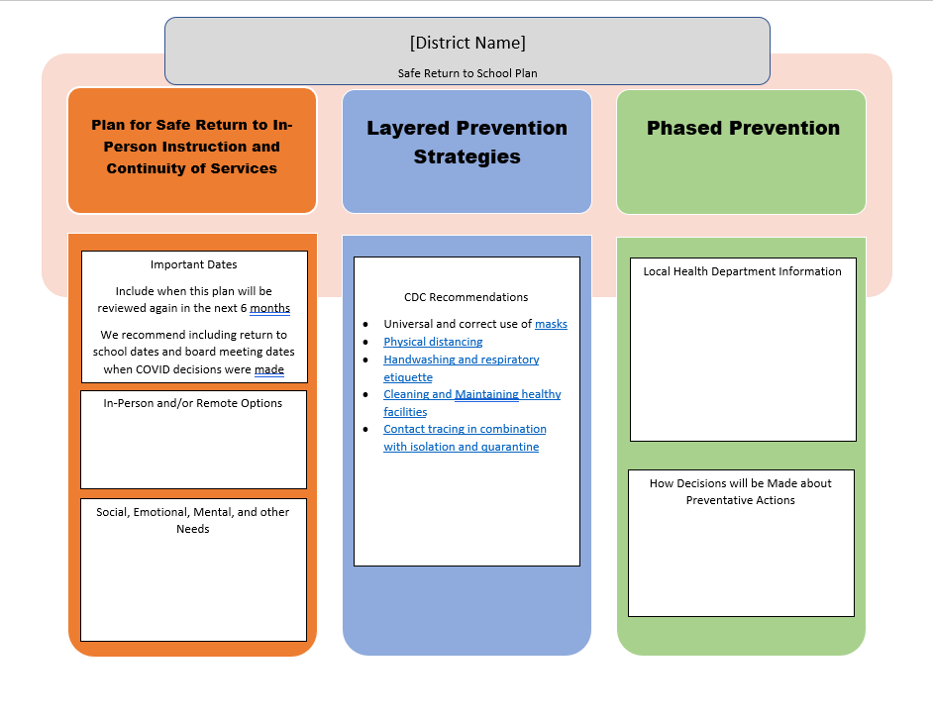
Sample Template
Sample Template
School Samples:
Rite of Passage
Valley View
Notes:
Mackenzie
This template is NOT a requirement. This is a courtesy sample for you to use if you need a springboard as you work with these plans.

Slide 16
Use of Funds Plan
Must be developed with stakeholder input
Must be posted on the LEA’s website as soon as possible (but no set deadline)
Must be submitted to CDE within 90 days of receipt of allocation
Must describe (respond to narrative questions in the online application):
  Plans for ensuring that the evidence-based interventions are responding to the social, emotional, mental health, and academic needs of students
  Plans for the 20% set aside for addressing impact of lost instructional time
  Plans for the 80%, including any strategies for preventing or mitigating the impact of COVID-19 on safety and health of students
Notes:
Shannon

Slide 17
Develop Plan with Key Stakeholders
Provide an opportunity for meaningful stakeholder engagement
Students
Families
School and district administrators (including special education administrators)
Teachers, principals, school leaders, other educators, school staff, and their unions
Where applicable
  Tribes
  Civil rights organizations (including disability rights organizations)
  Stakeholders representing interests of children with disabilities, English language learners, children experiencing homelessness, children and youth in foster care, migratory children, children who are incarcerated, and other underserved populations.
Does the LEA Plan need Board approval?
It depends on local policies, practices, and procedures.

Slide 18
20% Learning Loss Requirement
The LEA ensures it will reserve and use not less than 20 percent of its total ARP ESSER III allocation to address the academic impact of the pandemic, especially impact of lost instructional time, through the implementation of evidence-based interventions, such as summer learning or summer enrichment, extended day, comprehensive afterschool programs, extended school year programs, or other evidence-based interventions.
The LEA ensures that the amount set aside for addressing the academic impact of COVID-19 on practices that meet the criteria for evidence-based intervention under ESEA Section 8101(21).
Notes:
Shannon

Slide 19
Activities Related to Learning Loss Examples
Summer Learning and Enrichment Programs
  Stipends to provide summer school in order to address learning loss and other impacts of COVID for K-12 students who are identified during the 2021-22 school year as being in need of additional support.
  Paraprofessionals hired to support a cohort of students showing a significant learning loss due to the COVID closure - the enhanced learning program occurred during a 4 week summer school.
  Provide summer school learning for 9-12 HS students that attend district online program to address learning loss and credit recovery due to COVID-19. The programming takes place in a June session and a July session (5 days/week) with approx. XXX students per session with staffing to support student numbers.
Extended Day
  Salaries for approximately XXX staff members at different sites for extended day (after school), extended week (Friday) and extended year (summer).
Comprehensive after-school programs
  District ABC will hire 5 Instructional Paraprofessionals to provide after-school tutoring Monday-Thursday in order to address learning loss and other impacts of COVID.
  After-school tutoring for the first half of the 2023-2024 school year to address learning loss.
Notes:
Shannon

Slide 20

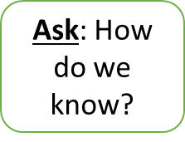
ARP - ESSER III Required Narrative Question
How the LEA will ensure that the interventions it implements, including but not limited to the interventions under section 2001(e)(1) of the ARP Act to address the academic impact of lost instructional time, will respond to the academic, social, emotional, and mental health needs of all students, and particularly those students disproportionately impacted by the COVID-19 pandemic, including students from low-income families, students of color, English learners, children with disabilities, students experiencing homelessness, children and youth in foster care, and migratory students.
    In what ways have students have been impacted by lost instructional time (the pandemic)?
    Have any student groups been disproportionately impacted? If so, which ones?
    How do the selected evidence-based interventions respond to
    Identified academic, social, emotional, and mental health needs?
    Any identified disproportionate impact?
    How will success of the interventions be measured?
Narrative Question Response Guidance Template
Notes:
Shannon

Slide 21
Narrative Example
• Exemplary Education Agency has analyzed [insert your LEA data]. Based on data results, EEA has determined that all students experienced [insert identified student needs].
• Data has been disaggregated for the groups listed in this question. Data shows [insert student needs] for [insert identified student groups] compared to the general student population.
• In selecting our evidence-based interventions, we focused on research-based approaches to address [insert high level priorities based on students needs] in order to respond to the identified student academic, social, emotional, and mental health needs. These interventions are detailed in the budget.
• EEA schools will be [insert methods for measuring impact of interventions] in order to measure the impact of our interventions on students’ academic, social, and behavioral needs.
1. In what ways have students been impacted by lost instructional time (the pandemic)?
2. Have any student groups been disproportionately impacted? If so, which ones?
3. How were the evidence-based interventions selected to respond to identified A.S.E.M. needs and any identified disproportionate impact?
4. How will we measure the success of the interventions on students’ academic, social, emotional, and mental health needs?
Notes:
Shannon

Slide 22
Narrative Example
• Exemplary Education Agency has analyzed interim reading and math scores, attendance data, and parent, staff, and student surveys. Based on data results, EEA has determined that all students experienced a drop in reading scores and an increased need for mental health services.
• Data has been disaggregated for the groups listed in this question. Data shows a greater academic decline for students of color, English learners, and students with disabilities compared to the general student population.
• In selecting our evidence-based interventions, we focused on research-based approaches to address the increased need for literacy instruction and need for access to mental health services in order to respond to the identified student academic, social, emotional, and mental health needs. These interventions are detailed in the budget.
• EEA schools will be conducting quarterly progress monitoring through the district reading assessment and annually analyzing beginning- and end-of-year parent, student, and staff mental health surveys in order to measure the impact of our interventions on students’ academic, social, and behavioral needs.
1. In what ways have students been impacted by lost instructional time (the pandemic)?
2. Have any student groups been disproportionately impacted? If so, which ones?
3. How were the evidence-based interventions selected to respond to identified A.S.E.M. needs and any identified disproportionate impact?
4. How will we measure the success of the interventions on students’ academic, social, emotional, and mental health needs?
Notes:
Shannon

Slide 23
ESSER III Supplemental Funds Grant Codes
Funding Codes:
  Supplemental ARP ESSER III (4418)
  Supplemental ARP ESSER III Learning Loss Set Aside (9418)
The second funding source will be used to indicate which activities will address learning loss. CDE will calculate the 20% requirement based on the learning loss set-aside funding source.
Notes:
Shannon

Slide 24
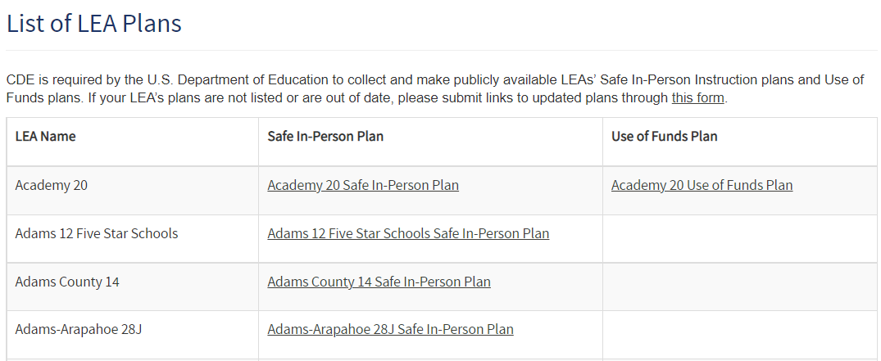
Plans Posted on Your and CDE’s Website
ESSER III requires that all grantees post two plans on their website:
  Safe In-Person Instruction plan [by 2/25/22]
  Use of Funds plan [by 5/20/22]
CDE is required by the U.S. Department of Education to collect and make these plans publicly available.
The plans that we have received from grantees are listed here.
When you have created or updated your plans, please submit the links through this form.
Resources to help you meet these requirements:
Office Hours recording and slides from Nov. 11 presentation on Use of Funds plan website requirements
ESSER III requirements page on the CDE website.
Use of Funds Plan Guidance
Safe Return to School Checklist

Slide 25
Timelines Associated with ESSER I, II, and III
 | ESSER I (CARES Act) | ESSER II (CRSSA Act) | ARP ESSER III (ARP Act) | ARP ESSER III – State Reserve Funds (ARP Act)
Award Period | 03/13/20 – 09/30/21 | 03/13/20 – 09/30/22 | 03/13/20 – 09/30/23 | 03/13/20 – 09/30/23
Tydings Period - will end and funds must be spent by | 9/30/22 | 9/30/23 | 9/30/24 | 09/30/24
USDE Award to CDE | 05/07/20 | 01/06/21 | 3/24/21 | 11/4/21
CDE Must Make Subgrants to LEAs (90%) – LEAs must have final approval on ESSER I and II and substantial approval on ESSER III | 05/07/21 Final Approval | 01/06/22 Final Approval | 05/23/21 Substantial Approval | NA
All awards must be final | 05/07/21 | 01/06/22 | 03/24/22 | 11/2/22
CDE Application for LEAs Opened | 05/31/20 | 02/12/21 | 4/27/21 | Varies Across Grants Formula Awards ~ 1/12/22
Preliminary Application (T&A, assurances, GEPA) due | NA | NA | 5/23/21 | NA
Safe In-Person Plans | NA | NA | 5/23/21 | 2/25/22
LEA Use of Funds Plan (budget in ESSER I & II; budget/narrative questions in ESSER III) | 12/31/20 | 9/30/21 | 12/16/21 | 5/20/22
CDE Application Closed/Closes | 12/31/20 | 09/30/21 | 03/24/22 | 9/2/22
PAR Open – Rolling Basis | Date of Final Approval | Date of Final Approval | Date of Final Approval | Date of Final Approval
PAR Closes | 06/30/21 | 06/30/22 | 06/30/23 | 6/30/23
Carryover Application Will Open (Unexpended Funds Carried Over to Next Year) | 07/01/21 | 07/01/22 | 07/01/23 | 07/01/23
Carryover Application Will Close | 06/30/22 | 06/30/23 | 06/30/24 | 6/30/24
Monthly Deadline for Requesting Funds (LEA’s Request for Funds, RFF) | First Day of Each Month | First Day of Each Month | First Day of Each Month | First Day of Each Month
Deadline for Final Spending | 09/30/22 | 09/30/23 | 9/30/24 | 9/30/24
Deadline for Final Draw Down of Funds (RFF) | October/November 2022 | October/November 2023 | October/November 2024 | October/November 2024

Slide 26
Online Application Demonstration

Slide 27
Application Process - Overview
All ESSER funds are distributed as reimbursement grants!
  Application submitted to CDE ~ substantial approval
    Can obligate funds by cannot draw down funds
    Until budget line items are approved, applicant is obligating funds at own risk
  CDE reviews and provides feedback/requests revisions or approves
    Revisions are required until can get final approval
  Final approval – on the date that the application receives final approval, applicant can start to spend funds and request reimbursement
    Requesting reimbursement takes several weeks, so please plan accordingly
  Post Award Revision – opens as soon as final approval has been granted and is available throughout the rest of the award period for making revisions as needed

Slide 28
Sections of ESSER Applications
Application Component | ESSER I | ESSER II | ARP ESSER III
Application Contacts Authorized Representative Fiscal Manager Other | Required Optional NA | Required Optional Optional | Required Optional Optional
Non-Public Schools Participating in Services | Required | NA | NA
GEPA Statement – General Education Provisions Act | Required | Required | Required
Budget | Required | Required | Required
Set Aside for Evidence Based Interventions | NA | NA | Required
Safe In-Person Plans [Posted on LEA website and link sent to CDE] | NA | NA | Required
LEA Plan Describing Use of Funds [Posted on LEA website and link sent to CDE] | NA | NA | Required
Beneficiaries or Recipients of Services (Whole District/School or Portion) | NA | Required | Required

Slide 29
Request for Funds (RFF)
Notes:
Michelle to GF

Slide 30
Step 1 - Register with SAM.gov
What is SAM.gov?
  SAM.gov is a portal that any entity who receives funds from the Federal Government, or does business with them, are required to register with. As such, any recipients of Federal Funds via a Federal grant, whether it be passed through, or as the prime recipient, must register with this site. This site manages all government contractors all over the world.
  The registrations expire annually, so put a reminder in your calendar! Expirations can and will delay the ability to receive a grant award, as the registration is required.
  There is no fee for this registration.
  SAM.gov is in the process of transitioning from registrants utilizing their DUNS number as their unique identifier. In April, 2022, it is anticipated that all registrations will then have a unique, SAM.gov identifier.
  SAM.gov is also the place where exclusions are noted. These are records that indicate that an entity who has worked with the Federal government has been involved in fraud, unallowable activity or other issue. When CDE makes an award to an applicant, we review these registrations are not expired and there are not exclusions. If there are exclusions, CDE is not allowed to grant to the applicant.
Notes:
GF

Slide 31
Step 1 - Register with SAM.gov Continued
Requirements for registration, things to have on hand during registration:
  Have a DUNS Number: If you do not already have one, prior to registration in SAM.gov, from Dun & Bradstreet, visit this link to obtain one: https://fedgov.dnb.com/webform/
  Registration/Renewal of DUNS number can be done here: https://sam.gov/content/home
  Incidentally, you may want to search under your entities name in case the DUNS number already exists.
Entity Information
legal business name
physical address
entity type
general entity information
Taxpayer Identification Number (TIN) and taxpayer name
Contractor and Government Entity (CAGE) code if you have one. if you don’t, the system will assign you one.
NATO Commercial and Government Entity (NCAGE) code if your entity is located outside of the U.S. and its territories
Financial and banking information to set up Electronic Funds Transfer (EFT)
Have an EIN (Employer Identification Number from the IRS
Have a business bank account
Notes:
GF

Slide 32
Step 2: Electronic Funds Transfer (EFT) Set Up
EFT is the method by which CDE will reimburse the awardees. This is required per Treasury.
The EFT funds will post to 1 bank account, upon completion of the EFT forms, Treasury does not have the ability to split or fund separate accounts.
Once a Request for Funds is received, reviewed, approved and moved on for payment to accounting, the awardee will receive an email notice that the funds will be deposited in approximately 3 business days. This email account should go to a generic email account, so that multiple people will have access to it. The notice looks like a check stub and will have the grant name in the description.
Three days from the notification, the funds will arrive.
If you will be setting this up for the first time and have not been set up as a ‘vendor’ with the State for any other reason, you will be required to complete a vendor packet as well.
If you already receive funds in this manner from CDE, you do not need to complete again, this indicates your entity already has a vendor file with the State.
Should you need these forms, please contact Judy Stirman, and she can provide them to your entity.
Notes:
GF

Slide 33
Step 3: Request for Funds Authorized Representative Designation Form
Facilities will need to complete and submit the Request for Funds Authorized Representative Designation form before requesting funds from CDE.
This form lets Grants Fiscal know who is authorized to submit RFFs.
The Authorized Representative and the Fiscal Representative can’t be the same person
  The Fiscal Representative needs to oversee the Authorized Representative
The Authorized Representative will then be given a 4 digit code unique to them
  This 4 digit code should not be shared.
  The 4 digit code will be used when requesting funds
Formsite Resources/Trainings can be found on CDE Grants Fiscal page http://www.cde.state.co.us/cdefisgrant/requestforfundsforms
Notes:
GF

Slide 34
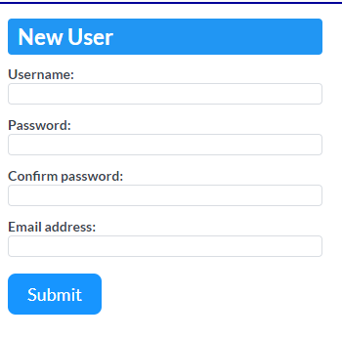
Step 4: Create an Account on Formsite
Create an account with formsite
Notes:
GF

Slide 35
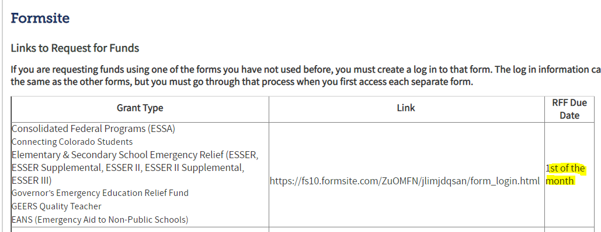
Step 5: Request Funds!
Grants Fiscal strives to process reimbursement requests within 30 days from the DUE DATE of the type of request as stated below (i.e., either the 1st or the 15th of the month). However, current staffing shortages, both in GFMU and in CDE's Accounting unit, may increase their processing times somewhat. Please plan accordingly, and we thank you for your patience.
Notes:
GF

Slide 36
Any Questions?

Slide 37
Additional Resources and Support
Monitoring Training Center
ESSER Monitoring Homepage
ESSER I Application
ESSER III Application
ESEA Office Hours
  Every Thursday from 2:00-3:30pm
  Register in advance for this meeting:
    https://us02web.zoom.us/meeting/register/tZwtdOmtpz0vHtBjrJU4Epvmwf4u4cs8bvBl
Notes:
Michelle

Slide 38
CDE Team!
CDE Contacts!
Emails: LastName_FirstInital@cde.state.co.us
ESSER/ESEA Program Partners
Nazie Mohajeri-Nelson, Director of ESEA Office
DeLilah Collins, Director of Grants Program Administration
ESEA Regional Contacts assigned by district
  Title I: Laura Meushaw, Kathryn Wisner, Niko Kaloudis
  Title II: Niko Kaloudis
  Title III: Kathryn Wisner
  Title IV: Tammy Giessinger, Michelle Prael
  Title V: TBD
ESSER Team
  Kristin Crumley, ESSER Monitoring Specialist
  Jonathan Schelke, ESSER Monitoring Specialist
  Shannon Wilson, ESSER/ESEA Grants Administration Coordinator
  Mackenzie Owens, ESSER Reporting Specialist
Data, Accountability, Reporting, and Evaluation
  Tina Negley, Alan Shimmin, Mary Shen, and Mackenzie Owens
Fiscal Partners
Jennifer Okes, Chief Operating Officer
Kate Bartlett, Executive Director of School District Operations
Jennifer Austin, Director of Grants Fiscal Management
Robert Hawkins, Grants Fiscal Analyst
Steven Kaleda, Grants Fiscal Analyst
ESSER Team
  Bill Parsley, ESSER Fiscal Monitoring Supervisor
  Hilery Morris, ESSER Fiscal Monitoring
  Sharon Mackey, ESSER Fiscal Monitoring

