Slide 1
CDE Office Hours
November 17, 2022

Slide 2
ESSER Office Hours
Topics
Updates and Reminders
  ARP ESSER III ~ Maintenance of Equity
Title I Schoolwide Programming Survey
Poverty Data
Comparability
ESSA State Plan, Public Comment Posting
Notes:
Nazie

Slide 3
Updates, Reminders, and Clarifications
Notes:
Nazie

Slide 4
ARP ESSER III - Maintenance of Equity
Reminder: ARP ESSER III requires that
An LEA does not disproportionately reduce State and local per-pupil funding in high-poverty schools.
An LEA does not disproportionately reduce the number of full-time-equivalent (FTE) staff per pupil in high-poverty schools.
CDE is required to identify schools that meet the criteria for high-poverty (in the highest quartile of schools served by the LEA based on the percentage of economically disadvantaged students). Communications coming in the near future outlining / reminding LEAs of MoEquity requirements.
LEA may be exempt from Maintenance of Equity requirements if the LEA:
Has a total enrollment of less than 1,000 students (automatic exception);
Operates a single school (automatic exception);
Serves all students within each grade span with a single school (automatic exception); or
Demonstrates an exceptional or uncontrollable circumstance, such as unpredictable changes in student enrollment or a precipitous decline in the financial resources of the LEA as determined by the Secretary (eligible to request an exception).
Notes:
Mackenzie

Slide 5
Maintenance of Equity Exception Certificate
CDE has determined that all LEAs in Colorado were excepted from Maintenance of Equity requirements for ESSER III in FY 2022-2023. Some LEAs received an automatic exception and the rest were excepted because they did not have an aggregate reduction in combined State and local per-pupil funding in FY 2023.
The latter LEAs must fill out the Maintenance of Equity exception certificate by Friday, November 18th to stay in compliance with federal regulations.
We have reached out directly to those LEAs who need to submit a certificate. If you have not received a call or email from CDE about Maintenance of Equity this week, you do not need to submit the certificate. If you are unsure, please check the exceptions list here or reach out to Mackenzie Owens at owens_m@cde.state.co.us.

Slide 6
Title I Schoolwide Programming Survey
Notes:
Laura/Rachel E.

Slide 7
ESEA Title I Schoolwide Programming Survey
The Federal Programs and Supports Unit is requesting input on what kinds of additional support are needed when implementing a Title I Schoolwide program. Through this brief, anonymous survey, we hope to gain perspective on:
How to support LEAs with implementing schoolwide programming
How to effectively customize schoolwide technical assistance for LEAs
LEA perceptions of monitoring implementation and effective implementation
Answer questions LEAs have around schoolwide programming and use of funds
Please take the next few minutes to provide your feedback
Link to Survey

Slide 8
Poverty Data
Updates and Upcoming Work!
Notes:
Nazie or Laura

Slide 9
Poverty Data
It is a challenge that we are going to overcome together!
Under Section 1113(a)(5) of the ESEA, requires an LEA to select a poverty measure from the following options for determining allocations to schools:
Children ages 5-17 in poverty as counted in the most recent Census data approved by the Secretary.
Children eligible for free and reduced-price lunches under the Richard B. Russell National School Lunch Act [NSLP data].
Children in families receiving assistance under the State program funded under Title IV, Part A of the Social Security Act (TANF).
Children eligible to receive medical assistance under the Medicaid program.
A composite of any of the above measures.
Last OHs, we asked which of these data points you have in your LEA?
20% listed several
NSLP includes direct certification through the Community Eligibility Provision (CEP)

Slide 10
Update and News from Our Nutrition Unit
The Healthy School Meals for All ballot initiative was passed in the November general election. This means that in School Year 2023-24 public school districts participating in the National School Lunch or School Breakfast Programs may choose to opt into the Healthy School Meals for All program. Opting into this program includes:
Notifying the CDE School Nutrition Unit of participation during next year’s application renewal
Participating in the Community Eligibility Provision and implementing School Breakfast and National School Lunch programs at all qualifying CEP schools
Providing free meals to all students enrolled in all school sites that participate in the School Breakfast or National School Lunch Program
Pending approval for the Direct Cert-Medicaid pilot, in School Year 2024-25, LEAs may also choose to receive funding for front line kitchen staff wage increases or stipends and incentives to purchase local food.
Current Healthy Meals for All FAQ (will be updated in next couple of weeks)
More information on CEP
For any follow up questions, please contact:
Brehan Riley
Kerri Link

Slide 11
How Does CEP Intersect with Title I Within LEA Allocations?
9. What are the areas of intersection between CEP and Title I?
There are several aspects of Title I that require the use of poverty data at the school or individual student level: within-district allocations, equitable services for eligible private school students, within-State allocations, and accountability. NSLP data are often used as an indicator of poverty to help carry out Title I programs; therefore, the decision to participate in CEP could also affect an LEA’s poverty data for Title I purposes.
USDE Guidance, FAQ on CEP and Title I, FAQ #19

Slide 12
How Will Using CEP Impact Title I?
“If an LEA has all CEP schools, the LEA may rank its schools by the percentage of directly certified students in each school….”
USDE Guidance, FAQ on CEP and Title I, FAQ #19
“Identified students” are students approved as eligible for free meals who are not subject to verification (i.e., in CEP schools, “directly certified” children). This definition includes students directly certified through SNAP, TANF, the Food Distribution Program on Indian Reservations or Medicaid (in States selected for a USDA pilot program); children experiencing homelessness and on the local liaison’s list;3 Head Start children; migrant youth; runaways; and non-applicants approved by local officials. Foster children who are certified through means other than a household application and students who are certified for free meals based on a letter provided by SNAP to the household are also included.
USDE Guidance, FAQ on CEP and Title I, FAQ #2

Slide 13
Long-Term Impact
As a state, we’ll need to think about and plan for the long-term impact of Healthy School Meals for All on Title I requirements. We will develop long-term plans with the help of colleagues at CDE, across the state, and…
The ESEA Committee of Practitioners;
National organizations, including the U.S. Department of Education, National Association of ESEA State Program Administrators (formerly the National Title I Association), and the Council of Chief State School Officers (CCSSO); and
You! [If you would like to help, please contact Laura Meushaw or Nazie Mohajeri-Nelson]
More to come as we continue to research and plan for the future!

Slide 14
Comparability
Notes:
Mary

Slide 15
What is comparability?
Section 1118 of the ESSA requires LEAs to provide state- and locally-funded services in schools receiving support under Title I, Part A that, taken as a whole, are at least comparable to services provided in schools that do not receive support under Title I, Part A
This requirement must be met for schools in the same grade spans: elementary, middle, and high school (EMH)
Ensure that Title I, Part A funds are not used to provide services that would otherwise be paid for with state and local funds, thus undermining the supplemental nature of Title I, Part A funds
Notes:
Title I, Part A funds are intended to provide additional resources for low-performing students from high-poverty neighborhoods, beyond what is provided with State and local funds.
Difference from “Supplement, Not Supplant”: Comparability focuses on educational materials and services provided with the State and local funds, as opposed to SNS which ensures schools receive the funds they would have received if the school had not participated in Title I, Part A.

Slide 16
Who is exempt from demonstrating comparability?
LEAs are NOT required to demonstrate compliance with the comparability requirements if they:
  Do not accept Title I, Part A funds, or
  Have less than 1000 students in the district, or
  Have only one school per grade span, or
  Have two or more schools in the same grade span, but any Title I school(s) has less than 100 students

Slide 17
How CDE runs comparability analyses
Analyses are conducted annually based on Student October Count and December HR Snapshot
Calculate school-level student teacher ratios
  Only teacher FTE paid with state or local funds are included
  All federally-funded FTE are excluded from analyses
Ensure that the student teacher ratios at Title I schools are comparable (no greater than 10%) to the ratios at Non-Title I schools
If all schools in a grade span are Title I, ensure that ratios are within 10% of each other

Slide 18
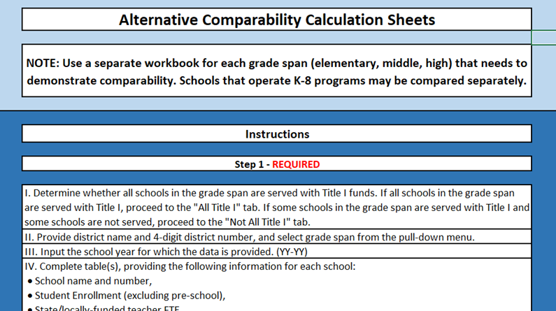
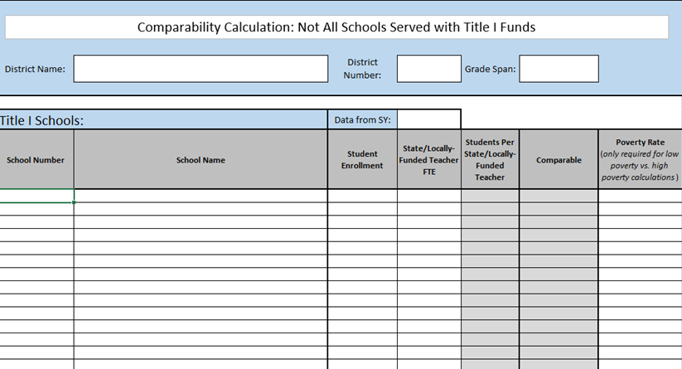
What to do if your LEA has received a comparability notification?
Review the school-level comparability data file (Sent via Syncplicity)
Submit local data via Alternative Comparability Calculator by January 31, 2023
  Download from https://www.cde.state.co.us/fedprograms/ti/a_comp (Under “Resources”)
Contact us if you have any questions or need support! (or if you need an extension on the deadline)
Notes:
The Alternative Comparability Calculator can be downloaded from https://www.cde.state.co.us/fedprograms/ti/a_comp (Under “Resources”)

Slide 19
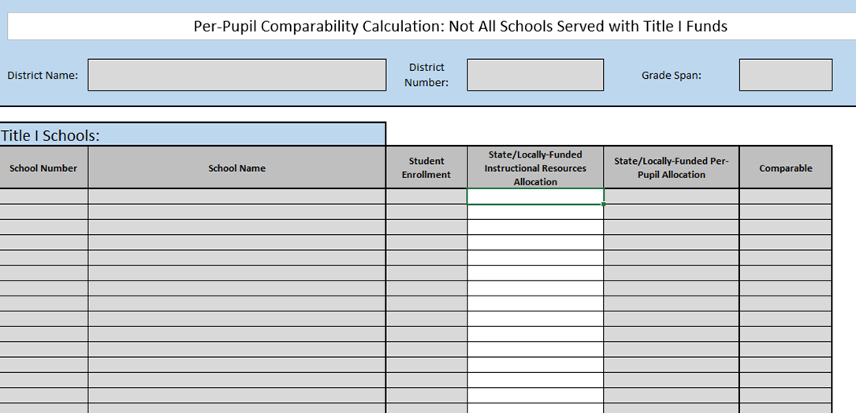
What to do if your LEA operates Consolidated Schoolwide?
Complete the Alternative Comparability Calculator, using either the FTE or Per-Pupil Allocation methodology
Notes:
More information on the PPA methodology can be found on slides 12-16 in the November 2020 Comparability Webinar (https://www.cde.state.co.us/fedprograms/ti/a_comp, under “Resources”)

Slide 20
Exceptions and exemptions from comparability
Circumstances exist for which demonstration of comparability may not be possible:
  Districts with schools in remote locations (Basic staffing levels are necessary to operate a school)
  Districts with schools that serve special populations (Additional resources may be allocated to address special needs)
To request an exception or exemption for your district, please send an email documenting the extenuating circumstances to Comparability@cde.state.co.us or to your Regional Contact

Slide 21
Resources
Comparability Webpage
https://www.cde.state.co.us/fedprograms/ti/a_comp
The November 2020 Comparability Webinar (PPT and Recording) and the Alternative Comparability Calculator are both located on this webpage under “Resources”.

Slide 22
Contact Information
Mary Shen
ESEA Program Evaluator and Research Analyst
Office of Program Effectiveness
shen_m@cde.state.co.us
720-766-8723
Comparability Mailbox
Comparability@cde.state.co.us

Slide 23
ESSA State Plan
Public Comment Posting
Notes:
Nazie

Slide 24
Impact of the Pandemic on our ESSA State Plan
Every state that accepts funds under ESSA must have a plan for implementation of ESSA requirements, including having a methodology for identifying schools for support and improvement. Colorado’s ESSA State Plan was approved by the U.S. Department of Education in May 2018. The COVID-19 pandemic impacted the availability of state assessments, which has necessitated changes to the methodology that the State uses to identify schools for support and improvement under ESSA.
The proposed changes will be available for public comment from Friday, November 18, 2022 through Monday, December 19, 2022 on our ESSA website. Please share with any stakeholders in your communities that would be interested in reviewing proposed changes and provide feedback.

Slide 25
General Feedback
Topics available for general, public feedback include:
Should the School Quality and Student Success Indicator include
  Science achievement?
  Chronic absenteeism?
    If so, reduction or a percentage
  Student growth to standard?
How many years of data should be used in the identification methodology?
How frequently should schools be identified for support and improvement?
How many years should schools receive support and improvement before being able to exit?

Slide 26
Technical Feedback
ESEA Committee of Practitioners and Technical Advisory Panel
In addition to the general feedback, also providing input on more technical decisions
  Specific achievement and growth questions
  Points assigned to indicators
  Cut-scores
  Reviewing and providing feedback on redlined version being submitted for approval
If you would like to provide input on the more technical aspects, please email Nazie Mohajeri-Nelson or Tina Negley

Slide 27
Upcoming Meetings
Notes:
Nazie

Slide 28

Any Requests for Upcoming Topics or Questions!
Upcoming Office Hours
December Changes!
December 1
December 15
December 29 - Cancelled
January Changes!
January 12
January 26 - BruMan Training

Slide 29
CDE Contacts!
Emails: Lastname_Firstinitial@cde.state.co.us
(e.g., Smith_a@cde.state.co.us)
Federal Programs & Supports (ESEA/ESSER Program Supports) | School Finance & Operations (Fiscal and Systems Supports)
Nazie Mohajeri-Nelson, Executive Director of Federal Programs & Supports Unit Program Specialists Program Implementation Supervisor: Laura Meushaw Program Monitoring Supervisor: Tammy Giessinger Program Effectiveness Supervisor: Tina Negley ESEA Programs Specialists and ESEA Regional Contacts (assigned by district) Title I: Laura Meushaw, Kathryn Wisner, Evita Byrd, Rachel Echsner Title II: Karen Bixler Title III: Rachel Temple Title IV: Tammy Giessinger, Nathan Hickman Title V: Shannon Wilson ESSER Program Specialists Kristin Crumley Jonathan Schelke Kim Boylan Shannon Wilson ESEA and ESSER Data and Reporting Specialists Tina Negley Mary Shen Mackenzie Owens | Kate Bartlett, Executive Director of School District Operations Unit Fiscal Specialists Jennifer Austin, Director of Grants Fiscal Management ESEA Robert Hawkins, Grants Fiscal Analyst Steven Kaleda, Grants Fiscal Analyst ESSER Fiscal Specialist Steven Kaleda Grants Fiscal Analyst ESSER Monitoring Bill Parsley, ESSER Fiscal Monitoring Supervisor Hilery Morris, ESSER Fiscal Monitoring Kristina Jones, Federal Fiscal Monitoring and Reporting Specialist Werner Hagemann, ESSER Fiscal Monitoring Specialist Application Systems Specialists DeLilah Collins, Director of Grants Program Administration Online Applications Systems Technical Support Michelle Prael

