Slide 1
CDE Office Hours
November 16, 2023

Slide 2
ESSER Office Hours
Topics
Updates and Reminders
  ESSER III Requirements
Updated Weapons Prohibition
Ensuring Multilingual Learners can Participate Meaningfully and Equally in Educational Programs
ESSER Reporting

Slide 3
Updates and Reminders

Slide 4
General Updates and Reminders
Monitoring
LEAs on the monitoring schedule for this year have updated results of your tier assignments to review in your Syncplicity folders
  Includes the fiscal tier now (program tier was included in the earlier version)
Spend Down and Requests for Reimbursement
Thank you to all of you who submitted RFFs by November 15th for ESSER II and expiring 2021-2022 funds
Lessons learned:
  Need to do quarterly outreach
  PARs need to be submitted in a timely manner
  Funds should be drawn down monthly, or at the very least quarterly
Now that ESSERs I and II are done, focus is on meeting ESSER III requirements
  MoEquity - all of our LEAs are exempt either automatically or through the exception form
    Thank you to all of you who submitted exception forms

Slide 5
ARP ESSER III Reminders

Slide 6

Post Award Revision (PAR) Submissions
Contact information
Review of ESSER III application
Change in needs or activities

Slide 7

Safe Return to In-Person Instruction Plan
Leave the LEA’s Safe Return to In-Person Instruction Plan actively posted on the LEA’s website through the end of the award period, September 30, 2024.
Review at least every 6 months
Update when needed
The LEA’s Safe Return to In-Person Instruction Plan must be linked on CDE’s page.
  Please check for your link here.
  Please submit a link here if your LEA’s link has expired or is not on the page.
CDE guidance

Slide 8
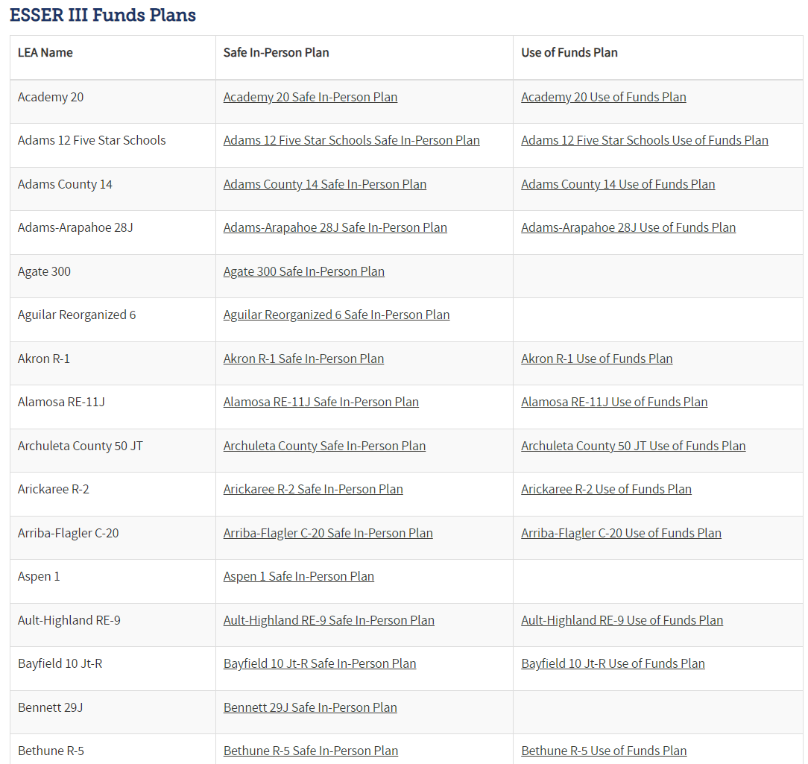
ARP ESSER III Use of Funds Plan
Leave the LEA’s ARP ESSER III Use of Funds Plan actively posted on the LEA’s website through the end of the award period, September 30, 2024.
Update the plan if the way funds are being spent changes.
Submit a PAR through the ESSER III application if the way funds are being spent changes.
The LEA’s ARP ESSER III Use of Funds Plan must be linked on CDE’s page.
  Please check for your link here.
  Please submit a link here if your LEA’s link has expired or is not on the page.
CDE guidance

Slide 9

20% Learning Loss Set-Aside
At least 20% of the LEA’s total allocation must be used to address learning loss caused by the pandemic.
The LEA must submit a PAR through the ESSER III application if learning loss activities are changing or are not being implemented.
Keep documentation of the impact of interventions implemented with this 20% set-aside.

Slide 10
Updated Weapons Prohibition

Slide 11
Weapons Prohibition Update
On October 6, 2023, President Biden signed into law a bipartisan bill called the Protecting Hunting Heritage and Education Act (Public Law No: 118-17).
The act:
  amends section 8526 regarding use of ESEA funds for the provision of, and training in, dangerous weapons (as defined in section 930(g)(2) of title 18 of the United States Code), and
  clarifies that the prohibition does not apply to the use of ESEA funds for activities that are carried out under ESEA programs and that are otherwise permissible, and that “provide students with educational instruction or educational enrichment activities, such as archery, hunting, other shooting sports, or culinary arts.”
*Note: This update may affect activities funded with, but not limited to, ESEA Title IV and the Stronger Connections Grant (SCG).

Slide 12
Ensuring Multilingual Learners
Can Participate Meaningfully and Equally
in Educational Programs

Slide 13
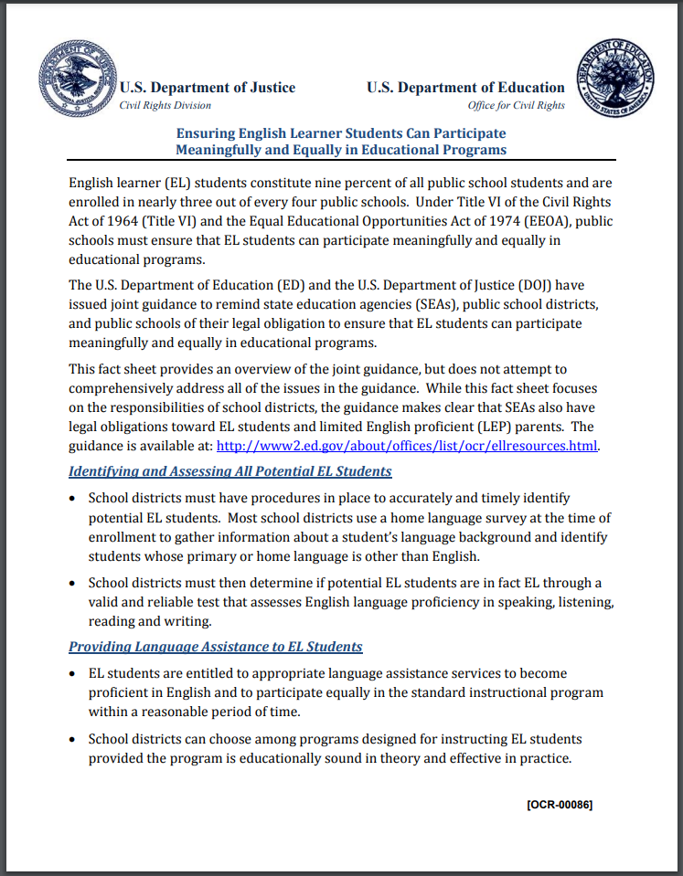
Joint Guidance: U.S. Department of Education and the U.S. Department of Justice
State education agencies (SEAs), public school districts, and public schools have a legal obligation to ensure that multilingual learners can participate meaningfully and equally in educational programs.
Additionally, there are legal obligations towards limited English proficient (LEP) parents.
4-page document

Slide 14
Acronyms
ELL = English Language Learner
EL = English Learner
ML = Multilingual Learner
ELD = English Language Development
DOJ = Department of Justice
ELP = English Language Proficiency
ELPA = English Language Proficiency Act
ESEA = Elementary and Secondary Education Act
ESSA = Every Student Succeeds Act
HLS = Home Language Survey
LEP = Limited English Proficient
LIEP = Language Instruction Educational Program
NEP = Non-English Proficient
OCR = Office of Civil Rights

Slide 15
10 Topics
Identifying and Assessing All Potential ML Students
Providing Language Assistance to ML Students
Staffing and Supporting an ELD Program
Providing Meaningful Access to All Curricular and Extracurricular Programs
Avoiding Unnecessary Segregation of ML Students
Evaluating ML Students for Special Education and Providing Dual Services
Meeting the Needs of Students Who Opt Out of ELD Programs or Particular Services
Monitoring and Exiting ML Students from ELD Programs and Services
Evaluating the Effectiveness of a District’s ELD Program
Ensuring Meaningful Communication with Limited English Proficient Parents

Slide 16
Civil Rights & Equal Educational Opportunities Act
Under Title VI of the Civil Rights Act of 1964 (Title VI) and the Equal Educational Opportunities Act of 1974 (EEOA), public schools must ensure that ML students can participate meaningfully and equally in educational programs.

Slide 17
Identifying and Assessing All Potential ML Students
School districts must have procedures in place to accurately and timely identify potential ML students.
A Home Language Survey (HLS) is completed at the time of enrollment to gather information about a student’s language background and identify students whose primary or home language is other than English.
  In Colorado, the English Language Proficiency Act (ELPA) requires all districts and schools to identify MLs.
  Per federal guidelines, students who have a language influence other than English must be screened, enrolled in a language instruction educational program, and parents must be notified within 30 days at the beginning of the school year. Throughout the remainder of the school year, determination must happen within two weeks of the student's enrollment.

Slide 18
Home Language Survey (HLS)
“One and done” (the HLS is not completed on an annual basis)
One per student, not one per family
OCR- and DOJ-approved home language survey questions:
  What is the primary language used in the home, regardless of the language spoken by the student?
  What is the language most often spoken by the student?
  What is the language that the student first acquired?
The HLS does not automatically qualify a student as an ML
Original copy is kept in the students’ cumulative files
Online Registration and Collection of HLS: Districts, schools, and charter schools using online registration during student enrollment must continue to maintain the same standards as in-person registration when evaluating HLS submitted electronically. There should be an internal systemic process in place to collect and evaluate HLS responses including how to evaluate and verify responses are accurate.

Slide 19
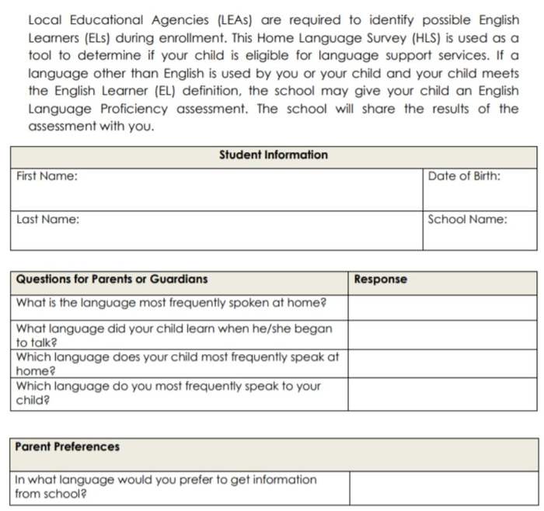
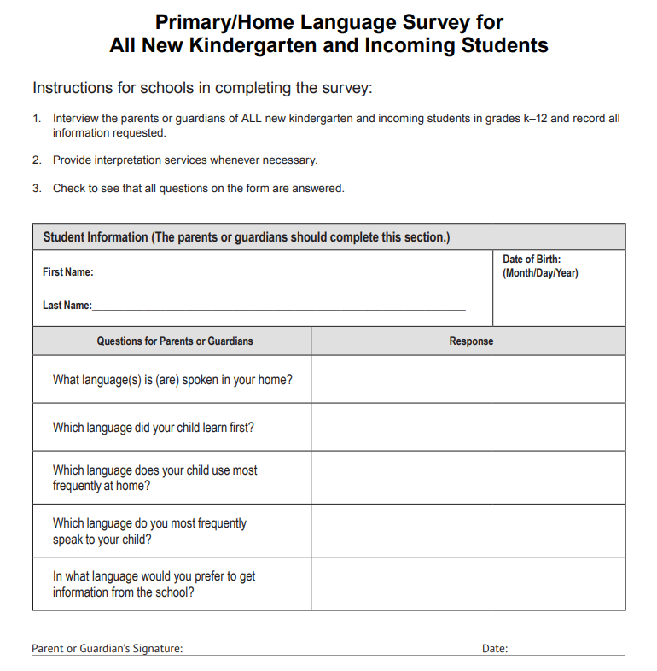
Home Language Survey Examples
(more examples can be found in Chapter 1 of the EL Toolkit)

Slide 20
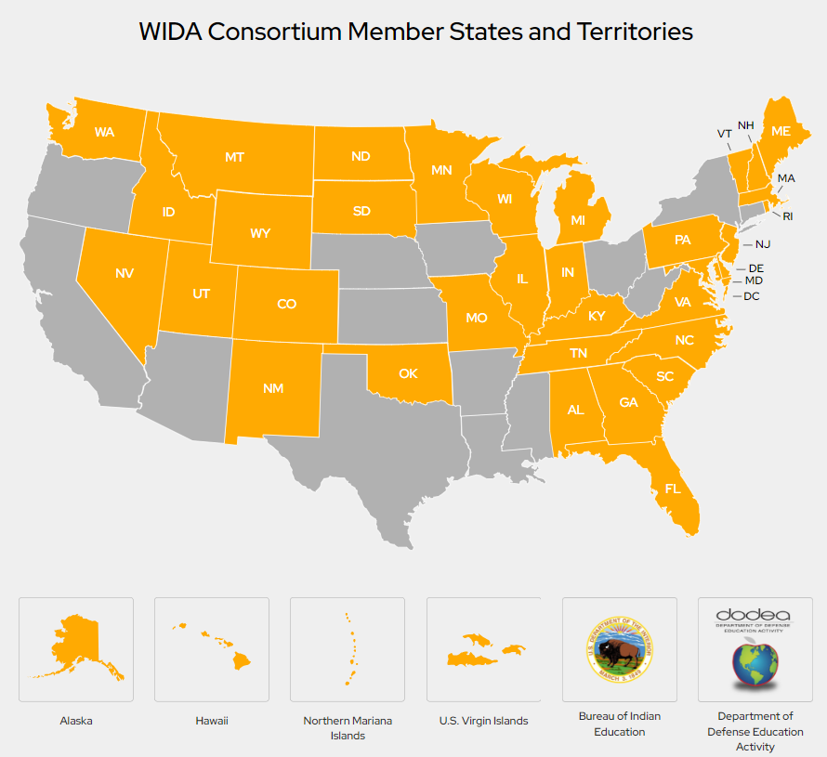
Identifying and Assessing All Potential ML Students (con’t)
School districts must then determine if potential ML students are in fact ML through a valid and reliable test that assesses English language proficiency in speaking, listening, reading and writing.
Colorado Senate Bill 109, CRS 22-24-106 requires the use of one common assessment to identify ML students. Colorado administers the Screener for Kindergarten and WIDA Screener for grades 1-12 as the state mandated placement assessment which must be used as one indicator to determine English language proficiency of newly enrolled and students transferring back to the district.

Slide 21
2. Providing Language Assistance to ML Students
ML students are entitled to appropriate language assistance services to become proficient in English and to participate equally in the standard instructional program within a reasonable period of time.
School districts can choose among programs designed for instructing ML students provided the program is educationally sound in theory and effective in practice.

Slide 22
Language Instruction Educational Programs (LIEPs)
  All identified NEP and LEP students must be enrolled in and receive adequate and appropriate English language development through the identified LIEP.
  NEP and LEP students are required by federal law to take the annual state ELP assessment, ACCESS/Alternate ACCESS. This includes students whose parents have chosen to decline the instruction offered in an LIEP.
  Districts, school, and charter schools must continue to monitor the English language development and academic growth of students whose parents have chosen to decline the instruction offered in an LIEP.
  If these students do not demonstrate appropriate ELP progress or achievement at appropriate academic grade levels, the district, school, and charter schools must inform families of student’s English language proficiency level and academic achievement and offer the family an opportunity to re-enroll student in an LIEP program or decline ELD instruction through an LIEP.

Slide 23
Non English Proficient (NEP) and Limited English Proficient (LEP)
ACCESS cut points to guide districts in making Non English Proficient (NEP), Limited English Proficient (LEP) and Fluent English Proficient (FEP) determinations for state reporting:
NEP: 1.0 – 2.4 (Overall)
LEP: 2.5 – 3.9 (Overall)
FEP M1: 4.0 Overall AND 4.0 Literacy

Slide 24
3. Staffing and Supporting an ELD Program
ML students are entitled to ELD programs with sufficient resources to ensure the programs are effectively implemented, including highly qualified teachers, support staff, and appropriate instructional materials.
School districts must have qualified ML teachers, staff, and administrators to effectively implement their LIEP, and must provide supplemental training when necessary.

Slide 25
4. Providing Meaningful Access to All Curricular and Extracurricular Programs
ML students must have access to their grade-level curricula so that they can meet promotion and graduation requirements.
ML students are entitled to an equal opportunity to participate in all programs, including pre-kindergarten, magnet, gifted and talented, career and technical education, arts, and athletics programs; Advanced Placement (AP) and International Baccalaureate (IB) courses; clubs; and honor societies.

Slide 26
5. Avoiding Unnecessary Segregation of ML Students
School districts generally may not segregate students on the basis of national origin or ML status. Although certain ELD programs may be designed to require that ML students receive separate instruction for a limited portion of the day or period of time, school districts and states are expected to carry out their chosen program in the least segregative manner consistent with achieving the program’s stated educational goals.

Slide 27
6. Evaluating ML Students for Special Education and Providing Dual Services
ML students with disabilities must be provided both the language assistance and disability-related services to which they are entitled under Federal law.
ML students who may have a disability, like all other students who may have a disability and may require services under the Individuals with Disabilities Education Act (IDEA) or Section 504 of the Rehabilitation Act of 1973, must be located, identified and evaluated for special education and disability-related services in a timely manner.

Slide 28
6. Evaluating ML Students for Special Education and Providing Dual Services (con’t)
To avoid inappropriately identifying ML students as students with disabilities because of their limited English proficiency. ML students must be evaluated in an appropriate language based on the student’s needs and language skills.
To ensure that an individualized plan for providing special education or disability-related services addresses the language-related needs of an ML student with a disability, it is important that the team designing the plan include participants knowledgeable about that student’s language needs.

Slide 29
7. Meeting the Needs of Students Who Opt Out of ELD Programs or Particular Services
All ML students are entitled to services. Parents may, however, choose to opt their children out of a school district’s ELD program or out of particular ML services within an ELD program.
School districts may not recommend that parents opt out for any reason. Parents are entitled to guidance in a language that they can understand about their child’s rights, the range of ML services that their child could receive, and the benefits of such services. School districts should appropriately document that the parent made a voluntary, informed decision to opt their child out.
A school district must still take steps to provide opted-out ML students with access to its educational programs, monitor their progress, and offer ML services again if a student is struggling.

Slide 30
8. Monitoring and Exiting EL Students from ELD Programs and Services
School districts must monitor the progress of all ML students to ensure they achieve English language proficiency and acquire content knowledge within a reasonable period of time. Districts must annually administer a valid and reliable English language proficiency (ELP) assessment, in reading, writing, listening and speaking, that is aligned to State ELP standards.
An ML student must not be exited from ELD programs, services, or status until he or she demonstrates English proficiency on an ELP assessment in speaking, listening, reading, and writing.
School districts must monitor the academic progress of former ML students for at least two years to ensure that students have not been prematurely exited; any academic deficits they incurred resulting from the ELD program have been remedied; and they are meaningfully participating in the district’s educational programs comparable to their peers who were never ML students (never-ML peers).

Slide 31
9. Evaluating the Effectiveness of a District’s ELD Program
ELD programs must be reasonably calculated to enable ML students to attain English proficiency and meaningful participation in the standard educational program comparable to their never-ML peers.
School districts must monitor and compare, over time, the academic performance of ML students in the program and those who exited the program, relative to that of their never-ML peers.
School districts must evaluate ML programs over time using accurate data to assess the educational performance of current and former ML students in a comprehensive and reliable way, and must timely modify their programs when needed.

Slide 32
10. Ensuring Meaningful Communication with Limited English Proficient Parents
LEP parents are entitled to meaningful communication in a language they can understand, such as through translated materials or a language interpreter, and to adequate notice of information about any program, service, or activity that is called to the attention of non-LEP parents.

Slide 33

Zoom Poll
Please vote for the topic that you’d like to hear about next during Office Hours:
Identifying and Assessing All Potential ML Students (11/16)
Providing Language Assistance to ML Students
Staffing and Supporting an ELD Program
Providing Meaningful Access to All Curricular and Extracurricular Programs
Avoiding Unnecessary Segregation of ML Students
Evaluating ML Students for Special Education and Providing Dual Services
Meeting the Needs of Students Who Opt Out of ELD Programs or Particular Services
Monitoring and Exiting EL Students from ELD Programs and Services
Evaluating the Effectiveness of a District’s ELD Program
Ensuring Meaningful Communication with Limited English Proficient Parents

Slide 34
RESOURCES
US Dept of Ed & Us Dept of Justice: Ensuring English Learner Students Can Participate Meaningfully and Equally in Educational Programs
CDE ELD Program Requirements: Identification and Placement
English Language Proficiency Act (ELPA)
EL Toolkit: Chapter 1 - Tools and Resources for Identifying All English Learners
Colorado Standardized Identification: Procedure and FAQs
Schools' Civil Rights Obligations to English Learner Students and Limited English Proficient Parents

Slide 35
Invitation to Attend and Extend to Your Colleagues
The CDE Culturally and Linguistically Diverse Education (CLDE) Office is hosting an OCR training on December 7th.
OCR will address ELD Plan components based in large part off of their, 2015 Dear Colleague Letter. If you would like to submit questions for the Q&A at the end of the office hours session, please complete this questionnaire prior to November 17, 2023.
Please share with any colleagues who might be interested in learning more about the topics discussed today.
CLDE Office Hours: https://www.cde.state.co.us/cde_english/webinars

Slide 36
ESSER Reporting

Slide 37
ESSER Reporting Survey Deadline Extended
The deadline for all three FY 22-23 ESSER surveys has been extended to December 1, 2023.
LEA Participation in ESSER Activities Survey (submitted via Syncplicity).
  All LEAs, including AUs, BOCES, etc., must submit.
  Please reach out if you need assistance or an extension.
Re-engaging Students Survey (Google form)
  All LEAs who received an ESSER 90% allocation (districts) must submit.
School-Level Allocation Survey (Google form)
  All LEAs who received an ESSER 90% allocation (districts) and allocated funds to schools in their ESSER applications during FY 22-23 must submit.
Our reporting website contains the surveys and helpful resources for completing them. Annotated and example versions of the participation survey templates are now available.

Slide 38
Example Reporting Scenario
Extended instructional time implemented at two schools within an LEA
Scenario: Two schools within an LEA implement extended school days for the 2022-2023 school year. These two schools have a combined total enrollment of 250 students.
Reporting instructions: For their FY23 LEA Participation in ESSER Activities survey, the LEA should:
Report “False” to “Is extended instructional time in place at all schools within the LEA?”
Indicate “250” as the “unique headcount of students enrolled in schools within the LEA with mandatory extended instructional time“
Provide the student group membership counts if using the aggregate LEA-level template or names and SASIDs if using one of the student-level templates for the 250 students who were enrolled at the two schools

Slide 39
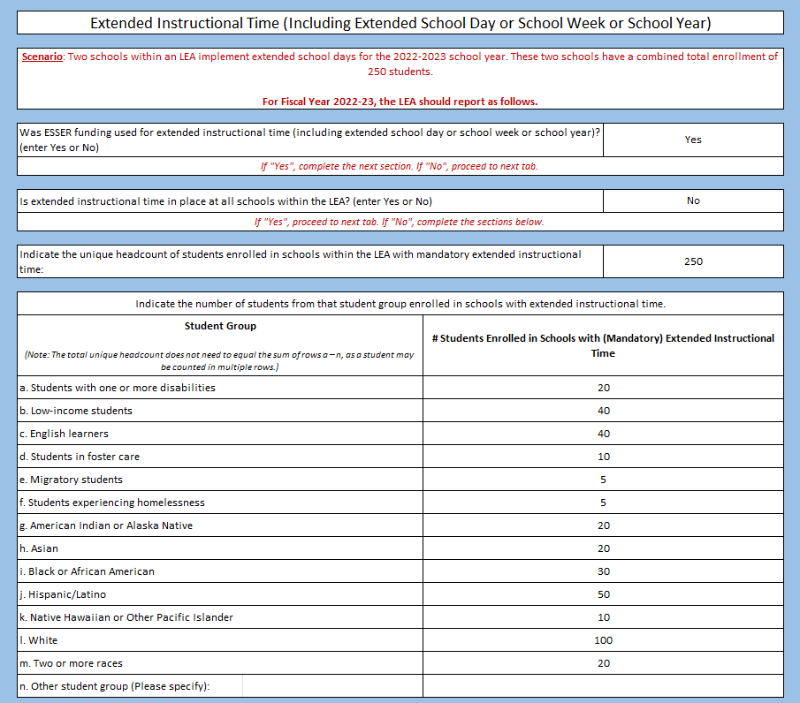
Example Template:
LEA-Level Survey for Implementation of Extended School Days at two schools within an LEA

Slide 40
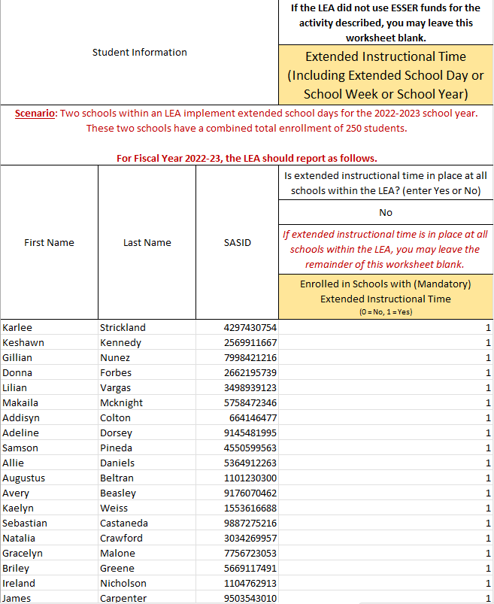
Example Template: Student-Level Survey for Implementation of Extended School Days at two schools within an LEA

Slide 41
Example Reporting Scenario #2
Targeted evidence-based high dosage tutoring at an LEA
Scenario: An LEA did not offer any ESSER-funded evidence-based high dosage tutoring in FY23.
Reporting instructions: For their FY23 LEA Participation in ESSER Activities survey, the LEA should:
Report “No” to “Was ESSER funding used for evidence-based high-dosage tutoring?”
Move on to the next tab

Slide 42
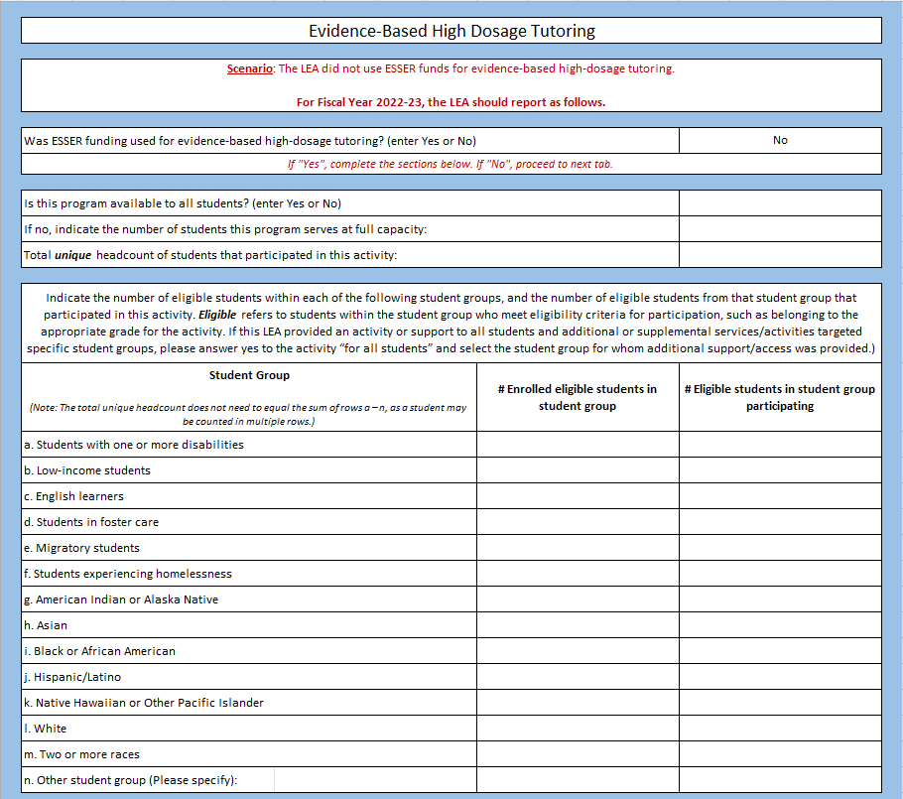
Example Template:
LEA-Level Survey for an LEA that did not offer ESSER-funded Evidence-Based High-Dosage Tutoring

Slide 43
Upcoming Meetings

Slide 44

Looking Ahead…
Any requests for topics or questions?
Upcoming Office Hours:
  November 30
  Cancelling - to allow attendees to join the Special Session with OCR
  December 14
Special Session with OCR
  December 7, 2023 via CLDE Office Hours
* Please note, due to the winter break, December office hours will be held once on December 14.

Slide 45
CDE Contacts!
Emails: Lastname_Firstinitial@cde.state.co.us (e.g., Smith_a@cde.state.co.us)
Federal Programs & Supports (ESEA/ESSER Program Supports) | School Finance & Operations (Fiscal and Systems Supports)
Nazie Mohajeri-Nelson, Executive Director of Federal Programs & Supports Unit Program Specialists Program Implementation Supervisor: Laura Meushaw Program Implementation Coordinator: Christina Adeboye Sullivan Program Monitoring Supervisor: Tammy Giessinger ESEA/ESSER Monitoring Coordinator: Kristin Crumley Program Effectiveness Supervisor: Tina Negley Program Evaluation & Research Coordinator: Mary Shen ESEA Programs Specialists and ESEA Regional Contacts (assigned by district) Title I: Laura Meushaw, Evita Byrd, Rachel Echsner, Kim Boylan Title II: Rachel Echsner Title III: Rachel Temple, Kim Boylan Title IV & Stronger Connections Grant: Nathan Hickman, Evita Byrd Title V: Christina Adeboye-Sullivan, Rachel Echsner ESSER Program Specialists Jonathan Schelke Kim Boylan Kriselda Craven ESEA and ESSER Data and Reporting Specialists Mackenzie Owens (ESSER) Melissa Chaffin (ESEA) Jerry Ring (ESEA) | Amy Carman, Executive Director of School District Operations Unit Fiscal Specialists Jennifer Austin, Director of Grants Fiscal Management ESEA Robert Hawkins, Grants Fiscal Analyst Steven Kaleda, Grants Fiscal Analyst ESSER Fiscal Specialist Steven Kaleda Grants Fiscal Analyst ESSER Monitoring Hilery Morris, ESSER Fiscal Monitoring Kristina Jones, Federal Fiscal Monitoring and Reporting Specialist Werner Hagemann, ESSER Fiscal Monitoring Specialist Application Systems Specialists DeLilah Collins, Director of Grants Program Administration Online Applications Systems Technical Support Michelle Prael

