Slide 1
CDE Office Hours
November 10, 2022

Slide 2
ESSER Office Hours
Topics
Updates and Reminders
  ARP ESSER III ~ Maintenance of Equity
  Monitoring Update
ESSA Identification Overview and 2022 Summary
Federal Teacher Loan Forgiveness
Notes:
Nazie

Slide 3
Updates, Reminders, and Clarifications
Notes:
Nazie

Slide 4
ARP ESSER III - Maintenance of Equity
Reminder: ARP ESSER III requires that
An LEA does not disproportionately reduce State and local per-pupil funding in high-poverty schools.
An LEA does not disproportionately reduce the number of full-time-equivalent (FTE) staff per pupil in high-poverty schools.
CDE is required to identify schools that meet the criteria for high-poverty (in the highest quartile of schools served by the LEA based on the percentage of economically disadvantaged students). Communications coming in the near future outlining / reminding LEAs of MoEquity requirements.
LEA may be exempt from Maintenance of Equity requirements if the LEA:
Has a total enrollment of less than 1,000 students (automatic exception);
Operates a single school (automatic exception);
Serves all students within each grade span with a single school (automatic exception); or
Demonstrates an exceptional or uncontrollable circumstance, such as unpredictable changes in student enrollment or a precipitous decline in the financial resources of the LEA as determined by the Secretary (eligible to request an exception).
Notes:
Mackenzie

Slide 5
Maintenance of Equity Exception Certificate
CDE has determined that all LEAs in Colorado were excepted from Maintenance of Equity requirements for ESSER III in FY 2022-2023. Some LEAs received an automatic exception and the rest were excepted because they did not have an aggregate reduction in combined State and local per-pupil funding in FY 2023.
The latter LEAs must fill out the Maintenance of Equity exception certificate by Friday, November 18th to stay in compliance with federal regulations.
We have reached out directly to those LEAs who need to submit a certificate. If you have not received a call or email from CDE about Maintenance of Equity this week, you do not need to submit the certificate. If you are unsure, please check the exceptions list here or reach out to Mackenzie Owens at owens_m@cde.state.co.us.

Slide 6
Monitoring Update
Notes:
Tammy

Slide 7
Coming Soon!
We have received preliminary approval to share the Program Monitoring and Fiscal Self-Assessments.
We will be sending communication to the LEAs being monitored within the next week. The communication will include the following:
  Access to the Program Monitoring and Fiscal Self-Assessments
  Directions for submitting evidence in Syncplicity
  Timelines for submission
  Opportunities and contacts for additional support

Slide 8
ESSA Identification of Schools for Support and Improvement
Federal Programs and Supports Unit
Notes:
Tina

Slide 9
ESSA Identification Overview
Notes:
Tina - Refresher (expanded ESSA Identification Overview provided during September 29th Office Hours, and available online).

Slide 10
Support and Improvement Under ESSA
Every state that accepts funds under the Every Student Succeeds Act (ESSA) must have an approved methodology for meaningfully differentiating the performance of and identifying schools for support and improvement.
  Developed in consultation with stakeholders.
  ESSA State Plan approved by the U.S. Department of Education in 2018.
  Accountability pause (2020-21 and 2021-22) as a result of the COVID-19 pandemic.
  Identification process resumed in Fall 2022.
Notes:
Tina

Slide 11
Identification of Schools
Annual identification of schools for Support and Improvement under ESSA:
Comprehensive Support and Improvement (CS)
  CS - Lowest 5%
    Title I schools with the lowest total percentage points earned
  CS - Low Graduation Rate
    All public high schools with 4-year and 7-year graduation rates below 67 percent for three consecutive years
  CS - Former ATS (first year of possible identification)
    Title I schools identified for Additional Targeted Support for four consecutive years for the same student group will be moved to this category
Targeted Support and Improvement (TS)
  Targeted Support (TS)
    Schools with at least one consistently underperforming student group
  Additional Targeted Support (ATS)
    Subset of TS schools with at least one disaggregated group that, on its own, meets the criteria for CS - Lowest 5%
Notes:
Tina

Slide 12
Addendum for SY 2022-23
Due to the COVID-19 pandemic, Colorado was approved to amend its State plan to account for short-term changes in the 2022-2023 school year (http://www.cde.state.co.us/fedprograms/essa).
  Use 1-year of accountability data, instead of 3-years of aggregated data.
  Modify the Academic Progress indicator to only include mathematics growth for grades 5 and 7, and English language arts growth for grades 4, 6, and 8.
  Modify the School Quality or Student Success (SQSS) indicator to:
    Exclude science achievement.
    Alter the definition of chronic absenteeism to include unexcused absences only.
  For schools identified for Comprehensive Support and Improvement in Fall 2022, modify the exit criteria such that schools may be eligible to exit after two consecutive years, rather than three consecutive years.
Notes:
Tina

Slide 13
ESSA Identification Categories in SY 2022-23
Under ESSA, districts may have schools identified in the following categories:
CS – Lowest 5%
  HOLD - School no longer meets identification criteria, but has not yet exited CS status (CS is a multi-year designation)
  Year 4 Or More - School met identification criteria for four or more consecutive years
  Due to Participation Only - School met identification criteria as a result of participation-adjusted calculations
CS - Low Graduation Rate
  HOLD - School no longer meets identification criteria, but has not yet exited CS status (CS is a multi-year designation)
  Year 4 Or More - School met identification criteria for four or more consecutive years
CS - Former ATS (first year of possible identification)
  No schools identified for this category in 2022-2023
Targeted Support (TS)
  2018-19/2019-20 - Not Exited by District - School no longer meets identification criteria, but was not exited by district
  Due to Participation Only - School met identification criteria as a result of participation-adjusted calculations
Additional Targeted Support (ATS)
  2018-19/2019-20 - Not Exited by District - School no longer meets identification criteria, but was not exited by district
  Due to Participation Only - School met identification criteria as a result of participation-adjusted calculations
The State is required to take more rigorous action.
Notes:
Tina
“Under ESSA, the State is required to take more rigorous action for schools that have been identified for CS-lowest 5% or CS-low graduation rate for 4 or more years. This is the first year that we have schools in this category. Prior to the pandemic, CDE had been working with stakeholders to determine the more rigorous action to be taken. However, that work was paused until this year. Based on stakeholder input, the schools that are also on the state accountability clock will not have any additional actions because of the efforts being implemented under the state accountability. For the CS-Y4+ schools that are only ESSA identified, CDE will work with the district and school to develop a plan that builds upon the improvement efforts taken to date. We are in the process of developing the options and will be reaching out to those districts directly.”

Slide 14
2022-23 ESSA Identification Results
Notes:
Tina

Slide 15
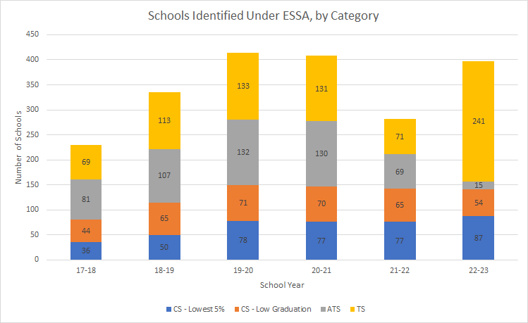
ESSA Identification Over Time
Notes:
Tina

Slide 16
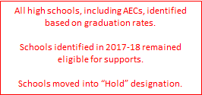
ESSA Identification Over Time
Notes:
Tina

Slide 17
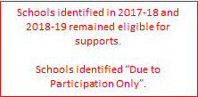
ESSA Identification Over Time
Notes:
Tina

Slide 18

ESSA Identification Over Time
Notes:
Tina

Slide 19
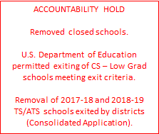
ESSA Identification Over Time
Notes:
Tina

Slide 20

ESSA Identification Over Time
Notes:
Tina

Slide 21

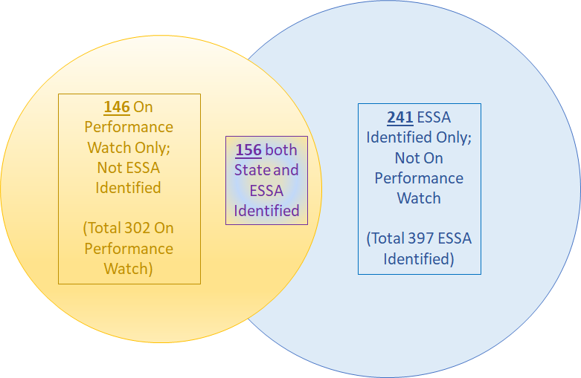


2022-23 Schools Identified for Support and Improvement
Notes:
Tina

Slide 22
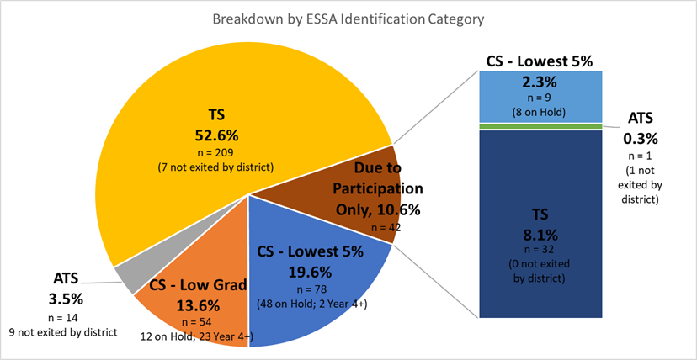
Overview of 2022-23 ESSA Identification
397 schools currently identified for support and improvement under ESSA
  189 newly identified schools
  15 schools exited by state (6 CS – Lowest 5%; 9 CS – Low Grad)
  75 ATS/TS schools exited by districts
Notes:
Tina

Slide 23
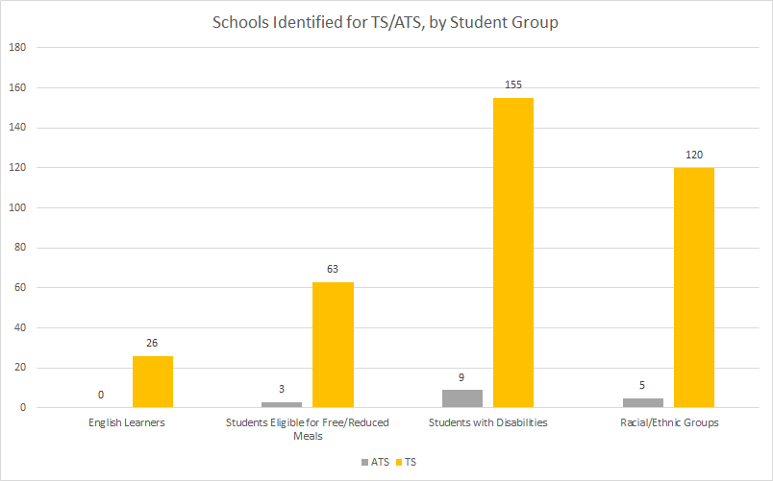

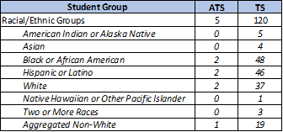
Schools Identified for Targeted Support
Notes:
Tina

Slide 24
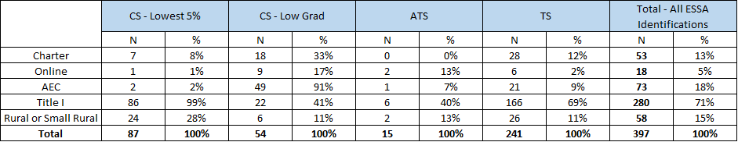
What Types of Schools Have Been Identified?
Notes:
Tina

Slide 25
Additional Information
For more information, please visit Colorado’s ESSA Methods and Criteria for Identification of Schools for Support and Improvement Webpage (http://www.cde.state.co.us/fedprograms/essa_csi_tsi)
For additional information regarding the methodology, criteria, or data used to identify schools for support and improvement under ESSA, please contact:
  Tina Negley
    Supervisor, Program Effectiveness Office
    720-766-2793
  Mary Shen
    ESEA Research Analyst
    720-766-8723
For considerations or questions about the future of ESSA Identification and/or possible revisions to the ESSA State Plan in this regard, please contact:
  Nazie Mohajeri-Nelson
    Executive Director, Federal Programs and Supports Unit
    720-626-3895
Notes:
Tina

Slide 26
Federal Teacher Loan Forgiveness and Cancellation Programs
Federal Programs and Supports Unit
Notes:
Karen

Slide 27
Teacher Loan Forgiveness
Notes:
Karen

Slide 28
Today we will review…
Federal Teacher Loan Forgiveness Program
Federal Perkins Loan Cancellation
The Teacher Cancellation Low Income Directory
CDE’s Role
Helpful Resources

Slide 29
Federal Teacher Loan Forgiveness Program

Slide 30
Federal Teacher Loan Forgiveness
Loan forgiveness up to (potentially) $17,500:
  Full-time Elementary or Secondary Special Education Teachers
  Secondary Math and Science Teachers
Elementary teachers and secondary teachers who teach a different subject from those listed above, could receive loan forgiveness up to (potentially) $5,000
Incentive - Retain highly effective teachers in the field.

Slide 31
Federal Teacher Loan Forgiveness: Eligibility
Teachers must have:
  an outstanding balance on Direct Loans or Federal Family Education Program Loans
  obtained loan after 10/01/1998
  been a full-time, highly qualified teacher for five complete and consecutive years
  been employed at an elementary school, secondary school, or educational service agency who serve low-income students at a school on the Teacher Cancellation Low Income (TCLI) Directory
The loans teachers are seeking forgiveness for must have been made before the end of their five academic years of qualifying teaching service.

Slide 32
Federal Teacher Loan Forgiveness: Loan Eligibility
Highly qualified teachers are eligible if they have one of the following loans:
  Direct Subsidized Loans;
  Direct Unsubsidized Loans;
  Subsidized Federal Stafford Loans; or,
  Unsubsidized Federal Stafford Loans

Slide 33
Federal Teacher Loan Forgiveness: Highly Qualified
To be a highly qualified teacher, the following must be met:
  attained at least a bachelor’s degree;
  received full state certification as a teacher; and
  not had certification or licensure requirements waived on an emergency, temporary, or provisional basis.
If teachers are employed at a public charter school, they are considered to have received full state certification as a teacher if they meet the requirements set forth in the state's public charter school law.

Slide 34
Federal Teacher Loan Forgiveness: Service
Teachers must teach for five consecutive years at a location that is on the TCLI directory
Teachers do not have to stay at the same school for all five years
When a teacher moves to a different school and would like to be eligible for loan forgiveness, ensure the school is low-income and on the Teacher Cancellation Low Income (TCLI) Directory
For more information about the program, visit Teacher Loan Forgiveness at Student Aid.

Slide 35
Federal Perkins Loan Cancellation Program

Slide 36
Federal Perkins Loan Cancellation: Eligibility
Teachers may qualify for cancellation of up to 100% of a Federal Perkins Loan if they have served full-time in a public or nonprofit elementary or secondary school system as a:
Teacher in a school serving students from low-income families (based on TCLI directory);
Special education teacher, including teachers of infants, toddlers, children, or youth with disabilities; or
Teacher in the fields of mathematics, science, foreign languages, or bilingual education, or in any other field of expertise determined by a state educational agency to have a shortage of qualified teachers in that state.
Note: Eligibility for teacher cancellation is based on the duties presented in an official position description, not on the position title. To receive a cancellation, teachers must be directly employed by the school system.

Slide 37
Federal Perkins Loan Cancellation
If teachers are eligible for cancellation, up to 100% of the loan may be canceled for eligible teaching service.
For more information about the program, visit Teacher Cancellation at Student Aid.

Slide 38
CDE’s Role & Teacher Cancellation Low Income Directory (TCLI)

Slide 39
CDE’s Role
The only role of CDE in the Federal Teacher Loan Forgiveness and Federal Perkins Loan Cancellation Program is to maintain the Teacher Cancellation Low Income Directory (TCLI). Teachers can search for a school in this directory to determine if the school qualifies as low income.

Slide 40
Teacher Cancellation Low Income Directory (TCLI)
School must be a public or other nonprofit elementary or secondary school.
The number of children enrolled in a school who are counted under Section 1124(c) of the ESEA (federal definition of poverty) must exceed 30.01 percent of the total enrollment of that school (PK-12 enrollment).
School must be a part of a Local Educational Agency that is eligible for Title I, Part A funds.
Pre-K and Facility Schools are included. Pre-K is included if associated with an Elementary. Stand alone preschools are not automatically added to the directory and schools will need to fill out the Eligibility Application.

Slide 41
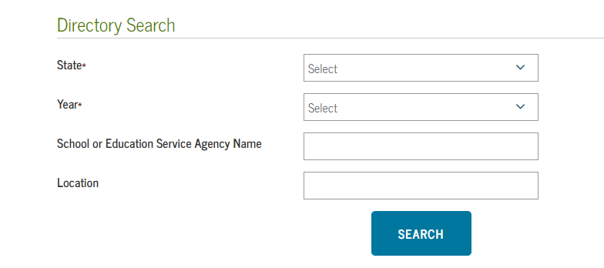
TCLI Directory: Search for a School
Enter the state.
Enter the school year.
Enter the first few* letters.
Leave BLANK!
*Less is more on the TCLI Directory

Slide 42
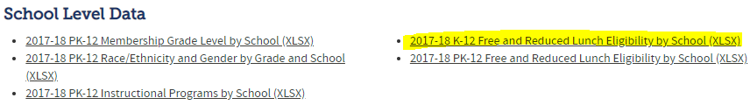
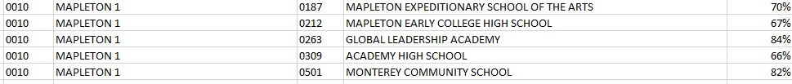
TCLI Directory: School Poverty Percentage
Not locating a school on the directory and believe it should be on there, check the Free and Reduced Lunch data on the Pupil Membership website
Find the data to see if a school is above the 30.01% threshold

Slide 43
Helpful Links & Contacts
Resources for guidance and information shared today:
Federal Teacher Loan Forgiveness and Federal Perkins Loan Cancellation
Contact: Karen Bixler at bixler_k@cde.state.co.us

Slide 44
Educator Loan Forgiveness & Cancellation, Scholarship or Stipend Opportunities
Federal Related
Teacher Loan Forgiveness Program
Federal Perkins Loan Cancellation
Public Service Loan Forgiveness
State Related
Colorado Educator Loan Forgiveness
ECE Educator Loan Forgiveness
ECE Stipends
ECE Scholarships

Slide 45
Upcoming Meetings
Notes:
Nazie

Slide 46

Any Requests for Upcoming Topics or Questions!
Upcoming Office Hours
November 17
  Comparability
November Changes!
November 24 (Thanksgiving Holiday) has been moved to November 17
December Changes!
December 1
December 15
December 29 - Cancelled

Slide 47
CDE Contacts!
Emails: Lastname_Firstinitial@cde.state.co.us
(e.g., Smith_a@cde.state.co.us)
Federal Programs & Supports (ESEA/ESSER Program Supports) | School Finance & Operations (Fiscal and Systems Supports)
Nazie Mohajeri-Nelson, Executive Director of Federal Programs & Supports Unit Program Specialists Program Implementation Supervisor: Laura Meushaw Program Monitoring Supervisor: Tammy Giessinger Program Effectiveness Supervisor: Tina Negley ESEA Programs Specialists and ESEA Regional Contacts (assigned by district) Title I: Laura Meushaw, Kathryn Wisner, Evita Byrd, Rachel Echsner Title II: Karen Bixler Title III: Rachel Temple Title IV: Tammy Giessinger, Nathan Hickman Title V: Shannon Wilson ESSER Program Specialists Kristin Crumley Jonathan Schelke Kim Boylan Shannon Wilson ESEA and ESSER Data and Reporting Specialists Tina Negley Mary Shen Mackenzie Owens | Kate Bartlett, Executive Director of School District Operations Unit Fiscal Specialists Jennifer Austin, Director of Grants Fiscal Management ESEA Robert Hawkins, Grants Fiscal Analyst Steven Kaleda, Grants Fiscal Analyst ESSER Fiscal Specialist Steven Kaleda Grants Fiscal Analyst ESSER Monitoring Bill Parsley, ESSER Fiscal Monitoring Supervisor Hilery Morris, ESSER Fiscal Monitoring Kristina Jones, Federal Fiscal Monitoring and Reporting Specialist Werner Hagemann, ESSER Fiscal Monitoring Specialist Application Systems Specialists DeLilah Collins, Director of Grants Program Administration Online Applications Systems Technical Support Michelle Prael

