Slide 1
CDE Office Hours
October 28, 2021

Slide 2
CDE Team!
CDE Contacts!
Emails: LastName_FirstInital@cde.state.co.us
ESSER/ESEA Program Partners
Nazie Mohajeri-Nelson, Director of ESEA Office (mohajeri-nelson_n@cde.state.co.us)
DeLilah Collins, Assistant Director of ESEA Office (collins_d@cde.state.co.us)
ESEA Regional Contacts assigned by district
  Title I: Laura Meushaw, Kathryn Wisner, Niko Kaloudis
  Title II: Niko Kaloudis
  Title III: Lorenzo Moreno, Kathryn Wisner
  Title IV: Tammy Giessinger, Michelle Prael
  Title V: Kristen Collins
ESSER Team
  Kristin Crumley, ESSER Monitoring Specialist (Crumley_k@cde.state.co.us)
  Jonathan Schelke, ESSER Monitoring Specialist (schelke_j@cde.state.co.us)
  Shannon Wilson, ESSER/ESEA Grants Administration Coordinator (Wilson_s@cde.state.co.us)
  Mackenzie Owens, ESSER Reporting Specialist (owens_m@cde.state.co.us)
Data, Accountability, Reporting, and Evaluation
  Tina Negley, Alan Shimmin, Mary Shen, and Mackenzie Owens
Fiscal Partners
Jennifer Okes, Chief Operating Officer (okes_j@cde.state.co.us)
Kate Bartlett, Executive Director of School District Operations (Bartlett_k@cde.state.co.us)
Jennifer Austin, Director of Grants Fiscal Management (Austin_j@cde.state.co.us)
Robert Hawkins, Grants Fiscal Analyst (Hawkins_s@cde.state.co.us)
Steven Kaleda, Grants Fiscal Analyst (Kaleda_s@cde.state.co.us)
ESSER Team
  Bill Parsley, ESSER Fiscal Monitoring Supervisor (parsley_w@cde.state.co.us)
  Hilery Morris, ESSER Fiscal Monitoring (morris_h@cde.state.co.us)
  Sharon Mackey, ESSER Fiscal Monitoring (mackey_s@cde.state.co.us)

Slide 3
ESSER Office Hours
Topics
ESSER I
  Carryover
  AFR
Updates, Reminders, and Clarifications
Notes:
Nazie

Slide 4
ESSER I
Demonstration by DeLilah Collins

Slide 5
Updates, Reminders, and Clarifications

Slide 6
Reminders
ARP ESSER III
  CDE has received 2/3 of the funds and had to submit an application for approval to the USDE [awaiting approval and receipt of the remaining 1/3]
    LEAs can only request for reimbursement and draw down funds up to 2/3 of your allocation until we receive the remaining 1/3 of funds. For the 2/3 and 1/3 amounts of your allocations see: https://www.cde.state.co.us/cdefisgrant/esseriiiallocations
    CDE cannot begin use of state reserve funds until after we have received approval and the remaining 1/3 of funds

Slide 7
Responses to Questions from Last Week
Are some LEAs automatically excepted from Maintenance of Equity requirements?
  Yes, LEAs that meet any of the following are automatically excepted (LEAs do not have to do anything additional)
    Total enrollment of less than 1,000 students;
    Operates a single school; or
    Serves all students within each grade span with a single school [no overlapping grades]
If state and local funding increased from 20-21 to 21-22, is this a reason for an exception?
  Yes, if the FY2022 (2021-2022 school year) combined state and local per-pupil funding is the same as or higher than FY 2021 (2020-2021 school year), then the LEA is eligible for an exception through “Certification of Exception” which must be submitted to CDE. However, this is not an automatic exception and requires submitting a certification of exception to CDE.
    “Exceptional Circumstances” may include and LEA that “did not and will not implement an aggregate reduction in combined State and local per-pupil funding in FY 2022 (i.e., is not facing overall budget reductions)” [Quote from letter to states from Secretary Cardona]
    Forms available on the ESEA/ESSER Resources Page: https://www.cde.state.co.us/fedprograms/resourcesandtechnicalassistance
      Certification of Exception from Local Maintenance of Equity [Word Doc Form]
      Submittal Process [Form via Smartsheets]
Are the maintenance of equity requirements based on allocations or actual expenditures and FTE?
  We are waiting for USDE guidance on this
    Some states are interpreting it as prior year expenditures compared to current year allocations

Slide 8
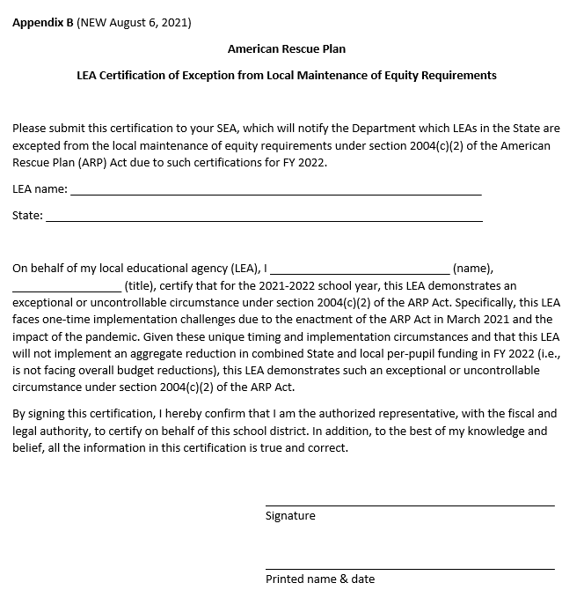
Screenshot of Certification Form
Fill in blanks
Print form
Sign and scan
Submitted signed form via Smartsheets

Slide 9
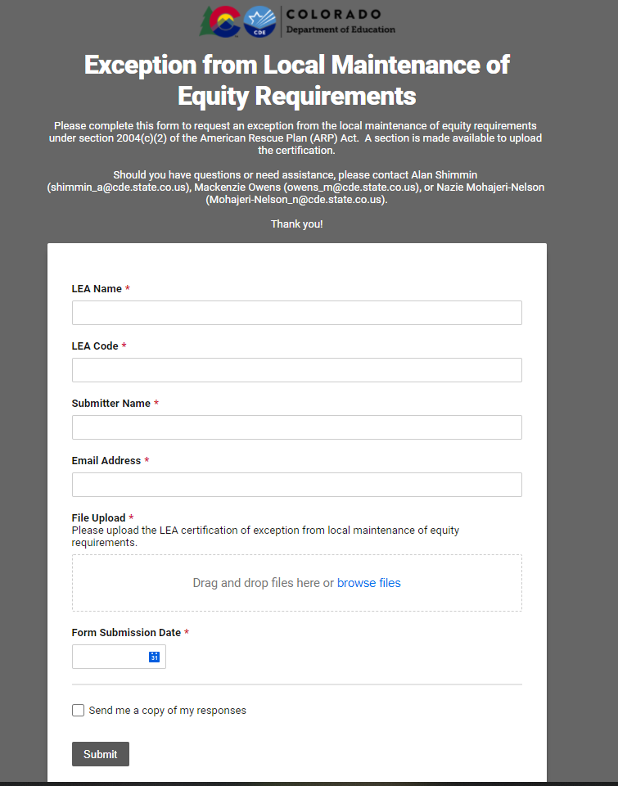
Screenshot of Exception Submittal Form
Clink on Smartsheet form from CDE’s webpage: https://www.cde.state.co.us/fedprograms/resourcesandtechnicalassistance
Enter information in all boxes
Upload the signed Word Doc
Select Form Submission Date
Hit submit

Slide 10
Maintenance of Equity – Where Can I Learn More?
USDE FAQ / Guidance: https://www.cde.state.co.us/fedprograms/resourcesandtechnicalassistance
On September 30th, Julia Martin, Esq., from the Brustein & Manasevit law firm presented on Maintenance of Equity. The recording and PowerPoint are available on the CDE Resources webpage (same link as above).
  PowerPoint | Recording

Slide 11
Reminders
Upcoming Due Dates
  October 29, 2021
    ESSER I AFR [for additional details see the October 21 Office Hours]
    Request to use grade span configuration for Maintenance of Equity – deadline extended
  November 15, 2021
    ESEA Consolidate Application AFR
  December 16, 2021
    ESSER III LEA Use of Funds Plans
  December 31, 2021
    Monitoring evidence due for LEAs being ESEA and/or ESSER monitored in 2021-2022 [exception – if we are working directly with you to develop monitoring timeline]

Slide 12

Any Requests for Upcoming Topics or Questions!
Upcoming Office Hours:
November 4:
  Marzano Research Team will share tools, resources, and how they can help with selecting evidence-based interventions and evaluating the impact of ESSER funds
November 11:
  Mapping data and how to submit any changes to your district boundaries
  Staff recruitment and retention
November 18: NO OFFICE HOURS
  Cancelled due to Committee of Practitioners meeting
November 25: NO OFFICE HOURS
  Cancelled due to Thanksgiving Holiday
December 2:
  Open Session – email requests for topics

Slide 13
Breakout Sessions by Region

Slide 14
Breakout Sessions by Region
Network with CDE staff and other districts in your region
Time for questions in smaller group setting
Share thoughts and ideas
  How is your school year so far – what’s going well with ESSER or ESEA funds?
  What are some challenges that your district is facing with implementing ESSER or ESEA?

Slide 15
CDE Team!
CDE Contacts!
Emails: LastName_FirstInital@cde.state.co.us
ESSER/ESEA Program Partners
Nazie Mohajeri-Nelson, Director of ESEA Office (mohajeri-nelson_n@cde.state.co.us)
DeLilah Collins, Assistant Director of ESEA Office (collins_d@cde.state.co.us)
ESEA Regional Contacts assigned by district
  Title I: Laura Meushaw, Kathryn Wisner, Niko Kaloudis
  Title II: Niko Kaloudis
  Title III: Lorenzo Moreno, Kathryn Wisner
  Title IV: Tammy Giessinger, Michelle Prael
  Title V: Kristen Collins
ESSER Team
  Kristin Crumley, ESSER Monitoring Specialist (Crumley_k@cde.state.co.us)
  Jonathan Schelke, ESSER Monitoring Specialist (schelke_j@cde.state.co.us)
  Shannon Wilson, ESSER/ESEA Grants Administration Coordinator (Wilson_s@cde.state.co.us)
  Mackenzie Owens, ESSER Reporting Specialist (owens_m@cde.state.co.us)
Data, Accountability, Reporting, and Evaluation
  Tina Negley, Alan Shimmin, Mary Shen, and Mackenzie Owens
Fiscal Partners
Jennifer Okes, Chief Operating Officer (okes_j@cde.state.co.us)
Kate Bartlett, Executive Director of School District Operations (Bartlett_k@cde.state.co.us)
Jennifer Austin, Director of Grants Fiscal Management (Austin_j@cde.state.co.us)
Robert Hawkins, Grants Fiscal Analyst (Hawkins_s@cde.state.co.us)
Steven Kaleda, Grants Fiscal Analyst (Kaleda_s@cde.state.co.us)
ESSER Team
  Bill Parsley, ESSER Fiscal Monitoring Supervisor (parsley_w@cde.state.co.us)
  Hilery Morris, ESSER Fiscal Monitoring (morris_h@cde.state.co.us)
  Sharon Mackey, ESSER Fiscal Monitoring (mackey_s@cde.state.co.us)

