Slide 1
CDE Office Hours
October 27, 2022

Slide 2
ESSER Office Hours
Topics
Updates and Reminders
  ESEA - Year At A Glance
  ARP ESSER III ~ Maintenance of Equity
  ESSER Annual Finance Reports
  Request for Funds
  CS UIP Training Resources
School District Review Program
Stronger Connections Grant
USDE Monitoring of CO: Title I Resource Allocation Review Monitoring Findings
Notes:
Nazie

Slide 3
Updates, Reminders, and Clarifications
Notes:
Nazie

Slide 4

The 2022-2023 Consolidated Applications!
Thank you for all of your hard work! We are so close!
Please address the comments and requests for revisions as soon as possible! (18 on the LEA side)
Goal - get all applications to final by 11/15/22!

Slide 5


ESEA Planning and Implementation
Year At A Glance
Happening Now - if applicable
  Determine if Title I carryover will be over 15%, submit a request for a waiver
  LEAs with ESSA identified schools:
    Notify schools; support school with revising/updating UIPs to address reasons for identification; determine if should and support school with applying for EASI.
  Ensure students of poverty and minority students are not taught at a higher percentage by ineffective, out-of-field, and inexperienced. Implement plan to address gaps, if applicable.
  Ensure services in Title I schools are comparable to non-Title I schools.
On the Horizon – Next Couple of Months
  Implement programs and plans as approved in the 2022-2023 Consolidated Application.
  Determine if implementation is achieving desired outcomes.
  If changes are needed after final approval, submit request for changes through the Post Award Revision (PAR) process.
  Post LEA Report Cards on the LEA website outlining school performance, including performance of disaggregated groups OR reference the CDE LEA report card on your website.

Slide 6
Data Question For You!
CDE is currently working on the 2023-2024 Transitional Year Consolidated Application (before we transition to the Grants Management System). We are seeking input on options for the most reliable and valid poverty data source?
  Please complete a short survey providing the following information:
    Your name, title, and organization
    List as many of the following that are available at your LEA:
      Free and Reduced Meal
      Counts of Students whose families receive assistance under the federal welfare program, Temporary Assistance for Needy Families (TANF)
      Counts of students eligible for Medicaid
      Other: [name/explain]
      Not sure
    Of the above list, which one would best represent the poverty rates of your schools

Slide 7
ARP ESSER III - Maintenance of Equity
Reminder: ARP ESSER III requires that
An LEA does not disproportionately reduce State and local per-pupil funding in high-poverty schools.
An LEA does not disproportionately reduce the number of full-time-equivalent (FTE) staff per pupil in high-poverty schools.
CDE is required to identify schools that meet the criteria for high-poverty (in the highest quartile of schools served by the LEA based on the percentage of economically disadvantaged students). Communications coming in the near future outlining / reminding LEAs of MoEquity requirements.
LEA may be exempt from Maintenance of Equity requirements if the LEA:
Has a total enrollment of less than 1,000 students (automatic exception);
Operates a single school (automatic exception);
Serves all students within each grade span with a single school (automatic exception); or
Demonstrates an exceptional or uncontrollable circumstance, such as unpredictable changes in student enrollment or a precipitous decline in the financial resources of the LEA as determined by the Secretary (eligible to request an exception).

Slide 8
ESSER Annual Financial Report (AFR)
Notes:
Shannon

Slide 9
ESSER Reporting Period(s)
ESSER I
Previously reported March 2020 - June 30, 2021 in last year’s ESSER I AFR This year, please report expenditures from July 1, 2021 - June 30, 2022 (FY21-22) Due October 28th
ESSER II
No AFR has been submitted for ESSER II. ESSER II will contain three AFR links: FY19-20: March 13, 2020 - June 30, 2020 FY20-21: July 1, 2020 - June 30, 2021 FY21-22: July 1, 2021 - June 30, 2022 Due October 28th
ESSER III
No AFR has been submitted for ESSER III. ESSER III will contain three AFR links: FY19-20: March 13, 2020 - June 30, 2020 FY20-21: July 1, 2020 - June 30, 2021 FY21-22: July 1, 2021 - June 30, 2022 Due October 28th
AFRs must be submitted for all years, even if no expenditures! Remember to click “Submit as Final”.

Slide 10
Contact Us!
If you have questions regarding the AFR, please contact the Grants Fiscal Unit:
  Steven Kaleda Kaleda_S@cde.state.co.us
  Robert Hawkins Hawkins_R@cde.state.co.us
If you have questions regarding the system, please contact the Grants Program Administration Office:
  Michelle Prael Prael_M@cde.state.co.us
  DeLilah Collins Collins_D@cde.state.co.us

Slide 11
Request for Funds (RFF)
Notes:
Steven

Slide 12
Request for Funds
LEA will need to complete and submit the Request for Funds Authorized Representative Designation form before requesting funds from CDE.
This form lets Grants Fiscal know who is authorized to submit RFFs.
The Authorized Representative and the Fiscal Representative can’t be the same person
  The Fiscal Representative needs to oversee the Authorized Representative
The Authorized Representative will then be given a 4 digit code unique to them
  This 4 digit code should not be shared.
  The 4 digit code will be used when requesting funds
Formsite Resources/Trainings can be found on CDE Grants Fiscal page http://www.cde.state.co.us/cdefisgrant/requestforfundsforms

Slide 13
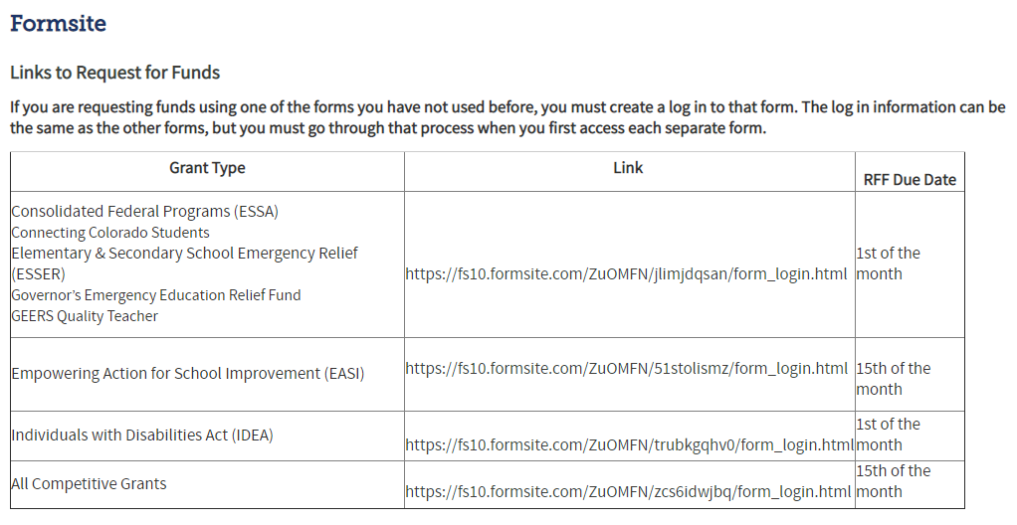
Formsite Links

Slide 14
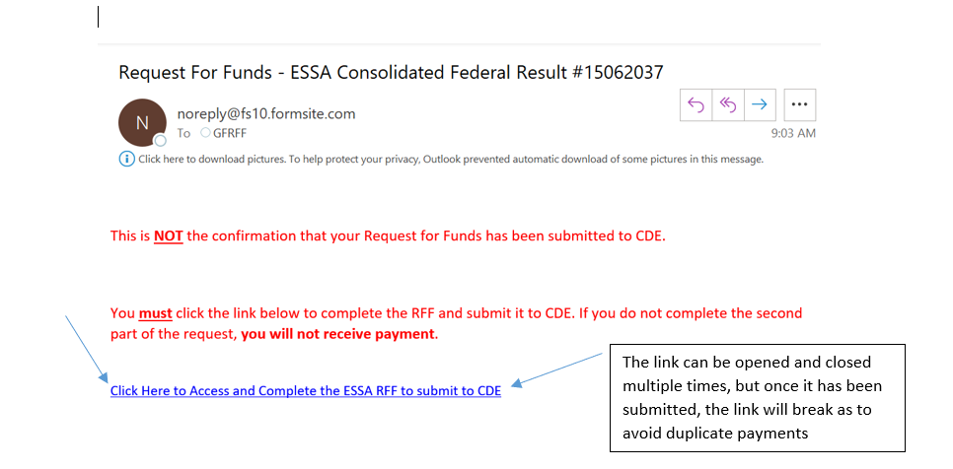
Part 1 – Preparer to Authorized Rep

Slide 15
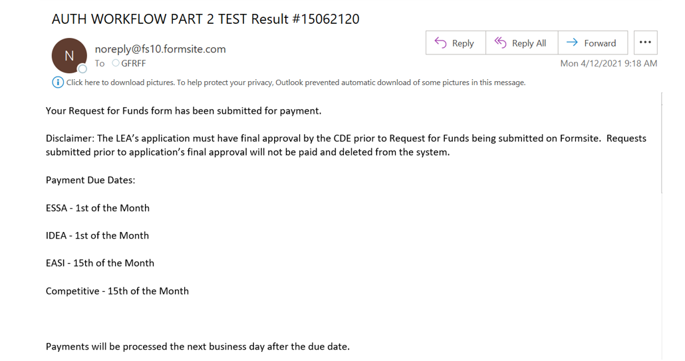
Submission to CDE

Slide 16
Funds That will Expire At the End of September!!!
ESSER I - Late Liquidation
If ESSER I funds were fully obligated by 9/30/22, but you need to request a late liquidation, please contact Nazie ASAP!
Late liquidation requests must be approved by the U.S. Department of Education and are due to USDE by 12/31/22!
Program / Funding Stream | Obligation Due Date | Request for Funds Form
ESEA FY20 | September 30, 2022 | November 1, 2022
ESEA FY21 | September 30, 2022 | November 1, 2022
ESSER I | September 30, 2022 | November 15, 2022
March 2022, GFMU sent emails about funds expiring at end of September!
Outreach attempts and reminders!
An approved PAR is required!
  Do you have activities that are allowable, reasonable, and necessary to meet program intent?
  Do you have an approved plan?
  Can you spend by September 30 and draw down by November?

Slide 17
CS UIP Training Resources
Notes:
Karen

Slide 18
Comprehensive Support and
Improvement Requirements and Planning
Recorded trainings and PowerPoints are available for information about identification, planning, development, and specific requirements with a focus on schools identified for Comprehensive Support and Improvement (CS-UIP)
Information & Training:
  ESSA Planning Requirements (trainings listed at bottom of page)
  Methods and Criteria for Identification of Schools for CS
Designed for Identification Categories: Schools Identified for CS-Low Graduation Rate or CS-Lowest 5%
Target Audience: District-level accountability administrators, Principals or the individuals writing school-level plans, as well as the district personnel responsible for supporting the development of, review, and approval of the School Comprehensive Support-Unified Improvement Plans (CS-UIPs)
Contacts:
Karen Bixler, bixler_k@cde.state.co.us
Tammy Giessinger,giessinger_t@cde.state.co.us
Notes:
Karen

Slide 19
Fall Regional Network Meetings
Notes:
Karen

Slide 20
Fall Regional Network Meeting
We are offering virtual and in-person training opportunities in the fall. The training is structured as three one-hour sessions. LEA staff may attend for the full time or for the sessions that are relevant to them.
Session 1
New LEA staff orientation
CDE staff will give an overview of the programs administered by the Unit of Federal Programs and Supports and provide helpful tools and resources to support new staff who work on these programs. LEA staff will have time to meet their Regional Contacts from CDE and network with LEA staff in their region.
Target Audience: LEA staff who are new to administering Title I-A, I-D, II-A, III, IV-A, or V-B or ESSER programs
Session 2
Post Award Revision Training
CDE staff will provide training on when and how LEAs should submit Post Award Revision in their ESEA Consolidated Application or ESSER applications. There will be time for LEA staff to work on Post Award Revisions with CDE staff available to answer questions.
Target Audience: LEA staff who complete the Consolidated Application or ESSER applications or who administer federal programs
Session 3
Monitoring Work Group
CDE staff will provide an overview of the 22-23 monitoring process, including the new self-assessment tools. Then, LEA staff will have time to work on completing the self-assessment and preparing documents for review with CDE staff present to support and answer questions.
Target Audience: Staff members from LEAs who are being monitored for ESEA or ESSER during the 22-23 school year.
Notes:
Karen

Slide 21
Fall RNM Dates and Locations
Completed
Completed
Northwest and West Central- Montrose
Tuesday, October 18, 9:00-12:00
Montrose School District Board Room
Register HERE
Pikes Peak Region- Colorado Springs
Tuesday, October 25, 12:30-3:30
District 49 Creekside Success Center Peak View Hall
Register HERE
Northeast and North Central- Fort Morgan
Thursday, November 10, 9:30-12:30
Fort Morgan Public Library
Register HERE
Completed
Completed
Northwest and West Central- Steamboat Springs
Wednesday, October 19, 9:00-12:00
Alpine Bank Conference Room
Register HERE
Metro Region- Denver
Thursday, October 27, 9:00-12:00
Colorado Talking Book Library
Register HERE
VIRTUAL
Tuesday, November 15, 9:00-12:00
Zoom
Register HERE
Completed
Southwest Region- Alamosa
Thursday, October 20, 12:30-3:30
San Luis Valley BOCES
Register HERE
Southeast Region- Lamar
Tuesday, November 8, 12:30-3:30
Southeastern BOCES
Register HERE
Note:
LEAs may attend at any location, regardless of region
Notes:
Karen

Slide 22
US. Census Bureau Annual School District Review Program
Notes:
Tina

Slide 23
Purpose
The School District Review Program (SDRP) enables state officials to review the Census Bureau’s school district information and update Federal School District Local Education Agency ID numbers, school district boundaries, names, levels, and grade ranges.
School district boundary data are used to estimate the number of school-aged children, ages 5 through 17, in families in poverty for each financially responsible school district.
  The SDRP considers a school district financially responsible when they pay for the education of the students that reside within their boundaries.
  These poverty estimates serve as the basis of Title I eligibility and are used to determine the distribution of Title I funding.

Slide 24
SDRP Phases
Two phases of the SDRP:
  Annotation Phase - State officials review and update the Census Bureau’s school district boundaries and information for their state. Available until December 2022.
  Verification Phase - State officials review the Census Bureau’s latest school district information to verify the accuracy and completeness of their Annotation Phase submission. Officials have one week to complete the verification starting in April 2023.
2023 SDRP Schedule
December 31, 2022 | Annotation Phase submission deadline
April 2023 | Verification Phase begins
December 2023 | Preliminary Poverty Estimates released

Slide 25
School District Boundaries
CDE is inviting districts to assist in the boundary review. Districts are encouraged to view their district boundaries online, using the TIGERweb application to determine if they accurately reflect school district boundaries.
  TIGERweb (https://tigerweb.geo.census.gov/tigerweb/) is the Census Bureau’s online application for viewing the most recent school district and legal boundaries.
  Applies to school district boundaries effective on or before January 1, 2023.

Slide 26
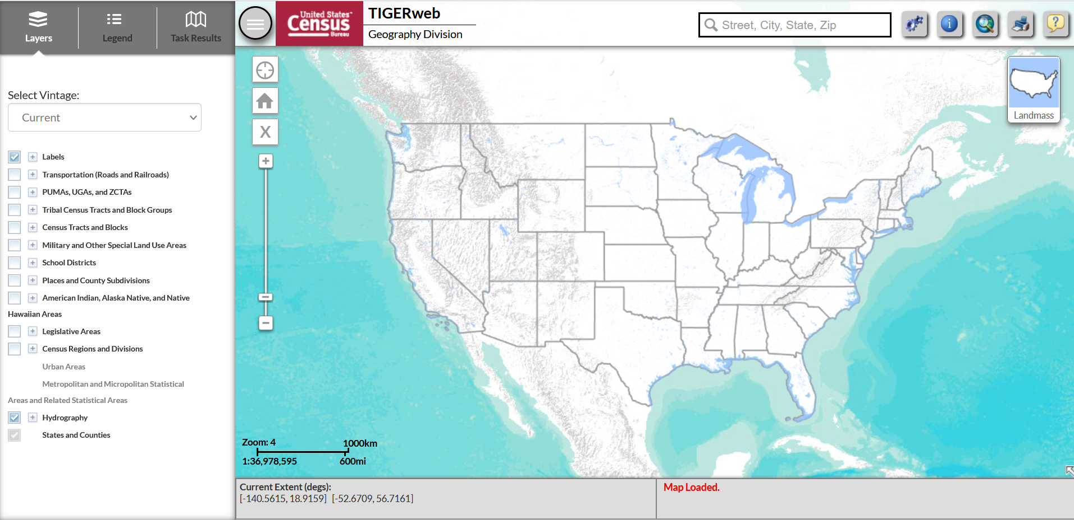
TIGERweb

Slide 27
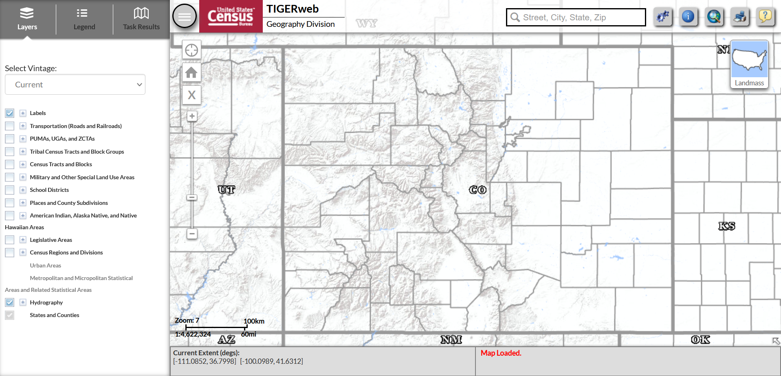
TIGERweb

Slide 28
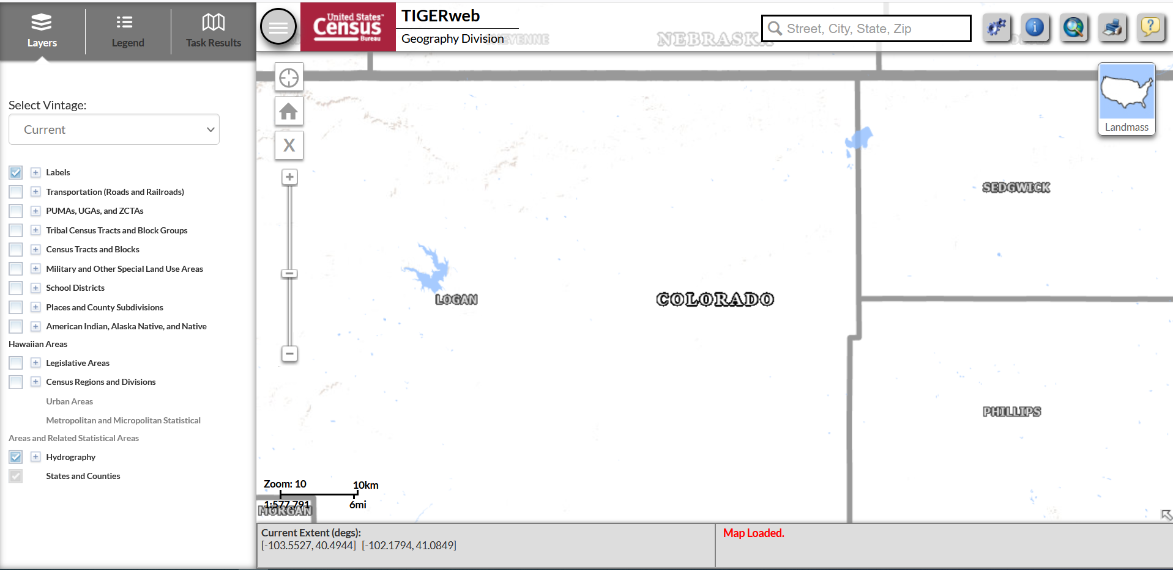
TIGERweb

Slide 29
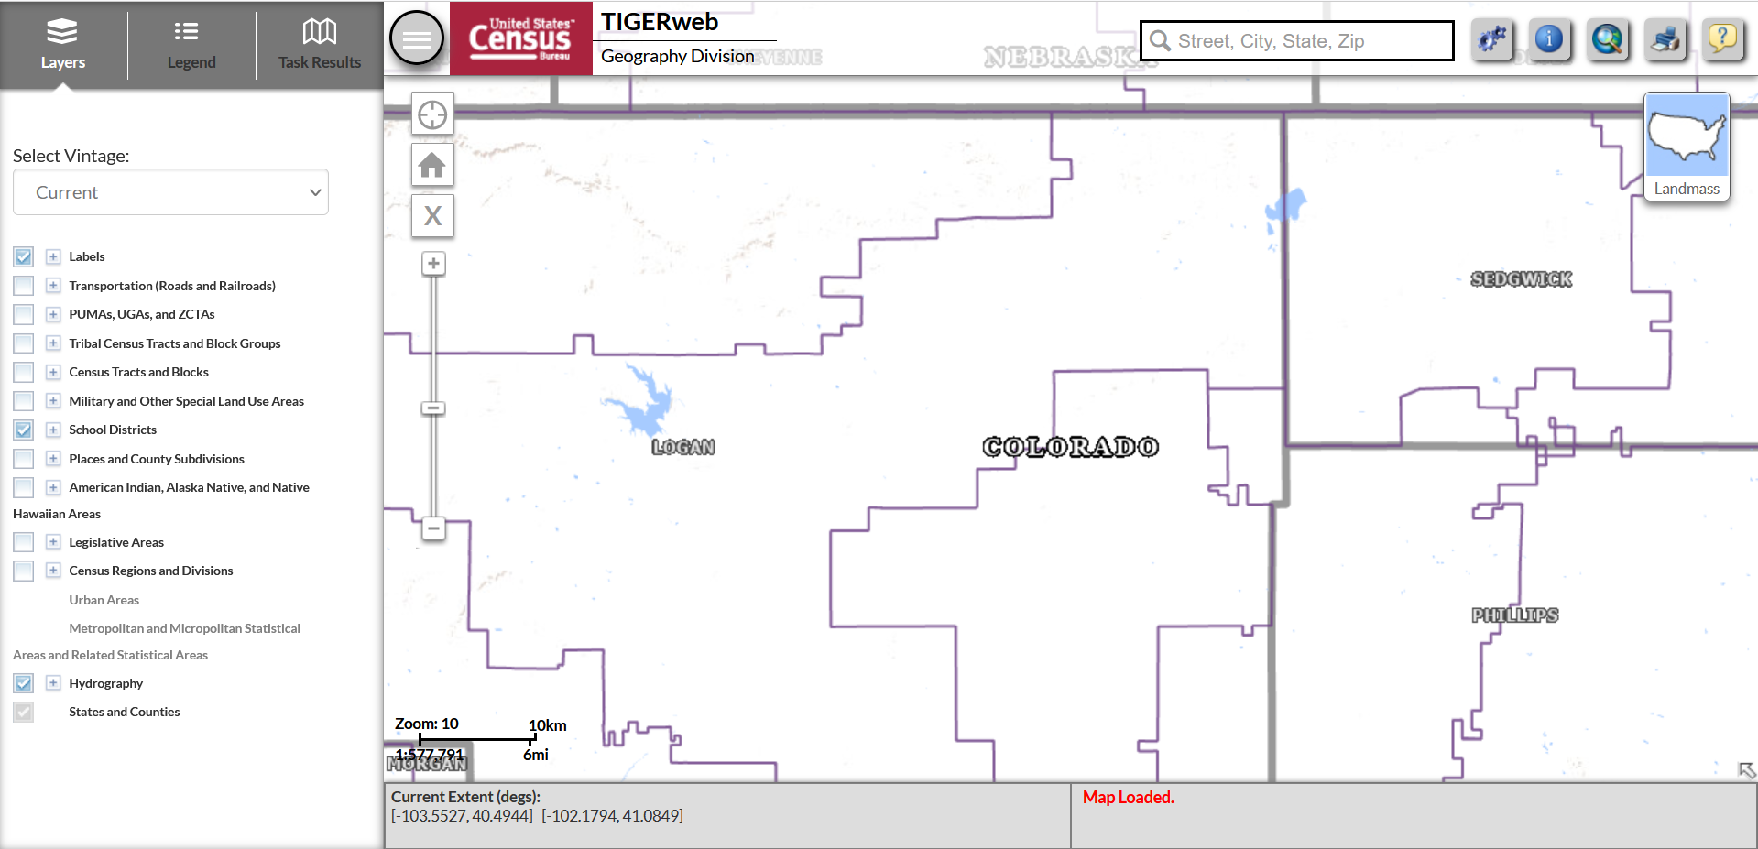
TIGERweb

Slide 30
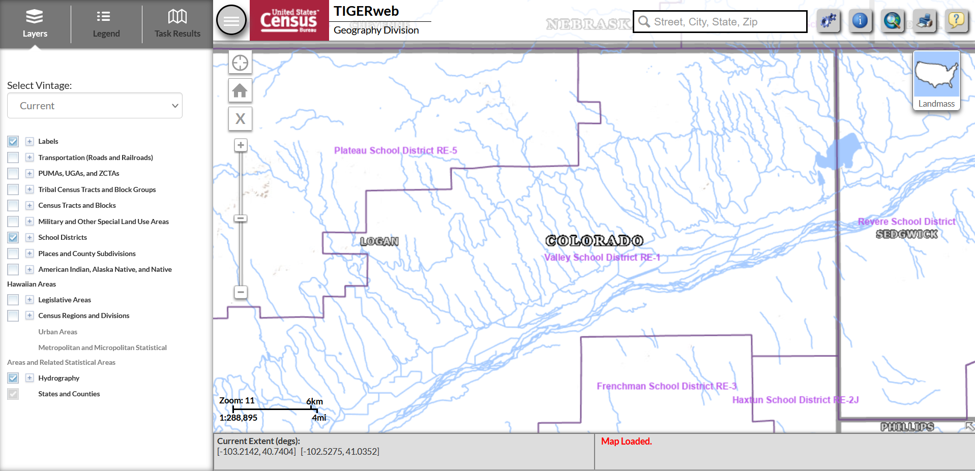
TIGERweb

Slide 31
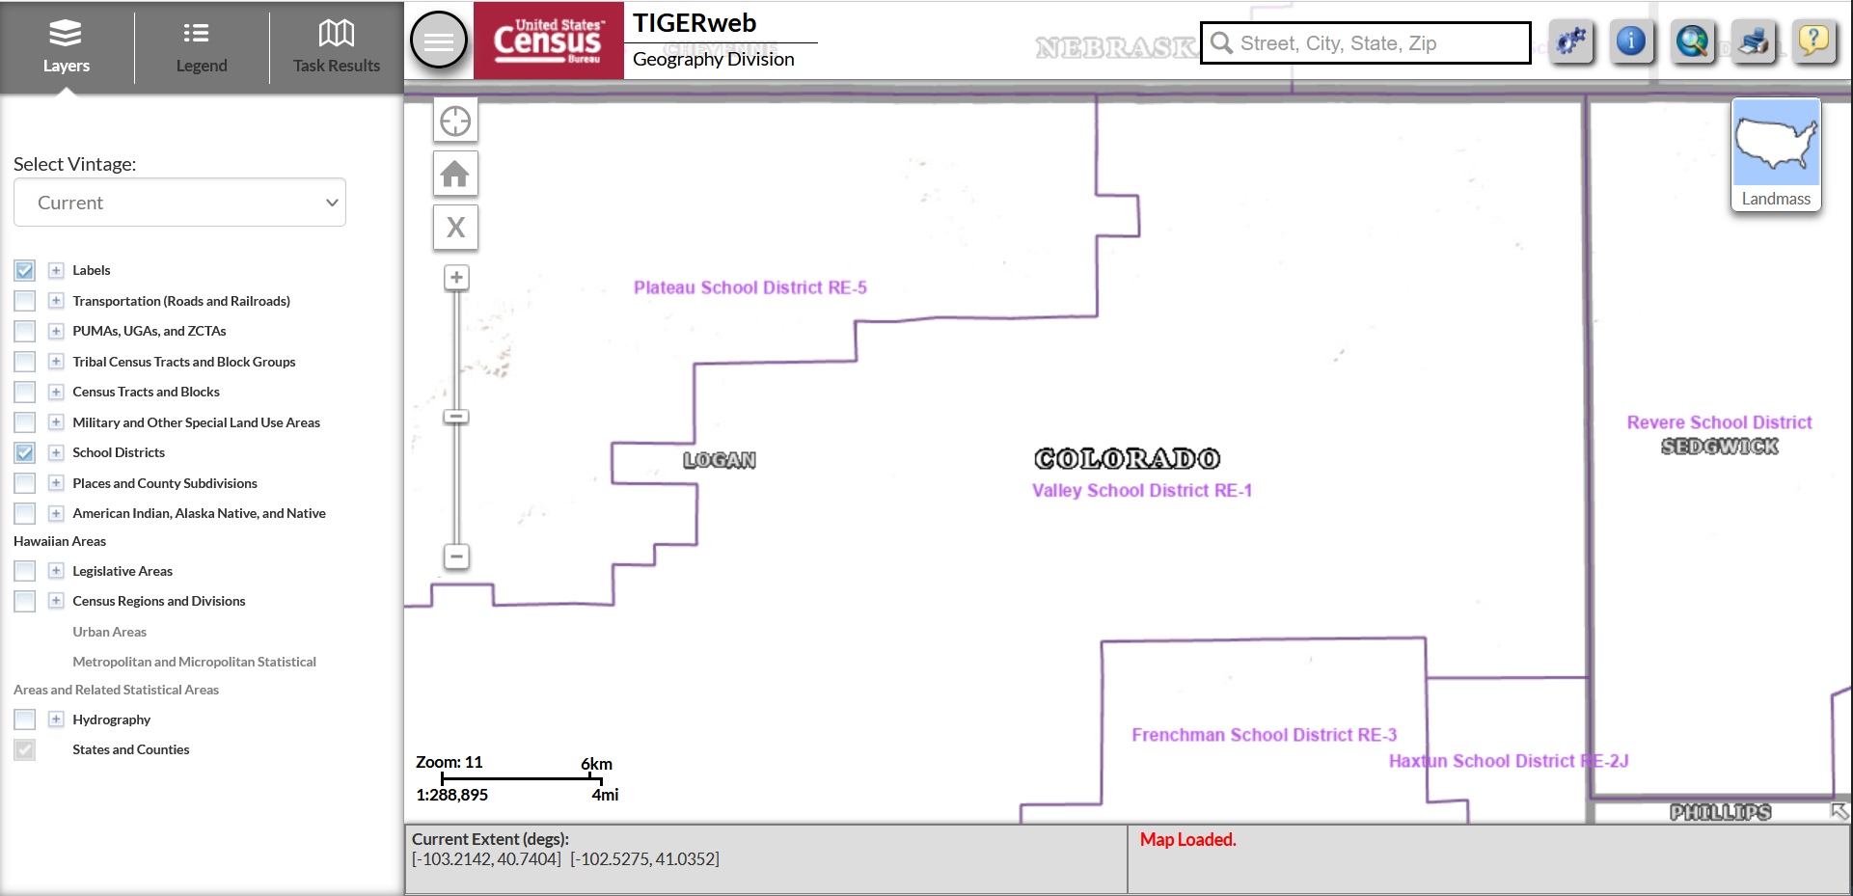
TIGERweb

Slide 32
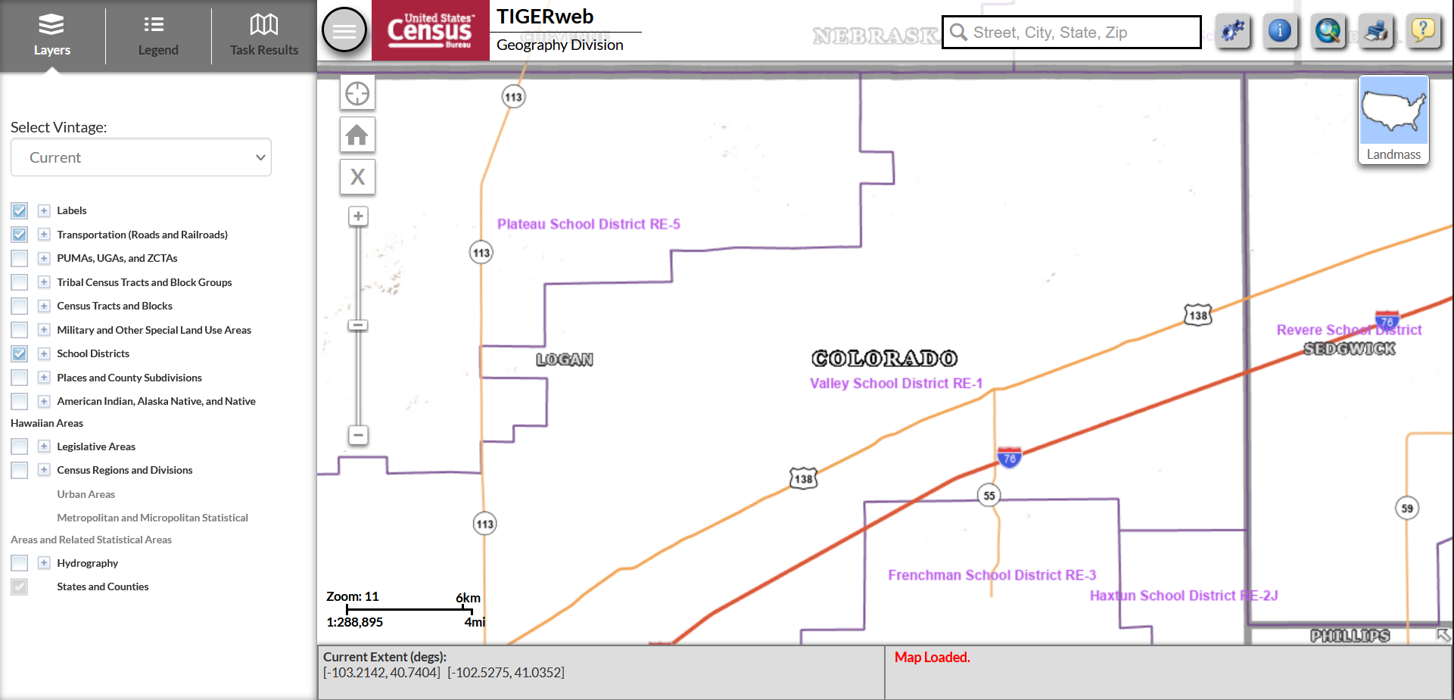
TIGERweb

Slide 33
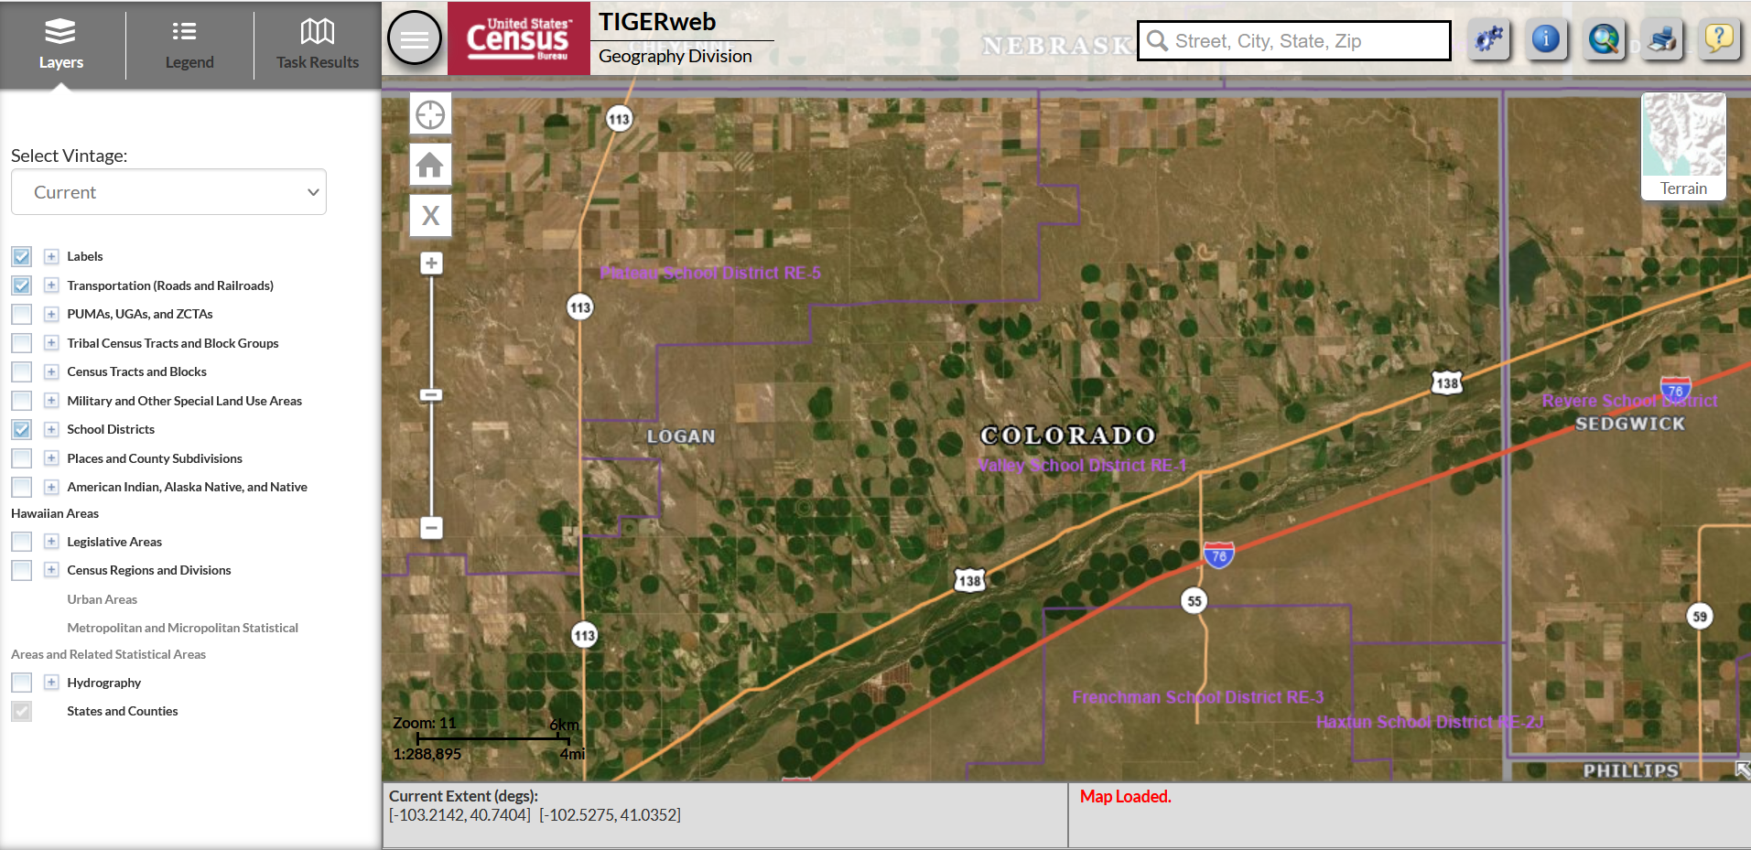
TIGERweb

Slide 34
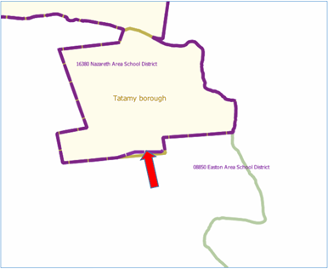
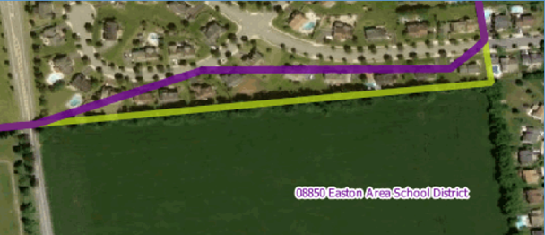
Correcting District Boundaries
To report an error in the district boundaries online, districts should take a screenshot of the current boundaries (using the TIGERweb system) and then annotate the updated boundary location on the same screenshot.
  District should notify CDE as soon as possible to report any errors.

Slide 35
Submitting Boundary Changes
All requests to update school district boundaries should be submitted to Tina Negley (negley_t@cde.state.co.us).
  Districts are encouraged to submit changes as soon as possible. All annotated screenshots must be submitted no later than December 15th to ensure the information is successfully uploaded in the Geographic Update Partnership Software (GUPS) by the December 31st deadline.
  Boundary changes occur when a school district adds or removes area. Boundary changes of less than 30 feet are not accepted when the change does not affect housing. In areas of sparse population, such as rural areas, differences of 60 to 70 feet are not considered to be significant.

Slide 36
Contact Information
For all SDRP-related questions, please reach out to:
  Tina Negley
  negley_t@cde.state.co.us
  720-766-2793

Slide 37
Stronger Connections Grant (SCG)
Notes:
Tammy

Slide 38
SCG Updates
Funding authorized through the Bipartisan Safer Communities Act
Colorado received an allocation of $9,356,572
Award period through 9/30/2025
Funds must be used for activities allowable under Section 4108 of the ESEA (Safe and Healthy Students)
90 days to submit our initial plan to the U.S. Department of Education
December 14th

Slide 39
Dear Colleague Letter from the Secretary
States are encouraged to prioritize funds to LEA applicants that demonstrate commitment to:
Implementing evidence-based strategies that meet students’ social, emotional, physical and mental well-being needs; create positive, inclusive, and supportive school environments; and increase access to place-based interventions and services.
Engaging students, families, educators, staff and community organizations in the selection and implementation of strategies and interventions to create safe, inclusive and supportive learning environments.
Designing and implementing policies and practices that advance equity and are responsive to underserved students, protect student rights, and demonstrate respect for student dignity and potential.
https://oese.ed.gov/offices/office-of-formula-grants/safe-supportive-schools/student-support-and-academic-enrichment-program/

Slide 40
State definition of “high-need LEA”
As States consider establishing criteria for “high-need LEAs” consistent with Congressional intent, the Department encourages States to consider a focus on LEAs with high rates of poverty and with one or more of the following characteristics:
1) a high student-to-mental health professional ratio;
2) high rates of chronic absenteeism, exclusionary discipline, referrals to the juvenile justice system, bullying/harassment, community and school violence, or substance abuse; or
3) where students recently experienced a natural disaster or traumatic event.
The Department encourages a measurement of poverty that considers LEAs with high numbers of students living in poverty, as well as LEAs with high percentages of students living in poverty (e.g., at least 40 percent).
CDE is working with the ESEA Committee of Practitioners (CoP) to develop Colorado’s definition!

Slide 41
(Some of the) SEA Assurances
The SEA will ensure that LEAs use SCG funds for activities allowable under section 4108 of the ESEA.
The SEA will ensure that LEAs do not use funds for the provision to any person of a dangerous weapon or training in the use of a dangerous weapon as prohibited under Section 13401 of BSCA, which amends section 8526 of the ESEA.
The SEA will ensure that LEAs receiving SCG funds provide equitable services to students and teachers in non-public schools as required under section 8501 of the ESEA.
The SEA will track the SCG funds separately from its regular allocation under Title IV, Part A of the ESEA and will ensure that its LEAs will also do so.

Slide 42

Stay Tuned!
Questions?
Ideas?
Comments?
Concerns?
Contacts
Tammy Giessinger
Nathan Hickman
Evita Byrd

Slide 43
USDE Monitoring of CO: RAR Monitoring Findings
Notes:
NMN

Slide 44
U.S. Department of Education’s Monitoring of Colorado’s Title I Program
Focus of Monitoring: Title I, Resource Allocation Review
CDE participated in monitoring between March 30, 2022 - June 20, 2022
  Self-assessment
  Evidence submittal
  Interviews
Tier II - Title I Resource Allocation Review (RAR) requirements
  CDE must oversee the resource allocation to schools identified for Comprehensive (CS) and Additional Targeted (ATS) Support and Improvement
  LEAs with identified schools must ensure that schools identified for CS or ATS
    Identify and address any resource inequities
Findings
  Commendation:
    CDE uses existing structures and integrates the RAR into existing processes (i.e., the Consolidated Application, monitoring, SNS methodology reviews, MOE, UIP reviews, EDT, Comparability analyses) to review and address any resource inequities
Required corrective action:
  CDE must ensure that LEAs review, approve, and monitor the implementation of ATS improvement plans consistent with requirements, including ensuring that resource inequities are identified and addressed
    Corrective Action Plan due by January 24, 2023

Slide 45
Corrective Action Plan
Plans to address findings
  Updates to website to emphasize and highlight ATS requirements.
  Updated trainings and guidance to LEAs around requirements for reviewing, approving, and monitoring implementation of ATS improvement plans and ensuring plans include identification and addressing of resource inequities.
  Revising/updating the question in Cons App about LEA oversight of ATS - how LEA is supporting identifying and addressing resource inequities - will be added to the Consolidated Application.
  Update monitoring protocols and indicators to check for LEA oversight of resource allocations to ATS, including identification and addressing resource inequities.

Slide 46
Upcoming Meetings
Notes:
Nazie

Slide 47

Any Requests for Upcoming Topics or Questions!
Upcoming Office Hours
November 10
  ESSA Identification Overview and 2022 Summary
  Setting Up an Implementation Plan to Strengthen an ESEA Investment
November 17
  Supporting Students with Disabilities; Avoiding Discriminatory Use of Discipline
November Changes!
November 10 - will stay the same
November 24 (Thanksgiving Holiday) has been moved to November 17

Slide 48
CDE Contacts!
Emails: Lastname_Firstinitial@cde.state.co.us
(e.g., Smith_a@cde.state.co.us)
Federal Programs & Supports (ESEA/ESSER Program Supports) | School Finance & Operations (Fiscal and Systems Supports)
Nazie Mohajeri-Nelson, Executive Director of Federal Programs & Supports Unit Program Specialists Program Implementation Supervisor: Laura Meushaw Program Monitoring Supervisor: Tammy Giessinger Program Effectiveness Supervisor: Tina Negley ESEA Programs Specialists and ESEA Regional Contacts (assigned by district) Title I: Laura Meushaw, Evita Byrd, Rachel Echsner Title II: Karen Bixler Title III: Rachel Temple Title IV: Tammy Giessinger, Nathan Hickman Title V: Shannon Wilson ESSER Program Specialists Kristin Crumley Jonathan Schelke Kim Boylan Shannon Wilson ESEA and ESSER Data and Reporting Specialists Tina Negley Mary Shen Mackenzie Owens | Kate Bartlett, Executive Director of School District Operations Unit Fiscal Specialists Jennifer Austin, Director of Grants Fiscal Management ESEA Robert Hawkins, Grants Fiscal Analyst Steven Kaleda, Grants Fiscal Analyst ESSER Fiscal Specialist Steven Kaleda Grants Fiscal Analyst ESSER Monitoring Bill Parsley, ESSER Fiscal Monitoring Supervisor Hilery Morris, ESSER Fiscal Monitoring Kristina Jones, Federal Fiscal Monitoring and Reporting Specialist Werner Hagemann, ESSER Fiscal Monitoring Specialist Application Systems Specialists DeLilah Collins, Director of Grants Program Administration Online Applications Systems Technical Support Michelle Prael

