Slide 1
CDE Office Hours
October 26, 2023

Slide 2
ESSER Office Hours
Topics
Updates and Reminders
  Multi-year Subscription Guidance
  Prayer Certification Guidance
  USDE Monitoring
  Equity and Excellence Conference
Post Award Revisions
ESSER Reporting
Notes:
Nazie

Slide 3
Updates and Reminders

Slide 4
Multi-year Licenses or Subscriptions
In the Allowable Uses of ESSER Funds Matrix, CDE had indicated that purchasing multi-year licenses or subscriptions with ESSER funds are allowable, if reasonable and necessary to prevent, prepare for, or respond to COVID-19, however, only for the performance period. Additional years in the contract would have to be pro-rated and paid out of other funds.
The U.S. Department of Education an FAQ document in December of 2022 outlining the risks associated with prepaying for services and stating that under some circumstances, preparing for services beyond the performance period might be allowable for a reasonable period.
CDE has released a guidance document that in Colorado a reasonable period beyond the performance period would be until the end of the final fiscal year for each ESSER’s performance period. For example, the reasonable period for paying for multi-year subscriptions or licenses with ARP ESSER III funds would be through June 30, 2025.
USDE FAQ/Guidance document states that under no circumstances may ESSER funds be used beyond the timeline in which funds revert back to the Treasury (four years).
Caution:
Misleading information is being disseminated by some organizations that this means that ESSER funds can now be used for an additional four years.

Slide 5
Multi-year Licenses or Subscriptions (con’t)
Other factors that must be considered:
Whether the funds were properly obligated within the period of availability and liquidated in a timely manner;
Whether the activities would be allowed to extend beyond the liquidation period under applicable State and local procurement rules (i.e., a State or LEA must follow the same policies and procedures it uses for procurements from its non-Federal funds) (see 2 CFR §§ 200.317 through 200.327, 200.403(c));
Whether the extended activities constitute a reasonable and necessary use of Federal funds; and
Whether prudent business practices (2 CFR § 200.404(b) & (d)) and internal controls (which generally limit prepayment) would support the continued activities for the length of time proposed.
New CDE Multi-Year Subscriptions and Licenses Guidance Document about the reasonable period is posted on our website.
Caution: The closer to end of the period of availability the obligations are made, the potential for more scrutiny during audits and monitoring. Reasonableness and necessity to prevent, prepare for, or respond to covid-19 become harder to demonstrate. Document need and connection to covid-19.

Slide 6
Prayer Certification Guidance
ESEA Section 8524(b) prohibits recipients of ESEA funds to have policies preventing or denying participation in constitutionally protected prayer in school.
An assurance in the Consolidated Application!
CDE is required to ensure that all LEAs have signed the assurance and report any complaints against an LEA alleging non-compliance with Section 8524(b) to the U.S. Department of Education.
Our certification is submitted each October. Sent on 10/23/23 this year.

Slide 7
USDE Monitoring
ESSER I, II, and III
Self-assessment due November 10, 2023
Review meeting November 28, 2023
Next steps might include participation by selected LEAs

Slide 8


Equity and Excellence Conference
See the answers to frequently asked questions on the Equity and Excellence Conference webpage.
Click here:
Bring books for book signing!
Notes:
Evita
Know Before You Go FAQs: https://www.cde.state.co.us/equityandexcellence/knowbeforeyougo

Slide 9
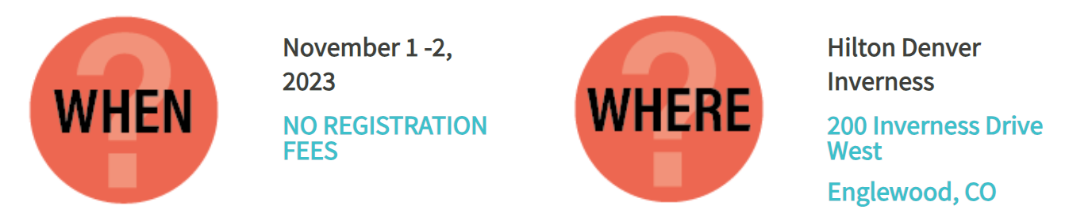
Equity and Excellence Conference
Additional Information
Free parking and wifi
Schedule and venue map located on Sched
Register for breakout sessions ASAP, if you haven’t already
Light refreshments provided throughout the day; lunch will not be provided
Follow us on Twitter, Instagram, Facebook, and LinkedIn, using Equity and Excellence conference hashtags: #EEConf2023, #AllMeansAll, #EmergingStronger, and #BestFirstInstruction.
Notes:
Evita
Know Before You Go FAQs: https://www.cde.state.co.us/equityandexcellence/knowbeforeyougo
Sched: https://equityandexcellence.sched.com/

Slide 10
Post-Award Revision
Tips and Tricks
Notes:
Presenter: Evita
So… The PAR window is open. Now what?

Slide 11
Substantial Approval and Final Approval
CDE grants Substantial Approval upon the submission of the ESEA Consolidated Application.
  LEAs can obligate (plan for) funds for proposed activities in the budget.
  LEAs cannot request reimbursement yet.
Final Approval is granted after the application is reviewed by CDE and the LEA addresses CDE’s comments.
  LEAs can now request reimbursement.
Post-Award Revisions (PAR) can be submitted after Final Approval has been granted.
Note: If CDE determines an activity is not allowable, the LEA will be asked to reallocate the funds to an allowable activity.
Notes:
We wanted to start today’s conversation by discussing where Post Award Revision lies in the life cycle of a Consolidated Application. In June when an LEA or BOCES submits a complete Consolidated Application, the application is granted Substantial Approval. This allows an LEA to begin obligating/planning for the proposed activities in the budget. However LEAs may not ask CDE for reimbursement until the application has received final approval. 132 LEAs have been granted final approval. There are 4 on CDE’s side for review and 16 application with feedback to be addressed by LEAs. Once your application has final approval, the LEA may submit a post award revision (PAR).

Slide 12
Purpose of the PAR Process
The PAR process is an opportunity for LEAs and BOCES to:
  revise the activities and budget that were approved in the initial Consolidated Application or ESSER application review process.
  include additional activities that require pre-approval based on local context and funding availability.
General Rule:
If you are changing how funds are being used,
you should submit a PAR.
Notes:
The purpose of the PAR is to provide the opportunity for LEAs and BOCES to revise their applications to address any adjustments in activities and/or budgets in either Cons App or ESSER. An LEA is required to receive approval prior to any expenditures that are different from what was approved in the initial application.

Slide 13
When To Submit a PAR
When changes to the budget exceed, or are expected to exceed, 10% of the amount approved
To update due to changes with allocations and/or indirect costs
To reflect changes in the project/program scope or objective
Any changes to equipment purchases require program approval
All budget revisions need to be approved by CDE prior to obligating funds and before the end of the grant.
Notes:
The information on this slide provides an overview of the types of revision requests that need to be submitted through the PAR process.
The first situation is when changes to the cost of any equipment purchases from the budget as it was last approved.
Another consideration LEAs should make during the PAR window is if you need to update your indirect costs. If the LEA overrode the indirect amount allocated, or if the LEA will now take the amount that was previously reduced, a PAR request should be submitted.
LEAs should also submit PAR requests when there is a change in the scope or objective for the use of the Title funds. If you had initially submitted a plan to use funds for Professional Development and has now decided to use the same funds to support Instructional materials, approval needs to be obtained. This would also apply to a change in the use of funds from Professional Development to supporting a salaried position for an Interventionist.
If an LEA is making changes among direct cost programs or within object categories, such as Salaries or Benefits, and these changes will exceed 10% of the total budget as last approved, you are also required to submit a PAR request.
When submitting the request, the PAR system will ask for a rationale for the changes, just as when the initial Consolidated Application was submitted. These rationale statements will be reviewed by CDE Program staff and feedback will be provided.
Equipment purchases: more in score rather than amount
Talking point from ESSER: Tell what was the original amount and give rationale

Slide 14
PAR Window
The PAR system will be open until June 30th of the fiscal year.
LEAs may submit revision requests, as necessary.
Final allocations will be pre-populated in the PAR system for the Consolidated Application in mid to late November.
  Allocations are posted on the Grants Fiscal website.
Only submit requests to revise your ESEA Consolidated/ESSER Application within the system.
The narrative questions and the school profile page will be locked and cannot be updated during the PAR process.
Notes:
Once the LEA receives final approval, the application will be moved in the system to the Open for PAR Request section, the revision system will remain open through June 30th. Districts can submit PARs as needed. Once submitted the application will be locked for CDE review. Once it is reviewed, if there are follow up questions, the application will be moved to District Review. If the application is approved, it will move to Revisions Approved. CDE will need to reopen the application for PAR to start the cycle again.
We encourage you to submit changes for all ESEA Title programs with each revision request submitted. We understand that some changes will continue to be made throughout the window, so you have the opportunity for multiple submissions if needed.
We would like to point out that we do not grant approval for activities outside of the Consolidated Application. We can provide input on whether activities are allowable uses of Title funds. We also want to remind you that pre-approval is not required in order to obligate funds; however, all activities must be approved in the online application platform or Post-Award Revision system before an LEA may seek reimbursement for the activity.
During the Post-Award Revision window, the Cross Program and Narrative responses will be locked. You will need to wait until the next application opens to make revisions to plans and processes. The focus of the Post-Award Revision process is to make adjustments to budget line items. If you want to discuss possible program changes, please contact your ESEA Regional Contact.

Slide 15
How to Enter a PAR Request
Notes:
In this next section, we will be reviewing the technical aspects of how to enter a PAR request.

Slide 16
Accessing the PAR System
The application access is through the Identity Management (IdM) system, the same login and password system used for Data Pipeline and UIP.
A good first step, if you have used IdM before, is to check with your District Local Assess Management (LAM) Group to grant you access to the CONSAPP application.
If you haven't used the IdM system before or are having trouble logging in with it, please use this access assistance form to find your district's LAM Group.
If you have used IdM before and have confirmed you have access to the CONSAPP application, please contact us at consolidatedapplications@cde.state.co.us for additional technical assistance.
Notes:
The Consolidated Application is on the identity management system. If you do not have access to the most recent application, you will have to reach out to your local access manager (LAM). The LAM will then need to assign your credentials to “CONSAPP.” Once “CONSAPP” is assigned, you will be able to access the application.
If you need additional support with logging in, please send an email to consolidatedapplications@cde.state.co.us.

Slide 17

Making Changes in the PAR System
Narratives - Each program narrative represents the LEA’s plans to implement the program requirements.
  The narratives are locked after Final Approval. If narrative changes are needed, use the General Comment box at the end of the program Funds page in the budget.
Budget
  Select the “Funds” tab for the Title program within which changes will be submitted.
  Click on the “edit” tool at the end of the budget line item.
  Provide the information requested, including a brief narrative description of the changes requested, to include the original approved amount, date of change requested to provide clarification for reviewers.
  All highlighted cells must include the rationale for change.
Notes:
Once you have entered the application, select the “Funds” tab for each Title program. You will use the edit tool which appears as a pencil icon to make updates to the activity description, dollar amount, or any other changes. There will also be a comment box available for each budget line item. This comment box will be located below the “Amount” field and should be used to provide a brief narrative description of the requested change.
The following slide shows the window that will appear after clicking on the edit tool.
Emphasize the 3rd bullet under budget to ensure the field has clarity about the information that is needed when submitting a PAR.

Slide 18
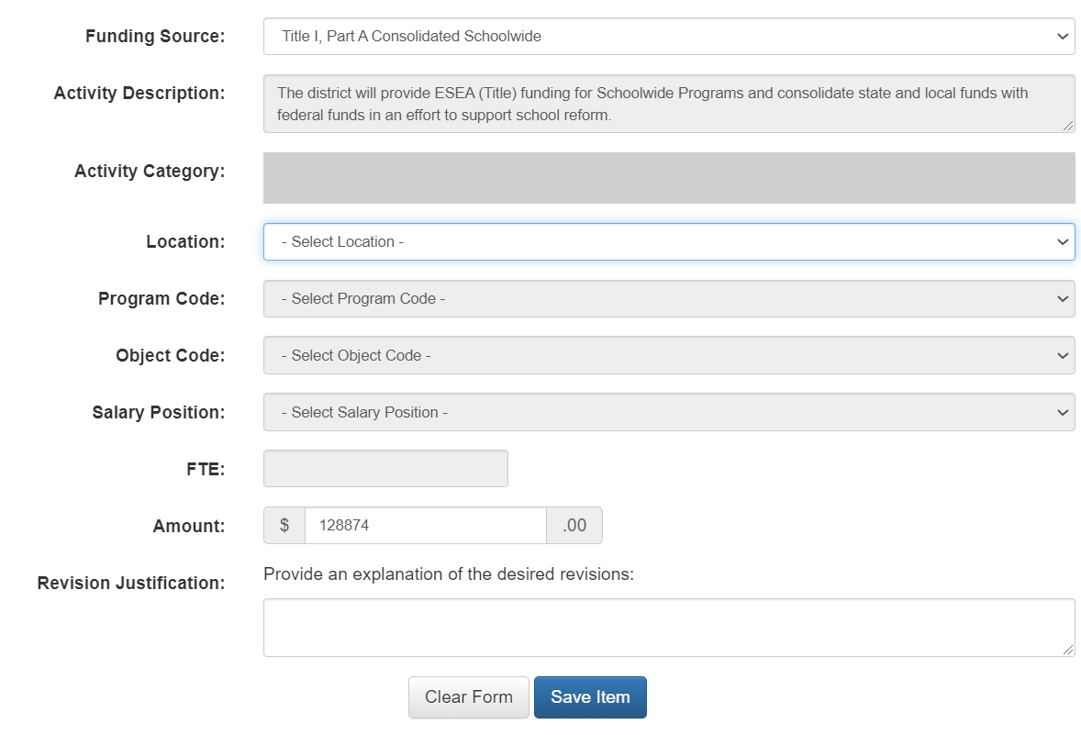
Revision Request Format
For the justification, please include the date of revision request, the change, and the reason for making the change.
Example:
01/31/23 The total amount was changed from $130,000 to $108,874 to update the amount to the actual amount spent.
Notes:
This is an example of what you will see after clicking on the edit tool. To note, your line item edit screen will not be blank.
You will use this format to make revision requests to previously submitted budget line items within each Title program. Once the information has been entered, save your changes.
As mentioned before, the rationale and narrative description of the change will be located below the “Amount” field on the Funds tab.

Slide 19
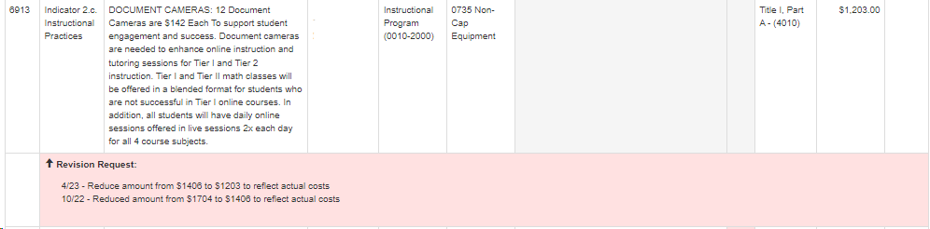
Example #1
Provide date of revision
Identify what changed
Reference the line that may be fiscally supporting effort
Align Activity Description with Revision Request

Slide 20
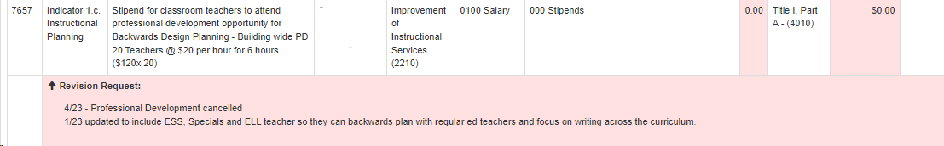
Example #2

Slide 21
Prior to Submittal Review
Rank Order - Any changes to allocations or activities may disrupt rank order in Title I, Part A (Locations Total Page)
Update any necessary district contact information.
  CDE uses the Consolidated/ESSER Application contact lists to communicate important information related to the application, school improvement requirements, and accountability.
Balance the budget to adjust for allocation changes.
Notes:
This does not apply to districts that choose method of serving: district less than a 1000.
LEA will be unable to submit the application until rank order issues are addressed.
Rank order does not apply to LEAs that choose district less than 1000 as the method of serving Title I funds in Module-A of the Consolidated Application

Slide 22
Consider Set-Asides
Parent Engagement - for districts with an award greater than $500,000, can have 10% at district but must have 90% at schools
Non-Public Schools - consider any required adjustments to NPS allocations
District-Managed Activities - A waiver is required if exceeding the 20% maximum allowable
ESSER III Learning Loss Set-Aside - must maintain 20% of allocation
Note: While a new signature authorization is not required for PAR requests, LEAs/BOCES should be continually informing their board members and any relevant parties such as fiscal and program departments of their plan changes related to ESSER and the ESEA Consolidated Applications.

Slide 23
PAR Review and Approval
CDE program staff will review revision requests on a continuous basis.
You can anticipate a response within two weeks of submission.
For program-specific questions, contact your ESEA Regional Contact or ESSER Contact.
For general Post-Award Revision (PAR) request questions, contact consolidatedapplications@cde.state.co.us.
Notes:
CDE Program staff will review Post-Award Revision requests on a continuous basis until April 30th.
You should anticipate a response with approval or a request for additional information no later than two weeks after submitting a revision request.
As always, please feel free to reach out to your ESEA Regional Contact with questions. Our contact information is included on the this slide. Please note that the ESSER Contact link downloads an Excel file with a list of all the ESSER contacts by LEA. You can also send general questions to consolidatedapplications@cde.state.co.us.
We are here to help! Please call us if you need support or have any questions.
We look forward to working with you during the Post-Award Revision process.
Thank you for your time!

Slide 24
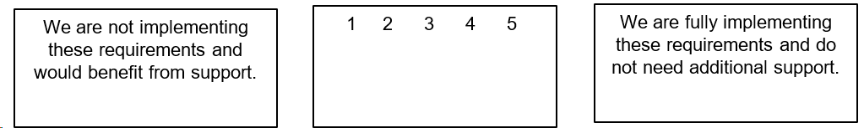
Prepare for Monitoring: ESSER
The LEA has processes in place to ensure that expenditures using ESSER funds match the activities approved by CDE through their ESSER application(s).
Funded and implemented activities comply with federal statutes, regulations, and terms and conditions of the grant program, including those outlined in the application, assurances, and grant award letters.
ESSER-funded activities were obligated within the performance period (on or after March 13, 2020) and prior to September 30, 2022 for ESSER I, prior to September 30, 2023 for ESSER II, and prior to September 30, 2024 for ARP ESSER III.
The LEA ensures that funded and implemented activities are reasonable, necessary, and allocable, meaning that funded activities or items were made necessary as a result of the COVID-19 pandemic and were necessary in order for the LEA to respond to, prepare for, or prevent the spread of COVID-19.

Slide 25
Prepare for Monitoring: ESEA
The LEA has processes in place to ensure that expenditures using ESEA funds match the activities approved by CDE through their Consolidated Application.
Funded and implemented activities comply with federal statutes, regulations, and terms and conditions of the grant program, including those outlined in the application, assurances, and grant award letters.
The LEA ensures that funded and implemented activities are reasonable, necessary, and allocable to each applicable ESEA program.

Slide 26
ESSER Reporting
Notes:
Mackenzie

Slide 27
ESSER Reporting Survey Deadline Extended
The deadline for all three FY 22-23 ESSER surveys has been extended to December 1, 2023.
LEA Participation in ESSER Activities Survey (submitted via Syncplicity).
  All LEAs, including AUs, BOCES, etc., must submit.
  Please reach out if you need assistance or an extension.
Re-engaging Students Survey (Google form)
  All LEAs who received an ESSER 90% allocation (districts) must submit.
School-Level Allocation Survey (Google form)
  All LEAs who received an ESSER 90% allocation (districts) and allocated funds to schools in their ESSER applications during FY 22-23 must submit.
Our reporting website contains the surveys and helpful resources for completing them. Annotated and example versions of the participation survey templates are now available.
Notes:
Note: As this activity continued into the FY24 reporting period, the LEA should prepare to report information about this activity in their FY24 (Year 5) APR and include student group membership counts for the 20 students who participated in the program in FY24. Enrollment counts for activities that occur during the summer should be taken from the previous school year.

Slide 28
Example Reporting Scenario
Evidence-based afterschool program available to all students at an LEA
Scenario: An LEA implements an ESSER-funded evidence-based afterschool program that is available to all students at the LEA. Throughout the course of FY23, 50 students participate in the afterschool program.
Reporting instructions: For question 4.b1.2 in their chosen template, the LEA should:
Report “Yes” to “Is this program available to all students?”
As the program is available to all students, the LEA will not need to report the count of students the program serves at full capacity
Report “50” as the “Total unique headcount of students that participated in this activity”
Provide the student group membership counts or SASIDs and names for all students at the LEA in the “Enrolled eligible students in student group” fields
Provide the student group membership counts or SASIDs and names for the 50 students who participated in the program in FY23 in the “Eligible students in student group participating” fields

Slide 29
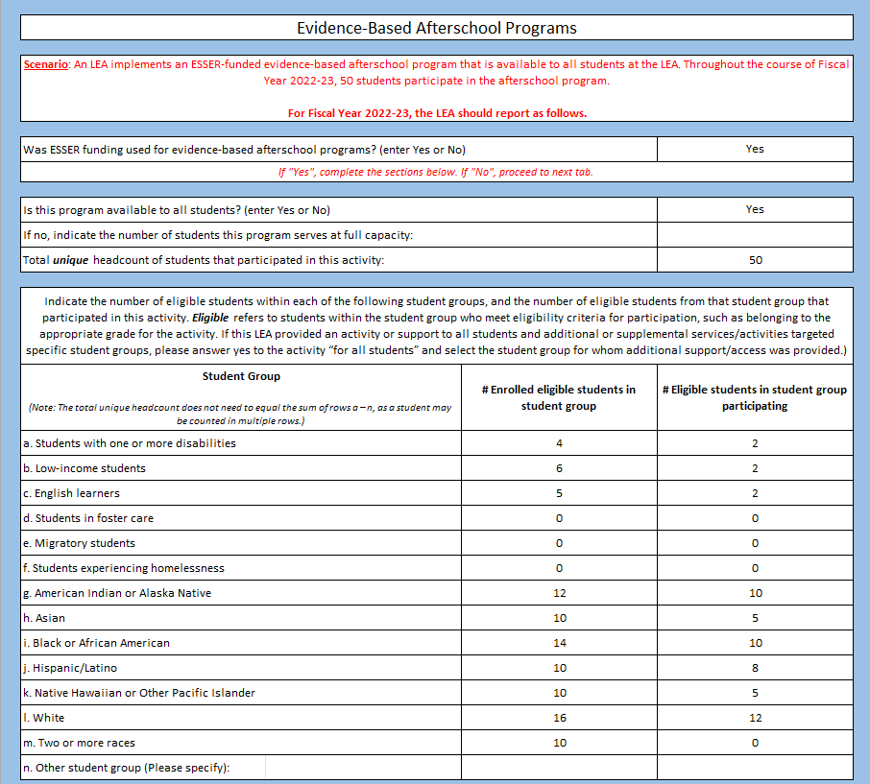
Example Template
LEA-Level Survey

Slide 30
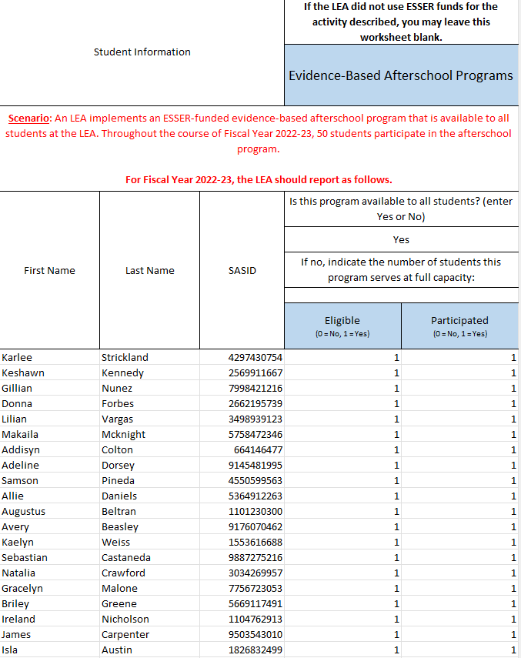
Example Template: Student-Level Survey

Slide 31
Douglas County School District
Template used
  ESSER Student-level separate so CDE can pull demographic information
Personnel/district resources for data collection
  Student data service department
  Charter school representatives
  Program/department coordinators
  Infinite Campus/individual school or district participation reports
Student criteria selection
Method for collecting data
Technology Tab example
  Two district programs fit the technology tab
  Determined that we would report all students K-12 eligible & participated as they could not be split on the report by specific technology and sent CDE an email with our submission to note all district (non-charter) students K-12 for that tab.
  Any charters with only some students added to the excel tab separately.
Notes:
Laura Gorman
Note: As this activity continued into the FY24 reporting period, the LEA should prepare to report information about this activity in their FY24 (Year 5) APR and include student group membership counts for the 20 students who participated in the program in FY24. Enrollment counts for activities that occur during the summer should be taken from the previous school year.

Slide 32
ESSER Reporting of
Student Participation
Notes:
Hassie Daron

Slide 33
Timeline & Process
(September 2022 – February 2023)
Sept/ Oct 2022
Nov 2022
Nov/ Dec 2022
Feb 2023
Met with SIS Team
Shared reporting requirements
Collaborated on process for capturing data
Created a step-by-step guidance document
Training for Schools
Virtual training session (recorded)
Newsletter with information & recording sent out
Tracking by Schools
Schools began entering student participation in SIS
Deadline was set for all back data from July 2022-present to be entered (Dec 16th)
Check-ins with Schools
SIS team pulled data
ESSER Team met with each school and addressed any missing data
      Established another deadline if needed

Slide 34
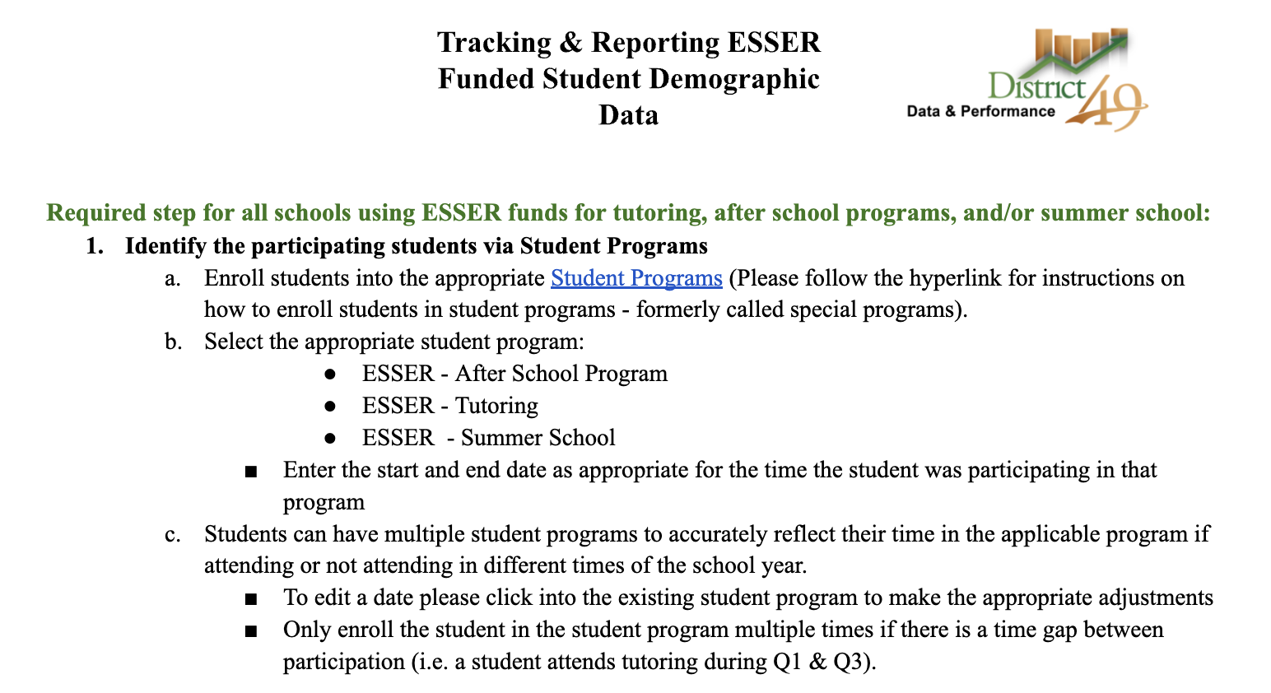
Step-by-Step Guidance
PowerSchool Student Programs
Notes:
Demo from SIS Team

Slide 35
Timeline & Process (November 2022)
Nov 2022
Training for Schools
Virtual training session (recorded)
Newsletter with information & recording sent out

Slide 36
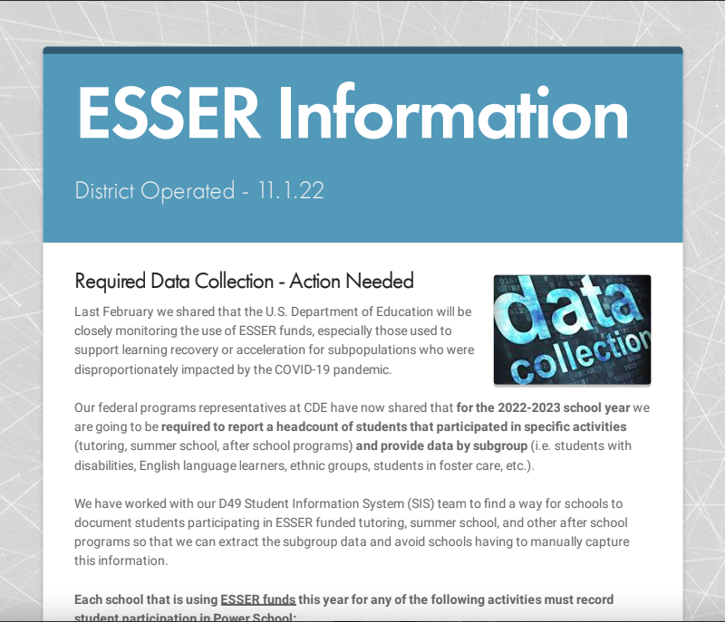
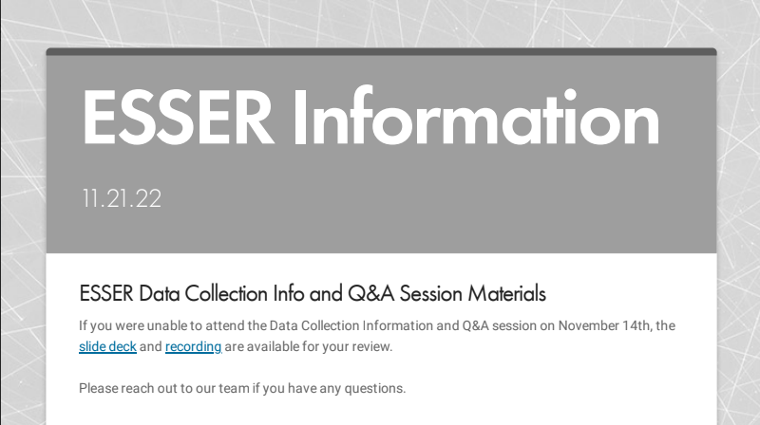
Training and Info for Schools

Slide 37
Timeline & Process
(November 2022 – February 2023)
Nov/ Dec 2022
Feb 2023
Tracking by Schools
Schools began entering student participation in SIS
Deadline was set for all back data from July 2022-present to be entered (Dec 16th)
Check-ins with Schools
SIS team pulled data
ESSER team met with each school and addressed any missing data
  Established another deadline if needed

Slide 38
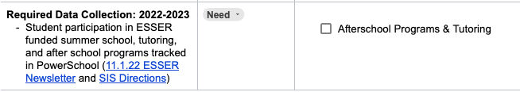
Training and Info for Schools
(Data Tool)

Slide 39
Timeline & Process
(Spring – September 2023)
Spring Semester
Aug 2023
Aug/ Sept 2023
Ongoing Reminders
Sent ongoing reminders in ESSER newsletters
Set and communicated deadlines for end of semester and summer school
Clarity on Definitions
Final clarity on high dosage tutoring definition
Survey sent to schools with tutoring data to determine high dosage tutoring eligibility
Final Data & Submission
SIS team pulled data
ESSER team reviewed for accuracy and alignment with expenditures
Data entered into reporting template
Uploaded into Syncplicity

Slide 40

What questions might you have?

Slide 41
Upcoming Meetings

Slide 42

Looking Ahead…
Any requests for topics or questions?
Upcoming Office Hours:
  November 16
  November 30
* Due to scheduling conflicts & Thanksgiving holiday, the November Office Hours have been rescheduled to Nov 16 and Nov 30.

Slide 43
CDE Contacts!
Emails: Lastname_Firstinitial@cde.state.co.us (e.g., Smith_a@cde.state.co.us)
Federal Programs & Supports (ESEA/ESSER Program Supports) | School Finance & Operations (Fiscal and Systems Supports)
Nazie Mohajeri-Nelson, Executive Director of Federal Programs & Supports Unit Program Specialists Program Implementation Supervisor: Laura Meushaw Program Implementation Coordinator: Christina Adeboye Sullivan Program Monitoring Supervisor: Tammy Giessinger ESEA/ESSER Monitoring Coordinator: Kristin Crumley Program Effectiveness Supervisor: Tina Negley Program Evaluation & Research Coordinator: Mary Shen ESEA Programs Specialists and ESEA Regional Contacts (assigned by district) Title I: Laura Meushaw, Evita Byrd, Rachel Echsner, Kim Boylan Title II: Rachel Echsner Title III: Rachel Temple, Kim Boylan Title IV & Stronger Connections Grant: Nathan Hickman, Evita Byrd Title V: Christina Adeboye-Sullivan, Rachel Echsner ESSER Program Specialists Jonathan Schelke Kim Boylan Kriselda Craven ESEA and ESSER Data and Reporting Specialists Mackenzie Owens (ESSER) Melissa Chaffin (ESEA) Jerry Ring (ESEA) | Amy Carman, Executive Director of School District Operations Unit Fiscal Specialists Jennifer Austin, Director of Grants Fiscal Management ESEA Robert Hawkins, Grants Fiscal Analyst Steven Kaleda, Grants Fiscal Analyst ESSER Fiscal Specialist Steven Kaleda Grants Fiscal Analyst ESSER Monitoring Bill Parsley, ESSER Fiscal Monitoring Supervisor Hilery Morris, ESSER Fiscal Monitoring Kristina Jones, Federal Fiscal Monitoring and Reporting Specialist Werner Hagemann, ESSER Fiscal Monitoring Specialist Application Systems Specialists DeLilah Collins, Director of Grants Program Administration Online Applications Systems Technical Support Michelle Prael

